Slide 1
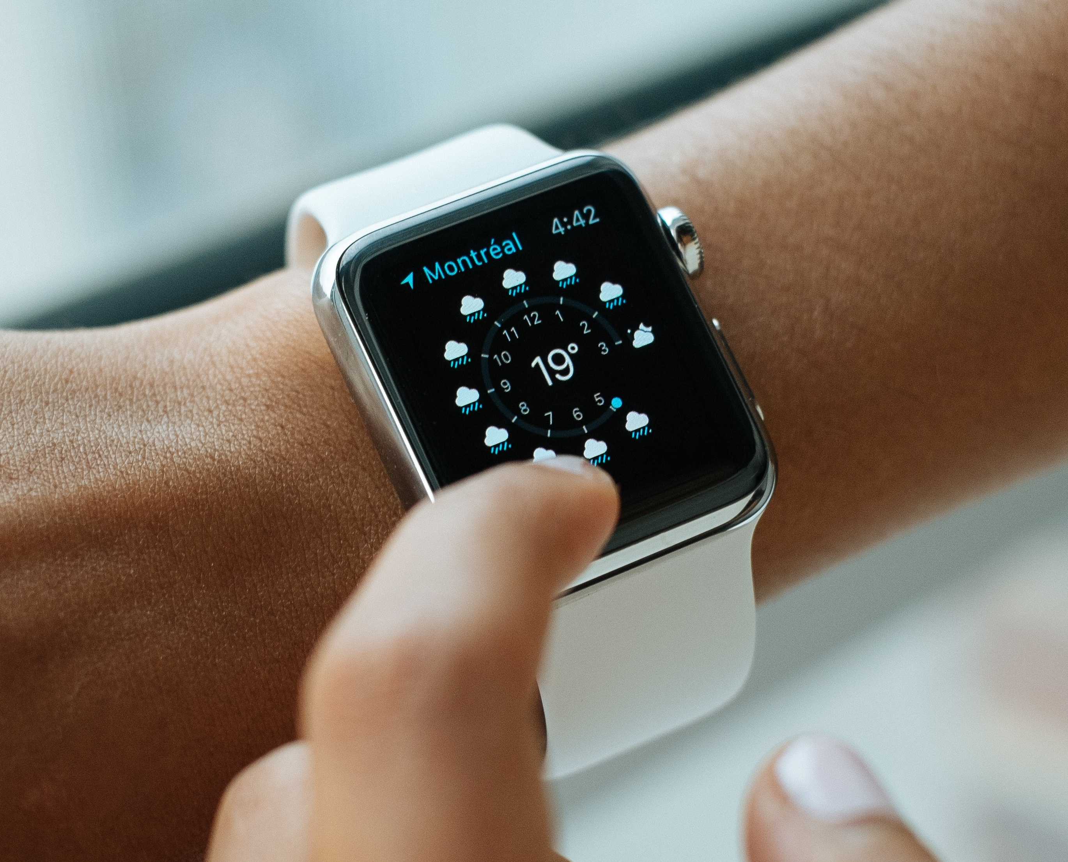
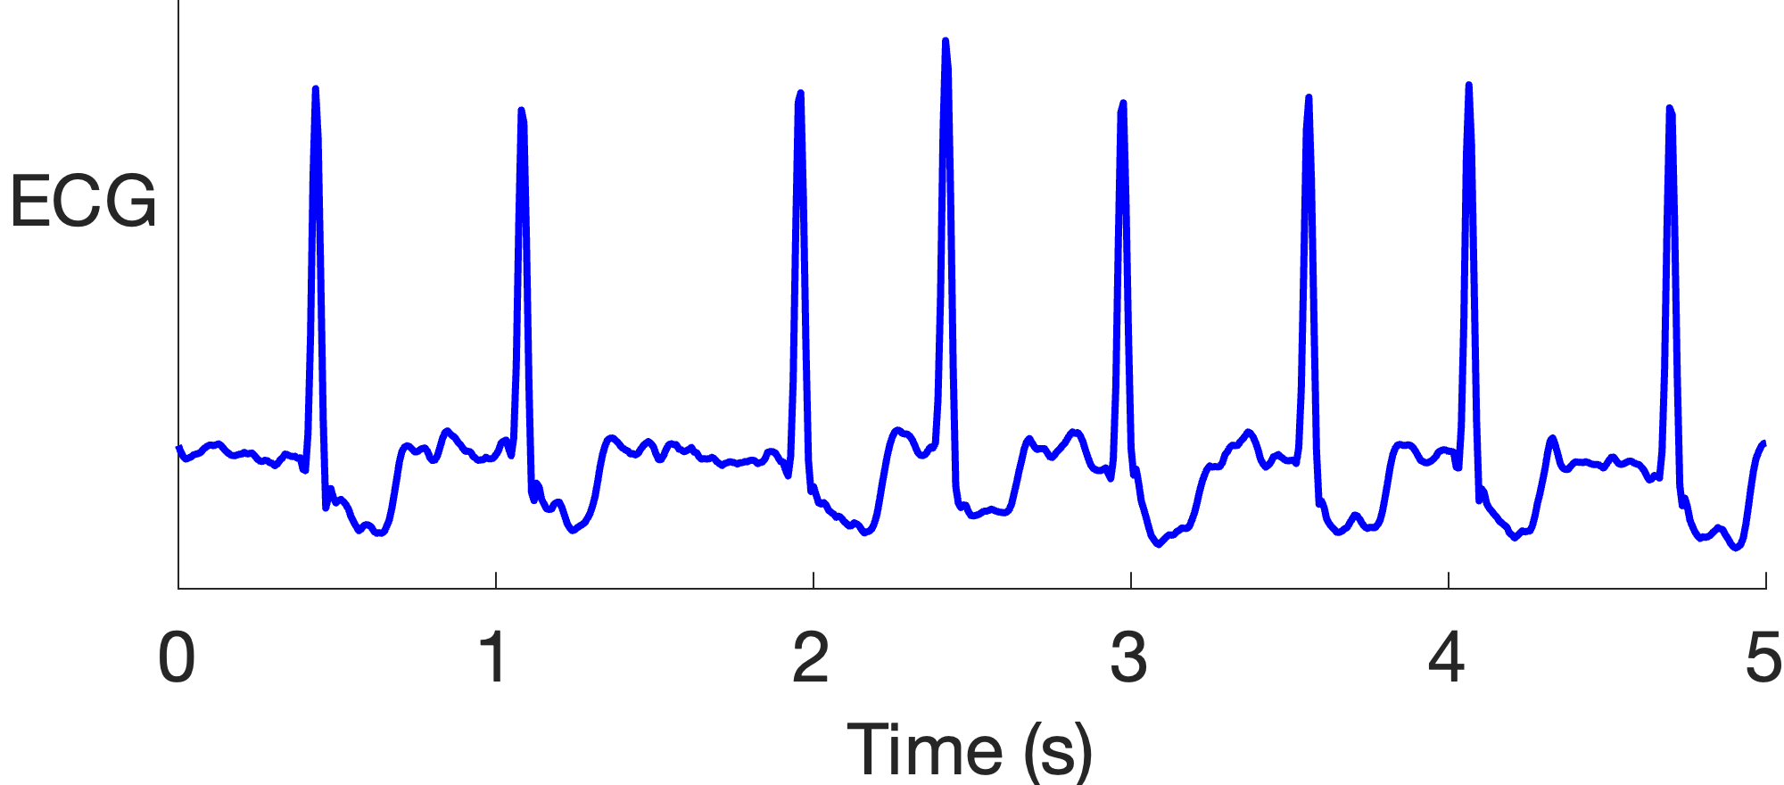
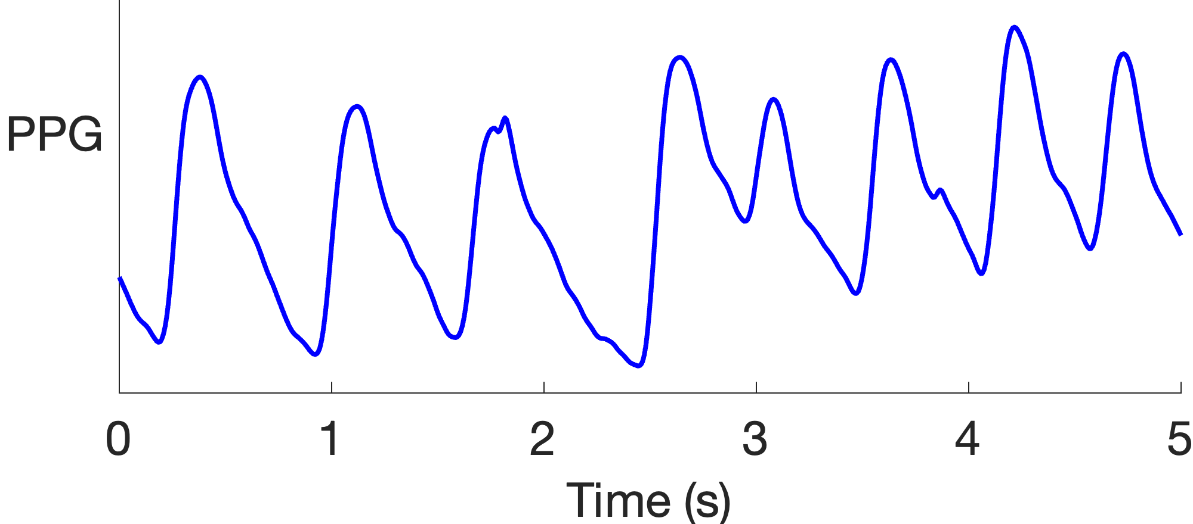
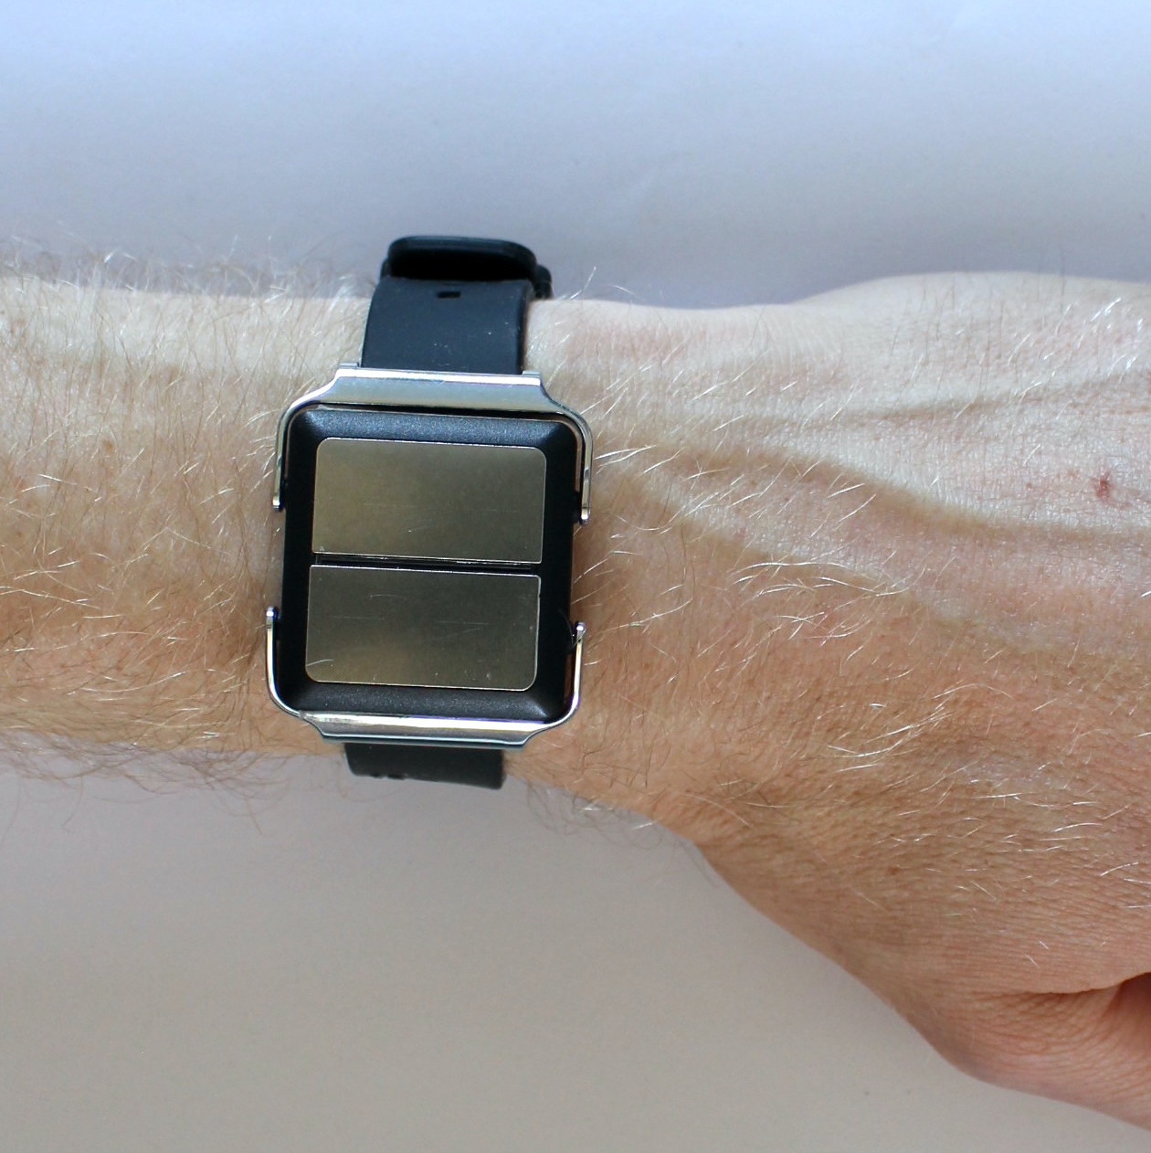
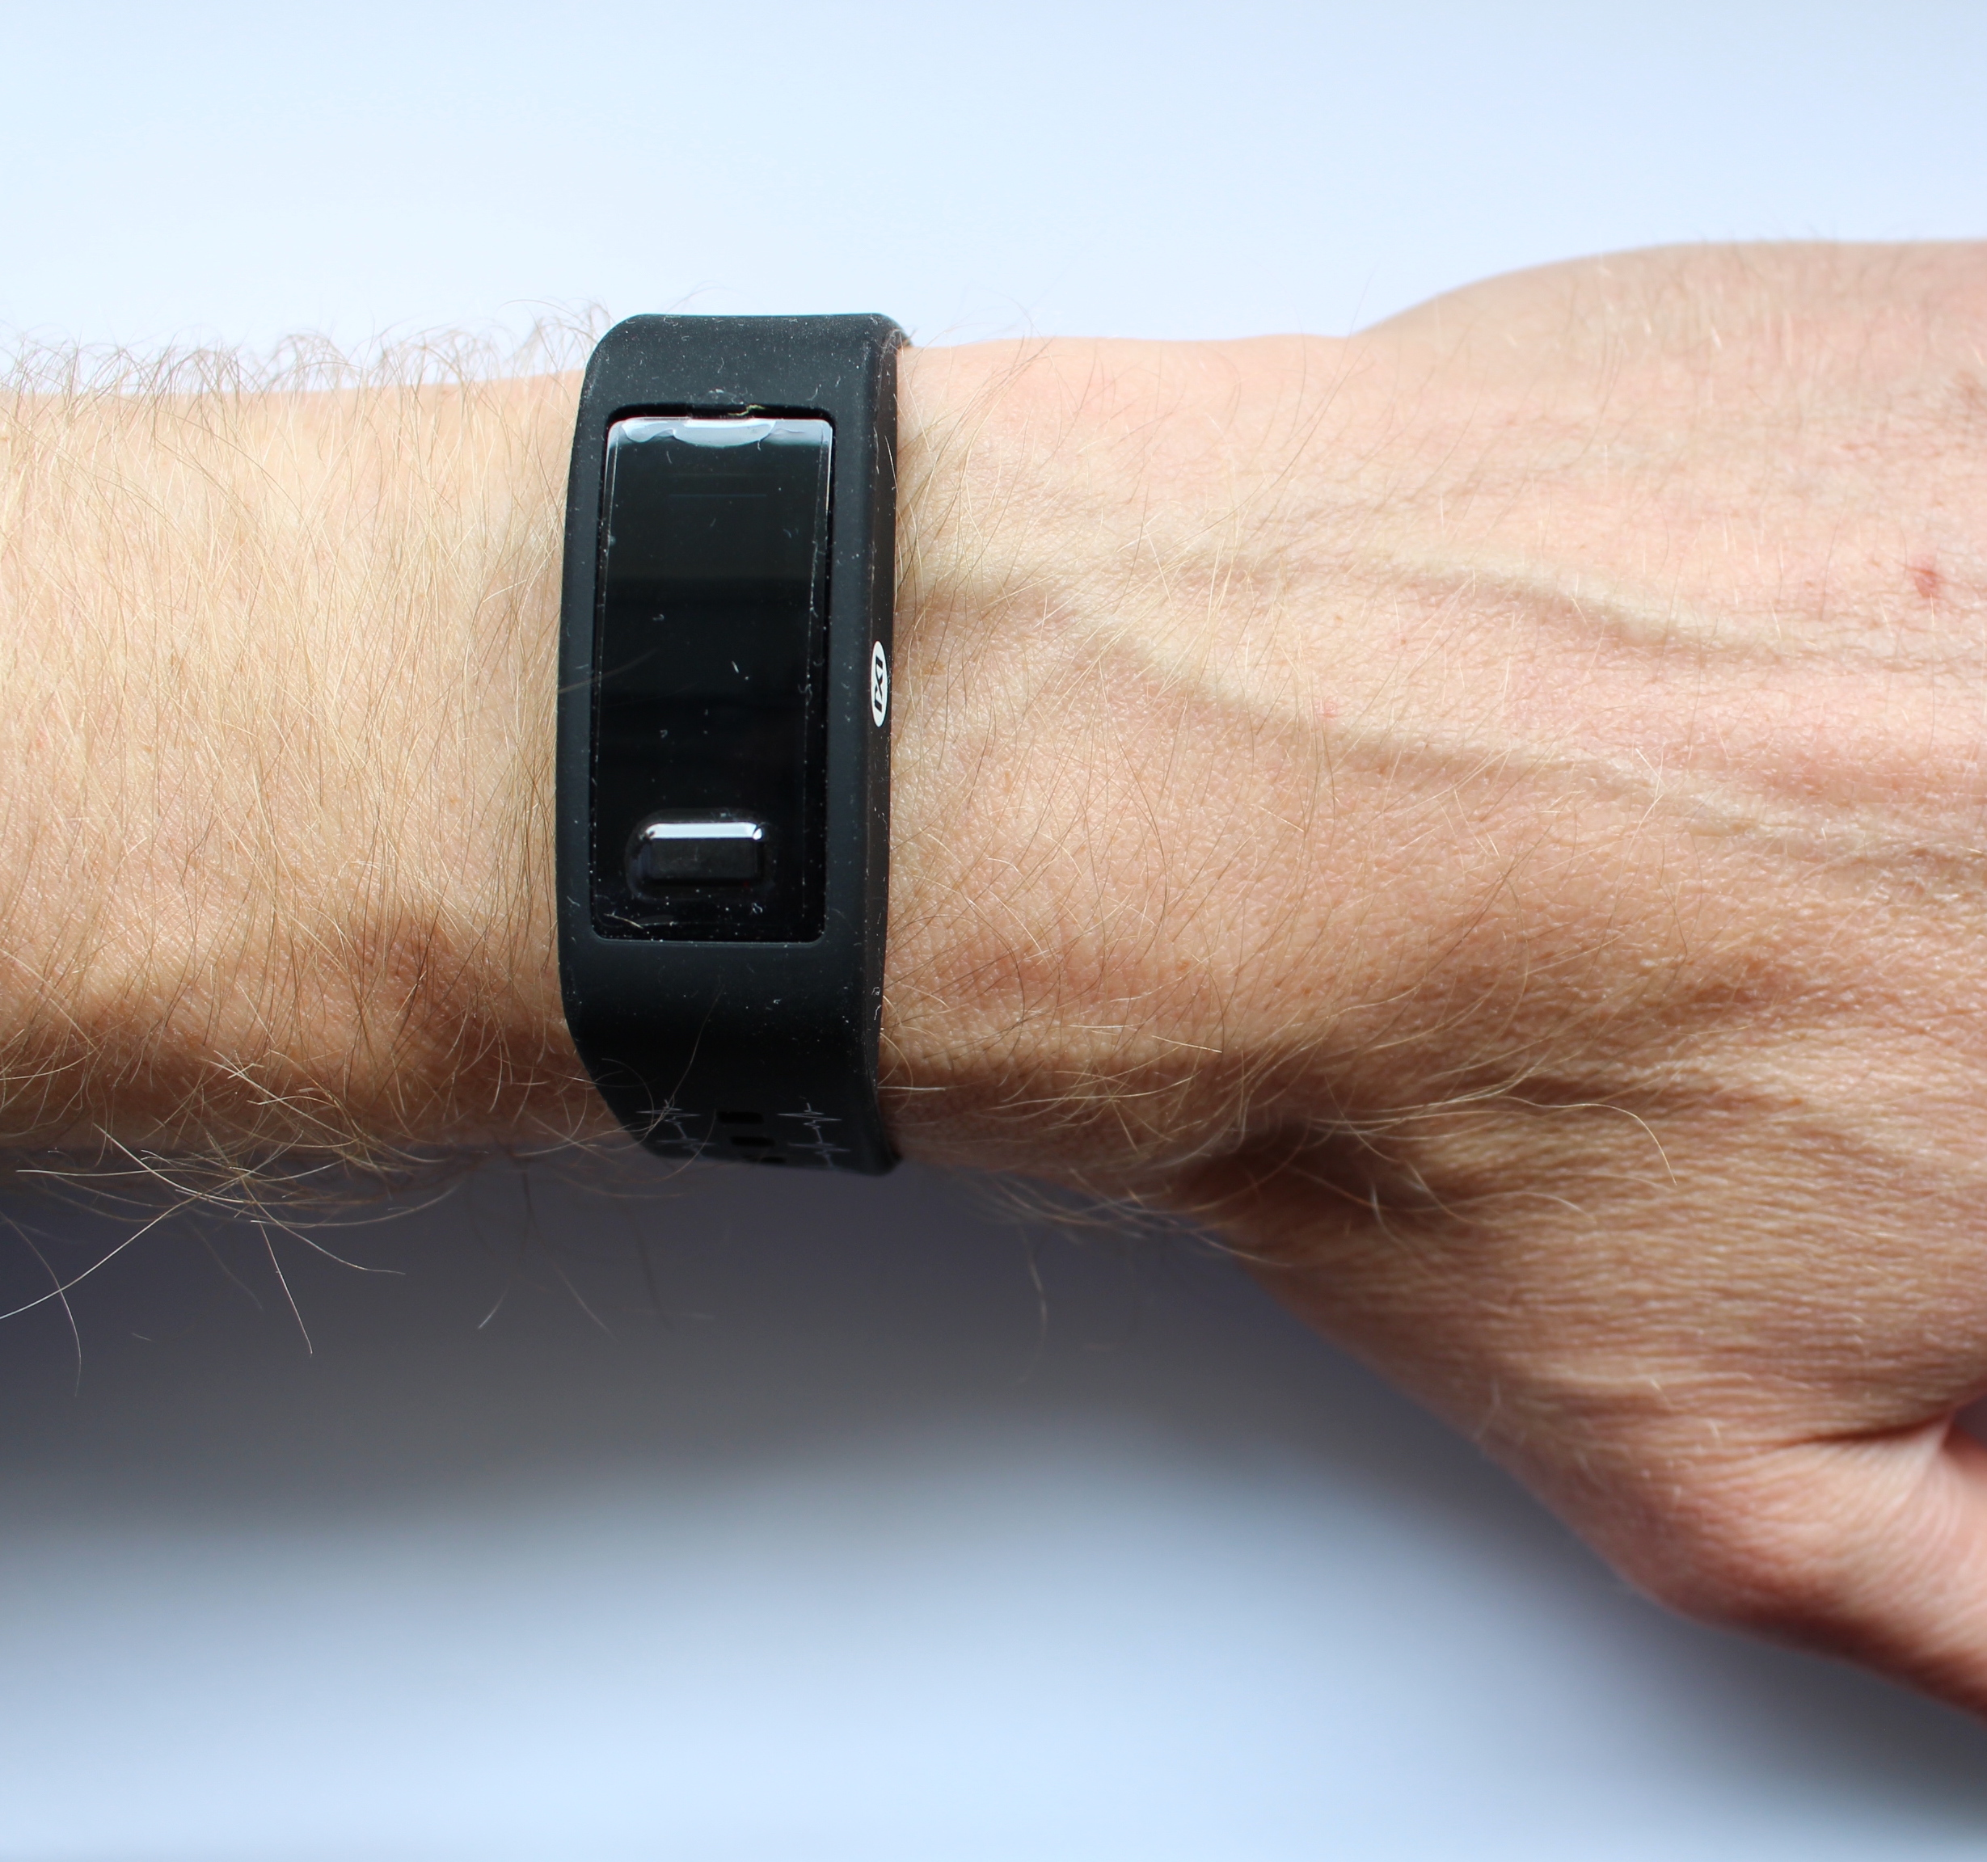
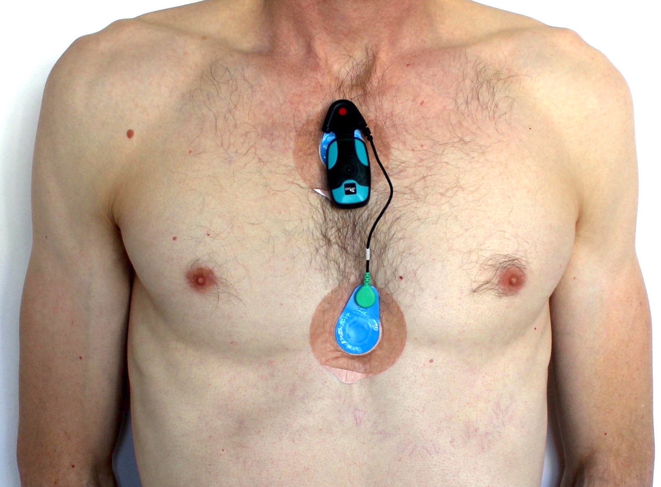
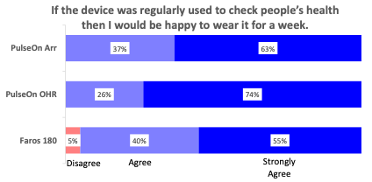
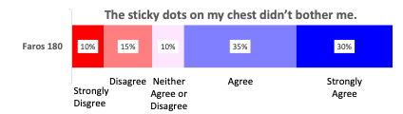



The Acceptability of Wearables for Atrial Fibrillation Screening: Interim Analysis of the SAFER Wearables Study
Peter H Charlton ¹², J Bacevicius ³, T Bonnici ⁴, J Brimicombe ¹, C Chapman ¹, A Dymond ¹, M Van Emmenis ¹,
PA Kyriacou ², V Marozas ⁵, A Rapalis ⁵, K Williams ¹, P Kyriacou ² & J Mant ¹
1 University of Cambridge, UK; 2 City, University of London, UK; 3 Vilnius University, Lithuania; 4 UCLH NHS F Trust, UK; 5 Kaunas University of Technology, Lithuania
Knowledge Gap
Wearable devices may have a role to play in AF screening:
Photoplethysmogram (PPG): an optical signal which can identify an irregular pulse indicating possible AF.
?
However, there is limited research on the acceptability of wearables in older adults, who are the target population for AF screening.
Systematic screening for Atrial fibrillation (AF) holds promise for improving diagnosis rates and reducing stroke risk through subsequent anticoagulation.
Electrocardiogram (ECG): to confirm AF diagnosis.
fancycrave1, https://commons.wikimedia.org/wiki/File:Apple_Watch-.jpg (CC0 1.0)
To identify factors influencing the acceptability of wearables in older adults.
Aim:
Methods
Devices: Participants were asked to wear three devices simultaneously for one week:
Participants
Community dwelling adults aged 65 and over who had previously been screened for AF were recruited through general practices.
Study Procedures
Devices were delivered by mail, and instructions were provided in a leaflet and telephone call. Informal feedback was collected via telephone calls during the week. Formal feedback was collected through a questionnaire at the end of the week.
PulseOn Arrhythmia Monitor
Continuous PPG. Vibrated 4 times per day and upon irregular pulse to prompt ECG recording.
PulseOn OHR
(Optical Heart Rate Tracker)
Intermittent PPG
Bittium Faros 180 chest patch
Continuous reference ECG
Results
Feedback
Most respondents would be happy to wear any device for a week:
But the chest electrodes irritated participants, with 8 (38%) participants reporting irritation during telephone calls.
Recruitment and participation
75 potential participants invited
42 consented to take part (56%)
21 had taken part at the time of this analysis
Device removals
Removals:
5 (24%) removed Faros 180 due to skin irritation
4 (19%) removed PulseOn OHR (3 due to battery running out, 1 due to skin irritation)
1 (5%) removed PulseOn Arr due to night-time vibrations
Other issues:
Faros 180: electrodes detached, form factor not suitable for women.
PulseOn Arr: night-time vibrations.
PulseOn OHR: battery running out.
Discussion and Conclusions
Next Steps
Possible strategies to improve acceptability:
Use different chest patch electrodes or locations.
Inform participants that accidental activation of PulseOn Arr can produce night-time vibrations.
Limitations:
One-week duration
Devices worn simultaneously
Conclusion:
Wearable devices were tolerated for one week by older adults, although the chest patch’s electrodes caused skin irritation leading to some participants removing it.
Complete SAFER Wearables Study:
Target recruitment: 130 participants (65 AF, 65 non-AF)
Assess performance of wearables for detecting AF.
Improve the reliability of AF diagnoses based on single-lead ECGs acquired from wrist-worn and handheld devices:
Guidelines state that AF diagnoses should be made based on manual interpretation of ECGs.
However, we have recently observed that when screening for AF using handheld ECG devices in SAFER: for every 100 participants diagnosed with AF by two cardiologists, the cardiologists would disagree on the diagnosis of a further 70 participants.
Acknowledgments
This study is funded by the British Heart Foundation [FS/20/20/34626], and the NIHR [Programme Grants for Applied Research Programme (RP-PG0217-20007)] and [School for Primary Care Research (SPCR-2014-10043, project 410)]. The views expressed are those of the author(s) and not necessarily
those of the NIHR or the Department of Health and Social Care. The study received support from the European COST ACTION ‘Network for Research in Vascular Ageing’ CA18216 supported by COST (European Cooperation in Science and Technology): www.cost.eu.
Material reproduced from the preprint of the same name under CC BY 4.0 .
peterhcharlton.github.io
pete@oxon.org
Notes:
ECG and PPG excerpts: create_ecg_ppg_excerpt_diagrams.m

