Slide 1
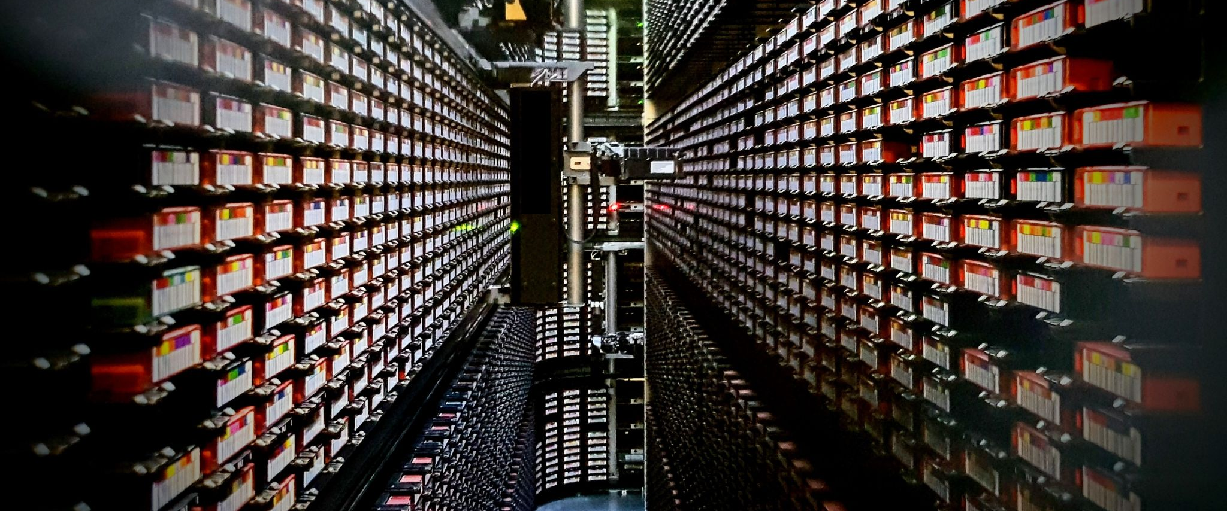
Lightning talk iPRES 2024
Intake of heterogeneous digital archival collections at meemoo: the challenges
19/09/2024 Lobke Vanden Eynden

Slide 2
Let’s dissect this title
Intake of heterogeneous digital archival collections at meemoo: the challenges

Slide 3
Let’s dissect this title
Intake of heterogeneous digital archival collections at meemoo: the challenges

Slide 4
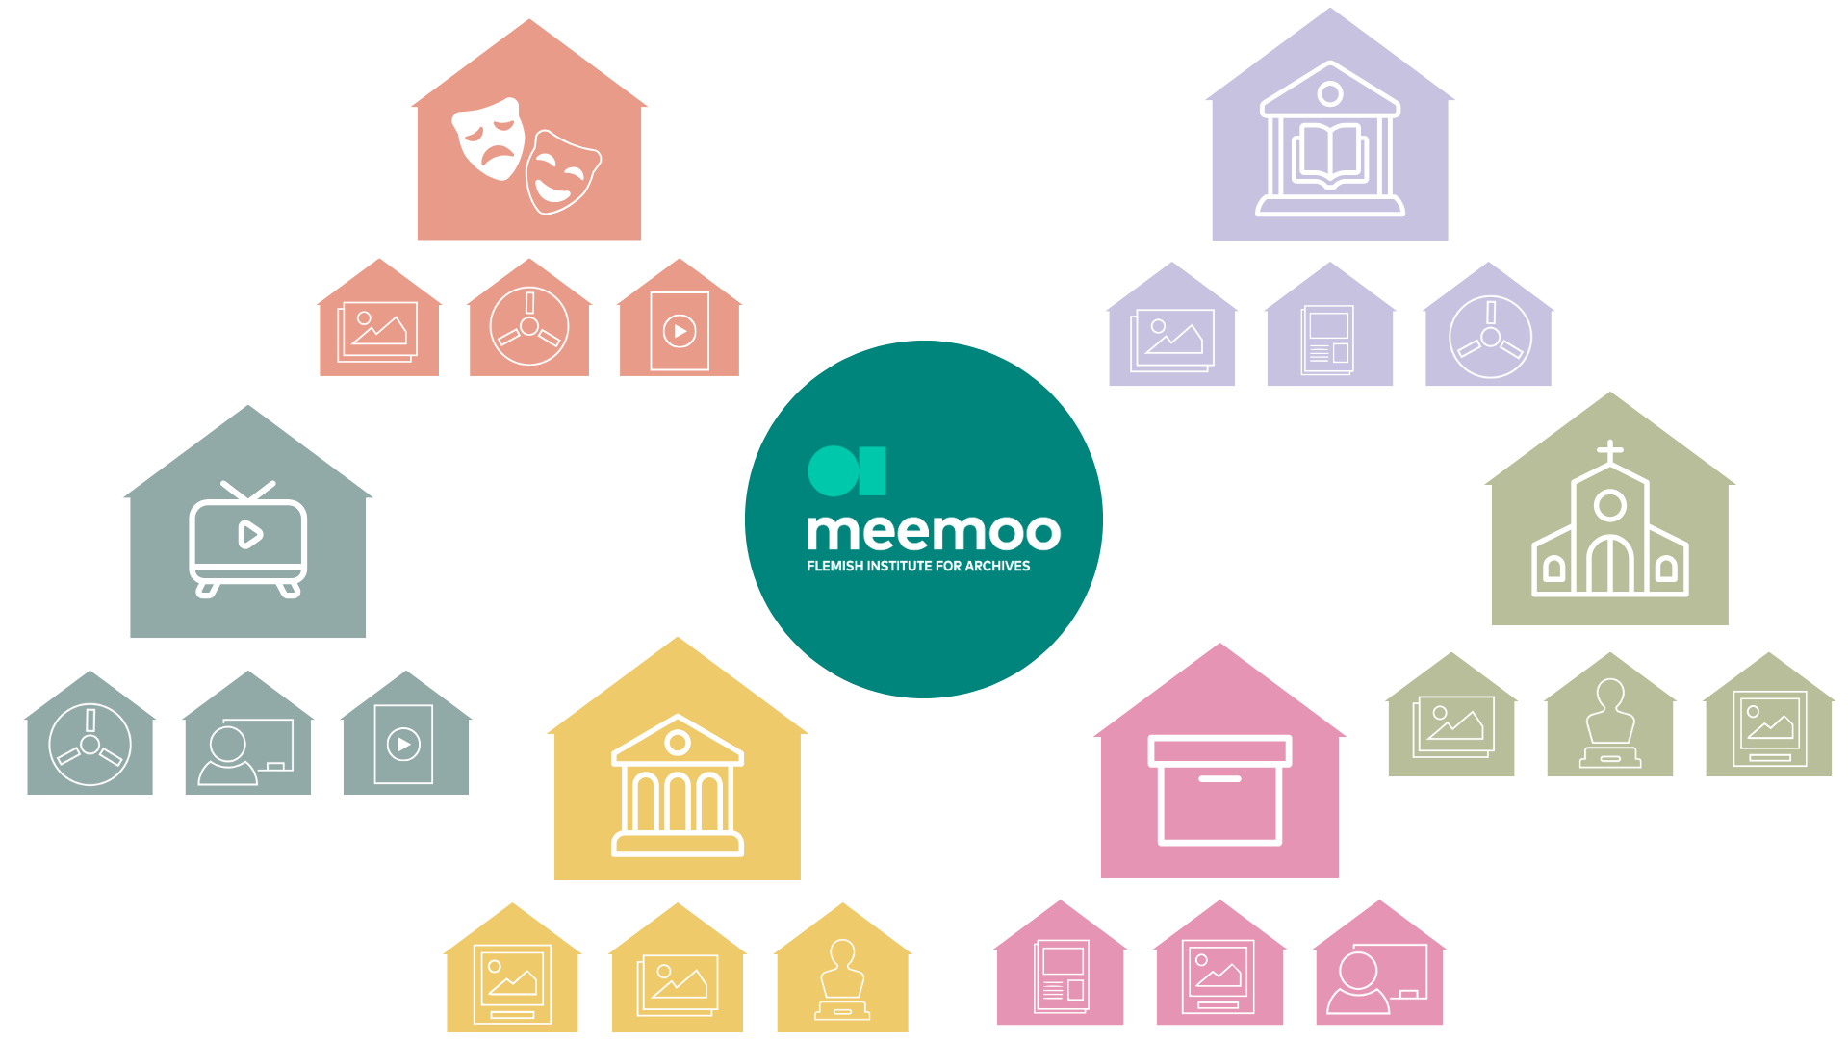
Notes:
Meemoo’s services are all aimed at helping other organisations with their digital archive and providing access to the rich wealth of Flemish archival content. We enter into permanent partnerships with some organisations (our content partners), and do more project-based work with others.
All these organisations have diverse archival collections, consisting of different types of content or files.
We do not have any ownership over any collections of our own. We only digitise and archive them and make them accessible, if possible.

Slide 5
Intake of heterogeneous digital archival collections at meemoo: the challenges

Slide 6
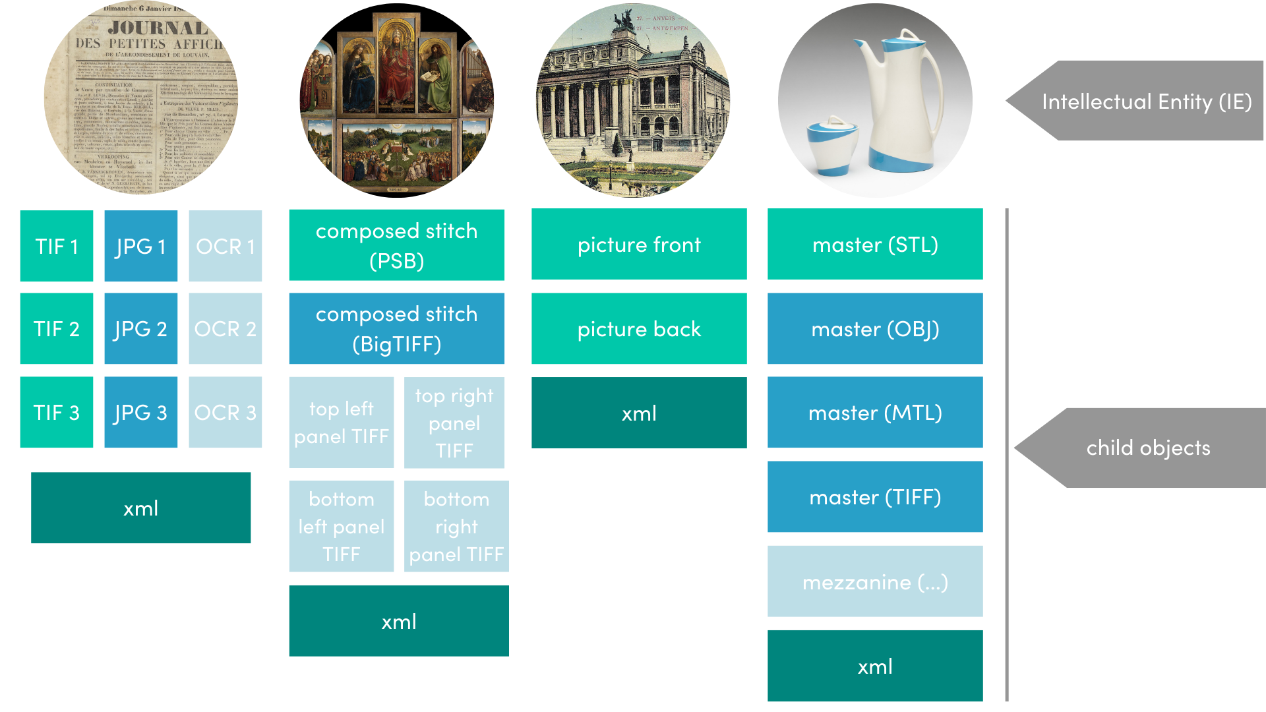
Notes:
Heterogeneous or complex objects are objects consisting of multiple files, which have a relationship between them. All these partial or child objects together give meaning to the main object, the parent, or the Intellectual Entity. The Intellectual Entity is packaged in a SIP, Submission Information Package.

Slide 7
error-prone
diverse
not standardised
Intake of heterogeneous digital archival collections at meemoo: the challenges
time-consuming
…
inefficient
not scalable

Slide 8
Some outcomes
development of (pre-)intake tooling (work in progress)
& implementation of E-ARK SIP (and CITS)
>> go to SIP documentation by meemoo
developer.meemoo.be/docs/diginstroom/sip/

Slide 9
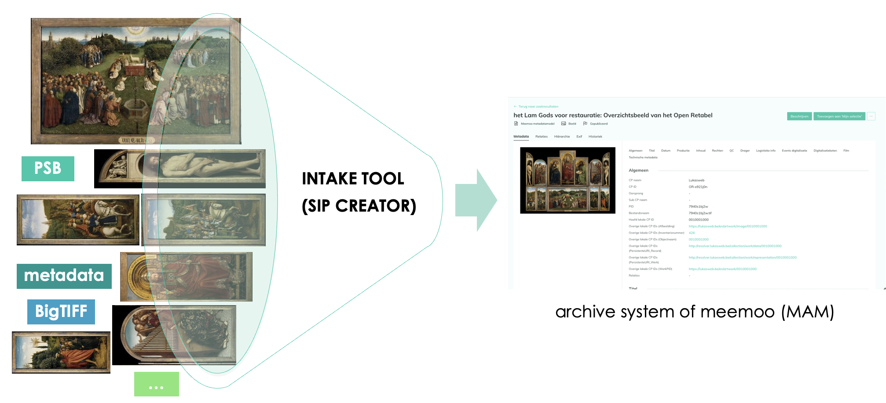

Slide 10
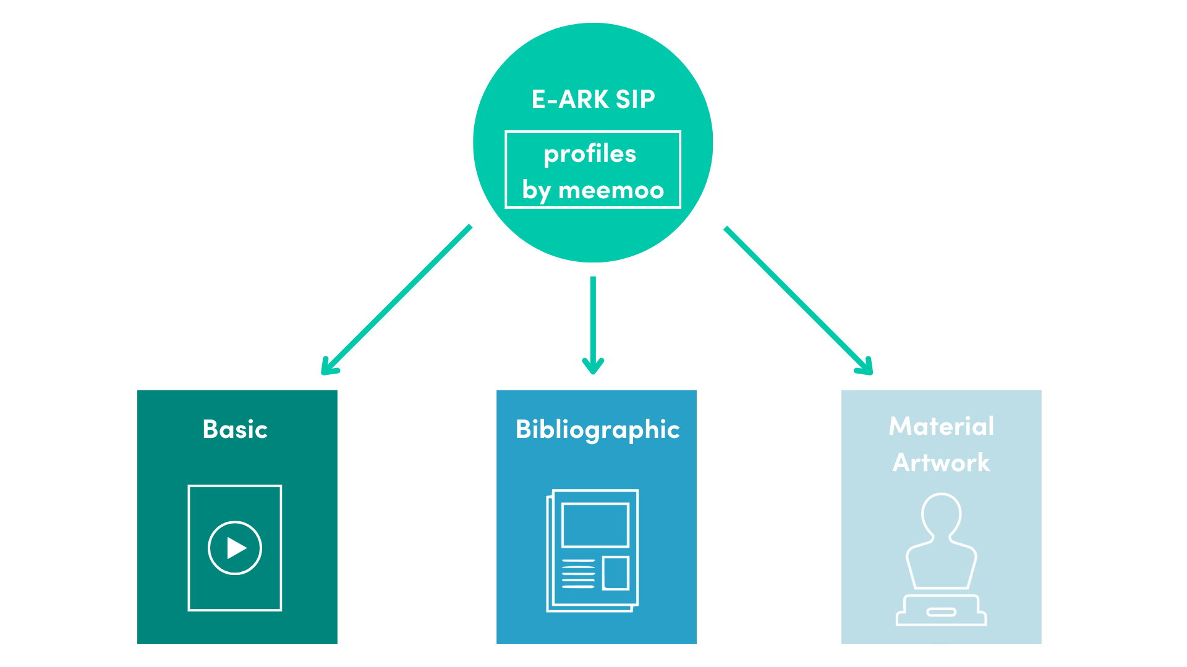
Notes:
some common rules → compliant to E-ARK specification of the SIP (rules, requirements, structure)
additional rules per profile or content type

Slide 11

Contact me!
lobke.vandeneynden@meemoo.be meemoo.be/en/team
‘Journal des petites affiches’, 06-01-1839, Weekblad voor het arrondissement Leuven, KU Leuven Bibliotheken, totindetail.be, public domain.
‘Het Lam Gods voor restauratie: overzichtsbeeld’, by Jan van Eyck and Hubert van Eyck, collection Sint-Baafskathedraal Gent, artinflanders.be, photo: Hugo Maertens, CC-BY-NC-ND 4.0.
‘Postkaart buitenzicht museum’, collection KMSKA, artinflanders.be, photo: Hugo Maertens, public domain.
'Koffiekan en suikerpot', by Ernest D'Hossche, collection Design Museum Gent, artinflanders.be, photo: Dries Van den Brande, public domain.

