Slide 1
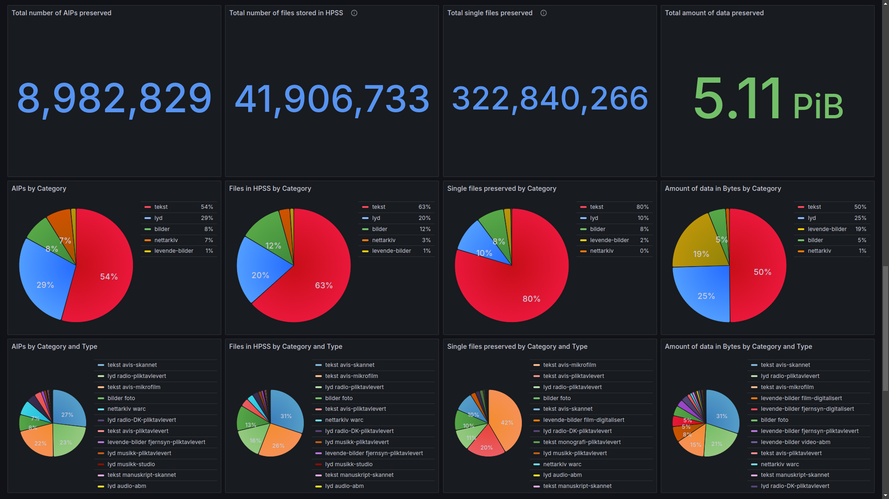
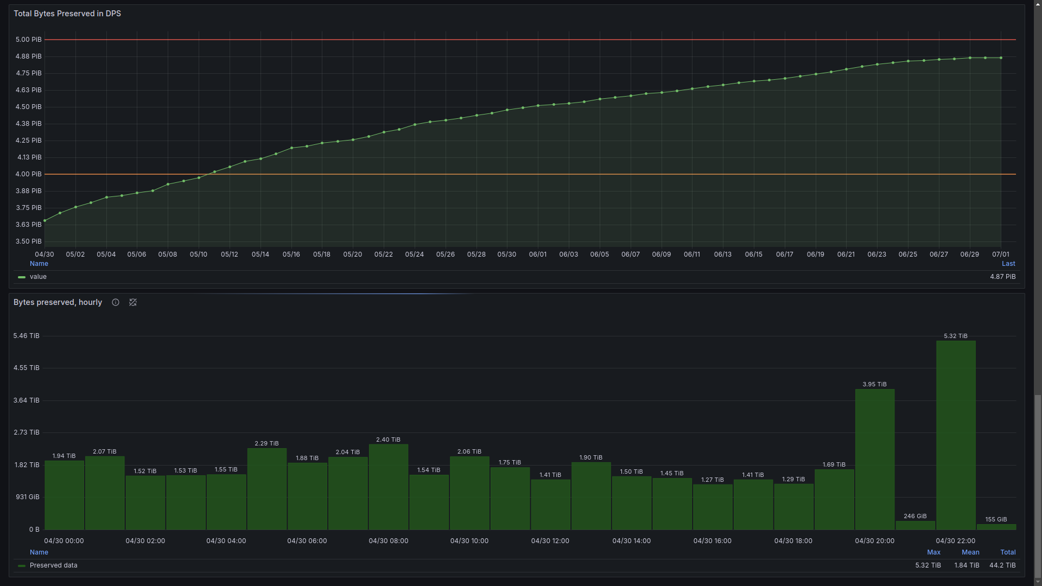
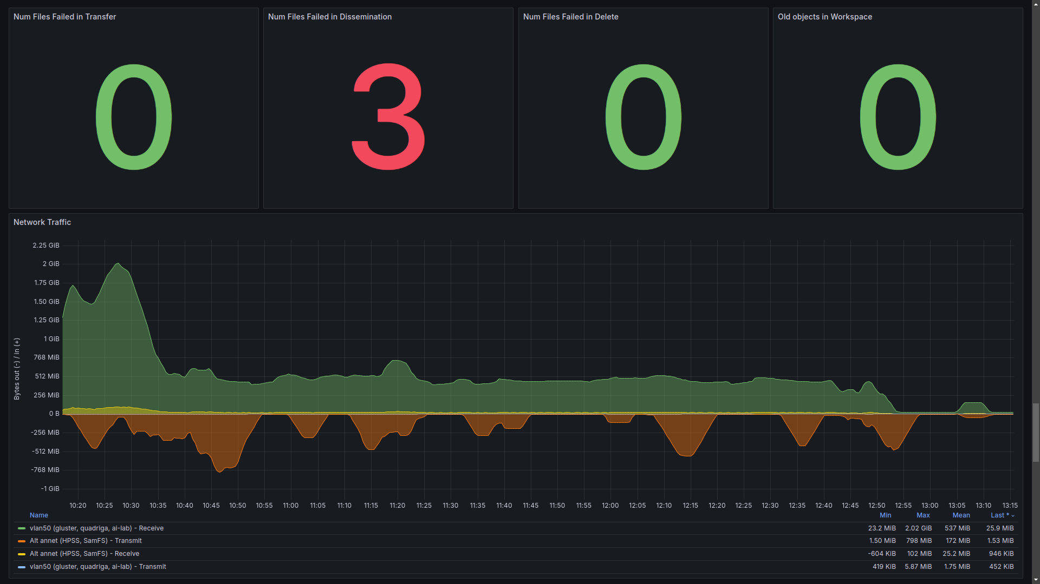
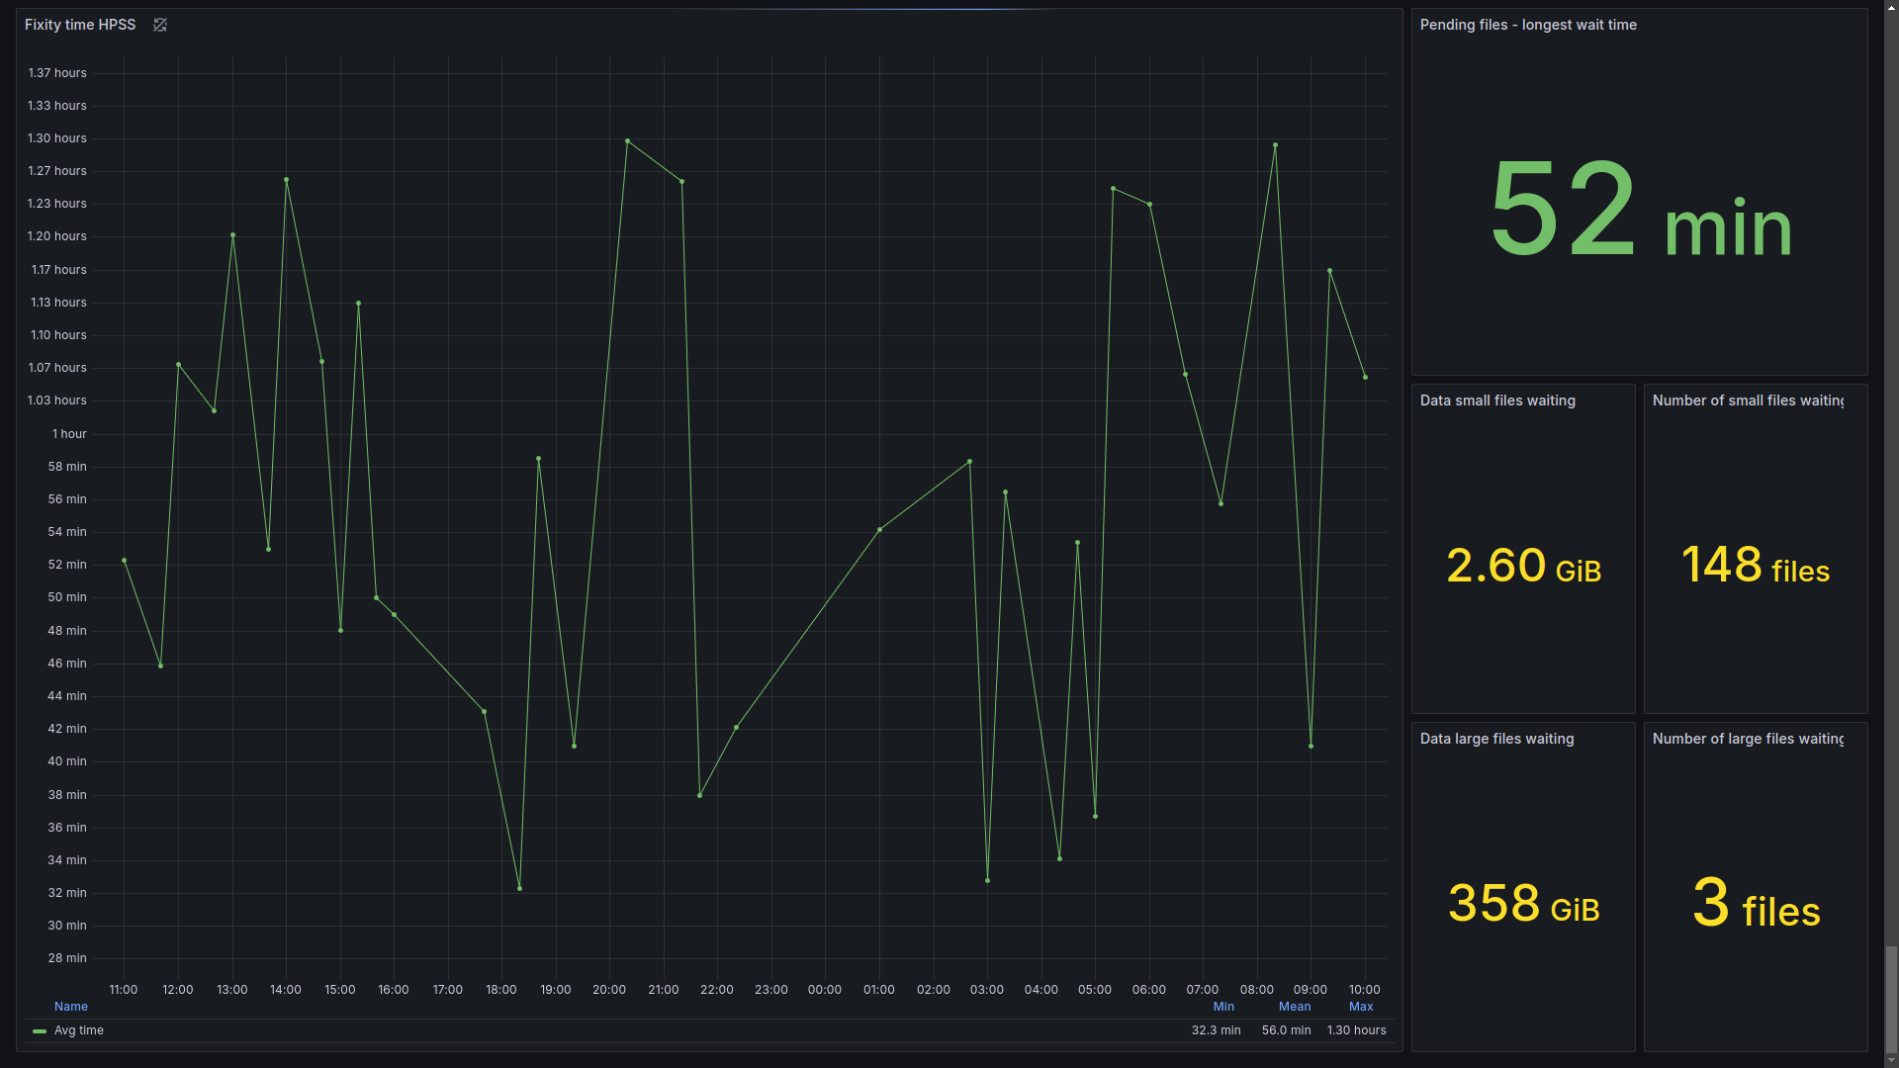
Inventory
Inventory
Health check
Health check

Slide 3
Inventory
Inventory
Health check
Health check

Slide 5
Inventory
Inventory
Health check
Health check

Slide 7
Inventory
Inventory
Health check
Health check

Slide 9
Inventory
Inventory
Health check
Health check

Slide 10




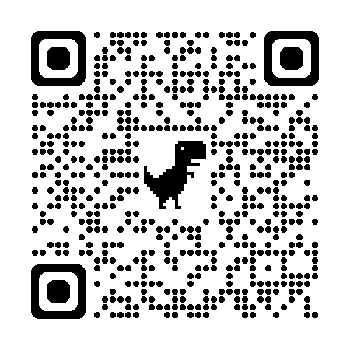


Contact information
Our Blog: https://digitalpreservation-blog.nb.no/
The preservation team at NLN: digitalbevaring@nb.no
Team lead: Trond.Teigen@nb.no
Tech lead: Thomas.Edvardsen@nb.no
Product lead: Torbjorn.Pedersen@nb.no

