Slide 1
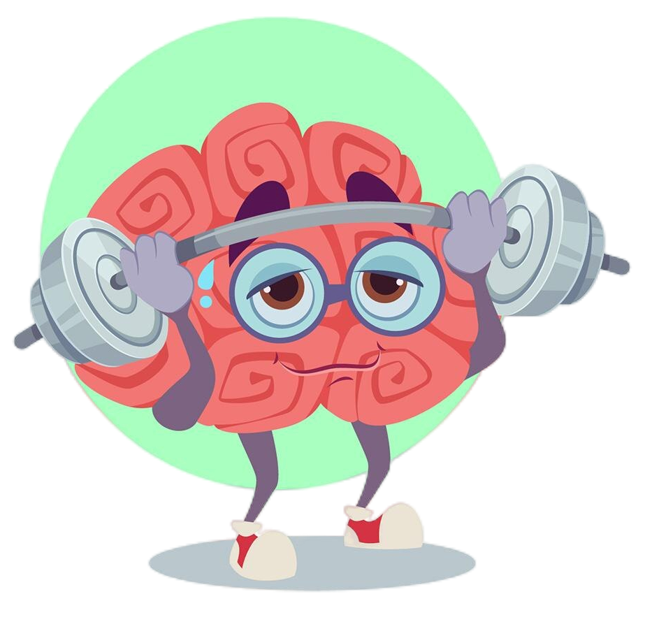
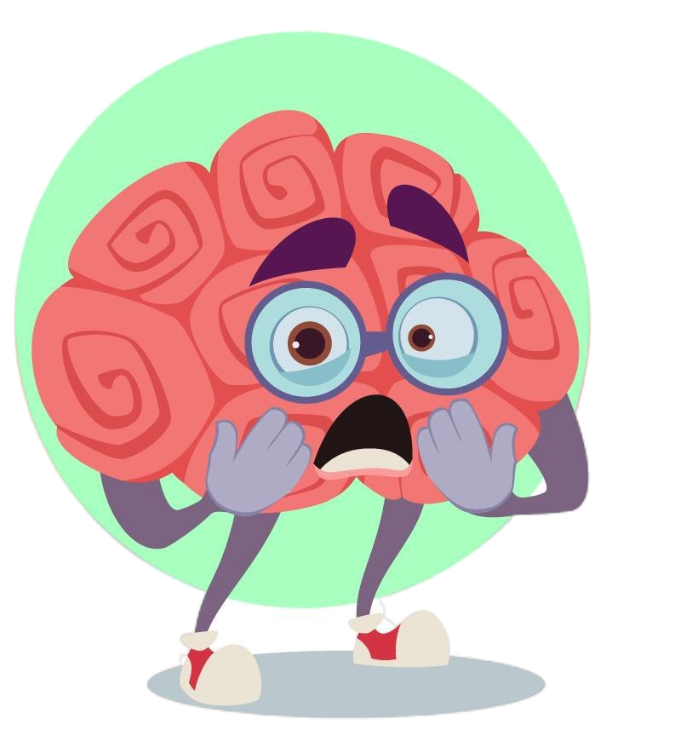
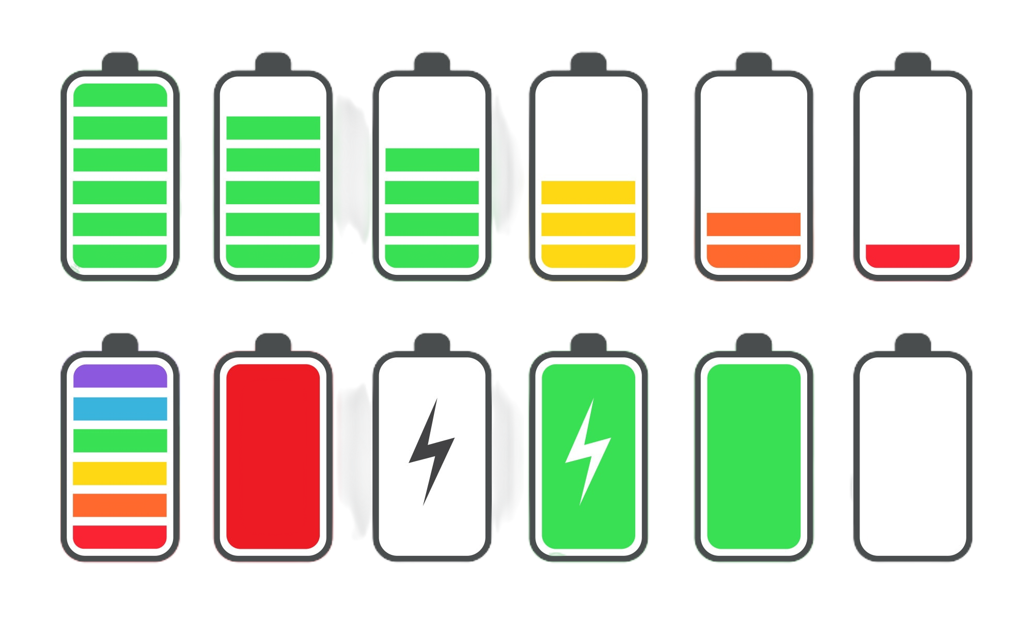
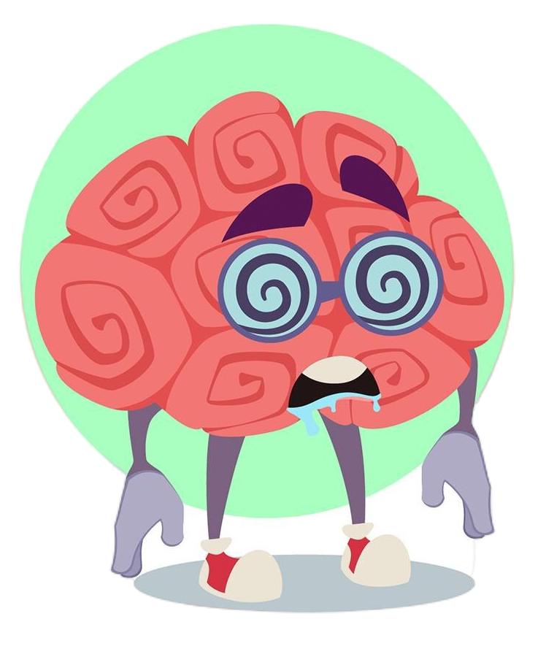
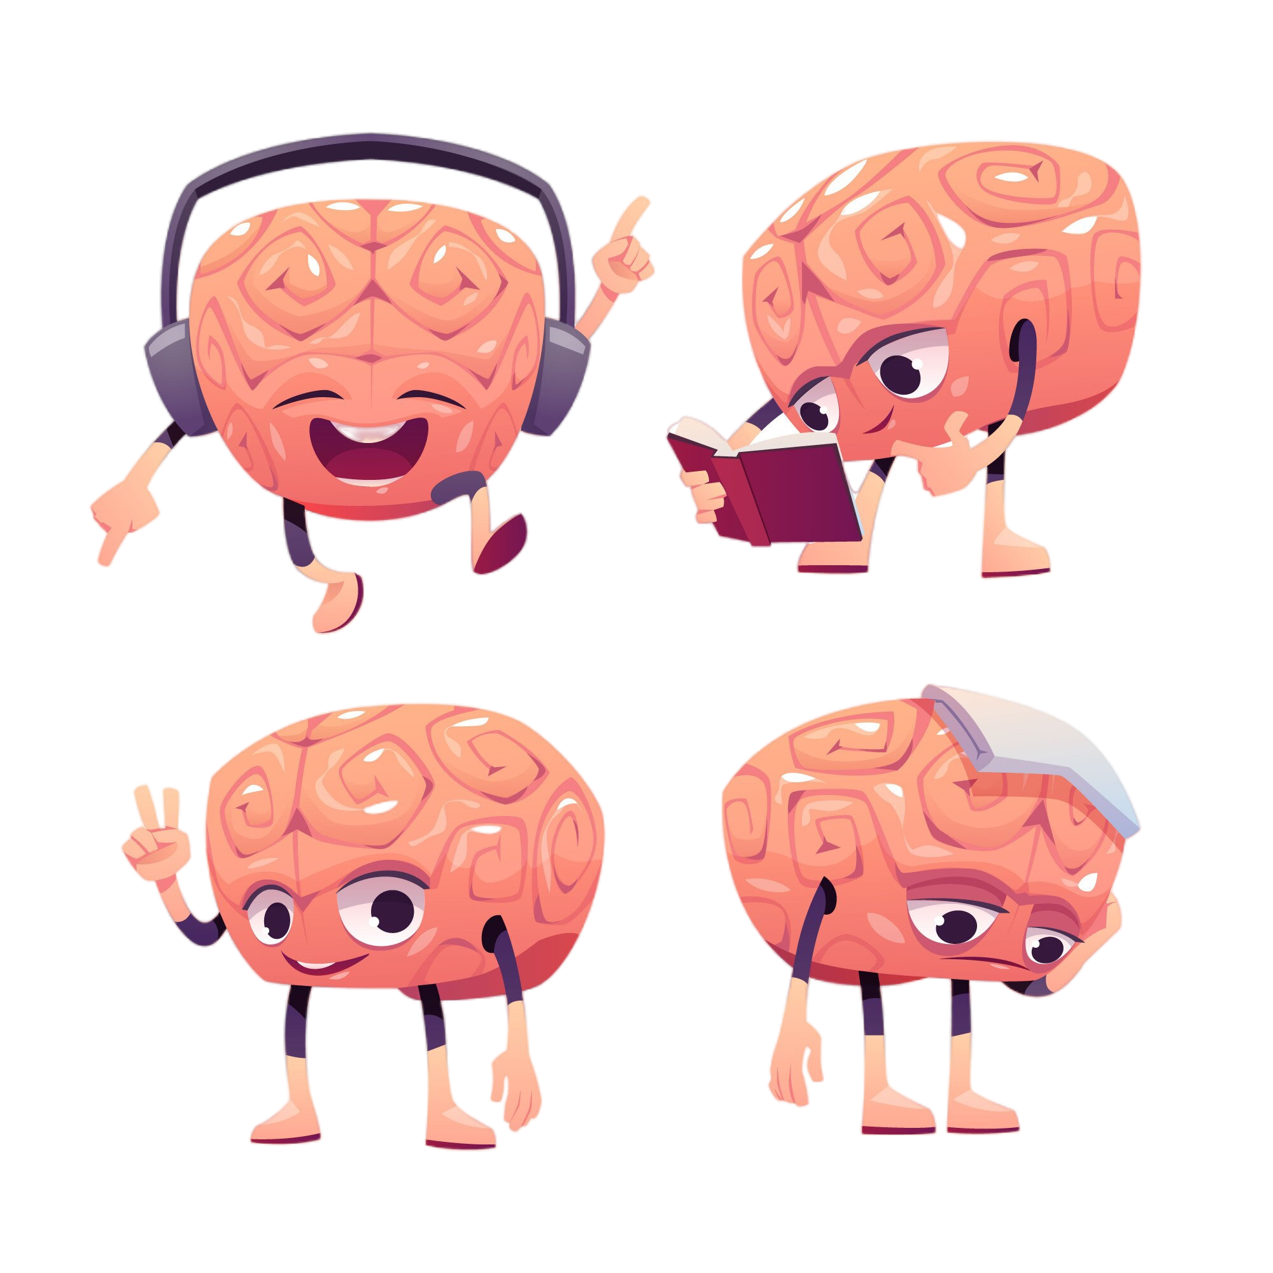

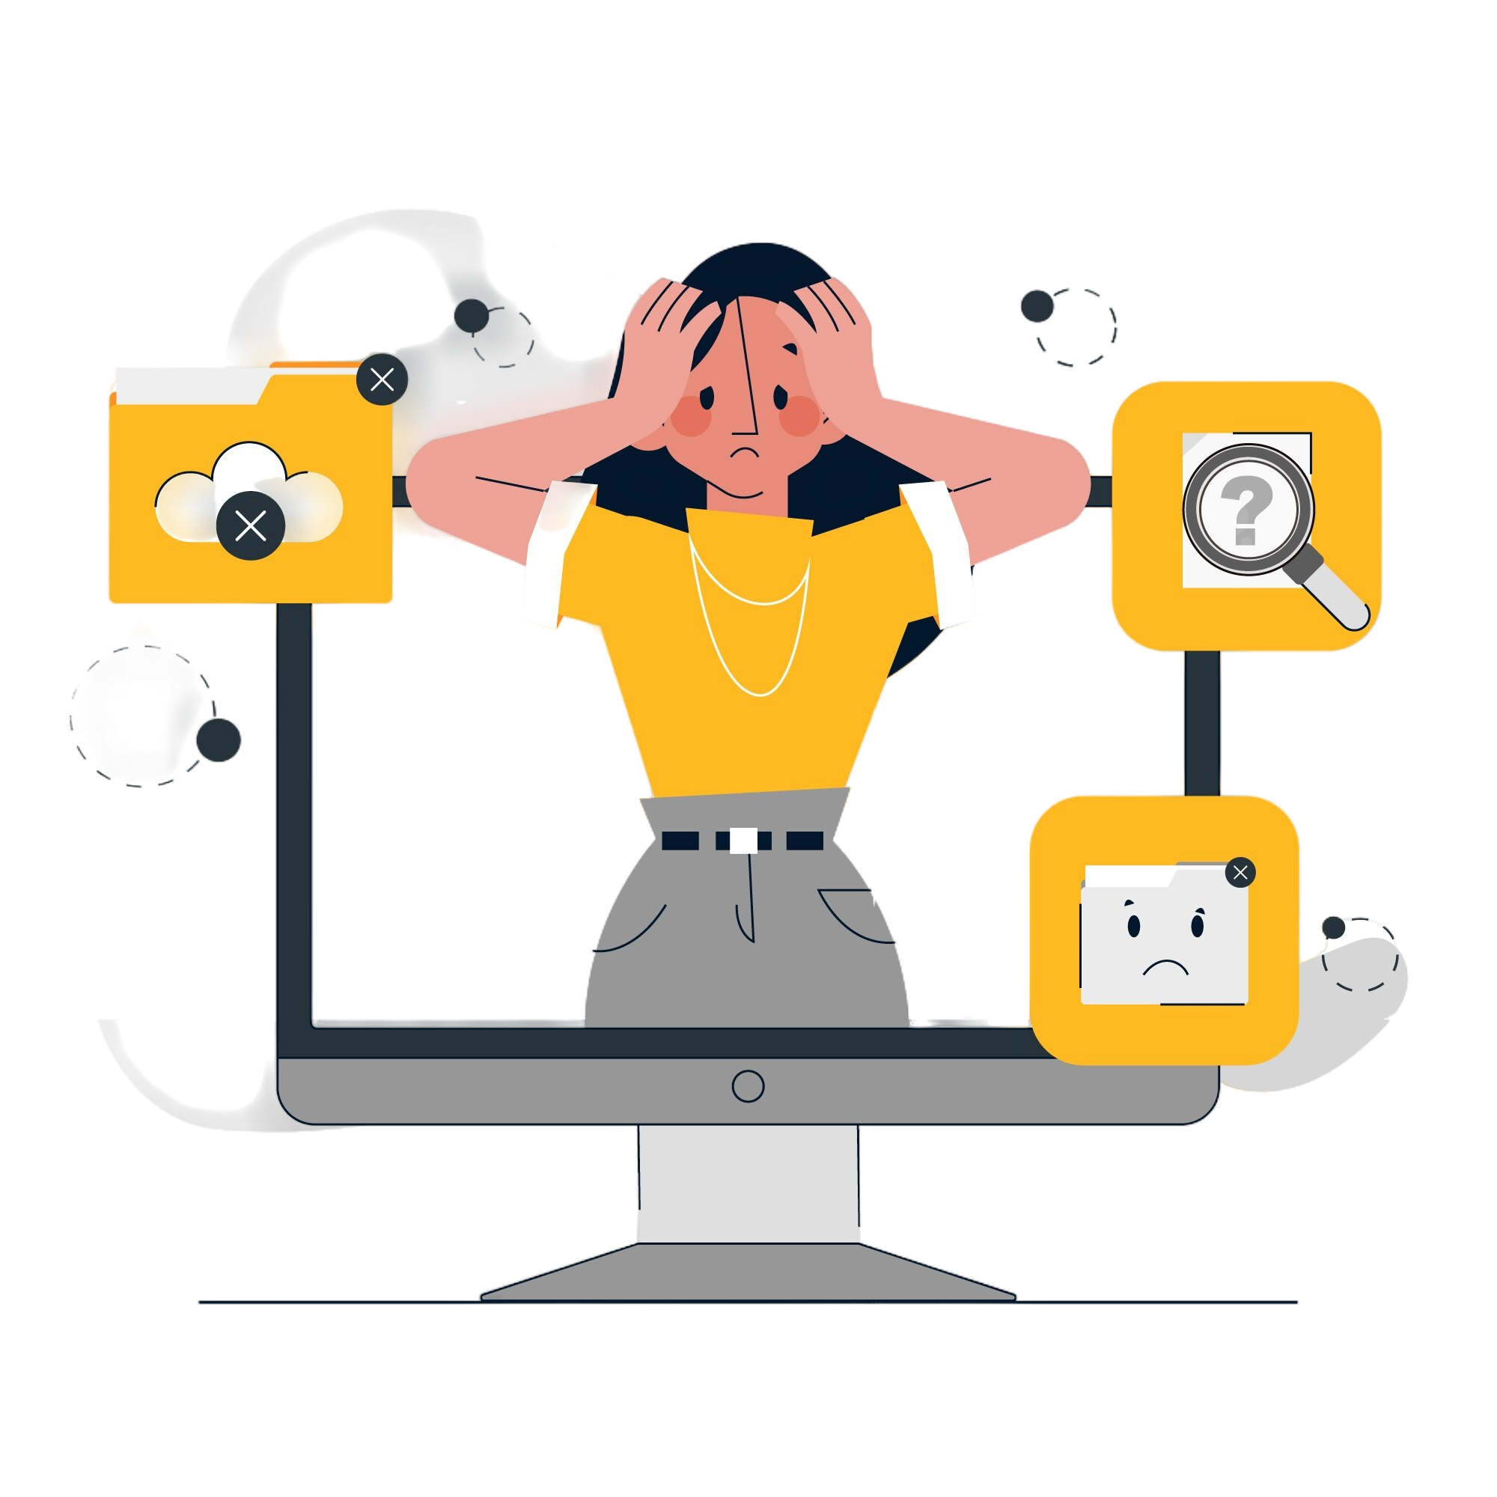
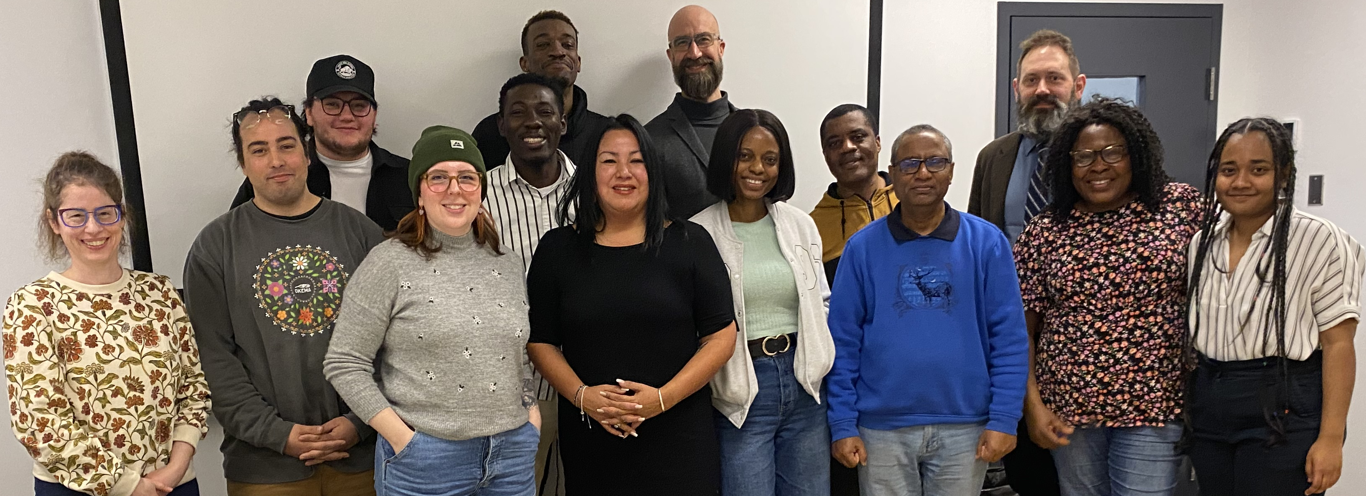

Self-Preservation:
Stress and Its Impacts on Digital Preservationists in Canada
A large percentage of digital preservationists in Canada are stressed out and experiencing burnout, anxiety, somatization, and depression, while nearly half are demonstrating some symptoms of psychological distress.
Conclusion & Future Study
While yet unproven, it is highly likely that the job-induced stress felt by digital preservationists in Canada is having a dramatic impact on their health and well-being. Further research will examine whether any correlations exist between stress and health/mood symptoms, as well as whether job satisfaction, role ambiguity/conflict/overload, the state of one’s digital preservation program, and certain demographics such as age, gender, and employment conditions affect stress levels.
Through this study, we hope to provide the evidence to support a conversation between GLAM administrators and digital preservationists to ensure our digital heritage can continue to be preserved and made accessible for future generations, without negatively impacting the health of its labour force.
Research Questions
To what degree are our roles as digital preservationists contributing to the stress levels in our lives and what are the major stressors impacting the Canadian community?
Is the stress we feel having a harmful effect on our mental and physical well-being?
Exhaustion
46% symptoms of depression
24% symptoms of somatization
33% symptoms of anxiety
47% positive for psychological distress
Burnout
N = 81
Disengagement
Methodology
A survey based on scales and measures commonly used in similar organizational psychology studies, including those pertaining to librarians, archivists, and information technologists, was distributed via list-servs and digital preservation networks in Canada in May 2023. ~40% of digital preservationists in Canada responded. The sample seemed to reflect the demographics and employment conditions of individuals in the profession.
Most respondents identified as:
General Levels of Stress
N = 81
Stressors specific to digital preservation:
N = 82
Stressor Category | Top Stressor in Category
Funding | Allocation of resources is too low in comparison to needs
Staffing | Lack of funding for new positions
Organizational commitment | Lack of resources to pursue organizational change
Discovery and access | Lack of technological infrastructure for access
Policies, strategies, and procedures | Lack of time/resources for policy development/procedure documentation
Tools and applications for preservation | Lack of money to support processing tools
Storage | High cost of local storage
N = 78
Brett Lougheed, University Archivist/Digital Curator (b.lougheed@uwinnipeg.ca)
Aynslie Hinds, Instructor (a.hinds@uwinnipeg.ca)
Do you feel stress related to the specialized technology that you are expected to use in your work?
Women
New or junior positions
$40-100K salary
Academic or government archives of varying budgets
Managing mid-level maturity digital preservation programs
Working alone or in small teams
We would like to acknowledge the contributions of the Quantitative Research Methods class from the University of Winnipeg Master’s of Development Practice in Indigenous Development program for their support in analyzing the survey data set and creating graphs and tables for the study.
N = 86
Images courtesy of Freepik

