Slide 1

The VO, FAIR Principles and Open Science
Division B Days, Session 3b
Community Engagement, Open Science and the Virtual Observatory
IAU General Assembly 2024
G. Bruce Berriman
(Caltech/IPAC-NExScI)
NASA Representative, IVOA Executive Committee
Chair, Division B, Functional Working Group on the VO.

Slide 2

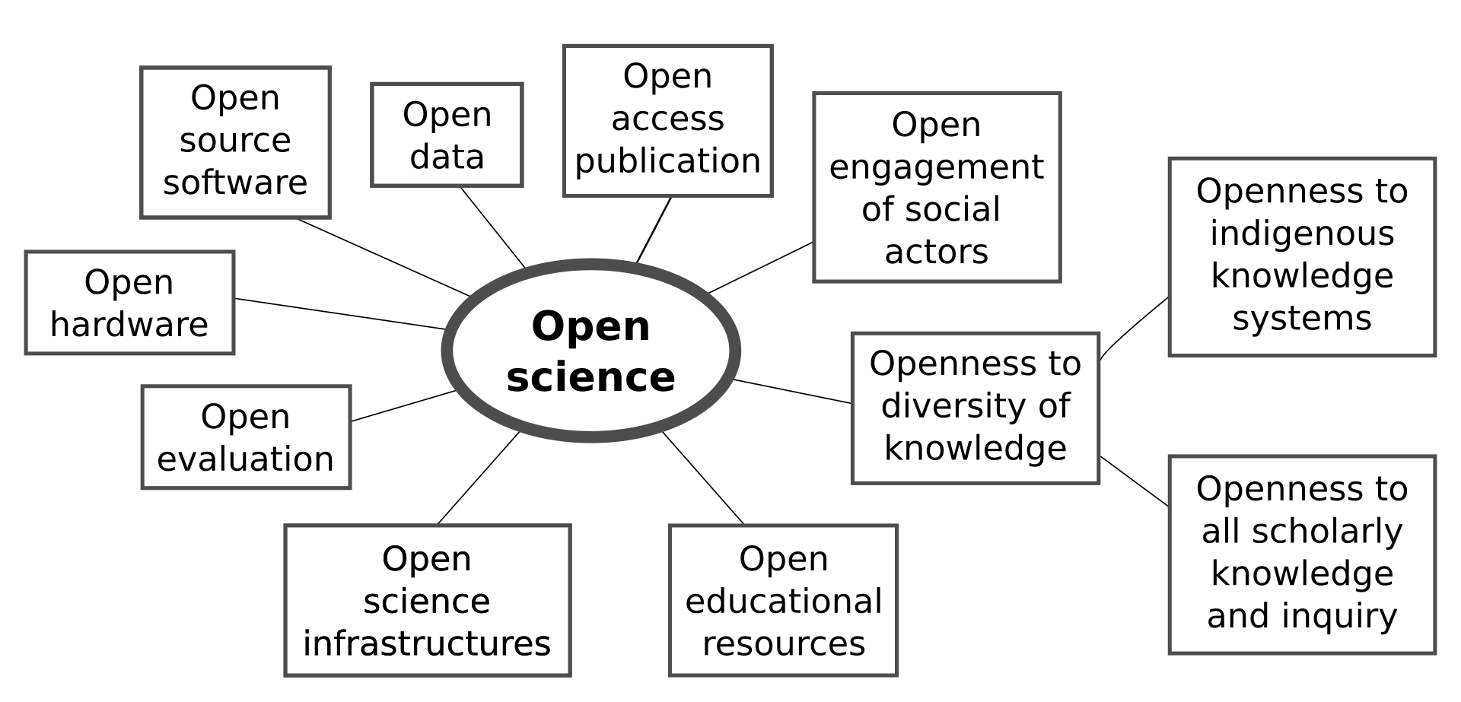
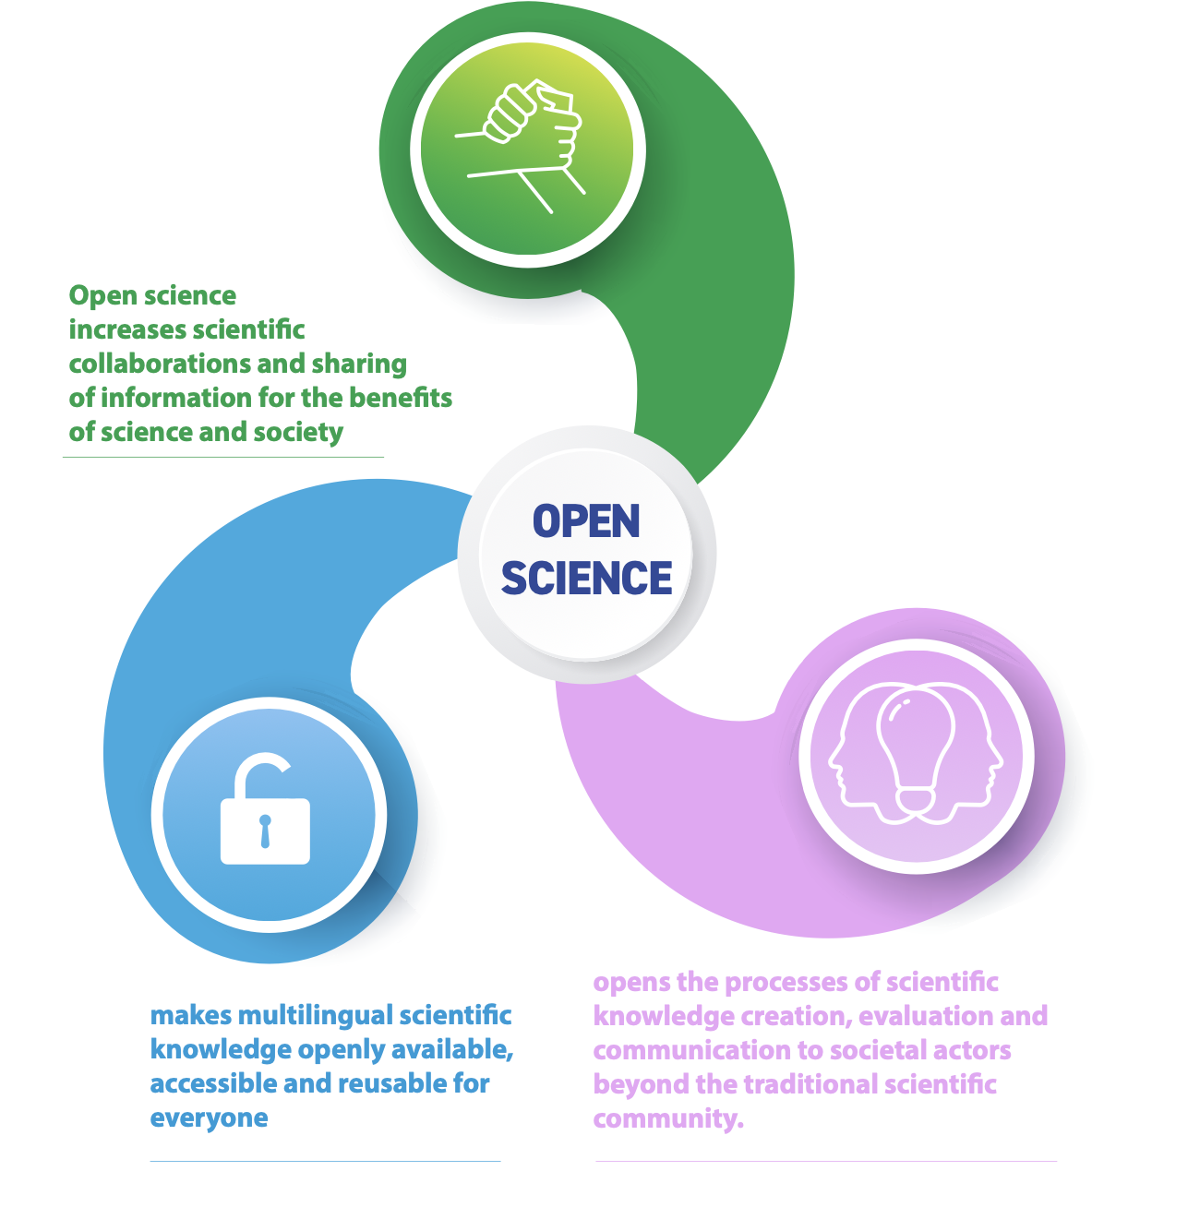
The IVOA Supports Open Science

Slide 3
OPENness and FAIRness are not the same thing!
“OPEN” IS ABOUT DATA RIGHTS AND LICENSING.
“F.A.I.R.” IS ABOUT MECHANICS OF MACHINE ACCESS
FAIR RECOGNIZES THAT DATA ARE DIVERSE AND SCATTERED ACROSS CYBERSPACE.
Courtesy: Anne Raugh

Slide 4
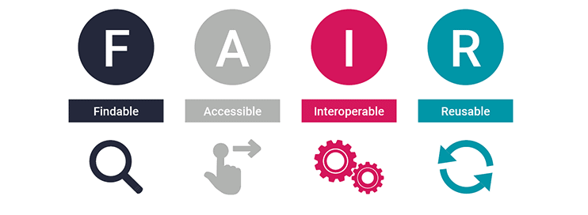
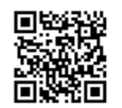
What are the FAIR Principles?
F1 | (Meta)data are assigned a globally unique and persistent identifier
F2 | Data are described with rich metadata (defined by R1 below)
F3 | Metadata clearly and explicitly include the identifier of the data they describe
F4 | (Meta)data are registered or indexed in a searchable resource
A1 | (Meta)data are retrievable by their identifier using a standardized communications protocol
A1.1 | The protocol is open, free, and universally implementable
A1.2 | The protocol allows for an authentication and authorization procedure, where necessary
A2 | Metadata are accessible, even when the data are no longer available
I1 | (Meta)data use a formal, accessible, shared, and broadly applicable language for knowledge representation.
I2 | (Meta)data use vocabularies that follow FAIR principles
I3 | (Meta)data include qualified references to other (meta)data
R1 | (Meta)data are richly described with a plurality of accurate and relevant attributes
R1.1 | (Meta)data are released with a clear and accessible data usage license
R1.2 | (Meta)data are associated with detailed provenance
R1.3 | (Meta)data meet domain-relevant community standards
“The FAIR Guiding Principles for scientific data management and stewardship”.
Wilkinson et al 2016. Sci Data 3, 160018 (2016). https://doi.org/10.1038/sdata.2016.18
The FAIR Principles at go-fair.org/fair-principles
It’s all about the metadata!

Slide 5
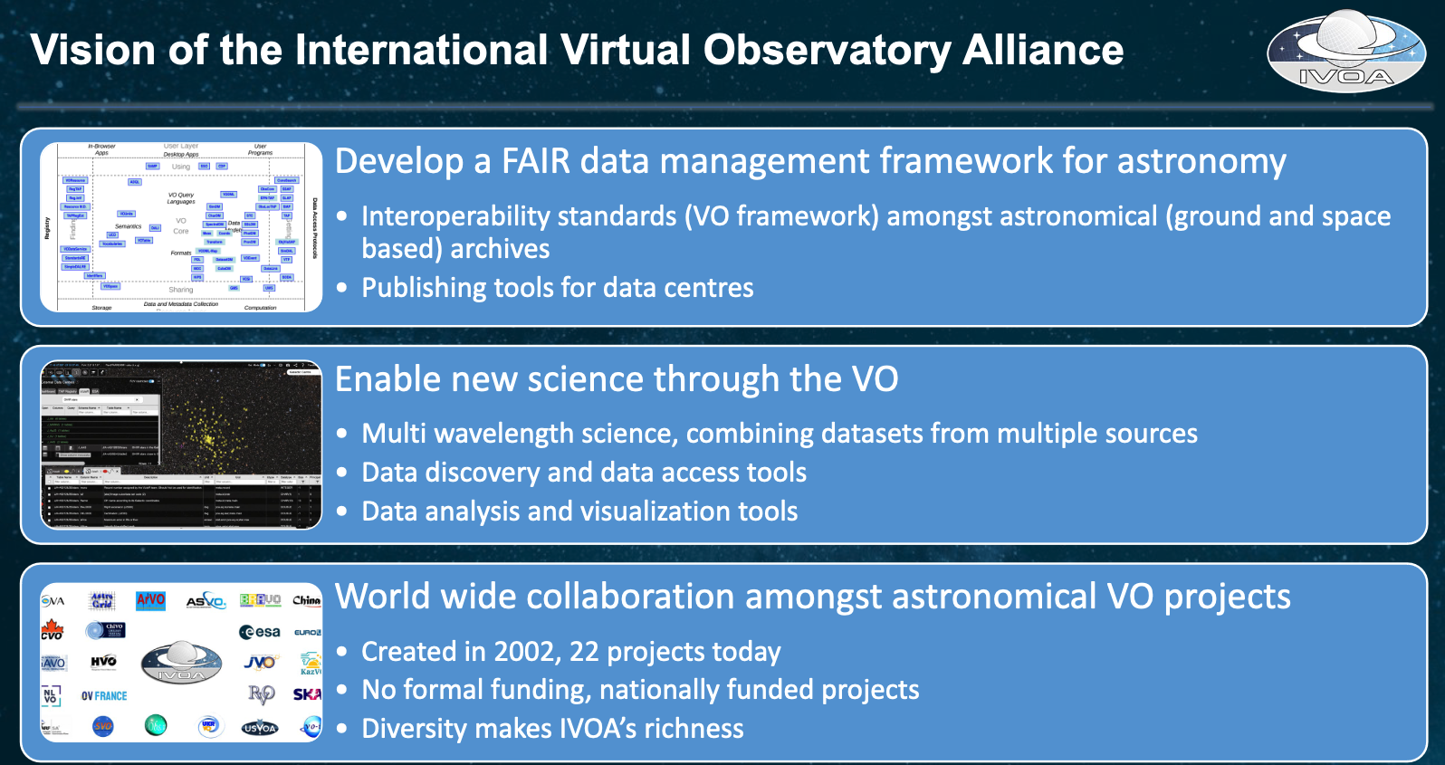
C. Arviset:
https://wiki.ivoa.net/internal/IVOA/InterOpMay2023/20230512-CA-IVOAExecClosingRemarks-Bologna.pdf

Slide 6
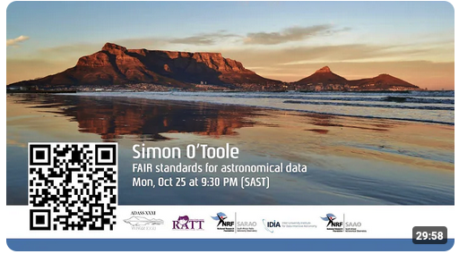
The IVOA and FAIR Principles
To a large degree, implementing IVOA standards goes a long way to implementing FAIR principles.
“ FAIR standards for astronomical data.” 2022. S. O’Toole and J. Tocknell.
ASP Conference Series, 535 (Proc. ADASS XXXI), 265
https://www.youtube.com/watch?v=IBzGBEWF7Rs&t=72s

Slide 7
IVOA and FAIR Principles
F1 | (Meta)data are assigned a globally unique and persistent identifier | NO (service providers)
F2 | Data are described with rich metadata (defined by R1 below) | YES
F3 | Metadata clearly and explicitly include the identifier of the data they describe | YES
F4 | (Meta)data are registered or indexed in a searchable resource | NO (service providers)
A1 | (Meta)data are retrievable by their identifier using a standardized communications protocol | YES
A1.1 | The protocol is open, free, and universally implementable | YES
A1.2 | The protocol allows for an authentication and authorization procedure, where necessary | YES
A2 | Metadata are accessible, even when the data are no longer available | NO (service provider)

Slide 8
IVOA and FAIR Principles
I1 | (Meta)data use a formal, accessible, shared, and broadly applicable language for knowledge representation. | YES
I2 | (Meta)data use vocabularies that follow FAIR principles | YES
I3 | (Meta)data include qualified references to other (meta)data | YES
R1 | (Meta)data are richly described with a plurality of accurate and relevant attributes | YES
R1.1 | (Meta)data are released with a clear and accessible data usage license | NO (Data Provider)
R1.2 | (Meta)data are associated with detailed provenance | PARTIAL
R1.3 | (Meta)data meet domain-relevant community standards | YES

Slide 9
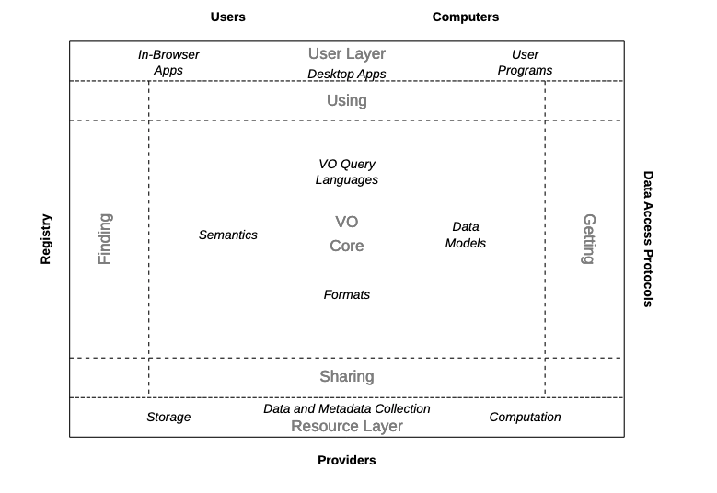
IVOA Architecture FAIR Principles

Slide 10
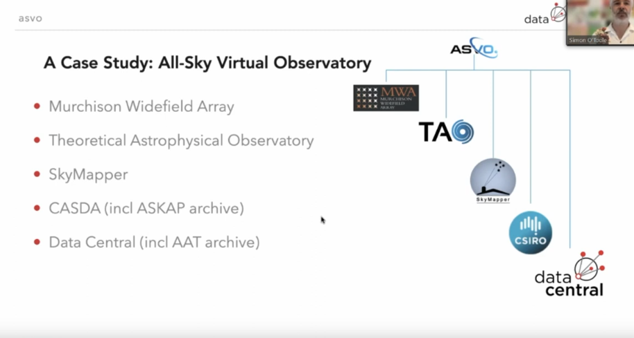
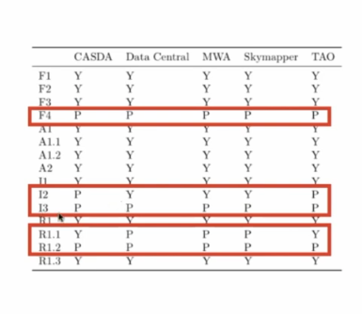

Slide 11
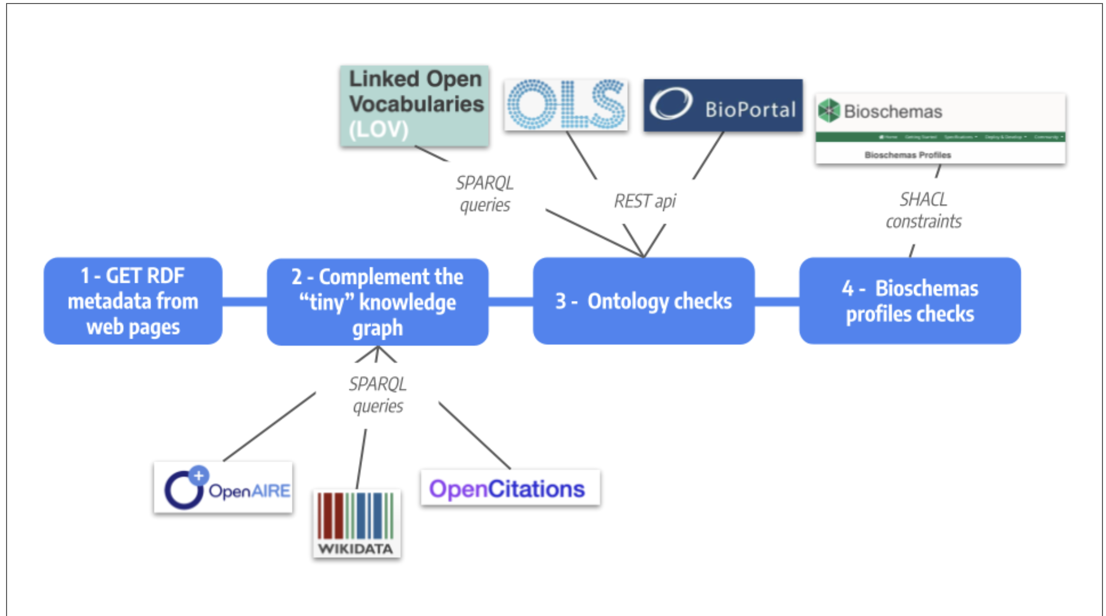
FAIR Validation: FAIR Checker
“FAIR-Checker leverages semantic web technologies to check that metadata use standards and recognized ontologies or controlled vocabularies”.
  https://fair-checker.france-bioinformatique.fr/
Gaignard, A., Rosnet, T., De Lamotte, F. et al. FAIR-Checker: supporting digital resource findability and reuse with Knowledge Graphs and Semantic Web standards. J Biomed Semant 14, 7 (2023). https://doi.org/10.1186/s13326-023-00289-5
Applicability to Astronomy? See https://wiki.ivoa.net/internal/IVOA/InterOpMay2023DCP/DCP-DOI.pdf. Landais, Muench, d’Abrusco

Slide 12
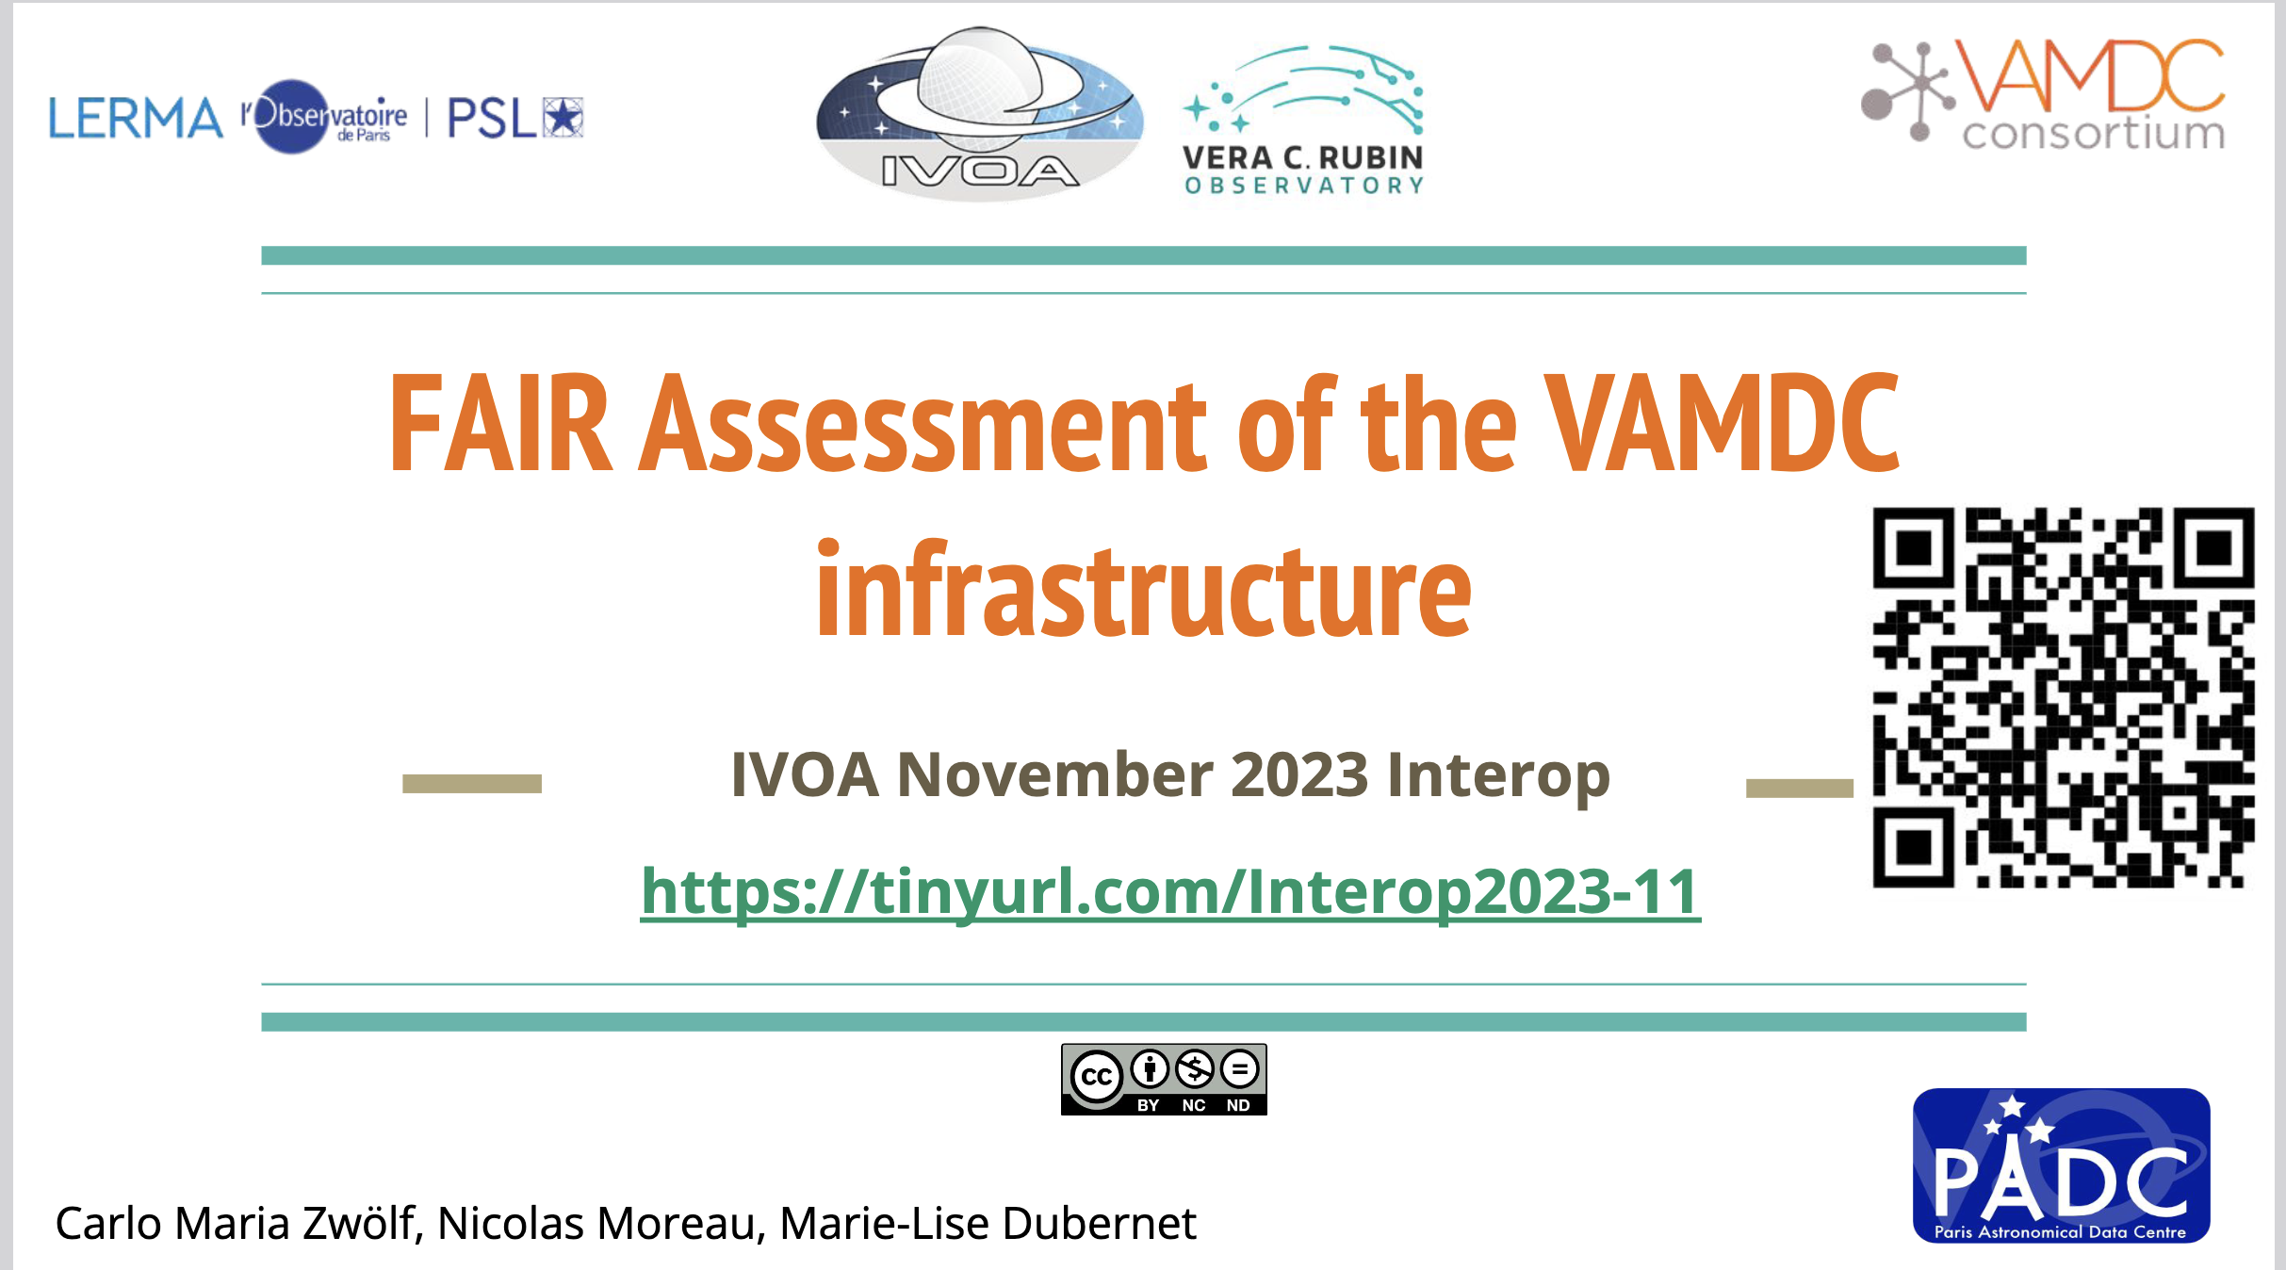
https://wiki.ivoa.net/internal/IVOA/InterOpNov2023DCP/IVOATucson-FAIR-VAMDC.pdf

Slide 13
The IVOA and Persistent Identifiers
Basic Definition
Persistent identifiers (PIDs) are long-lasting references to digital objects of various types
US Government Definition
A digital identifier that is globally unique, persistent, machine resolvable and processable, and has an associated metadata schema.
https://www.whitehouse.gov/wp-content/uploads/2022/08/08-2022- OSTP-Public-Access-Memo.pdf
Sara Bowman, JCDL Conference, Santa Fe, New Mexico, June 2023

Slide 14
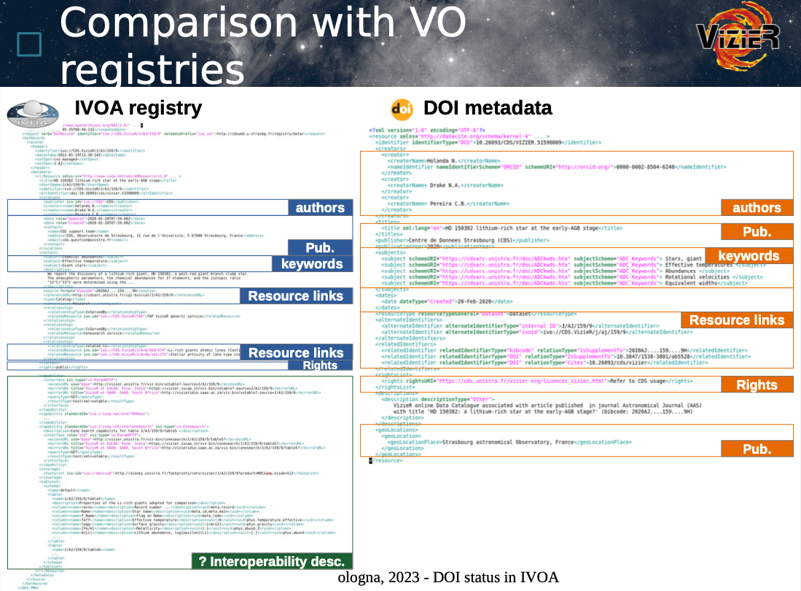

Slide 15

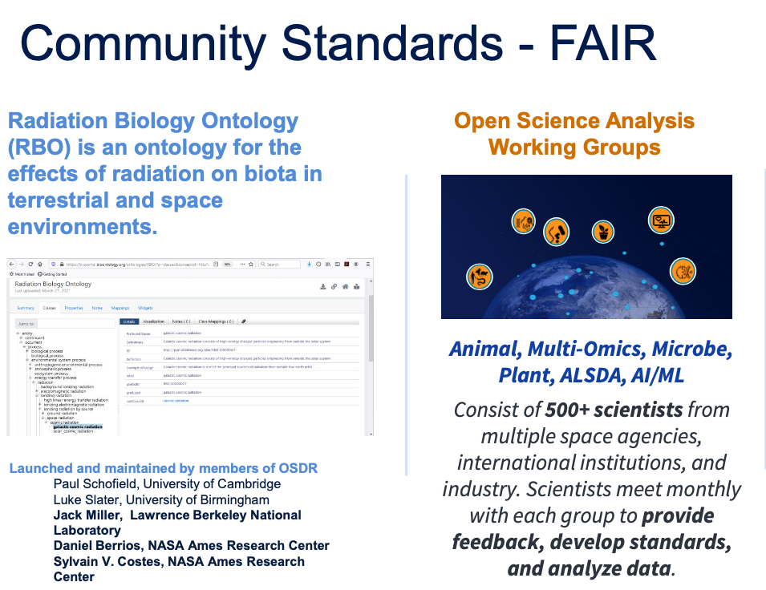
FAIR: A worldwide, multi-discipline endeavor
Berriman is IAU representative to CODATA
Promoting FAIR principles across disciplines
Common issues:
  What is FAIR?
  What tooling is available?
  Validators?
  Funding?

Slide 16
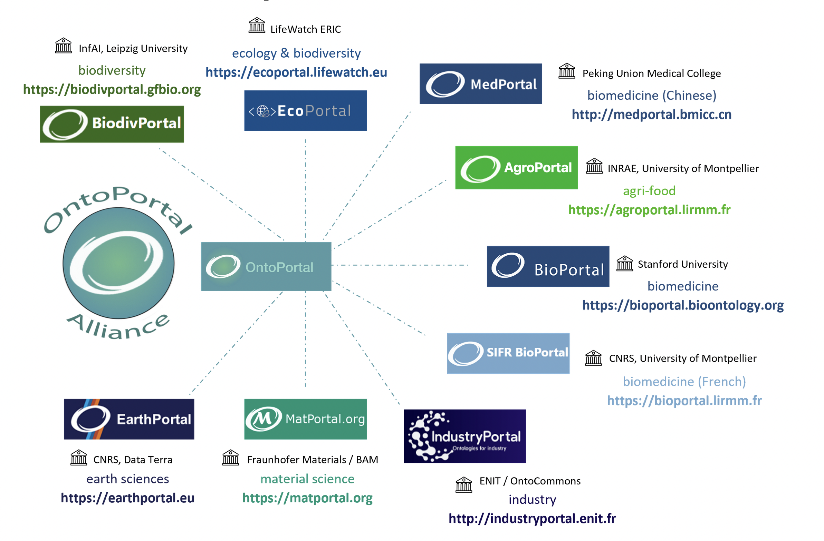
OntoPortal (ontoportal.org)
Developing a framework for ontology management.
  Goal: promote matching, reuse and curation of vocabularies and ontologies.
Astronomy prototype: http://voparis-ontoportal-dev.onspm/fr
  All IVOA vocabularies (not all successfully!)
  Scope: astronomy, planetary science, heliophysics, particle physics, atomic and molecular data.

Slide 17
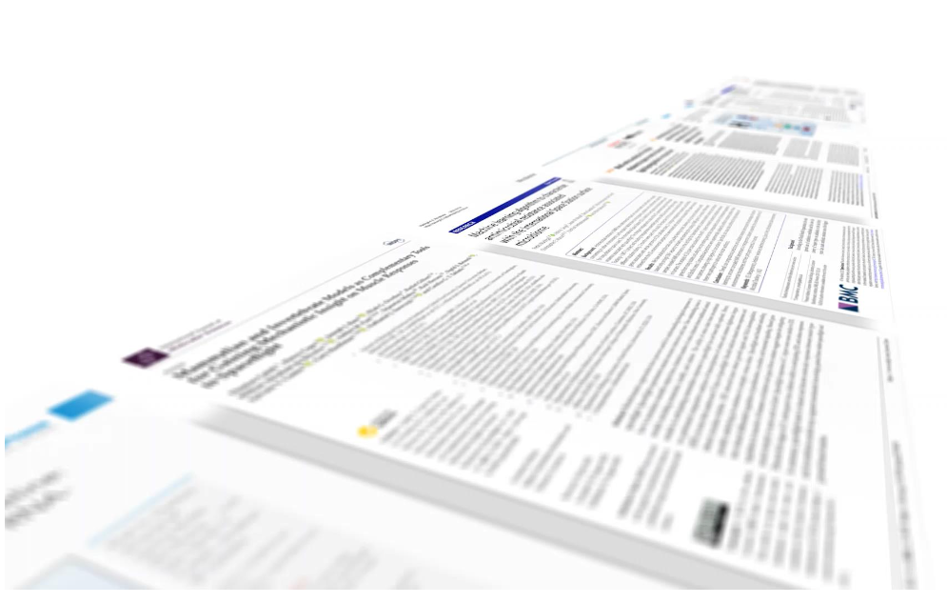
The IVOA and FAIR data management: whither next?
Promote FAIR principles and the IVOA in astronomy
Continue with FAIR development work
Engage with other communities
  Share war stories and best practices
  Share or adapt tooling, validators
Exciting new science!
Thank-you!

