Slide 1

Towards Preservation of Life Science Data with NFDI4BIOIMAGE
Robert Haase
ScaDS.AI, Leipzig University
With the exception of logos and cited third-party content, the content of these slides is shared under the terms of the Creative Commons Attribution License (CC-BY 4.0) unless the content is marked otherwise.

Slide 2

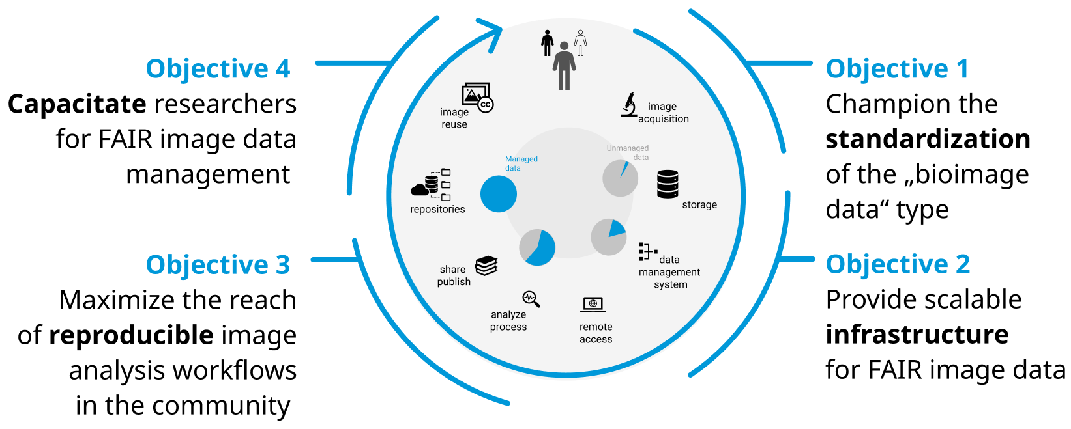
NFDI4BIOIMAGE Core mission
Enable FAIR bioimage data management for German researchers, across disciplines and embedded in the international framework.
IT
2
2
2
IT

Slide 3
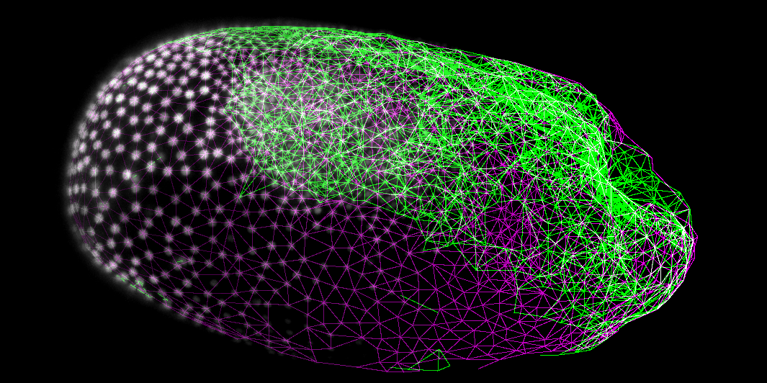
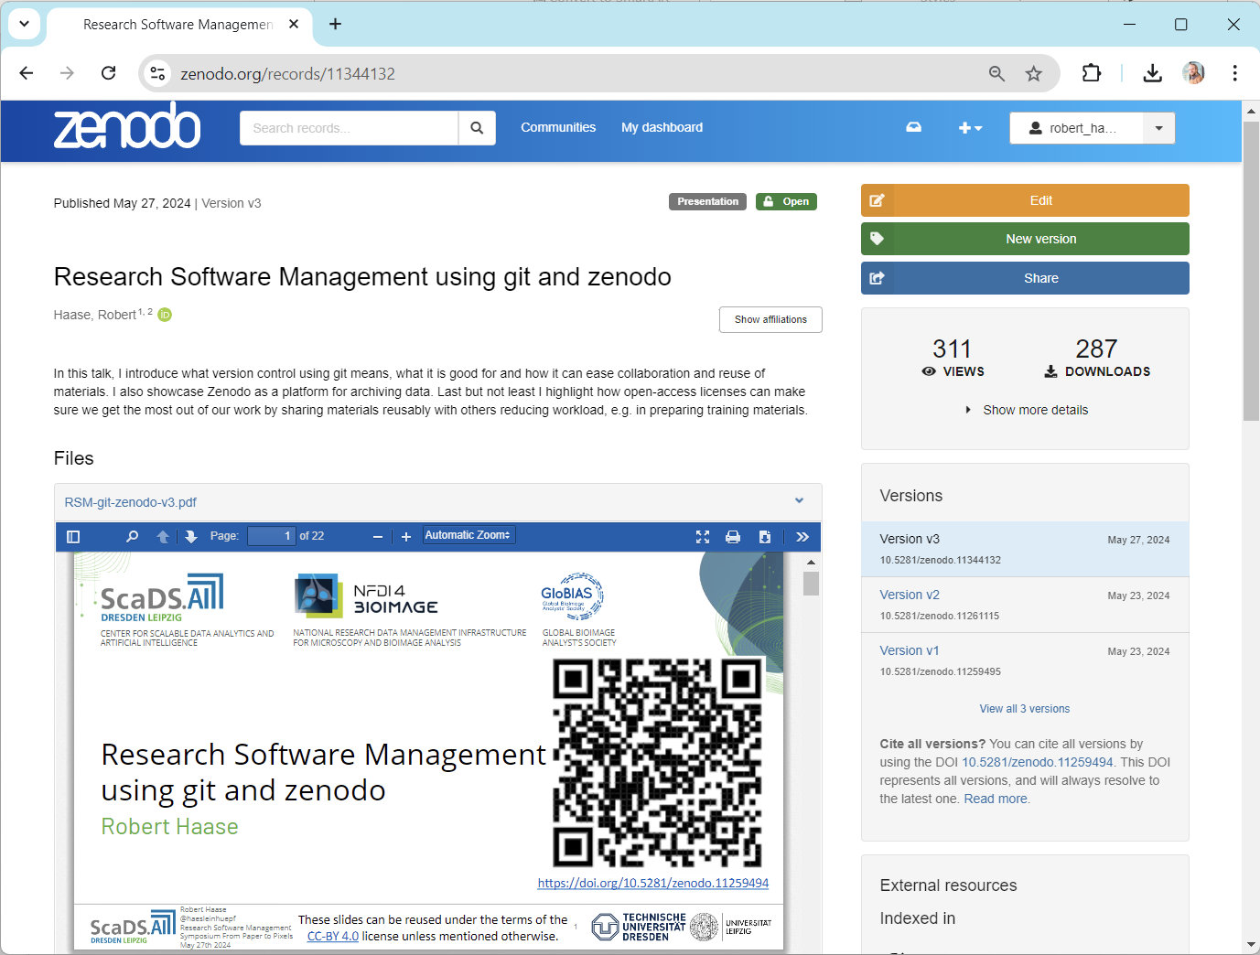
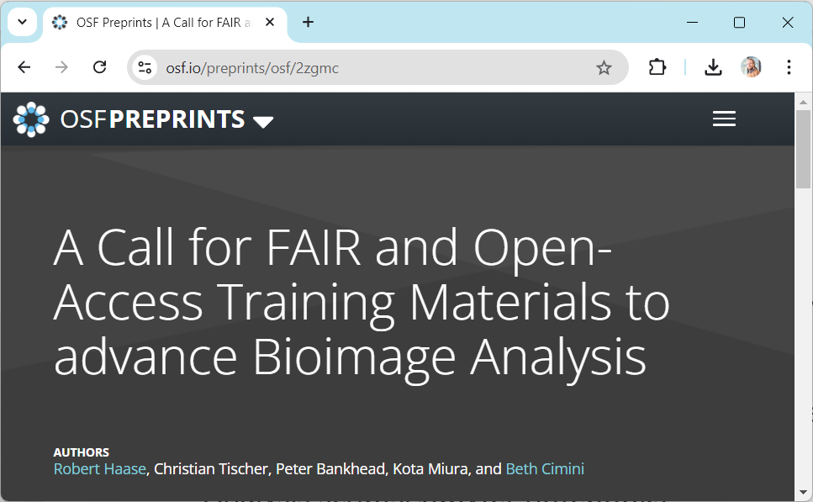
What types of research data do we want to keep?
Huge variety of imaging data [types]
  2D RGB images, from thousands of experiments
  3D electron microscopy data
  3D timelapse data
  Uncommon data types (point-based, hyperspectral, …)
Code
  Analysis scripts, Jupyter notebooks
  Workflows (nextflow, galaxy, fractal)
  Environments (docker, conda, Fiji)
  Modular, re-usable software
Training materials
  Research data management
  Image analysis basics
  Machine / Deep Learning
Terabyte range
Tribolium castaneum, lightsheet microscopy
new to many life-scientists
https://osf.io/preprints/osf/2zgmc
https://zenodo.org/records/11344132

Slide 4
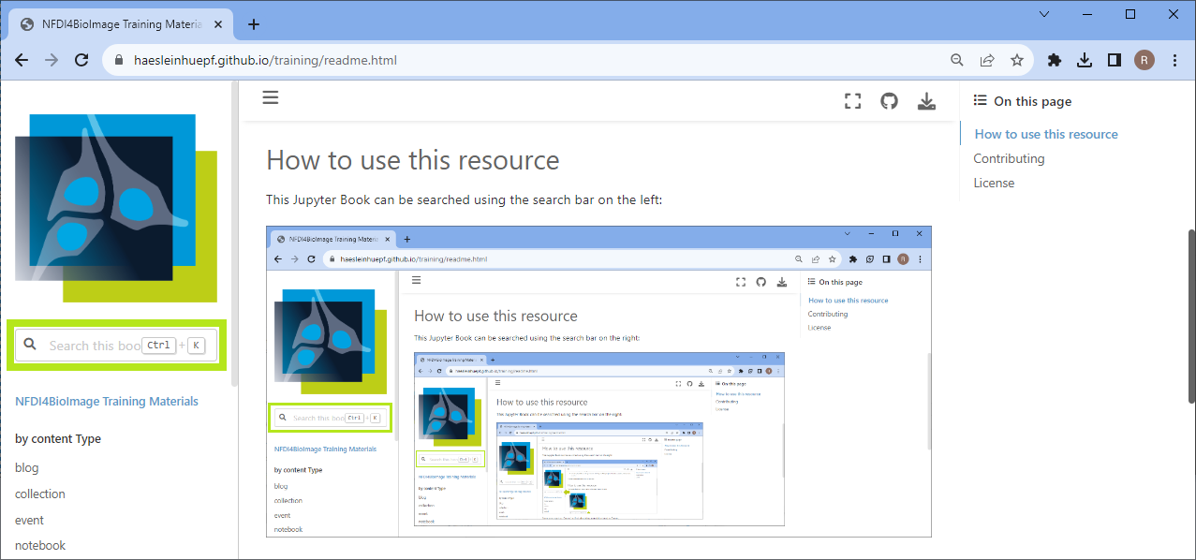
Which data is preserved where?
Imaging data
  Bioimage Archive
  [Image Data Resource]
  Zenodo
Preferred: institutional Omero server
Code
  Github
  Zenodo
  Protocols.io
If nothing above works: institutional git server
Training materials
  Zenodo
  F1000
  Github
No matter where, we collect links in an index:
Omero
Gitlab
https://www.openmicroscopy.org/omero/
https://nfdi4bioimage.github.io/training

Slide 5
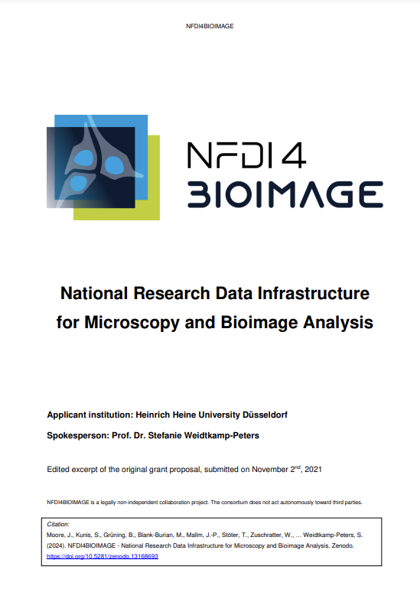
How do we make sure the data is safe as well as re-usable?
Task-Area 1: Image (meta)data formats and standardization
Task-Area 2: Technical infrastructure and cloud resources
Task-Area 5: Training and community integration
M1.1 Define FAIR Image Objects (FAIR-IO)
M1.2 Increase usability of Linked Metadata
M1.3 Enabled cloud-native image formats
M1.4 Formalize FAIR-IO RFC process
M1.5 Implement community requirements & use cases
M2.1 Infrastructure as a Service
M2.2 Community Software as a Service
M2.3 Development and extension of community services
M2.4 Desktop as a Service
M5.1 NFDI4BIOIMAGE training portfolio
M5.2 Implement a cross-site search index for bioimaging RDM training resources
M5.3 Community-driven process for curation and long-term viability of training materials
M5.4 Data Stewardship and Help Desk activities
https://zenodo.org/records/13168693

Slide 6
Who is in charge at the different stages in data lifecycle?
Responsible: The PI
In charge: The scientist, overseen by PI, potentially delegated to senior scientist (defined in: Data Management Plan)
Data Stewards don’t take care of project specific data

Slide 7
Challenges
Lack of incentives for sharing data
  Young PIs care most about re-usability of data
Different philosophies in the community
  Open source software developers are “all in” when it comes to sharing
  Experimentalists with “hot” research data, they are afraid of sharing
  (“Available on request”)
Everyone has heard about the FAIR principles, but scientists don’t know:
  Where to publish data
  What license to use
  Who owns the data
  Who to talk to, to figure things out

Slide 8
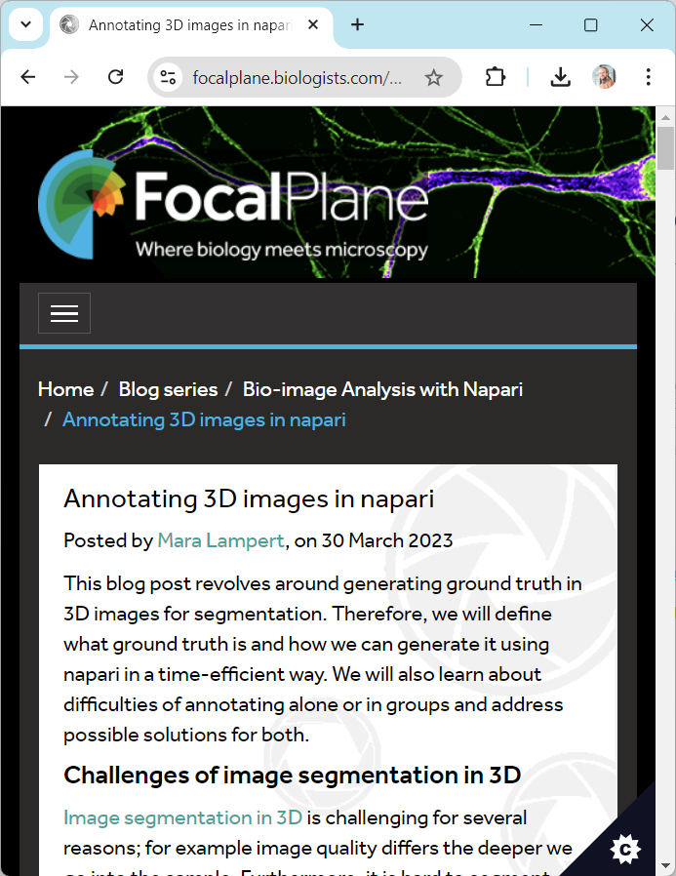
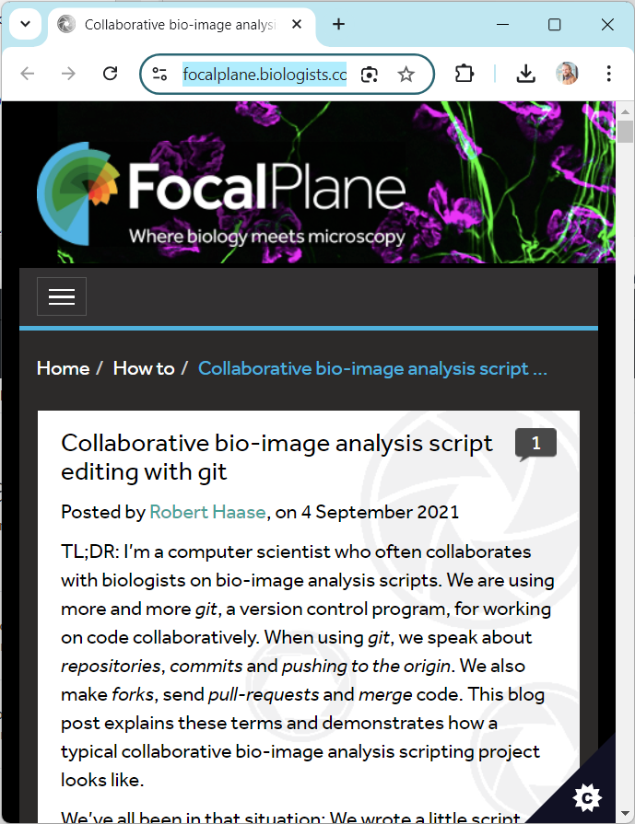
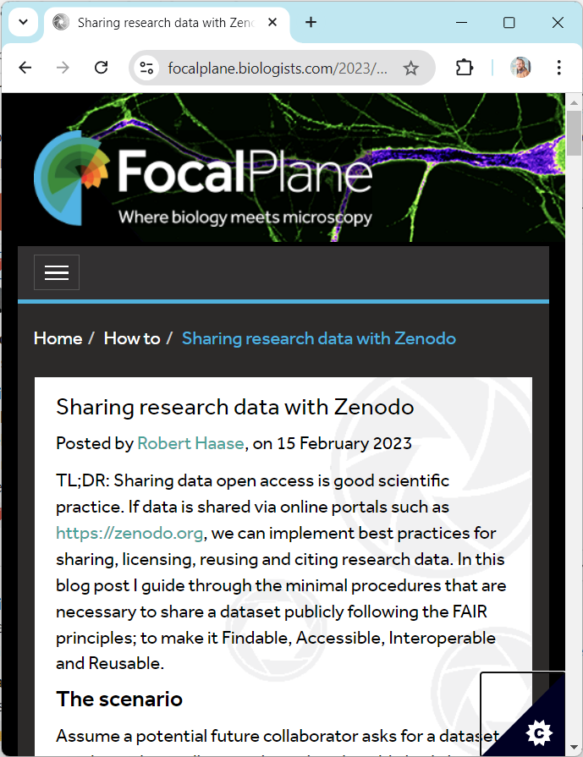
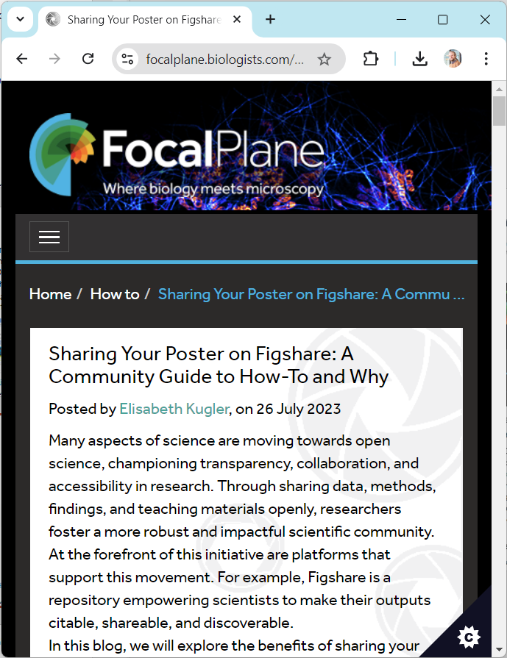
Communication is key
Spreading the word about best-practices close to the community
https://focalplane.biologists.com/2023/03/30/annotating-3d-images-in-napari/
https://focalplane.biologists.com/2021/09/04/collaborative-bio-image-analysis-script-editing-with-git/
https://focalplane.biologists.com/2023/02/15/sharing-research-data-with-zenodo/
https://focalplane.biologists.com/2023/07/26/sharing-your-poster-on-figshare/

Slide 9
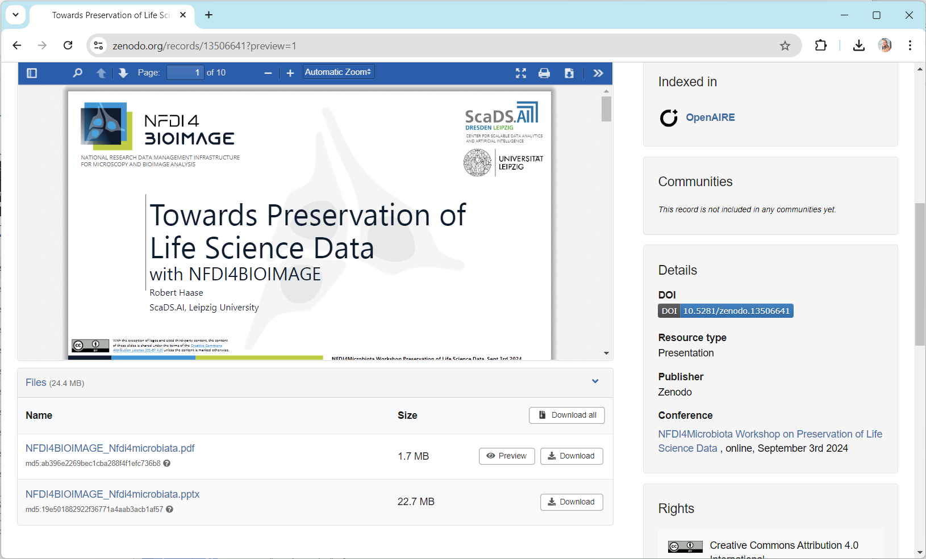

Communication is key
Living a good example:
If we RDM-experts don’t share things, why should our community?
https://doi.org/10.5281/zenodo.13506641

Slide 10
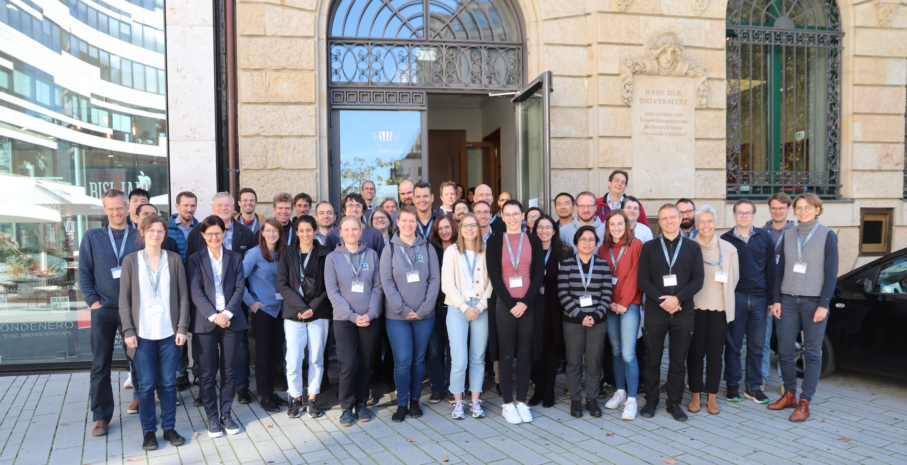


Acknowledgements
NFDI4BIOIMAGE
task area leads
Participants
coordinators
data stewards
research software engineers
(international) collaborators
All-hands Meeting NFDI4BIOIMAGE, Oct. 23, Düsseldorf
Funded by the Deutsche Forschungsgemeinschaft (DFG, German Research Foundation) under the National Research Data Infrasstructure – NFDI 46/1 – 501864659
10

