Slide 1


Insights from Acquiring Open Medical Imaging Datasets for Foundation Model Development
Stefan Dvoretskii ¹,⁵ | Paul Jäger ¹,²,⁴ | Fabian Isensee ¹,⁴ | Tassilo Wald ¹,⁴ | Constantin Ulrich ¹ | Lucas Kulla ¹,⁵ Philipp Schader ¹,⁵ | Klaus Maier-Hein ¹,³ | Josh Moore ⁶ | Marco Nolden ¹,³,⁵
¹ DKFZ Division of Medical Computing; ² DKFZ Interactive Machine Learning; ³ Pattern Analysis and Learning Group, Heidelberg University Hospital; ⁴ Helmholtz Imaging, German Cancer Research Center (DKFZ), Heidelberg, Germany; ⁵ Helmholtz Metadata Collaboration (HMC) Hub Health, DKFZ, Heidelberg, Germany;
⁶ German BioImaging e.V., University of Konstanz, Germany
Helmholtz Munich

Slide 2
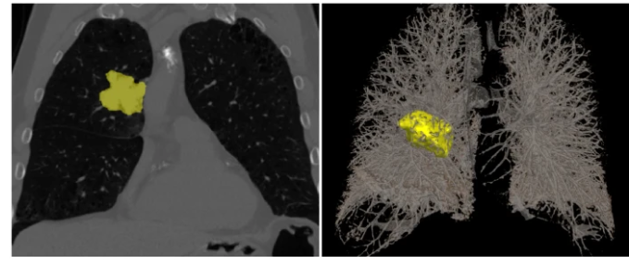

Foundation Model for Radiology
Aid radiological research and clinical practice
Variety of tasks in the domain
Example: Segmentation of pathologies
Clinical: Early detection, Therapy response monitoring
Problem: “real” clinical imaging data is difficult to share! (in Germany)
Example task: lung nodules segmentation
Source: Isensee, Jäger et al. Nat Methods 2021
Notes:
Deutschland: für Bilder besondere Regeln (RACOON)

Slide 3
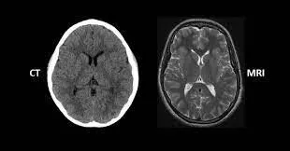

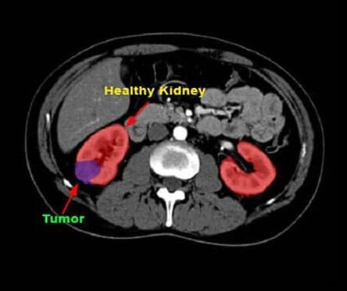
We were looking for diverse and big open clinical imaging datasets
Different body parts
Different modalities (CT, MR)
Different institutions and geographic regions
Validation subset: high-quality annotations
Source: [1]
Source: [2]
https://www.maximedturkey.com/de/blog/ct-scan-vs-mri-what-s-the-difference
https://www.freepik.com/photos/world
https://medium.com/vsinghbisen/what-is-medical-image-annotation-role-in-ai-medical-diagnostics-a44338bb9bdb
Source: [3]

Slide 4
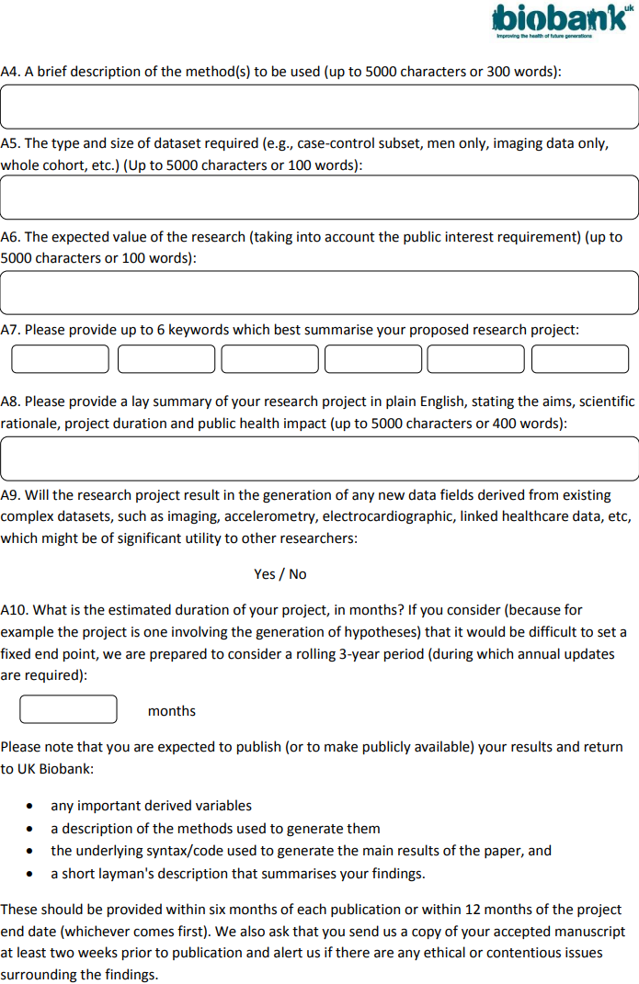
We ended up doing a lot by hand
Fetching metadata
Portal registrations
Access requests
License evaluation

Slide 5
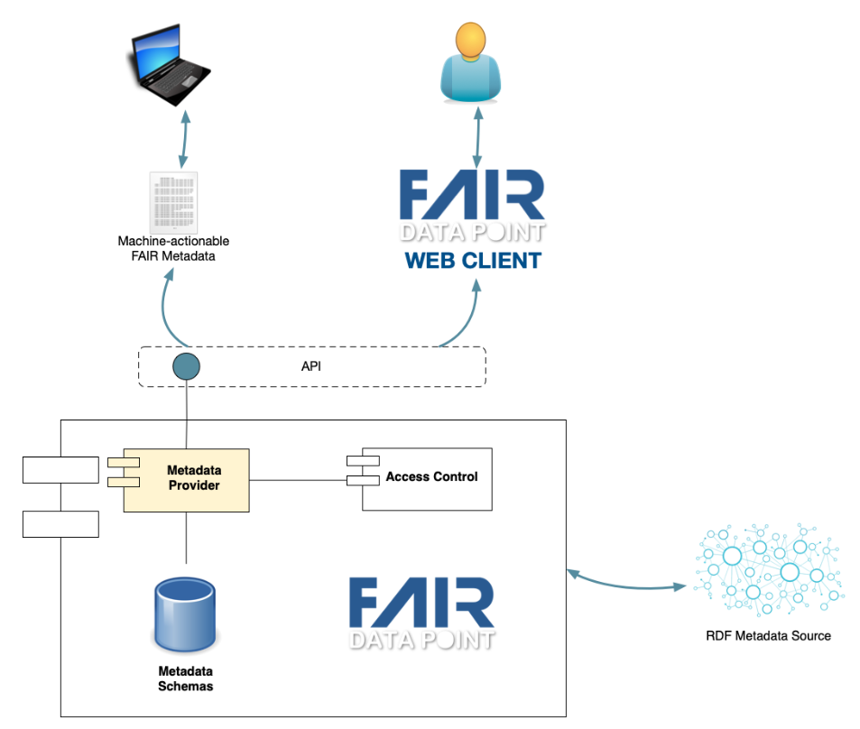
How to make data fetching more machine-actionable?
Efficient and transparent access requests
Efficient exposure of data and metadata
FAIR Data Point, FAIR Digital Object
FAIR should be machine-actionable
High-level architecture of a FAIR Data Point
https://specs.fairdatapoint.org/fdp-specs-v1.2.html
Notes:
machine-actionable requirement for FM training and retraining in the future

Slide 6

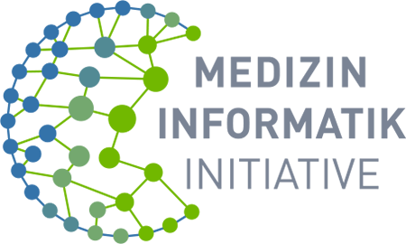

Modern initiatives transform public data landscape
Data spaces
Trusted research / Secure processing environments
The way data is handled evolves
Metadata is getting more important

Slide 7
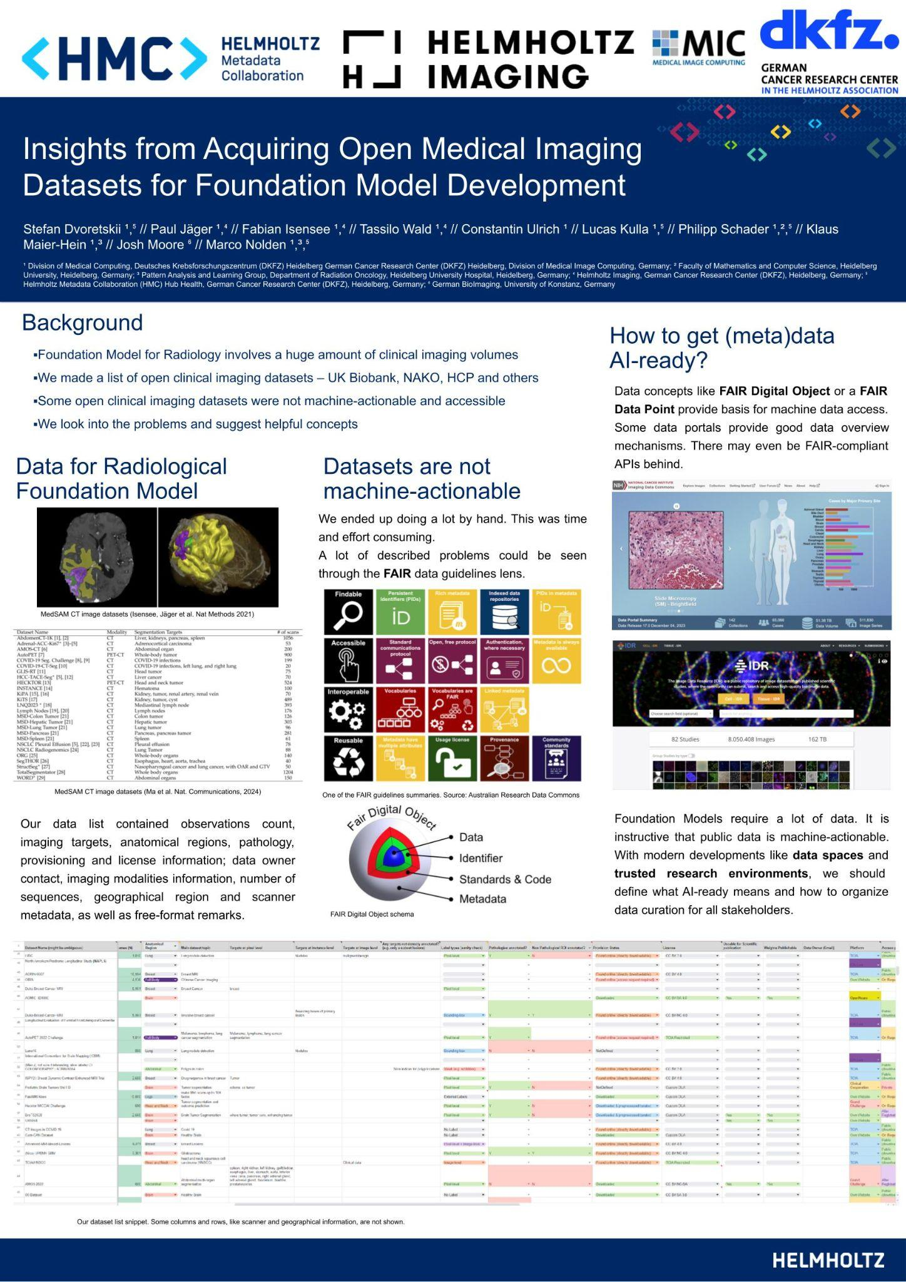
Conclusion and open questions
Open Medical Imaging data is rich
Preparing it for Foundation Model development poses machine-actionability problems
How to assure open imaging data is AI-ready?
What are the relevant metadata for Foundation Models?
Notes:
machine-actionability is important for retraining

Slide 8
Thank you for your attention

