Slide 1



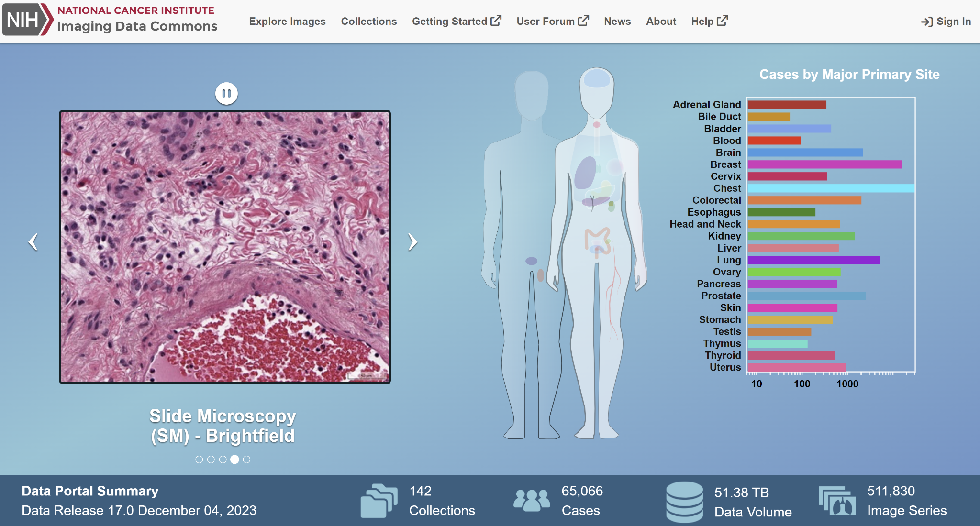
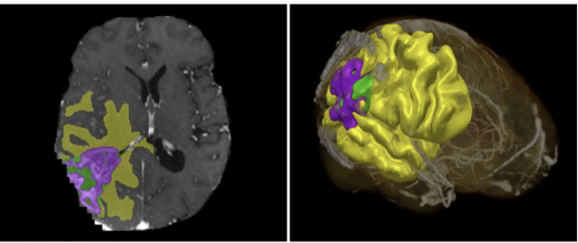
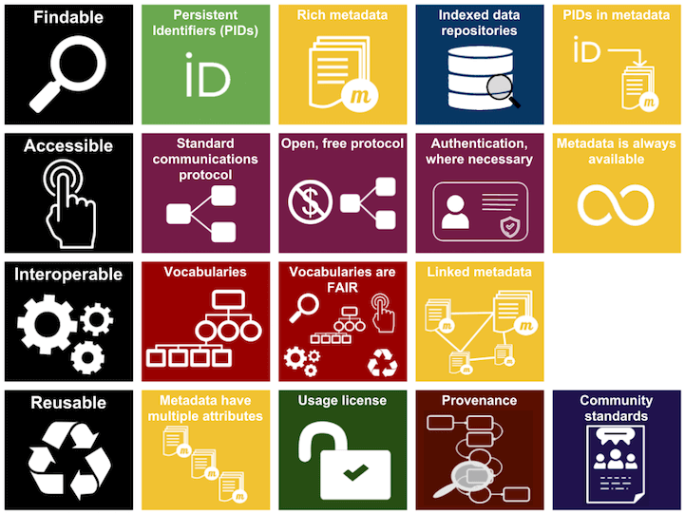
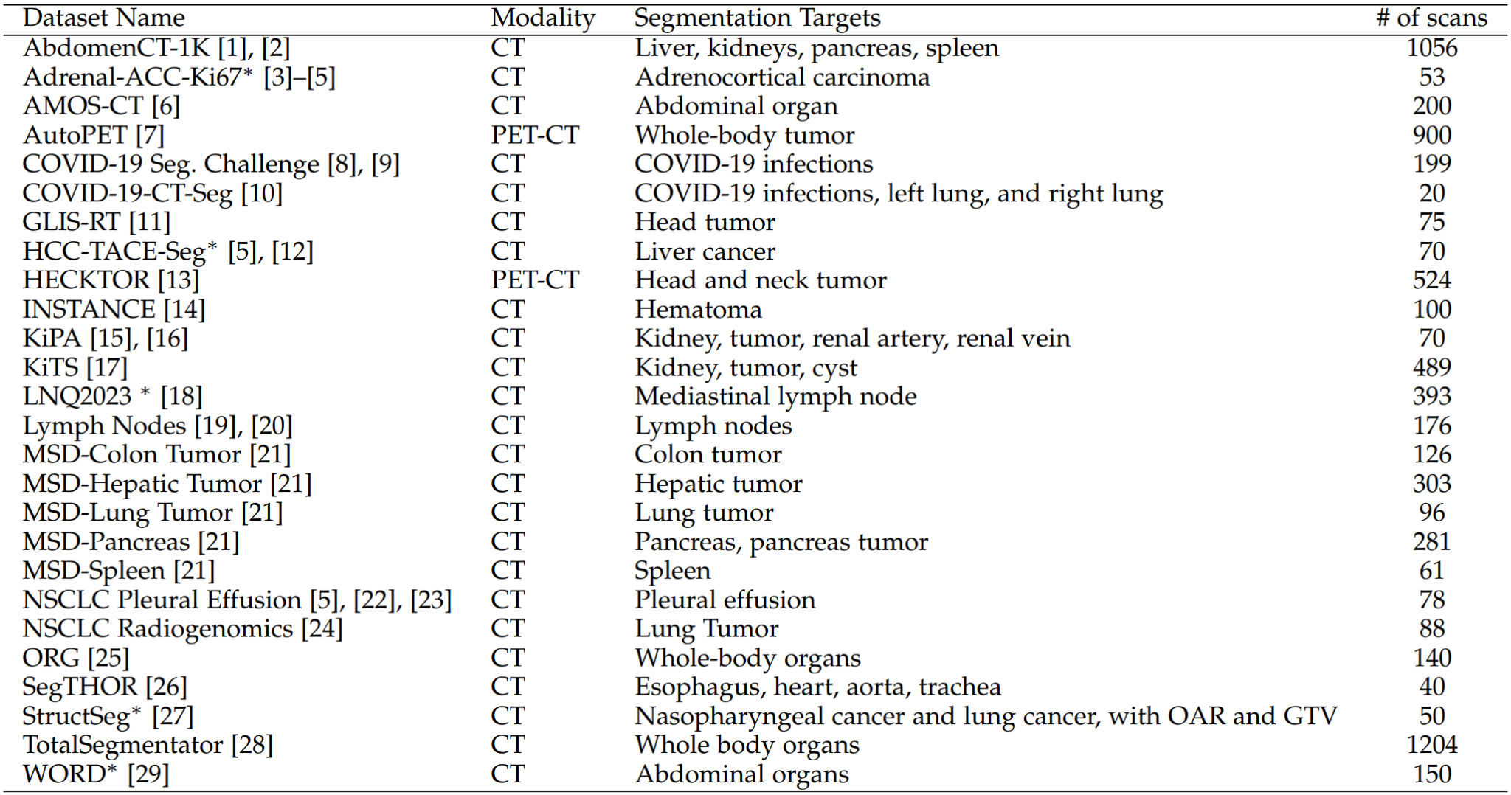
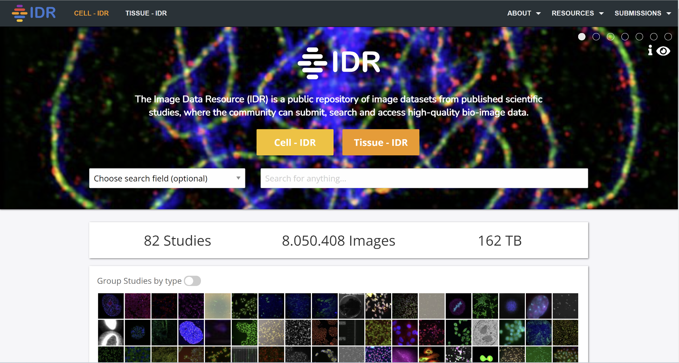
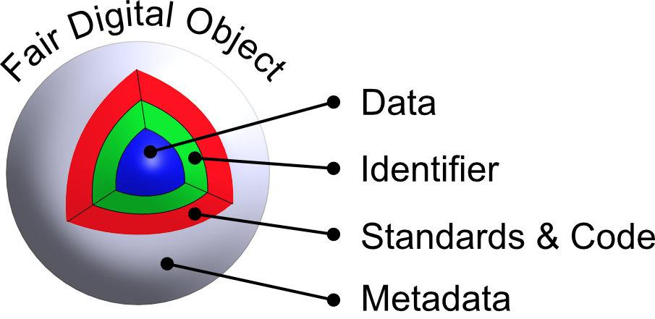
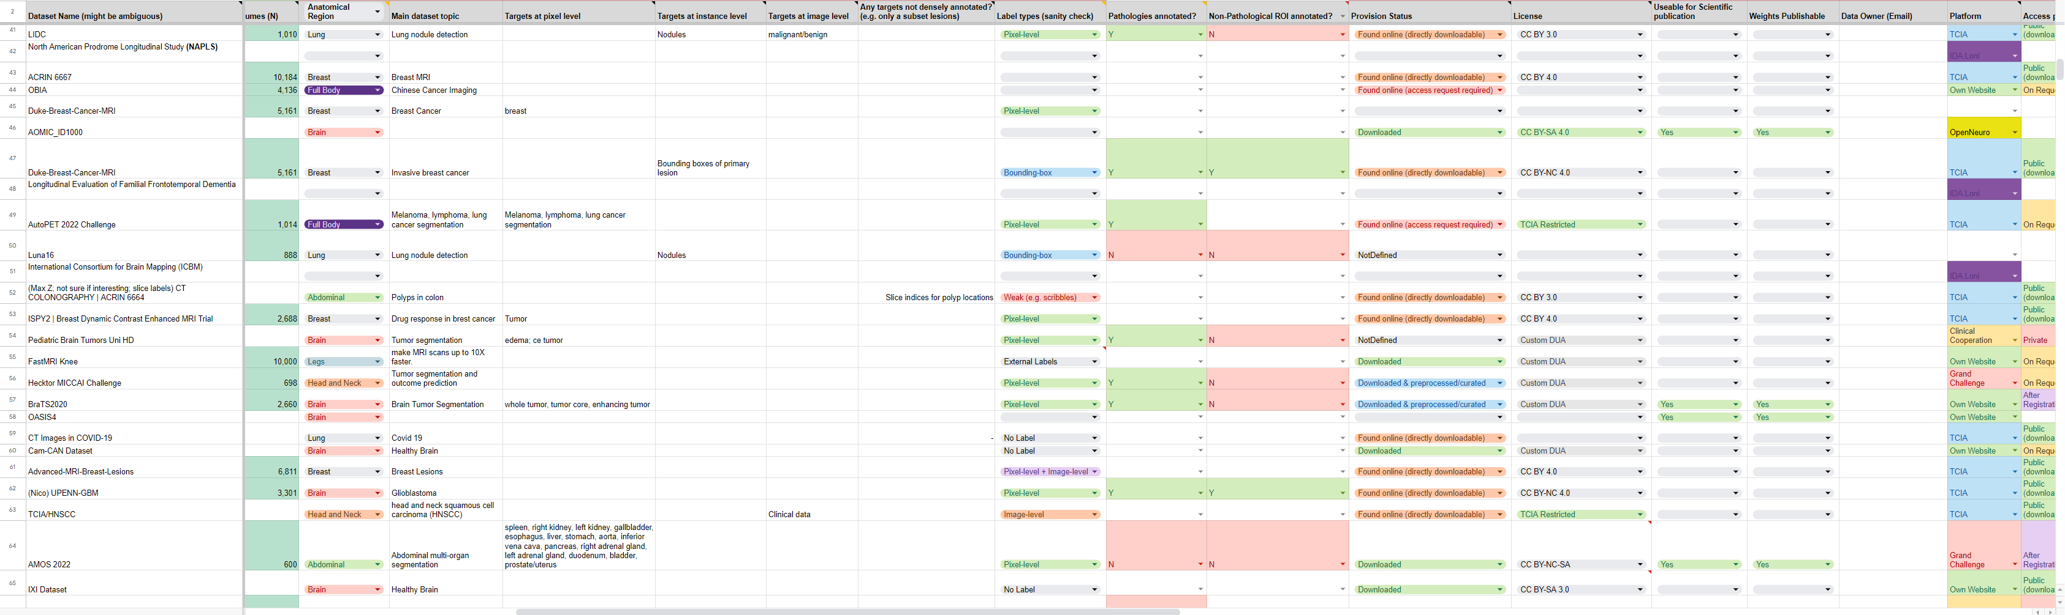
Insights from Acquiring Open Medical Imaging
Datasets for Foundation Model Development
Stefan Dvoretskii ¹,⁵ // Paul Jäger ¹,⁴ // Fabian Isensee ¹,⁴ // Tassilo Wald ¹,⁴ // Constantin Ulrich ¹ // Lucas Kulla ¹,⁵ // Philipp Schader ¹,²,⁵ // Klaus Maier-Hein ¹,³ // Josh Moore ⁶ // Marco Nolden ¹,³,⁵
¹ Division of Medical Computing, Deutsches Krebsforschungszentrum (DKFZ) Heidelberg German Cancer Research Center (DKFZ) Heidelberg, Division of Medical Image Computing, Germany; ² Faculty of Mathematics and Computer Science, Heidelberg University, Heidelberg, Germany; ³ Pattern Analysis and Learning Group, Department of Radiation Oncology, Heidelberg University Hospital, Heidelberg, Germany; ⁴ Helmholtz Imaging, German Cancer Research Center (DKFZ), Heidelberg, Germany; ⁵ Helmholtz Metadata Collaboration (HMC) Hub Health, German Cancer Research Center (DKFZ), Heidelberg, Germany; ⁶ German BioImaging, University of Konstanz, Germany
Background
How to get (meta)data AI-ready?
Foundation Model for Radiology involves a huge amount of clinical imaging volumes
We made a list of open clinical imaging datasets – UK Biobank, NAKO, HCP and others
Some open clinical imaging datasets were not machine-actionable and accessible
We look into the problems and suggest helpful concepts
Data concepts like FAIR Digital Object or a FAIR Data Point provide basis for machine data access.
Some data portals provide good data overview mechanisms. There may even be FAIR-compliant APIs behind.
Data for Radiological Foundation Model
Datasets are not machine-actionable
We ended up doing a lot by hand. This was time and effort consuming.
A lot of described problems could be seen through the FAIR data guidelines lens.
MedSAM CT image datasets (Isensee, Jäger et al. Nat Methods 2021)
MedSAM CT image datasets (Ma et al. Nat. Communications, 2024)
One of the FAIR guidelines summaries. Source: Australian Research Data Commons
Our data list contained observations count, imaging targets, anatomical regions, pathology, provisioning and license information; data owner contact, imaging modalities information, number of sequences, geographical region and scanner metadata, as well as free-format remarks.
Foundation Models require a lot of data. It is instructive that public data is machine-actionable. With modern developments like data spaces and trusted research environments, we should define what AI-ready means and how to organize data curation for all stakeholders.
FAIR Digital Object schema.
Our dataset list snippet. Some columns and rows, like scanner and geographical information, are not shown.

