Slide 1
Open science fundamentals for Bioinformatics
(and any field)
Malvika Sharan Connect @malvikasharan
15 August 2024
This work is licensed under a Creative Commons Attribution 4.0 Generic License
Short link: https://bit.ly/bon-2024-ms, Zenodo link: https://zenodo.org/records/13379994

Slide 2






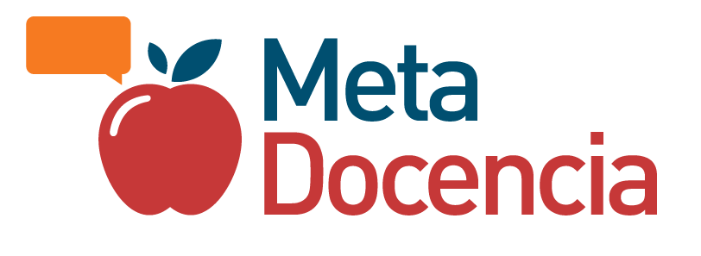
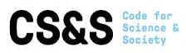
London, UK
Co-Founded Open Life Science
Senior Researcher - The Alan Turing Institute
Co-lead of The Turing Way
Lead of Community Management Team
Germany
M.Sc, PhD, Community Building
Worked in European Molecular Biology Laboratory, connected with Open Science projects
Bangalore
Bachelor's degree
and worked briefly
Ranchi, Jharkhand
Hometown

Slide 3
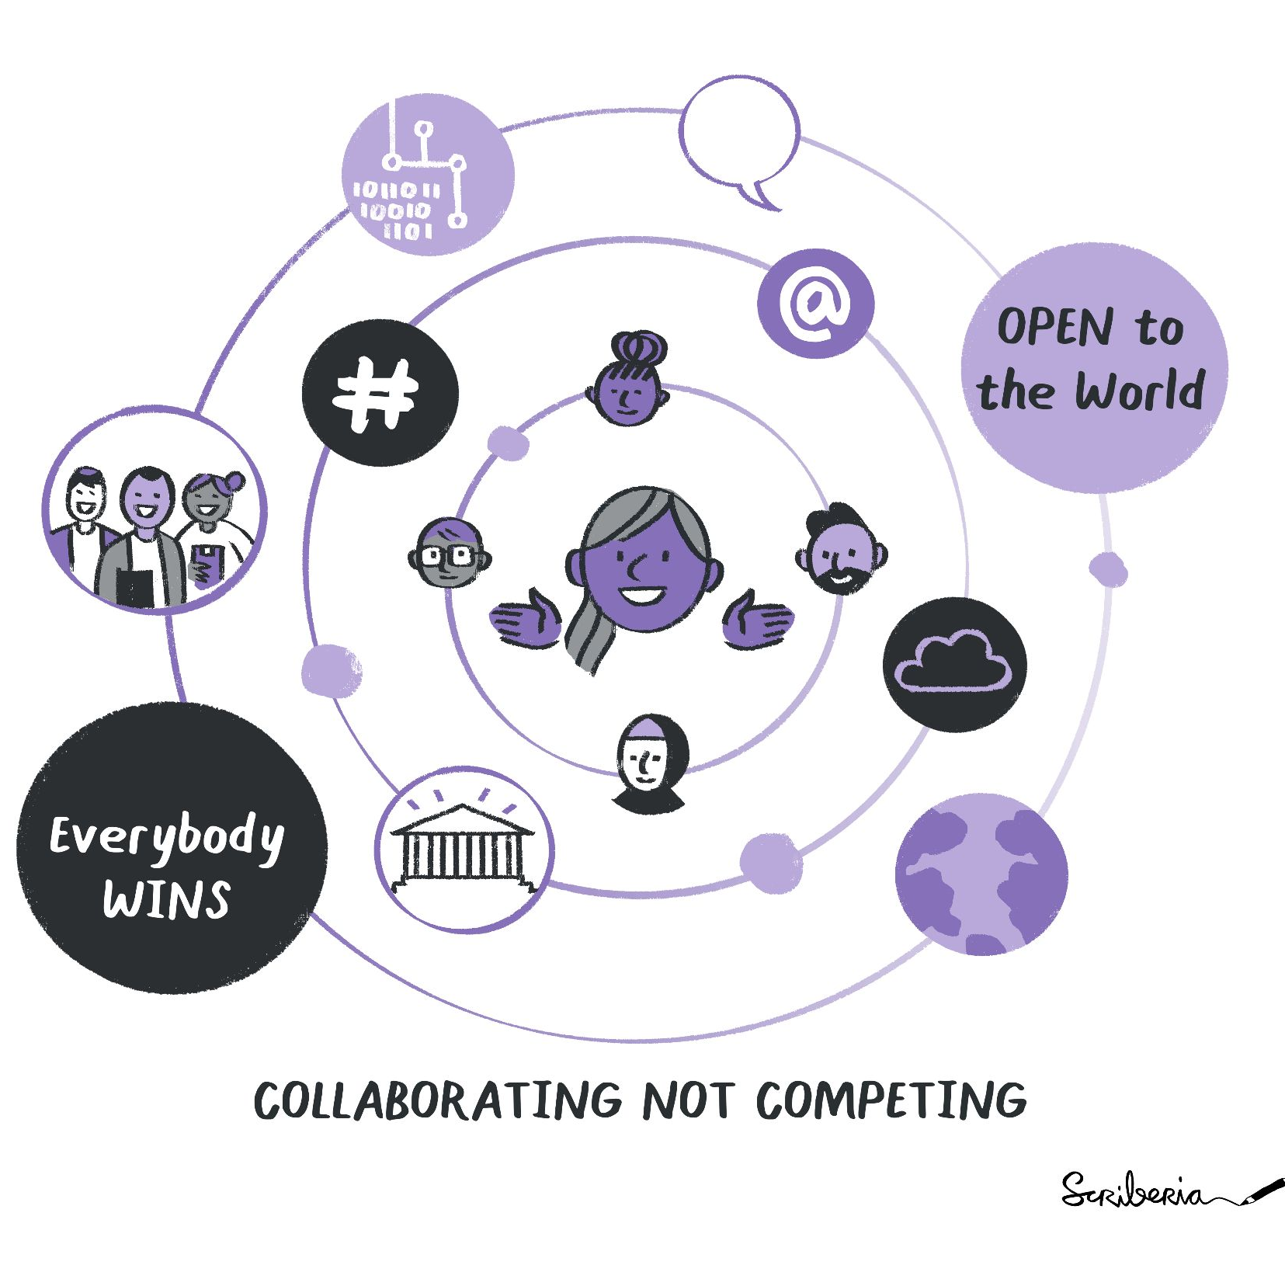
Open Source Software
Scripts and software that can been read, reused, modified and distributed by anyone
without any cost or access barriers.
This work is licensed under a Creative Commons Attribution 4.0 Generic License

Slide 4

About me
London, UK
Co-Founded Open Life Science
Senior Researcher - The Alan Turing Institute
Co-lead of The Turing Way
Lead of Community Management Team
Germany
M.Sc, PhD, Community Building
Worked in European Molecular Biology Laboratory, connected with Open Science projects
Open Source
Bangalore
Bachelor's degree
and worked briefly
Ranchi, Jharkhand
Hometown

Slide 5
Bioinformatics heavily rely on open source and Open Data
Sequence alignment tools: BLAST, CLUSTAL, HMMER …
Database: NCBI, UNIPROT, PDB, Genbank, Ensembl, KEGG …
Phylogenetic analysis and pattern recognition tools and databases (PHYLIP, MEME, ProViz)
Sequence analysis by Python and R, Bioconductor, Biopython
Omics data analysis tools and reproducible workflow (like Galaxy)
Image Copyright: ©SolisImages - stock.adobe.com
This work is licensed under a Creative Commons Attribution 4.0 Generic License

Slide 6

What open Source looked like for me
📚 Big mystical library books
🐞 LOTS of error messages!?
🤓 Debugging sessions with my colleagues
😩 Late night debugging session by myself
🤩 Finally writing scripts that does the job
🔁 Repeat!
Image Copyright: ©SolisImages - stock.adobe.com
This work is licensed under a Creative Commons Attribution 4.0 Generic License

Slide 7
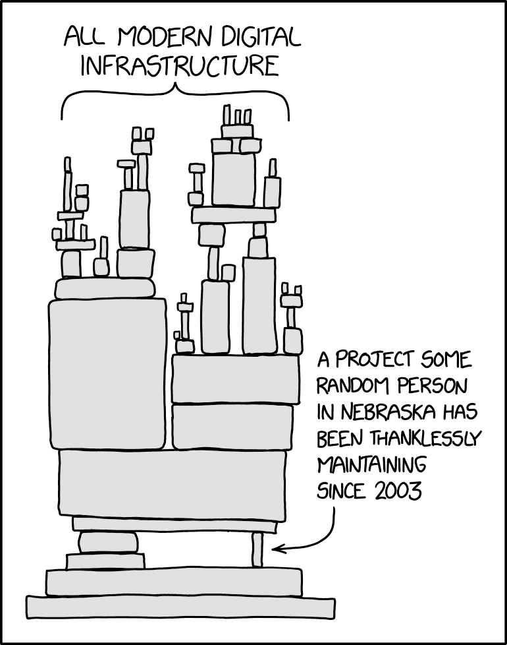
The More you know!
We all use open source and open data even if we don’t know it ‘yet’!
Most operating systems use/rely on open source, many apply variants of Unix (70’s) and Linux
Languages: Python, R, C, C++, Java, Scala …
GitLab/GitHub → An online platform built on the powerful ‘git’ for version control
Machine learning problems rely on open data
If you want to learn about open, start with your daily life!
This work is licensed under a Creative Commons Attribution 4.0 Generic License
XKCD comics, Dependency. https://xkcd.com/2347
Notes:
Technology architecture is often illustrated by a stack diagram, in which higher levels of rectangles indicate components that are dependent on components in lower levels. This is analogous to a physical tower of blocks, in which higher blocks rest on lower blocks.
The current model of libraries and open-source development (topics which Randall has addressed extensively in the past) relies heavily on the free and continued dedication of unpaid hobbyists. Though some major projects such as Linux may be able to garner enough attention to build an organization, many smaller projects, which are in turn reused by larger projects, may only be maintained by one person, either the founder or another who has taken the torch. Maintaining libraries requires both extensive knowledge of the library itself as well as any use cases and the broader community around it, which usually is suited for maintainers who have spent years at the task, and thus cannot be easily replaced.

Slide 8
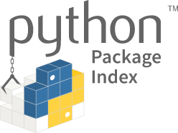
Good news!
Contributed to Open Source
Created a software, used GitHub
Published it on PyPI
People used it!!!! 🤯
This work is licensed under a Creative Commons Attribution 4.0 Generic License

Slide 9
Good news!
Open science is a much broader field that include Open Source and open data
Contributed to Open Source
Created a software, used GitHub
Published it on PyPI
People used it!!!! 🤯
This work is licensed under a Creative Commons Attribution 4.0 Generic License

Slide 10
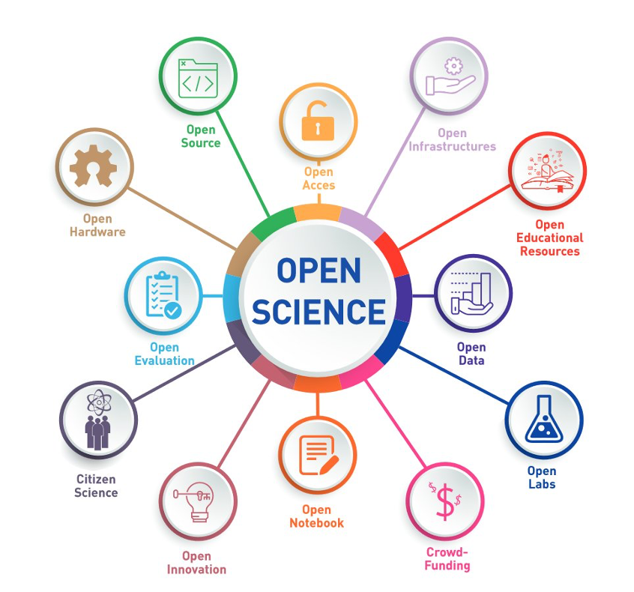
Openness of
diversity of
knowledge
Resources that can been read, reused, modified and distributed by anyone without any cost or access barriers.
Improves transparency and collaboration with users, researchers and contributors.
-Toward a UNESCO Recommendation on Open Science: Canadian Commission for UNESCO By Ella Chan, Dick Bourgeois-Doyle, Michael Donaldson, and Eleanor Haine-BennettOttawa, Canada, April 2020, 2021

Slide 11
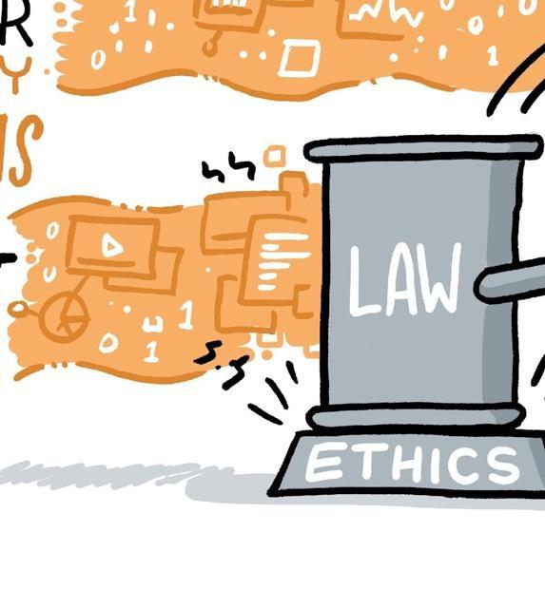
Science including scientific errors have real world effects
We have an obligation to consider the validity and impact our work.
CC-BY 4.0, https://the-turing-way.netlify.app/ethical-research/ethical-research.html, DOI: 10.5281/zenodo.7692516
Notes:
Taking ethics as the study of what behaviours are right and what behaviours are wrong, ethical research highlights actions we take in research.

Slide 12
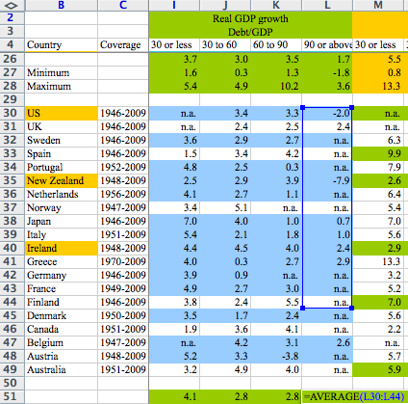
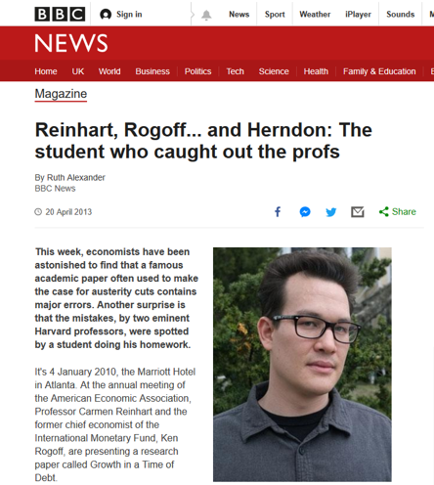
Scientific errors have real world effects
https://statmodeling.stat.columbia.edu/2013/04/16/memo-to-reinhart-and-rogoff-i-think-its-best-to-admit-your-errors-and-go-on-from-there
https://www.bbc.co.uk/news/magazine-22223190
Taken from Kirstie Whitaker’s slides, The Turing Way, DOI: 10.5281/zenodo.7428708, https://zenodo.org/record/10522776
Notes:
This is an example from a famous academic paper by Harvard professors, Carmen Reinhart and Kenneth Rogoff that was often used to make the case for austerity cuts (budget reduction, public tax increase) at the time of economic crisis (to deal with global recession) contains major errors.
Thomas Herndon, a phd student back in 2013, but now a professor was looking at this paper with an intention to replicate the findings. After several failed attempts he got in touch with the author requesting for the original data, which they shared in an excel sheet. He immediately found out
The authors had accidentally only included 15 of the 20 countries under analysis in their key calculation (having excluded Australia, Austria, Belgium, Canada and Denmark);
For some countries, some data was missing;
High debt is correlated with somewhat lower growth, but the relationship is much gentler and there are lots of exceptions to the rule.

Slide 13
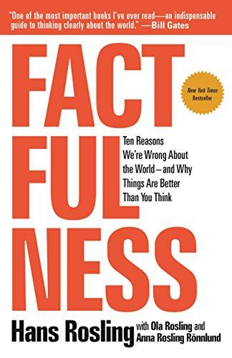
Scientific errors have real world effects
“We will redouble our efforts to avoid such errors in the future …” - Reinhart & Rogoff
“Our problem is that we don’t know what we don’t know, and even our guesses are informed by unconscious and predictable biases.” - Hans Rosling
https://www.gapminder.org/, Rosling, H., Rönnlund, A. R., & Rosling, O. (2018). Factfulness: Ten Reasons We're Wrong About the World--and Why Things Are Better Than You Think. ‏https://www.bbc.co.uk/news/magazine-22223190
Notes:
Low reproducibility stems mostly from authors' omitting to provide crucial information in scientific papers and we stress that sharing all computer code and data is not a solution.
Author said that “We are grateful to Herndon et al. for the careful attention. We will redouble our efforts to avoid such errors in the future.”
mistaken way to examine (country specific) data provides an intellectual rationalisation for things that affect how people think about the world, especially people in power, eventually affects how the world works. - Daniel Hamermesh

Slide 14
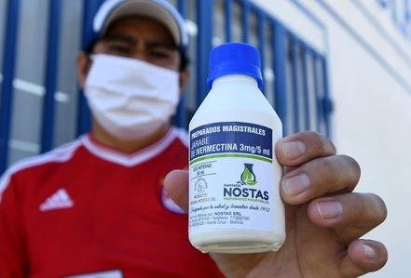
Price of Popularity
Researchers in Australia publishes unreliable COVID-19 data with their preprint and misreported that an anti-parasite drug could stop the virus from replicating in cells.
In a desperate attempt to save dying patients, doctors began justifying the drug’s use against COVID-19 as the virus spread aggressively throughout Latin America.
Reardon, S. (2021). Flawed ivermectin preprint highlights challenges of COVID drug studies. Nature, 596, 173–174. doi: 10.1038/d41586-021-02081-w. Mega, E. R. (2020). Latin America’s embrace of unproven COVID treatment hinders drug trials. Nature, 586, 481–482. doi: 10.1038/d41586-020-02958-2, Slides under DOI: 10.5281/zenodo.7428708
Notes:
Ivermectin grabbed attention in April, when scientists were throwing every already-approved drug they could at the coronavirus. Researchers in Australia had noted that high doses of ivermectin could stop the virus from replicating in cells¹. Shortly afterwards, a preprint appeared online that suggested the drug could reduce coronavirus-related deaths in people.
The paper’s irregularities came to light when Jack Lawrence, a master’s student at the University of London, was reading it for a class assignment and noticed that some phrases were identical to those in other published work. When he contacted researchers who specialize in detecting fraud in scientific publications, they found other causes for concern, including dozens of patient records that seemed to be duplicates, inconsistencies between the raw data and the information in the paper, patients whose records indicate they died before the study’s start date, and numbers that seemed to be too consistent to have occurred by chance.
The paper was retracted in June, but it was a bit too late for Latin America, where the eagerness to use the treatment only grew as the virus spread aggressively in their countries. The problem is when non-evidence-based public policies are made.

Slide 15
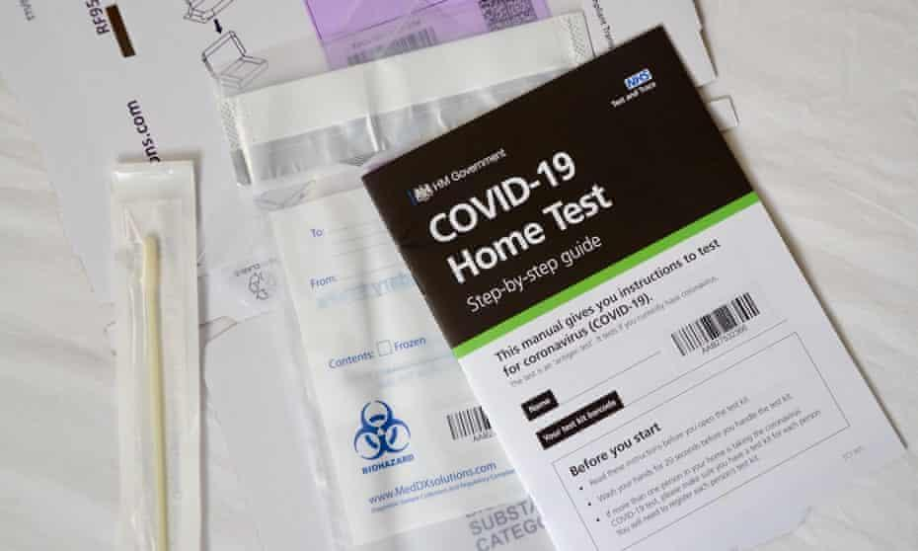
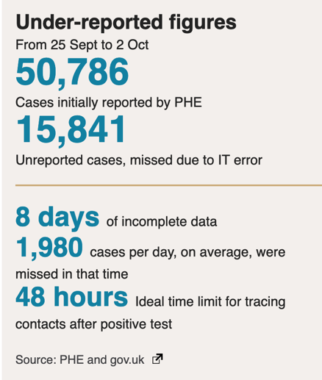
Public Scrutiny is Important for Accountability
@turingway, CC-BY 4.0,
The Turing Way, DOI: 10.5281/zenodo.7428708
Kelion, B. L. (2020). Excel: Why using Microsoft's tool caused Covid-19 results to be lost. BBC News. https://www.bbc.co.uk/news/technology-54423988
Notes:
The badly thought-out use of Microsoft's Excel software was the reason nearly 16,000 coronavirus cases went unreported in England.
The issue was caused by the way the agency brought together logs produced by commercial firms paid to analyse swab tests of the public, to discover who has the virus. They filed their results in the form of text-based lists - known as CSV files - without issue. Public Health England had set up an automatic process to pull this data together into Excel templates so that it could then be uploaded to a central system and made available to the NHS Test and Trace team, as well as other government computer dashboards. Each template could handle only about 65,000 rows of data rather than the one million-plus rows that Excel is actually capable of. And since each test result created several rows of data, in practice it meant that each template was limited to about 1,400 cases. When that total was reached, further cases were simply left off. unreported cases meant as many as 48,000 contacts had not been traced and therefore not made aware that they may have been exposed to COVID. Which means that likely some of them were in fact infected - potentially spreading the infection.

Slide 16
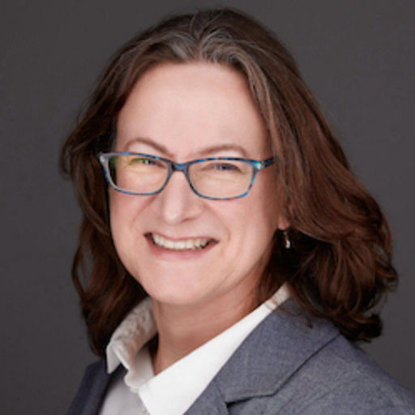
Lack of accountability and risks of subversion
“We need to rely on science, but we need to be better able to distinguish good science from bad. We need to make science more self-correcting.”
Elisabeth Bik
Microbiologist by training,
Scientific misconduct hunter by passion, professional scientific integrity consultant
Dal-Ré, R., & Ayuso, C. (2019). Reasons for and time to retraction of genetics articles published between 1970 and 2018. 56(11), 734–740. doi: PMID: 31300549, Ross-Hellauer, T. (2017). What is open peer review? A systematic review. 6(588), 588. PMID: 28580134

Slide 17
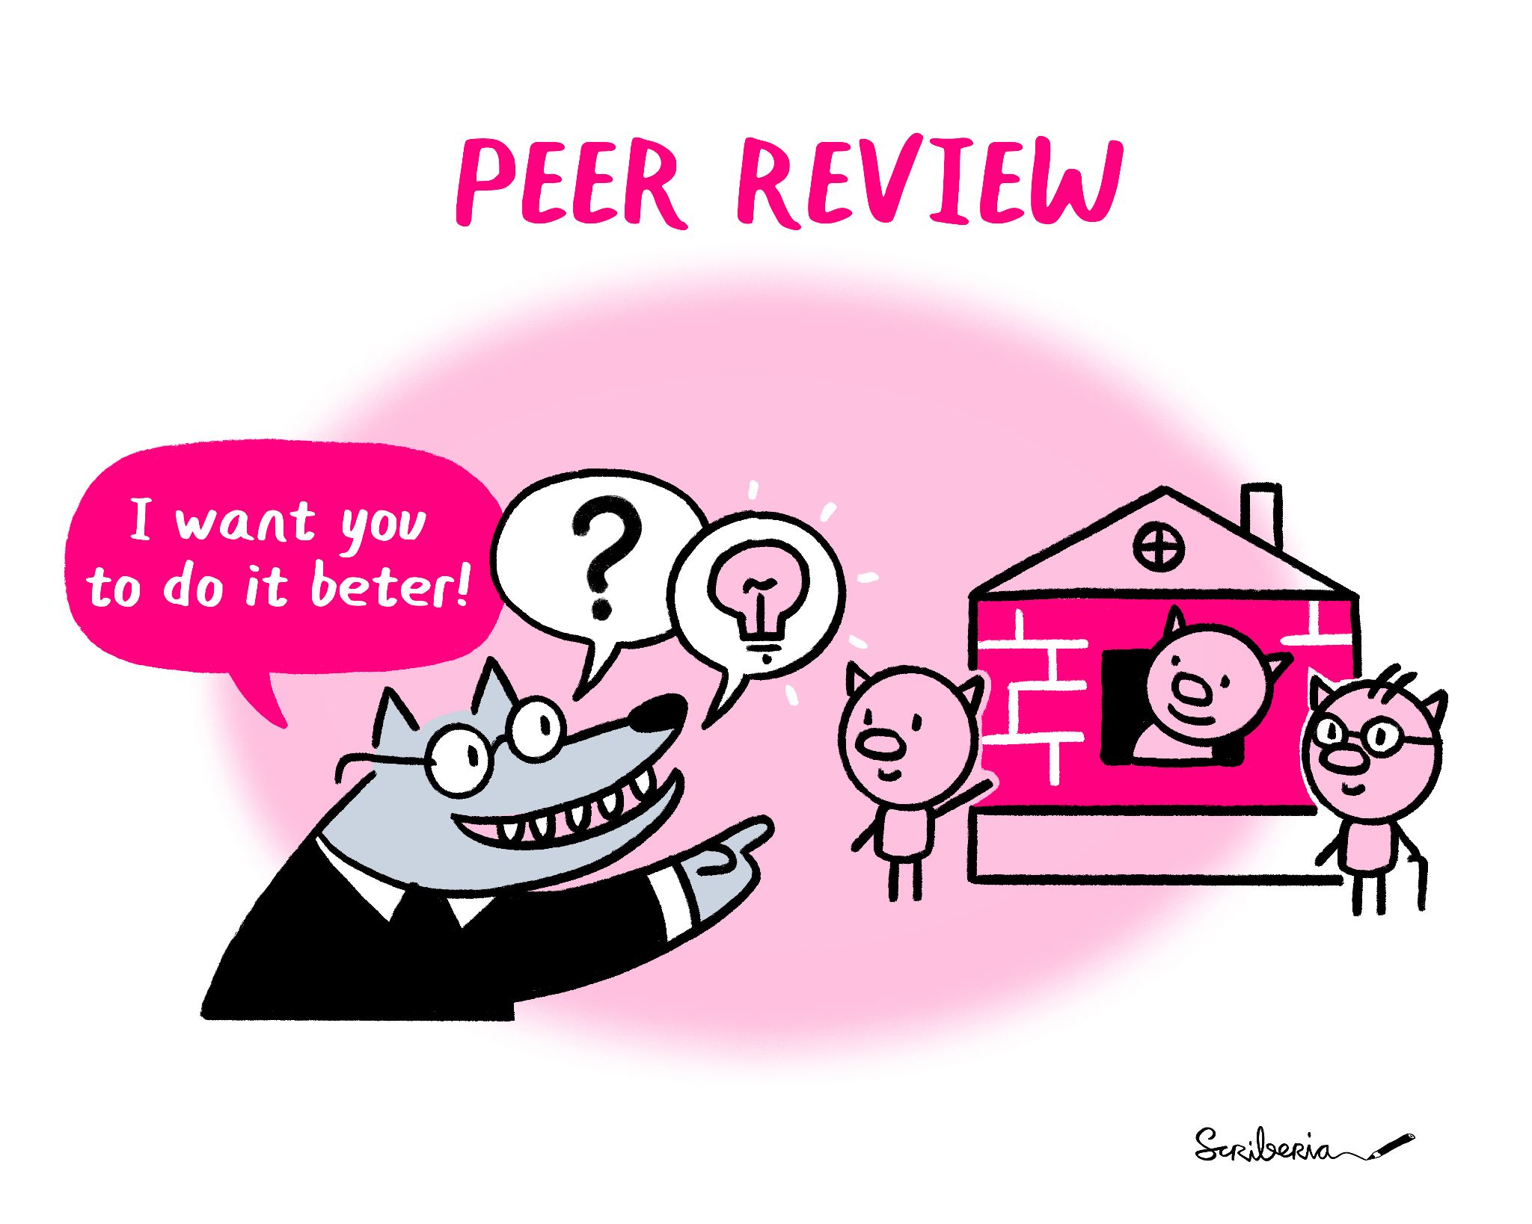

Lack of accountability and risks of subversion
“We need to rely on science, but we need to be better able to distinguish good science from bad. We need to make science more self-correcting.”
Elisabeth Bik
Microbiologist by training,
Scientific misconduct hunter by passion, professional scientific integrity consultant
We should all learn to assess the novelty or expected impact of a research (output) to validate methodology, analysis and argumentation of a research.
Dal-Ré, R., & Ayuso, C. (2019). Reasons for and time to retraction of genetics articles published between 1970 and 2018. 56(11), 734–740. doi: PMID: 31300549, Ross-Hellauer, T. (2017). What is open peer review? A systematic review. 6(588), 588. PMID: 28580134

Slide 18
Avoid Errors Before the Harm Occurs
Mistaken research design or analysis processes
  Lack of reproducible and collaborative research design
Lack of diverse tools, methods and expertise to draw from
  Lack of openness or community-developed tools
Inappropriate baseline comparison and assumption of future use
  Lack of technical understanding and ethical implications
Allison, D. B., Brown, A. W., George, B. J., & Kaiser, K. A. (2016). Reproducibility: A tragedy of errors, 530(7588), 27. doi: 10.1038/530027a
@malvikasharan, CC-BY 4.0, The Turing Way, Zenodo: DOI: 10.5281/zenodo.7428708, https://zenodo.org/record/10522776
Notes:
https://www.ncbi.nlm.nih.gov/pmc/articles/PMC4831566/

Slide 19
Storing Data: Open Data
Developing source code: Open Source
Designing hardware: Open Hardware
Sharing methods or protocols: Open Access publications
Communicating results early: Preprints
Peer-based Review: Open Peer-Reviews
Transferring skills by training: Open Education and training materials
Collaborating with public: Citizen Science
Inviting & collaborating with peers contributors, maintainers: Community Building
Supporting and connecting others in your field: Scientific Network
Openness of
diversity of
knowledge
-Toward a UNESCO Recommendation on Open Science: Canadian Commission for UNESCO By Ella Chan, Dick Bourgeois-Doyle, Michael Donaldson, and Eleanor Haine-BennettOttawa, Canada, April 2020, 2021

Slide 20
Reproducibility
 |  | Data
 |  | Same | Different
 | Same | Reproducible | Replicable
 | Different | Robust | Generalisable
Analysis
Analysis
https://the-turing-way.netlify.app/reproducible-research/
overview/overview-definitions.html
@turingway, CC-BY 4.0, The Turing Way,
DOI: 10.5281/zenodo.7692516
Notes:
So what is reproducible research? - I have borrowed the definition from The Turing Way - which is a guide to reproducible research - they state that reproducible research is work that can be independently recreated from the same data and the same code that the original team used.
As you can see here it is distinct from replication that involves using different data but the same analysis and also different from robust that uses both different data and analysis to address the same question.
These words are often used in different ways in different disciplines and also can be used interchangeably so it’s worth thinking about what you are trying to achieve in your own research.
Really the idea is to make every stage of your research transparent so that other researchers could reproduce or replicate any part of it.

Slide 21
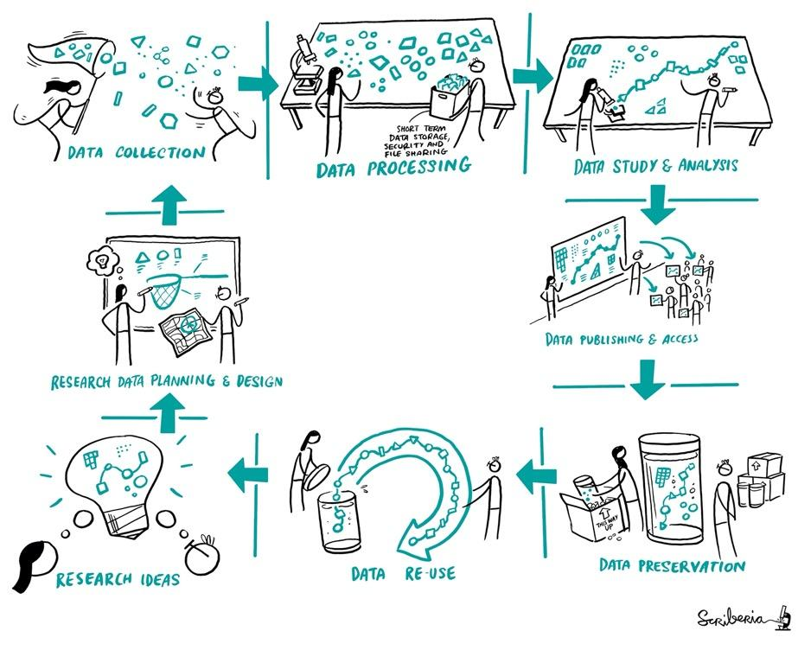
Considering Open and Reproducibility in Research
CC-BY 4.0, CC-BY image by The Turing Way and Scriberia, , DOI: 10.5281/zenodo.7692516
Notes:
It starts right when you have a research idea. You want to communicate with others, plan and design your work. Then you will describe your protocol and collect data sets. Then, you start processing and wrangling your data, conduct your studies and analysis, publishing your data, and other research components so everybody can access it. Then comes the archiving that can ensure that your data is reusable, meaning, that someone else can go through this whole process of reproducing or building upon your work.
That's quite an overwhelming process and we will talk about it more later.

Slide 22
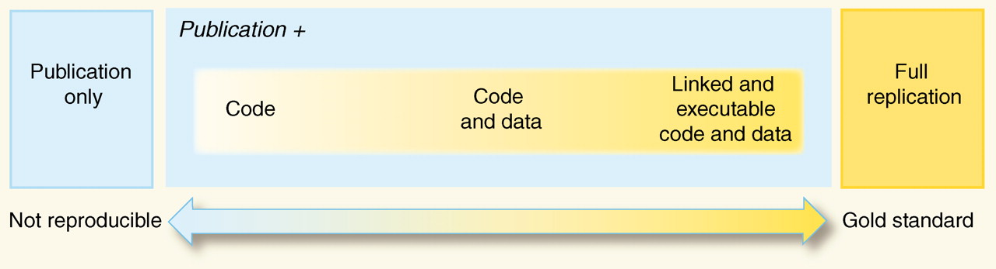
We need research environment and guidelines too!
“An article about computational science in a scientific publication is not the scholarship itself, it is merely advertising of the scholarship. The actual scholarship is the complete software development environment and the complete set of instructions which generated the figures.” - Buckheit and Donoho (paraphrasing John Claerbout, 1995)
Peng, R. D. (2011). Reproducible Research in Computational Science, 334(6060), 1226–1227. (slide courtesy of Chris Holdgraf and the Jupyter Team)
Notes:
Illustration from Peng in 2011 about how code and data aren’t enough to do a full replication.
You don’t want to let perfect be the enemy of the good here! All movement along this axis is progress towards better science.
you may have experienced the challenge of actually EXECUTING someone else’s code…..

Slide 23
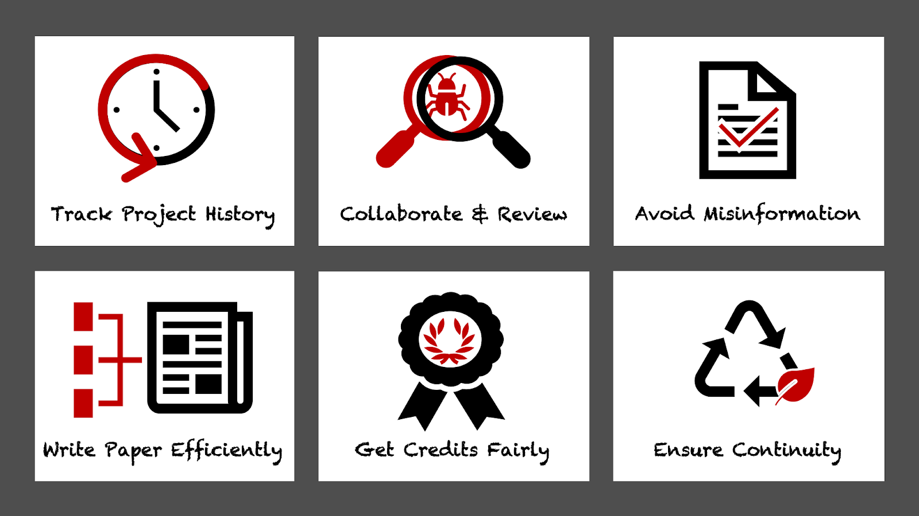
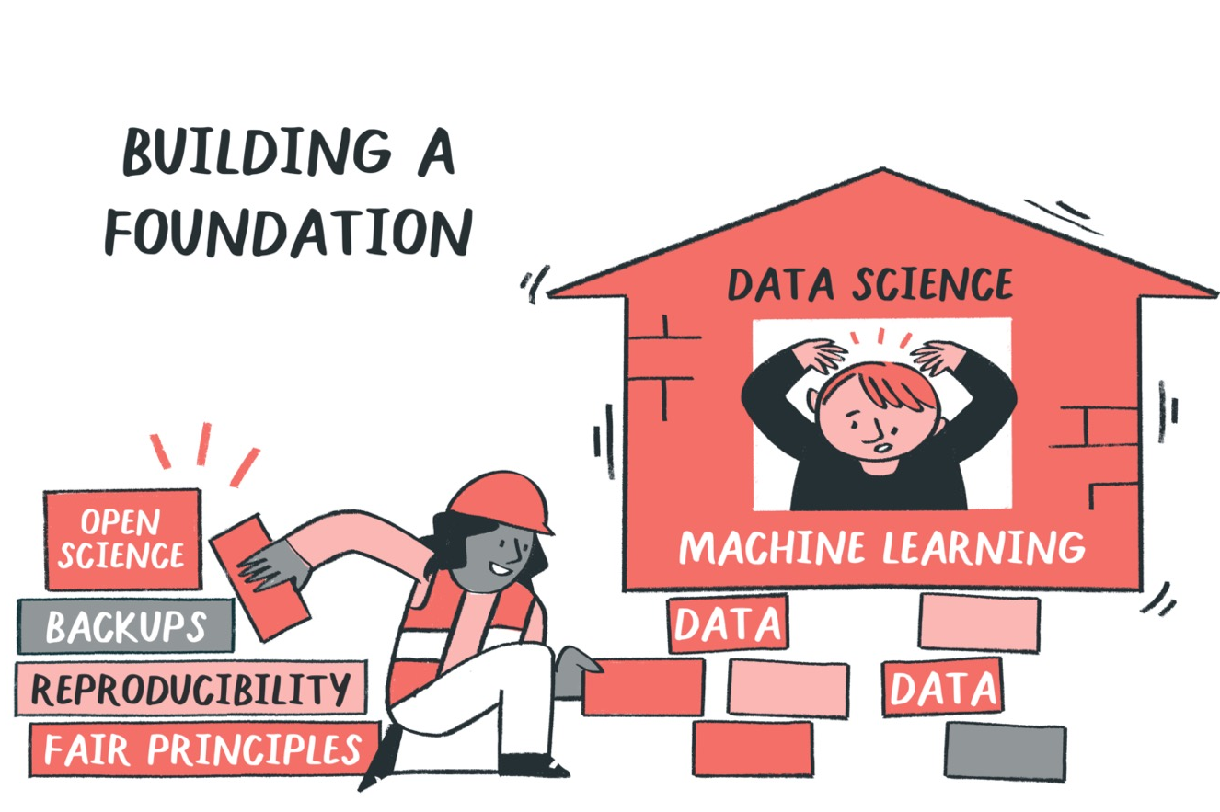
Open Science and reproducibility are foundational
NOTE: Not all data can or should be published.
@malvikasharan, CC-BY 4.0, The Turing Way, Zenodo: DOI: 10.5281/zenodo.7428708, https://zenodo.org/record/10522776
Notes:
Open science should be foundational to all research. Purpose of openness is to ensure scientific integrity, rigor and quality by applying
reproducible, ethical and collaborative approaches. So, although we may place huge importance in outcome, openness or reproducibility is not a one off thing.

Slide 24
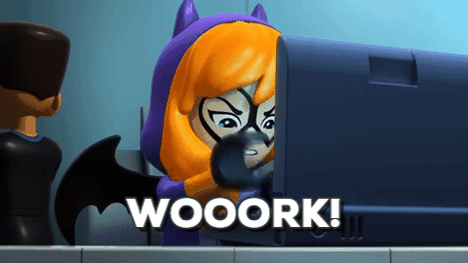
We need research environment and guidelines too!
Peng, R. D. (2011). Reproducible Research in Computational Science, 334(6060), 1226–1227. (slide courtesy of Chris Holdgraf and the Jupyter Team)
Notes:
Illustration from Peng in 2011 about how code and data aren’t enough to do a full replication.
You don’t want to let perfect be the enemy of the good here! All movement along this axis is progress towards better science.
you may have experienced the challenge of actually EXECUTING someone else’s code…..

Slide 25

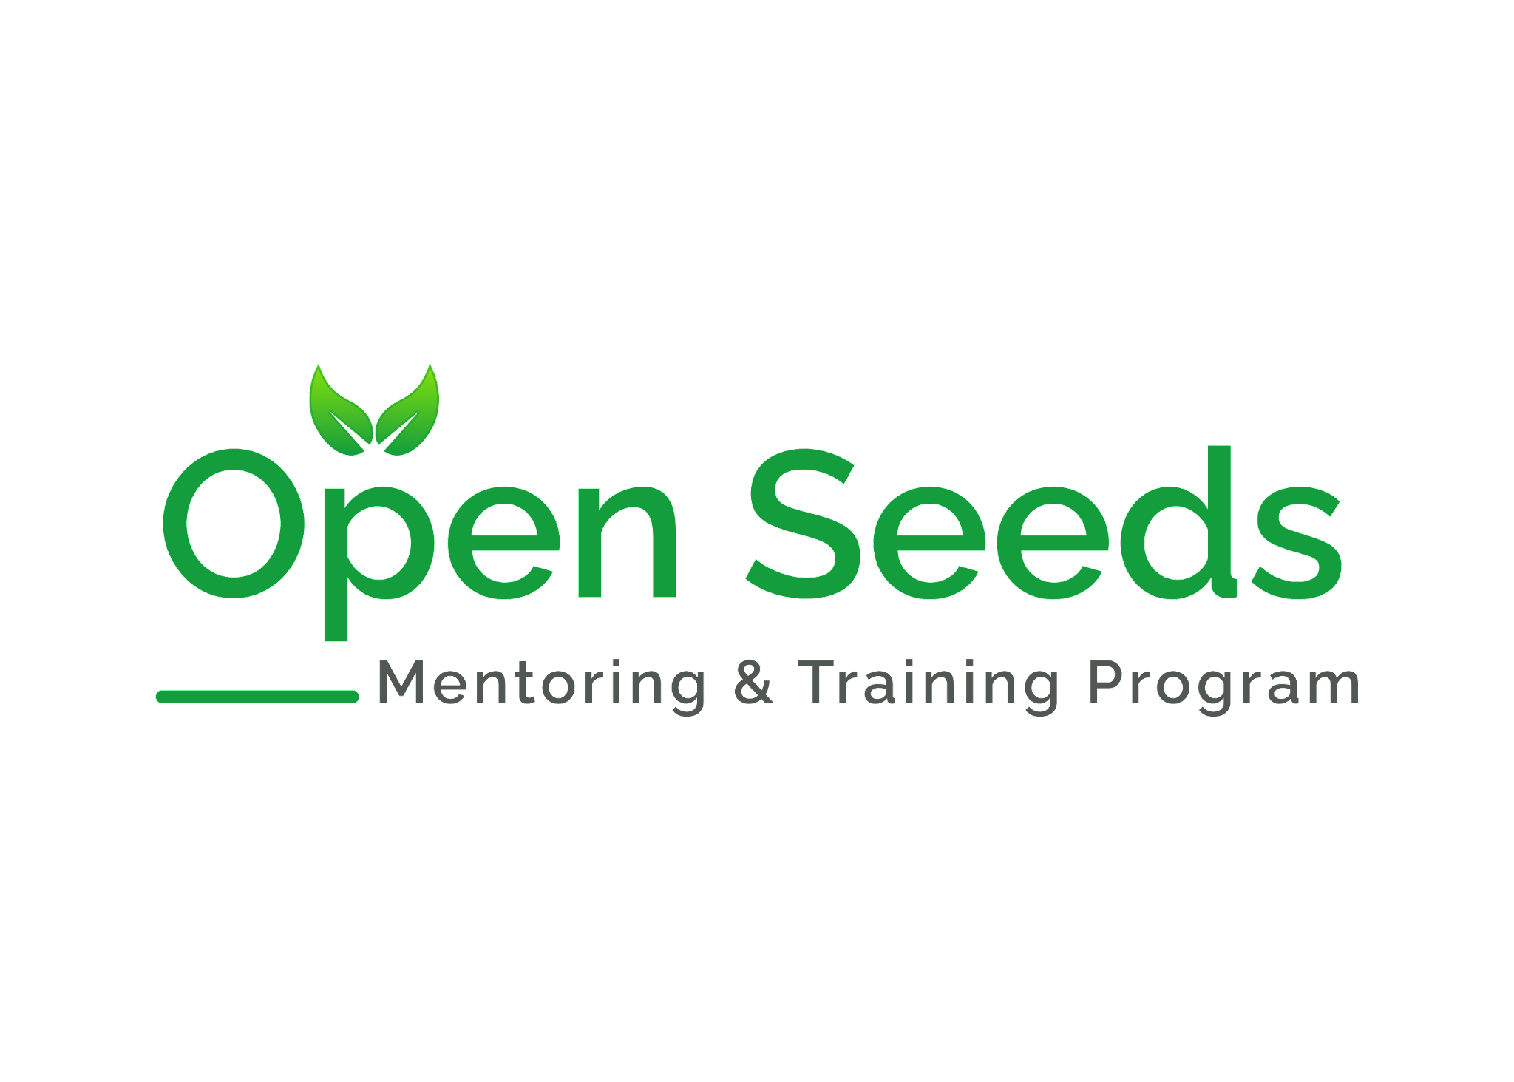

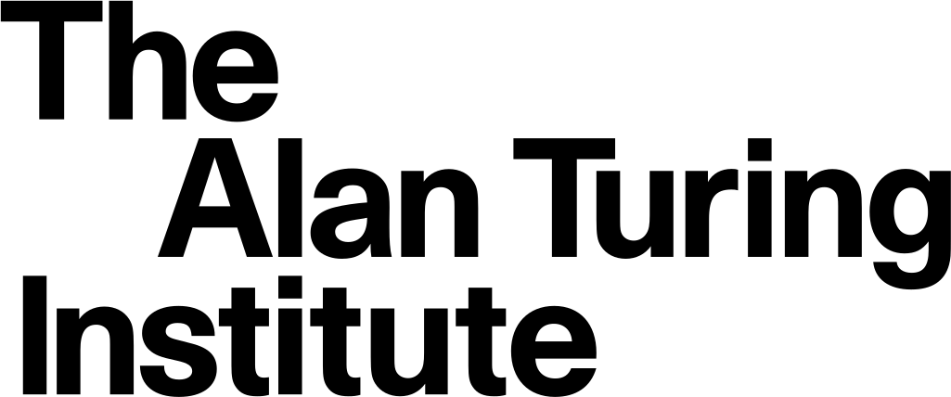





The OLS (formerly Open Life Science) is an open science training & capacity building organisation.
We create training, mentoring and learning resources with practical opportunities to apply open science, reproducibility and community approaches.
openlifesci.org
OLS-9 starting in September
Notes:
For this part, I am drawing an example from OLS, better known as Open Life Science. We are an open science capacity-building organisation.

Slide 26

Science can advance only when we share our work with others
Image on Unsplash by @unlesbar

Slide 27

… but, researchers are often skeptical about sharing their work due to their fear of getting scooped, being criticised ...
Also read: https://www.software.ac.uk/blog/2020-12-17-ten-arguments-against-open-science-you-can-win, Image on Unsplash by @rodlong

Slide 28


Together, we explore the important concepts and practices in Open Science and apply them in our work
- one step at a time.
@openlifesci
This work is licensed under a Creative Commons Attribution 2.0 Generic License
Image on Unsplash by @joannakosinska

Slide 29
https://openlifesci.org/ols-7/schedule
Welcome to Open Life Science!
Meet cohort, share project vision, an introduction to working openly (open canvas)
Open Science I:
Project Development
Iterative and agile project management; Open-source software, hardware and data
Open Leadership: Academia, industry and beyond!
Hear from professionals from different career paths
Diversity and Inclusion & Ally Skills
Personal ecology and sustainability; practical allyship
Graduation presentations 🎊
Invitation to join next OLS cohort as mentor/expert
Week 1-2
Week 6-7
Week 9
Week 12
Week 15-16
Week 3-5
Week 8
Week 10-11
Week 13-14
Open Projects Tooling & roadmapping
Open licenses; Goals and Roadmap; Contributors guidelines; Code of Conduct;
Community Design for Inclusivity
Implicit bias; personas and pathways for contributors; community interactions
Open Science II: Knowledge dissemination
Publishing data and code, preprints, DOIs and citation
Open Science III:
Next steps in Open
Data and software management, public engagement
@openlifesci
This work is licensed under a Creative Commons Attribution 2.0 Generic License
bit.ly/
c2d3-2022-community

Slide 30



OLS - Program structure
16-week long mentorship and cohort-based training
Cohort-based training
Hands on practice
1 on 1 mentoring
& openlifesci
openlifesci.org
Notes:
To summarize, a cohort of OLS is a 16 week long program which alternates between one-on-one mentorship calls and cohort-based training calls. At the end of each calls, assignments are given to apply the open leadership skills to their project.
I will now go through the different cohort calls to illustrate the different skills learned during the program

Slide 31
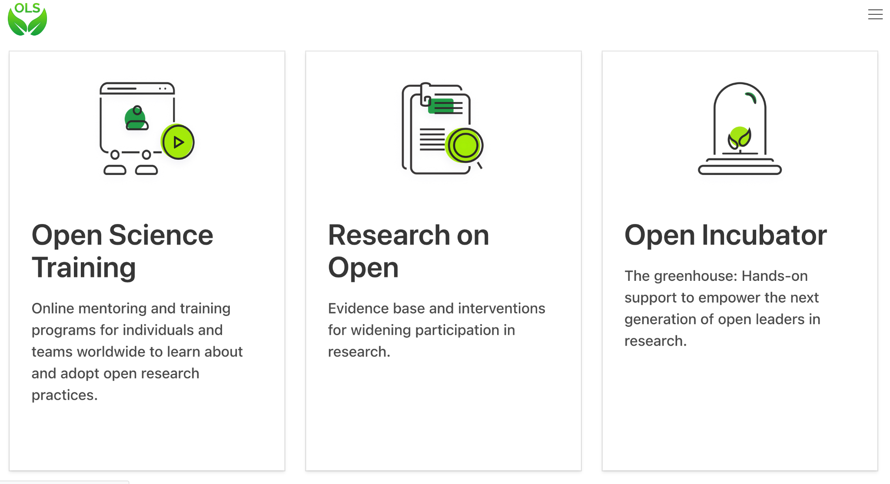
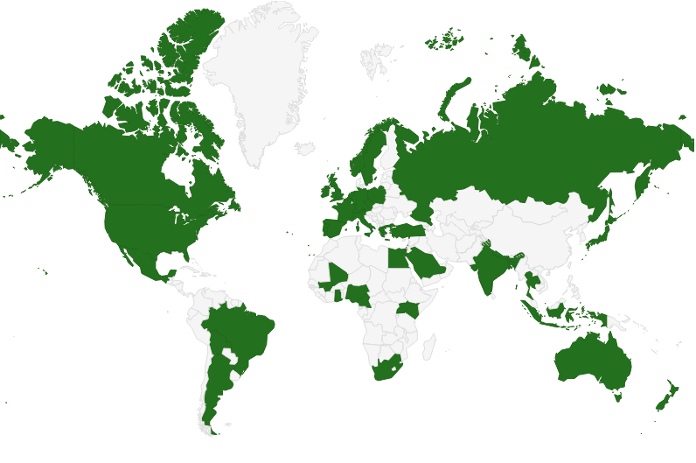
OLS’s Impact in Numbers (since 2020)
8
Cohorts
500+
Participants
200+
Mentors & Speakers
70+
Countries
A worldwide community
Organizational Pillars

Slide 32

6-week open science training
~4 hours / week
Group projects or solo
1:1 mentorship
Topics:
Ethos of Open
Open Data
Open Software
Open Results
Tools & Resources
🌍 https://we-are-ols.org
@yoyehudi
This work is licensed under a Creative Commons Attribution 2.0 Generic License
bit.ly/
2023-ebi-repro

Slide 33
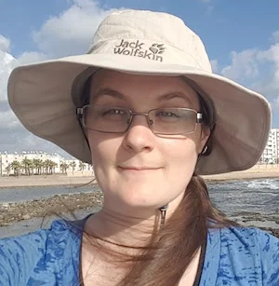
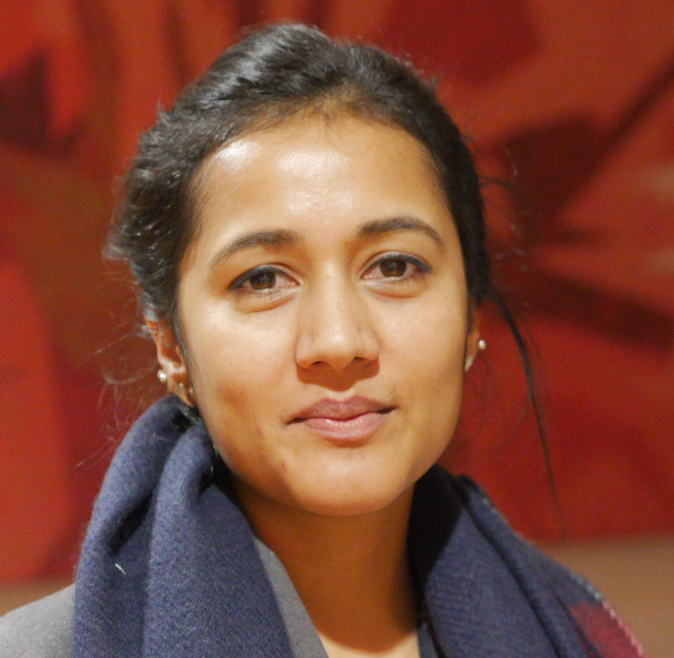
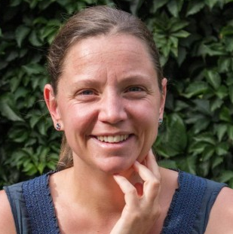
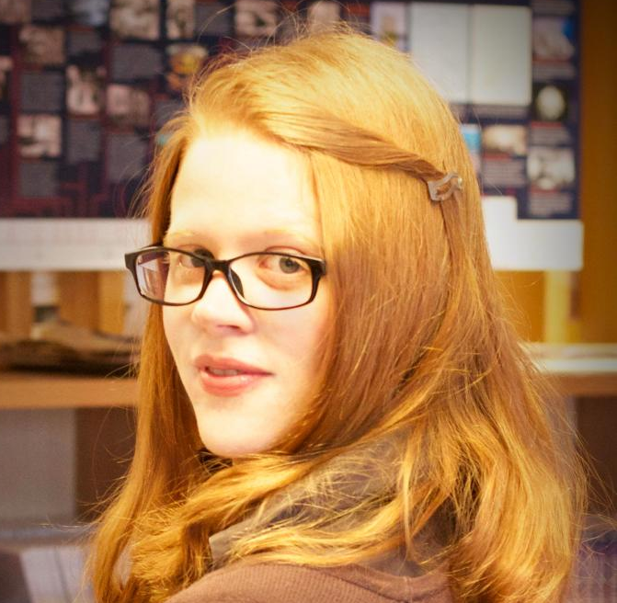
OLS Leadership
Yo Yehudi
Executive Director
Malvika Sharan
Director of Partnership
Bérénice Batut
Director of Technology
Patricia Herterich
Chief of Staff

Slide 34
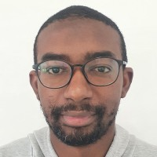
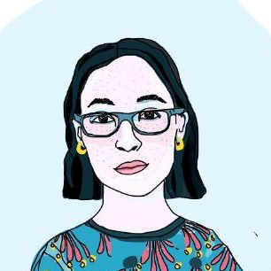
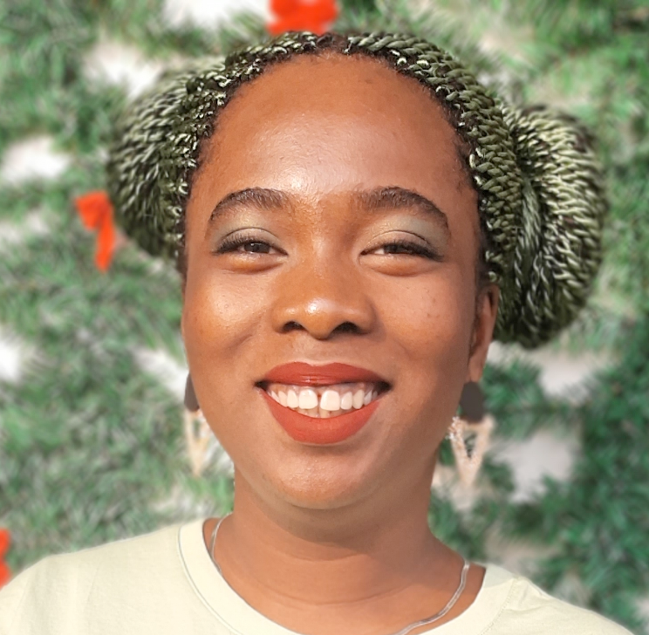
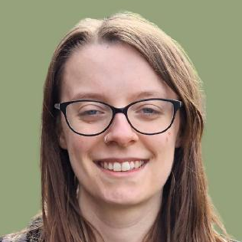
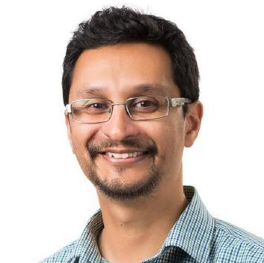
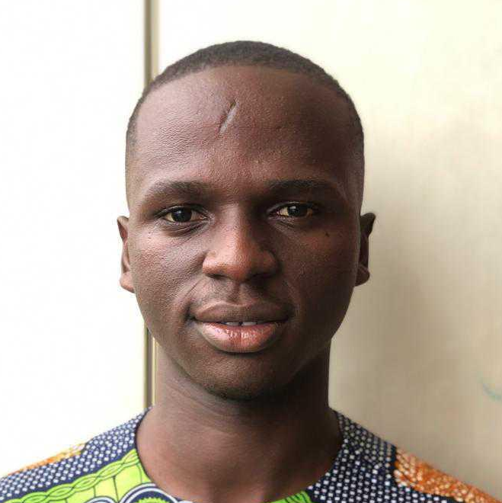
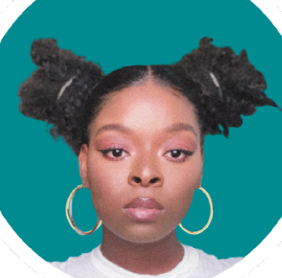

OLS Staff, Contractors and Resident Fellows
Tajuddeen Gwadabe
Program Manager: Catalyst
Irene Ramos
Project Coordinator: Nebula
Deborah Udoh
Junior Web Developer
Bethan Illey
Finance Manager
Rowland Mosbergen
Resident Fellow: Practical Diversity and Inclusion
Seun Olufemi
Junior Resident Fellow: OLS-9 DRI-EDIA
Jilaga Nneoma
Web Designer
Camille Gonzalez
Executive Assistant

Slide 35
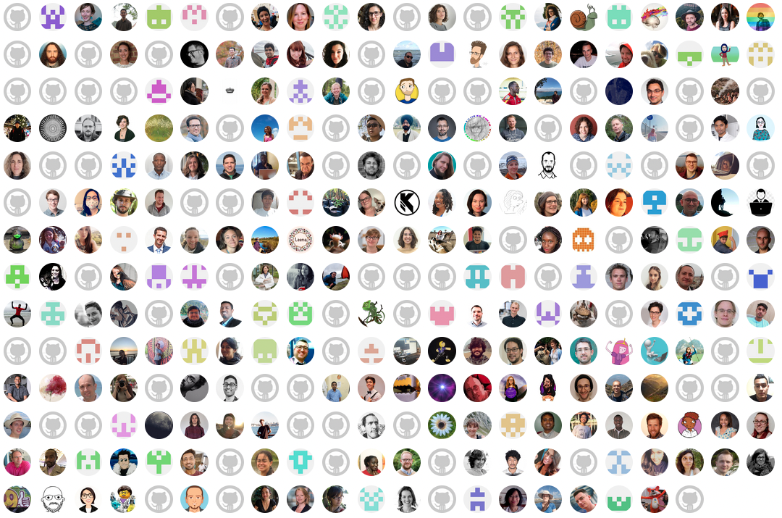
Who we are:
500+ mentors, mentees, facilitators, and expert speakers
Testimonials
Notes:
But we’re a lot more than that. We’re really 422 people who have been speakers, mentors, mentees, and call facilitators. Many people have held more than one of these roles - and we come from six out of the seven continents in the world. We’re really proud to have such a global network of people. I’ll share some of the things we do to build this.

Slide 36
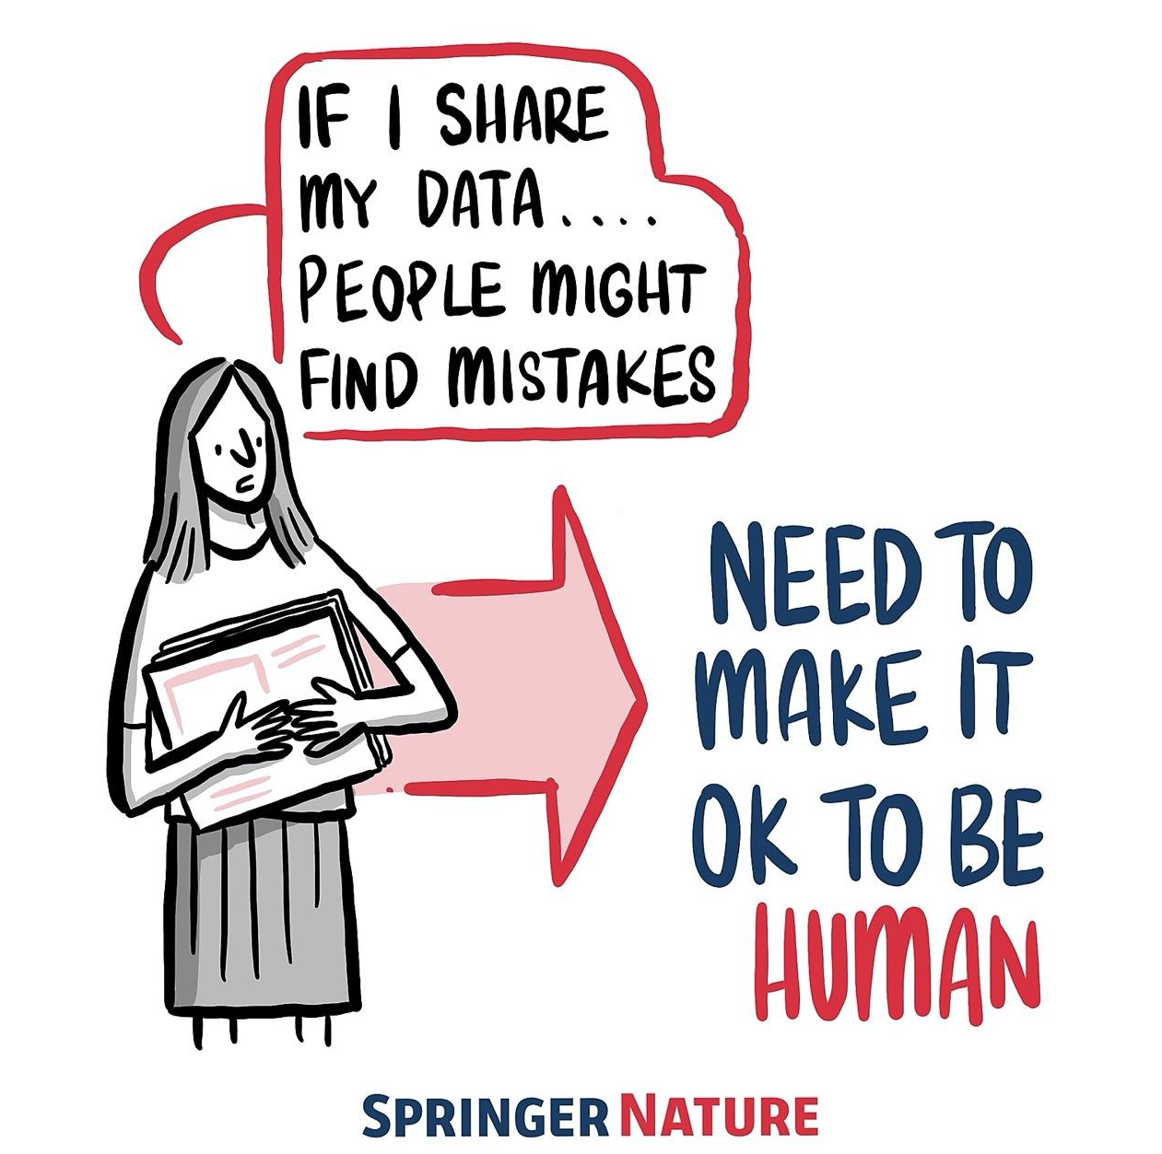
Applying open and reproducible practice require intention, resources, time, support and collaboration, which can be overwhelming.
We need open communities where we can learn with others.
Blog post: https://www.software.ac.uk/blog/2020-12-17-ten-arguments-against-open-science-you-can-win
Notes:
TIMING: 4
So of course there are barriers to this way of working

Slide 37
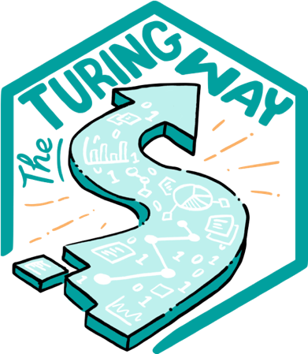
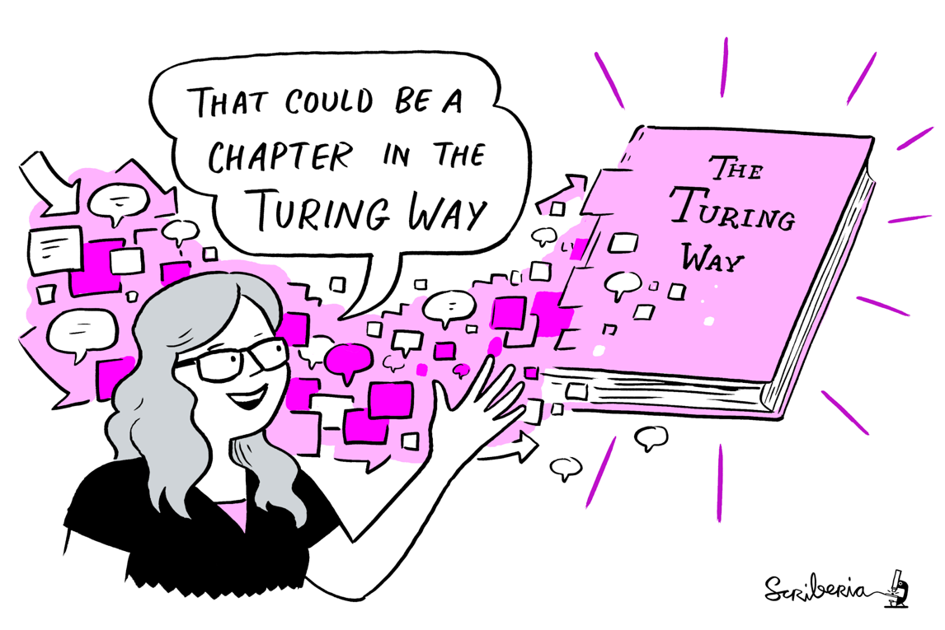
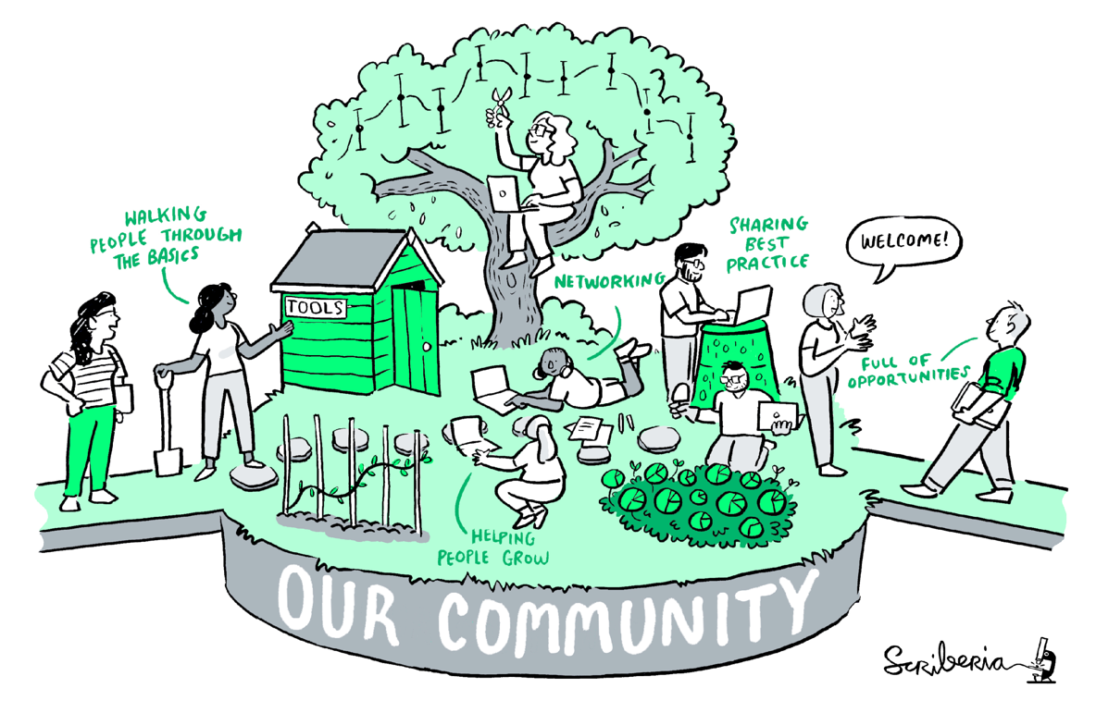
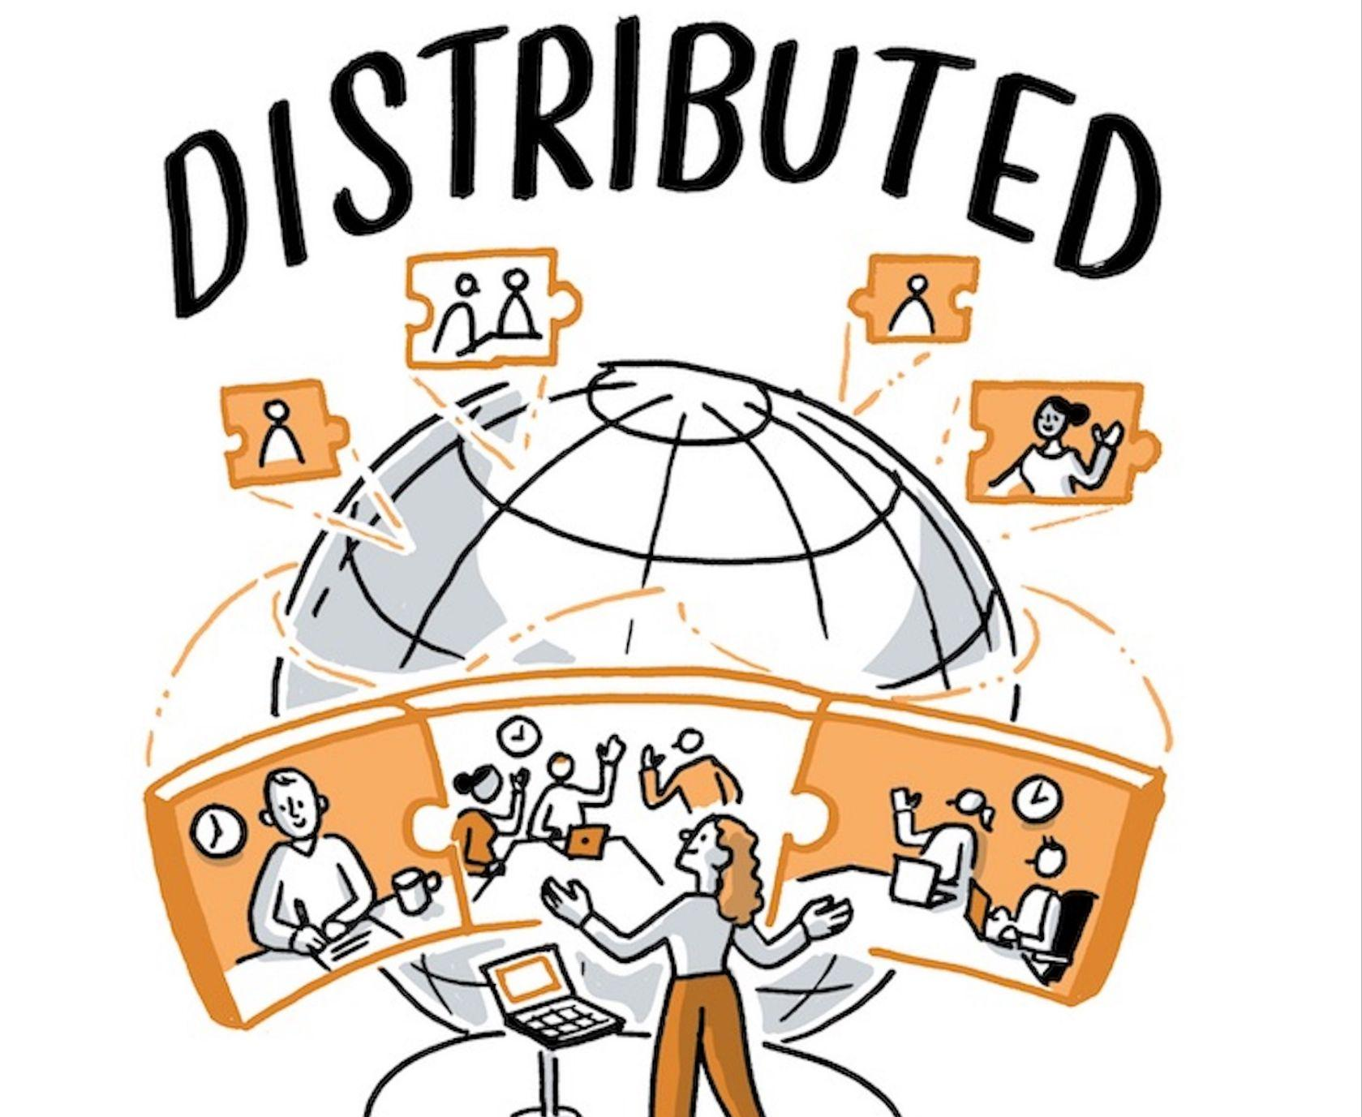
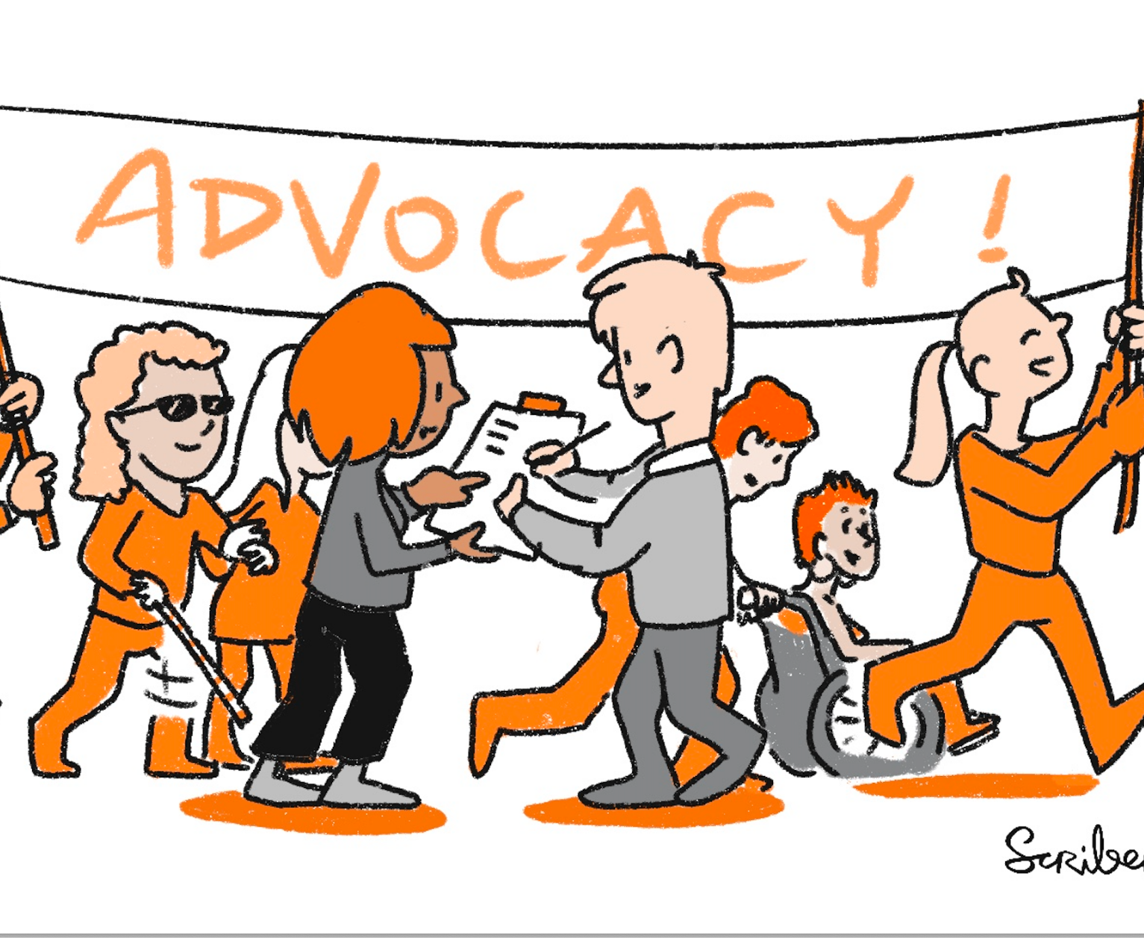
The Turing Way
A community-led handbook to best practices in Data Science.
We involve and support a diverse community to make research reproducible, ethical, and collaborative for everyone.
Book
Community
Global Collaboration
Culture Change
@malvikasharan @turingway, CC-BY 4.0, CC-BY image by The Turing Way and Scriberia, Presentation DOI: 10.5281/zenodo.7692516
Notes:
Therefore, The Turing Way is a book, a community, a global collaboration and a movement for culture change.

Slide 38
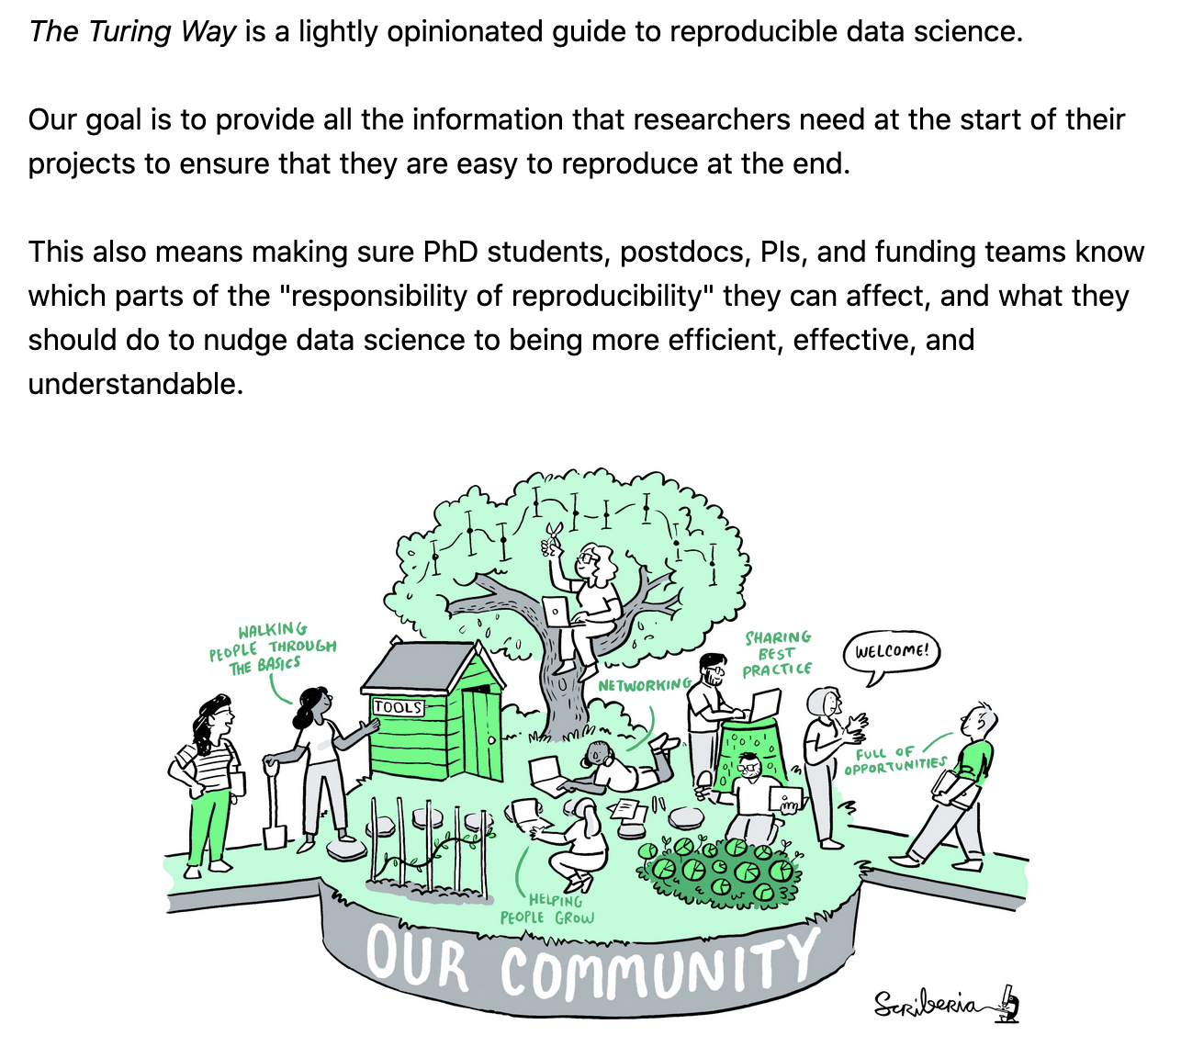
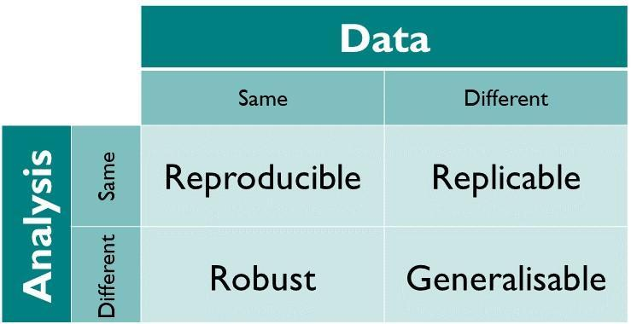
The Turing Way: Book on Reproducibility
@malvikasharan @turingway, CC-BY 4.0, CC-BY image by The Turing Way and Scriberia, Zenodo: https://doi.org/10.5281/zenodo.3332807. Presentation DOI: 10.5281/zenodo.7692516
Notes:
Reproducibility is When the same analysis is applied to the same data, it should give the same result. There are other concepts around reproducibility like replicability – when same analysis is applied to different data or experiments in different conditions, then there are robustness and generalisability as well. However, reproducibility in computational analysis should be maintained as a minimum criteria to ensure quality and integrity of our research.

Slide 39
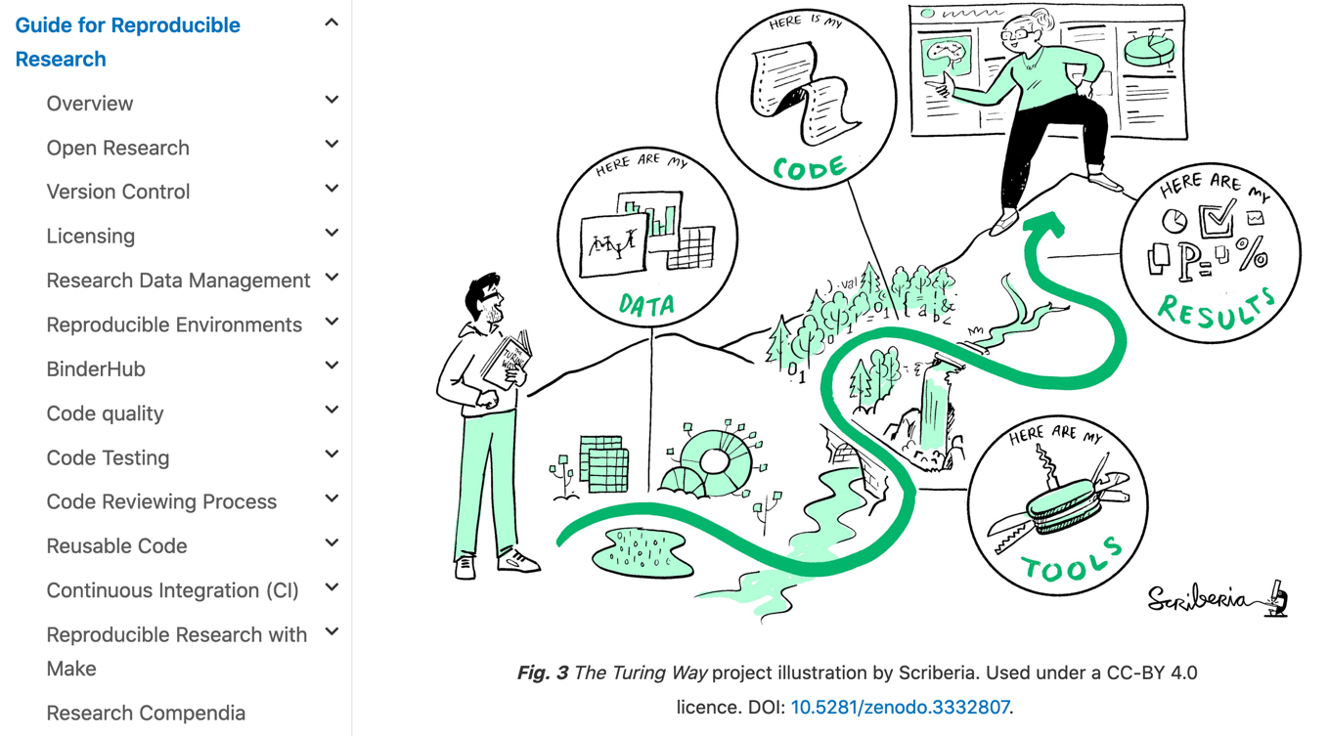
Guide for Reproducible Research
@malvikasharan @turingway, CC-BY 4.0, Book: https://the-turing-way.netlify.app/welcome,
CC-BY image by The Turing Way and Scriberia, Zenodo: https://doi.org/10.5281/zenodo.3332807. Presentation DOI: 10.5281/zenodo.7692516
Notes:
With this definition, the project started with contributors who documented best practices, guidance and recommendations in chapters, describing various concepts and tools that can ensure the reproducibility aspects of data research.
These chapter include topics such as open research, version control, licensing, data management, code testing and reviewing, continuous integration and so on.
However, these data practices were not enough, as research also includes the way we communicate our work with others, how do we design our project, how efficiently we collaborate with each other. All these while ensuring the highest ethical standards and research integrity in our research.

Slide 40
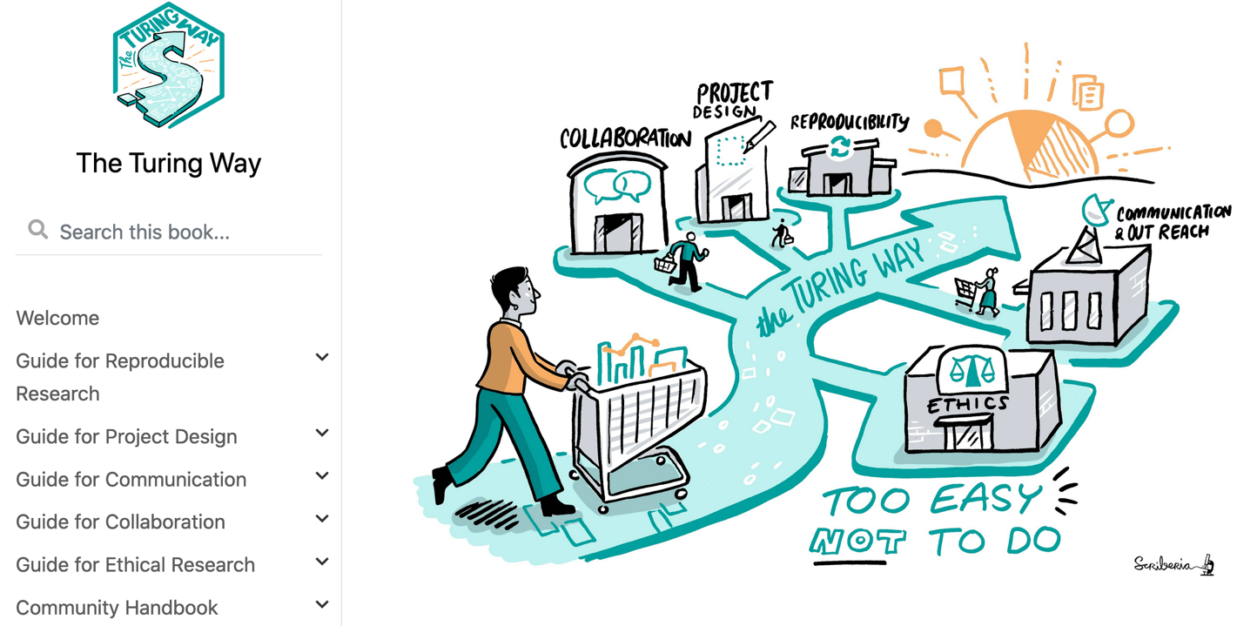
The Turing Way Guides
@malvikasharan @turingway, CC-BY 4.0, Book: https://the-turing-way.netlify.app/welcome
CC-BY image by The Turing Way and Scriberia, Zenodo: https://doi.org/10.5281/zenodo.3332807. Presentation DOI: 10.5281/zenodo.7692516
Notes:
In order to accommodate all these requirements in research and data science, the project expanded to include four more guides in addition to the guide for reproducible research: project design, communication, collaboration and ethical research.
To ensure that a project like The Turing Way can be reproduced across different communities, we also maintain the community handbook that compiles all the processes and community practices that could be reused by others.

Slide 41
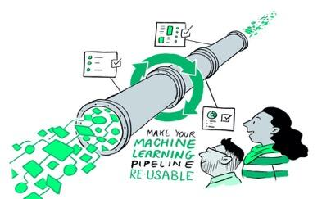
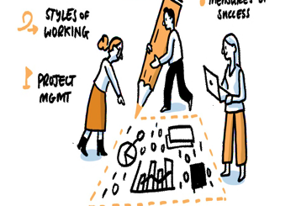
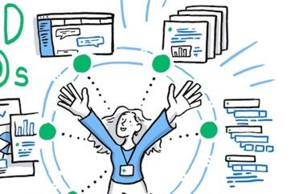
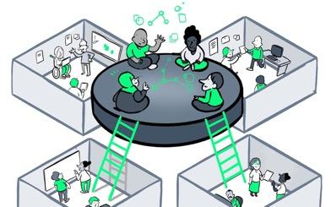


The Turing Way Guides
Reproducibility
Project Design
Communication
Collaboration
Ethical Research
Community Handbook
Notes:
To help people build this foundational skill set, the project expanded to include four more guides in addition to the guide for reproducible research: project design, communication, collaboration and ethical research.
To ensure that a project like The Turing Way can be reproduced across different communities, we also maintain the community handbook that compiles all the processes and community practices that could be reused by others.

Slide 42





The Turing Way: Guides on Data Science
5 years
>350 Chapters
500+ Contributors
Numerous training and community resources.
Kirstie Whitaker
Malvika Sharan
Director: Tools, Practices & Systems Programme (TPS)
TPS Senior Researcher: Open Research & Community
Anne Lee Steele
Arielle Bennett
Community Manager,
The Turing Way
TPS Programme Manager
@malvikasharan, Zenodo: https://zenodo.org/record/8379470,. CC-BY 4.0 Book: https://the-turing-way.netlify.app
Notes:
Kirstie and I co-lead The Turing Way, our team was joined by Anne Lee Steele as our research community manager and Alexandra Araujo Alvarez as the research project manager.
The project is in its 5th year, and provides five guides, a community hand book with over 300 chapters along with a range of community infrastructure and collaborative projects led with different teams and communities.

Slide 43





Thanks to our community of contributors & users!
Notes:
None of this work would be possible without our community of collaborators.
We'd like to invite you to become a contributor to the Turing Way, to help us develop chapters of data, transparent reporting, communication and other topics that can help others to stay updated with current practices. We welcome all kinds of contributions.
Case studies, and lived experiences, are welcome too. You don't need to have coding experience to contribute! You just need an idea and a willingness to learn.

Slide 44


































Working with the community
5 years, >350 Chapters, community resources
500+ contributors, 5000+ monthly users - supported by community-based governance
Replication/extension by 4 Turing & 6+ external projects (e.g. ONS, UCL, Uni Oxford, LIBER: Association of European Research Libraries)
@malvikasharan, https://star-history.t9t.io/#alan-turing-institute/the-turing-way, Presentation DOI: 10.5281/zenodo.7692516
Notes:
[Malvika]
With that overview of open science and the Turing way, I'd like to invite you to use, contributor to and build on the Turing Way, You don't need to have coding experience to contribute! You just need an idea and a willingness to learn.
So, if you are new to the community, you can join us. You can learn a new skill or share your skills. You can collaborate with others and receive mentoring or mentor others’ contributions. You can also represent this community. We welcome all kinds of contributions.

Slide 45






A Book
A Community
An Open Source Project
A Culture of Collaboration
Start:
the-turing-way.start.page
Notes:
What I so far talked about, described The Turing Way as a Book.
But The Turing Way is more than a Book.
It's a community where people come together to collaboratively write chapters, build and maintain resources, share their skills and ideas around best practices in data science and research.
It's an open source project, built on open source infrastructure and maintained using open source principles
And finally, it's built on the culture of collaboration, which is the process and the backbone of our project. For us, all of this together is what makes up a digital commons

Slide 46


The project belongs to the community
This is not a Turing project - although it has great support from the Institute.
This is always a work in progress - evolving with the needs in the community.
We are creating community resources together -- it’s about the way, the journey, not a set of rules.
Impact report: https://www.turing.ac.uk/research/impact-stories/changing-culture-data-science, @malvikasharan, Zenodo: https://zenodo.org/record/8379470, CC-BY 4.0 Image by Scriberia for The Turing Way
Notes:
A note on the name:
This is not a Turing project (although it has great support from the Institute)
This is always a work in progress - evolving with the needs in the community.
We are creating guidance together, the way is a journey not a set of rules

Slide 47





Internationalisation and translation work
GitHub: https://github.com/the-turing-way
450+ contributors
User map: The Turing Way book visitors -
5000+ Monthly visitors
Notes:
The project is built and shared openly via GitHub,
On the right you can see the map of our monthly users locations, over 5000 visitors a month from nearly every country on the globe
Our contributors come from around the world and they bring skills, challenges and resource requirements from their local communities - in 2023 we need to discard the notion English language resources are all that's needed to promote open research practices.

Slide 48


The Turing Way Community Handbook
Online book: https://the-turing-way.netlify.app/community-handbook, @malvikasharan @turingway
CC-BY image by The Turing Way and Scriberia, Zenodo: https://doi.org/10.5281/zenodo.3332807. Presentation DOI: 10.5281/zenodo.7692516
Notes:
All the community practices are described in The Community Handbook of the Turing Way book, that are open for remix and reuse by other communities who would like to reproduce or build on our work.

Slide 49
Open Science promotes access and equity in research and education
This work is licensed under a Creative Commons Attribution 4.0 Generic License

Slide 50

Open Science promotes access and equity in research and education
Image Credit: A collaboration between Center for Story-based Strategy & Interaction Institute for Social Change. With links to https://www.storybasedstrategy.org/the4thbox and http://interactioninstitute.org/

Slide 51
Open Science promotes access and equity in research and education
Image Credit: A collaboration between Center for Story-based Strategy & Interaction Institute for Social Change. With links to https://www.storybasedstrategy.org/the4thbox and http://interactioninstitute.org/

Slide 52

Open Science promotes access and equity in research and education
Equity versus Equality (Triple Participation). (2018, September 10). https://ces101fall2018.wordpress.com/2018/09/10/equity-versus-equality-triple-participation

Slide 53
Combines many forms of practices to make scientific knowledge ‘open’ (by design).
Openness of
diversity of
knowledge
Equitable Open Science
-Toward a UNESCO Recommendation on Open Science: Canadian Commission for UNESCO By Ella Chan, Dick Bourgeois-Doyle, Michael Donaldson, and Eleanor Haine-BennettOttawa, Canada, April 2020, 2021

Slide 54
Combines many forms of practices to make scientific knowledge ‘open’ (by design).
Openness of
diversity of
knowledge
Equitable Open Science
Accessible for everyone
No price barriers, no technical barriers!
-Toward a UNESCO Recommendation on Open Science: Canadian Commission for UNESCO By Ella Chan, Dick Bourgeois-Doyle, Michael Donaldson, and Eleanor Haine-BennettOttawa, Canada, April 2020, 2021

Slide 55
Combines many forms of practices to make scientific knowledge ‘open’ (by design).
Openness of
diversity of
knowledge
Equitable Open Science
Accessible for everyone
No price barriers, no technical barriers!
Inclusive for everyone
Enables everyone to participate and benefit from scientific advancements.
-Toward a UNESCO Recommendation on Open Science: Canadian Commission for UNESCO By Ella Chan, Dick Bourgeois-Doyle, Michael Donaldson, and Eleanor Haine-BennettOttawa, Canada, April 2020, 2021

Slide 56

Open by Design
Openness should not be a thoughtless default
Image on Unsplash by @ktabori
Notes:
We also believe that openness shouldn’t be a thoughtless default, but something that is consciously designed into what you’re doing, carefully thinking about the ethics and implications at every step.

Slide 57

Game
time
Open or Not Open
This work is licensed under a Creative Commons Attribution 4.0 Generic License

Slide 58

TARO
TARO loves to write Python scripts
Joined a research team as a Computer Science intern
Helps people in their research group with programming questions
Their supervisor suggested them to share the scripts online
Taro created a public GitHub repository and shared the scripts
Sent out an email to their team members to use their repository
This work is licensed under a Creative Commons Attribution 4.0 Generic License

Slide 59
Open by Default
TARO
The repository is public and open but
How can their team members reuse their scripts?
Can they help improve the scripts?
How can someone credit them if they use their work?
Can they share them with others outside their lab?
What happens if interactions in their repository are unpleasant?
This work is licensed under a Creative Commons Attribution 4.0 Generic License

Slide 60

The question is not "will we open this?", rather "how will we open this?"
Quote adapted from: Open by Design post on https://www.data.govt.nz/blog/open-by-design/
Image on Unsplash by @iankosky

Slide 61
Open by DESIGN
TARO
Adds an open source license in their repository for reuse
Creates a README file with information on their scripts
Adds a user manual and a process for asking for help
Adds a contribution guideline for others to help improve
Makes it clear how to cite/credit their work
Selects a Code of Conduct for their repository
This work is licensed under a Creative Commons Attribution 4.0 Generic License

Slide 62
Open by DESIGN
TARO
Adds an open source license in their repository for reuse
Creates a README file with information on their scripts
Adds a user manual and a process for asking for help
Adds a contribution guideline for others to help improve
Makes it clear how to cite/credit their work
Selects a Code of Conduct for their repository
Openness is more than just putting it online!
This work is licensed under a Creative Commons Attribution 4.0 Generic License

Slide 63
This work is licensed under a Creative Commons Attribution 4.0 Generic License

Slide 64

References: Mewa, & Goudarzi. (2018). Mapping Academic Publishing: Locating Enclaves of Development Knowledge. ELectronic PUBlishing, Connecting the Knowledge Commons: From Projects to Sustainable Infrastructure, Image: https://doi.org/10.6084/m9.figshare.953177, Quote: https://www.force11.org/blog/open-access-inclusion-interview-juan-pablo-alperin
Notes:
I became more aware of the disconnect of the research practices as well as narratives between Western communities and the Global South that includes communities in Asia, Africa and Latin America. You can see in this map from 2016 visualising a shrunken representation of publications from the global south. As the author Juan Pablo Alperin puts it: Access is not only about being able to read but being able to have a voice that shape the direction of discipline.
A simple example is that, curriculum developed by one community with most members from western organisations was not directly applicable to another part of the world if we didn’t put them in their local contexts. Only through opportunities to teach with local educators in India, Argentina and South Africa I learned to challenge what we were teaching and how we we could manage better participation. Simple changes to content, collaborative methods and local languages when possible made a huge difference in people’s learning process. So even though open science resources are developed online where everyone can in theory find, access and contribute to them, it doesn’t take away the fact that there are barriers to participation online. Even those who participate aren’t always involved in designing and decision making, raising challenges to reuse research output without massive redevelopment and hence perpetuating the cycle of more publication of resources from the Global north, than the Global south.

Slide 65
Access is not only about being able to read but being able to have a voice and shape the directions, economic models and infrastructure.
- Juan Pablo Alperin
References: Mewa, & Goudarzi. (2018). Mapping Academic Publishing: Locating Enclaves of Development Knowledge. ELectronic PUBlishing, Connecting the Knowledge Commons: From Projects to Sustainable Infrastructure, Image: https://doi.org/10.6084/m9.figshare.953177, Quote: https://www.force11.org/blog/open-access-inclusion-interview-juan-pablo-alperin
Notes:
I became more aware of the disconnect of the research practices as well as narratives between Western communities and the Global South that includes communities in Asia, Africa and Latin America. You can see in this map from 2016 visualising a shrunken representation of publications from the global south. As the author Juan Pablo Alperin puts it: Access is not only about being able to read but being able to have a voice that shape the direction of discipline.
A simple example is that, curriculum developed by one community with most members from western organisations was not directly applicable to another part of the world if we didn’t put them in their local contexts. Only through opportunities to teach with local educators in India, Argentina and South Africa I learned to challenge what we were teaching and how we we could manage better participation. Simple changes to content, collaborative methods and local languages when possible made a huge difference in people’s learning process. So even though open science resources are developed online where everyone can in theory find, access and contribute to them, it doesn’t take away the fact that there are barriers to participation online. Even those who participate aren’t always involved in designing and decision making, raising challenges to reuse research output without massive redevelopment and hence perpetuating the cycle of more publication of resources from the Global north, than the Global south.

Slide 66

You are participant and organiser of open science in bioinformatics
Systems to get involved and access support and mentorship
Opportunities for diverse representation in all spaces
Recognition for all contributions and rewards through visible roles
Community-led process for transparent decision-making
This work is licensed under a Creative Commons Attribution 4.0 Generic License

Slide 67

The more I know!
Kaylee Somerville, The Hidden Power of Intellectual Humility - The Decision Lab. 2020.
https://thedecisionlab.com/insights/society/the-hidden-power-of-intellectual-humility
Notes:
You probably already know some things about open and reproducible research but there is always more to learn! And when you actually start to practice it, it can be another thing.
Learning journey’s are not a straight line and especially with reproducibility and open science practices there are many new skills to learn and more than one way to do everything. So we often take a rather windy road to knowing everything we need to know to do open and reproducible research.

Slide 68

I only know the directions I want to take, I don’t know where I will end up!
https://www.freepik.com/free-vector/flat-explorers-nature-landscape-searching-exploring-new-opportunities, Image by redgreystock, on Freepik

Slide 69

Everyone fails - learns - grows (whirlwind!)
London, UK
Co-Founded Open Life Science
Senior Researcher - The Alan Turing Institute
Co-lead of The Turing Way
Lead of Community Management Team
Germany
M.Sc, PhD, Community Building
Worked in European Molecular Biology Laboratory, connected with Open Science projects
Bangalore
Bachelor's degree
and worked briefly
Ranchi, Jharkhand
Hometown

Slide 70

Your Open Source/Science Journey
Our skills aren't fixed in place. You can be good at lots of things. You can do anything. – Tania Reilly
Technical Leadership and the Glue Work.
@malvikasharan @turingway, CC-BY 4.0, CC-BY image by The Turing Way and Scriberia, Presentation DOI: 10.5281/zenodo.7692516
Notes:
Our skills aren't fixed in place. You can be good at lots of things. You can do anything.

Slide 71
I can’t wait to see amazing things you will do
Our skills aren't fixed in place. You can be good at lots of things. You can do anything. – Tania Reilly
Technical Leadership and the Glue Work.
@malvikasharan @turingway, CC-BY 4.0, CC-BY image by The Turing Way and Scriberia, Presentation DOI: 10.5281/zenodo.7692516
Notes:
Our skills aren't fixed in place. You can be good at lots of things. You can do anything.

Slide 72
Acknowledgements & Links
The Turing Way
– Kirstie Whitaker, The Turing Way core contributors and community
– Anne Lee Steele, Alexandra Araujo Alvarez, Arielle Bennett, All TPS members
– Book: the-turing-way.netlify.com, Twitter: twitter.com/turingway
– GitHub: github.com/alan-turing-institute/the-turing-way, Start: the-turing-way.start.page
OLS (Open Life Science)
– Open Life Science community; Yo Yehudi, Bérénice Batut, Emmy Tsang
– Website: openlifesci.org, Twitter: twitter.com/openlifesci
– GitHub: github.com/open-life-science/open-life-science.github.io
Parts of my talk reuse materials from presentations given previously in Open Life Science and The Turing Way by the team members listed in this slide.
Short link: https://bit.ly/bon-2024-ms, Zenodo link: https://zenodo.org/records/13379994
Notes:
Thanks to Kirstie Whitaker for starting this project. All our resources including this presentation are available online. With that, I am happy to take any question.

Slide 73

Meeting you where you are!
Join the community
Learn a new skill
Share your skills
Collaborate with others
Mentor others’ contributions
Represent this community
Join us, participate, learn, share!
@malvikasharan @turingway, CC-BY 4.0, CC-BY image by The Turing Way and Scriberia, Presentation DOI: 10.5281/zenodo.7692516
Notes:
[Malvika]
With that overview of open science and the Turing way, I'd like to invite you to use, contributor to and build on the Turing Way, You don't need to have coding experience to contribute! You just need an idea and a willingness to learn.
So, if you are new to the community, you can join us. You can learn a new skill or share your skills. You can collaborate with others and receive mentoring or mentor others’ contributions. You can also represent this community. We welcome all kinds of contributions.

Slide 74
Contents of this template
Here’s what you’ll find in this Slidesgo template:
A slide structure based on a multi-purpose presentation, which you can easily adapt to your needs. For more info on how to edit the template, please visit Slidesgo School or read our FAQs.
An assortment of pictures and illustrations that are suitable for use in the presentation can be found in the two alternative resources slides.
A thanks slide, which you must keep so that proper credits for our design are given.
A resources slide, where you’ll find links to all the elements used in the template.
Instructions for use.
Final slides with:
The fonts and colors used in the template.
A selection of illustrations. You can also customize and animate them as you wish with the online editor. Visit Storyset to find more.
More infographic resources, whose size and color can be edited.
Sets of customizable icons of the following themes: general, business, avatar, creative process, education, help & support, medical, nature, performing arts, SEO & marketing, and teamwork.
You can delete this slide when you’re done editing the presentation.

