Slide 1





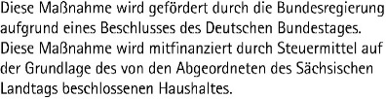
CENTER FOR SCALABLE DATA ANALYTICS AND ARTIFICIAL INTELLIGENCE
NATIONAL RESEARCH DATA MANAGEMENT INFRASTRUCTURE FOR MICROSCOPY AND BIOIMAGE ANALYSIS
GLOBAL BIOIMAGE ANALYST’S SOCIETY
Large Language Models:
An Introduction for Life Scientists
Robert Haase
These slides can be reused under the terms of the CC-BY4.0 license.
https://doi.org/10.5281/zenodo.13374649

Slide 2
Overview
Neural
networks
LLMs
Prompt engineering
Embeddings
Retrieval Augmented Generation (RAGs)
Vision-LMs
Fine-tuning
Image-Generation-LMs
Function calling

Slide 3
Large Language Models (LLMs)
Text-to-text, translation, …
Hello world
Hallo Welt
English
German
Neural network

Slide 4
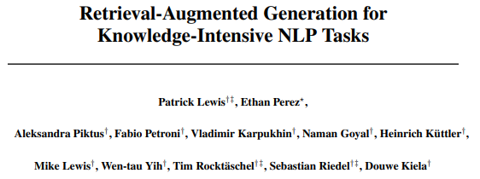
Large Language Models (LLMs)
Text-to-text, translation, knowledge retrieval
Answer
↑↓?
Question
Hallucinations
https://arxiv.org/abs/2005.11401

Slide 5
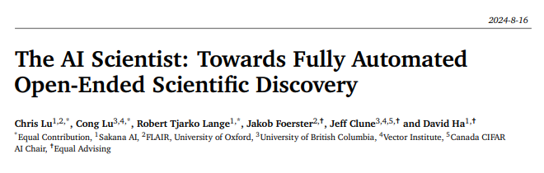
Large Language Models (LLMs)
Text-to-text, translation, reasoning
Hypothesis
Proof + Explanation
https://arxiv.org/abs/2408.06292

Slide 6
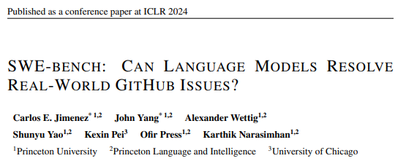
Large Language Models (LLMs)
Text-to-text, translation, code generation
from skimage.io import imread
image = imread(“hela-cells.tif”)
Open hela-cells.tif
English
Python
https://arxiv.org/abs/2310.06770

Slide 7
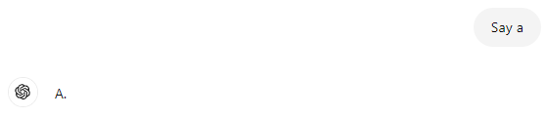
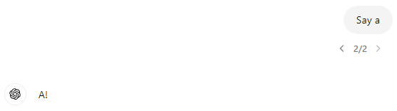
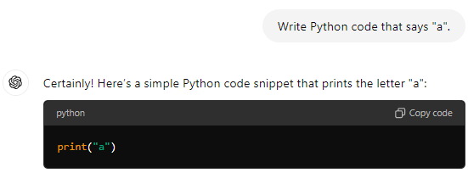
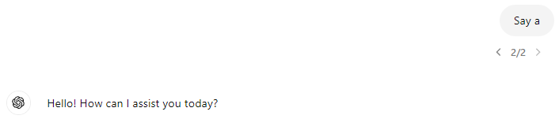
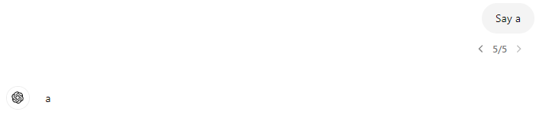
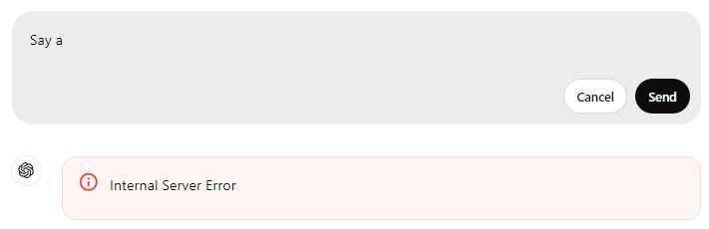
Why code generation using LLMs?
Output of LLMs is often criticized for
Limited reproducibility
Hard to evaluate (automatically)
Output of LLM-generated code is
Reproducible
Can be executed and evaluted (automatically)
No matter how often you execute this code, the output is always garanteed to be „a“.

Slide 8
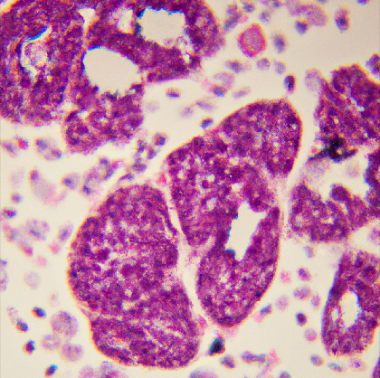
Image Generation LLMs
Interesting challenges for our community ahead
Text-to-image prompting
a histology image of lung cancer cells and some healthy tissue
https://scads.github.io/generative-ai-notebooks/40_image_generation_openai/10_generating_images_dall_e.html

Slide 9
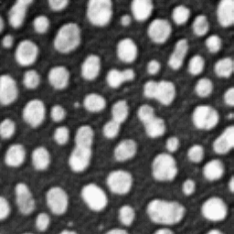
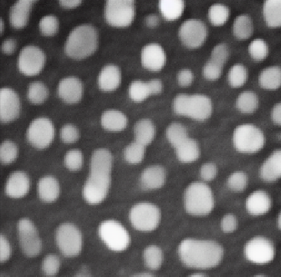

Image Generation LLMs
Image-to-image prompting, image variations
Blur the image
https://arxiv.org/abs/2211.09800
https://scads.github.io/generative-ai-notebooks/41_image_generation_huggingface/60_image_variations_pix2pix.html

Slide 10
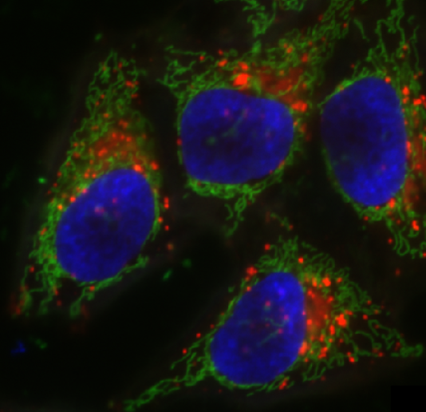
Vision Langage Models VLMs
Combining image and text: Multi-Modal LMs
There are nuclei, presumably stained with DAPI and imaged using a fluorescence microscope.
What’s in the blue-channel of this image?

Slide 11





Use case: Code generation
That’s right!
That makes sense!
You need to have image analysis knowledge to write prompts like this
Biologist
Computer
scientist
https://scads.github.io/generative-ai-notebooks/50_code_generation/25_vision-microscopy-hints.html

Slide 12
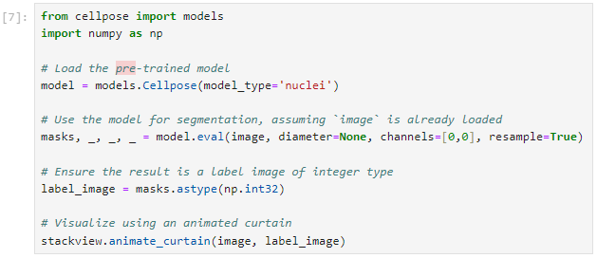
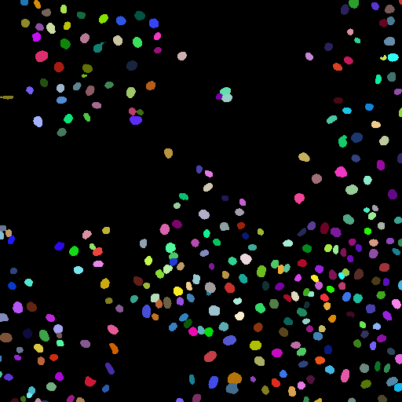
Use case: Code generation
Jeey!
Jeey!
Biologist
Computer
scientist
You need programming skills to proof-read this code.
https://scads.github.io/generative-ai-notebooks/50_code_generation/25_vision-microscopy-hints.html

Slide 13
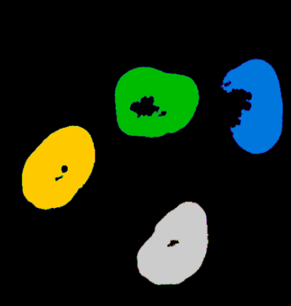
Multi-modal LLMs
Combining image, text and […] data, to gain new insights.
There are 4 cells.
I just marked their nuclei.
How many cells are there?
I‘m not aware of any implementation of this (yet).

Slide 14
Transformer neural networks

Slide 15
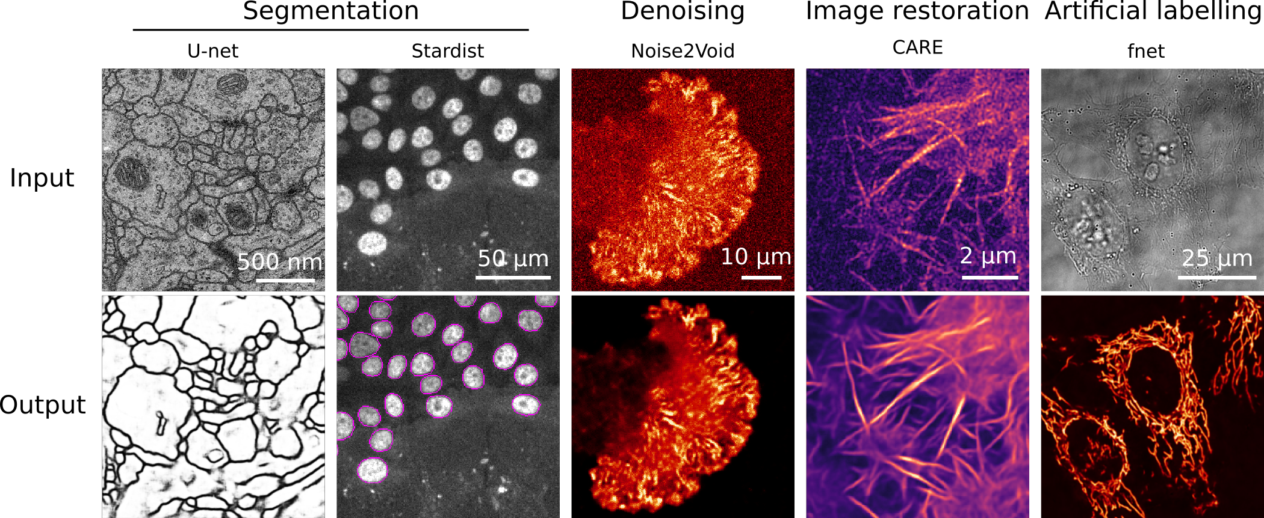
Traditional architecture: Encoder-Decoder Networks
Related: „Auto-encoder“, „Variational Auto-Encoder“, „U-Net“
Encoder
Decoder
Skip-connections (optional)
Input
Output
Input:
noisy image
“Bottleneck”, “Embedding”,
“Latent space”
Input:
denoised image
1
2
Images demonstrating noise2void, cropped from https://github.com/HenriquesLab/ZeroCostDL4Mic/blob/master/Wiki_files/FigureS2.png license: MIT

Slide 16
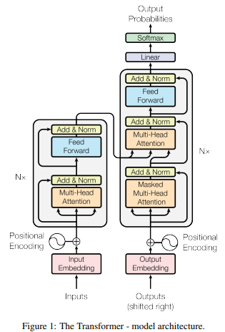
What‘s new? Transformers
LLMs use the transformer neural network architecture
Related: Generative Pretrained Transformer (GPT)
Figure source: Ashish et al 2017. "Attention is all you need". License: Provided proper attribution is provided, Google grants permission to reproduce the tables and figures in this paper solely for use in journalistic or scholarly works.
https://arxiv.org/abs/1706.03762

Slide 17
What‘s new? Transformers
LLMs use the transformer neural network architecture
Related: Generative Pretrained Transformer (GPT)
Encoder
Decoder
Output
2
To avoid cheating while training
Masking
1
3
Input
[Shifted] Output

Slide 18
What‘s new? Transformers
LLMs were originally developed for translation tasks and next-word prediction.
Encoder
Decoder
Output
„[…] Microscope“
2
„Die Katze sitzt neben dem Mikroskop.“
Masking
„The cat sits next to the […]“
1
3
Input
Output

Slide 19
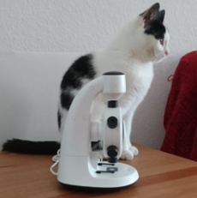
What‘s new? Transformers
VLMs use combinations of traditional neural network architectures and transformers.
Encoder
Decoder
Output
„[…] Microscope“
2
Input
Masking
„The cat sits next to the […]“
“Embedding”,
“Latent space”
3
Input image
1
Output

Slide 20
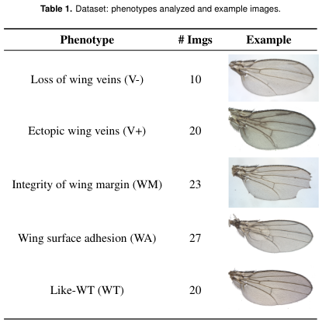
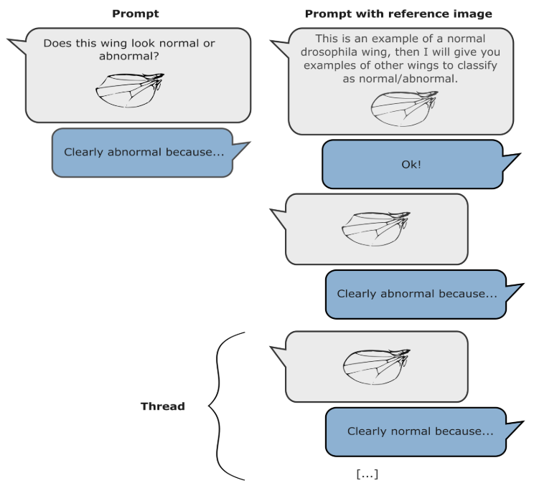
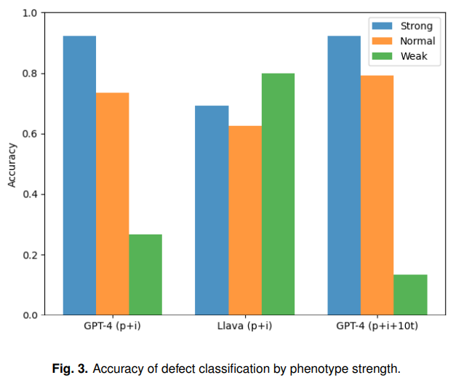
Use case: Descriptive biology
“… while visual language models are in their infancy, they already show potential for multiple applications in automated phenotyping studies. We encourage the community to carefully test them… “
Cropped from Paci & Nanni (2024), licensed CC-BY 4.0
https://www.biorxiv.org/content/10.1101/2024.05.27.594652v1

Slide 21
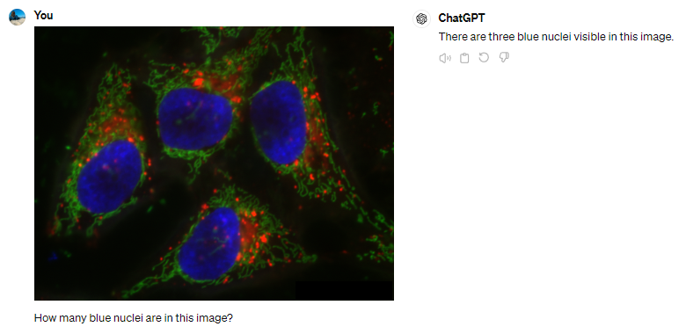
Vision language models for counting objects
LLMs were not exactly built for this use-case…
n=1

Slide 22
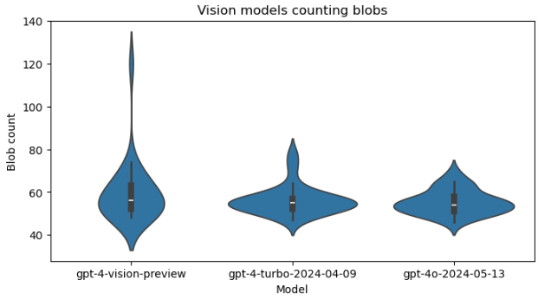
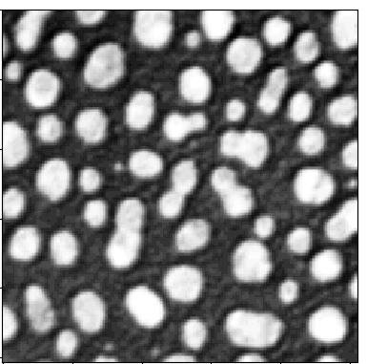
Vision language models for counting objects
Prompt: „Analyse the following image by counting the bright blobs. Respond with the number only. “ (n=25)
Nov 2023
Apr 2024
May 2024
https://scads.github.io/generative-ai-notebooks/80_benchmarking_llms/20_vision_models.html

Slide 23
Benchmarking

Slide 24
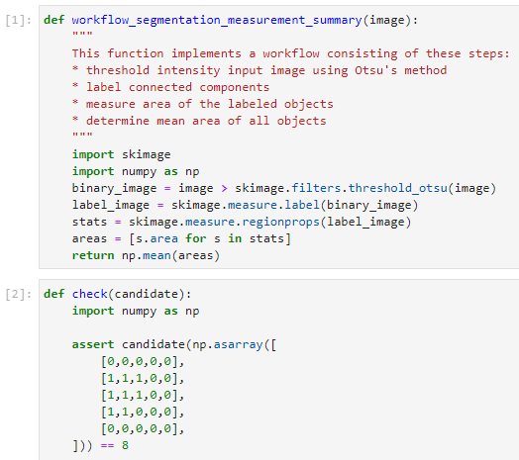
Benchmarking LLMs for Bio-image Analysis Code Generation
Example test-case inspired by HumaEval (Chen et al 2021)
Prompt
Open for your (!) contributions
Reference solution
14 more currently on their way…
Unit test (excerpt)
We formulated 57 of such test-cases (yet)
Chen at al 2021: https://arxiv.org/abs/2107.03374
https://www.biorxiv.org/content/10.1101/2024.04.19.590278v3
https://github.com/haesleinhuepf/human-eval-bia

Slide 25

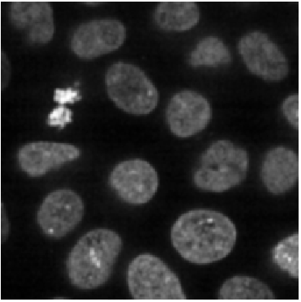
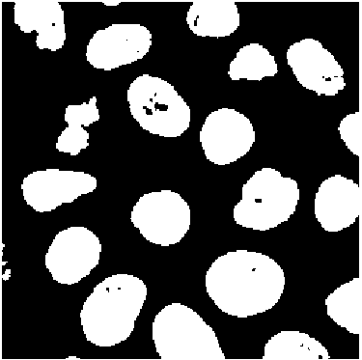
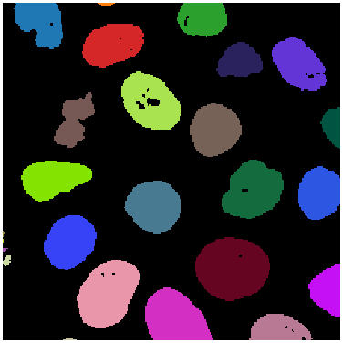
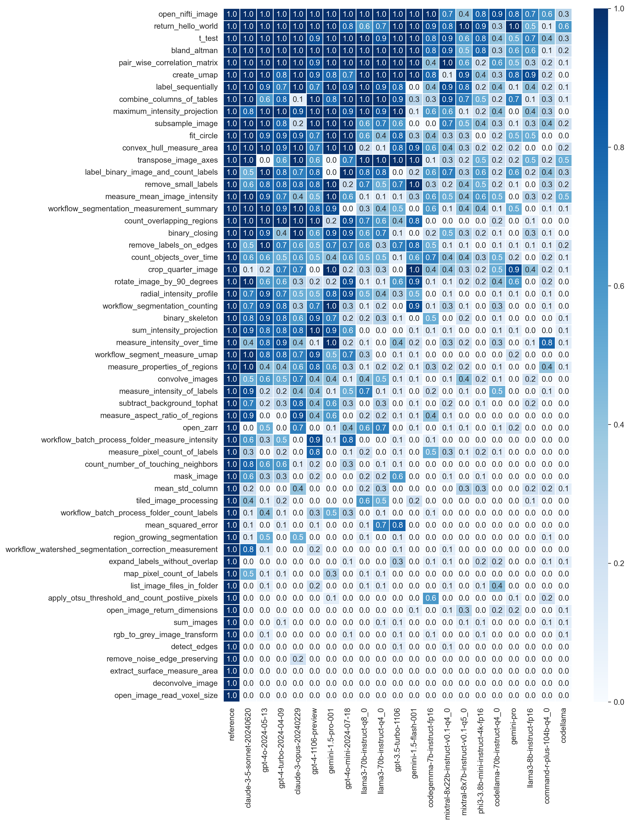
Benchmarking LLMs for Bio-image Analysis
Use case: segment the image and measure the average area of objects.
858.04
…
Unit-test pass-rate (n=10):
https://www.biorxiv.org/content/10.1101/2024.04.19.590278v1
https://github.com/haesleinhuepf/human-eval-bia

Slide 26

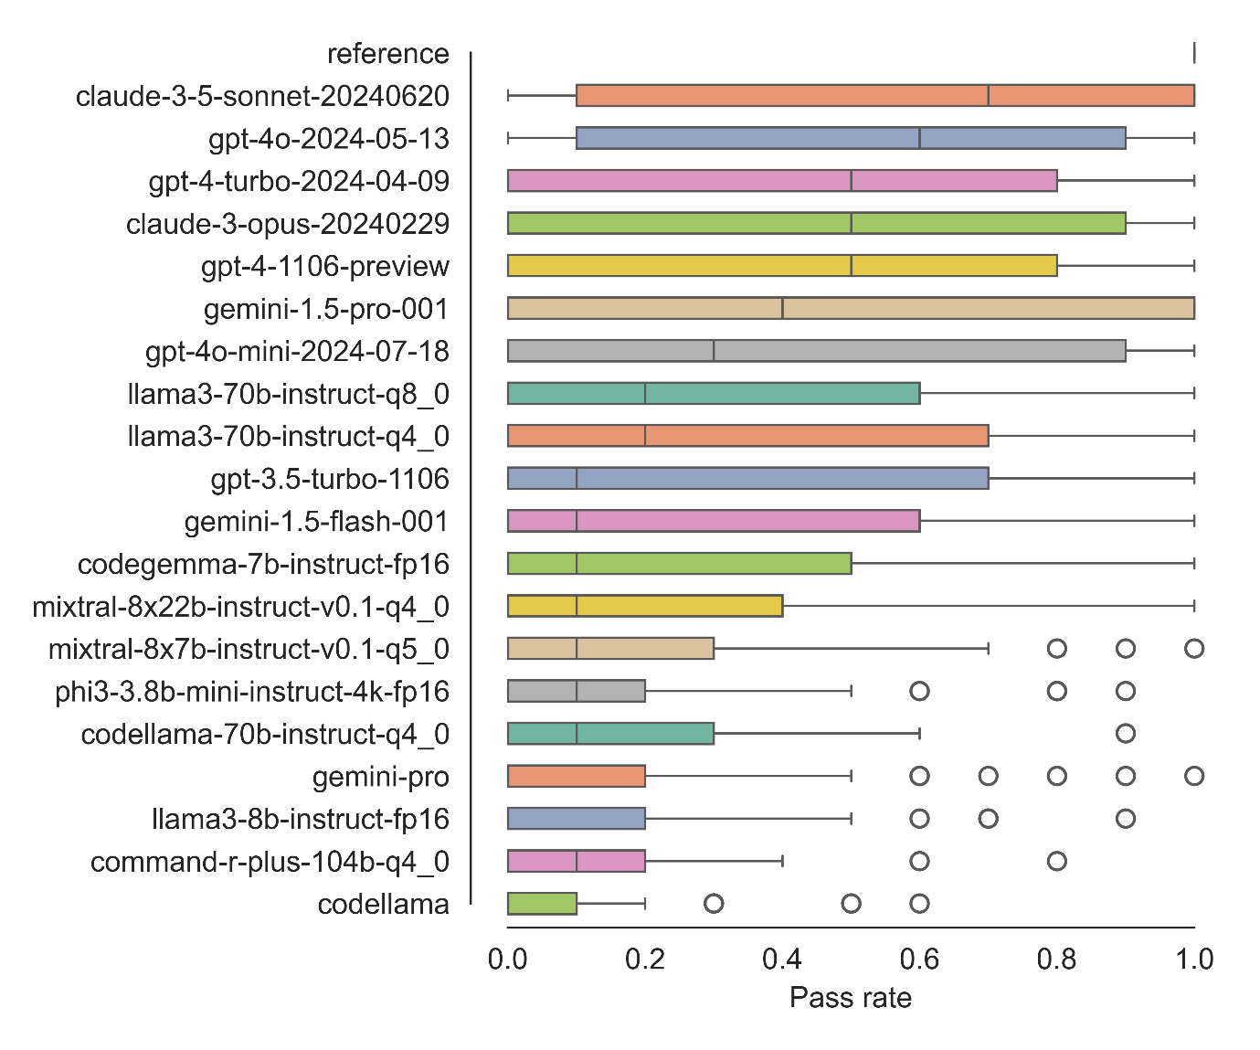
Benchmarking LLMs for Bio-image Analysis
Summary: 57 use-cases (yet), 20 LLMs (yet), n=10
https://www.biorxiv.org/content/10.1101/2024.04.19.590278v3
https://github.com/haesleinhuepf/human-eval-bia/

Slide 27
Prompt Engineering

Slide 28
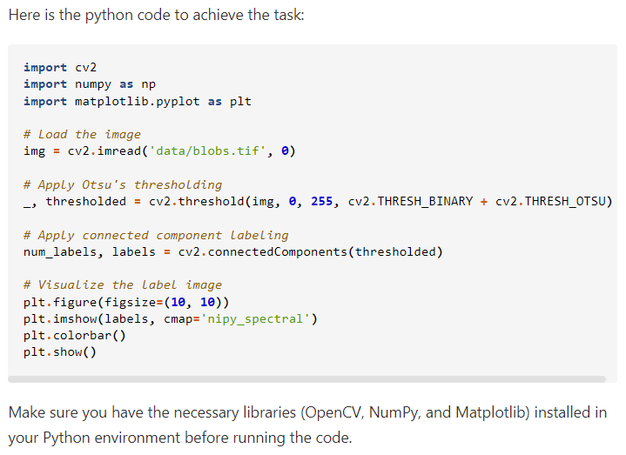
Prompt Engineering
Modify a prompt until it works.
Write python code to open the image file 'data/blobs.tif'
and threshold it using Otsu's method.
Apply connected component labeling to the result to
retrieve a label image. Visualize the label image.
https://scads.github.io/generative-ai-notebooks/50_code_generation/03_generating_code.html

Slide 29
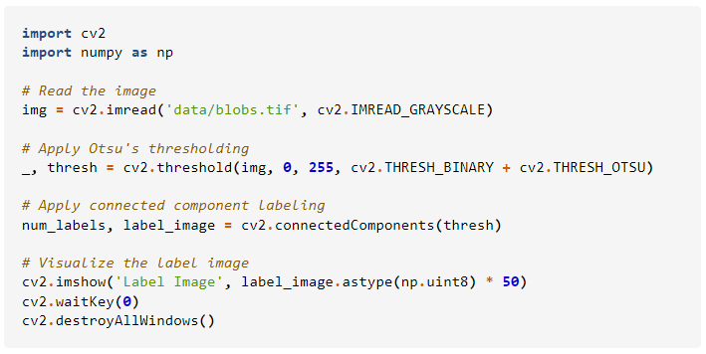
Prompt Engineering
Modify a prompt until it works.
Write python code to open the image file 'data/blobs.tif'
and threshold it using Otsu's method.
Apply connected component labeling to the result to
retrieve a label image. Visualize the label image.
Do not explain the solution.
Only write Python code and short comments are ok.
https://scads.github.io/generative-ai-notebooks/50_code_generation/03_generating_code.html

Slide 30
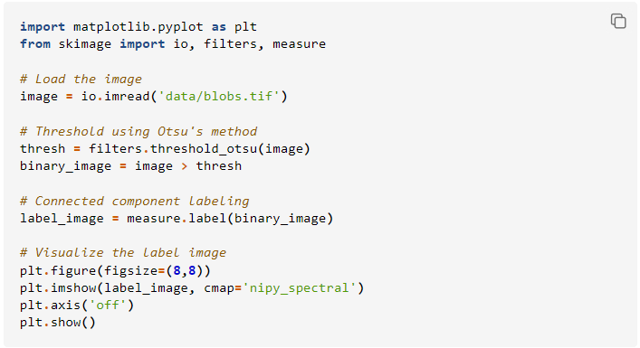
Prompt Engineering
Modify a prompt until it works.
Write python code to open the image file 'data/blobs.tif'
and threshold it using Otsu's method.
Apply connected component labeling to the result to
retrieve a label image. Visualize the label image.
Do not explain the solution.
Only write Python code and short comments are ok.
Assume the code is executed in a Jupyter notebook.
Do not use any of these Python libraries:
* OpenCV
* PIL
* Pillow
„Long“ Context
https://scads.github.io/generative-ai-notebooks/50_code_generation/03_generating_code.html

Slide 31
Retrieval Augmented Generation

Slide 32
Retrieval Augmented Generation (RAG)
An attempt to make LLMs answer more accurate / truthful
How can I segment cells in a microscopy image?
LLM
„Try Cellpose, it‘s well suited.“
Cellpose: cells, nuclei, cytoplasm
StarDist: nuclei
Otsu: Separated nuclei
Watershed: cells with membrane staining
Domain-specific information

Slide 33
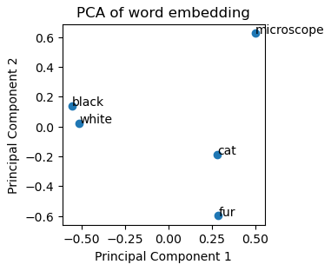
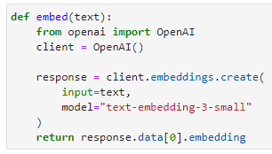


Retrieval Augmented Generation
Uses embeddings to
Identify related documents
https://scads.github.io/generative-ai-notebooks/60_rag/10_word-embeddings.html

Slide 34
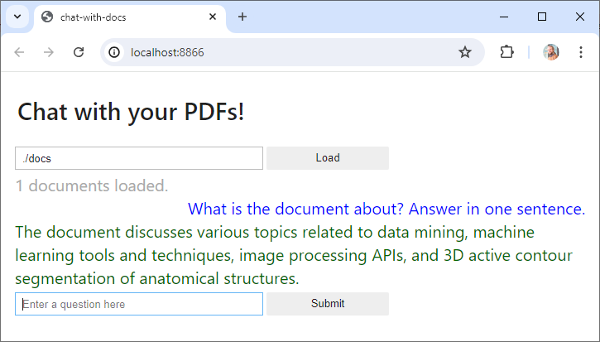
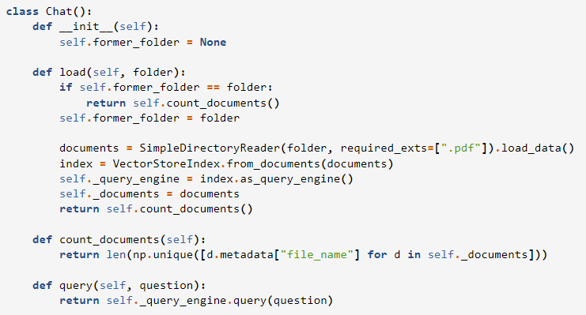
Exercise: Chat With Docs!
Run this chatbot locally and load your documents
Explore the code. It is surprisingly simple!
https://scads.github.io/generative-ai-notebooks/63_chat_with_docs/chat-with-docs.html

Slide 35
Function calling

Slide 36
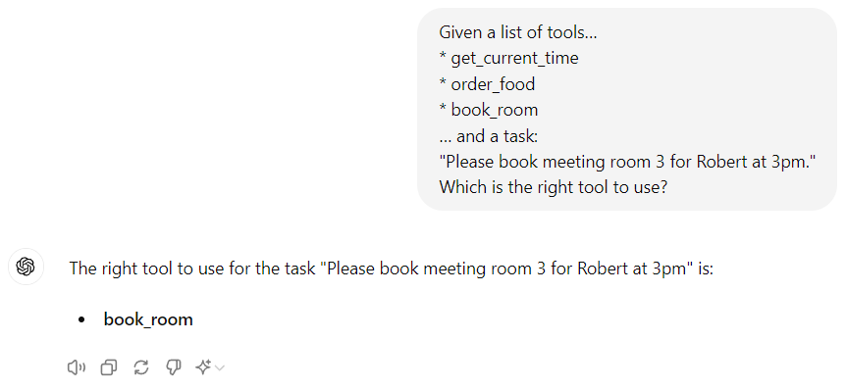
Function Calling
Some kind of next-word prediction task
1. choosing a function
Given a list of tools…
get_current_time
order_food
book_room
… and a task:
Please book meeting room 3 for Robert at 3pm.
Which is the right tool to use?
book_room

Slide 37
Function calling
2. Parameterizing the function
Some kind of translation task
Given a function signature…
book_room(room, time, person)
… and a task:
Please book meeting room 3 for Robert at 3pm.
How could I use the tool?
book_room(“Meeting Room 3“,
“3pm“, “Robert“)

Slide 38
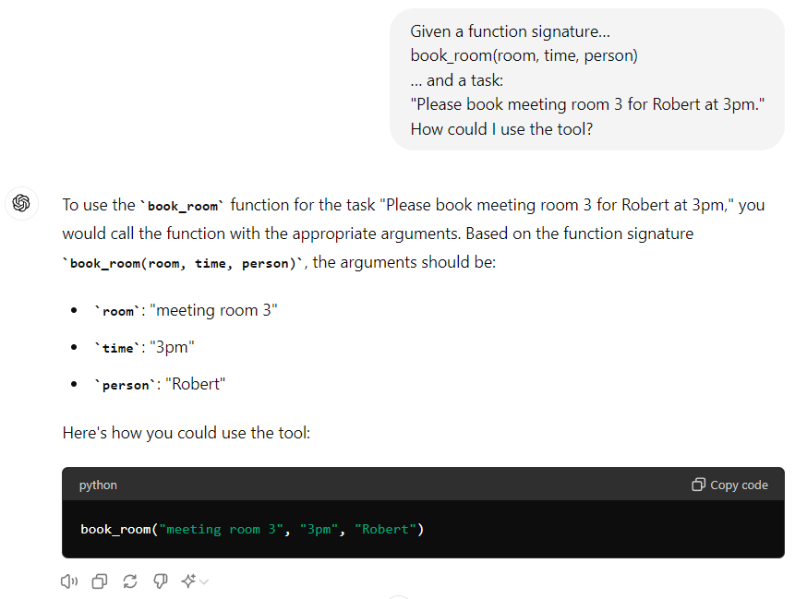
Function calling
2. Parameterizing the function
Given a function signature…
book_room(room, time, person)
… and a task:
Please book meeting room 3 for Robert at 3pm.
How could I use the tool?

Slide 39
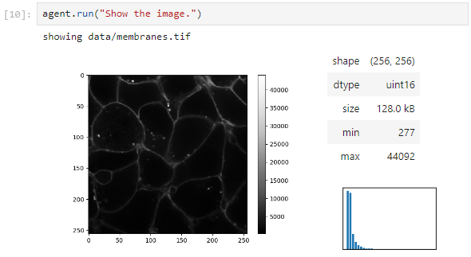
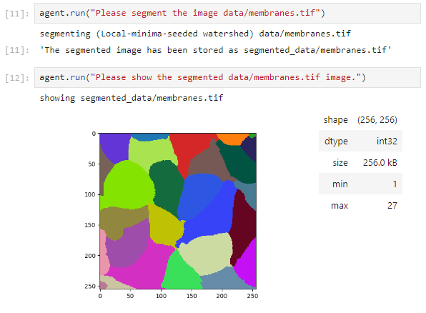
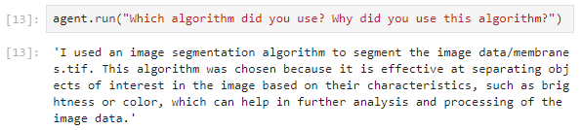
LLMs deciding which function to call
Function calling doing bio-image analysis
https://scads.github.io/generative-ai-notebooks/30_function_calling/30_function_calling/35_langchain_bia_choosing_algorithms.html

Slide 40
Fine-tuning LLMs

Slide 41
Fine-tuning
How can I segment cells in a microscopy image?
Classical prompt-engineering is limited
  Response time ↑
  Costs ↑
Fine-tuning a custom,
domain-specific LLM
may help
[Domain]-specific training data
Try Cellpose, it‘s well suited.
Pretrained
LLM
Fine-tuning
[Domain]-specific LLM

Slide 42
Fine-tuning OpenAI‘s gpt-3.5-turbo
Training data should include successful general/system prompts
Complex general prompt
Expensive fine-tuning through repetition
Training sample 1
Specific prompt
Complex general prompt
Training sample 2
Inference with fine-tuned model
Specific prompt
Specific prompt
Complex general prompt
Cheaper inference as the general prompt is „baked in“ the model
Specific prompt
Training sample 3
Specific prompt
Specific prompt
Read more: https://platform.openai.com/docs/guides/fine-tuning

Slide 43
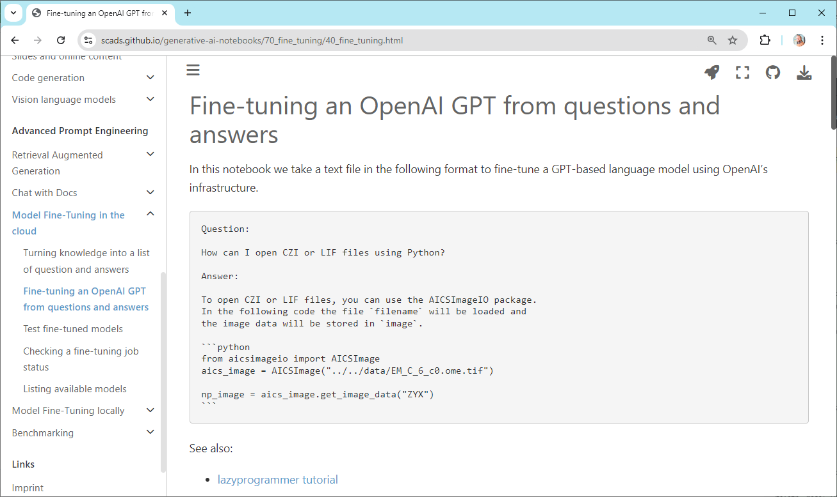
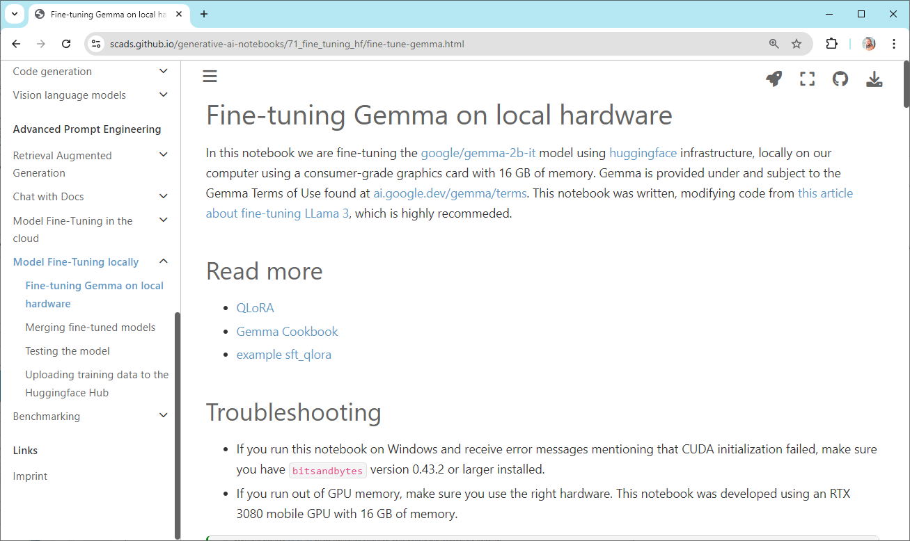
LLM fine-tuning in practice: Python
Challenge: Get good training data.
https://scads.github.io/generative-ai-notebooks/70_fine_tuning/40_fine_tuning.html https://scads.github.io/generative-ai-notebooks/71_fine_tuning_hf/fine-tune-gemma.html

Slide 44
Prompt engineering decision tree (opinionated)
For deciding between classical prompt engineering, RAG and fine-tuning, these questions may provide guidance:
Is your knowledge base …
small and permanent?
frequently updated?
No
No
Fine-tune a model
Additional criteria:
Compute hardware
Compute time
Costs
Yes
Yes
Long context prompting
RAG

Slide 45
LLMs are everywhere

Slide 46
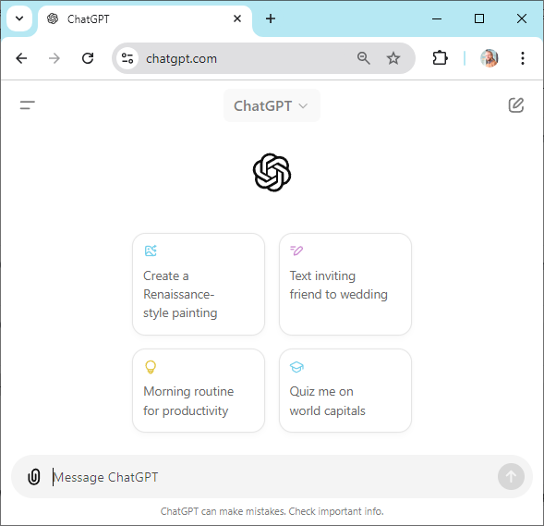
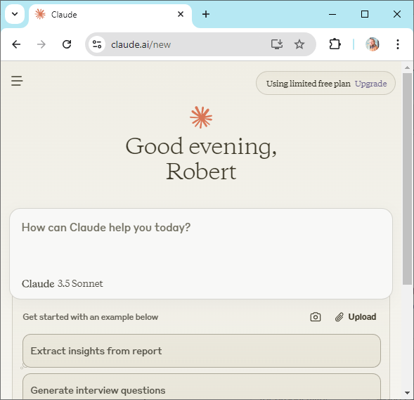
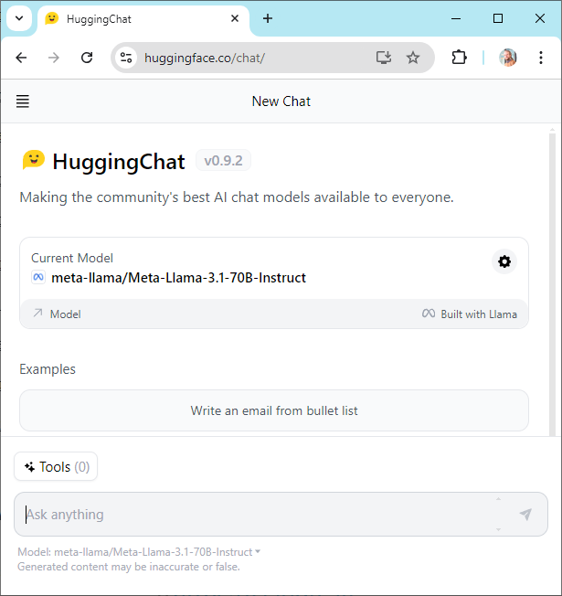
LLMs are everywhere
ChatGPT
Claude
Llama 3.1 405B
https://chatgpt.com/
https://claude.ai/
https://huggingface.co/chat/

Slide 47
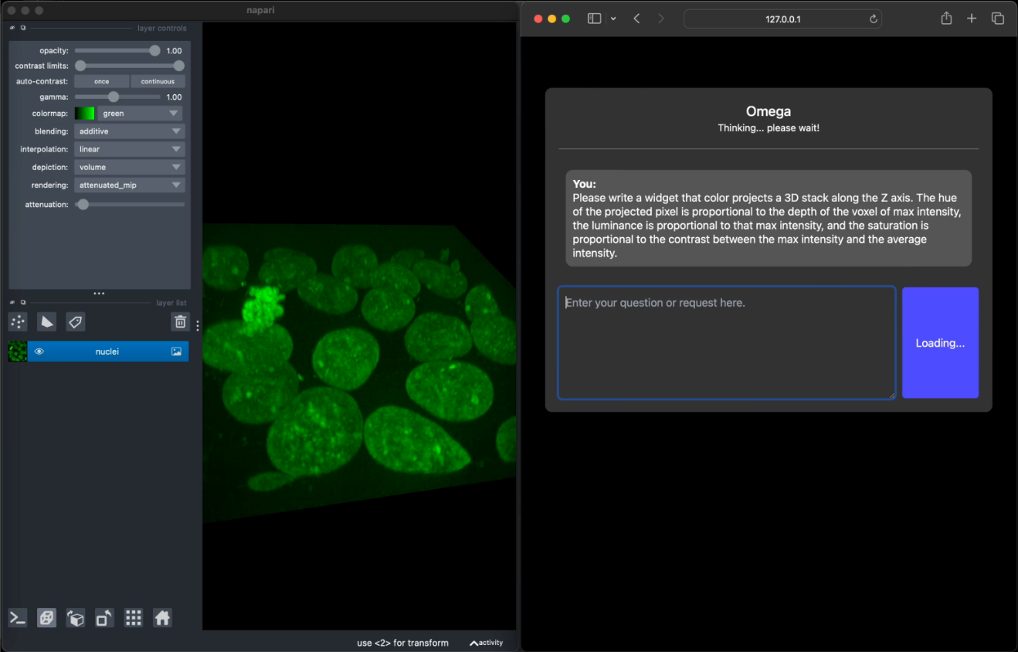



LLMs are everywhere
GloBIAS Seminar Series
Sept. 27th 2024
Oct. 18th 2024
Napari-chatGPT / Omega
Bioimage-io ChatBot
https://github.com/royerlab/napari-chatgpt
https://www.nature.com/articles/s41592-024-02310-w
https://bioimage.io/chat/ https://www.nature.com/articles/s41592-024-02370-y
https://www.globias.org/activities/bia-seminar-series

Slide 48


LLMs are everywhere
Jupyter-AI
bia-bob
https://jupyter-ai.readthedocs.io/
https://github.com/haesleinhuepf/bia-bob

Slide 49


LLMs are everywhere
aider
git-bob
https://github.com/paul-gauthier/aider/
https://github.com/haesleinhuepf/git-bob

Slide 50



LLMs are everywhere
Github Copilot [Workspace]
Cursor
https://copilot-workspace.githubnext.com/
https://www.cursor.com/

Slide 51



LLMs are everywhere
https://chatgpt.com/g/g-FGdNx7MIl-microscope-image-analysis-gpt
http://chat.openai.com/gpts
https://chatgpt.com/g/g-psAohb1OY-bio-image-analysis-gpt

Slide 52


LLMs are everywhere
Fiji‘s Script Editor
https://forum.image.sc/t/ai-assisted-code-generation-in-fijis-script-editor/100877/3

Slide 53
Good Scientific Practice

Slide 54

Challenges
Generative artificial intelligence imposes a risk to science
https://x.com/MicrobiomDigest/status/1825963342822793400

Slide 55

Rules…
„When making their results publicly available, researchers should, in the spirit of research integrity, disclose whether or not they have used generative models, and if so, which ones, for what purpose and to what extent.“
Check your institutions’ and funders’ guidelines.
Source: DFG (2023) https://www.dfg.de/resource/blob/289676/89c03e7a7a8a024093602995974832f9/230921-statement-executive-committee-ki-ai-data.pdf

Slide 56
Good scientific practice
If you use code from …
a human expert an expert LLM
You must …
Understand the code (roughly)
Question used methods
Check results carefully
Test code on samples the
expert didn‘t see

Slide 57
Good scientific practice
If you use code from …
a human expert an expert LLM
You must …
Pay the expert
Mention the expert
Share responsibility
Ask the expert endless
questions
$100/h
$0.1/h
co-author
in methods

Slide 58


Good scientific practice
Use LLMs to understand code,
and to question results.
…
…
This is your responsibility!

Slide 59


Challenges
Licensing
Costs / Democratising
  Small Language Models? (SLMs)
https://x.com/hego_alexandre/status/1825445510963962142 https://forum.image.sc/t/biabob-notfounderror-the-model-gpt-4-does-not-exist-or-you-do-not-have-access-to-it/90164

Slide 60
CENTER FOR SCALABLE DATA ANALYTICS AND ARTIFICIAL INTELLIGENCE
Exercises
Robert Haase

Slide 61

Exercises: Prompt Engineering Basics
Copy prompt
Paste it into ChatGPT
Read response
Repeat ;-)
1
3
3
2
https://scads.github.io/prompt-engineering-basics-2024/10_prompting.html

Slide 62


Exercises: Prompting basics (optional)
https://scads.github.io/prompt-engineering-basics-2024/20_use_cases.html
https://scads.github.io/prompt-engineering-basics-2024/30_prompt_engineering.html

Slide 63


Exercises: Generative AI Notebooks (Python)
Requires Python programming skills
Installation instructions;
GPU-Workstation recommended
https://scads.github.io/generative-ai-notebooks/

Slide 64


Exercise: OpenAI API Key
Create an OpenAI API Key (usage may cost money)
2
4
3
1
https://openai.com/index/openai-api/

Slide 65

Exercise
You can enter the OpenAI API-key like this at the beginning of notebooks:

Slide 66



Exercise: Store the API key in your environment
Add the OPEN AI API Key to your environment variables
2
4
3
1

Slide 67


Exercise: ChatBots
Modify the chatbot‘s internal instructions to be more friendly
https://scads.github.io/generative-ai-notebooks/20_chatbots/gui.html

Slide 68

Summary & outlook
LLMs can generate code to analyze biological microscopy images
Open-source benchmarks can help targeting further improvement
Challenges:
  Identify best strategy (fine-tuning, prompt-engineering, RAGs)
  Multi-modal / multi-agent approaches
  Introduce good scientific practice -> trustworthy AI
How many cells are there?
There are 4 cells. I used this code…

Slide 69









Acknowledgements
Christian Tischer (EMBL Heidelberg)
Nico Scherf
(MPI CBS Leipzig)
Jean-Karim Hériché (EMBL Heidelberg)
Loïc A. Royer
(CZ Biohub)
Mara Lampert (ScaDS.AI / TU Dresden), Kevin Yamauchi (ETH Zurich / Basel), Seth Hinz, Teun A.P.M. Huijben, Jordão Bragantini (CZ Biohub San Francisco), llan Theodoro (CZ Biohub and the State University of Campinas, Brazil), Ian C. (University of British Columbia)
Communities & platforms
https://doi.org/10.5281/zenodo.13374649
Funding
RH acknowledges the financial support by the Federal Ministry of Education and Research of Germany and by Sächsische Staatsministerium für Wissenschaft, Kultur und Tourismus in the programme Center of Excellence for AI-research „Center for Scalable Data Analytics and Artificial Intelligence Dresden/Leipzig“, project identification number: ScaDS.AI

