Slide 1



Latimer Core Workshop
BETA Version!
A practical overview of the Latimer Core data standard
SPNHC-TDWG 2024 | 4th September 2024
Okinawa Convention Centre, Japan
Laurence Livermore Science Digital Programme Manager, NHM
Matt Woodburn Head of Science Data Engineering, NHM
Ben Norton Senior Data Scientist, EPR
Presenter ORCID: 0000-0002-7341-1842
Presentation/workshop contents: 10.5281/zenodo.13354147
Funding Source: HORIZON-INFRA-2023-DEV-01
Grant Number: 101130121
Notes:
Thank you for joining me today - this is the first time that we have run a Latimer Core Workshop so it might be a little rough around the edges!
All workshop links and content are available in a Zenodo Lesson Dataset, so if you want to continue to experiment or show your colleagues after the conference then you are able to do so :)

Slide 2
Introduction
Workshop structure:
Objectives & outcomes
Standards work in DiSSCo Transition
Overview of Latimer Core
Applications of Latimer Core
Orientation and exercises
Discussion & feedback
Resources and acknowledgements
Notes:
Today I’ll give an overview of Latimer Core and its development, followed by some existing and planned applications, then we will jump into a hands on orientation and exercise session, then wrap up with a short discussion and feedback session.

Slide 3
1. Objectives & outcomes
Understand how Latimer Core (LtC) can be used and how you might use it
Become familiar with the LtC data structure
Create your own LtC dataset that you can continue to edit after the workshop
Give feedback on how we can support you implement new standards for your work
Understand how you can participate in standards development
Notes:
By the end of the workshop I am hoping you will all:
Understand how Latimer Core can be used and how you might use it
Become familiar with the Latimer Core data structure
Create your own Latimer Core dataset that you can continue to edit after the workshop
Give feedback on how we can support you implement new standards for your work
Understand how you can participate in standards development

Slide 4
2. Standards work in DiSSCo Transition
“DiSSCo aims to bring together natural science collections from 175 museums, botanical gardens, universities and research institutes across 23 countries in a distributed infrastructure that makes these collections physically and digitally open and accessible for all forms of research and innovation.”
The Distributed System of Scientific Collections (DiSSCo) is a pan-European Research Infrastructure (RI) initiative
DiSSCo Transition - an EC-funded project that supports the establishment of a distributed infrastrastructure
Part of DiSSCo Transition’s work is support collaboration and development of biodiversity data standards including OpenDS, Latimer Core and MIDS
Koureas D et al (2024) DiSSCo Transition Abridged Grant Proposal. Research Ideas and Outcomes 10: e118241. DOI: 10.3897/rio.10.e118241
Funding Source: HORIZON-INFRA-2023-DEV-01
Grant Number: 101130121
Notes:
We were able to run this workshop thanks to the DiSSCo Transition project.
Distributed System of Scientific Collections (DiSSCo) is a pan-European Research Infrastructure (RI) initiative
DiSSCo aims to bring together natural science collections from 175 museums, botanical gardens, universities and research institutes across 23 countries in a distributed infrastructure that makes these collections physically and digitally open and accessible for all forms of research and innovation.
DiSSCo Transition - an EC-funded project that supports the establishment of a distributed infrastrastructure
Part of DiSSCo Transition’s work is support collaboration and development of biodiversity data standards including OpenDS, Latimer Core and MIDS

Slide 5
3. Overview of Latimer Core

Slide 6

Our utopian vision:
A global dataset of fully digitised natural science collection objects
… versus reality:
Digitised specimens are still just the tip of the iceberg.
Collections data that are published are commonly high-level, sparse, text-based, and lack standardisation.
A standard approach is needed to describing undigitised collections, making them discoverable, and linking them to digitised specimens.
Notes:
Digitization and publishing of museum specimen data is happening worldwide. While many museums are actively engaged in this process, others have yet to begin. Information about what collections hold is urgently needed by many stakeholders including the collections themselves, funders, researchers, policy-makers, industry, and educators. At higher levels, museums can start by sharing what they know about their holdings, long before each item has its own record. But, if we are going to aggregate this “metadata” information from all natural science collections, the data need to be “standard.” If everyone shared in their own format, we could not compare / or add up what we have, for example. To share this data in its most effective format, it needs to be standardized. But where does this standard come from? Who decides what the fields (terms, elements, properties) are going to be? The Biodiversity Information Standards Group formerly known as TDWG (the International Taxonomic Databases Working Group), develops many of the standards currently used to share biodiversity data. Some of you may be familiar with Darwin Core, or ABCD, for example.
The TDWG CD Task Group is actively working to develop a standard for the express purpose of making it possible to share this type of museum data. With this standard, many groups can share their collections data in their own sites, and across sites.
Once all collections are fully digitized, that is, every physical object in a collection, has a digital record online for anyone to access – then we can add up what we have worldwide. We would know all the taxonomic groups collected, and the geographic ranges covered or missing. However, it’s going to be a long time before we have individual-object-level data for every specimen. We need more higher-level information now, in order to help us mobilize more specimen data, for more objects, in a strategic, coordinated manner.
We need “metadata” about collections to do this.

Slide 7
Why describe a collection?
Digitisation Strategy
  Time and cost forecasting
  Progress monitoring
Collections Discovery
  Loans and visits
  Virtual access & digitisation on demand
Collections Management
  Conservation
  Resource allocation
  Collections moves
  Risk management
Collections Inventory
  Reporting
  Disaster prevention & recovery
  Succession planning
Linkage
  Digital resources
  Virtual collections
Impact Tracking & Engagement
  Citation
  Attribution
  Public
  Funders & donors
Collections Development Strategy
  Strengths and weaknesses
  Prioritisation
Institutional Information
  Contacts
  Resource and expertise
Notes:
Source slide: CDLandscapeIntro_MWoodburn_DPaul_SYNTHvirtualWorkshop_2020-04-06_animations: SLIDE 3
Text from similar slide (BioDiversityNext):
What could structured, standardised collection descriptions actually achieve? Well, the answer appears to be really quite a lot. From the use cases and the conversations that the group has analysed, they can help to support digitisation strategy, including planning, progress monitoring and impact tracking. They’re obviously useful for collections discovery, supporting management of loans and visits, as well as new efforts to offer virtual access and digitisation on demand. Within institutions, collections breakdown can provide a more informed, data-driven approach to collections management, and they also provide a sustainable collections inventory.
And it continues. Collection descriptions can be used to link groups of specimens to related digital resources, and to create virtual collections that span institutions. They can be use for tracking citation and attribution, and play a role in public engagement and attracting funders and donors. They can be used to guide collections development strategy, within and across institutions, and also link to institutional information and contacts.

Slide 8
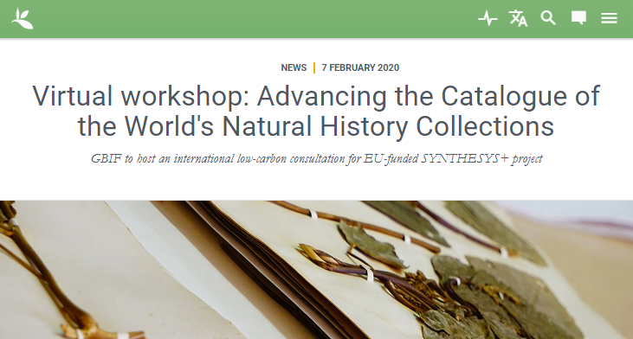
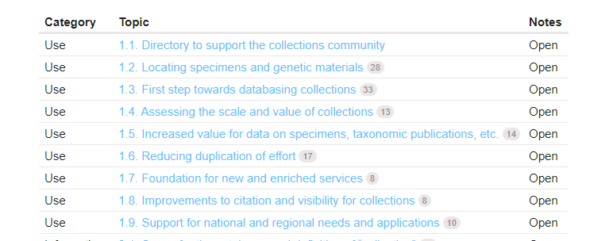
Challenges
Lack of standardisation - different data models, schemas and standards
Interoperability - siloed datasets that are not machine-discoverable
Duplication of effort - providing data to multiple surveys and platforms
Time - people have limited time available to generate and provide the data
Incentivisation - tangible benefits needed for people and collections to provide data
Sustainability - maintaining multiple platforms and datasets
Notes:
But when we talk about these use cases across the wider collection communities, a common set of challenges tend to emerge.
There’s a lack of standardization across platforms and data sets, using different data models, schemas and standards. This limits interoperability between those datasets and their ability to be easily discovered and queried using software tools and interfaces.
It also means duplication of effort, as institutions are asked to provide data in different shapes to multiple platforms. And it takes time and effort to generate and provide that data, and we’re all busy people who only have so much time to spare.
There are also challenges in incentivizing people to provide the data – what tangible benefit will they gain from investing that time and effort that they could be spending on other things? And also, there’s the issue of sustainability – each separate initiative requires ongoing investment of resources and funding to maintain it and keep it updated, and there’s a limited pot of those to go round.

Slide 9
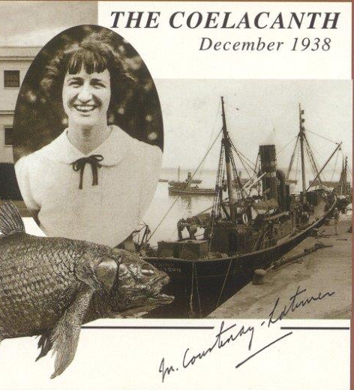





What is Latimer Core?
A data standard for collection descriptions​
Applies to a wide range of collection description use cases, from describing the overall collections holdings of an institution to the contents of a single drawer of material​
Supports the representation and discovery of natural science collections, by structuring data about the groups of objects that those collections and their subcomponents encompass​
Enables the modelling of the often complicated relationships between these groups of objects​
​Named for Marjorie Courtenay-Latimer (1907-2004)​, a museum curator, and bringer of the coelacanth to the attention of the world
Postcard commemorating the discovery of the coelacanth by Marjorie Courtenay-Latimer in December 1938
Public Domain image
See: https://github.com/tdwg/cd/wiki​
Notes:
Latimer Core is a data standard for collection descriptions. There are a number of standards already out there, including Darwin Core and ABCD, which can be used for describing individual specimens and collection objects, but Latimer Core is about describing those objects not individually but as a group. This may be because specimen level digitisation takes time, so we don’t yet have records at a specimen level, but still want some way of describing and quantifying the collections at a higher level in the meantime. That higher level may be as granular as the objects found within a single drawer, or as broad as the overall collections holding of an institution. There are also a variety of other use cases, for example creating thematic collections, or adding richer text narratives to historic and notable collections. So Latimer Core is intended to support these different angles on the representation and discovery of collections, and also provide a method for modelling the often complex interactions between them.
For those of you who are thinking “why Latimer Core?”, I should explain that the standard is named after Marjorie Courtenay-Latimer. She was curator at the East London Museum in South Africa, and the person who brought the continued existence of the coelacanth to the attention of the world back in 1938.

Slide 10
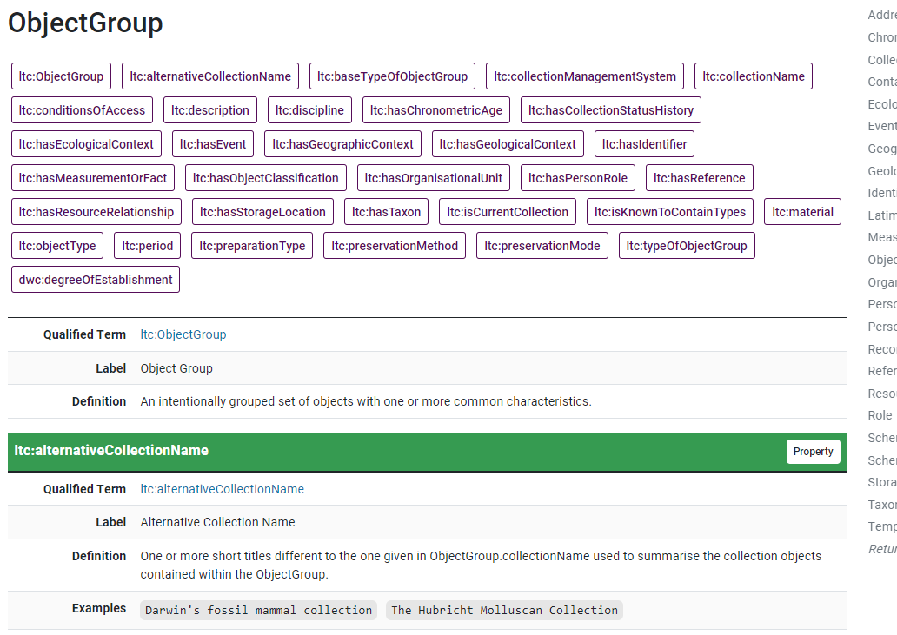
What is a data standard?
A common set of data ‘terms’ with definitions, and (optionally) a set of rules for how the data are structured
Allows us to
  exchange data in a common format
  interlink, combine and query across different datasets
  avoid reinventing the wheel when developing our own data structures

Slide 11
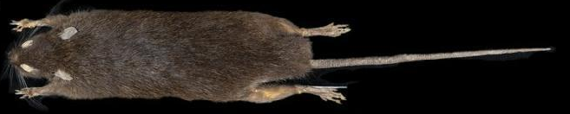
History of Latimer Core
(and how TDWG standards are developed)
2008
Natural Collection Descriptions (NCD) draft standard
2016
Collections Descriptions Interest Group Reformed
2018-2022
Construction period
2023 – 2024
Open community review
Period of dormancy…
2018
Collection Descriptions Data Standard Task Group Formed
2022-2023
TDWG internal expert review
2024
Ratification
Notes:
Before we get back into the standard, a quick run-though of where Latimer Core came from and where we are now. The precursor to Latimer Core was the NCD standard, way back in 2008, which some in this room will have been involved in. For various reasons, that didn’t get formally ratified and there was limited uptake as a result. After a bit of a hiatus, conversations around TDWG conferences in 2016 led to the rebooting of the Collection Descriptions Interest Group, which showed there was still a need for something in this space. In 2018, a task group was formed to develop the new standard, and then followed 4 years of working meetings, workshops, virtual barbecues, term definitions and documentation writing, until we finally got to the point a few months ago of being able to submit Latimer Core to TDWG as a draft standard for review. We’re now in the middle of that review, and will hopefully be in a position to kick off a community review early next year and, fingers crossed, push this through to being a formally ratified standard.​

Slide 12
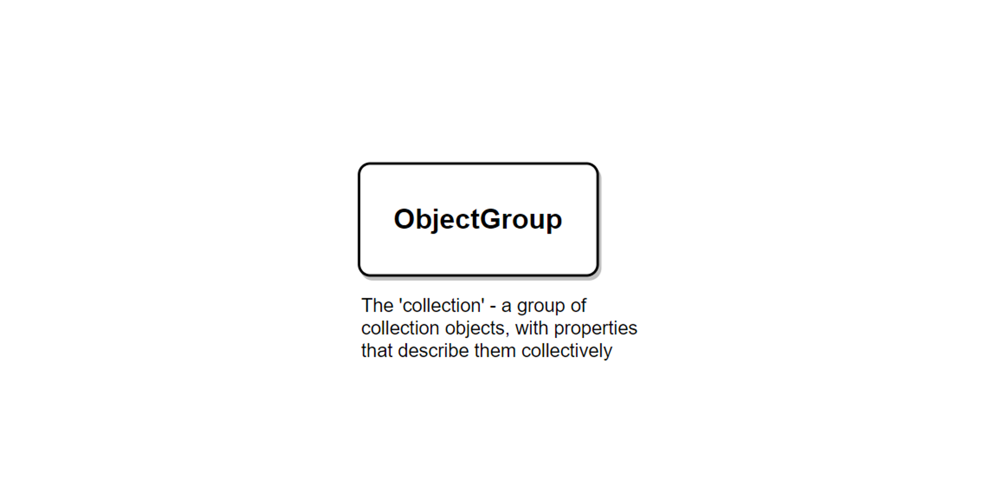
Core concept: the ObjectGroup
Notes:
The central concept to get your head around in Latimer Core is the ObjectGroup. As the name suggests, this class represents the concept of the collection – but in the sense that, depending on the use case, it could represent be any group of more than one collection objects, from an entire museum’s collection to a few objects in a box or drawer.

Slide 13
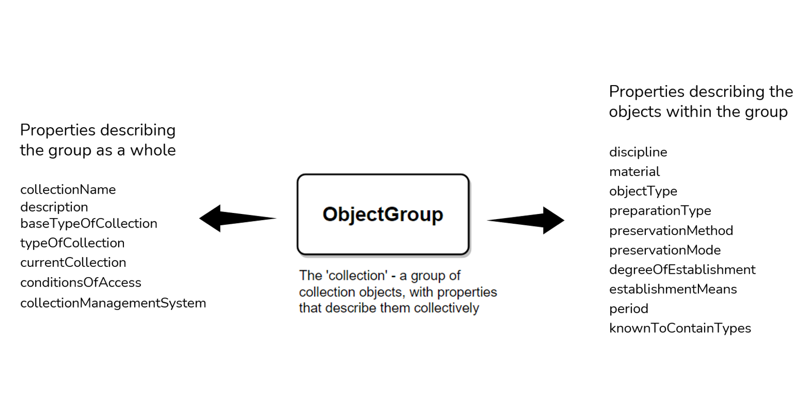
ObjectGroup properties
Notes:
The ObjectGroup concept is represented by a class that has a number of properties. These can be broadly divided into those which describe the group as a whole, such as a name, description, and conditions of access, and those which describe the properties of the objects within the group – for example the type of object and preservation method.

Slide 14
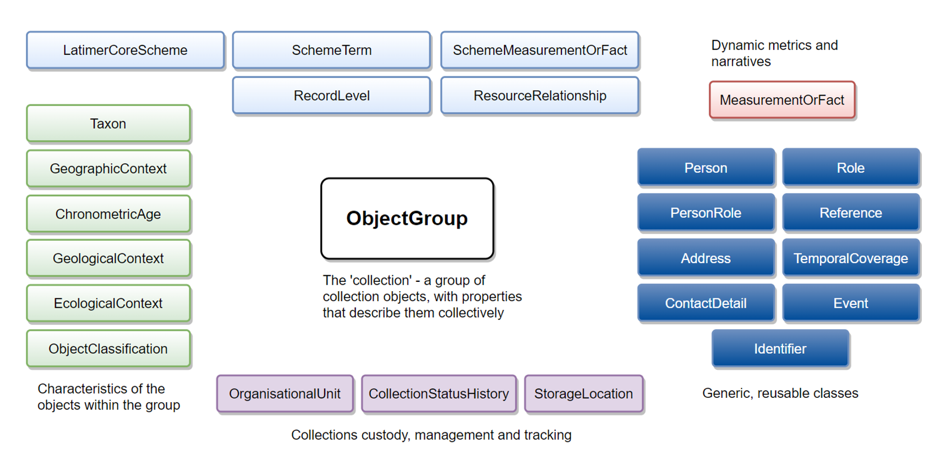
Overview of the full standard
Notes:
Positioning that within the wider standard, we’re adding a richer set of descriptors in the form of a set of classes for describing the more complex characteristics of the objects in the ObjectGroup, such as the taxonomy and the stratigraphy. We have some classes for representing the custodianship and management of the ObjectGroup, including OrganisationalUnit which can be used to represent the institution and/or subunits within that institution. There’s a set of more generic, re-usable classes that represent some common concepts such as people, identifiers and events. We’ve also pinched the MeasurementOrFact class that’s present in Darwin Core and ABCD, in order to support flexible textual narratives and quantitative metrics. And finally, there are some classes that are related to structuring and describing the data in the Latimer Core record itself.

Slide 15


When and how can you use Latimer Core?
When?
How?
Whenever you need to store structured data about groups of collection objects.
Whenever you need to think about groups of objects, and the information and processes around them.
Familiarise with the concepts in the standard
Think of a use case
Define a Latimer Core Scheme
Consider what tool you might need to record the data
Notes:
Whenever you need to store structured data about groups of collection objects. This could be for the purpose of providing information to GRSciColl or a national collections survey, or a range of the use cases mentioned earlier in the presentation.
Whenever you need to think about groups of objects, and the information and processes around them. Even if you’re not using Latimer Core directly, the concepts in the model be useful for thinking about groups of objects (disciplinary collections, thematic collections, lots, contents of a drawer…) and their related concepts (collectors, taxonomy, storage locations, counts…) in a joined up way.
Familiarise with the concepts in the standard – what ObjectGroups can be, how they interact, how to describe them using LtC properties
Think of a use case that you have for recording information about groups of objects, recording them as data, and potentially sharing that data with others
Define that use case as a Latimer Core Scheme (a subset of the overall standard that best represents the use case)
Consider what tool you might need to record the data. Simpler use cases should be manageable in a spreadsheet, more complex and structured use cases might be better off in some form of database.
For help and guidance on any of this, you can contact the TDWG Latimer Core Maintenance Group.

Slide 16
4. Applications of Latimer Core

Slide 17
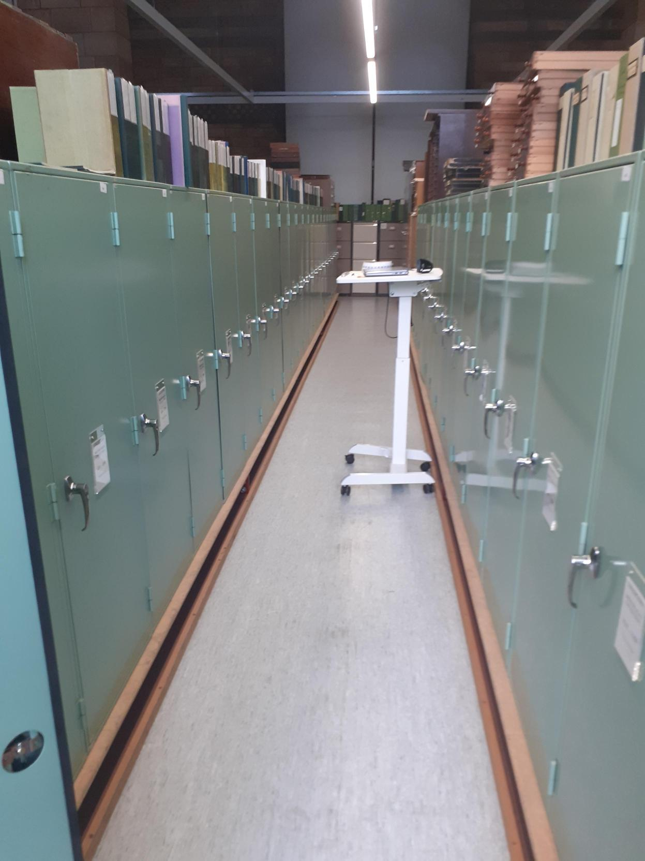
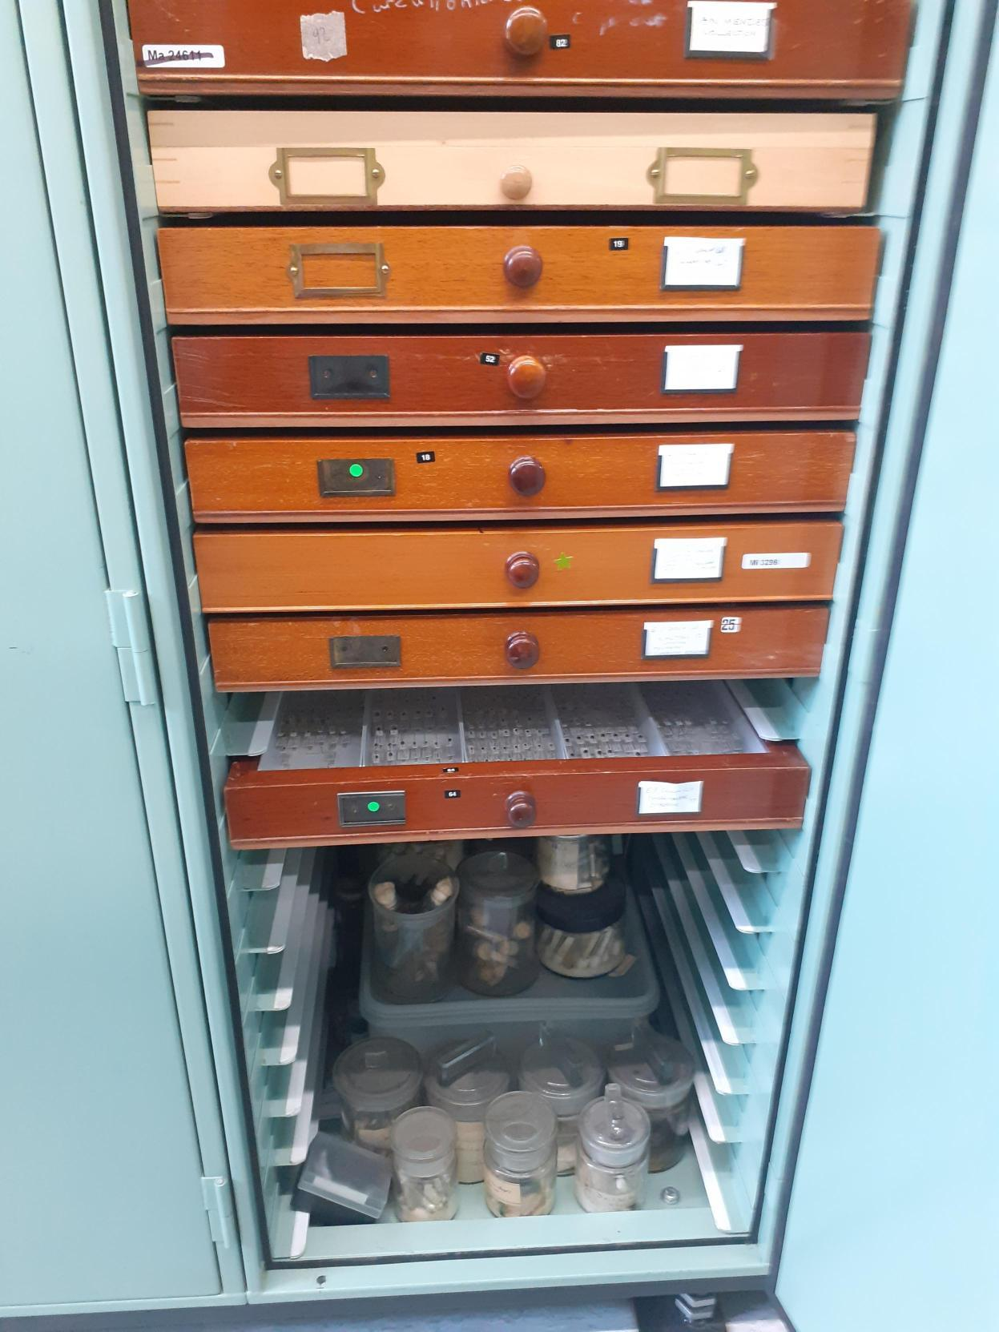
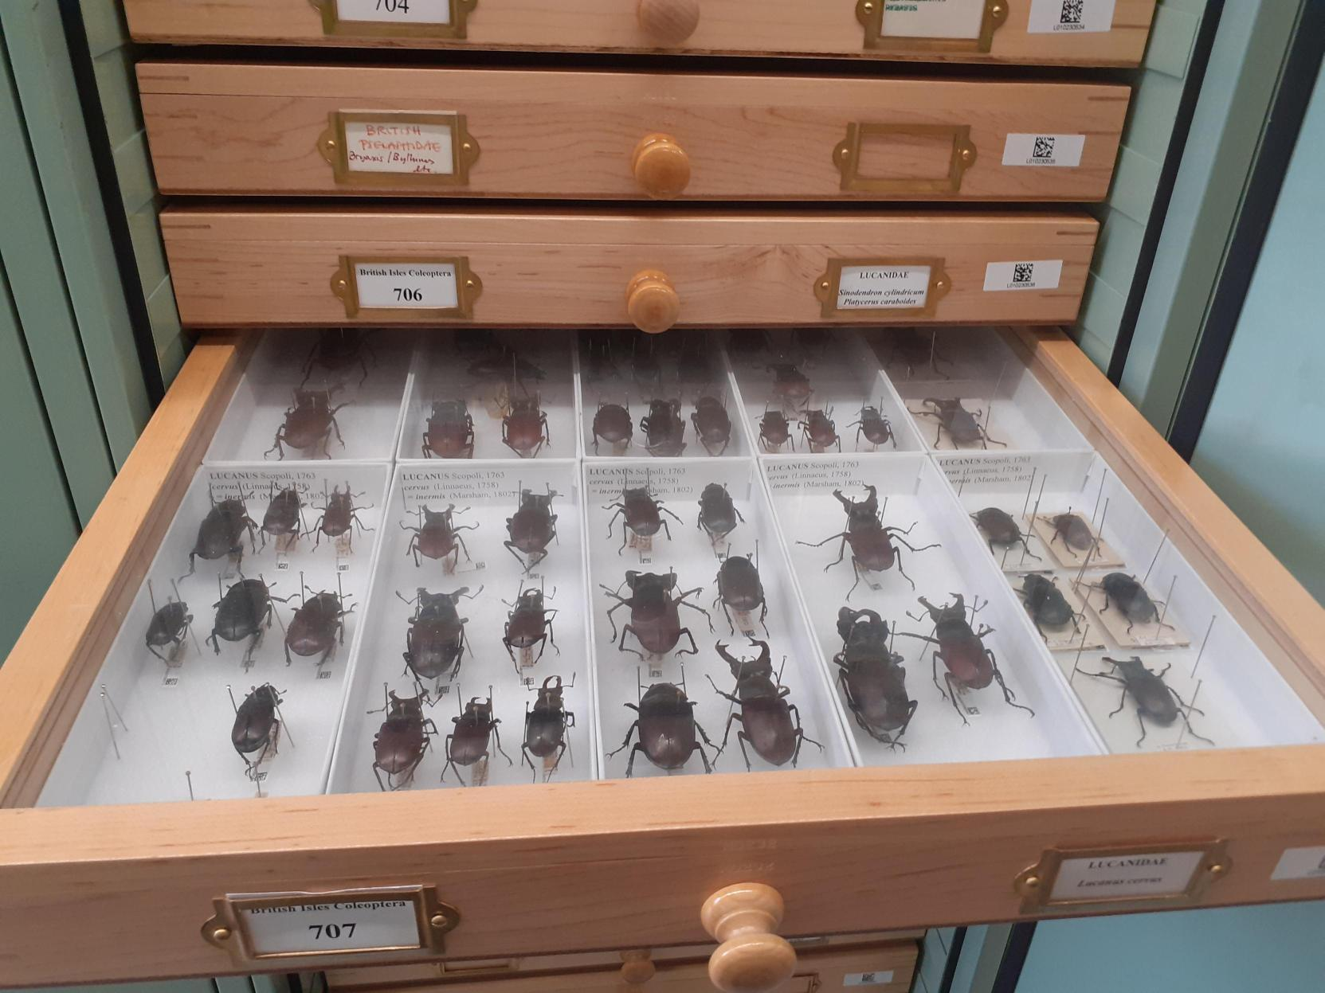
NHM Unlocked
Large scale collections move
38 million specimens scheduled to move, 28 million to a new building
In-scope collections largely not yet digitised to object level
Represented as ~210,000 ObjectGroup records, each representing the contents of a drawer, shelf, tank etc
Associated data including custodianship, storage location, object types, special conditions/handling requirements, and metrics on occupancy and condition
Used for:
  Modelling space needed in new locations
  Planning and tracking move preparation activities
Notes:
NHM Unlocked is our programme to build new off-site collections storage and undertake a large collection move of ~38 million - both of collections from our main South Kensington site to the new storage site, and the movement of millions of specimens internally.
Most of the collections that are in-scope are not yet digitised to object level
We are using storing data on around 210,000 ObjectGroup records which represent the contents of a drawer, shelf, tank etc
Data associated with these ObjectGroups include custodianship, storage location, object types, special conditions/handling requirements, and metrics on occupancy and condition
This data is being used for modelling space needed in new locations and planning and tracking move preparation activities.

Slide 18
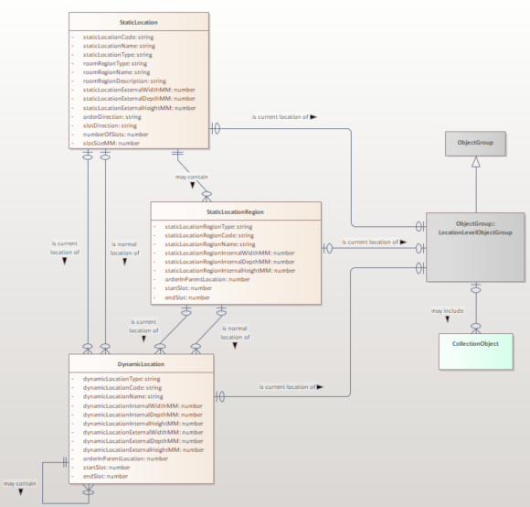
RECODE
Collections management system implementation
NHM is implementing a new CMS through configuring a Content Services Platform (CSP) solution. This includes developing a new set of data models and related functionality.
In this work, Latimer Core concepts are being explored for various object group use cases, including:
Drawer/shelf level object group management (as precursor to full digitisation), incorporating data from NHM Unlocked
Drawer-level digitisation and imaging
Collection indexes
Collection-level descriptions and narratives
Collected material from collecting events
Notes:
There have been a few talks about RECODE, our project to create a new Collections Management System.
We are intending on implementing Latimer Core for Object Group management to store structured data for multiple objects in standardised storage locations e.g. drawers or shelves - this builds on the work from NHM Unlocked. To associate and describe collection indexes and data like acquisition or collecting events, to provide accessible and searchable high-level descriptions of collections.

Slide 19
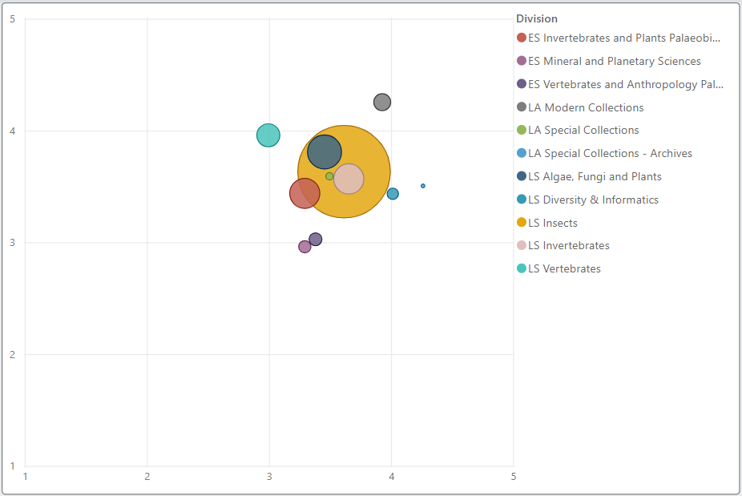
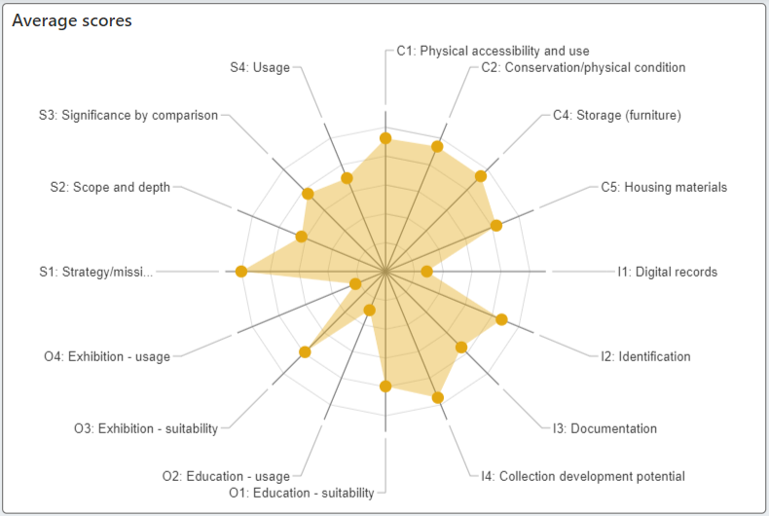
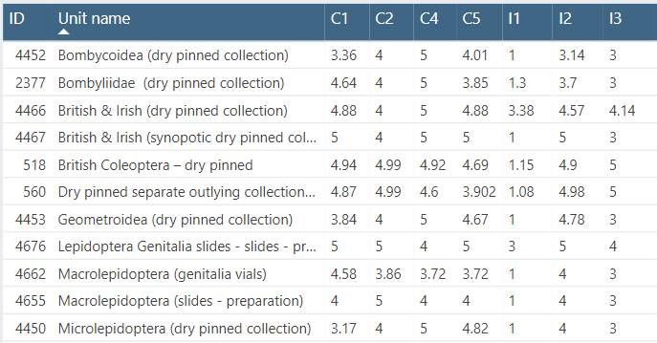
Join the Dots
Collections assessment and demographics
The Join the Dots dataset spans the whole of the NHM’s life sciences, earth sciences and library and archives collections.
  Broken down into ~3000 ObjectGroups by discipline, object type, storage room and taxonomy and/or stratigraphy
  Annotated with object counts and curatorial assessment scores, updated annually
Used for strategic and operational collections planning, tracking impact and change over time, and collections reporting/discovery
Work in progress to align with and publish as Latimer Core, and develop a Latimer Core compliant user interface
Notes:
Join the Dots is our annual collections assessment and data capture exercise (based on a similar process from the Smithsonian).
This is a very high-level curatorial assessment used for strategic and operation planning. While there is some overlap with Latimer Core, this audit was implemented prior to completion of the Latimer Core standard but we intending on aligning this with Latimer Core.

Slide 20
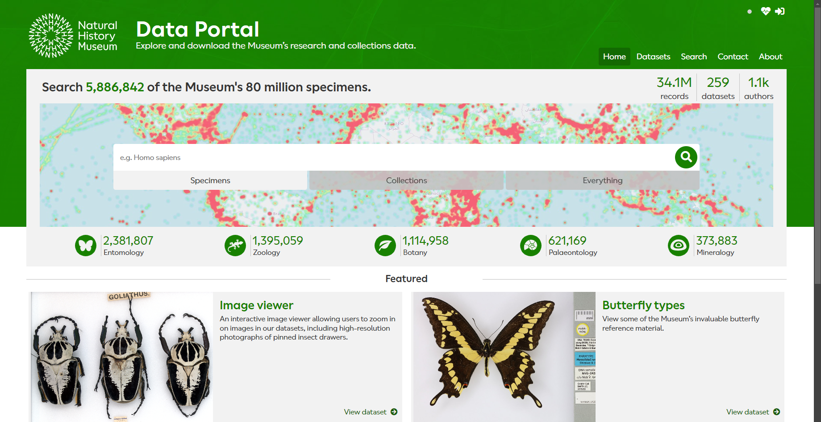
NHM Data Portal
Collections discovery layer
Exploring potential to use Latimer Core to create a collection-level discovery layer, that sits above and integrates with specimen-level records.
Benefits include:
Providing users with new ways to browse and navigate through the collection
Giving visibility of, and information about, the undigitised portions of the collection
Supporting data and image publication for drawer-level digitisation
Mapping collection-level data assets (Join the Dots, CMS collection-level narratives and index lots, NHM Unlocked object groups) to Latimer Core provides the ability to harmonise and publish a wealth of existing data.
Notes:
Finally, we intend on using Latimer Core to provide an alternative entry point for users to browse and navigate our collections. Our public Data POrtal

Slide 21
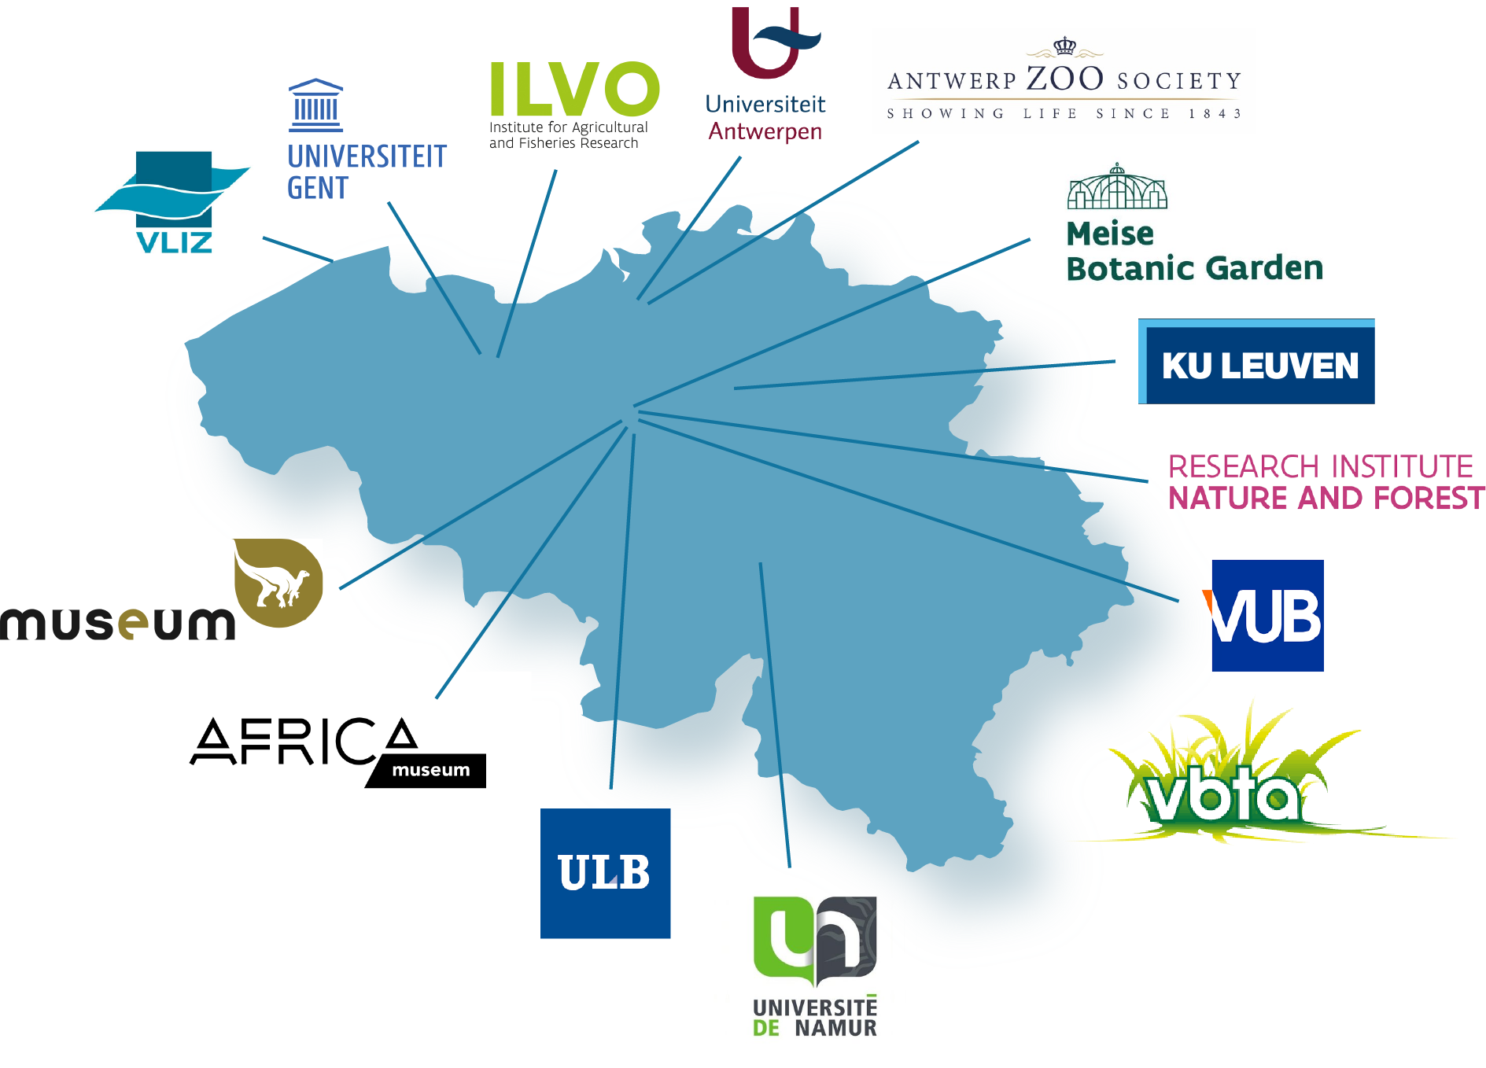
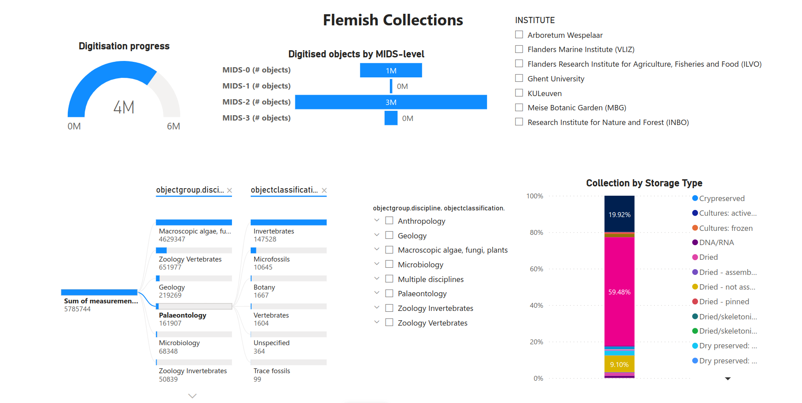
DiSSCo Flanders
Flemish node of the DiSSCo RI
Mixed consortium of collection
Goal: increase digital visibility of collections from institutional to specimen
LtC piloted to describe collections above specimen level
Institutional data collected via spreadsheets
Imported into MySQL database and used for a Microsoft PowerBI dashboard
Figures from: Breugelmans L, Trekels M (2023) Implementation Experience Report for the Developing Latimer Core Standard: The DiSSCo Flanders use-case. Biodiversity Information Science and Standards 7: e113766. 10.3897/biss.7.113766
Dashboard link: https://app.powerbi.com/view?r=eyJrIjoiNTgyYmEyNWQtOGE2My00NWVkLTkyN2YtYzBjZDI4M2I2MDI1IiwidCI6ImQ4NjA5MTVlLWI4YmUtNGY3Yi04NmJlLWUxNzNjMTgyZWFhZiIsImMiOjl9
Notes:
NHM London are not the only organisation using Latimer Core
DiSSCo Flanders is the Flemish node of DiSSCo
It is a consortium of universities, research institutions and botanical gardens
Its goal is to increase the digital visibility of collections from institutional level to specimen level
Specimens records are already made available via GBIF and Latimer Core is being piloted to describe collections at higher organisational levels
DiSSCo UK is planning on following in DiSSCo Flanders footsteps

Slide 22


Future community adoption
GBIF’s Global Registry of Scientific Collections (GRSciColl)
2023-2024 Roadmap: Review data schema and align to Latimer Core
GRSciColl 2023-2024 road map - GRSciColl (gbif.org)
DiSSCo RI’s natural science Collections Digitisation Dashboard:
Aims to improve the discoverability of natural science collections (NSCs) held in European institutions, both digitised and undigitised.
It will serve as a dynamic visual assessment tool for strategic decision-making, including the prioritisation of digitisation.
Tilley et al. (2024) Systematic Design of a Natural Sciences Collections Digitisation Dashboard. Research Ideas and Outcomes 10: e118244.DOI: 10.3897/rio.10.e118244
Notes:
Finally, there are larger scale community initiatives that aim to implement Latimer Core.
GBIF’s Global Registry of Scientific Collections (GRSciColl) plans to review their data schema to align with Latimer Core
DiSSCo’s aims to build a natural science collections digitisation dashboard which amongst other functions will support strategic decision making on collections, including prioritisation of digitisation projects.

Slide 23

5. Orientation and exercises
https://rb.gy/djlb0l
Latimer Core Workshop: Orientation and Exercises

Slide 24


Prototyping Latimer Core in Airtable
What is Airtable? (https://airtable.com)
Why are we using it for Latimer Core prototyping?
Limitations
Latimer Core Workshop: Orientation and Exercises https://rb.gy/djlb0l
Notes:
What is Airtable?
Airtable (https://airtable.com/) is a cloud platform that functions like a spreadsheet-database hybrid. Users can create multiple databases (called ‘bases’ in Airtable), create tables within those bases, and add fields of defined data types, including formulae, to those tables. Relationships can also easily be configured within a base by adding lookup fields that reference other tables within the same base. However, like a spreadsheet, users can work directly with table data in a grid-like interface. The aim is to provide users with a spreadsheet-like feel for direct data management, while also providing richer database-like functionality (such as relationships and data types) through no-code configuration. Over this, Airtable provides functionality for configuring interfaces over the data (again without the use of code) for different user experiences.
Why are we using it for Latimer Core prototyping?
LtC is a fairly structured and relational standard, and its potential applications can therefore be quite difficult to explore and demonstrate using flattened structures like spreadsheets or CSVs. In Airtable however it’s quite straightforward to configure bases that mirror the LtC standard and structure, using tables that represent the LtC classes, fields that represent the LtC properties, and lookup fields that represent the LtC data model relationships. In particular, it’s very easy to configure many-to-many relationships in Airtable, of which there are a number in LtC (for example, a single ObjectGroup record may relate to multiple Taxon records, and a single Taxon record may relate to multiple ObjectGroup records).
Airtable’s functionality for developing custom user interfaces also helps us to prototype and demonstrate ideas for how software might be developed to provide a cohesive user experience in working with structured LtC data. In addition, Airtable also provides an API that enables us to prototype the extraction of data in LtC-compliant, standardised formats (such as JSON and CSV).
Limitations
Airtable is commercial software, although with a free tier that anyone can sign up to without cost. The free tier includes a lot of the core functionality, but has restrictions in areas like the maximum number of records per base (1,000), number of editors, and API calls per month. Paid tiers have less restrictions and more functionality, but come with a monthly per-user licensing cost. Further details can be found at https://airtable.com/pricing. The free tier used for this demonstration should have everything needed for an LtC sandbox environment, but an upgrade may be required for LtC datasets of any significant size.

Slide 25
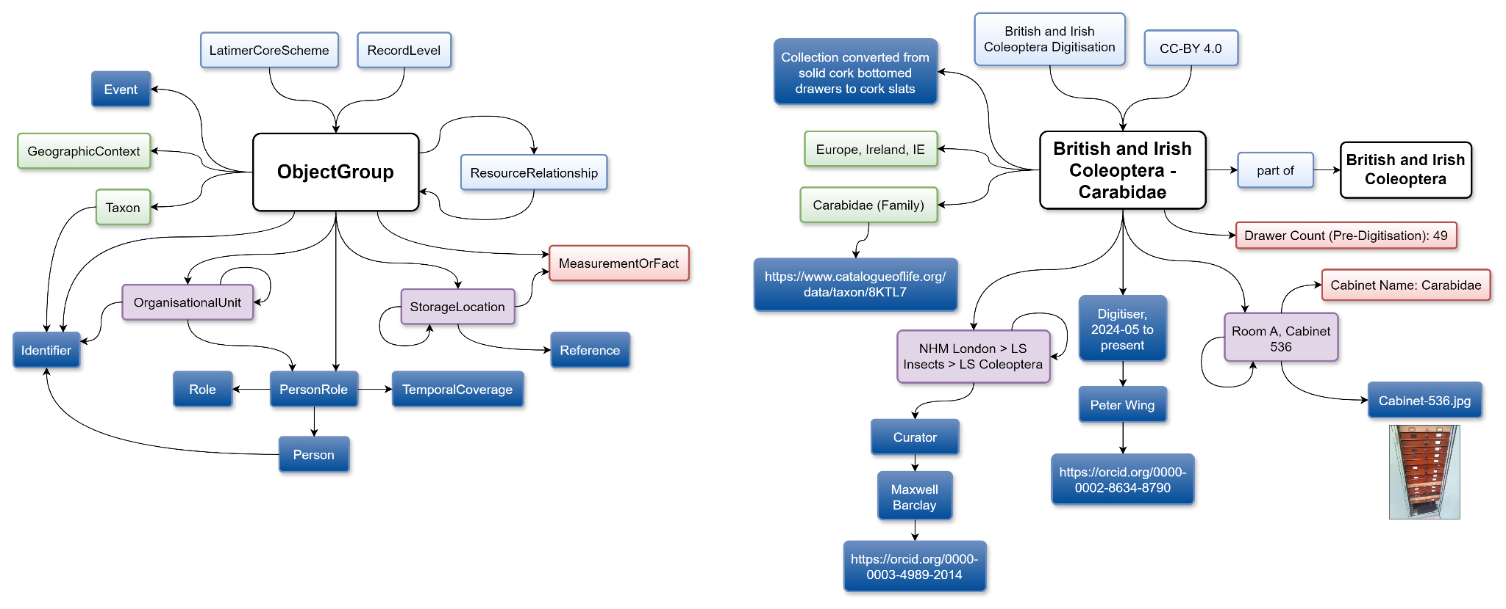
British and Irish Coleoptera Digtisation pilot
parts of LtC in use
what it looks like (ish) with data
Notes:
We made an example dataset for a large collection of 600,000 specimens prior to specimen-level digitisation. On the left hand side you can see the parts of Latimer Core that are in use and on the right hand side the corresponding data including a reference to multimedia for the storage.

Slide 26
Latimer Core example bases
Two example bases:
1) TDWG: Latimer Core Template https://airtable.com/appPnlzRZyJ5dkTdV/shr59oUbbXh1M0FJr
2) TDWG: Latimer Core Digitisation Example
https://airtable.com/apphqjDuC81ffdAiS/shrnqR2n9ZoxJ0noa
Latimer Core Workshop: Orientation and Exercises https://rb.gy/djlb0l
Notes:
1. TDWG: Latimer Core Template
https://airtable.com/appPnlzRZyJ5dkTdV/shr59oUbbXh1M0FJr
This base is effectively an empty template (containing with no data) with the data structure and interfaces configured to represent the full scope of the LtC standard. It’s intended as a starting place that people can replicate (as many times as desired) to try out different LtC use cases.
The base is configured to have a table for each LtC class, and within them a field for each LtC property. These include lookup fields for all ‘relationship’ properties in LtC (the ‘has…’ properties, such as ‘hasTaxon’ or ‘hasIdentifier’), in order to configure the relevant relationships between the tables in the base.
Additional lookup tables have also been created for some properties (e.g. ‘preservationMethod’, ‘baseTypeOfObjectGroup’) where LtC recommends that users apply controlled vocabularies to those properties. This enables us to demonstrate interface features for controlled vocabulary maintenance through the demonstration interfaces.
Interfaces have been configured that should allow users to browse, add, edit and delete data in any part of the data model.
The base contains no data, so that it provides a clean template for users to enter and experiment with their own Latimer Core schemes.

Slide 27
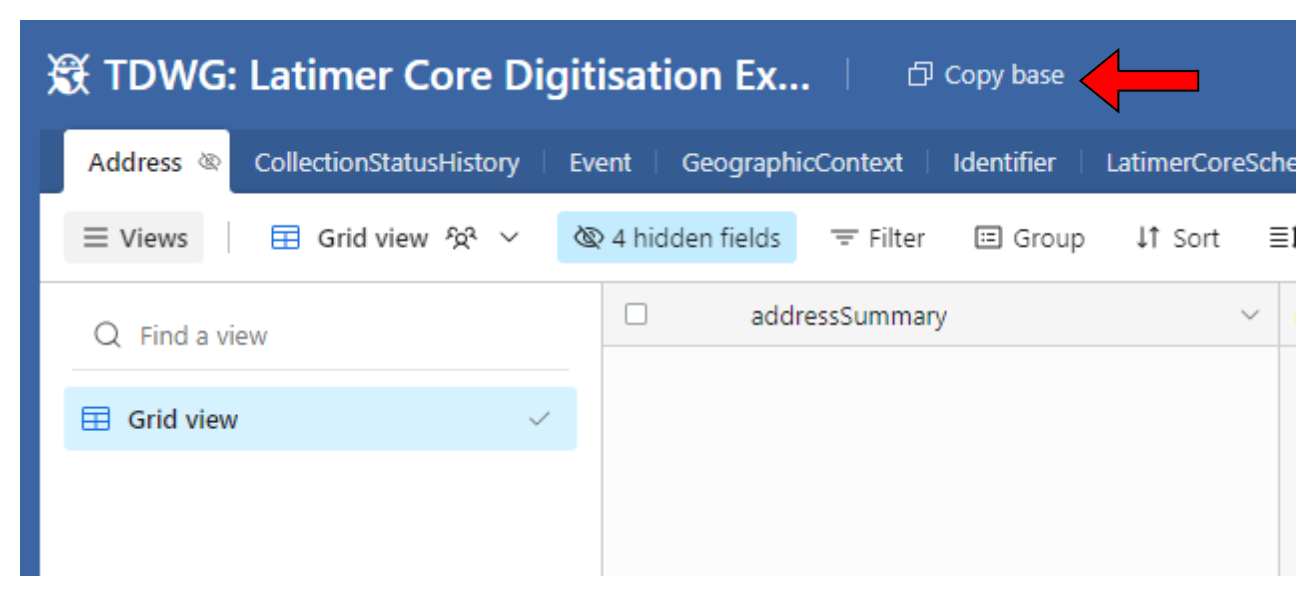
Getting started
Click first link:
https://airtable.com/apphqjDuC81ffdAiS/shrnqR2n9ZoxJ0noa
Sign in / create account
Copy base to Workspace
Repeat for second link:
https://airtable.com/appPnlzRZyJ5dkTdV/shr59oUbbXh1M0FJr
Latimer Core Workshop: Orientation and Exercises https://rb.gy/djlb0l

Slide 28
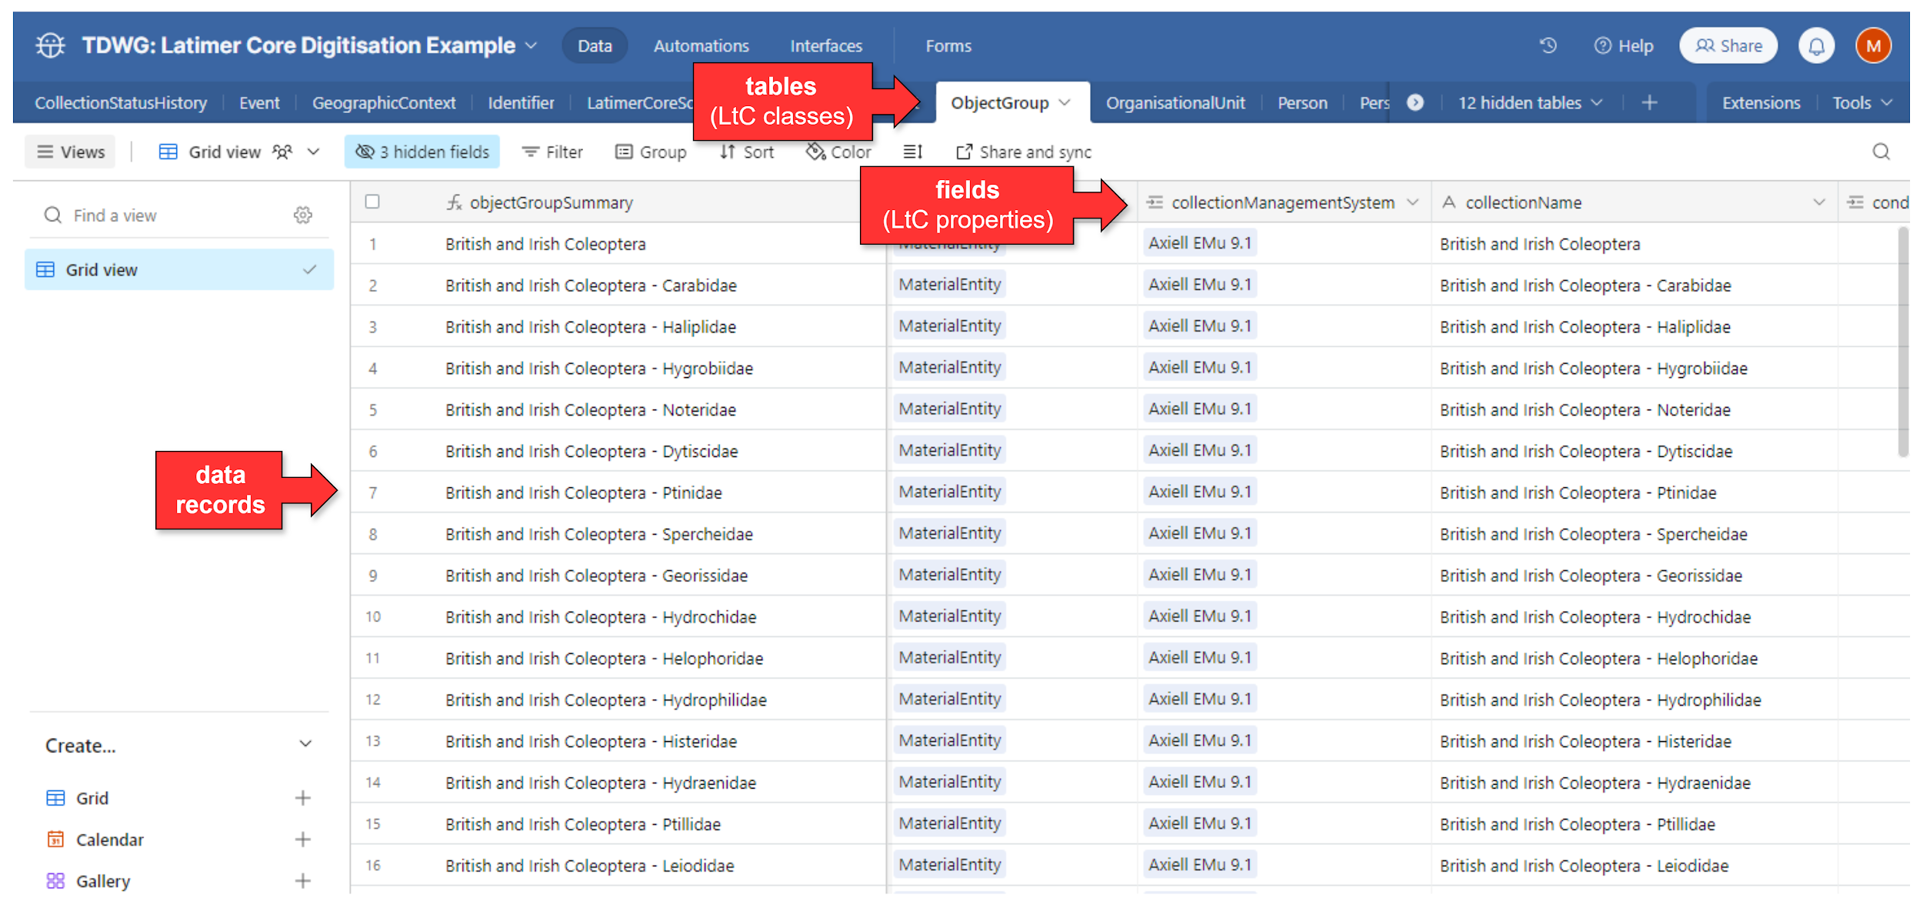
Exploring
‘Data’ view
Latimer Core Workshop: Orientation and Exercises https://rb.gy/djlb0l

Slide 29
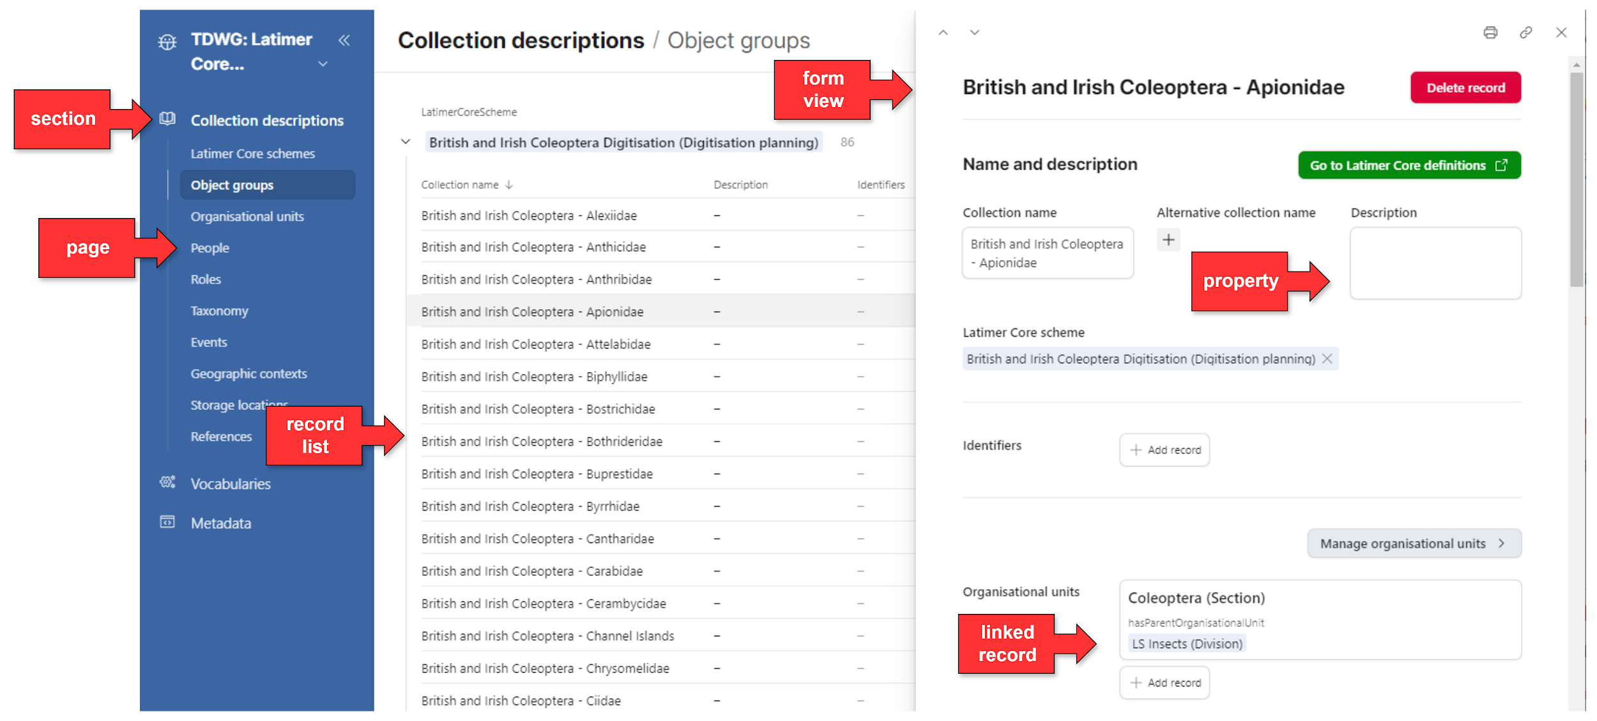
Exploring
‘Interface’ view
Latimer Core Workshop: Orientation and Exercises https://rb.gy/djlb0l

Slide 30
Creating schemes
There are three mandatory elements to an LtC dataset:
LatimerCoreScheme
ObjectGroup
RecordLevel
Examples of these records can be found in the ‘TDWG: Latimer Core Digitisation Example’ base, by using the ‘Data’ view and exploring the ‘LatimerCoreScheme’, ‘ObjectGroup’ and ‘RecordLevel’ tables
Latimer Core Workshop: Orientation and Exercises https://rb.gy/djlb0l
Notes:
There are three mandatory elements to an LtC dataset:
1) LatimerCoreScheme: There must be at least one record in the LatimerCoreScheme table, and it must have a ‘schemeName’ entered and ‘isDistinctObjects’ set to true or false.
2) ObjectGroup: there must be at least one record in the ObjectGroup table, it must be linked to a LatimerCoreScheme via the LatimerCoreScheme’s ‘hasObjectGroup’ property, and it must have a value for ‘baseTypeOfObjectGroup’.
3) RecordLevel: there must be at least one record in the RecordLevel table, which must have a value for ‘license’ and a related Identifier record (using the ‘hasIdentifier’ property) providing an identifier for the dataset.
Examples of these records can be found in the ‘TDWG: Latimer Core Digitisation Example’ base, by using the ‘Data’ view and exploring the ‘LatimerCoreScheme’, ‘ObjectGroup’ and ‘RecordLevel’ tables

Slide 31
Exercise 1
Creating a new Latimer Core Scheme
Create a LatimerCoreScheme record
  Specify the scheme name
  Specify whether an individual object can be included in >1 ObjectGroup within the scheme ('isDistinctObjects' = false) or not ('isDistinctObjects = true)
Create an ObjectGroup record
  Specify the base type of the ObjectGroup
Link the ObjectGroup record to the LatimerCoreScheme (using the latter's 'hasObjectGroup' property)
Add a RecordLevel record
  Specify a license
  Create an Identifier record to represent a Latimer Core dataset identifier
Link the ObjectGroup record to the RecordLevel record (using the latter's 'hasObjectGroup' property)
Latimer Core Workshop: Orientation and Exercises https://rb.gy/djlb0l

Slide 32
Exercise 2
Building a basic collection description
Give your ObjectGroup a collection name
Add a brief description of the collection
Add some some details of the nature of the objects (types of material, preservation methods etc) that the collection contains
Add some more information on the scope of the collection:
  Add one or more Taxon records and link them to the ObjectGroup
  Add one or more GeographicContext records and link them to the ObjectGroup
  Add one or more GeologicalContext records and link them to the ObjectGroup
  Add one or more EcologicalContext records and link them to the ObjectGroup
Add an OrganisationalUnit representing your institution, and link it to the ObjectGroup
Latimer Core Workshop: Orientation and Exercises https://rb.gy/djlb0l

Slide 33
Exercise 3
Annotating the collection with metrics and narratives
Add MeasurementOrFact records linked to the ObjectGroup to represent 1. the estimated number of objects in the collection and 2. the percentage digitised.
Add a MeasurementOrFact record linked to the ObjectGroup to summarise the history of the collection
Add a MeasurementOrFact record linked to the ObjectGroup to provide a note about the collection's current state of housing conditions
Latimer Core Workshop: Orientation and Exercises https://rb.gy/djlb0l

Slide 34
Exercise 4
Incorporating people
Add yourself as a person
Add yourself as the data creator to the RecordLevel metadata
Link yourself with your current job title to the OrganisationalUnit representing your institution
Add one or more curators to the ObjectGroup
Add one or more notable collectors to the ObjectGroup
Latimer Core Workshop: Orientation and Exercises https://rb.gy/djlb0l

Slide 35
Exercise 5
Adding references to external identifiers
For one of the Taxon records created earlier, look up the taxon in the Catalogue of Life (https://www.catalogueoflife.org/), and add that to the Taxon record as a linked Identifier record
Look up your institution in ROR (https://ror.org/) and add the identifier using an Identifier record linked to your institution's OrganisationalUnit
Add an Identifier record for your ORCID (if you have one) and link it to your Person record
Latimer Core Workshop: Orientation and Exercises https://rb.gy/djlb0l

Slide 36
6. Discussion & feedback

Slide 37
Discussion
Do you think Latimer Core will be useful to you?
Do you think Latimer Core would be useful to others in your organisation?
What real-world applications or problems would you use Latimer Core for?
What support or training would be most helpful to you in using Latimer Core in the future?

Slide 38

Workshop Survey
https://forms.gle/THNbnFDj2eEKd3Nu9

Slide 39
7. Resources & acknowledgements

Slide 40
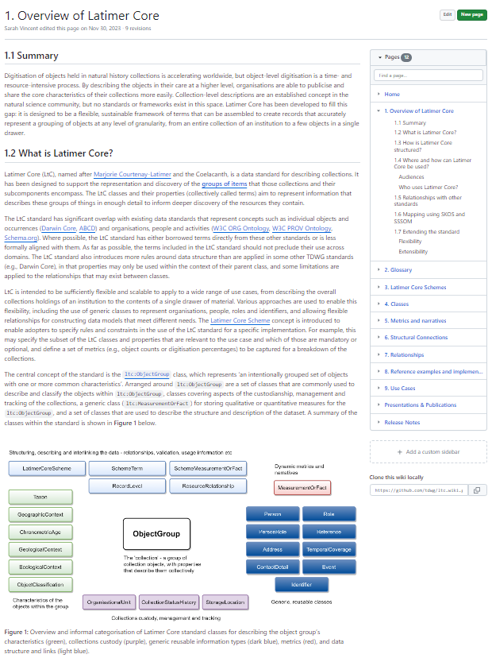
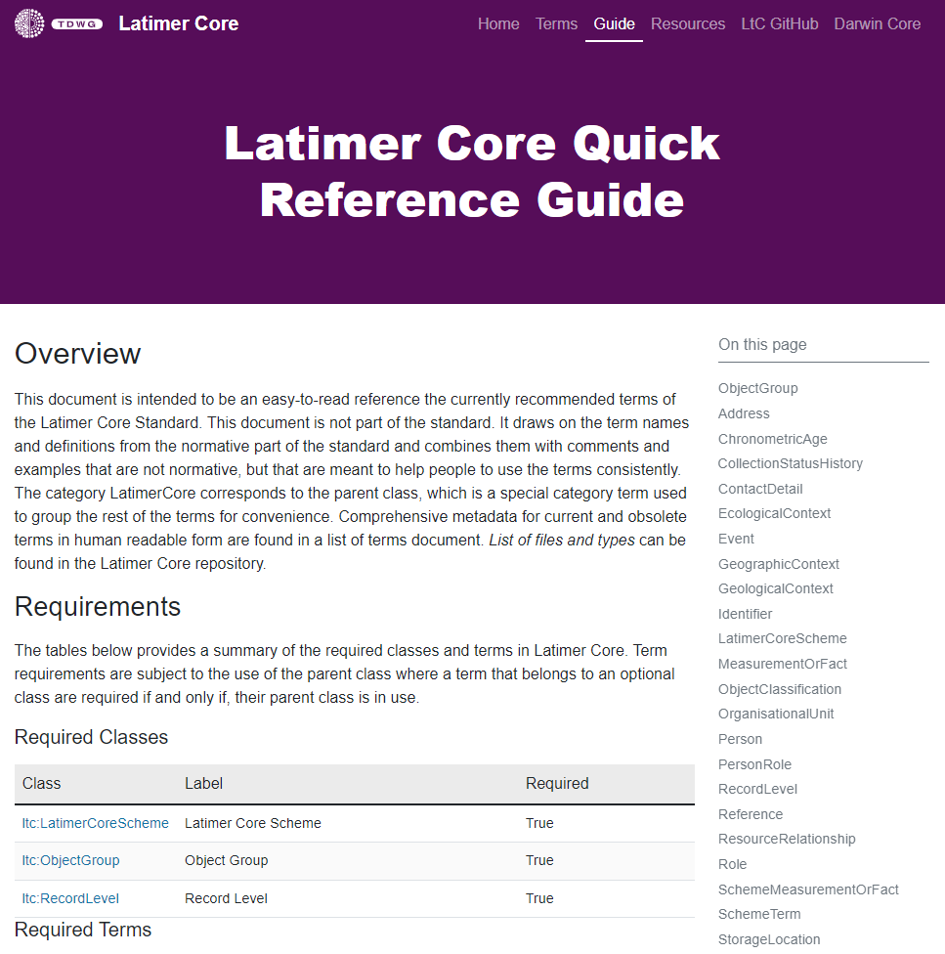
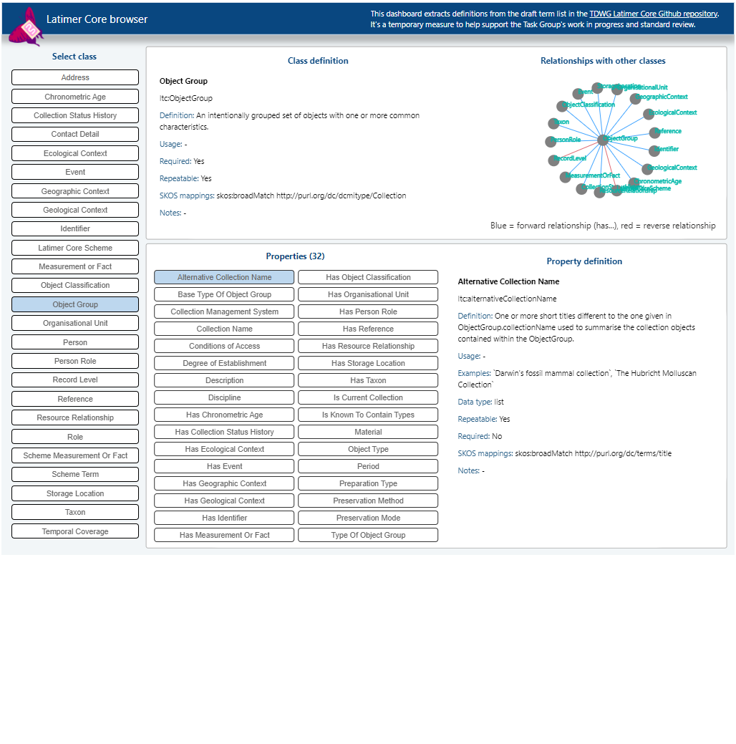
Where can you find out more?
Read the LtC Wiki
Visit the official TDWG homepage
Browse the standard
https://github.com/tdwg/ltc/wiki
https://ltc.tdwg.org/
https://rebrand.ly/tdwg-cd-standard-browser

Slide 41
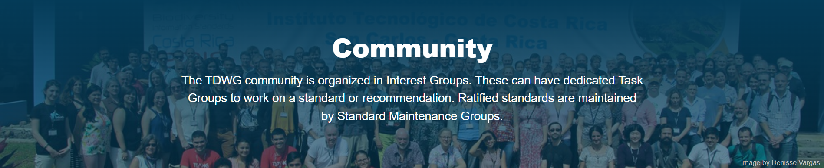
How can you get involved in with biodiversity information standards?
tdwg.org/community
The work of TDWG benefits from broad community participation from researchers, curators, registrars, domain experts as well as technical experts
You do not need a deep understanding of data standards to get involved!
Notes:
Point at TDWG communities page: https://www.tdwg.org/community/
Stress that researchers, curators, registrars and other domain experts are just as important as technical experts, and that you don’t need a deep understanding of data standards to get involved

Slide 42
Workshop materials
Zenodo Lesson Dataset: 10.5281/zenodo.13354147
Contains:
Workshop presentation
Orientation and exercises document
Links to bases
Links to Latimer Core documentation

Slide 43
Acknowledgements
TDWG Collections Descriptions (CD) Task Group contributors and reviewers
Sharon Grant
Janeen Jones
Kate Webbink
Matt Woodburn
Jutta Buschbom
Sarah Vincent
Maarten Trekels
Quentin Groom
Ben Norton
Rob Sanderson
Ian Engelbrecht
Steve Baskauf
Gabi Droege
David Bloom
Deborah Paul
Niels Raes
Mike Trizna
William Ulate
… and many others in the global natural sciences community who contributed to the use cases, development and review of the Latimer Core standard.
This workshop content and delivery was done as part of the DiSSCo Transition project.
Funding Source: HORIZON-INFRA-2023-DEV-01
Grant Number: 101130121

