Slide 1
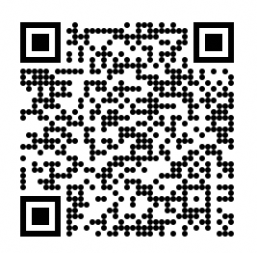

From Document to Data(sets)
A New Lens into the National Library Singapore’s Digital Collection
Metadata of digitised books, maps, newspapers, images, sound and video recordings and websites for non-commercial analysis and new discovery channels
Accelerate
Adapt
Leverage
Offer
Contribute
Expand
Organisational change via innovation to improve existing research services
Remain relevant and adopt modern tools for content delivery and user engagement
AI to enhance access of collections, transcribe, translate digitised materials and datasets
Machine-readable formats for use in new and interactive ways like digital storytelling
Digital scholarship to uncover new insights
Collaborate with heritage and new cross-sector players
to enhance research
Service Vision
Provide thematic metadata open datasets
Offer open datasets for copyright free content from our digital collection
Provide other types of datasets like API
Work with partners to produce new datasets
New opportunities for access, research, innovation, and preservation for present and future generations
Presented by Belinda Chan, National Library, Singapore / belinda_chan@nlb.gov.sg . iPRES 2024

