Slide 1






ABRIR X MEPS WORKSHOP ON
OPEN SCIENCE AND BIG-TEAM SCIENCE
15 AUGUST 2024
2-4 PM (GMT +8)
ONLINE
PRESENTED BY:
DR. BRENDAN CH’NG
ORGANISED BY:
SUPPORTED BY:
This event was made possible with the backing from The Open Research Funders Group via the Seed Award Program.

Slide 2



Welcome!
We’re glad to
have you here.

Slide 3
For a smooth session,
  Be mindful that this event will be recorded - you may choose to turn off your mic/webcam, but we encourage you to turn on your webcam so we can see you :)
  We encourage you to use devices with a larger screen (desktop, laptop) for easier navigation and contribution to the discussion later
  Please mute your mic if you’re not presenting
  Be kind to each other - we all have different background and experiences
  It’s okay to speak in bahasa rojak!
  Materials and resources will be shared after the event.

Slide 4
AGENDA
01
REPLICATION CRISIS IN PSYCHOLOGY
02
THE WORLD OF OPEN SCIENCE
03
WORKING IN A BIG-TEAM SCIENCE
04
HACKATHON: BREAKOUT ROOM SESSIONS

Slide 5



Today’s presenter
Dr. Brendan Ch’ng
Independent researcher
  PhD in Educational Psychology (University of Malaya, Malaysia).
  Master of Education specialising in Gifted Education (Monash University, Australia).
  Research areas & interests: Educational psychology, environmental sensitivity, gifted education, well-being, higher education
@ChngBrendan

Slide 6
This event is a collaboration between
ADVANCING BIG-TEAM REPRODUCIBLE SCIENCE THROUGH INCREASED REPRESENTATION
MALAYSIA EDUCATIONAL PSYCHOLOGY SOCIETY
This event was made possible with the backing from The Open Research Funders Group via the Seed Award Program.
Notes:
This event is a collaboration between ABRIR and MEPS.

Slide 7

MALAYSIA EDUCATIONAL PSYCHOLOGY SOCIETY
The Malaysia Educational Psychology Society (MEPS) is a community dedicated to advancing the field of educational psychology. Established in 2018, MEPS has evolved into a thriving network of professionals, educators, and enthusiasts passionate about enhancing educational experiences through psychological support.
Website: myedpsych.com
Facebook: Malaysia Educational Psychology Society - MEPS
X: @MEPS_Connect
Notes:
Now I will (virtually) pass the floor to Mr. Teow Chean Khai, the current President of MEPS to introduce what MEPS is all about.

Slide 8
ADVANCING BIG-TEAM REPRODUCIBLE SCIENCE THROUGH INCREASED REPRESENTATION
  International consortium of psychological researchers - founded in 2022.
  ABRIR’s long-term mission:
    identify the challenges uniquely faced by researchers from low/middle-income countries while participating in and leading Big-Team/Open Science projects.
    compile resources that can be shared within the academic community.
    build a collaborative network of psychological science researchers from the Global South to explore and answer questions of deep relevance to their local regions.
  Regional hubs were created to engage with researchers:
    ABRIR Europe, ABRIR Asia, ABRIR Latin America and Caribbean, ABRIR Africa
abrirpsy.org
X: @ABRIR_Psy
Bluesky: @abrir.bsky.social

Slide 9

Open Science
Sains Terbuka

Slide 10
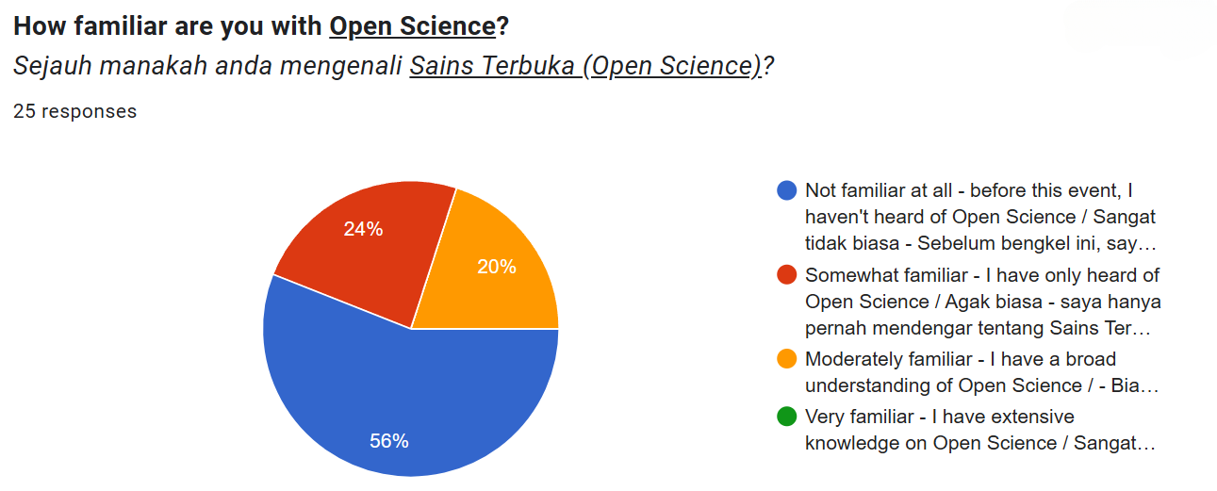
Results from the mini survey
14
6
5
0

Slide 11
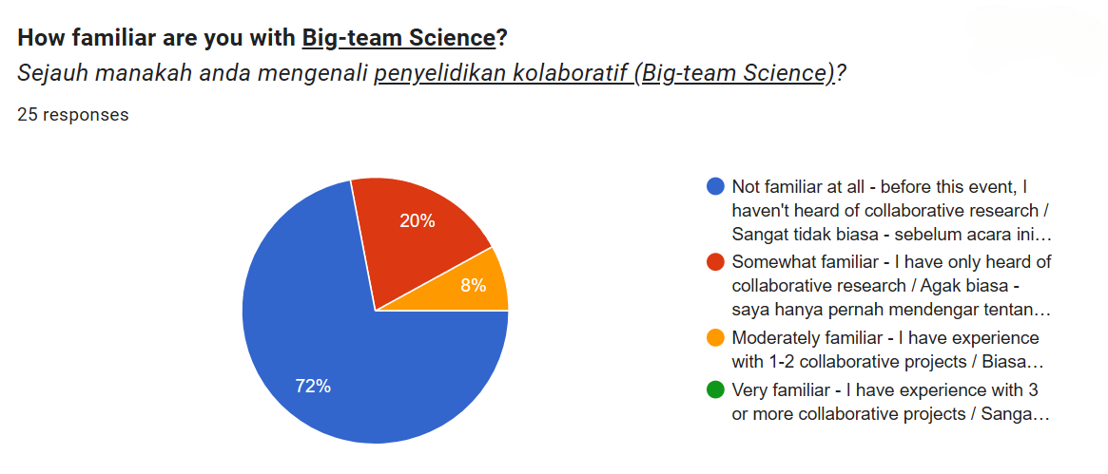
Results from the mini survey (cont.)
18
5
2
0

Slide 12
Replication/reproducibility crisis in psychology
Replication
- the process of repeating a study or experiment with the goal of verifying effects or generalising findings across new models or populations.
Reproducibility
- assessing the accuracy of the research claims based on the original methods, data, and/or code.
Korbmacher, M., Azevedo, F., Pennington, C. R., Hartmann, H., Pownall, M., Schmidt, K., Elsherif, M., Breznau, N., Robertson, O., Kalandadze, T., Yu, S., Baker, B. J., O’Mahony, A., Olsnes, J. Ø.-S., Shaw, J. J., Gjoneska, B., Yamada, Y., Röer, J. P., Murphy, J., … Evans, T. (2023). The replication crisis has led to positive structural, procedural, and community changes. Communications Psychology, 1(1), 1–13. https://doi.org/10.1038/s44271-023-00003-2
Notes:
Korbmacher, M., Azevedo, F., Pennington, C. R., Hartmann, H., Pownall, M., Schmidt, K., Elsherif, M., Breznau, N., Robertson, O., Kalandadze, T., Yu, S., Baker, B. J., O’Mahony, A., Olsnes, J. Ø.-S., Shaw, J. J., Gjoneska, B., Yamada, Y., Röer, J. P., Murphy, J., … Evans, T. (2023). The replication crisis has led to positive structural, procedural, and community changes. Communications Psychology, 1(1), 1–13. https://doi.org/10.1038/s44271-023-00003-2

Slide 13
Thousands of studies are published, but only few could be replicated.
Successful replication rates range between 25% for social psychology and 50% for cognitive psychology.
This crisis has raised concerns about the reliability of psychological research and credibility of the field as a whole.
Can we (esp. the public) trust what we read?
Renkewitz, F., & Heene, M. (2019). The replication crisis and open science in psychology: Methodological challenges and developments. Zeitschrift Für Psychologie, 227(4), 233–236. https://doi.org/10.1027/2151-2604/a000389
Notes:
Renkewitz, F., & Heene, M. (2019). The replication crisis and open science in psychology: Methodological challenges and developments. Zeitschrift Für Psychologie, 227(4), 233–236. https://doi.org/10.1027/2151-2604/a000389

Slide 14
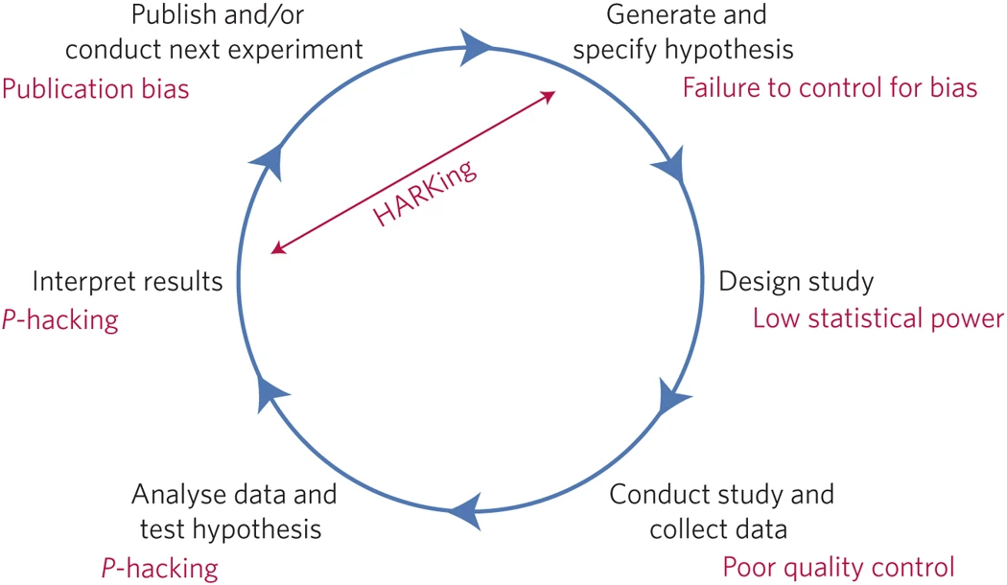
Threats to reproducible science
QUESTIONABLE RESEARCH PRACTICES
  p-hacking (manipulating data to achieve significant results)
  HARKing (hypothesizing after results are known)
  selective reporting
Image source: Munafò, M., Nosek, B., Bishop, D. et al. A manifesto for reproducible science. Nat Hum Behav 1, 0021 (2017). https://doi.org/10.1038/s41562-016-0021
Notes:
Image source: Munafò, M., Nosek, B., Bishop, D. et al. A manifesto for reproducible science. Nat Hum Behav 1, 0021 (2017). https://doi.org/10.1038/s41562-016-0021

Slide 15


PUBLISH OR PERISH
  The pressure to publish in high-impact journals for personal gain (e.g. promotions).
  Incentives structures not aligned to best practices.
Why do some scientists engage in QRPs?
PUBLICATION BIAS
  High-impact journals tend to publish positive data i.e. “significant/positive results”.
  Researchers may tweak data to get positive results.

Slide 16
How do we respond to this crisis?
OPEN SCIENCE!

Slide 17
What is Open Science?
An umbrella term reflecting the idea that scientific knowledge of all kinds, where appropriate, should be openly accessible, transparent, rigorous, reproducible, replicable, accumulative, and inclusive, all which are considered fundamental features of the scientific endeavour.
Source: FORRT
Notes:
https://forrt.org/glossary/english/open_science/

Slide 18
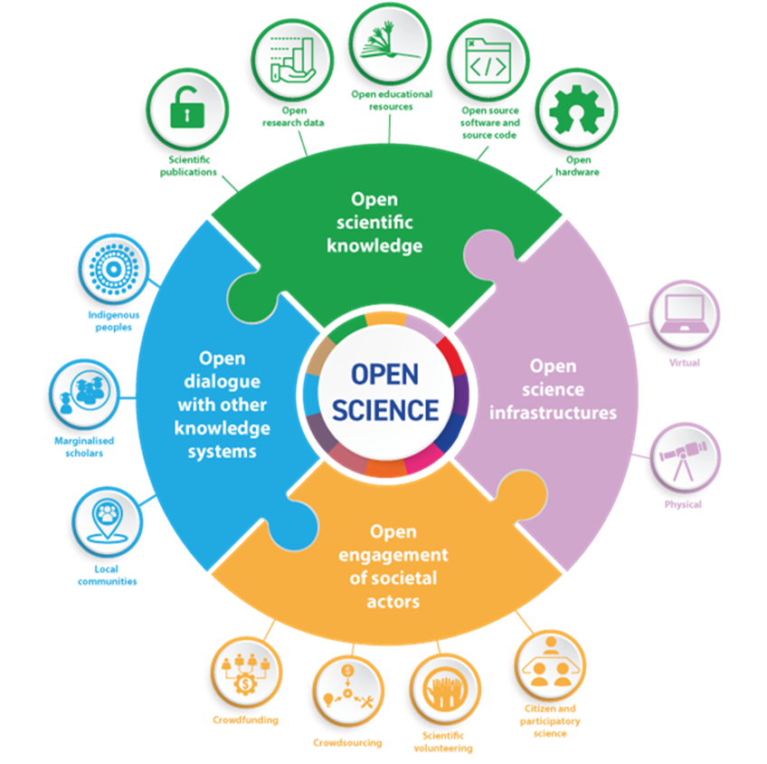
Elements of open science
Open science has six major aspects:
  open data
  open methodology
  open source
  open access
  open peer review
  open educational resources
Source: FORRT
Source: UNESCO Open Science Toolkit
Notes:
https://forrt.org/glossary/english/open_science/
https://unesdoc.unesco.org/ark:/48223/pf0000383323

Slide 19



Open data & repositories
Open data refers to data that is freely available and readily accessible for use by others without restriction.
This usually involves:
  (selectively) sharing your data publicly in repositories
  using open licences for data
Open data allows for:
  more transparency since others can access data and verify the results
  fraud detection
  duplication to be avoided = less resources wasted
  researcher’s visibility to be boosted
Source: FORRT
Notes:
https://forrt.org/glossary/english/open_data/

Slide 20
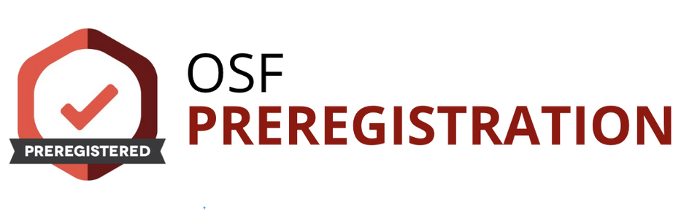
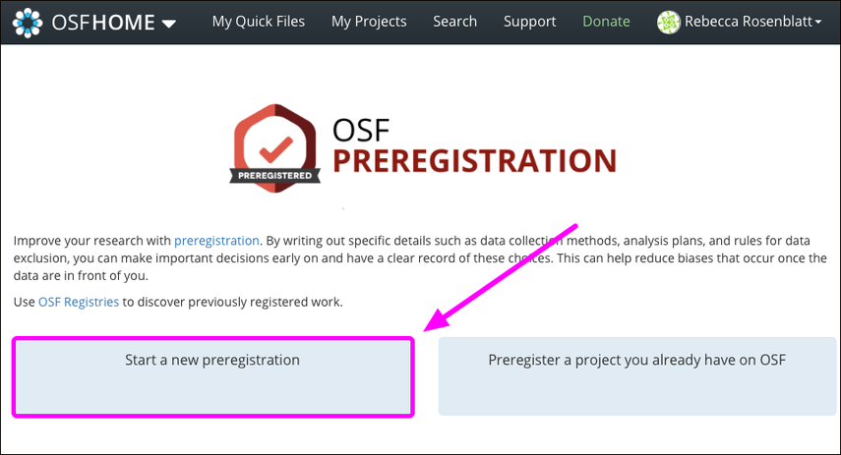
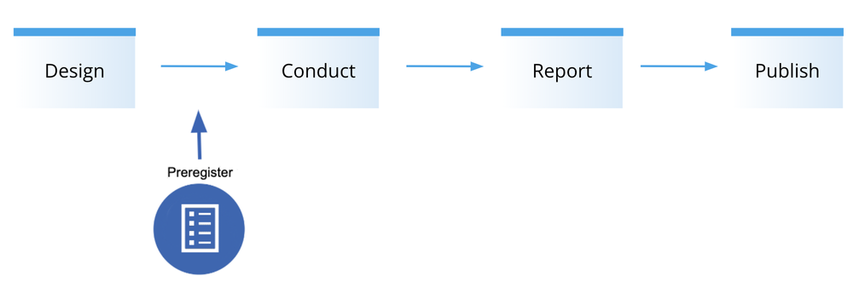
Open methodology
Open methodology refers to making the methods and processes used in scientific research openly available and accessible to others.
One way of doing this is to preregistration, i.e.
  the practice of publishing the plan for a study, including research questions/hypotheses, research design, data analysis before the data has been collected or examined.
  a preregistration document is time-stamped and typically registered with an independent party (e.g., a repository).
  preregistration provides a transparent documentation of what was planned at a certain time point,
  this allows third parties to assess what changes may have occurred afterwards.
Source: FORRT
Notes:
https://forrt.org/glossary/english/preregistration/

Slide 21
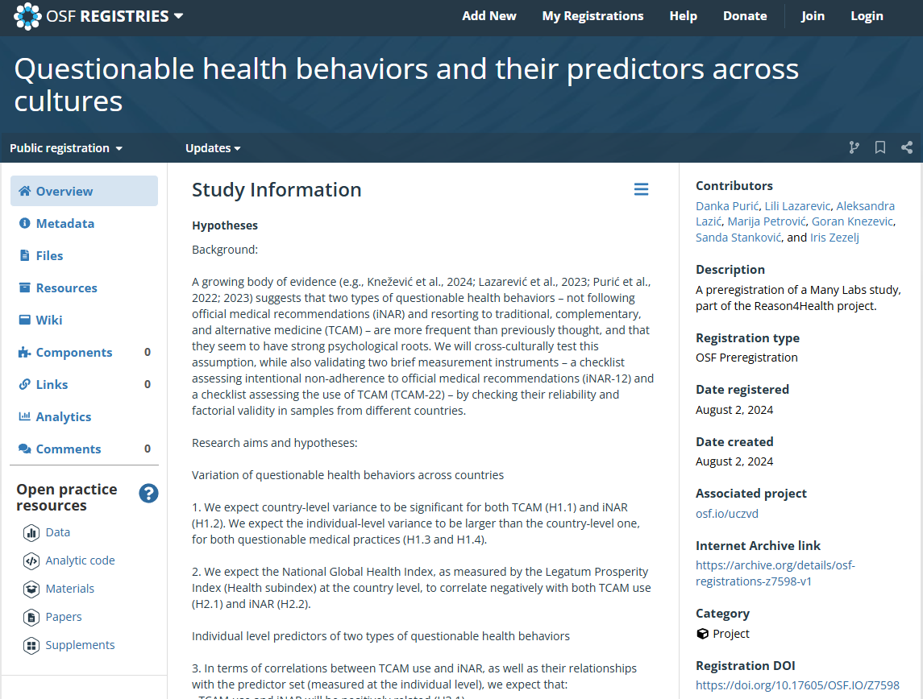


https://osf.io/z7598
Notes:
https://osf.io/z7598

Slide 22
Open source?
Open access?
Open educational resources?

Slide 23
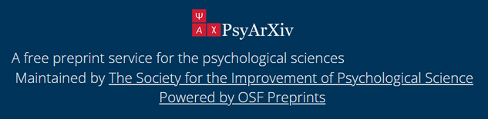
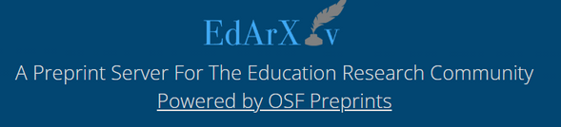
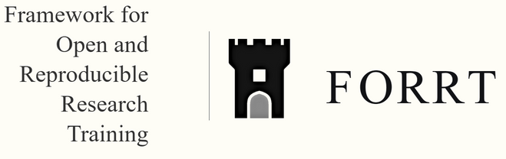
Making computer software or code (e.g., programming, analysis code, stimuli generation) freely and publicly available.
Open source
Free availability of scholarship on the public internet, so that any users to read, download, copy, distribute, print, search, or link to the full texts of these research articles for free.
Open access
Open educational resources
Sharing educational materials and resources openly to enhance learning and teaching in scientific disciplines.

Slide 24
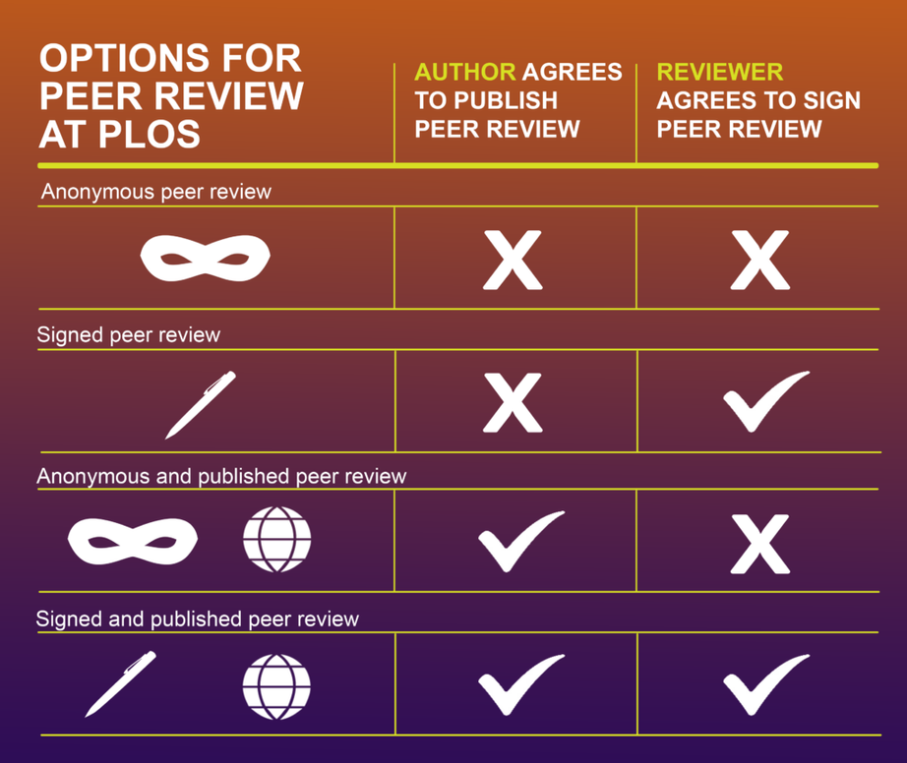
Open peer review
This usually involves:
  providing disclosure of any combination of author and referee identities
  publishing peer-review reports and editorial decision letters, to one another or publicly at any point during or after the peer review or publication process.
Open peer review allows for:
  people to understand the rigorous review process and the types of questions being asked
  reviewers to be recognised for their hard work (“free labour”)
  better quality of review to be obtained
https://plos.org/resource/open-peer-review/
Source: FORRT
Notes:
https://osf.io/z7598
https://plos.org/resource/open-peer-review/

Slide 25


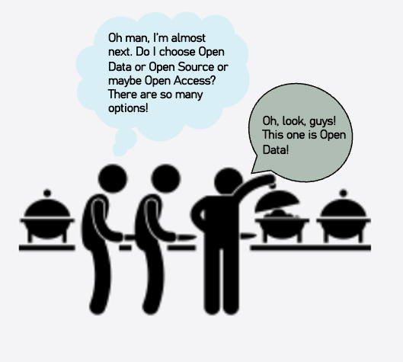
Where do we start?
Image source: https://guides.library.cmu.edu/opensciencehomepage/opensciencebuffet
Notes:
Image source: https://guides.library.cmu.edu/opensciencehomepage/opensciencebuffet

Slide 26
any questions?

Slide 27
Let’s take a break
5-10 minutes

Slide 28

BIG-TEAM SCIENCE

Slide 29

What is Big-Team Science?
LARGE-SCALE COLLABORATIONS:
  BTS involves bringing together many researchers from diverse backgrounds to work on a common problem
  Allow individual researchers to specialise into roles that matches their skills
  Leverage on the expertise of experienced researchers
  BTS projects gather resources like data, materials, and funding to enable research to be done at a larger scale
BENEFITS OF BIG-TEAM SCIENCE
  Work with larger sample sizes
  “Access” to non-WEIRD populations
  Can also help to respond to the replication crisis
  Enable researchers to invest their limited resources for individual reward (e.g. authorship, grant, networking) - important for those in the Global South.

Slide 30

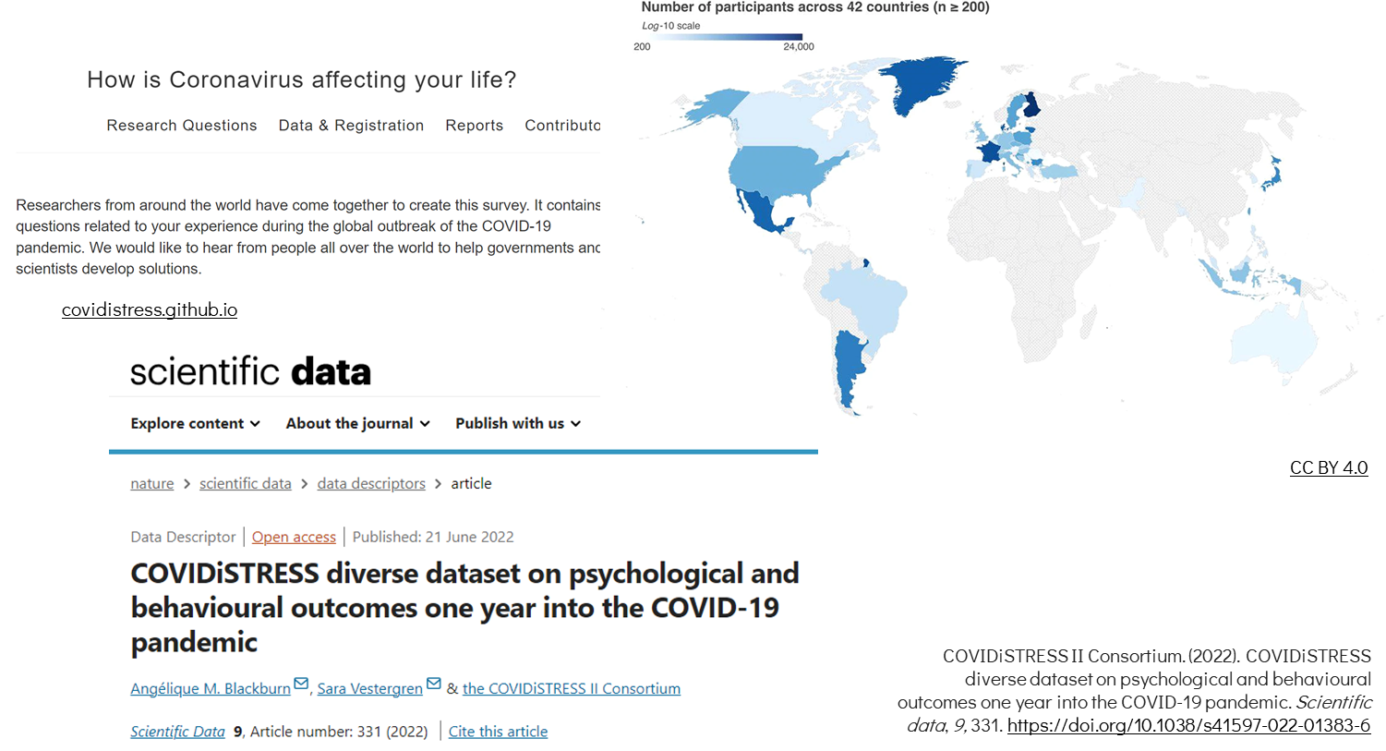
Image source:
https://doi.org/10.5281/zenodo.12760677

Slide 31



other examples of Big-team Science...
MANY BABIES - MANYBABIES.ORG
studying developmental psychology
PSYCHOLOGICAL SCIENCE ACCELERATOR (PSA) - PSYSCIACC.ORG
studying social and cognitive psychology
REASON4HEALTH - REASONFORHEALTH.F.BG.AC.RS/EN/
studying health psychology

Slide 32

BTS is also not entirely perfect, for now.
Problem:
  Most participants (samples) in psychological research comes from WEIRD countries.
  Not everyone is well-represented in BTS projects across the world.
  i.e. researchers and population of study from the Global South are often being left out
Initiatives like ABRIR is trying to solve this.

Slide 33

ABRIR needs your help to understand...
  what would make you more willing to engage in open science practices?
  what barriers would limit your participation in OS/BTS practices?
  support required that encourages you to participate in OS/BTS practices?
  propose research ideas that you would be interested to collaborate with others

Slide 34
Hackathon time!
10-15 mins

Slide 35
Share your thoughts.

Slide 36
OPEN SCIENCE IS BECOMING THE NORM IN PSYCHOLOGY...
... ARE WE READY TO EMBRACE IT?

Slide 37
ABRIR GLOBAL EVENT
Coming soon in October 2024!
Notes:
In October, ABRIR will be hosting a global event on Open Science.

Slide 38

THANK YOU
ANY QUESTIONS?
EMAIL :
brendanchng@protonmail.com
@ChngBrendan

Slide 39
Credits
FORRT Glossary - https://forrt.org/glossary/
Unconference (4b) Consortium of psychological scientists and researchers from developing countries_ “ Establishment, vision and agenda” (1).pptx
  https://osf.io/pnhtb
Open and Big Team Science: Serbia and Bosnia-Herzegovina Perspective
  https://doi.org/10.5281/zenodo.12760677
Castille, C. M., Kreamer, L. M., Albritton, B. H., Banks, G. C., & Rogelberg, S. G. (2022). The open science challenge: Adopt one practice that enacts widely shared values. Journal of Business and Psychology, 37(3), 459–467. https://doi.org/10.1007/s10869-022-09806-2
Ellis, R. J. (2022). Questionable Research Practices, Low Statistical Power, and Other Obstacles to Replicability: Why Preclinical Neuroscience Research Would Benefit from Registered Reports. eNeuro, 9(4). https://doi.org/10.1523/ENEURO.0017-22.2022
Korbmacher, M., Azevedo, F., Pennington, C. R., Hartmann, H., Pownall, M., Schmidt, K., Elsherif, M., Breznau, N., Robertson, O., Kalandadze, T., Yu, S., Baker, B. J., O’Mahony, A., Olsnes, J. Ø.-S., Shaw, J. J., Gjoneska, B., Yamada, Y., Röer, J. P., Murphy, J., … Evans, T. (2023). The replication crisis has led to positive structural, procedural, and community changes. Communications Psychology, 1(1), 1–13. https://doi.org/10.1038/s44271-023-00003-2
Munafò, M. R., Nosek, B. A., Bishop, D. V. M., Button, K. S., Chambers, C. D., Percie Du Sert, N., Simonsohn, U., Wagenmakers, E.-J., Ware, J. J., & Ioannidis, J. P. A. (2017). A manifesto for reproducible science. Nature Human Behaviour, 1(1), 0021. https://doi.org/10.1038/s41562-016-0021
Renkewitz, F., & Heene, M. (2019). The replication crisis and open science in psychology: Methodological challenges and developments. Zeitschrift Für Psychologie, 227(4), 233–236. https://doi.org/10.1027/2151-2604/a000389

