Slide 1

Hyponatremia
Muhammad Tanzeel Ul Haque

Slide 2

Learning Objectives
By the end of this session, participants would be able to:
Define hyponatremia
Identify signs and symptoms of hyponatremia
Investigate
describe types of hyponatremia
Manage

Slide 3


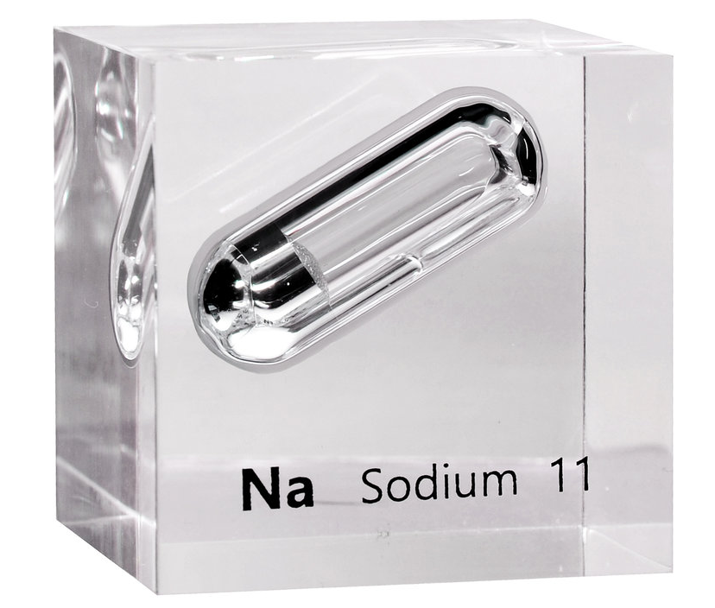
Definition: serum sodium concentration below 135 mEq/L
135-145 mEq/L

Slide 4
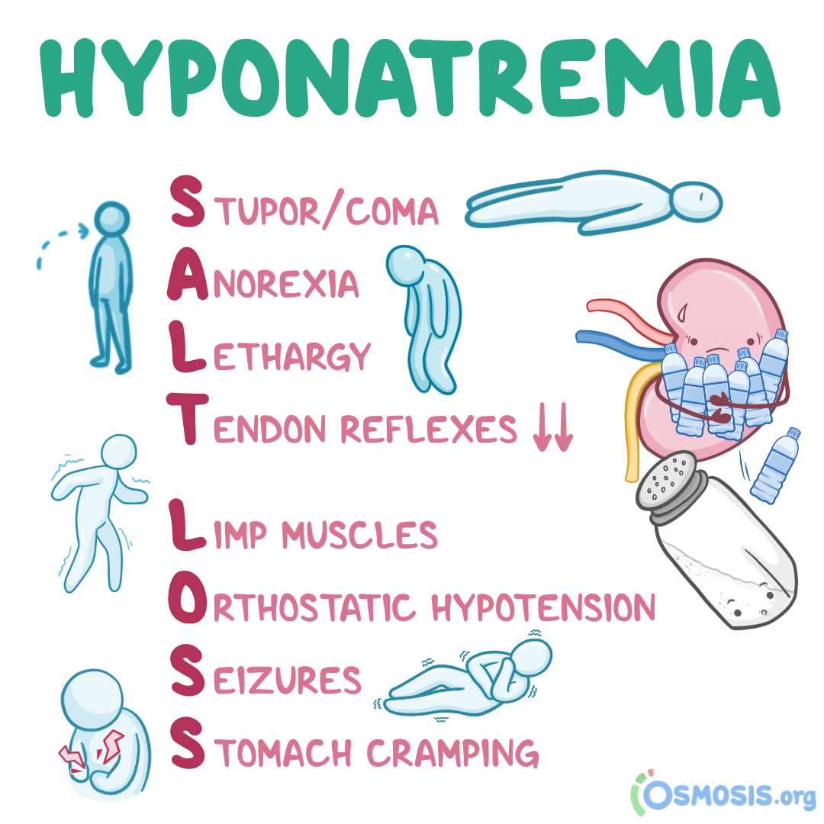
Signs and symptoms:
Nausea and vomiting
Headache
Confusion
Loss of energy and fatigue
Restlessness and irritability
Muscle weakness, spasms, or cramps
Seizures
Coma (in severe cases)

Slide 5

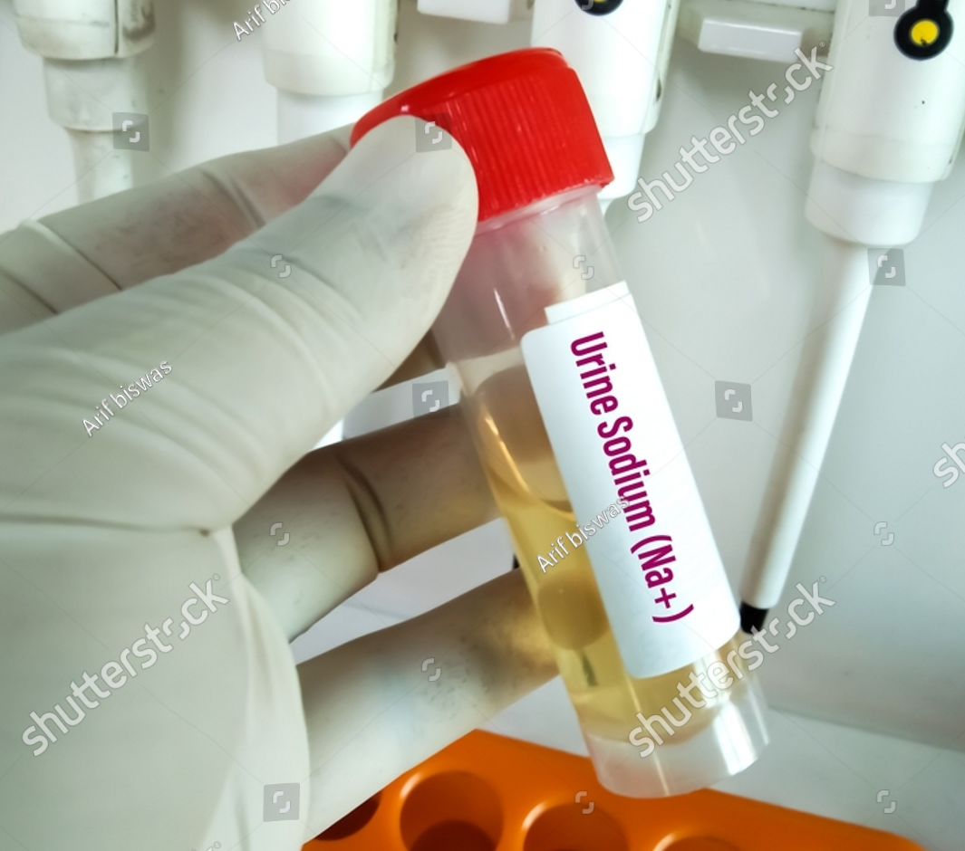
FBC
UCE
Serum osmolality
Urinary sodium
urinary osmolality
TFT/ BNP/ Echo/ LFT/ Cortisol
Notes:
Hypothyroidism causes hyponatremia: reduced cardiac output can stimulate ADH release and cause water retention.
Cortisol helps identify adrenal insufficiency which causes increased ADH secretion.
Heart failure and liver failure and renal failure are other causes.

Slide 6

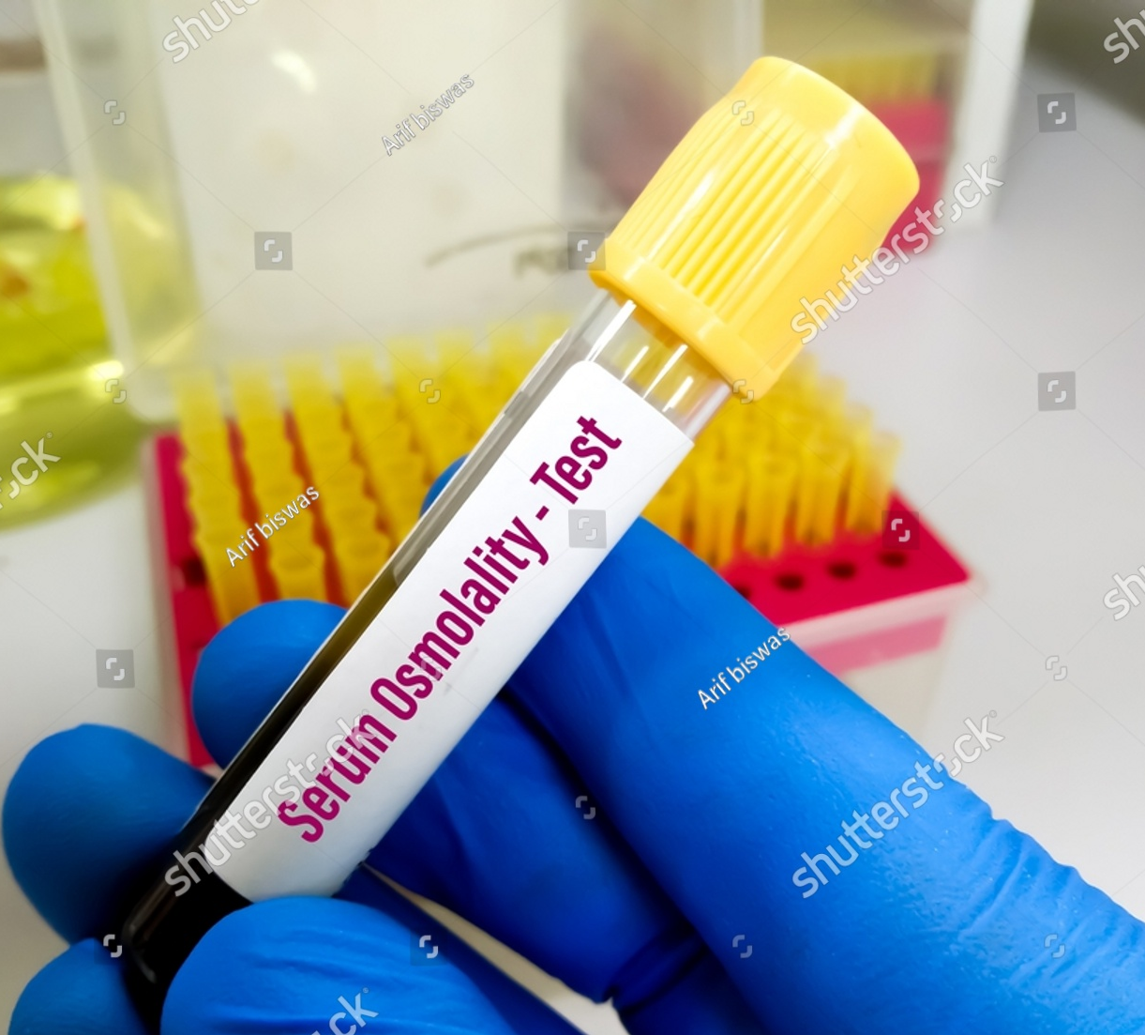

True hyponatremia?

Slide 7

Management
Monitor daily sodium levels
Treat the underlying cause
Hypertonic saline is almost never justified, requires close monitoring
Review medications and refer to appropriate specialist for treatment of any underlying cause
Notes:
Rapid correction of hyponatremia leads to osmotic demyelination syndrome: The rapid osmotic shift damages the myelin sheath surrounding nerve cells, leading to neurological impairment.

Slide 8

A 40-year-old man presents to the A&E with a 4-day history of severe diarrhoea and vomiting. He reports feeling dizzy and weak. On examination, he is found to have dry mucous membranes, decreased skin turgor, and a blood pressure of 90/60 mmHg with a heart rate of 118 bpm.
Blood investigations show a serum sodium level of 129 mEq/L, elevated BUN and creatinine levels, low serum osmolality. Urine test shows low sodium.
What is the diagnosis leading to hyponatremia?
Vomiting and diarrhoea

Slide 9
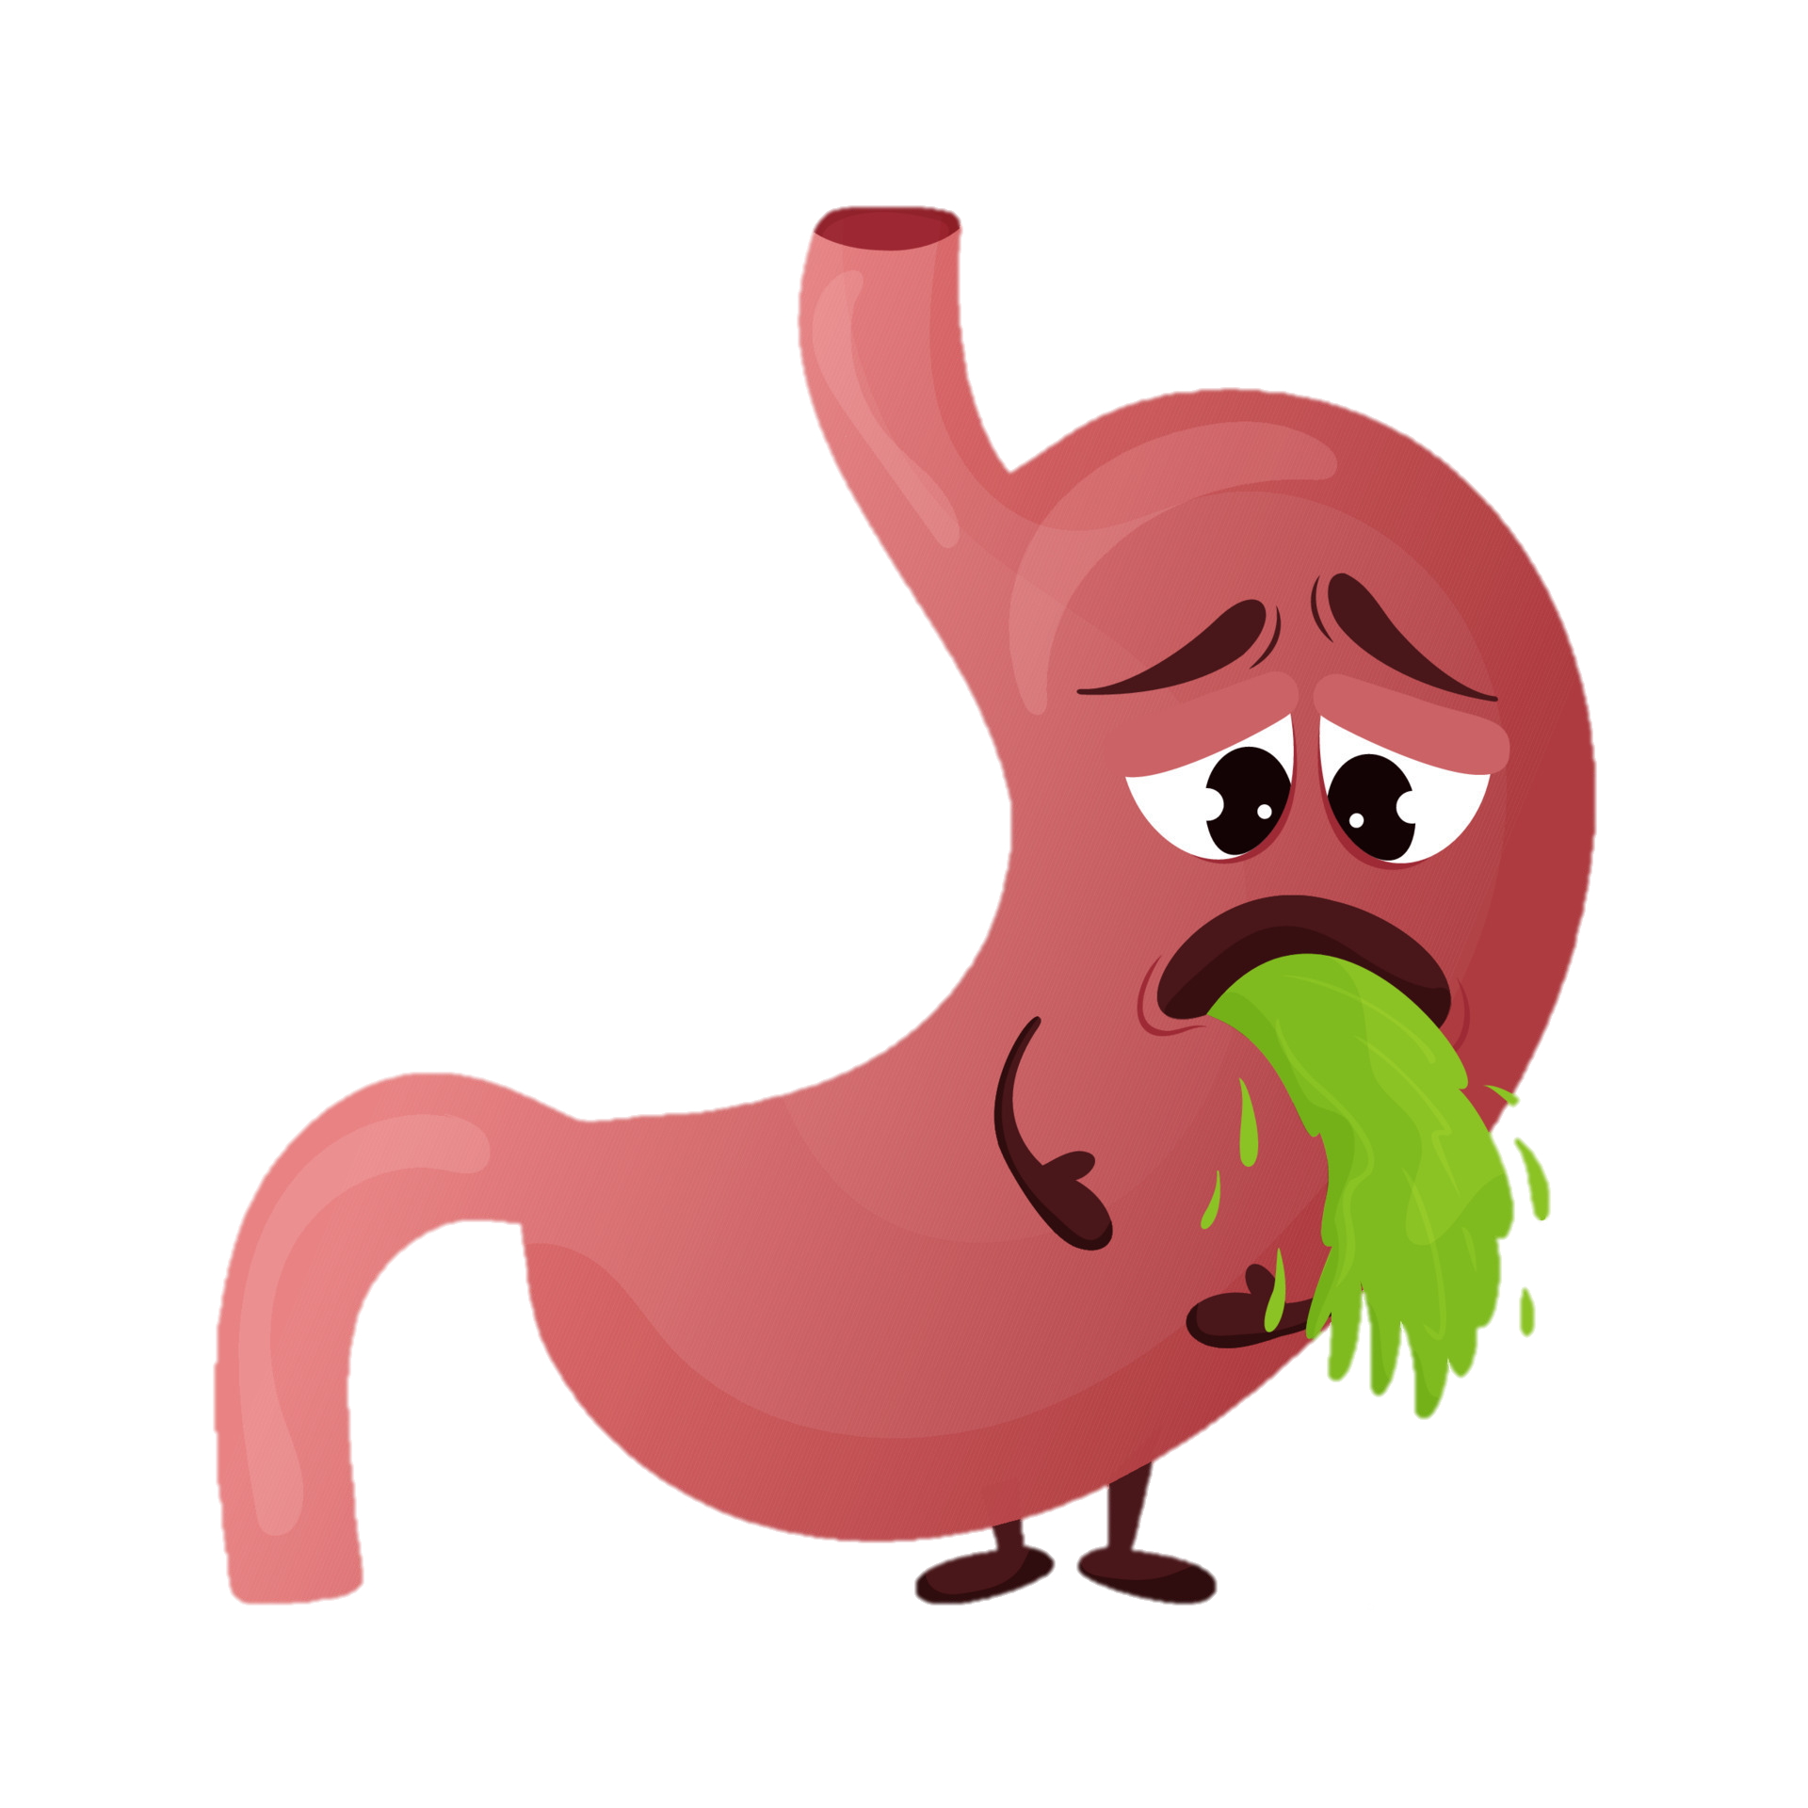
Hypovolemic Hyponatremia:
Loss of both sodium and water, with a greater loss of sodium
Vomiting
Diarrhea
Diuretic use (especially thiazides)
Adrenal insufficiency (Addison's disease)
Burns
Pancreatitis

Slide 10
Stop any drugs causing hyponatremia
Stop sick day medications
IV fluid replacement with 0.9% sodium chloride
Monitor U&E 12 hourly, if sodium rises by >5mmol/L in 12hr, reduce rate of infusion by 30%
Notes:
Sick day medications: Sulfonylureas, ACEi, Diuretics, Metformin, ARBs, NSAIDs, SGLT2 inhibitors

Slide 11
A 75-year-old woman presents with worsening dyspnea, bilateral lower limb swelling for past 1 week. She has been previously diagnosed with type 2 diabetes.
Physical examination reveals bilateral pitting edema, jugular venous distension, and crackles in both lung fields.
Laboratory tests show a serum sodium level of 130 mEq/L, low serum osmolality, low urine sodium, and elevated BNP.
What is the diagnosis leading to hyponatremia?
Heart Failure
Notes:
Reduced renal perfusion due to low cardiac output impairs the kidneys' ability to excrete free water.
Decreased blood flow and pressure sensed by baroreceptors stimulate the release of ADH from the pituitary gland.
Reduced cardiac output and effective circulating blood volume lead to activation of RAAS. the reabsorption of water can disproportionately exceed sodium, diluting the serum sodium concentration.

Slide 12

Hypervolemic Hyponatremia:
low sodium levels in the blood where the water retention is disproportionately greater than the sodium retention. This imbalance leads to a dilution of sodium in the extracellular fluid.
Heart failure
Liver cirrhosis
Nephrotic syndrome
Chronic kidney disease

Slide 13
Restrict Na+ intake <100mmol/day = 2.3g
Fluid restriction <1.5L/day
Seek specialist review

Slide 14
A 38-year-old woman presents with confusion and lethargy. Otherwise, neurological examination is normal. There are no signs of dehydration or fluid overload/oedema.
She is on selective serotonin reuptake inhibitors (SSRIs) for the management of her depression for past few months. She is otherwise fit and well.
Blood investigations show serum sodium level is 125 mEq/L, serum osmolality is low. Thyroid and adrenal function tests are normal. Urine osmolality and urine sodium are elevated.
What is the diagnosis leading to hyponatremia?
SIADH
Notes:
SSRIs are known to cause SIADH. Excessive ADH secretion leads to water retention, this causes volume expansion which diminishes RAAS system to restore blood volume but in turn it causes natriuresis and increased urine osmolality. The result is euvolemia.
Assess if SSRIs are still needed, if so, change to different anti-depressant. Do not stop abruptly, taper off the drug.
Monitor sodium levels, advise fluid restriction. If not improving, consider ADH antagonists like tolvaptan.

Slide 15
Euvolemic Hyponatremia:
Normal or near-normal body sodium, with an increase in body water
Syndrome of inappropriate antidiuretic hormone secretion (SIADH)
Hypothyroidism
Primary polydipsia
Exercise-associated hyponatremia
Certain medications (e.g., antidepressants, anticonvulsants)
Notes:
Urine osmolality and urinary sodium are elevated. In other two types, the urinary sodium is low.
Euvolemia is maintained by natriuresis, Atrial natriuretic peptide released form atria due to volume expansion leads to natriuresis

Slide 16

THANKS

