Slide 1


Understanding Metadata
DDI Alliance Training Library
Version 1.0
DDI Alliance, DDI Training Working Group
This work is licensed under Creative Commons Attribution 4.0 International License.

Slide 2
Contents
Defining Metadata
Data or Metadata?
Examples
Roles
Usage
Management
History
Summary

Slide 3
Audience
The content in this slide deck is broad and was created for a general audience with little to no knowledge of metadata.

Slide 4
Defining Metadata

Slide 5
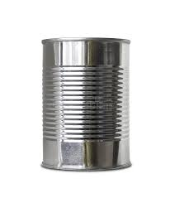
What is in this can?

Slide 6

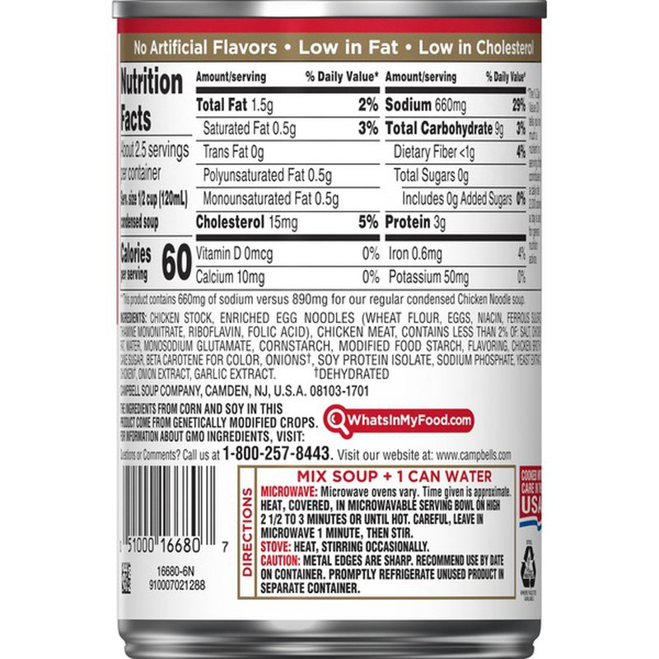
Now you know!

Slide 7
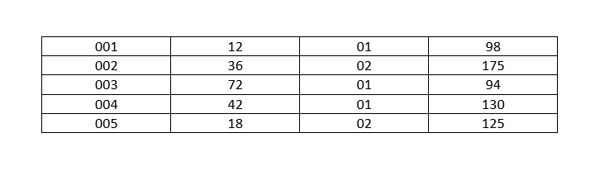
What do the numbers in this table mean?

Slide 8
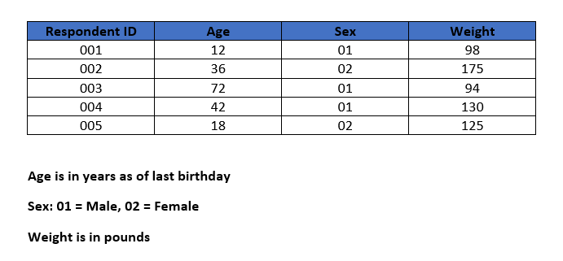
Metadata tells us!
Metadata

Slide 9
What Does “Meta” Mean, Anyway?
Metadata are descriptions or information about some thing(s)
Greek: μετά- is a prefix meaning
    Beyond
    After
    Transcending
Literally – metadata are beyond the thing(s) being described

Slide 10
Metadata Clarification
The numeric table –
  Metadata are
    Headings for the columns
    Descriptions of the values in each column
  They describe the table and the data in the cells
People define it as “data about data”, but…
The food can –
  Metadata are what is written in the label on the can
  They describe the contents of the can
Let’s look at this in more detail …

Slide 11
Metadata Defined – Not Just Data about Data
Metadata may be about data
  Numeric table example
Metadata may be about some other “things”
  Food can example
Requires broad view of metadata
  “Data about some resource”
Enhanced definition
  Metadata: data describing some object(s)
But, metadata can be more than “about” data, it can also be data

Slide 12
Data or Metadata?

Slide 13
Metadata – A Role
Metadata is a role for data
No data are always metadata
  Data are metadata when they appear in a description
  The description, though, is data with respect to the software used to create it
Most (if not all) data can sometimes appear as metadata
Depends on usage
  Same data, different perspective

Slide 14
Metadata or Data? It depends!
Question – How do we intend to use the data?
Microdata Example –
  Data collected from respondents
    Responses to questions are descriptive of the respondent
    These are metadata because they describe each respondent
  Data used to create estimates of a population
    Each record has a weight
    Represents some fraction of the total population
    These are statistical data
  Same data – Different roles or intentions!
Metadata are intended to describe
Statistical Data are intended to measure

Slide 15
Examples of Metadata

Slide 16
Dublin Core Metadata Example
Dublin Core
  Commonly used metadata standard
  Dublin Core Metadata Element Set
    Originally 15 core elements
    Over 40 additional elements
  Developed by
    Online Computer Library Center – Dublin, OH
  Used in many digital libraries
    Museums, Book libraries
  Objects of interest (notably, not data):
    Museums – paintings, bones, pictures, documents, tools
    Book libraries – books and magazines

Slide 17
Telephone Call Example (1)
Another example – telephone company data
  Telephone company knows
    Who called whom
    Whether connection is made or why it failed
    Length of connection
  But they don’t have the content of each conversation
Telephone data contains:
  one number was used to call another
    including subscriber information of caller
  date/time this occurred
  whether a connection was made
  how long connection lasted

Slide 18
Telephone Call Example (2)
Use as data
  Build network of calls
    Nodes are phone number / subscribers
Use as metadata
  Part of the description of a particular phone call
The role the data play is crucial for making the distinction

Slide 19
Classification Scheme Example
Classification scheme entry
    Concept, code, definition, description, relationships
  Data for a classification database
  Data for construction of n-cubes, as element of a dimension
  Data for construction of a stratified sample
  Metadata for user of a table as description (meaning) of a cell
  Metadata for user of data based on the stratified sample

Slide 20
Paradata Example
Paradata: data used to record actions taken in data collection
  Therefore, metadata about the collection process
Paradata can include
  Contact attempts
  Time taken to complete an interview
  Non-response
Many National Statistical Offices (NSOs) collect and analyze paradata
So, part of the description (metadata) of each data point
  Brings metadata management to level of individual datums

Slide 21
Roles

Slide 22
Roles of Metadata
Metadata supports 3 main uses:
  Discovery - find relevant resources (e.g. data)
  Understandability - convey the semantics of resources
  Usage - describe limits of reasonable use
Above uses are roles
  Variables apply in all 3 cases
  So do data sets
  Structures of data do as well
The role idea clarifies “classification” of metadata, too

Slide 23
Classification of Metadata
Classification
  Assumes each classified thing belongs to one and only one category
  Often this is not true for metadata
Does it make sense to classify metadata?
  Significant overlap across classification categories of metadata
  For example:
    Usage and Discovery both need to know about data sets
    Semantic and Structural both need to know about variables
Use roles
  Each metadata element might play many roles
    e.g., variables play both semantic and structural roles
  Like idea of metadata itself
    Kinds are just refinements of the role of describing something

Slide 24
Usage

Slide 25
What do we want to describe?
Metadata may be used to describe …
Data
Variables
Segments
Value Domains
Classification schemes
Code lists
Questions
Questionnaires
Instruments
Collection process
Sample design
Weighting
Data transformations
Editing procedures
Machine Learning methods
Allocation
Estimation
Disclosure control

Slide 26
Uses of Metadata - Simple
Document descriptions of statistical objects
  Promote records management
Provide means of comparison across
  Objects (e.g., classification schemes)
  Programs, experiments, studies
  Time
  Organizations
  Subject areas (including within broad domains)
  Cultures (especially languages)
  Political entities (e.g., countries)

Slide 27
Uses of Metadata - Enhanced
Create new descriptions of more complex objects
  Descriptions of variables used to describe each data set
  Descriptions of questions used to describe question form or questionnaire
Promote reuse – “describe once, use many”
  Increase comparability
  Reduce inconsistency
    Avoid gratuitous differences
  Increase quality
  Reduce future burden
  Reduce costs

Slide 28
Uses of Metadata - Advanced
Promote machine-readable metadata
  Avoid using long prose documents
  Implement machine-readable formats (e.g., XML, JSON)
  Strive towards metadata driven processing
Promote concept management
  Note how and where concepts are used
    E.g., Concept, Universe, Category, Variable
  Link similar meanings
  For definitions, use principles defined in
    ISO 704 (Terminology – Principles and methods)
    ISO/IEC 11179-4 (Information technology — Metadata registries (MDR) — Part 4: Formulation of data definitions)
  For theory behind the approach, see Terminological approach to data and metadata
    Based on ISO 704, see Appendices
Notes:
See also https://ddi-cdi-resources.bitbucket.io/2024-03-12/field-level-documentation/

Slide 29
Advanced Metadata Needs Structure
Textual “documentation” vs. structured metadata
  Same content, but…
  Structured metadata is based on a schema
A schema is a formal technique for organizing metadata
  Elements
  Attributes
Machine-actionable metadata must be structured
Structured metadata is needed to support reuse

Slide 30
Structured Metadata: Example
Full text
  “The ESS Round 9 data set from 2018 of the European Social Survey is located at https://www.europeansocialsurvey.org/data/”
Metadata
  Metadata schema
    Data file source
    Data file name
    Data file date
    Data file location
  Metadata content
    European Social Survey
    ESS Round 9
    2018
    https://www.europeansocialsurvey.org/data/

Slide 31
Metadata vs. Documentation
In general,
  Text approach is…
    Written natural language description
  Metadata approach has…
    Schema element/attribute names
    Schema element/attribute content
Metadata are shorthand for written long-hand descriptions
Formal effective schema allows back and forth translation
But some descriptions are hard to formalize except on ad hoc basis
  E.g., rationales, “readme” files

Slide 32
Management

Slide 33
Managing Metadata (1)
Metadata are data
  Metadata can be managed in a database
    A metadata repository is a database of metadata
    Metadata is also often stored in data repositories
Data Structures: Relational, Object-oriented, Graph / Network, Other
  Each can be used to organize and manage metadata
  Depends on several factors
    Available software
    Current expertise
    Integration with other systems
    Time frame
    Costs
    Risks

Slide 34
Managing Metadata (2)
Repositories
  Database of metadata
Register
  Repository containing authoritative list of items
  Maintained for documenting and promoting consistent usage
Registry
  Rules and roles for maintaining and accessing a register
Authorities manage Registries that use Registers
  Auto registrations
  Passport applications

Slide 35
Benefits of Managed Metadata
More consistency in the production and dissemination of data
  More comparable data
  More understandable data
  More FAIR data
Assessing and ensuring data quality
Organizational efficiency
  Reuse of metadata assets
  Better design, implementation, and execution of processes
  Increased automation

Slide 36
History

Slide 37
Metadata – A Short History (1)
Need for metadata
  Been around for a long time
    Data
    Libraries (electronic card catalogs go back to the 1980s)
    Museums
    Laws
    Scholarly articles
The term “metadata” – coined around 1970
  3 independent “discoverers”
  All produced the same definition
    Data about data
  Underlying approaches radically different

Slide 38
Metadata – A Short History (2)
Philip Bagley, 1968
  Extension of programming language concepts
    published by US National Institute for Standards and Technology – 1969
  Book as paper on the web
Jack Myers, 1969
  Claim, but not published
  Founded the Metadata Company
    Trademarked the term METADATA (1986)
    Sued others for its use
    Suits countered by showing prior published use of the term

Slide 39
Metadata – A Short History (3)
Bo Sundgren, 1973
  Statistics Sweden
  An Infological Approach to Databases
    PhD dissertation, published in 1973
    For philosophical underpinning, see Essays on Infology
  35-year influence on international official statistics community
  Many papers

Slide 40
Metadata – A Short History (4)
Lawrence Berkeley Lab – 1980s
  CODATA project
  About statistical data
  Led to OSIRIS
  Which led to DDI-Codebook beginning in 1995
DDI-Lifecycle started in early 2000s and DDI Alliance in 2003
Many other DDI products
  Controlled vocabularies
  DDI-CDI
  SDTL
  XKOS

Slide 41
Metadata – A Short History (5)
UNECE Statistical Metadata Working Group (METIS) – 1988-2010
  Bi-yearly meetings of National Statistical Offices
  Heavily influenced by Sundgren
  Development of GSBPM – first standard under UNECE
UNECE High Level Group (HLG) and Supporting Standards Group (SSG)
  2010 - present
  Led to development of GSIM, GAMSO, CSPA, CSDA, Metadata Glossary, etc.

Slide 42
Summary
Definition of metadata
  Data intended to be used for describing some object(s)
Compare with data
  When are data metadata? It depends.
Roles
  Metadata can be used for multiple purposes (administrative, semantic, etc.)
Uses
  Human readable documentation
  Sharing metadata and reusable descriptions
  Concept management and machine-readable metadata
Management
  Metadata are data, so they may be managed similarly
History
  Evolution and continued development

Slide 43
Credits: DDI Training Working Group
DDI Training Working Group Wiki/Confluence Page
Official DDI Training Materials on Zenodo
These DDI training materials are approved products of the DDI Alliance. The Data Documentation Initiative (DDI) is an international metadata standard for describing the data produced by surveys and other observational methods in the social, behavioral, economic, and health sciences.
These official training materials are created by volunteers and undergo a quality review process by the DDI Training Working Group and the DDI Scientific Board. They are designed for self-guided learning about DDI and can also be reused to teach others about DDI and related topics.

Slide 44

Scan this QR Code with Your Smartphone to Access the DDI TG Linktree
https://linktr.ee/DDItraining

