Slide 1


THE SECURITY AWARENESS RESOURCES HUB is here!
Davina Luyten
Subtask lead Awareness WP8 – T2 Human Factor
SIG-Marcomms - TNC24
10 June 2024
Public

Slide 2
Which initiatives do we run?
Annual Cyber Security Month campaign
Awareness survey

Slide 3

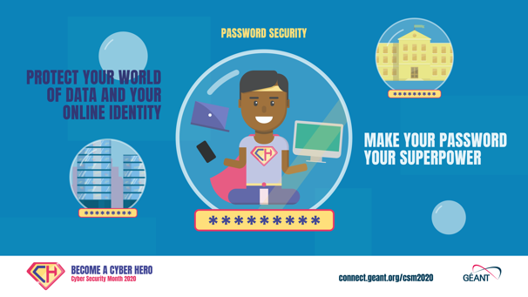
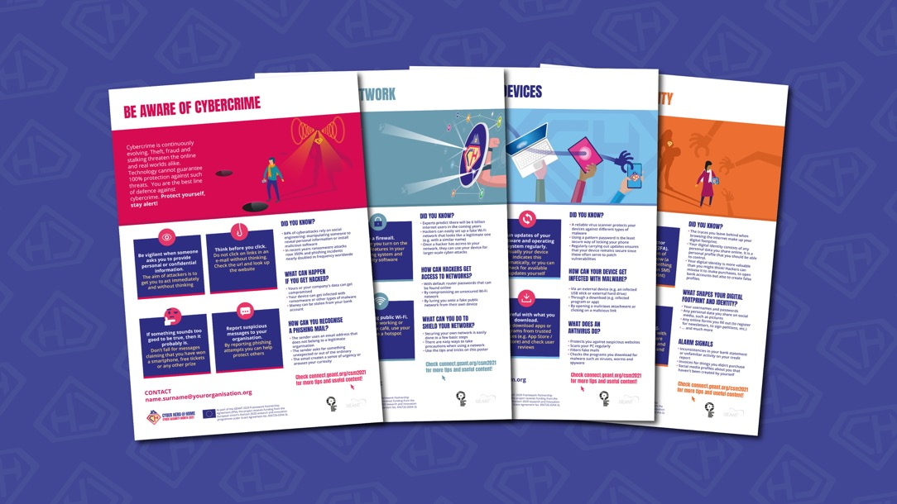

Awareness survey 2023
Our community is most interested in sharing best practices and experiences with other NRENs (84%) and in receiving ready-to-use awareness materials (76%).

Slide 4

Which initiatives do we run?
Annual Cyber Security Month campaign
Awareness survey
Awareness community

Slide 5
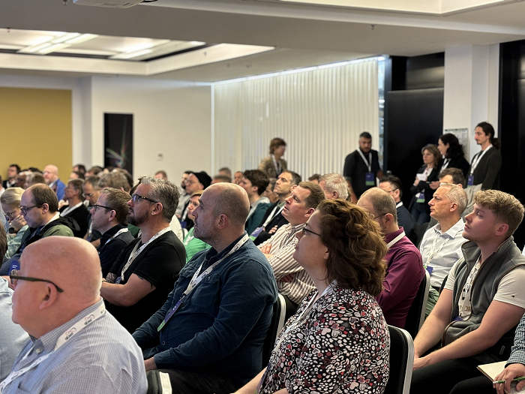
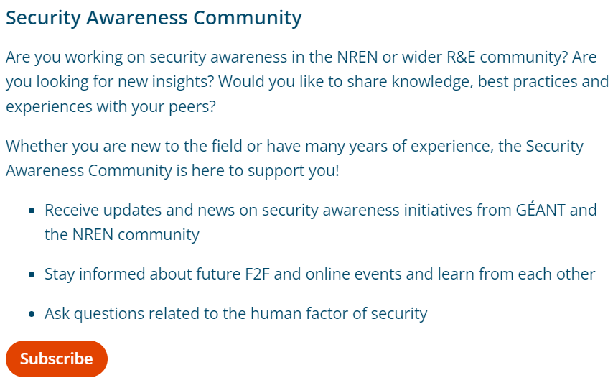
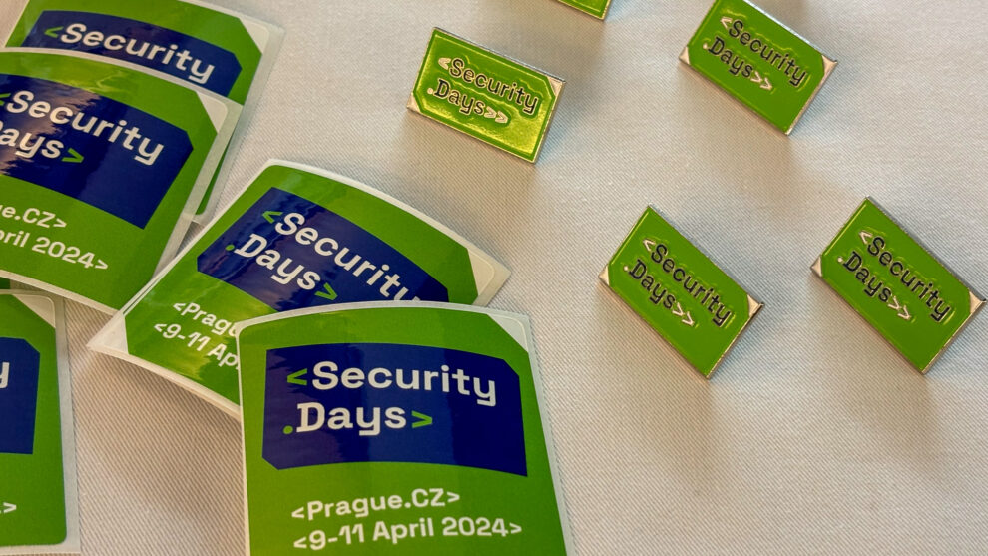
Join the GÉANT awareness community
A community for awareness experts from the NREN and wider R&E community
Meet your peers and share knowledge and experiences
F2F and online events - Save-the-date:
  12 November 2024: online event
  8-10 April 2025: GÉANT Security Days
Subcribe to our mailing list to receive updates and invitations

Slide 6
Which initiatives do we run?
Annual Cyber Security Month campaign
Awareness survey
Awareness community
Security Awareness
Resources Hub

Slide 7
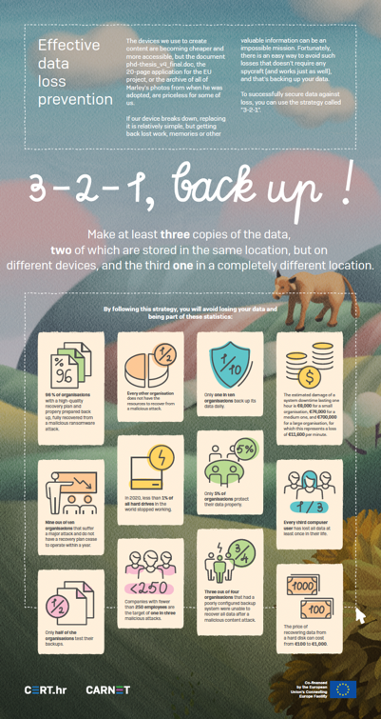
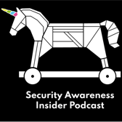

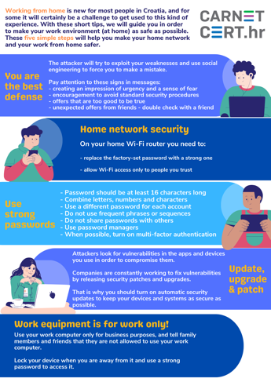
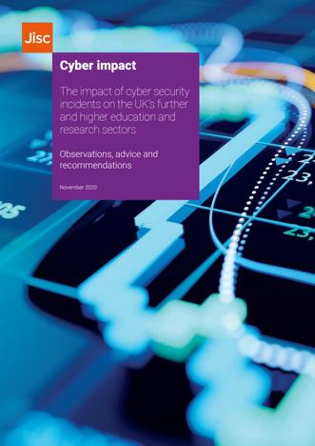
Security Awareness Resources Hub
A knowlegde base where you can find different types of awareness materials from NRENs and other organisations, for possible re-use and re-distribution.
Within the GÉANT Security website: https://security.geant.org
This is just a stepping stone.
Podcasts
Training, courses, games
Posters, guidelines, templates
Reports

Slide 8
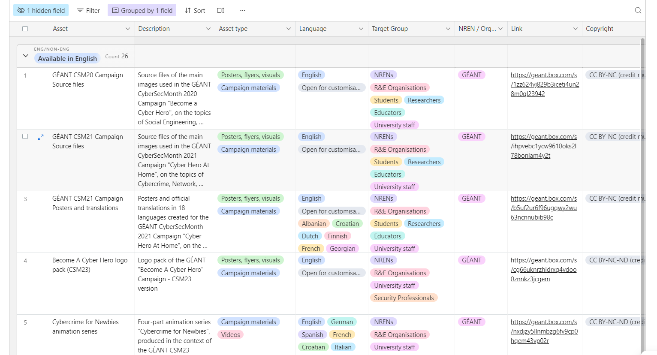
Security Awareness Resources Hub: demo
Notes:
Show the filtering sytem, explain how to add their own materials

Slide 9
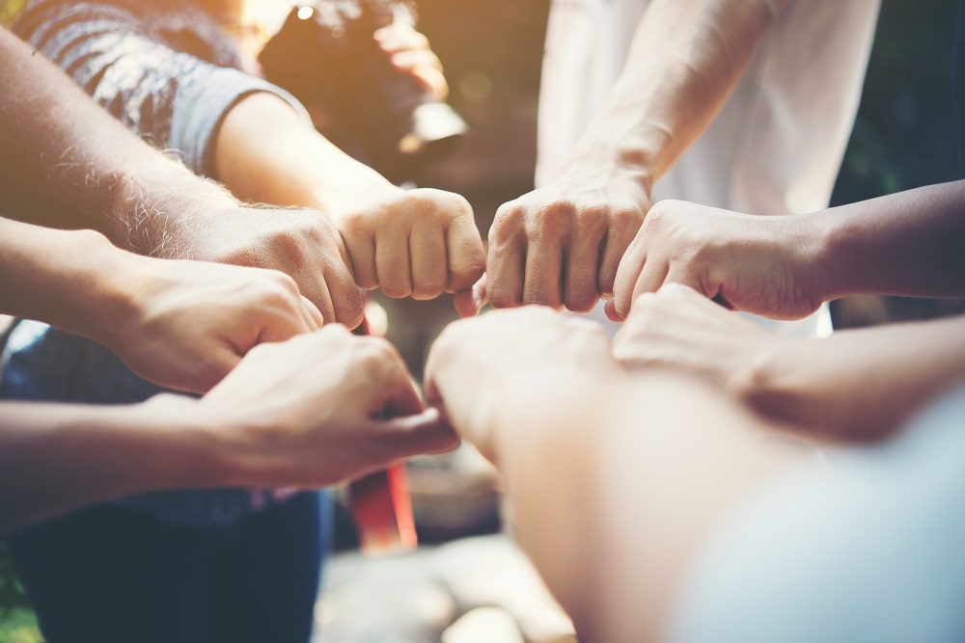







Subtask Awareness: meet the team
Charlie van Genuchten, SURF
Rosanna Norman, GÉANT
Leonardo Marino, GÉANT
Cornelia Puhze, SWITCH
Marina Dimić Vugec, CARNET
Simona Venuti, GARR
Mark Tysom, Jisc
Laetitia Lagneau, Belnet
Davina Luyten, Belnet

Slide 10

Thank You
Any questions?
csm@geant.org
www.geant.org

