Slide 1
White Hat Hackers: Marketing Strategy
SIG Marcomms, TNC24

Slide 2

The context
Projection of
3.5 MILLION
of unfilled cybersecurity vacancies worldwide by 2025.
By 2025, cybercrime is projected to cost
$ 10.5 TRILLION
in damages per year globally.
Ransomware attacks have grown
41%
in 2022.
Fraud cases already increased in
70%
since 2020.
The global cybersecurity workforce gap has widened
26%
since 2022.

Slide 3

The goal
Training qualified labor to reduce the gap between vacancies and professionals in the area;
Democratizing knowledge in cybersecurity and IT;
Providing support for technological development projects;
Stimulating the creation of a security and privacy ecosystem in Brazil.

Slide 4
Objectives in MarComms
1
Promote Hackers do Bem to its target audience and stakeholders, in order to attract 30.000 students, convert participants to the events and generate interest in the national cybersecurity hub.
2
Increase the reputation of the institutions involved in the program in the technology niche, as well as the authority on the topic of cybersecurity.
Notes:
Falar do Senai SP – in charge of training labor for Brazilian Industry
Softex – an organization that promotes software and competitivity in the country

Slide 5
No budget for marketing
The problem

Slide 6

Creativity
The solution

Slide 7
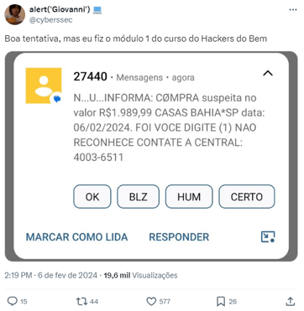
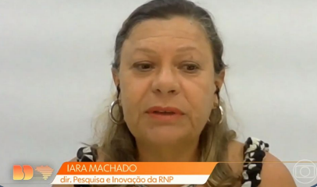
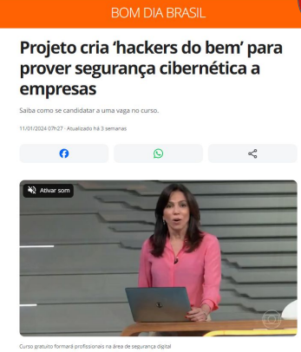
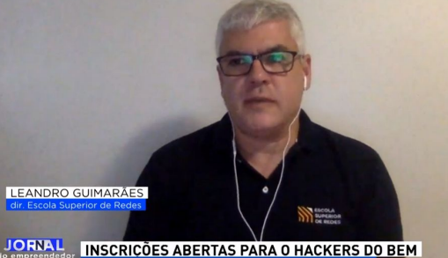
Solution
Press release - spontaneous media;
Posts on RNP and partners’ social networks;
Publications on institutional channels, such as website and newsletters;
Welcome live to students on YouTube with the Minister of Science and Technology.

Slide 8


Results
We attracted 130 thousand students to the program.
The number of simultaneous accesses was so great that the platform crashed.
We reinvest in technology to provide quality to all these accesses.
We continue with the challenge of reaching our goal, which is to certify a high number of students at each stage (for example, 30 thousand students at the leveling and basic levels, the first two).

Slide 9
When the learning platform was unavailable, we had many negative mentions on social media, emails and other channels. It was a moment of negative exposure for RNP brand as well. Today, we are thinking about creating specific social networks for the program... What do you think about this? What would you do?
For discussion

Slide 10
Stela Tsirakis Toti
stela.tsirakis@rnp.br

