Slide 1
Transforming web design with AI-generated code
Nisreen Al Kouz - ASREN
10 June 24 - TNC

Slide 2

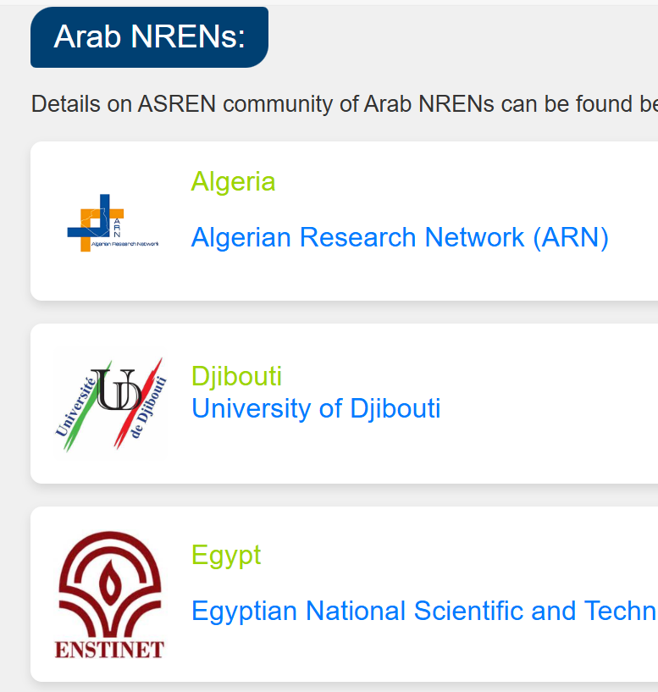
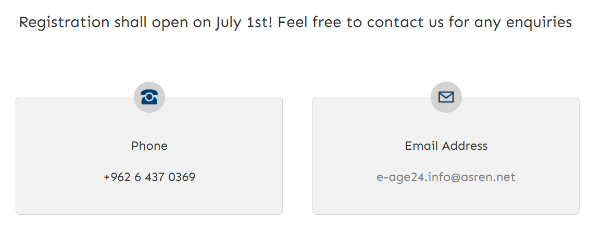

Slide 3
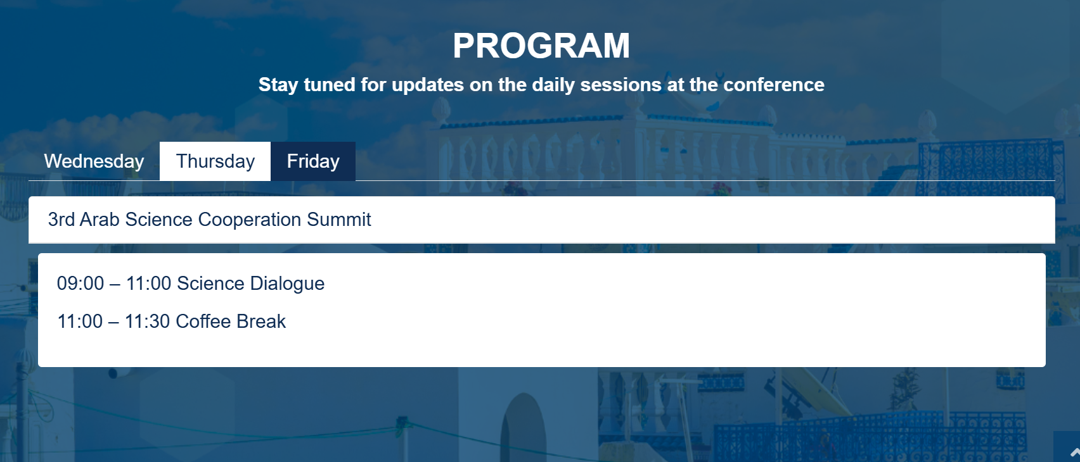

Slide 4


Slide 5
Pros & Cons
Efficiency
Learning Aid
Accessibility
Basic coding knowledge helps!
Not always perfect

Slide 6
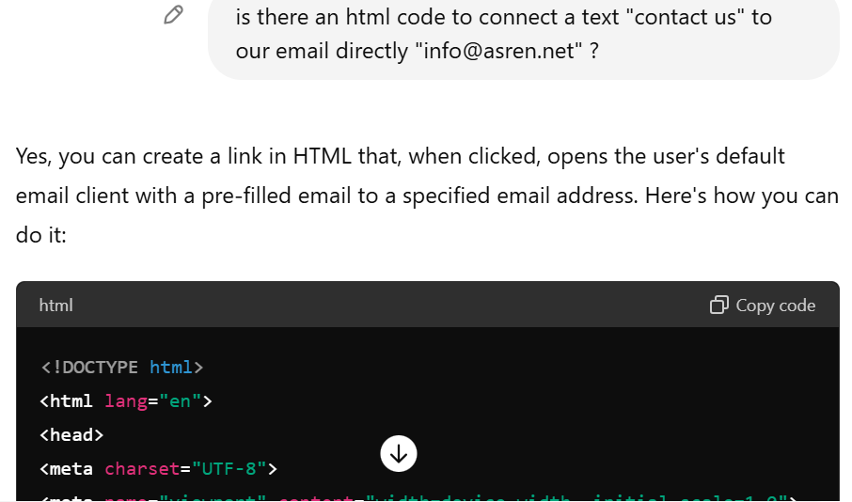
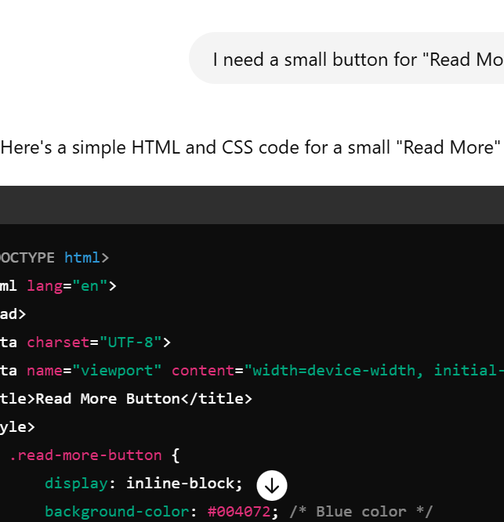
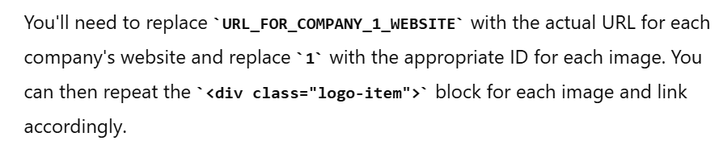
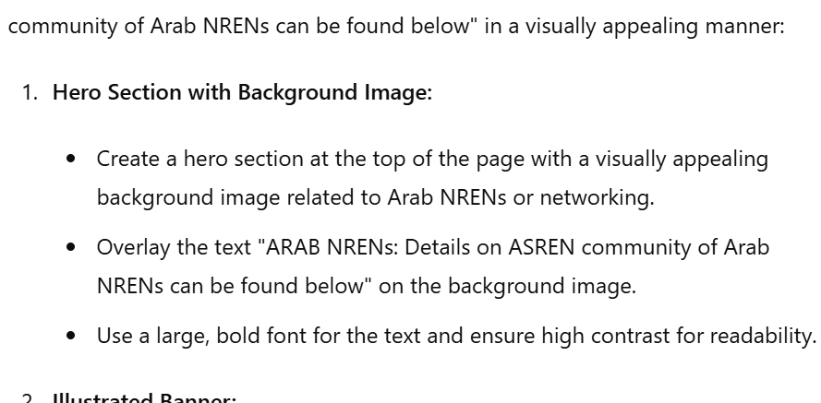

Slide 7



Thank You!
asren.net
@ASRENorg
@ASRENorg

