Slide 1
Progress in the Development of a Damage Growth Model for Leading Edge Erosion Incorporating Inspection Data
Ryan Clarke

Slide 2
IEA task 43 WP 5: Operations and Maintenance
provide guidance on digitalization practices and implementations with the potential to deliver wind O&M advancements and new opportunities
Case study: Risk-based Maintenance of Leading Edge Erosion.
Team:
Alex Byrne – DNV GL
Joshua Paquette – Sandia National Laboratories
Ryan Clarke – Sandia National Laboratories
Jannie Sønderkær Nielsen – Aalborg University
Des Farren – Servusnet
Nikolay Krasimirov Dimitrov – DTU
Nathan Hoerning – Wisconsin Public Utility
Liliana Haus – EPRI
Noah Myrent – EPRI
Murray Fisher – Gulf Wind Technology

Slide 3
Risk-Based Maintenance Framework
Risk-Based Recommendation
High priority/low priority repair
Inspect within specific time
Inspect at next regularly scheduled interval
Modify turbine operations
Decision Model
Probabilistic Damage Growth Model
Cost Model
Inspection Data
Site Environmental Characteristics
Structural Parameters
Inspection Costs
Repair Costs
Downtime Costs
Operating Constraints
Damage Classification
Precipitation
Wind loading
Turbine model
Material properties
Fixed
Variable
Fixed
Variable
Lost Revenue
Logistics Costs
Weather window
Budgetary
Contractual

Slide 4
Erosion Damage Growth Model for O&M Prediction and Optimization
Short-Term Damage Rate/Mass Loss Rate
(Springer Model [1])
Rain Statistics
(Rain Intensity, Droplet Size Distribution)
Wind Statistics
(Wind Speed)
Turbine Model
(Power Curve)
Long-Term Damage Rate [2]
(Weighted sum of short term erosion damage rate together with probability of occurrence of all possible rain and wind conditions)
Incubation Period Prediction
Rate of Mass Loss
Inspection data
Erosion Category
(Severity of erosion at all points in a wind blades lifetime)
[1] GS Springer, CL Yang; PS Larsen, "Analysis of Rain Erosion of Coated Materials," Journal of Composite Materials, vol. 8, pp. 229-252, 1974.
[2] A. Shankar Verma et al., "A probabilistic long‐term framework for site‐specific erosion analysis of wind turbine blades: A case study of 31 Dutch sites," Wind Energy, vol. 24, no. 11, pp. 1315-1336, 2021, doi: 10.1002/we.2634.

Slide 5
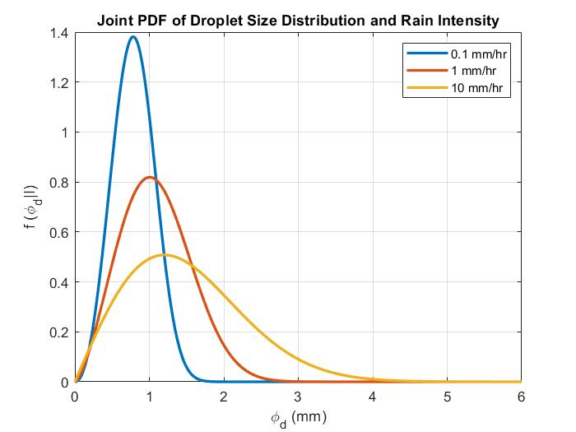
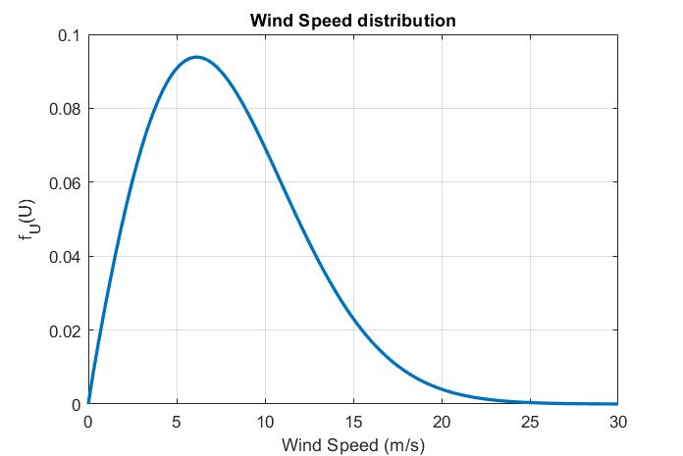
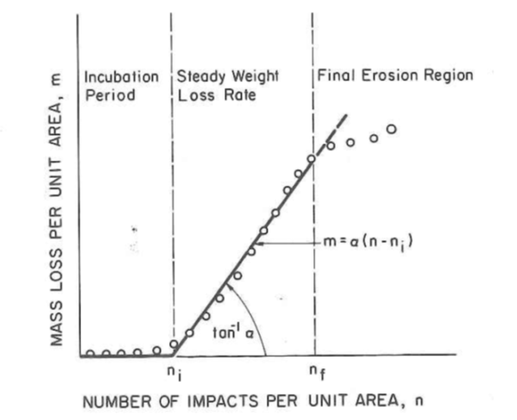
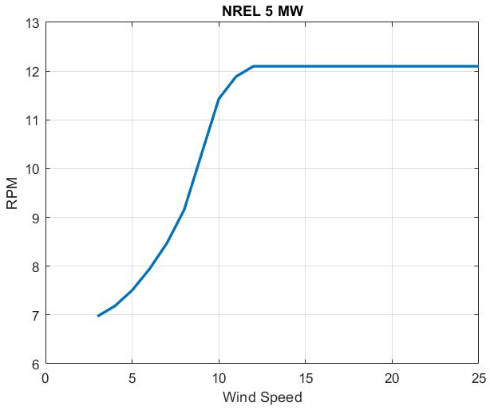
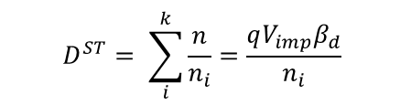
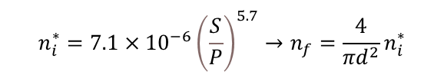
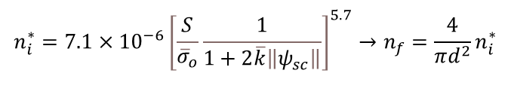
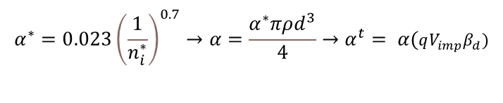
Inputs
Springer Model
Rain Statistics
Wind Statistics
Quasi-empirical model based on classical fatigue analysis fit to experimental results
Incubation period (number of impacts) for coated laminates
$$n_{i}^{∗}=7.1×{10}^{−6}{\left[\frac{S}{{\overline{σ}}_{o}}\frac{1}{1+2\overline{k}\left\|ψ_{sc}\right\|}\right]}^{5.7}→n_{f}=\frac{4}{πd^{2}}n_{i}^{∗}$$
Incubation period for uncoated laminates
$$n_{i}^{∗}=7.1×{10}^{−6}{\left(\frac{S}{P}\right)}^{5.7}→n_{f}=\frac{4}{πd^{2}}n_{i}^{∗}$$
Damage Rate - Palmgren-Miner Rule
$$D^{ST}= \sum_{i}^{k}{\frac{n}{n_{i}}}=\frac{qV_{imp}β_{d}}{n_{i}}$$
Turbine Power Curve
Mass loss rate
$$α^{∗}=0.023{\left(\frac{1}{n_{i}^{∗}}\right)}^{0.7}→α=\frac{α^{∗}πρd^{3}}{4}→α^{t}= α(qV_{imp}β_{d})$$
$$m=α\left(n−n_{i}\right)→m=α^{t}\left(t−t_{i}\right)$$

Slide 6
Long-term Damage Calculation
$$D^{LT}= \sum_{i}^{∞}{\sum_{j}^{∞}{\sum_{k}^{∞}{D_{ijk}^{ST}}\left(I_{i},φ_{d_{j}},U_{w_{k}}\right)∗}}f_{φ_{d}\left|I\right.}\left(I_{i},φ_{d_{j}}\right)∗P\left(I_{i}\right)∗f_{U_{w}}\left(U_{w_{k}}\right) ∆I∆φ_{d}∆U_{w}$$
$$α^{LT}= \sum_{i}^{∞}{\sum_{j}^{∞}{\sum_{k}^{∞}{α_{ijk}^{ST}}\left(I_{i},φ_{d_{j}},U_{w_{k}}\right)∗}}f_{φ_{d}\left|I\right.}\left(I_{i},φ_{d_{j}}\right)∗P\left(I_{i}\right)∗f_{U_{w}}\left(U_{w_{k}}\right) ∆I∆φ_{d}∆U_{w}$$

Slide 7
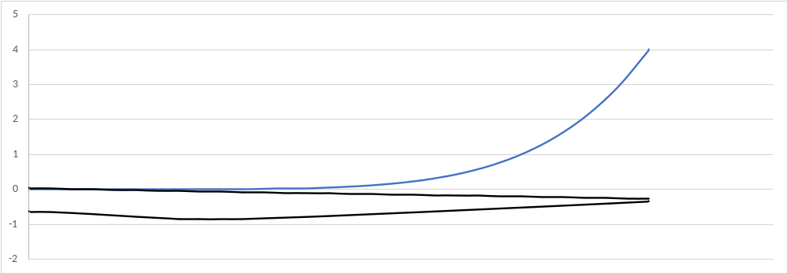

Relationship Between Mass Loss and Erosion Class
1D model at the blade tip, need to account for different erosion states along the blade for total AEP loss [3].
Erosion Class | Description | Coating Mass Loss | Laminate Mass Loss
1 | Light pitting of coating | <10% | 0%
2 | Small patches of missing coating | 10% - 50% | 0%
3 | Large patches of missing coating | 50% - 100% | <10%
4 | Erosion of laminate | 100% | 10% - 80%
5 | Complete loss of laminate | 100% | 100%
Category 4
Category 3
$$m∝V^{5}$$
Calculated Initiation Point
Category 2
Category 1
[1] C. Bak, "A simple model to predict the energy loss due to leading edge roughness," presented at the The Science of Making Torque from Wind Delft, Netherlands, 2022.
Notes:
Erosion class can be determined from expert analysis or using visual analysis tools and attributing area of erosion to mass i.e. 10% by area of coating gone $≈$10% Coating mass loss

Slide 8
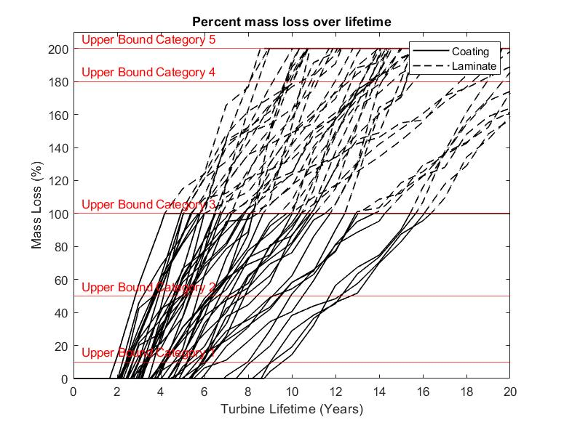
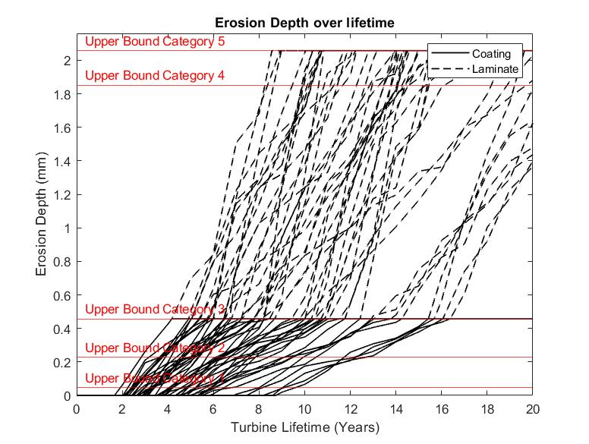
Output and Assumptions
Substrate is considered fatiguing even while it is covered by coating.
Currently only two material combinations can be considered.
Both coating and substrate are modeled as homogeneous materials.
Material properties are time invariant stochastic variables.
Weather statistics are time-variant stochastic variables.

Slide 9
Inspection Model
LEE uncertainty in inspection is a combination of likelihood of detection and likelihood of misidentifying damage category
Parameters | Minimum Fidelity: Ground-based visual | Moderate Fidelity: Drone w/ AI interpretation of results | High Maturity: Rope access manual inspection
 | Uncertainty | Uncertainty | Uncertainty
Existence of damage properly identified (likelihood of non-detection) | Cat 2: 30% Cat 3: 20% Cat 4: 5% Cat 5: 0% | Cat 2: 30% Cat 3: 20% Cat 4: 5% Cat 5: 0% | Cat 2: 10% Cat 3: 5% Cat 4: 0% Cat 5: 0%
Type of damage improperly identified (likelihood of misidentification of damage type) | Cat 2: 30% Cat 3: 25% Cat 4: 15% Cat 5: 0% | Cat 2: 30% Cat 3: 25% Cat 4: 15% Cat 5: 10% | Cat 2: 5% Cat 3: 5% Cat 4: 5% Cat 5: 5%

Slide 10
Bayesian Network: Updating based on inspection
M₀
M₁
M₂
Used before for fatigue processes [4].
Stochastic damage growth model informs probabilities for Damage size and Model parameters.
Lowest damage state = no damage (pristine leading edge).
D₀
D₁
D₂
R₁
I₁
Nodes / variables
Damage size: D_{i}
Model parameter: M_{i}
Inspection outcome: I_{i}
Preventive repair decision: R_{i}
[4] D. Straub, "Stochastic Modeling of Deterioration Processes through Dynamic Bayesian Networks," Journal of engineering mechanics, vol. 135, no. 10, pp. 1089-1099, 2009, doi: 10.1061/ASCEEM.1943-7889.0000024.

Slide 11
Future Work
Validation of model and framework from real wind farm inspections.
Adding leading edge erosion cost model of inspection, repair, and lost efficiency to framework.
Decide on model for repair, perfect repair, imperfect repair, knock-down factors, etc.
Adding a decision model to pair with damage growth model for optimal risk-based inspections.

Slide 12
Questions?
Notes:
Questions for the crowd: Does anyone have experience with dynamic Bayesian Networks and what’s needed from a model to implement one?

