Slide 1
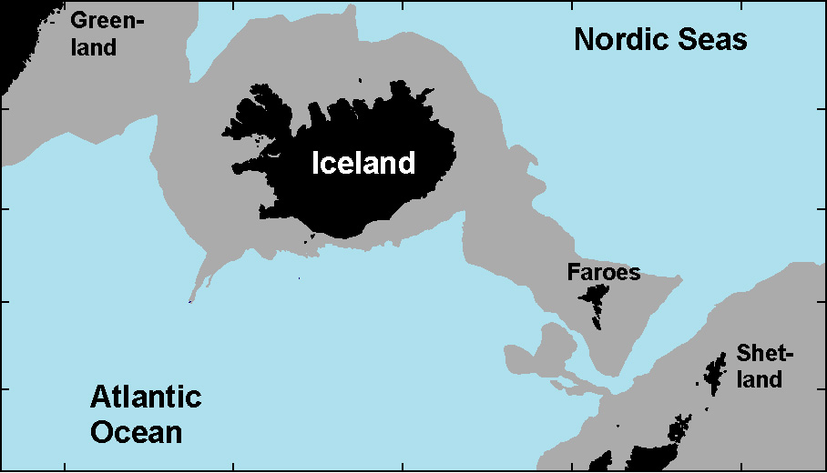
Overflow through the Western Valley of the Iceland-Faroe Ridge is negligible
Bogi Hansen, Karin M. H. Larsen, Steffen Olsen, Detlef Quadfasel, Kerstin Jochumsen, Svein Østerhus
Arctic Mediterranean
WV-overflow:
IFR
Canonical value for
IFR-overflow: 1 Sv

Slide 2
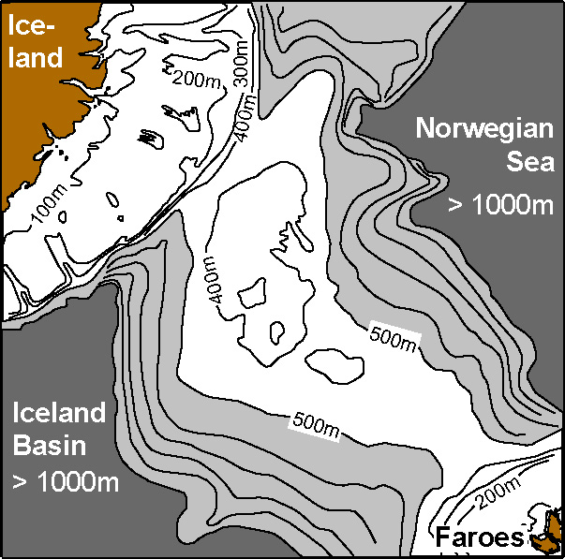
Western Valley overflow
Perkins et al. (1998): “find no evidence for significant flow through the WV”
Upstream interface
300m above
Western Valley sill
Western Valley
Field experiment
2016-2017
Strong
Perkins et al. (1998):
Strong bottom current
Quadfasel: ADCP moored 2 years
Persistent

Slide 3
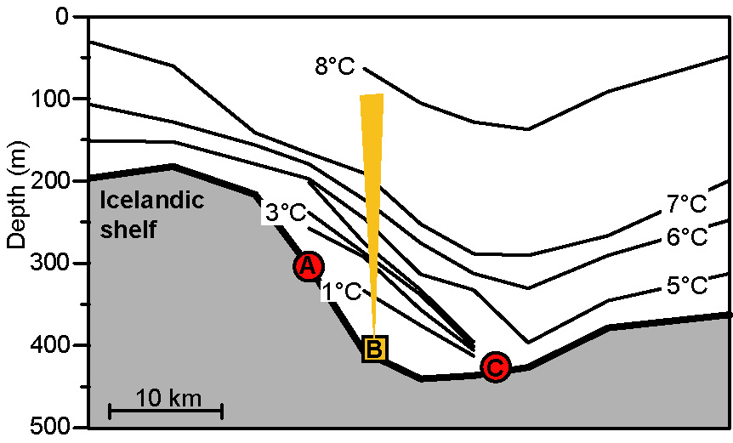
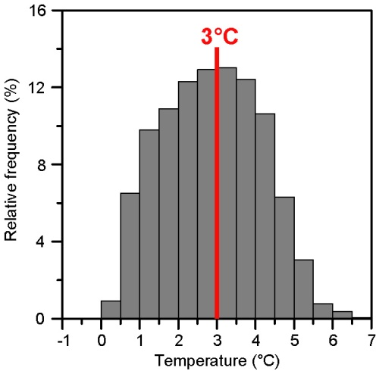
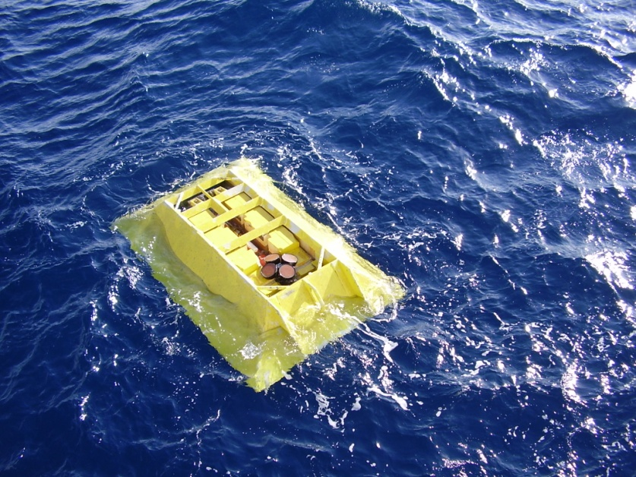
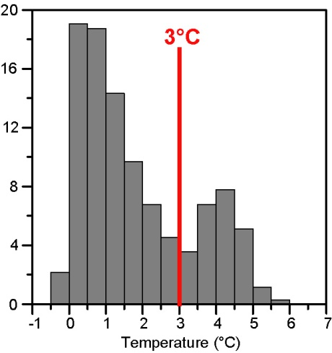
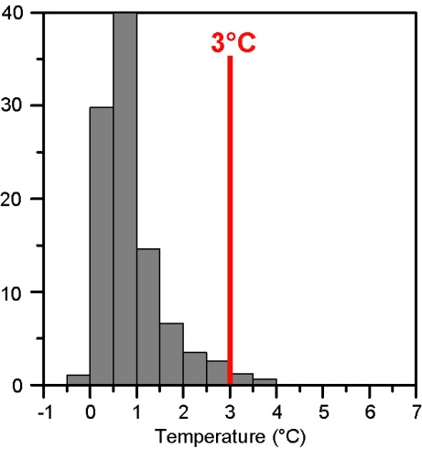
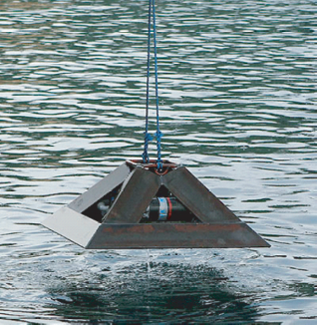
WOW field experiment
3 moorings, 278 days
Temperature during recovery cruise May 2017
Overflow water
Width < 20 km
Bottom temperature
Bottom temperature
ADCP

Slide 4
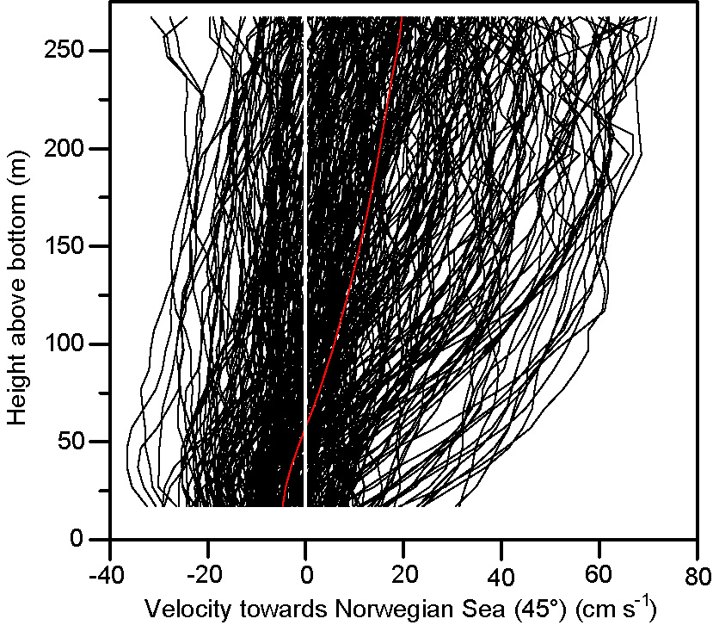
278 daily averaged ADCP profiles
ADCP
Average velocity
Transport density:
Overall average: <q> = 1.5 m²/s
Volume transport:
(Transport density) × (Width)
(1.5 m²/s) × (20 km)
≤ 0.03 Sv
Overflow

Slide 5
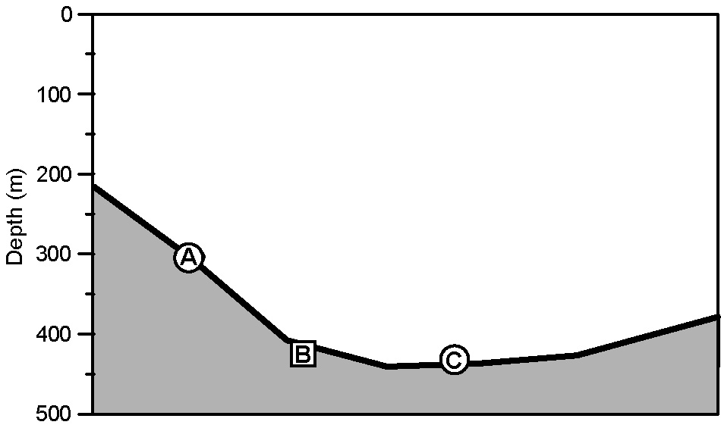

Height of overflow layer above ADCP
Transport density:
h = h₀ + h₁ – h₂
L
ϕ
h₂
h₁ = (3°C – T_{A}) × 31m
h₁
h₂ = L × tan(ϕ)
h
3°C
h₀
tan(ϕ) is calculated from velocity shear by Thermal Wind Eq.
h_{C}
T_{C}
Correlation between h_{C} and T_{C} is -0.73

Slide 6
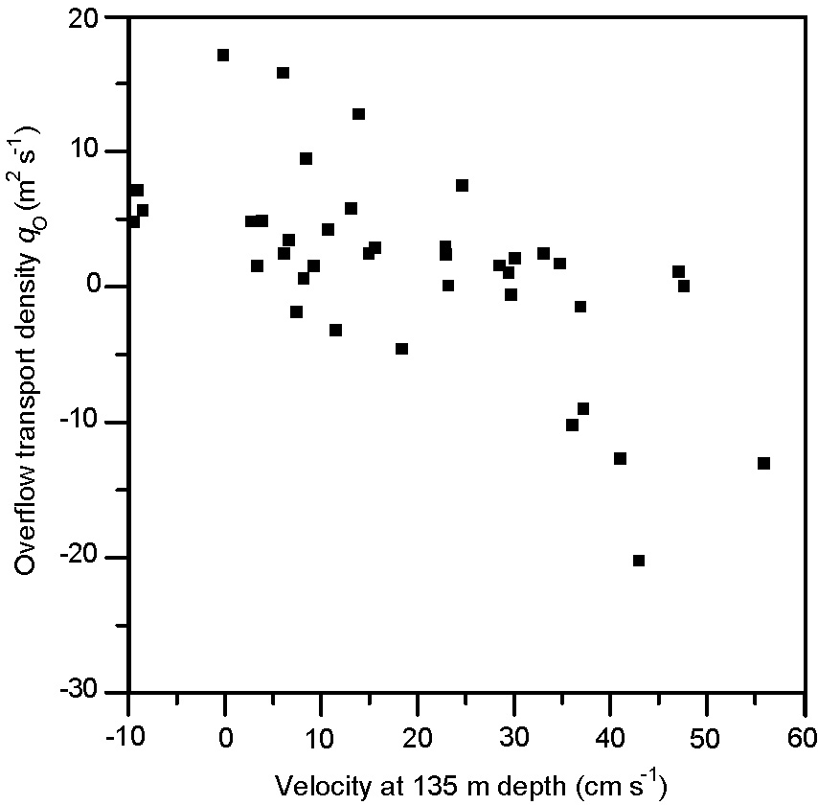
Transport density at ADCP site
Weekly averaged transport density:
Atlantic inflow blocks WV-overflow
Friction between inflow and overflow
Thermal wind equation: Strong shear gives thin overflow layer
Sea level difference generates
barotropic pressure gradient
R = -0.64
Inflow weak
Inflow strong
Atlantic inflow

Slide 7
Thermal wind equation
A thinner overlow layer is more sensitive to bottom friction
Weak Atlantic inflow
Weak shear
Strong Atlantic inflow
Strong shear
Overflow layer

Slide 8
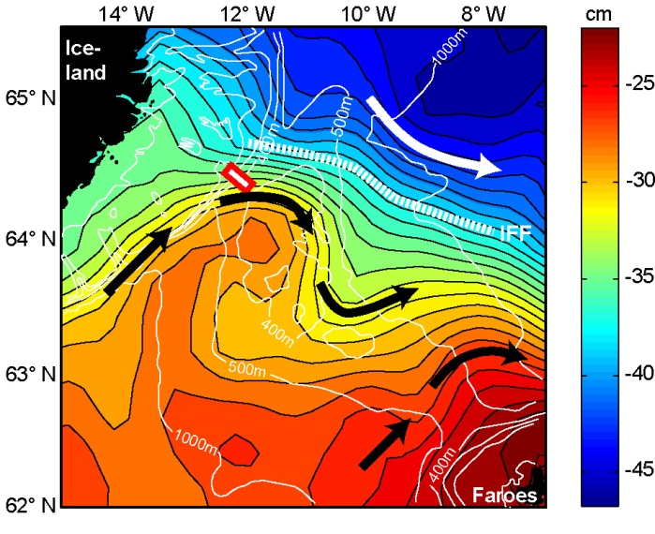
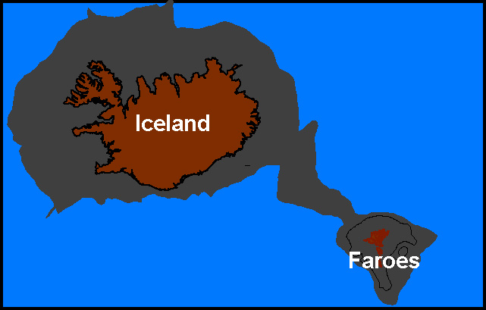
Barotropic pressure gradient
Mean Dynamic Topography
.
Upstream
Upstream
∆η
ρ₀
∆D
U
p_{S}
p_{U}
ρ₀+∆ ρ
Sill
1
∆ρ
Bernoulli: ½∙U² = ∙(p_{U} – p_{S}) = g∙( ∙∆D - ∆η)
)
ρ₀
ρ₀
1
∙ 200m
- 10 cm
= 0
2000

Slide 9
During the period of our field experiment, the average WV-overflow was < 0.03 Sv
Was the period perhaps abnormal ???????

Slide 10
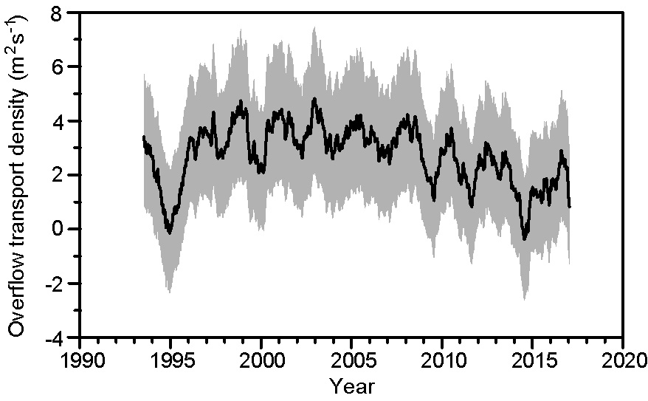
Satellite altimetry
Overflow transport density at ADCP site is correlated with velocity at 135m depth: R = - 0.64
Velocity at 135m depth is correlated with sea level tilt from satellite altimetry: R = 0.86
Overflow transport density at ADCP site is correlated with sea level tilt : R = - 0.60
This allows regression to reproduce overflow transport density for whole altimetry period
Average overflow 1993 - 2016
Transport density < 5 m²/s
Volume transport:
(Transport density) × (Width)
≤ 0.1 Sv
Average
Field
Exp.

Slide 11
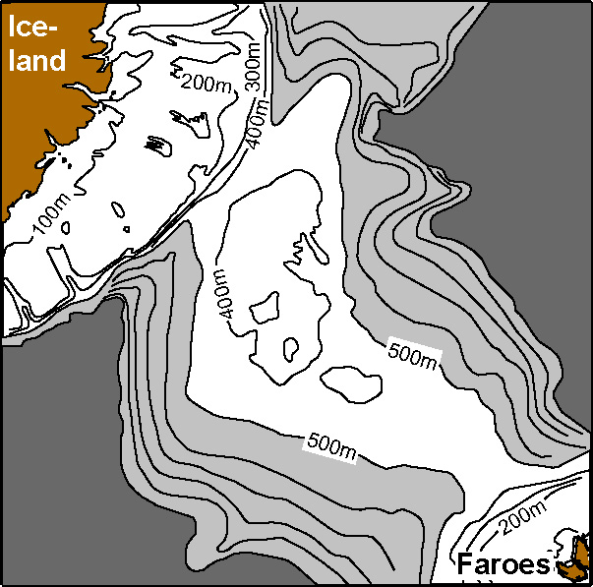
Total Iceland-Faroe Ridge overflow
<0.1 Sv
?
0.3 Sv
Beaird et al. (2013)

Slide 12
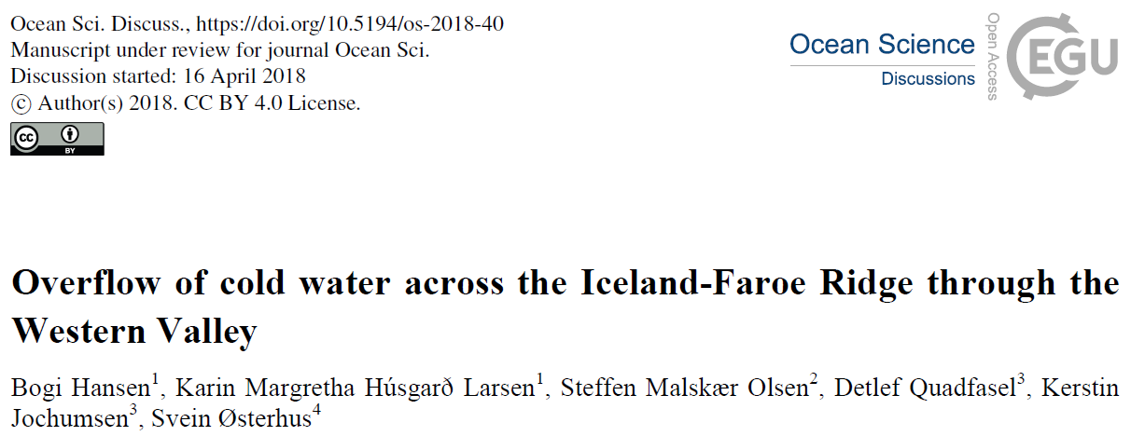
Funding agencies:
The Danish Energy Agency as part of the Arctic Climate Support Programme (Western Valley Overflow project).
RACE II – Regional Atlantic Circulation and Global Change funded by the German Federal Ministry for Education and Research (BMBF), Förderkennzeichen 03F0729B.
The Blue-Action project has received funding from the European Union's Horizon 2020 research and innovation programme under grant agreement No 727852.

