Slide 1
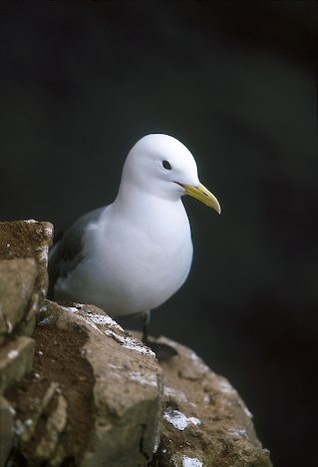
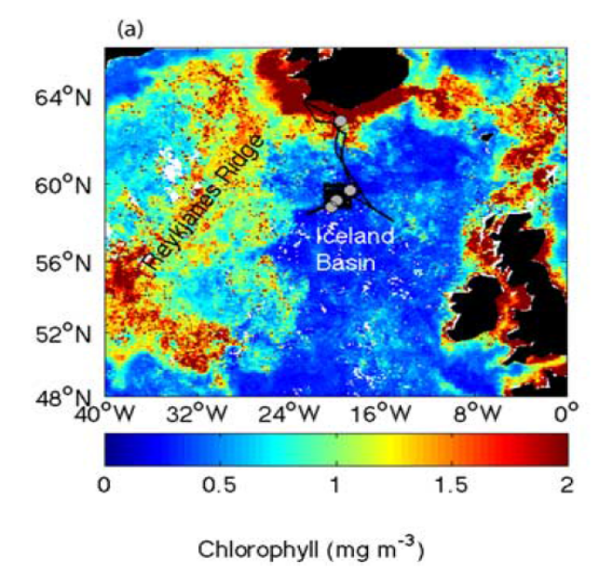
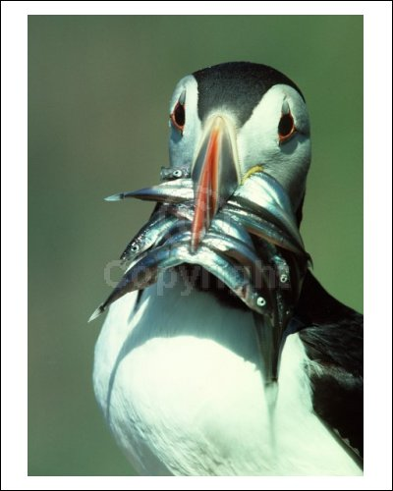
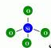
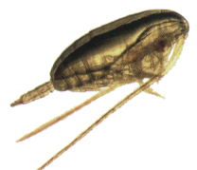
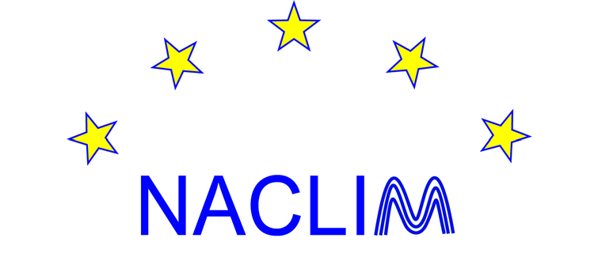



Selected short-stories from Icelandic waters
Hjálmar Hátún
And many good people ☺
October 2017

Slide 2
Outline
The subpolar gyre
A marked silicate decline
Zooplankton south of Iceland
The post-2006 mackerel expansion
Seabirds
Disappearance of Calanus hyperboreus
(north of the Faroe Islands)

Slide 3
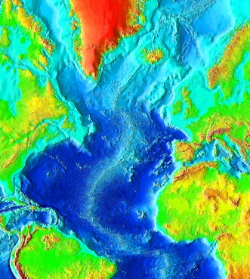
1. The subpolar gyre – and the marine climate
Subpolar
Gyre
Labrador Sea
convection
Subtropical
Gyre
(Hátún et al., Science 2005)

Slide 4
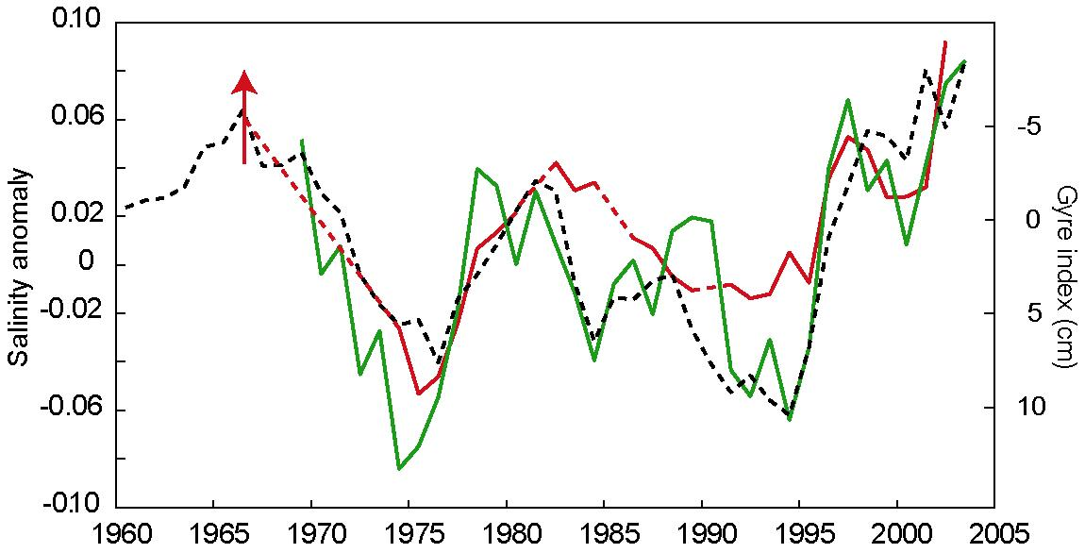
1. The Subpolar Gyre
Mid-90s decline
- and salinity ’dips’
On-shelf biological production
I
R
Gyre index
Salinity ‘dips’
Weak.
Salinity at Rockall (obs.)
Mid-1990s
Regime shift
(Hátún et al., 2009)
or Great Salinity Anomalies
Salinity in the Irminger Current (obs.)
Strong

Slide 5
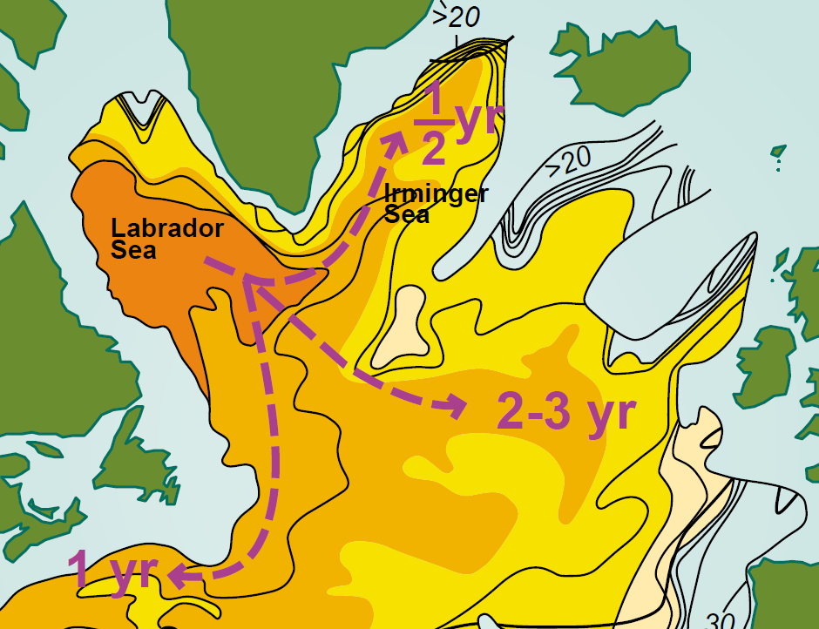
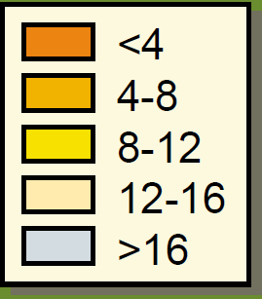
Degree of
stratification
~ 1 yr
PV
Convection
From: (Pickart, 2003)/(Talley & McCartney, 1982)

Slide 6
2. The Subpolar Gyre:
A large nutrient source
(Concentrations
in June, 50m)
Nitrate
Green-
land
Silicate
Source: WOA
Notes:
The average abundance of CF is much largest in within the subpolar gyre. They also appear at the surface during winter, probably because of the ongoing vertical mixing of water masses.

Slide 7
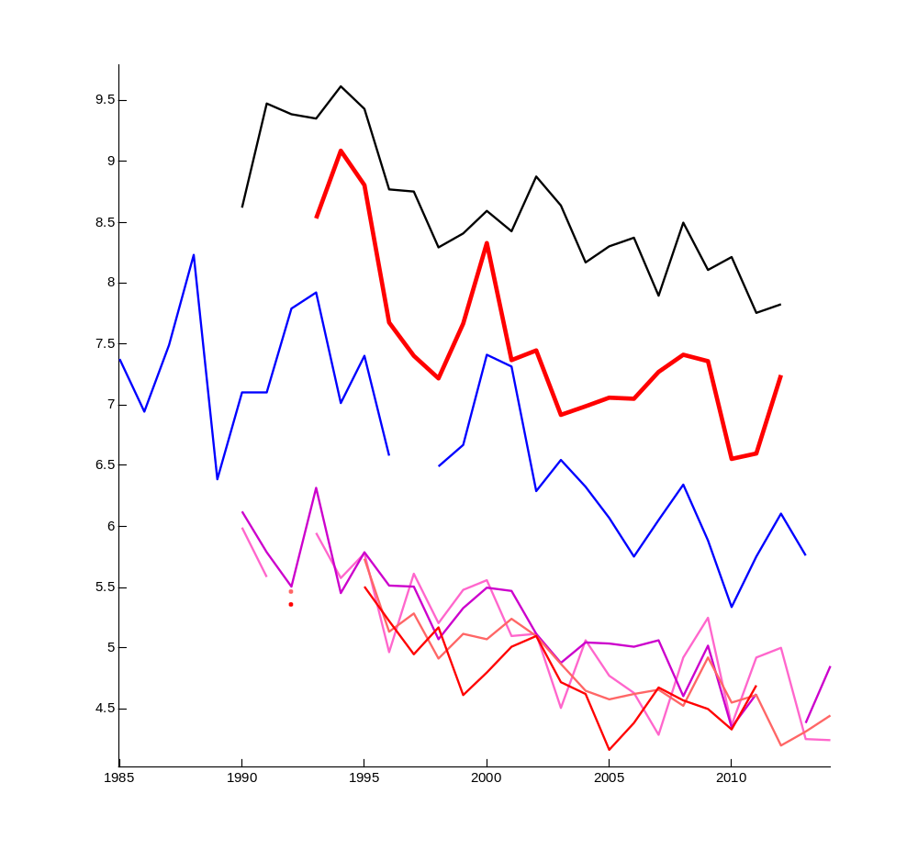
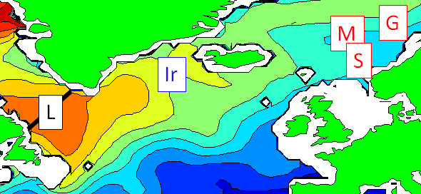
2. Silicate decline
µM
(Hátún et al.,
Nature Sci. Rep.)
L
150-500 m, Mai
(Kumiko Azetsu-Scott)
Ir
Gyre Index
Winter Silicate conc.
0-200 m, February
(Jón Ólafsson)
S,M,G
Atlantic W., March
(Francisco, Rey)
Year

Slide 8
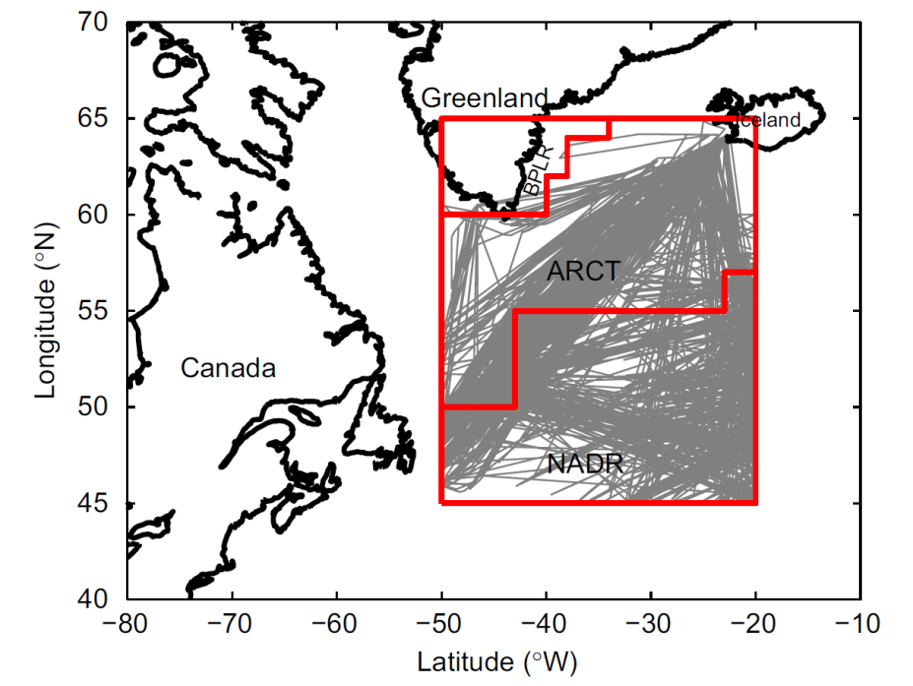
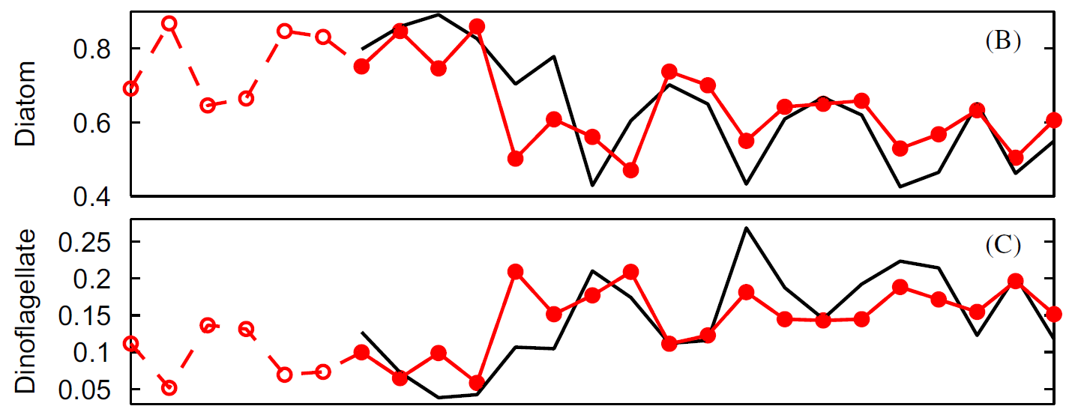
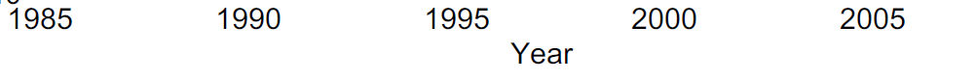
2. Phytoplankton in
the central subpolar gyre
CPR
Ratios to total phytoplankton abundance
Estimated ratios
Diatom ratio decreases
Dinoflaggelate ratio increases
As expected from the silicate decline
(L. Zhai et al, 2014)

Slide 9
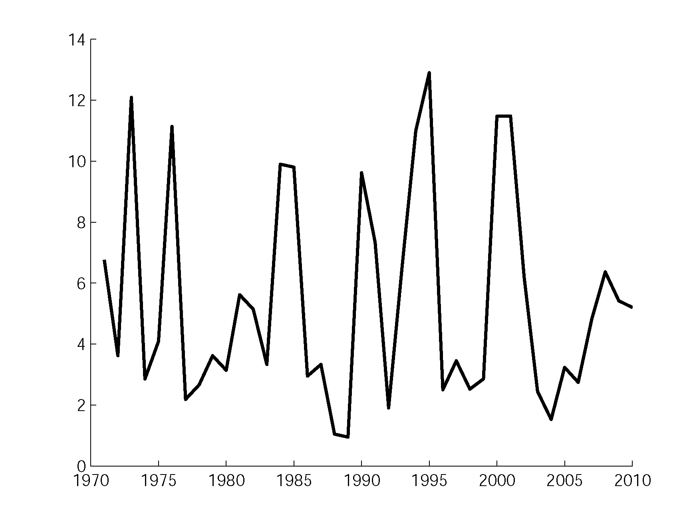
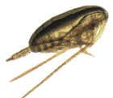
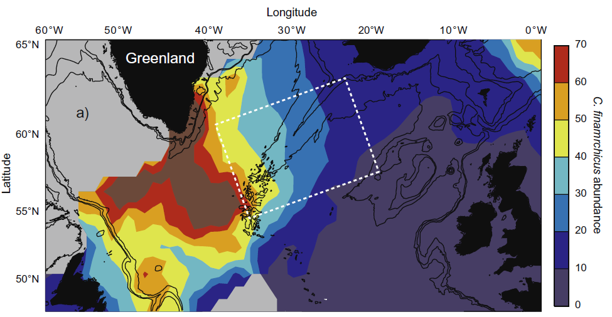
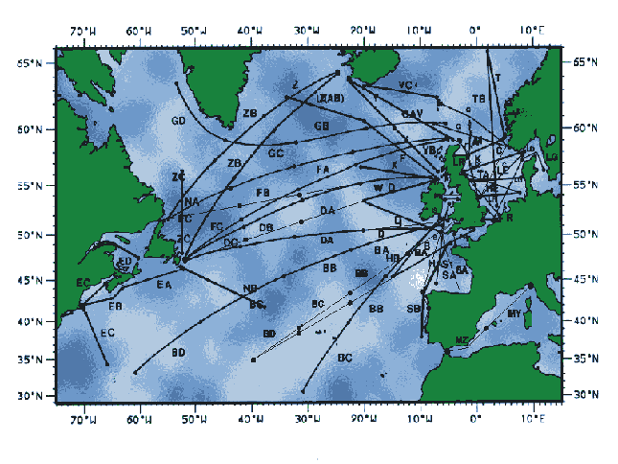
3. The Subpolar Gyre:
A large zooplankton source
- Continuous Plankton Recorder (CPR)
Mainly
C. finmarchicus
(Hátún, et al., 2009)
South Iceland shelf
Hypothesis:
A north-eastward extended subpolar gyre improves
the biological productivity southwest of Iceland
– both oceanic and potentially on the shelf.
(Hátún et al., PIO 2016)
The subpolar gyre is a
zooplankton epicenter
Average abundance
of Calanus finmarchicus
Towing lines since the 1940s
Notes:
The average abundance of CF is much largest in within the subpolar gyre. They also appear at the surface during winter, probably because of the ongoing vertical mixing of water masses.

Slide 10
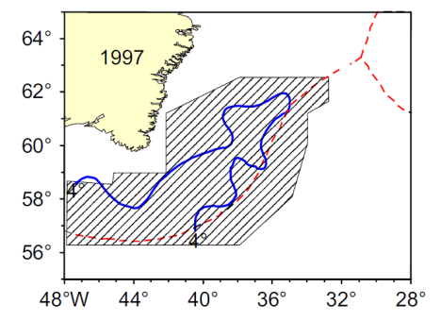
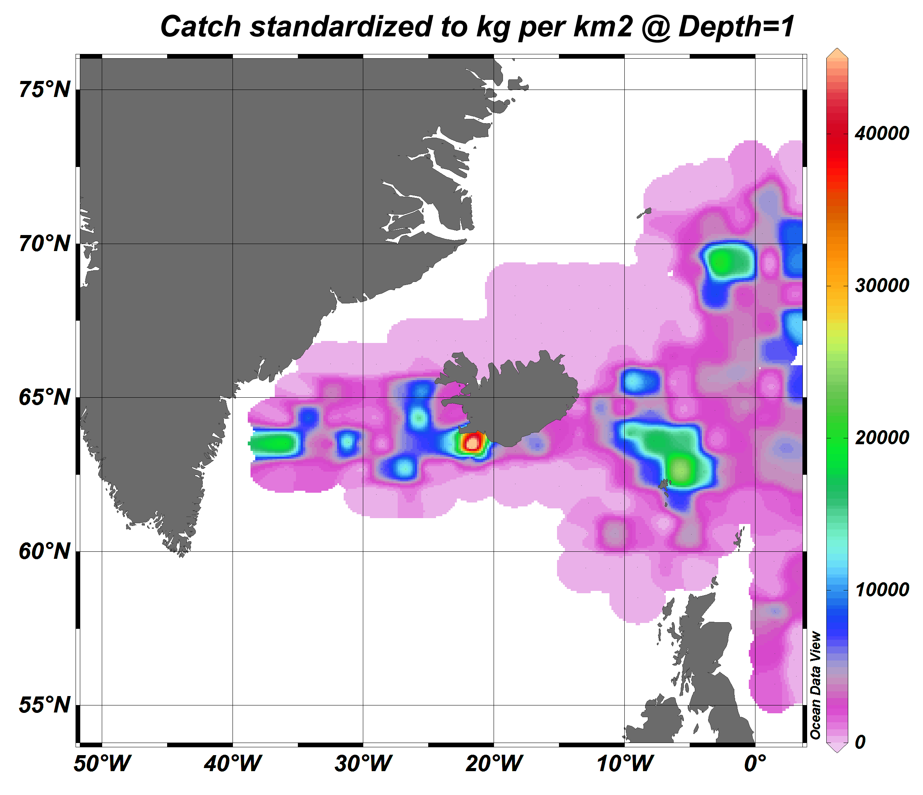
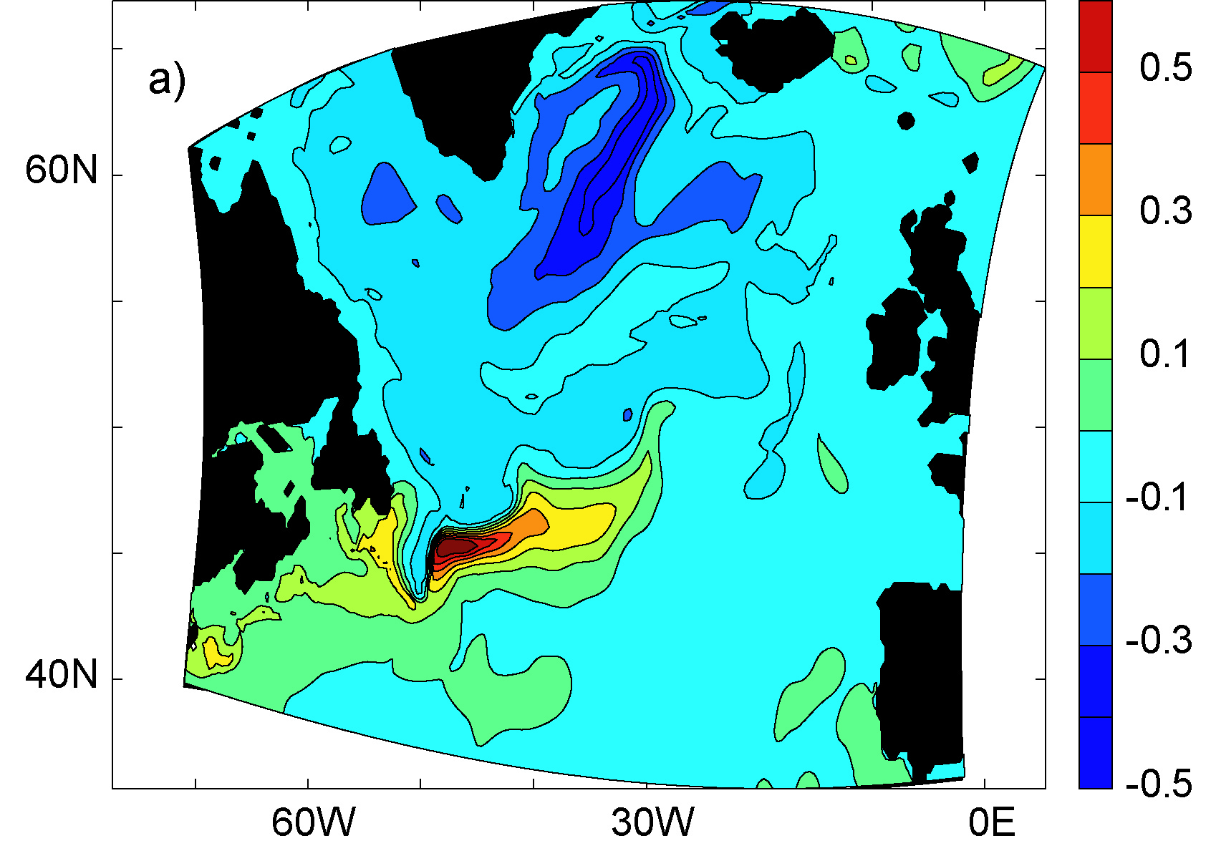
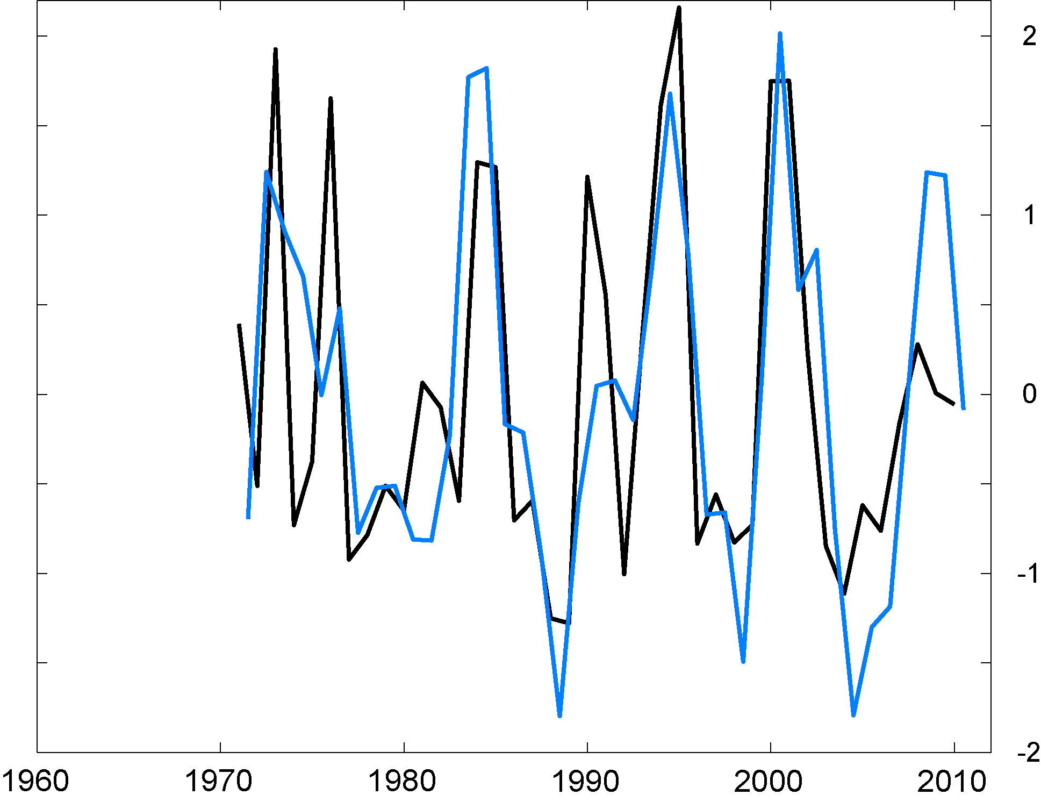
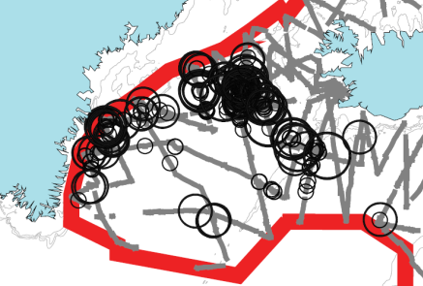
3. The biologically productive sub-arctic front
Bluefin tuna
(Mackenzie, Payne et al., 2014)
(Hátún et al., PIO 2016)
Frontal shift towards Iceland
Shelf
zooplankton
Redfish
(Pedchenko, 2005)
Mackerel in 2013
(PGNAPES)
EOF-upper ocean temperature
(Hátún et al., 2005)
Gyre Index
(detrended)
r = 0.80, p = 1e-9
Increased zooplankton abundance
when the sub-arctic front is shifted towards Iceland
Finwhales
(Víkingsson et al., 2009)

Slide 11

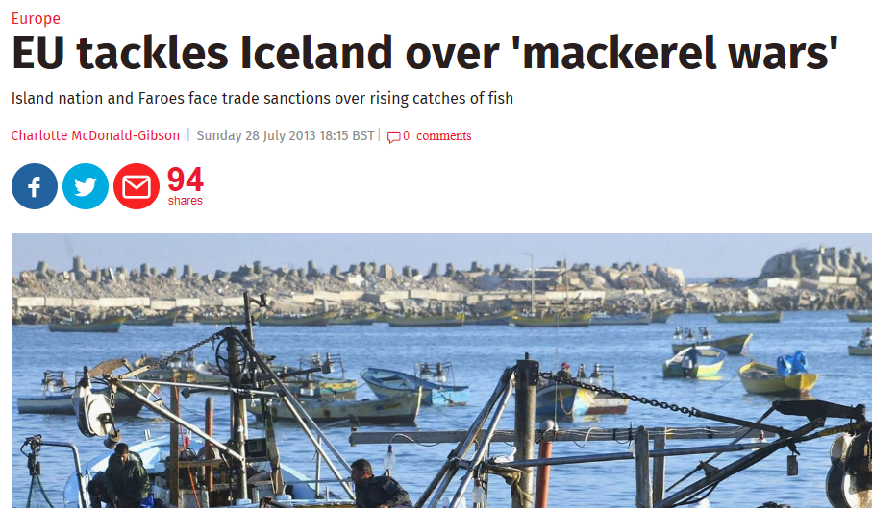
4. The post-2006 mackerel expansion
68°N
GREENLAND
NORWEGIAN SEA
The independent
ICELAND
64°N
POST-2006
EXPANSION
60°N
ICELAND
BASIN
56°N
SPAWNING
(Pacariz, Hátún
and others, 2016)
52°N
EUROPE
36°W 24°W 12°W 0°

Slide 12
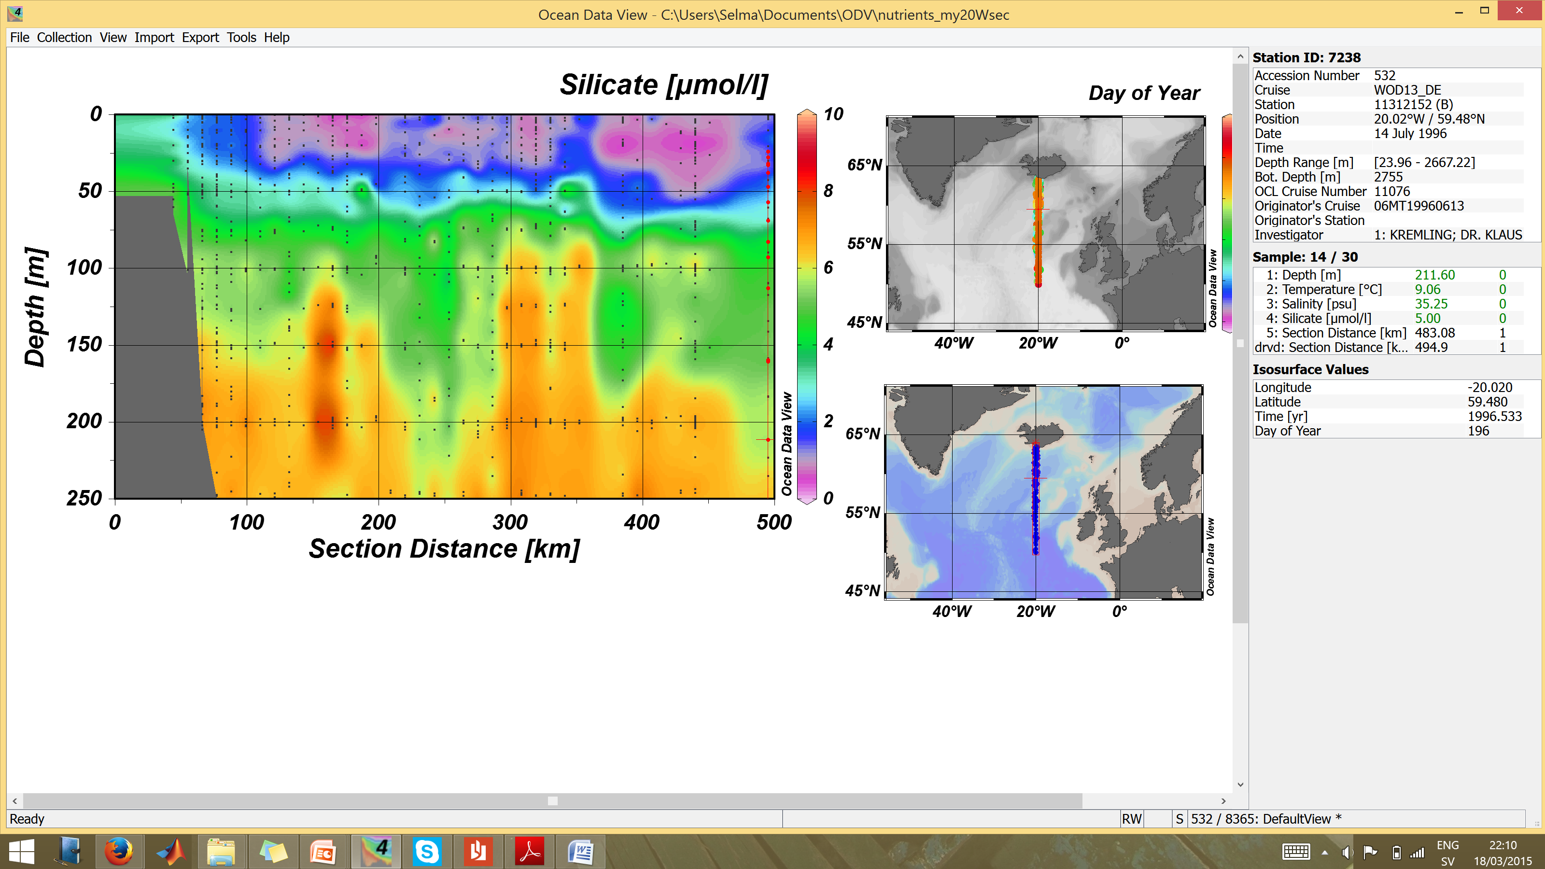
4. Empty Iceland Basin?
– a richer ‘corridor’
ICELAND
CORRIDOR
Limiting at 2 µM
50
‘Corridor’
100
Iceland Basin
DEPTH (m)
JULY
150
200
100
200
300
400
ICELAND
Silicate
summer concentrations (µM)
ICELAND
BASIN

Slide 13
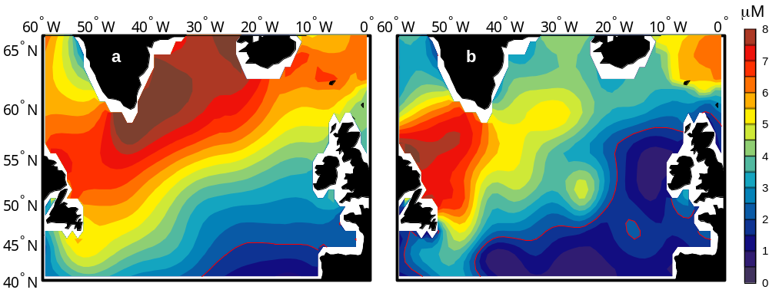
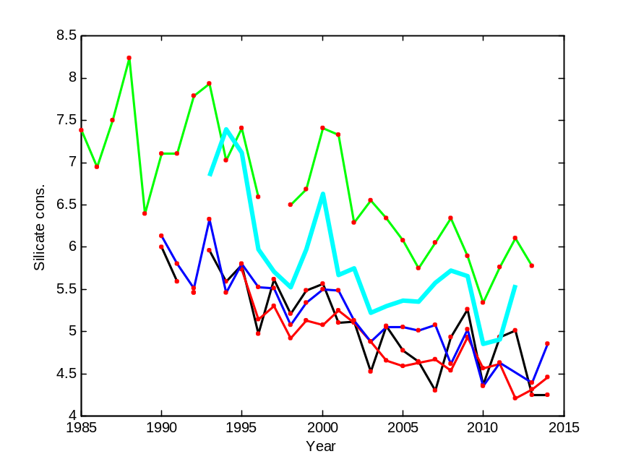
4. A new mackerel hypothesis
East-west nutrient gradient
Nutrient decline
+
Nutrient
limitation
The post-2006 westward mackerel expansion
is induced by the west-high, east-low nutrient gradient, together with the recent strong nutrient decline in the North Atlantic
(Pacariz et al., 2016)

Slide 14
5. Seabirds

Slide 15
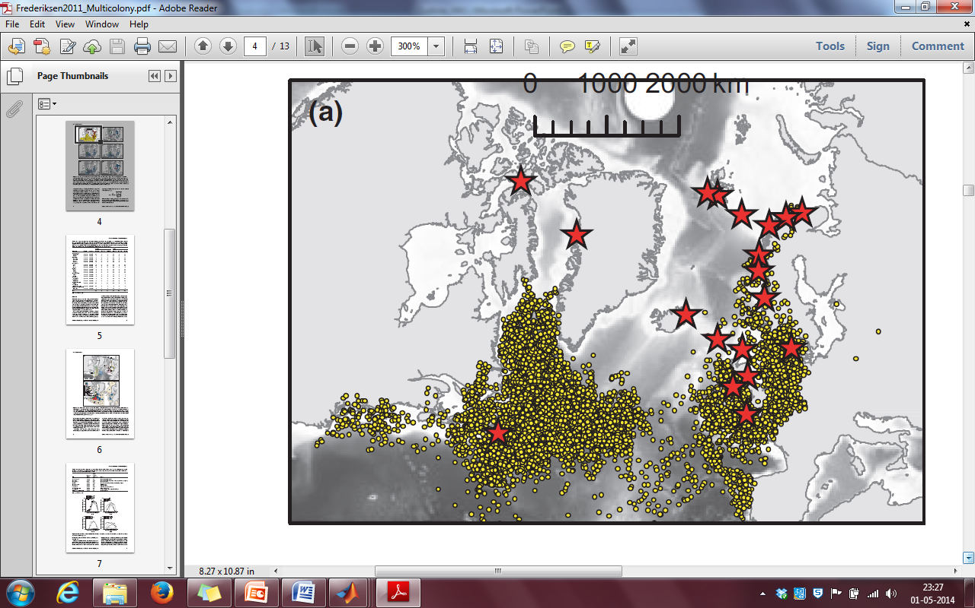
5. Broad seabird decline in the NE Atlantic
?
Large and concomitant declines in chick production (breeding success)
Typically asociated with warming – physical processes elusive
Link to the subpolar gyre mentioned qualitatively

Slide 16
5. Winter migration of seabirds (kittiwakes)
Geolocator
Feed within the subpolar gyre
(Frederiksen, et al. 2012)

Slide 17
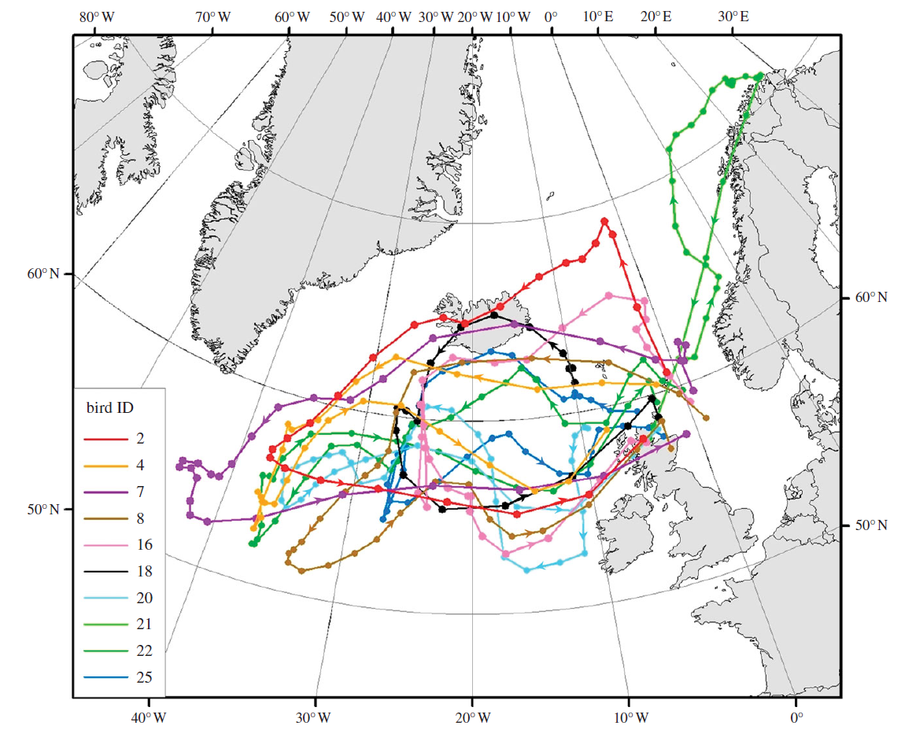
5. Pre-breeding exodus
(kittiwakes)
In March
Zooplankton
observations
The productive
sub-arctiv front
(Bogdanova et al., 2011)

Slide 18
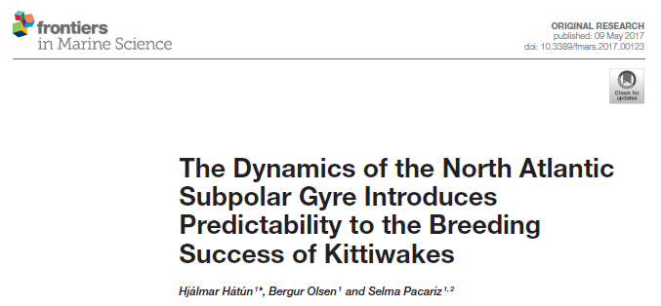
5. Potential gyre regulation
(2017)
1. Non-breeding season
Iceland
Faroe Islands
Food
Zooplankton
(Hátún et al., 2016)
Zooplankton?
2. Breeding
season
SPG

Slide 19
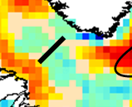
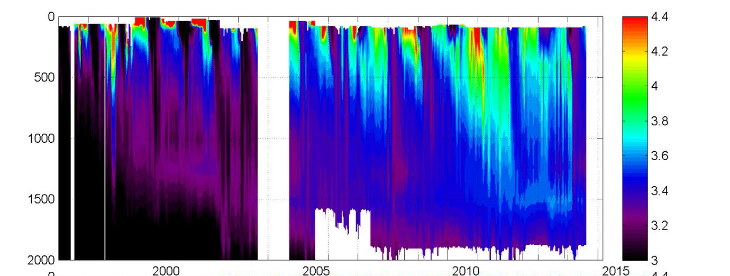
Intensified convection after 2014
The Labrador Sea
1999-2001
2008-2009
2012
2014
T (°C)
Depth (m)
Time (Yr)
(Courtesy: I. Yashayaev)

Slide 20
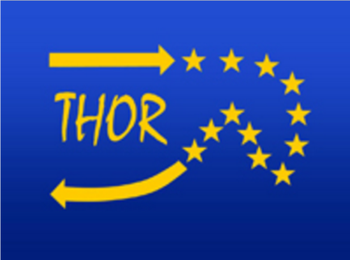
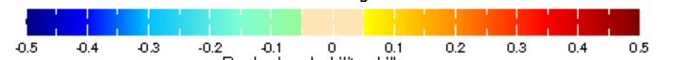
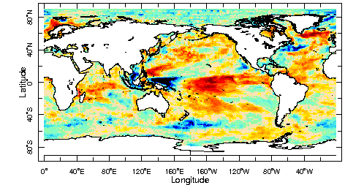
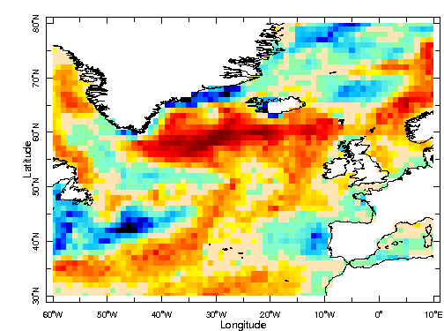
SST Predictability
Intra-seasonal to inter-annual
Ranked probability
skill score
Amongst the highest predictability
potential in the World
10.5 months lead
Start in March
US National Multi-Model Ensemble (NMME) seasonal forecasting system.

Slide 21
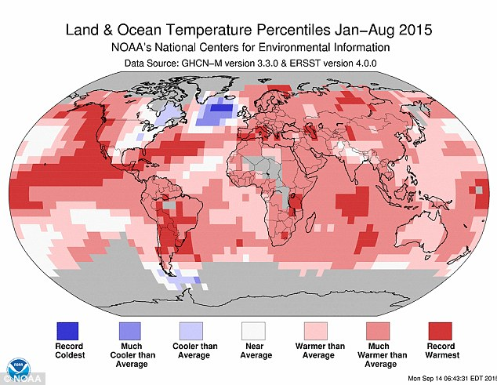
‘Cold blob’ in 2015
Good for ecosystems
- as suggested by Hátún et al., 2016

Slide 22
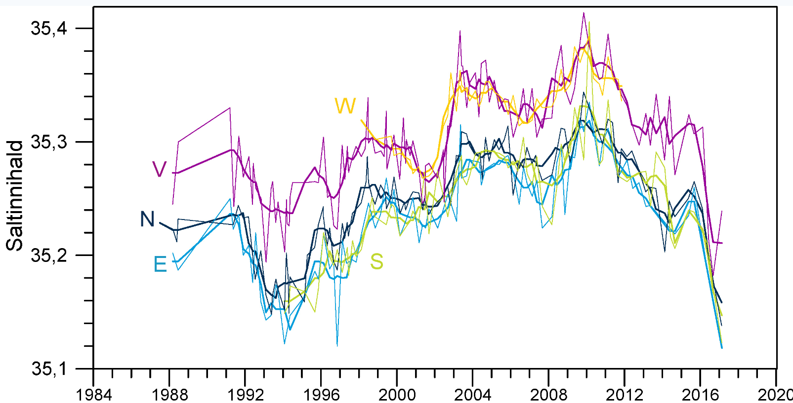
A present
‘Great Salinity Anomaly’
Faroes
(A review study in progress, Holliday et al.)
2014-16
Salinity
2012
2000
2008
1994-95

Slide 23
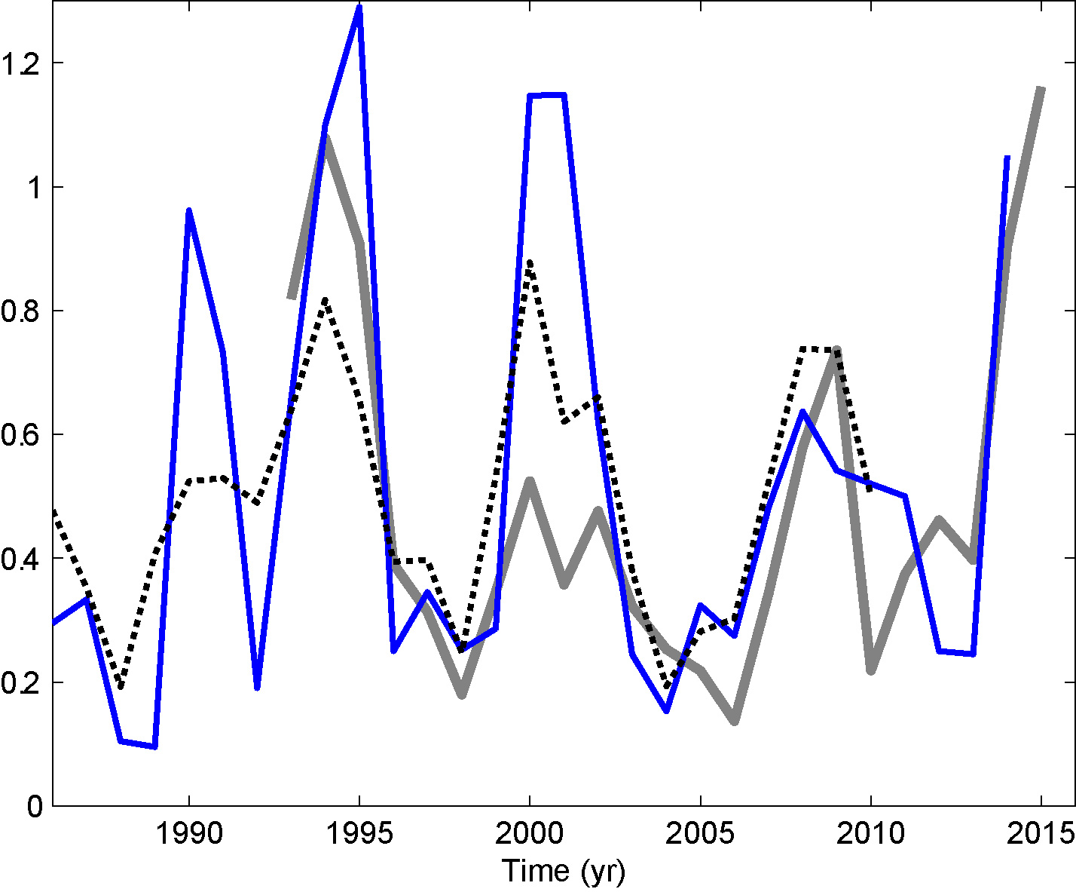
5. Impact of recent convection
- Iceland zooplankton
(Hátún et al., 2016,
updated)
1994-95
2000-01
2014
2008
MPIOM
Still holds ☺
Gyre index
(de-trended)

Slide 24
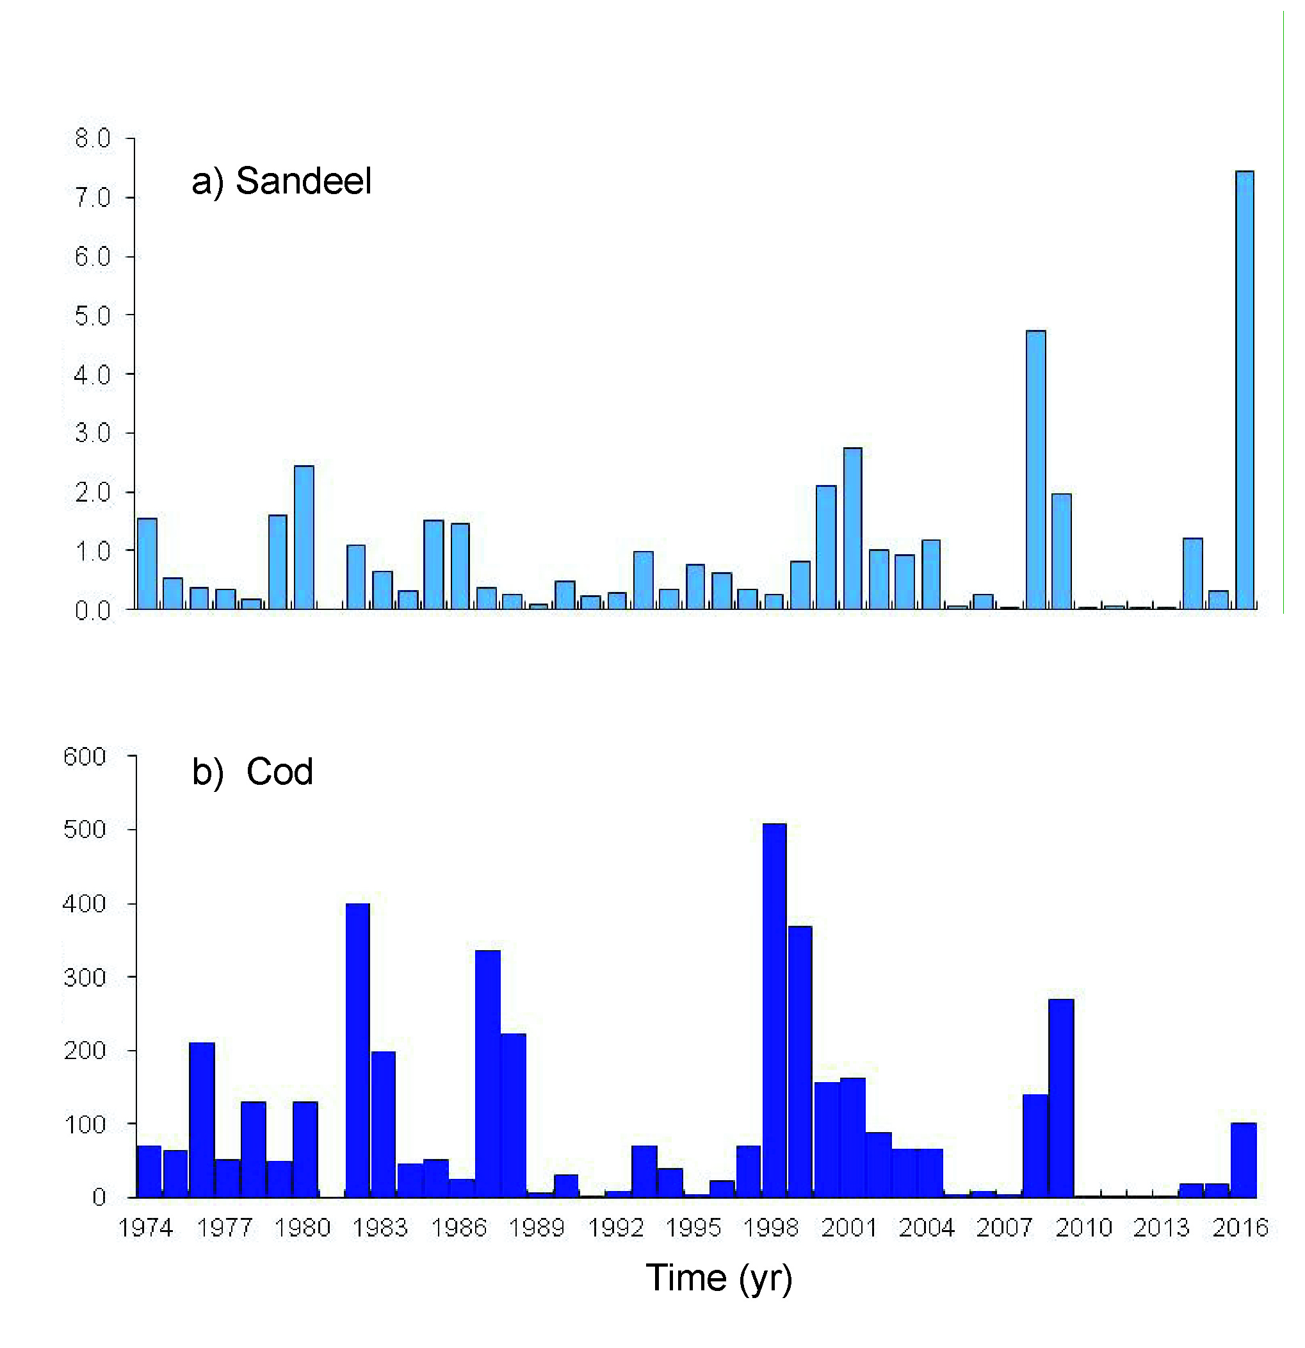
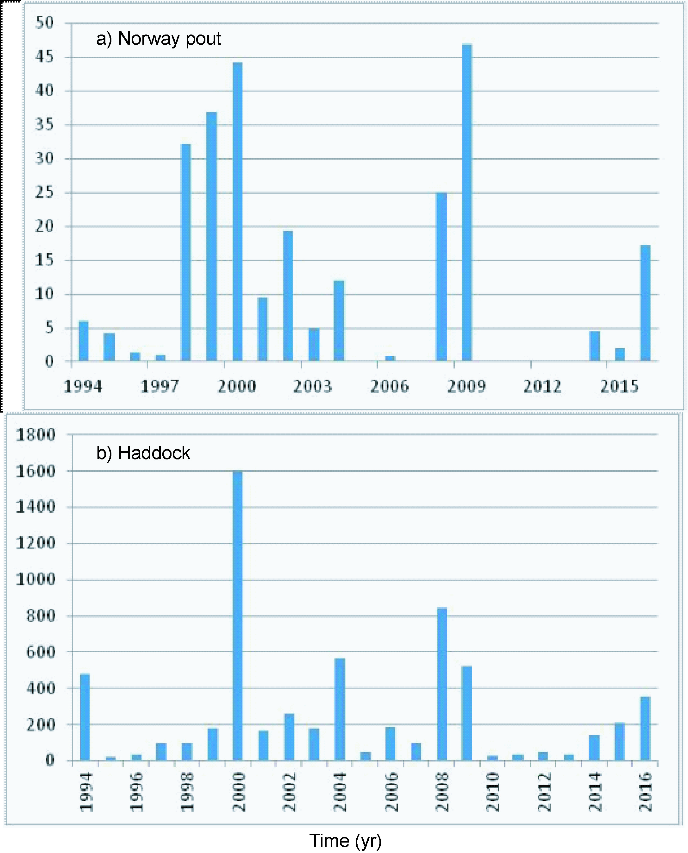
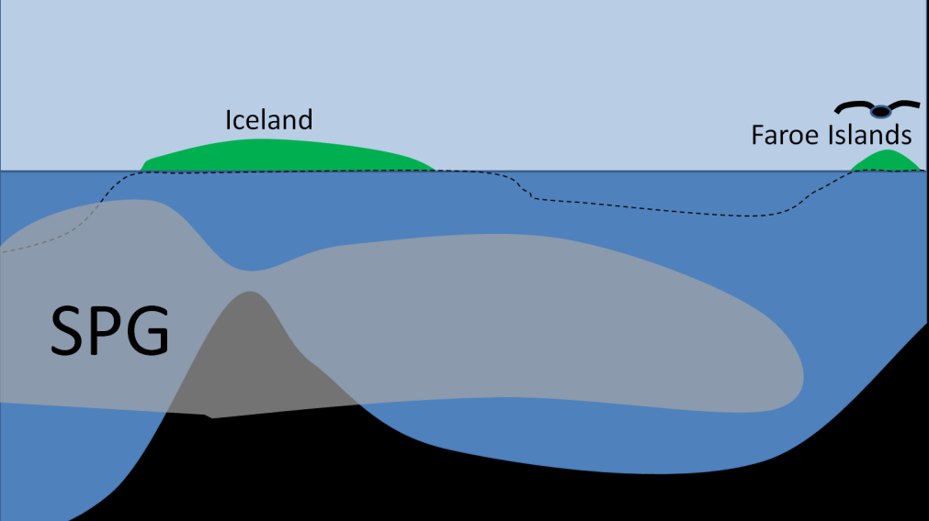
5. Local food
O-group fish breeding season
2000,
2001
2008,
2009
2014-16
Sandeel
“The 2015 breeding season on Isle of May proved to be
another good year following the general success of 2014”
“...black-legged kittiwakes had one of their
most successful seasons on record”
(http://www.ceh.ac.uk/isle-may-breeding-season-summaries#2015)
Cod
Norway
pout
A general improvement for seabirds in the Faroe Islands in
2014, 2015 and especially in 2016 and 2017 (pers. Comm Bergur Olsen)
The 2014-2016 convection
has blown life!
- forecasting potential
Haddock
# young puffins captured in the Vestmannaeyjar islands (South Iceland) in 2015 quadrupled compared to 2014

Slide 25
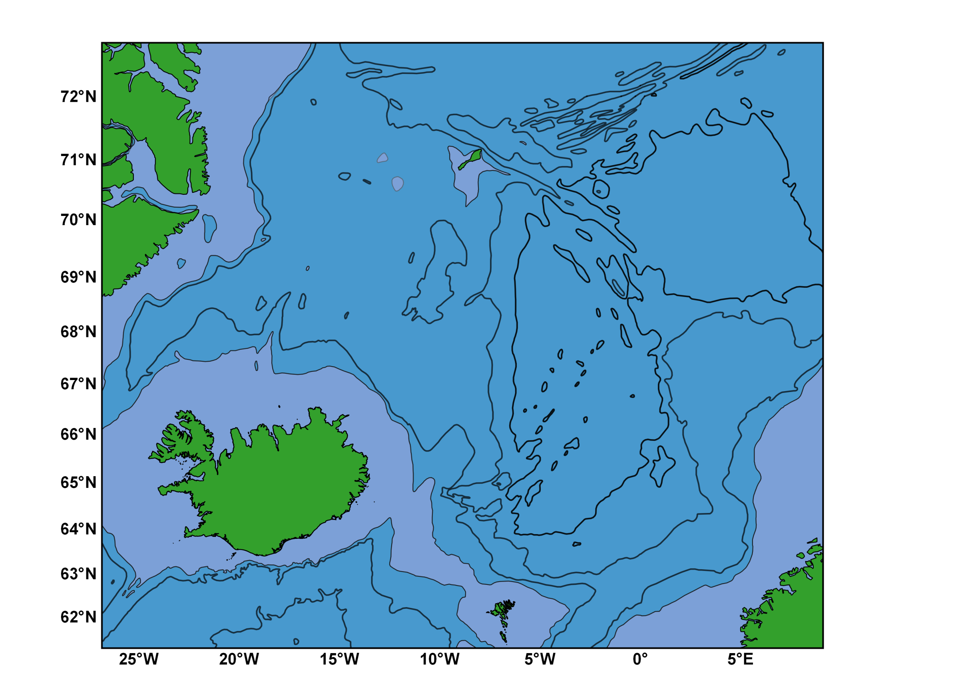
6. Calanus
hyperboreus
Iceland → the Faroes
Work in progress:
Kristiansen, Pétursdóttir, Gislason
and others
Iceland
Sea
Norwegian Basin
Iceland
Faroe Islands

Slide 26
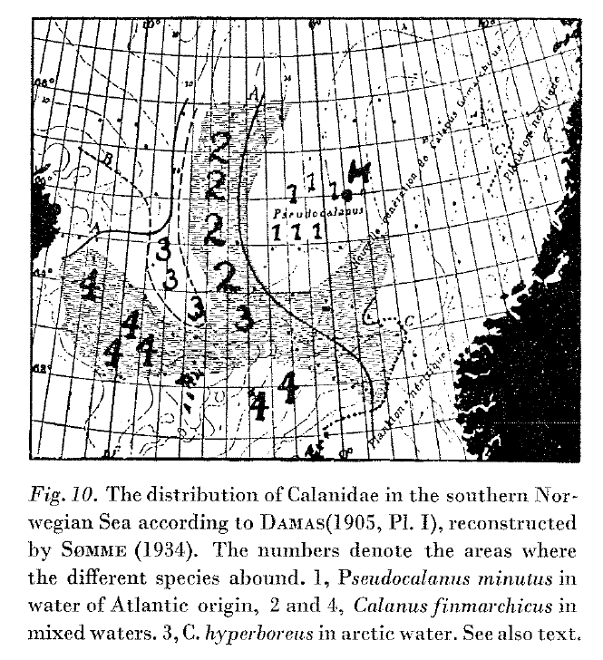
6. Calanus
hyperboreus
East Icelandic
Water
Section N
(Wiborg, 1955)

Slide 27
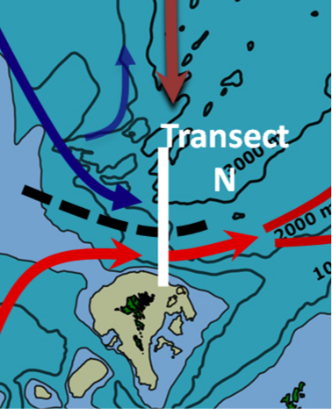
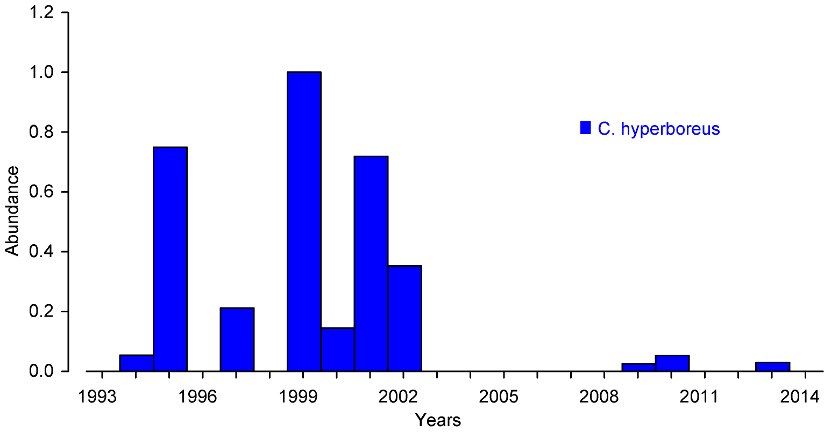
6. Calanus
hyperboreus
C. hyperboreus
Abundance (Normalized)
Years
(Kristiansen et al., 2015)

Slide 28
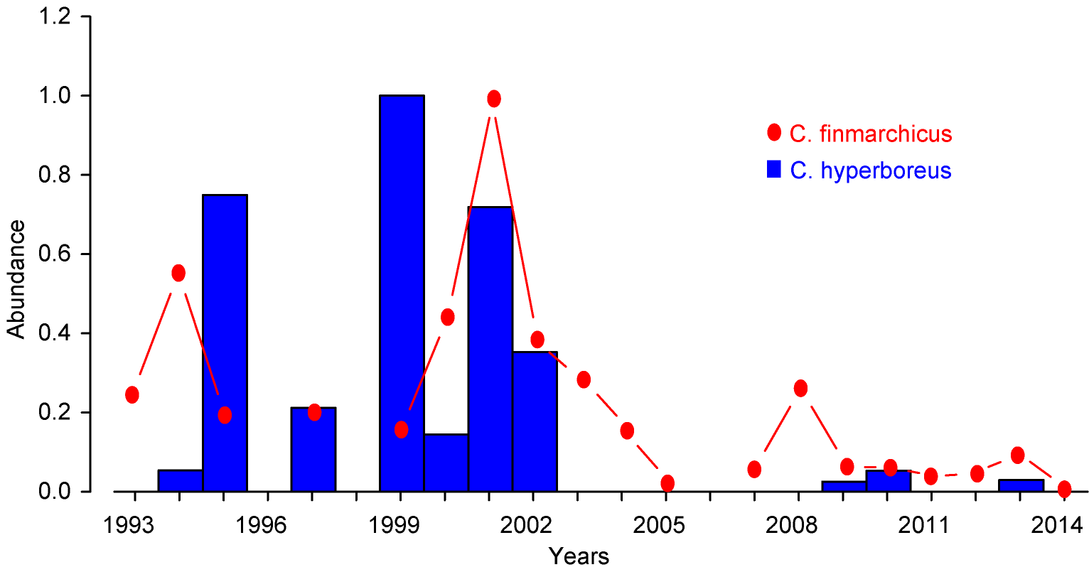
6. Calanus
hyperboreus
and C. finmarchicus (CV-CVI)
C. hyperboreus
Abundance (Normalized)
2003
Years
(Kristiansen et al., In progress)

Slide 29
Working hypothesis
6. Calanus
hyperboreus
The post-2003 disappearance
of C. hyperboreus and large C. finmarchicus
is caused by reduced influence
of East Icelandic Water
(Kristiansen et al., In progress)

Slide 30
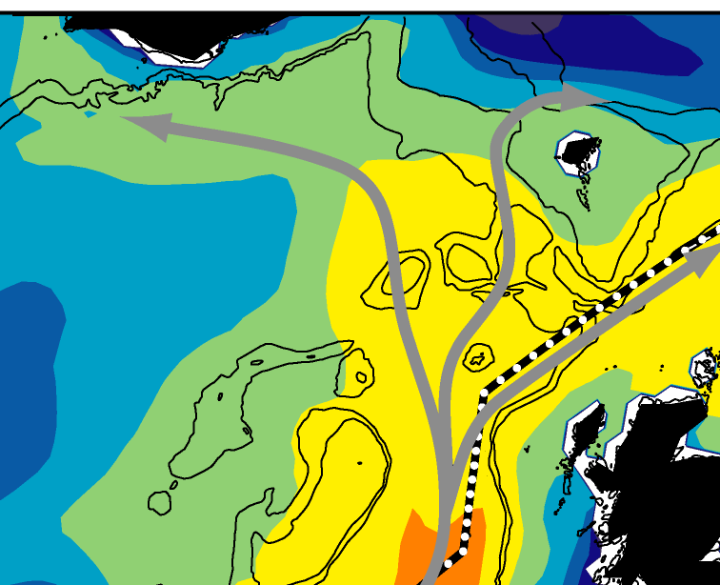
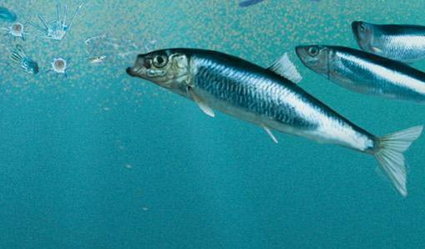

Summary
Cal fin
Gyre index
Strong
Diatoms
Silicate
Shifted
5 years →
Puffin catches (Vestmannaeyjar)
Weak
(Courtesy: Freydís Vigfúsdóttir)

Slide 31
Conclusions
Climate is more than temperatures
The subpolar gyre impacts Icelandic waters
Winter convection might induce a predictable signal – 0.5-1.5 years time horizon
The post-1995 decline of the subpolar gyre has reduced silicate concentrations ☹
  large-scale ecosystem impact is likely
Broad ecosystem improvement after the 2014-2016 winter convection ☺

Slide 32



The research leading to these results has received funding from the European Union 7th Framework Programme (FP7 2007-2013), under grant agreement n.308299
NACLIM www.naclim.eu

