Slide 1


Vincent Rennie, PhD
Annelies Van Rie, MD, PhD

Slide 2
Agenda
Vision: WGS to empower (DR)-TB control
Brief overview of the workflow of the MAGMA pipeline
Overview of the performance of the MAGMA pipeline
Next step: the MAGMA platform
Input from WHO and FIND as stakeholder

Slide 3
Potential roles of WGS in EndTB strategy
Precision public health to reduce transmission of
Any TB
Drug resistant TB
Personalized medicine to provide effective treatment
Any TB
Drug resistant TB
Surveillance of drug resistance
Monitoring progress towards (pre)-elimination of DR-TB and TB

Slide 4
TB Elimination

Slide 5
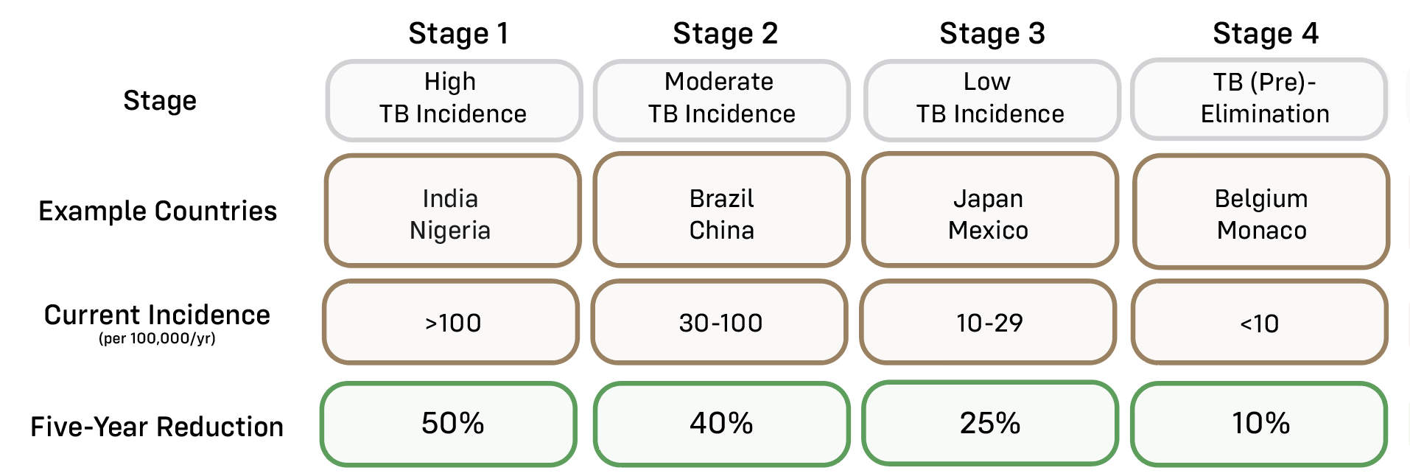
Adapted from Migliori et al Eur Respir J 2023; in press

Slide 6
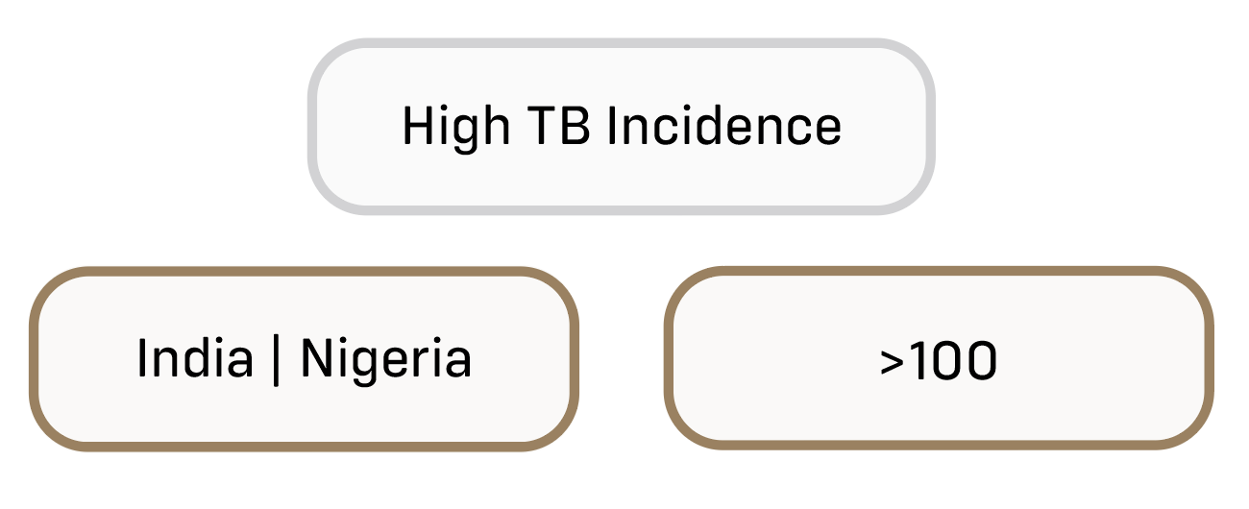
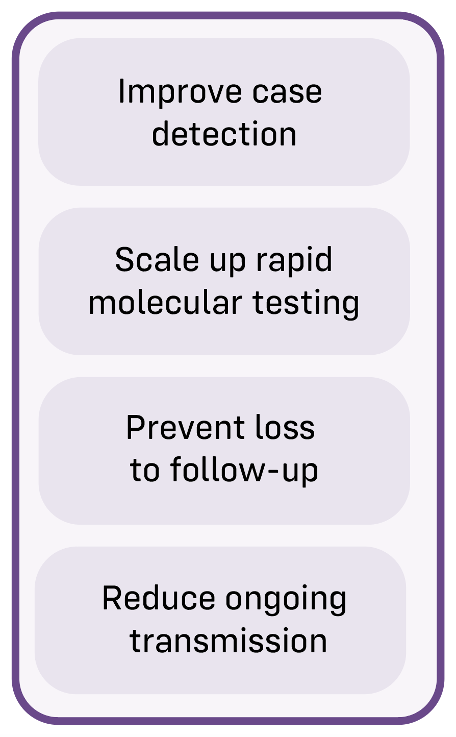

Stage 1
Key Objectives
Role of WGS

Slide 7
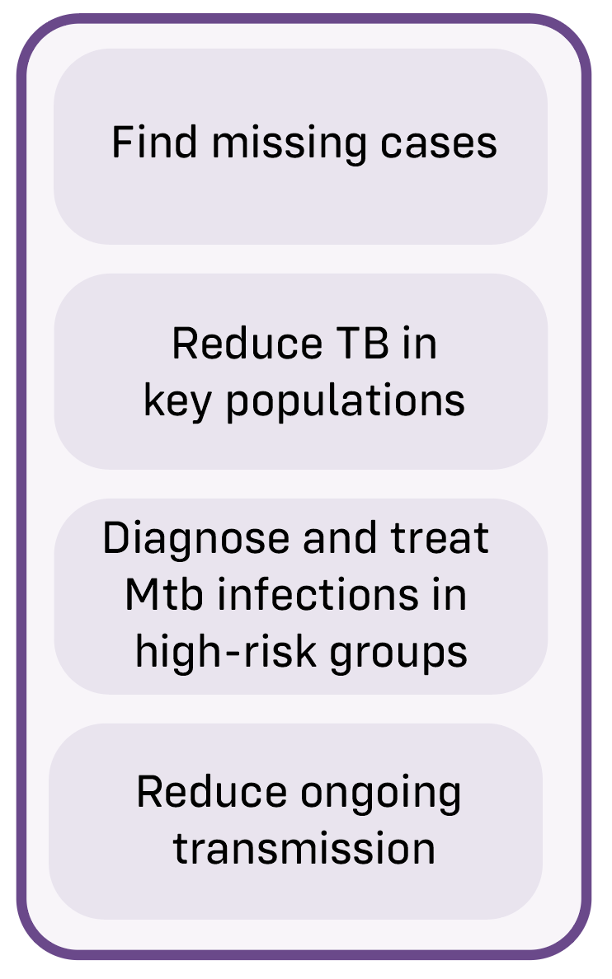
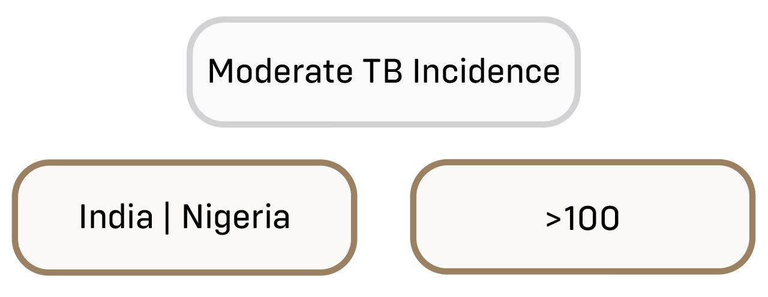
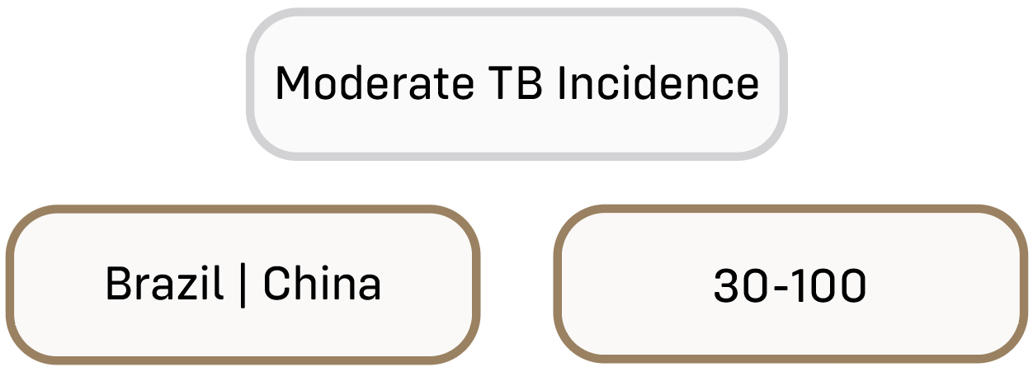
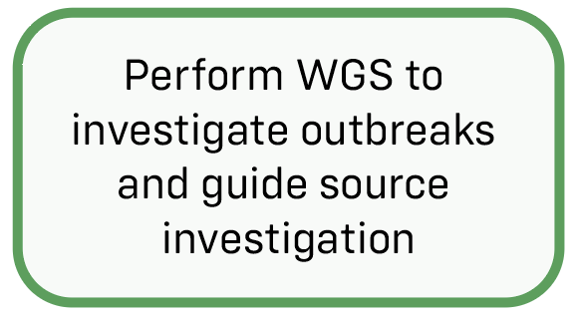
Stage 2
Key Objectives
Role of WGS

Slide 8
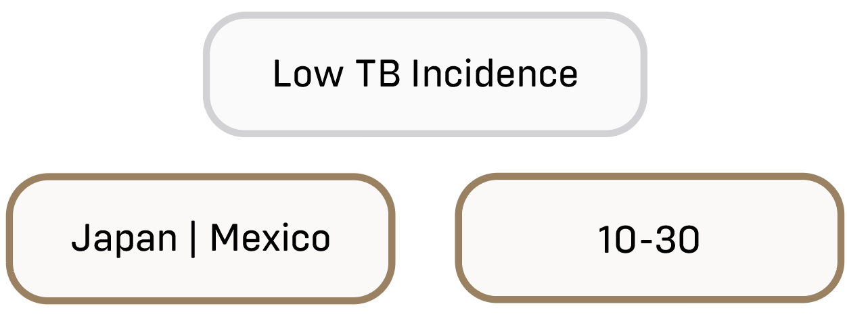
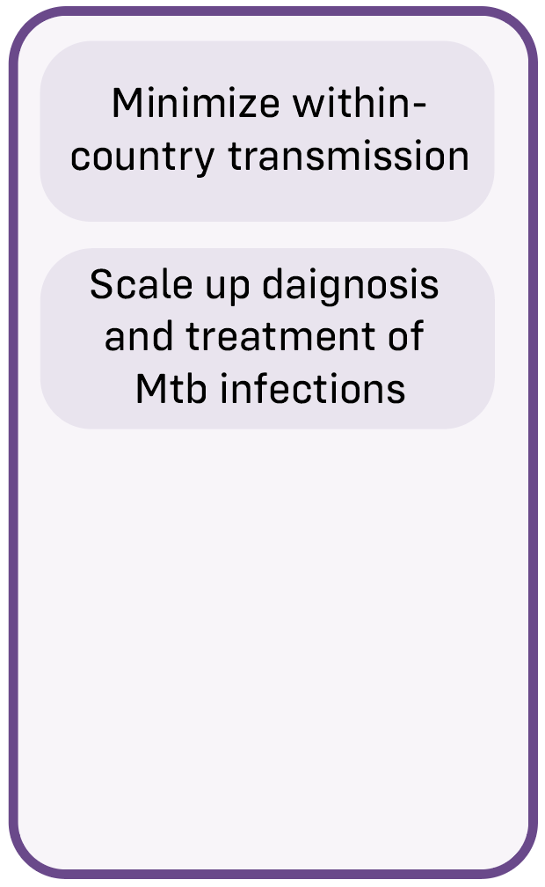
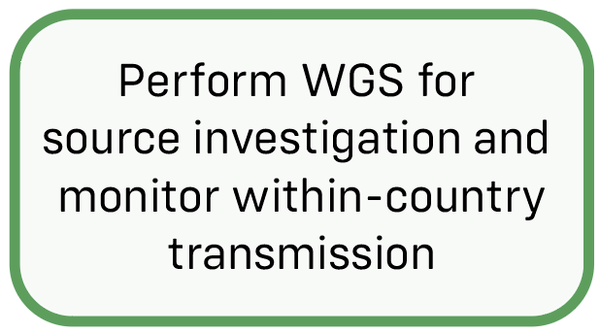
Stage 3
Key Objectives
Role of WGS

Slide 9
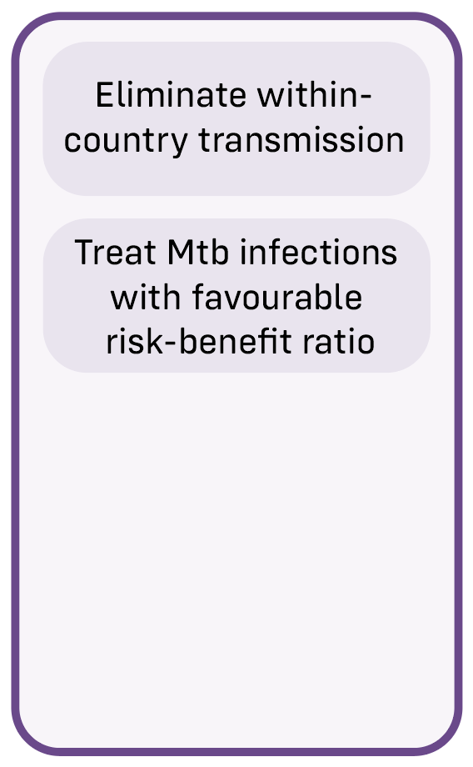
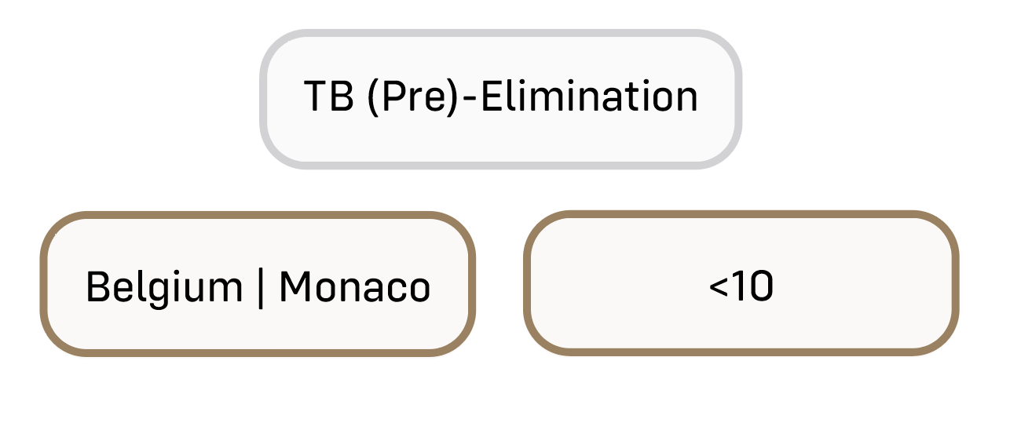
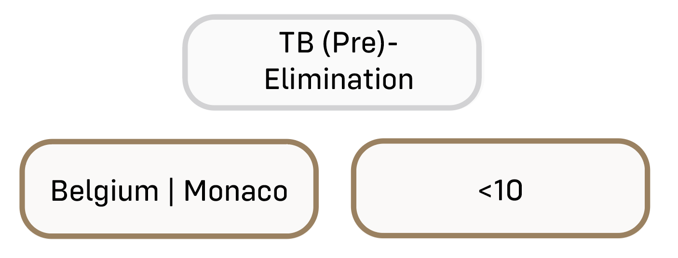
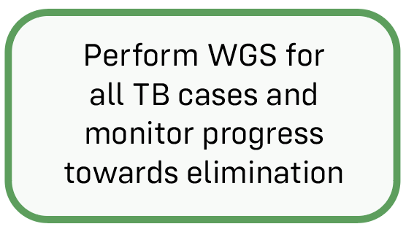
Stage 4
Key Objectives
Role of WGS

Slide 10
RR-TB Elimination

Slide 11
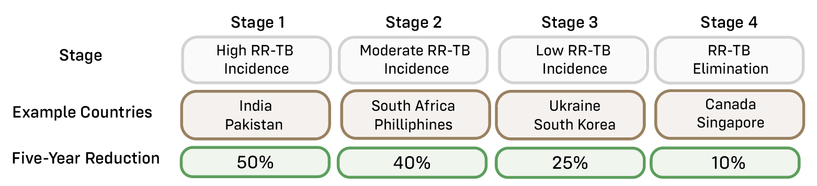

Slide 12
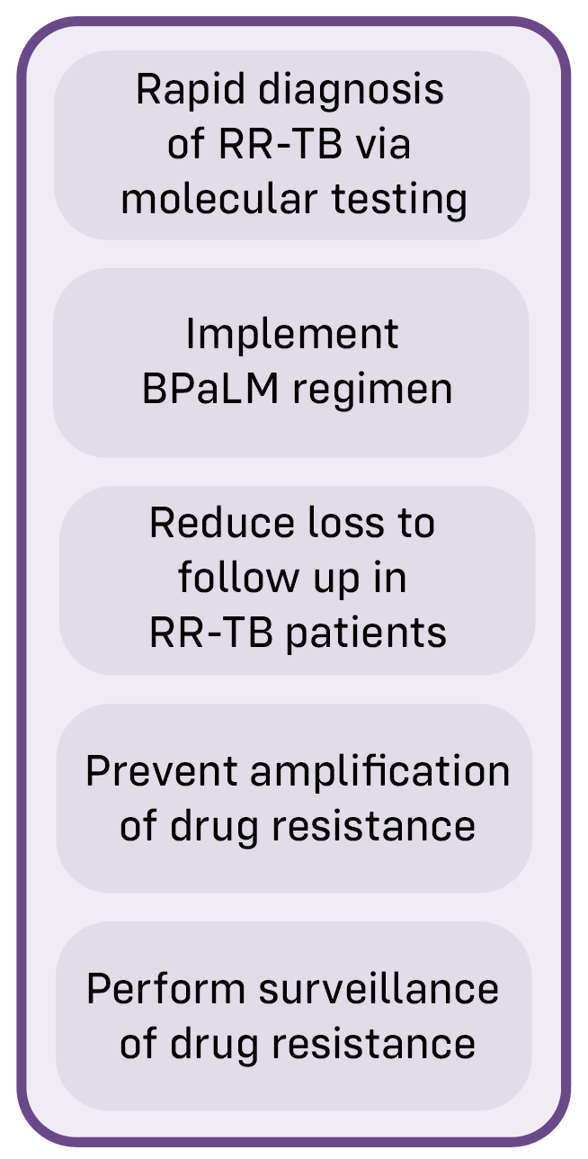

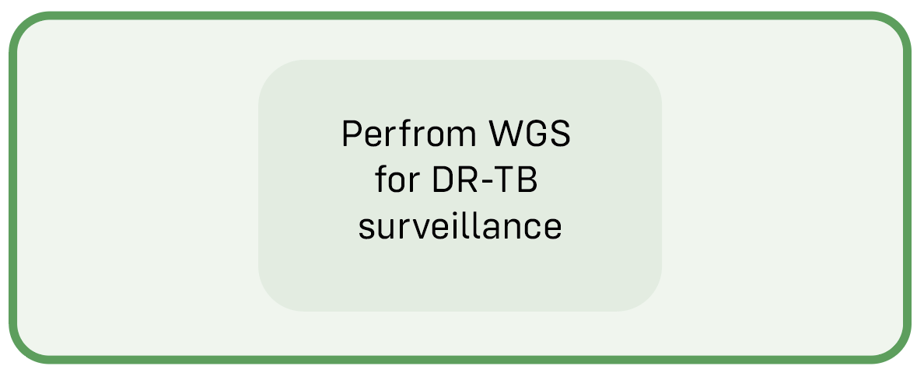
Stage 1
Key Objectives
Role of WGS

Slide 13
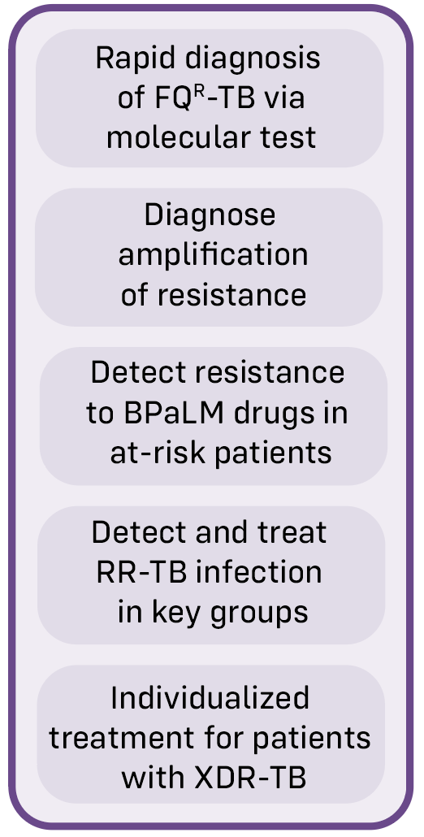

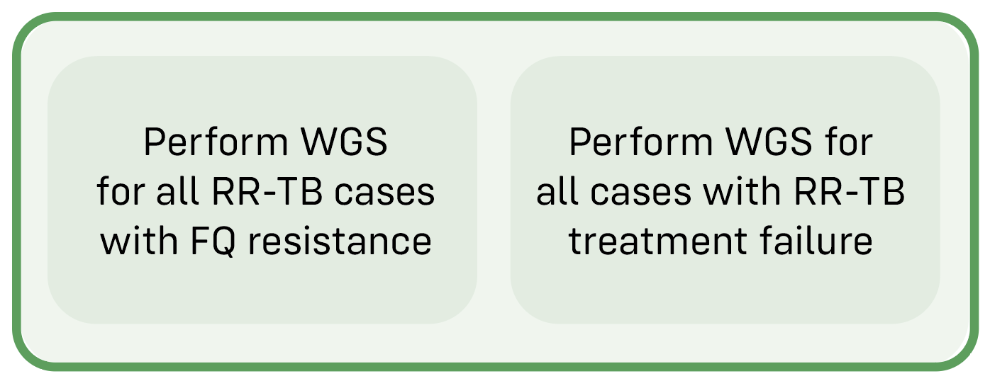
Stage 2
Key Objectives
Role of WGS

Slide 14
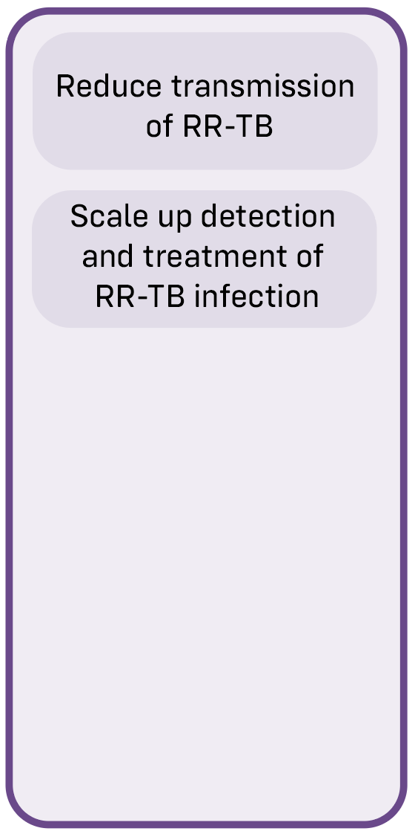

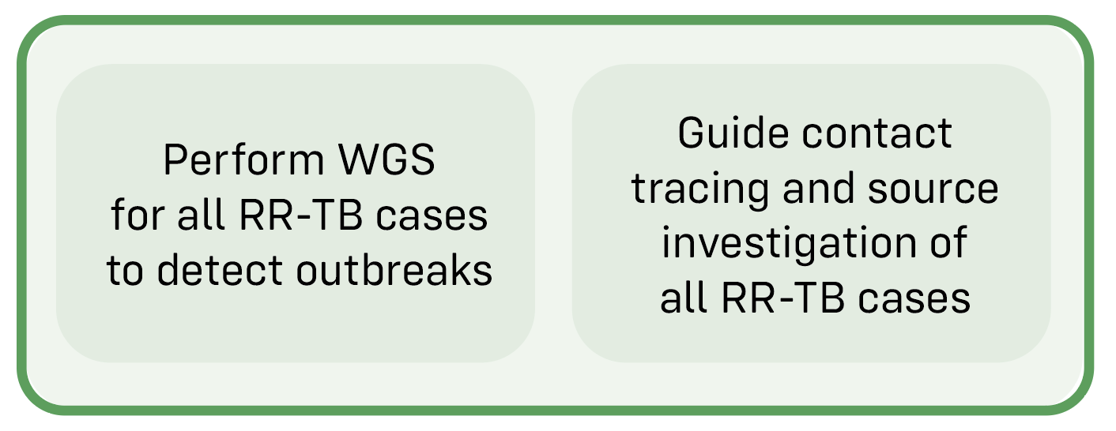
Stage 3
Key Objectives
Role of WGS

Slide 15
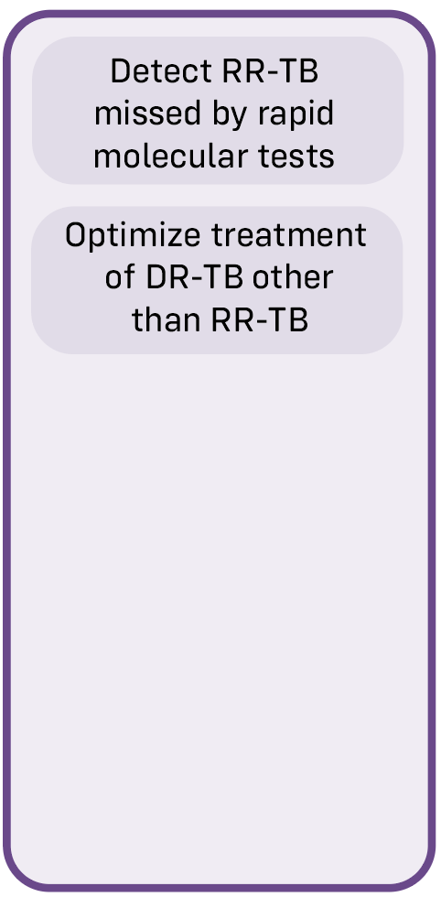

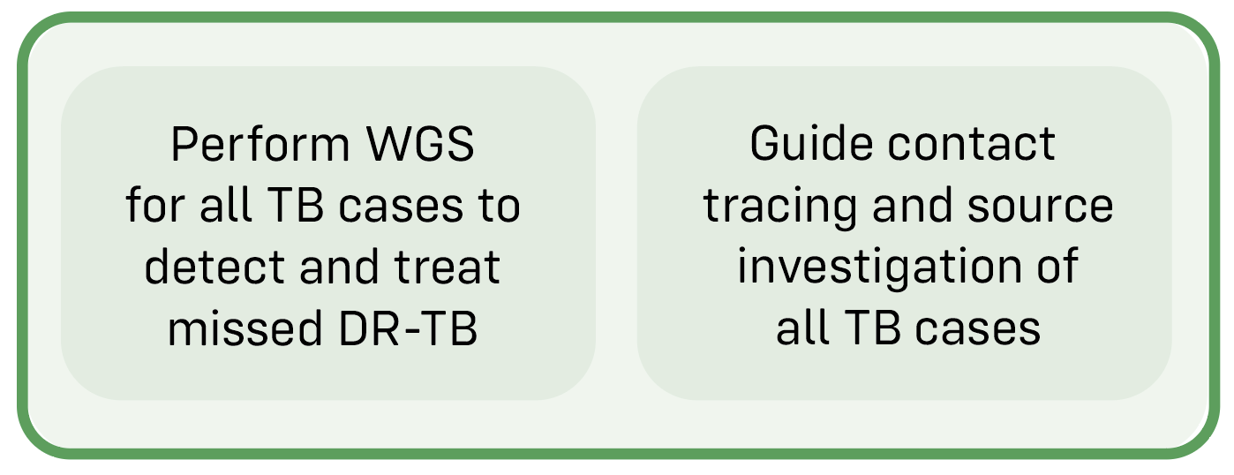
Stage 4
Key Objectives
Role of WGS

Slide 16
The MAGMA pipeline

Slide 17
Why develop another pipeline?

Slide 18
Mtb pipelines were developed for research
What we need now is
a clinical bioinformatics pipeline
for personalized DR-TB treatment
and targeted public health interventions

Slide 19
Challenges posed by clinical Mtb samples
Low amount of Mtb in sputum samples and primary MGIT cultures
High levels of contaminating sequences (human, NTMs, other bacteria)
Low amounts of (hard-to-extract) Mtb DNA
Mixed infections and hetero-resistance
Need to disentangle mixed infections
Need to detect major and minor variants
Mtb genome contains conserved regions similar to contaminating sequences
Can lead to false positive variants in candidate resistance genes (e.g rrl, rrs)
Mtb genome contains repetitive regions
Elimination of complex regions by most analysis pipelines (loss of data)

Slide 20
MAGMA: Maximum Accessible Genome for Mtb Analysis
Aim One:
Call variants in genomes with low coverage
Aim Two:
Call both major and minor variants
Aim Three:
Call variants in the presence of contaminating sequences
Aim Four:
Retain data from complex regions for phylogenetics

Slide 21
MAGMA Workflow

Slide 22
Core Software Package
Developed for human genomics
Key features:
1
2
Joint variant calling
of major variants
Filtering of artefacts
and contamination

Slide 23
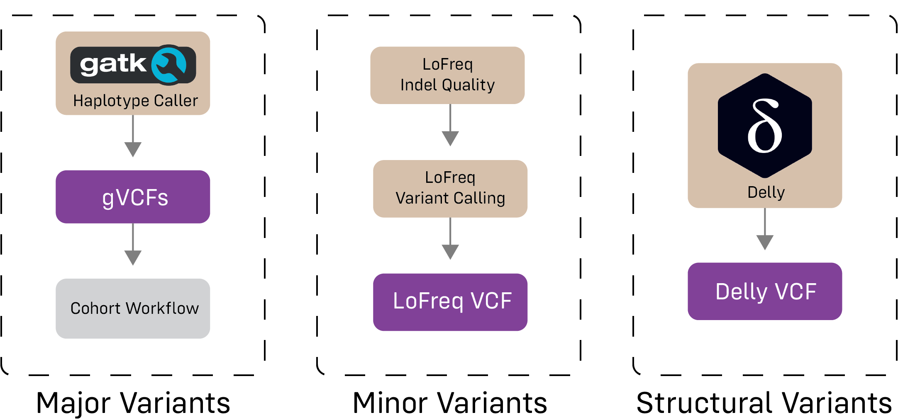
Variant Calling

Slide 24
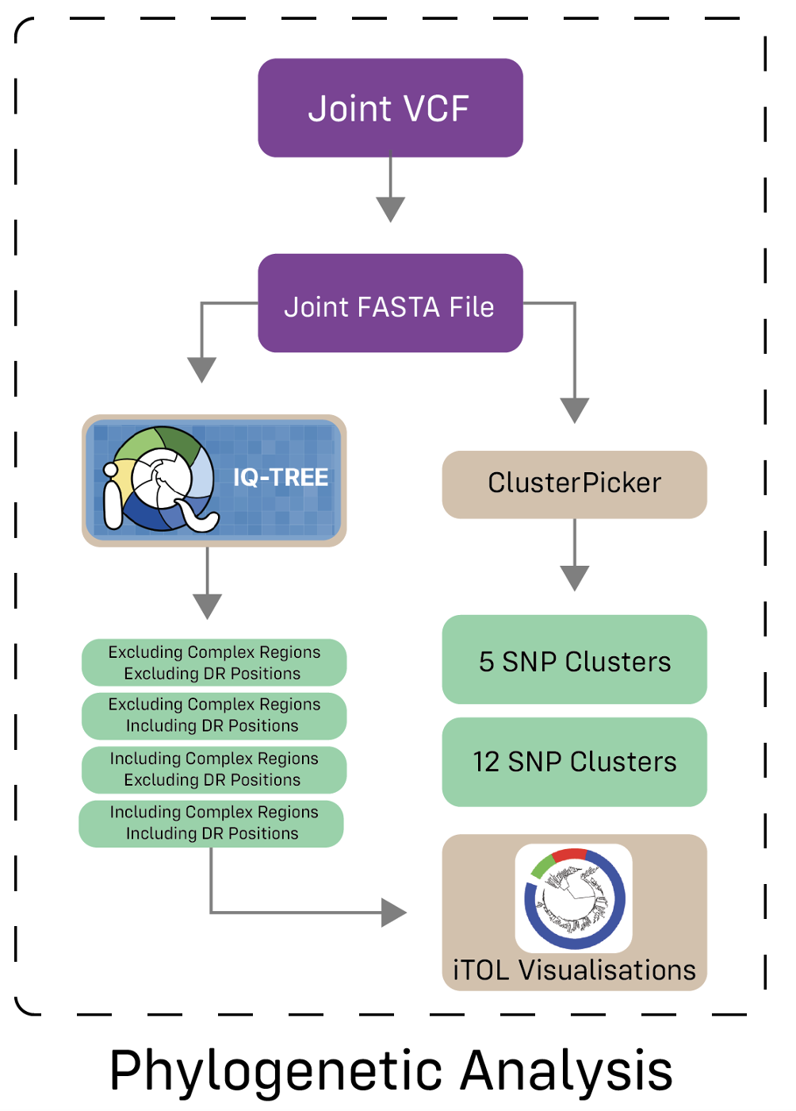
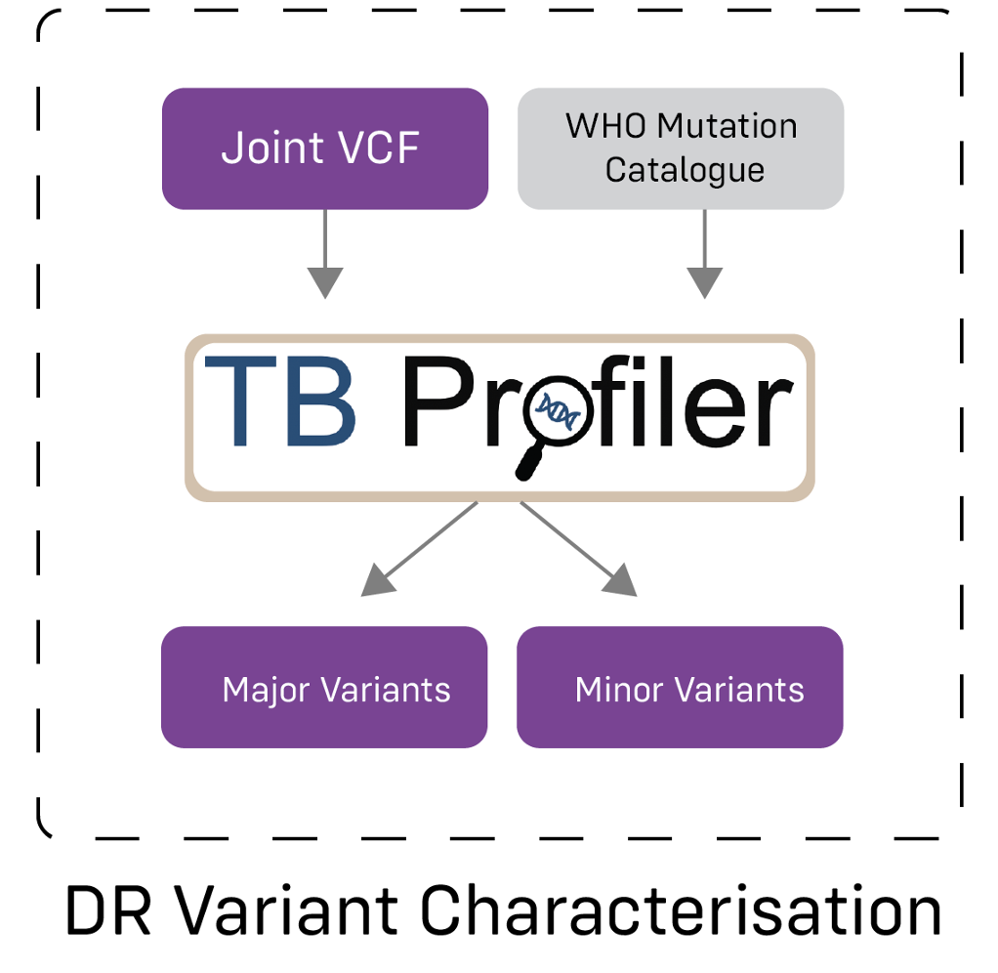
Primary outputs

Slide 25

Improving automation and standardization

Slide 26
Questions?

Slide 27
MAGMA Performance
How does MAGMA compare with other Mtb pipelines?
Heupink TH, Verboven L, Warren RM, Van Rie A. Comprehensive and accurate genetic variant identification from contaminated and low-coverage Mycobacterium tuberculosis whole genome sequencing data. Microb Genom. 2021

Slide 28

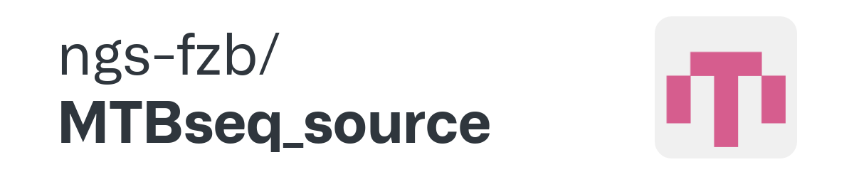
Comparison with two MTB pipelines
UVP pipeline
MTBseq pipeline
UVP: Ezewudo, M., Borens, A., Chiner-Oms, Á. et al. Integrating standardized whole genome sequence analysis with a global Mycobacterium tuberculosis antibiotic resistance knowledgebase. Sci Rep 2018
MTBSeq: Kohl TA, Utpatel C, Schleusener V, De Filippo MR, Beckert P, Cirillo DM, Niemann S. MTBseq: a comprehensive pipeline for whole genome sequence analysis of Mycobacterium tuberculosis complex isolates. PeerJ. 2018

Slide 29



Accuracy at low coverage
UVP: Variability in performance even at high depth of coverage
MTBSeq: high performance at depths ≥20x, performance drops rapidly at lower depth
MAGMA: Performance never drops below a 0.95 F₁ score
Notes:
Performance (F1 scores) for SNP calling in simulated Mtb culture isolates at six levels of depth of Mtb genomic coverage

Slide 30
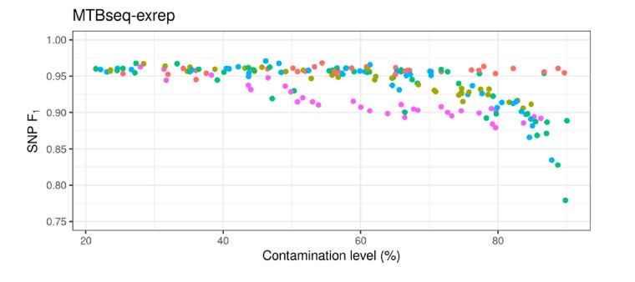
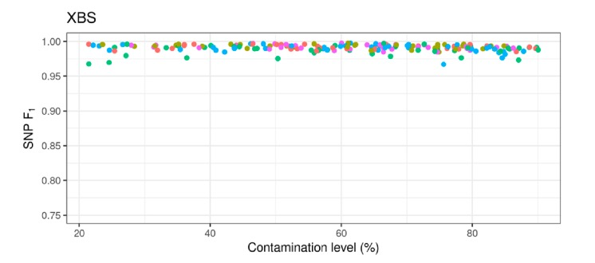
Performance in presence of contamination
(MAGMA)
UVP: Does not analyse samples containing >20% contamination
MTBSeq: does not perform well at high >40%) levels of contamination
MAGMA: Performance never drops below a 0.95 F₁ score
Notes:
Note: the UVP pipeline does not analyse samples with ≥20% contamination
Performance (F₁ scores) for SNP calling in sputum samples with minimum 20× Mtb coverage and various types and levels of contamination

Slide 31
Accuracy for complex/repetitive regions
UVP: excludes complex/repetitive regions
MTBSeq basic: good performance at depths ≥20x, performance drops with lower depth
MTBSeq exrep: poor performance at all depths
MAGMA: Performance never drops below F₁ score of 0.9 ; accurate identification of variants in complex regions increases analytic coverage of Mtb genome by ~ 9%
Notes:
Performance (F1 scores) of four bioinformatic pipelines for SNP calling in complex regions of the genome using simulated Mtb culture isolates at six levels of depth of Mtb genomic coverage

Slide 32

Conclusion
All Mtb-specific pipelines work with high quality samples (>20x genome coverage | <20% contamination)
MAGMA’s performance is superior for “difficult samples”
(<20x contamination | >40% contamination)
MAGMA increases “accessible” positions in Mtb genome by 9% through partial inclusion of repeat regions, giving higher resolution for phylogenetic analyses

Slide 33
MAGMA Performance
MAGMA on WGS from primary culture compared to tNGS (Deeplex) directly on sputum
M de Diego Fuertes, A Dippenaar, E Costa Conceição, F Wells, T Tu, V Rennie, SMARTT consortium, R Warren, A van Rie
Performance of targeted and whole genome sequencing for routine genotypic drug resistance profiling of Mycobacterium tuberculosis
Abstract submitted for ESM conference June 2023

Slide 34
WGS vs. tNGS Comparison
67 consecutive patients diagnosed with rifampicin-resistant tuberculosis (RR-TB) by Xpert Ultra in South Africa
Deeplex® Myc-TB (tNGS) was performed on DNA extracted from NALC-NaOH sputum sediments
MAGMA: WGS data from DNA extracted from a clinical primary liquid cultures (CPLCs) of the same sputum sediment

Slide 35
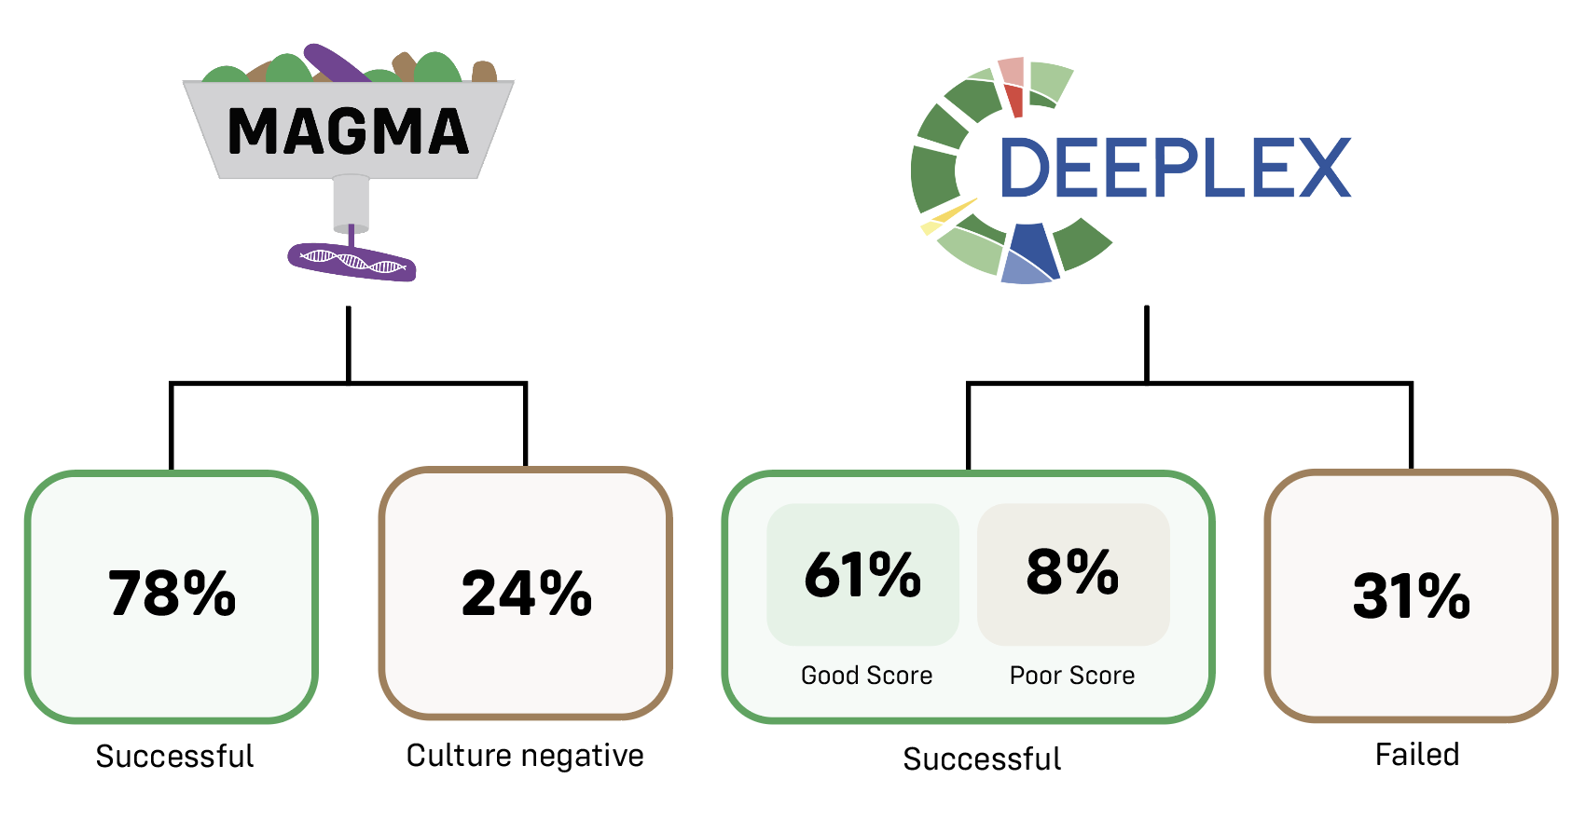
Results Generated
*
n=15
*1 culture -ve
14 culture –ve | 6 culture +ve

Slide 36
Minor Variants in DR-genes
Sample | Variant | Frequency of Minor Variant (MAGMA) | Frequency of Minor Variant (Deeplex)
LP-145 | gid_386delG | 4% | Not found
LP-189 | embB_Ala504Thr | Not found | 4%
LP-189 | ethA_delG | Not found | 4%
MM-092 | katG_371delG | 2% | Not found
TM-141 | inhA_Ile194Thr | Not found | 2%
MM-107 | rpoB_Leu452Pro | 2% | 3%

Slide 37
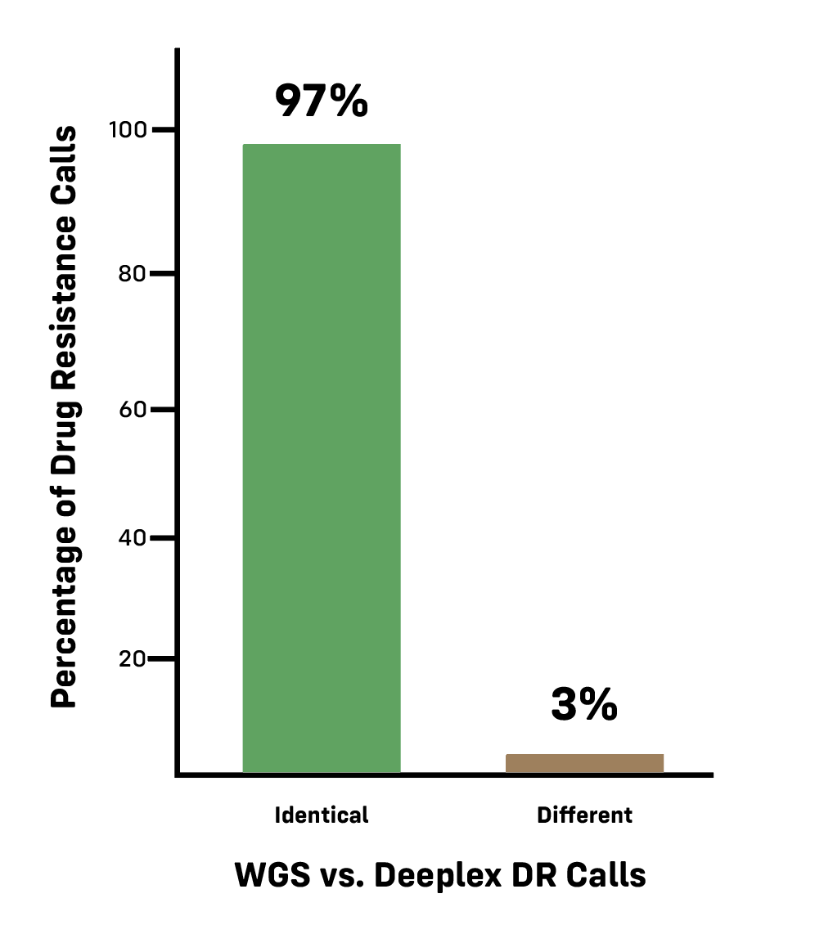
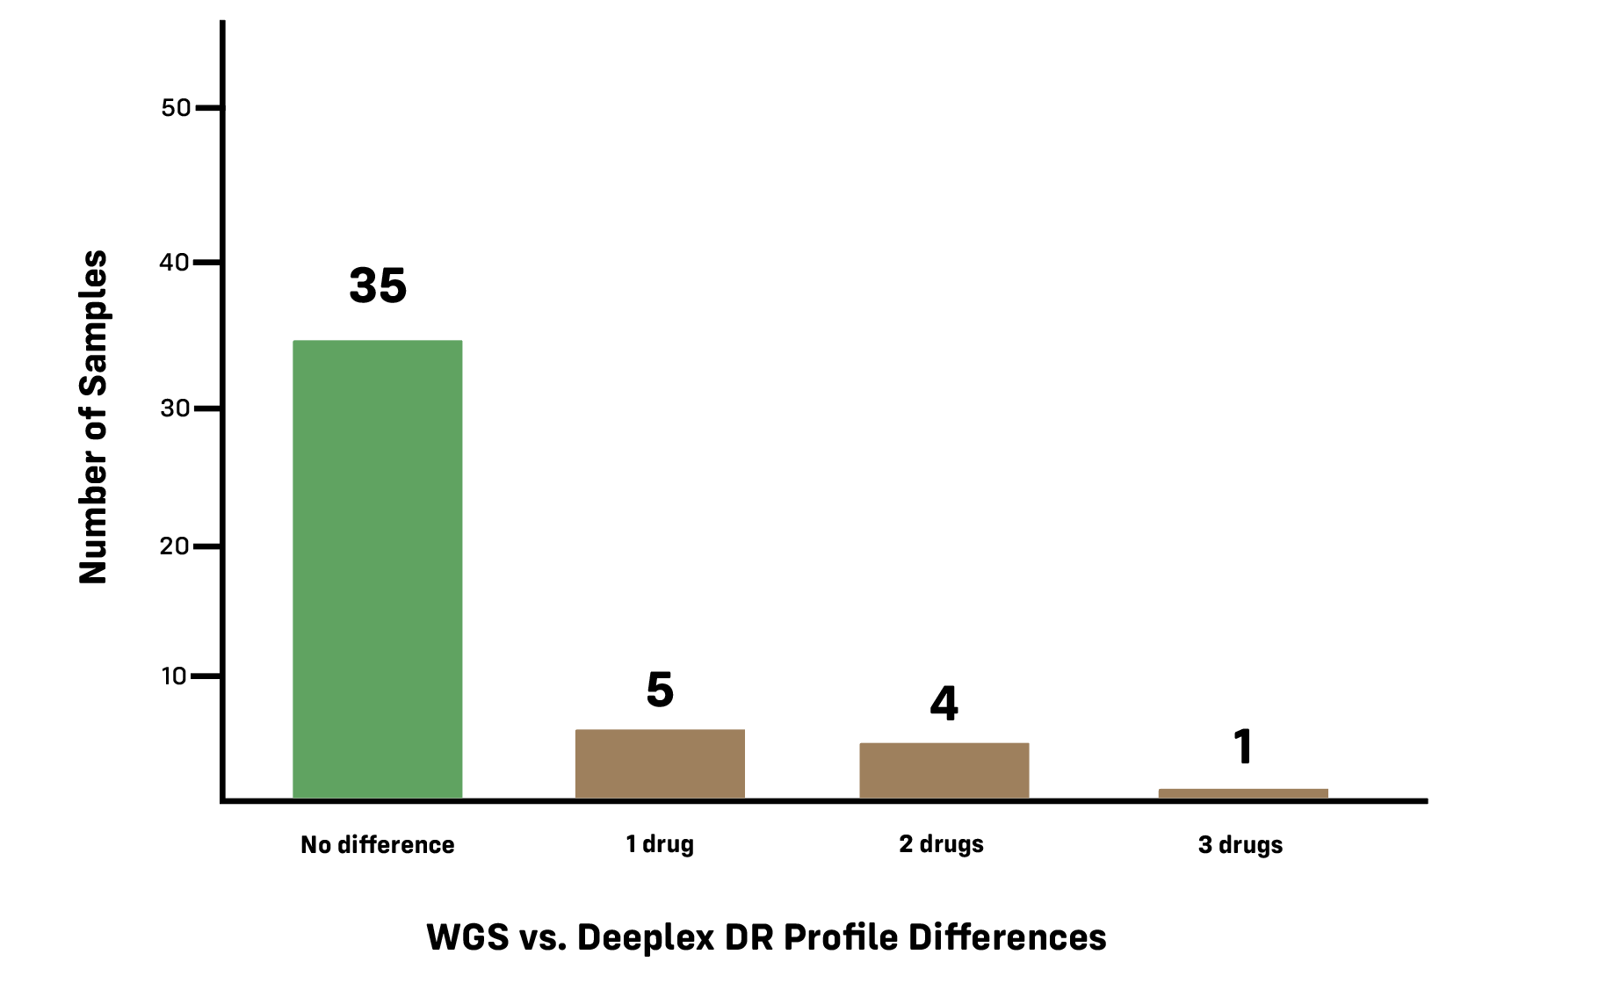
Differences between the two methods
n=45
n=585

Slide 38
Differences
Difference in detection of minor variants (n=5)
Difference in interpretation of ethA variant (n=2)
Large deletion in pncA (n=1) or katG (n=1) detected by Deeplex but not found by MAGMA (being addressed)
Variants found by MAGMA outside regions covered by Deeplex
inhA_-154G>A (n=3)
embA_c.-12C>T (n=1)

Slide 39

Conclusions
MAGMA analysis of WGS on primary liquid cultures provided results for 9% more cases than Deeplex directly on sputum
Differences in results for drugs resistance profiles were minimal
No differences in accuracy to detect minor (<5%) variants in drug resistance genes
Small sample size. Results need to be confirmed with larger studies and assessment of cost-effectiveness also requires comparison of
Time to result
Cost
Impact of ability to identify transmission events

Slide 40
Questions?

