Slide 1




On the Overflow through the Western Valley of the Iceland-Faroe Ridge
Bogi Hansen, Karin Margretha H. Larsen, Steffen Olsen,
Detlef Quadfasel, Kerstin Jochumsen, Svein Østerhus
ICES WGOH meeting
Norwich - UK, 20. March 2018

Slide 2
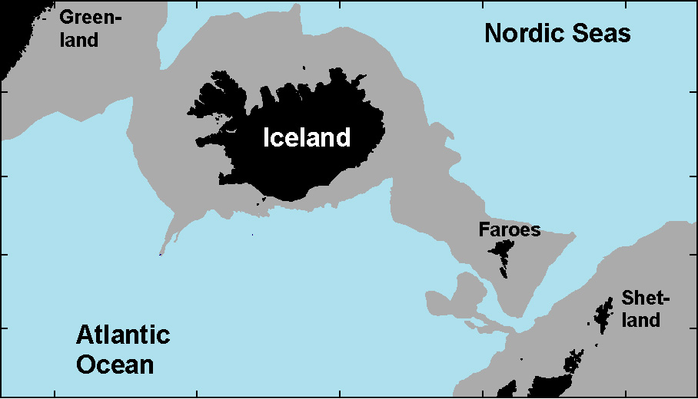
Overflows across the Greenland-Scotland Ridge
Arctic Mediterranean
DS: 3.2 Sv
Jochumsen et al, 2017
Iceland
Faroe
Ridge
IFR: ~1 Sv
FBC: 2.2 Sv
Hansen et al, 2016
WTR: 0.3 Sv
Johnson et al, 2017

Slide 3
What drives the exchanges across the Greenland-Scotland Ridge?
Cooling
Atlantic Ocean
Arctic Mediterranean
Warm Atlantic inflow
Heat
Overflow
Greenland
Scotland
Ridge

Slide 4
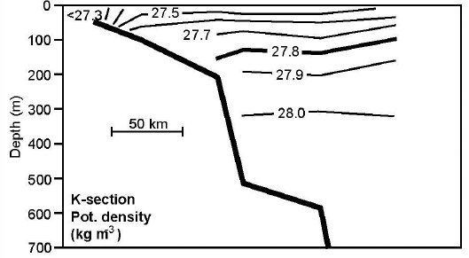
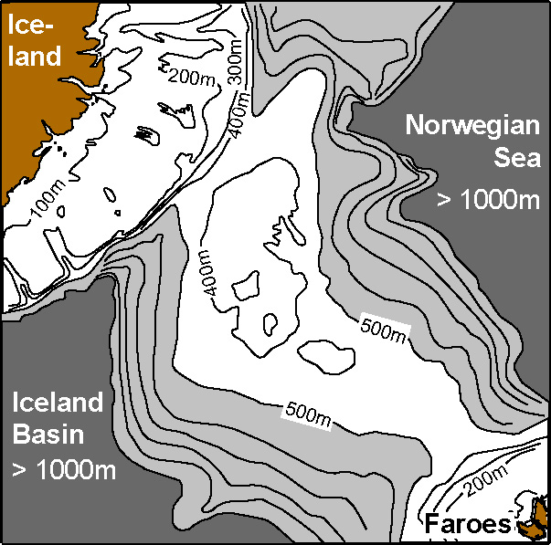
Iceland-Faroe Ridge overflow
σ_{θ}=27.8 kg/m³
Østerhus et al., 2008
125m
300m
Icelandic standard section
Persistent
WV Sill
425m
Pot. Density
(kg m⁻³)
Western Valley
Field experiment
2016-2017
Overflow volume transport:
= 1.65 Sv
Bottom current
(Perkins et al, 1998; Voet, 2010;
Olsen et al, 2016)
Strong (50 cm/s), Persistent (> 2 yrs)
Intermittent

Slide 5
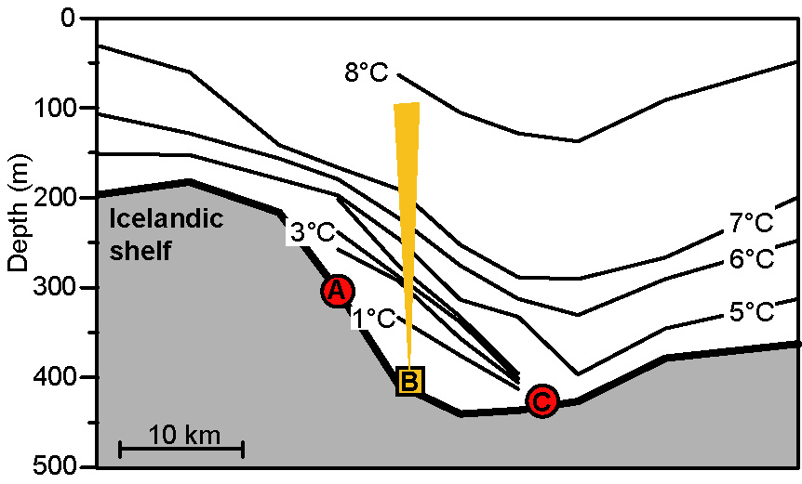
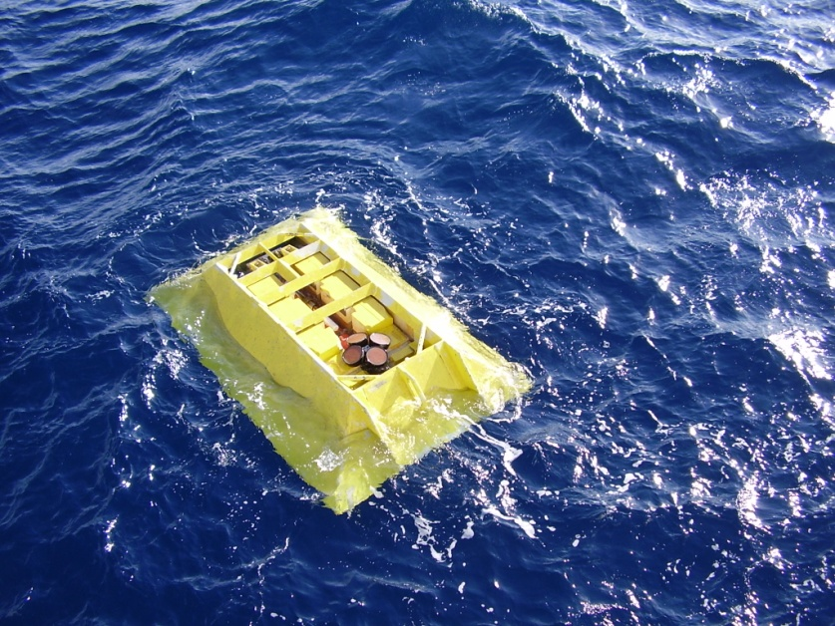
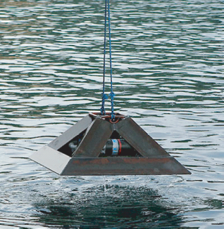
WOW field experiment
3 moorings, 278 days
Temperature during recovery cruise May 2017
Overflow water
Bottom temperature
Bottom temperature
ADCP

Slide 6
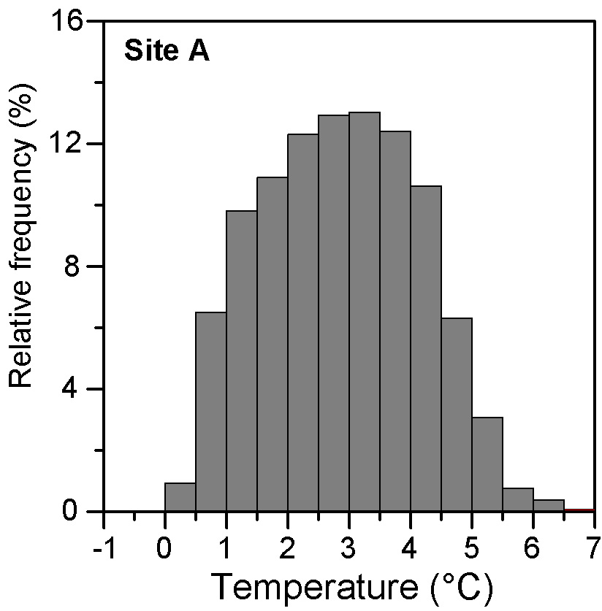
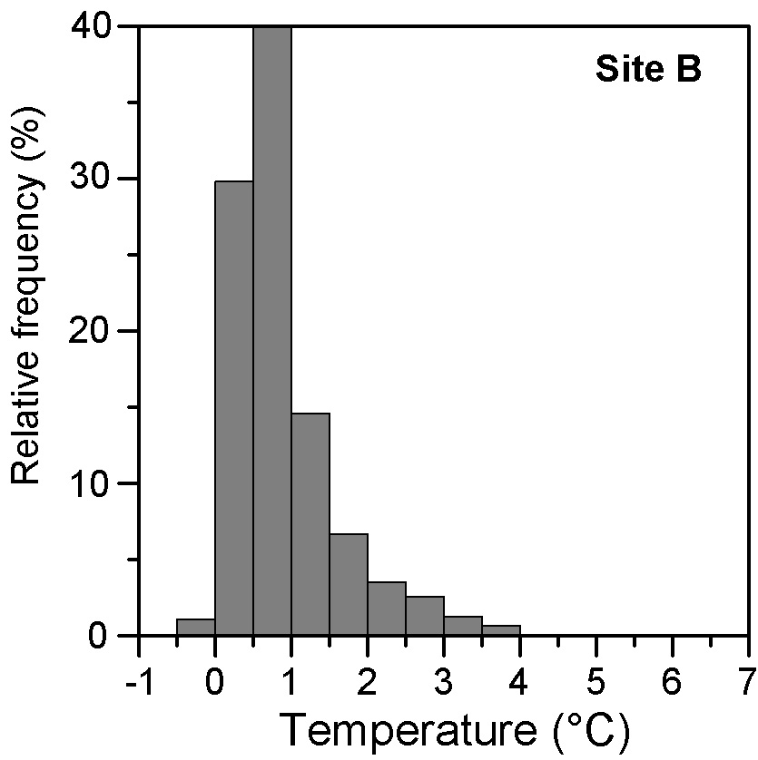
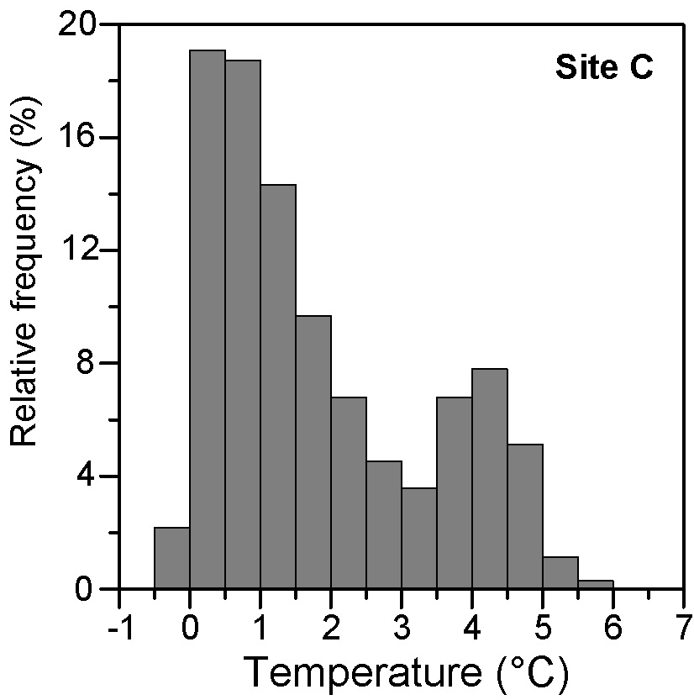
WV field experiment
3 moorings, 278 days
Temperature during recovery cruise May 2017
Width < 20 km

Slide 7
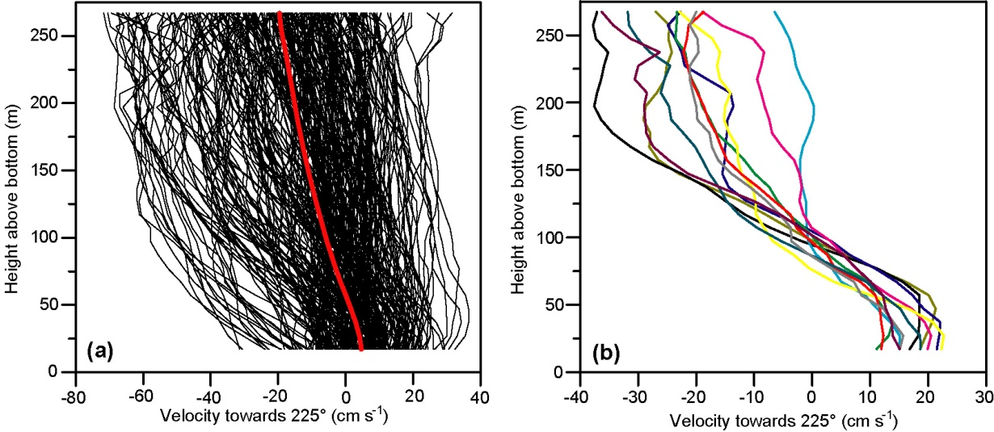
278 daily averaged ADCP profiles
ADCP
Average velocity profile
Transport density:
Overall average: <q> = 1.5 m²/s
Volume transport:
(Transport density) × (Width)
≤ 0.03 Sv
Overflow
What about properties?

Slide 8
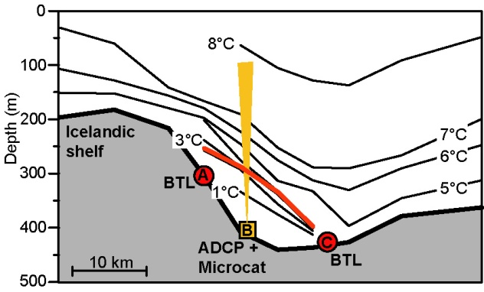
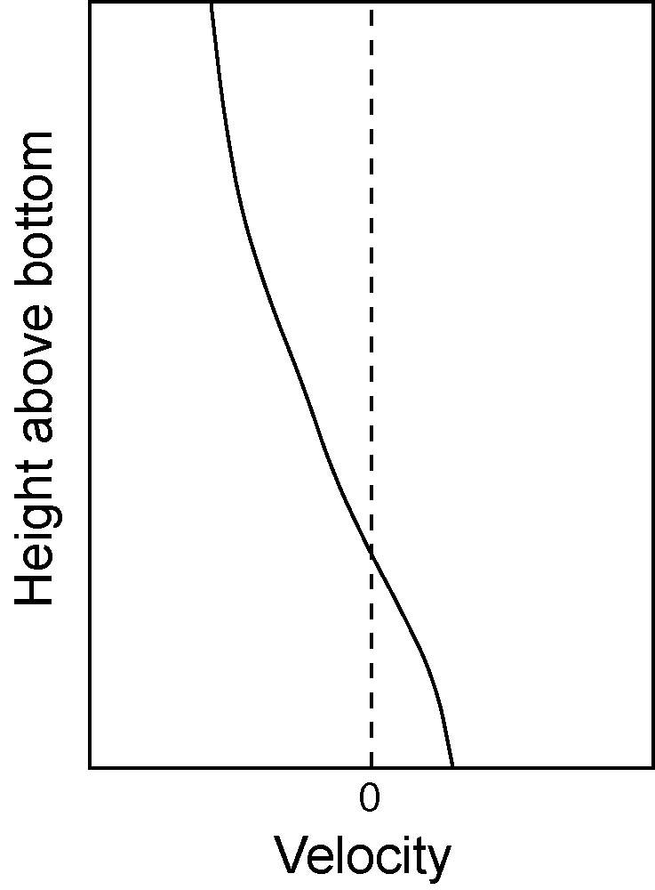

Improved estimate of overflow transport density
T = 3°C ~ σ_{θ} = 27.8 kg m⁻³
Estimate the height of the 3°C isotherm at site B
Long term avg: <q₀> = 2 m²/s
Overflow transport ≤ 0.04 Sv
Variable height
3°
3°

Slide 9
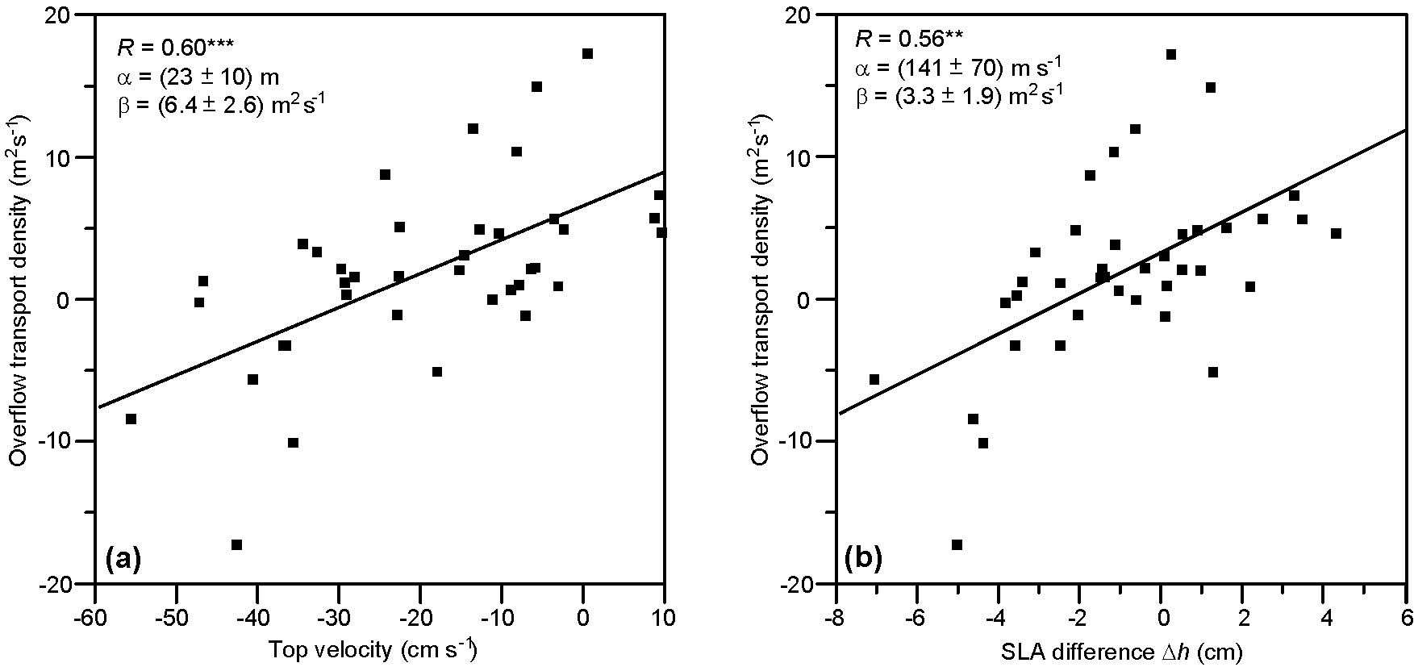
Why is WV-overflow so weak ?
ADCP
Weekly averaged transport density, q₀
Weak inflow
Atlantic inflow blocks
the WV-overflow
Strong Inflow
Atlantic inflow

Slide 10
During the period of our field experiment, the average WV-overflow was < 0.04 Sv
Was the period perhaps anomalous?

Slide 11
WV-overflow is linked to altimetry
∆h
Weekly averaged transport density, q₀
Allows estimate of the overflow transport density
for the whole altimetry period
∆h
Atlantic inflow

Slide 12
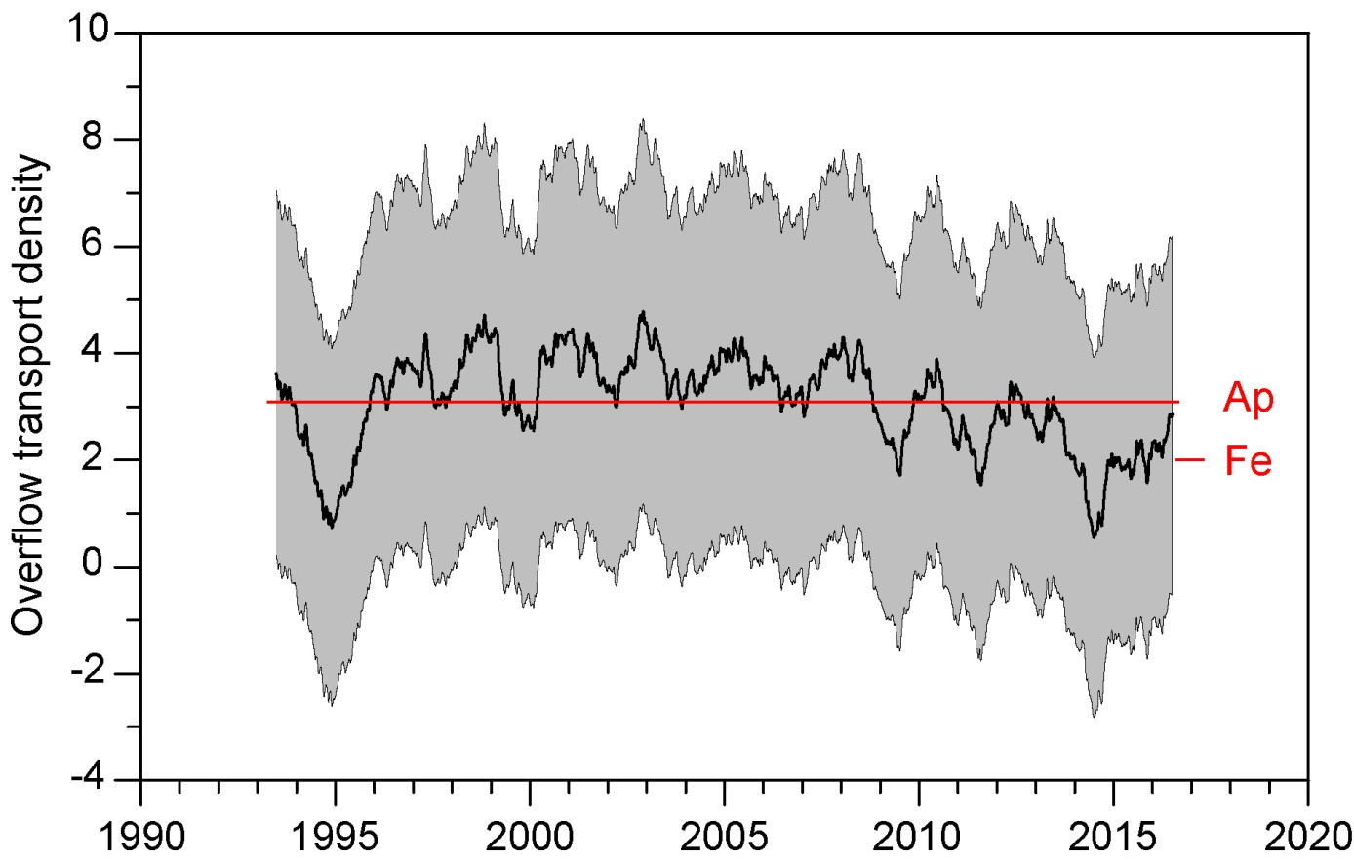
Altimetry based Overflow Transport Density
Long term
average ~ 3 m²/s
Field exp.
average ~ 2 m²/s
Annual average
Uncertainty
Long term Western Valley overflow ≤ 0.1 Sv

Slide 13
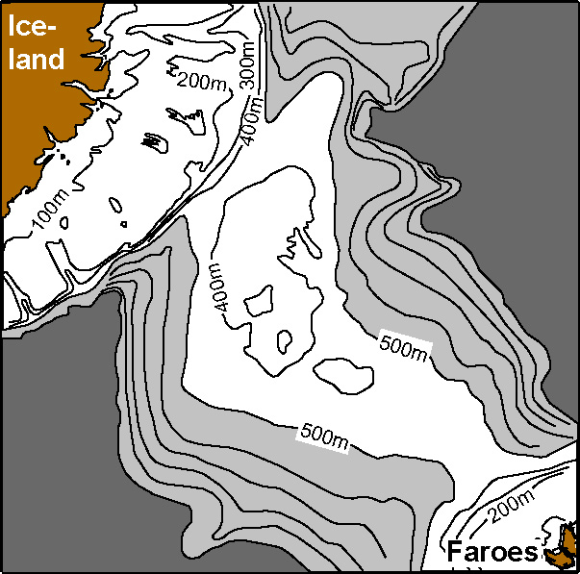
Total Iceland-Faroe Ridge overflow
Total probably
< 0.5 Sv
<0.1 Sv
?
0.3 Sv
Beaird et al. (2013)

Slide 14

Funding was received from:
The Danish Energy Agency as part of
the Arctic Climate Support Programme
RACE II – Regional Atlantic Circulation and Global Change Funded by the German Federal Ministry for Education and Research (BMBF), Förderkennzeichen 03F0729B
The Blue-Action project has received funding from the European Union’s Horizon 2020 research and innovation programme under grant agreement No 727852

