Slide 1




The Research Software & Systems Community in Africa
Anelda van der Walt
Talarify
anelda@talarify.co.za
RSE-AfOx Workshop
June 2024

Slide 2




Who am I?
Open science & reproducible research
Website
Community
engagement partner
Digitally enabled & computational research
Newsletters
Policy level
engagements
Training, mentorship, & communities of practice
Monthly meetups
Funders and decision-makers
Other
https://talarify.co.za
https://rsse.africa
https://researchsoft.org

Slide 3
Joined by RSSE Africa colleagues…
Peter van Heusden
Richard Dushime
Mireille Grobbelaar
South Africa
DRC but based in Uganda
South Africa
Open source contributor
Bioinformatics
Done: MSc Physiology
Secretary
RSE Asia Australia
Unconference
Founder of RSSE Africa
Busy: MSc Data Science
Research software & systems
RSSE Africa Independent Consultant
RSSE Africa Independent Consultant
https://talarify.co.za
https://rsse.africa
https://researchsoft.org

Slide 4



What do we know about the state of African research software and systems and the people who develop it?
https://talarify.co.za
https://rsse.africa/
https://researchsoft.org/

Slide 5


We have a growing repertoire of software-producing research projects on the continent including
astronomy
genomics/bioinformatics
machine learning applications
health and public health
geospatial
physics
computational social sciences
digital humanities
and more…
https://talarify.co.za
https://rsse.africa/
https://researchsoft.org/

Slide 6
African respondents in SSI surveys since 2017
2017
South Africa: 22
2018
South Africa: 23
Botswana: 2
Malawi: 1
Nigeria: 1
Mauritius: 1
Ethiopia: 1
2022
South Africa: 2
2017 & 2018 survey: https://github.com/softwaresaved/international-survey
2022 survey: https://github.com/softwaresaved/international-survey-2022
https://talarify.co.za
https://rsse.africa/
https://researchsoft.org/

Slide 7
African research software stakeholders mapped
ReSA 2022: Benin, Botswana, Cameroon, Democratic Republic of the Congo (DRC), Ghana, Kenya, Namibia, Nigeria, and South Africa.
39 Communities or organisations involved in Research Software
In South Africa:
South African National Bioinformatics Institute
Council for Scientific and Industrial Research
UCT eResearch
RSE at SUN
Martinez, Paula Andrea. (2022) doi.org/10.5281/zenodo.7179892
https://talarify.co.za
https://rsse.africa/
https://researchsoft.org/

Slide 8
African research software stakeholders map v2.0
Talarify 2023: 26 African countries (67 in South Africa)
Type | Number mapped
Community | 78
Research organisation | 52
Research group | 19
Training provider | 7
Research infrastructure | 5
Research software project | 2
National Research and Education Network | 1
Civic Tech organisation | 1
Advisory body | 1
Nomalungelo Maphanga, & Anelda Van der Walt. (2023). doi.org/10.5281/zenodo.7594454
https://talarify.co.za
https://rsse.africa/
https://researchsoft.org/

Slide 9
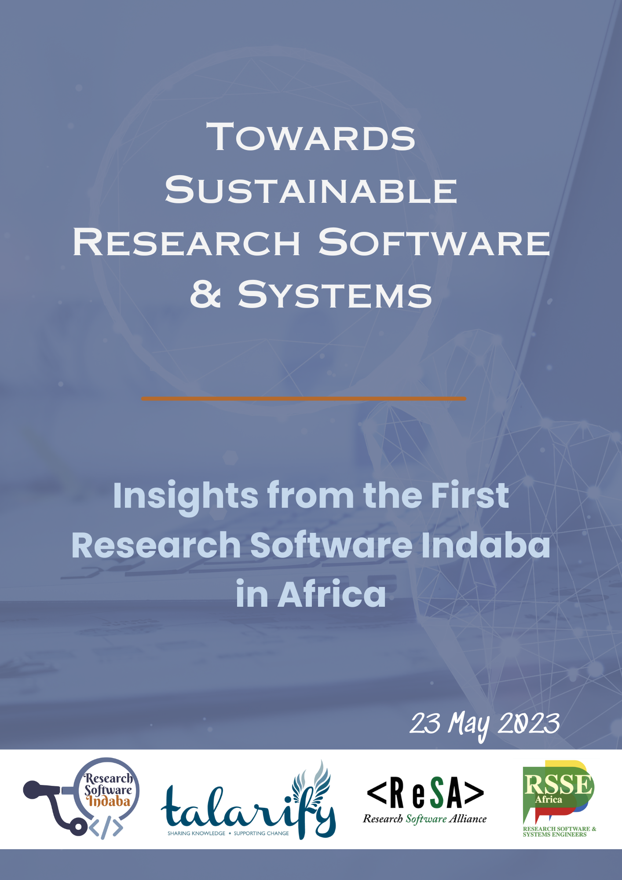
Research Software Indaba - South Africa 2023
Is your organisation involved in… | Responses
Research software or systems (data/compute) development and/or maintenance for in-house research | 16
Employ research software or infrastructure developers | 13
Training in research software or infrastructure development, maintenance, etc. | 13
Research software or systems (data/compute) development and/or maintenance as a service to others | 11
Provide access to specialised infrastructure on which research software runs (cloud/HPC) | 10
Develop policies related to the research software ecosystem | 9
Provide funding for research software projects, infrastructure, research, training, etc | 8
Research software project management | 8
Other | 8
Anelda Van der Walt, & Noxolo Chalale. (2023). doi.org/10.5281/zenodo.7980636
https://talarify.co.za
https://rsse.africa/
https://researchsoft.org/

Slide 10

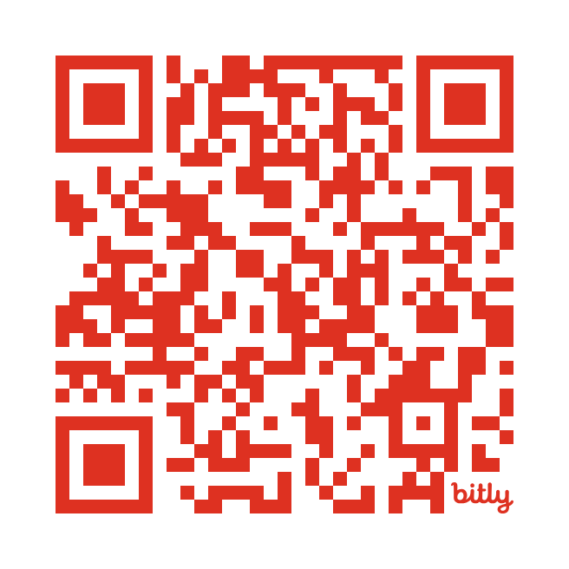
Join the African research software community
RSSE-Africa
Uniquely African forum for African RSSEs
Explicitly includes research system engineers
e.g. data storage and computational infrastructure designers/developers (the extra “S”)
Founded in 2019
No membership fees
https://rsse.africa
Read more about our history
https://talarify.co.za
https://rsse.africa/
https://researchsoft.org/

Slide 11





What we do in this community
Raise awareness of RSE
Share knowledge and resources
Share our work and collaborate
Showcase African expertise
Help to connect African RSEs and the global community
https://talarify.co.za
https://rsse.africa/
https://researchsoft.org/

Slide 12
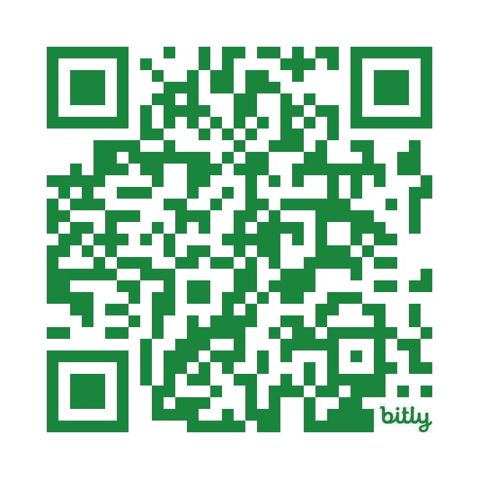
The Research Software Alliance
https://researchsoft.org/
Advance the research software ecosystem by collaborating with decision makers and key influencers
Funders’ Forum
  Meet every 6 weeks
  International workshop annually
  Amsterdam Declaration on Funding Research Software Sustainability (ADORE.software) - https://adore.software/
Monthly newsletter
  https://bit.ly/resa-news
https://talarify.co.za
https://rsse.africa/
https://researchsoft.org/

Slide 13

Huge opportunities to benefit from work done globally since 2010 for
individuals
research groups
institutions
funders
https://talarify.co.za
https://rsse.africa/
https://researchsoft.org/

Slide 14
1
https://talarify.co.za
https://rsse.africa/
https://researchsoft.org/

Slide 15

An invitation to join the RSE movement in
Africa and beyond
https://talarify.co.za
https://rsse.africa/
https://researchsoft.org/

Slide 16
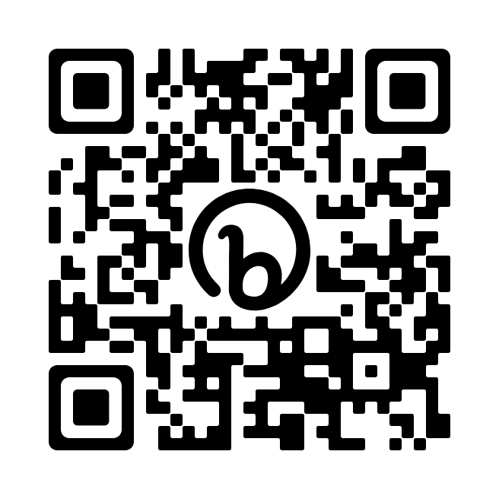
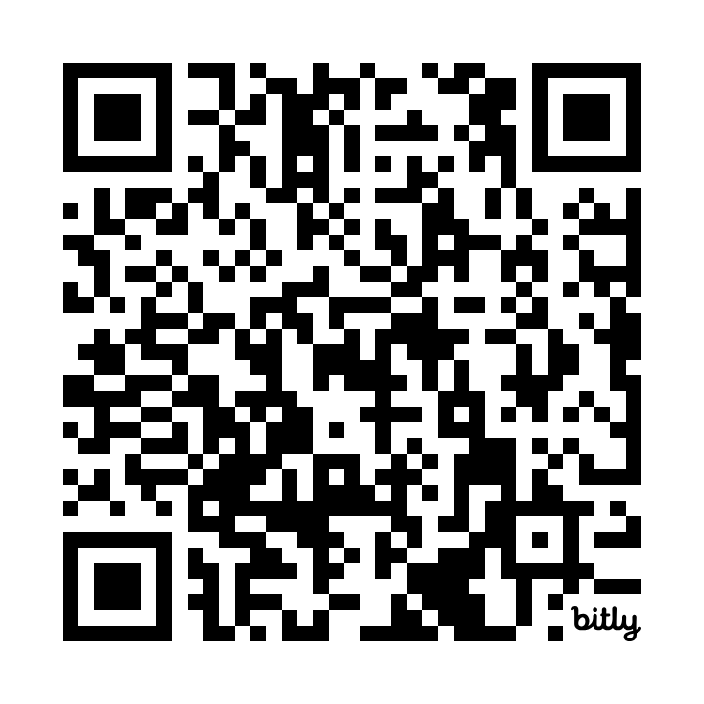
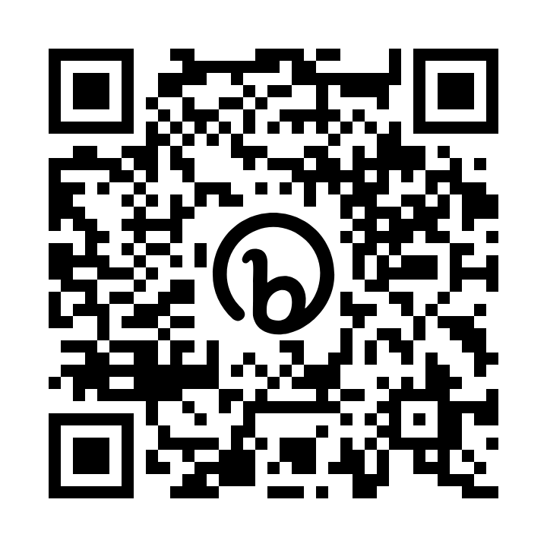
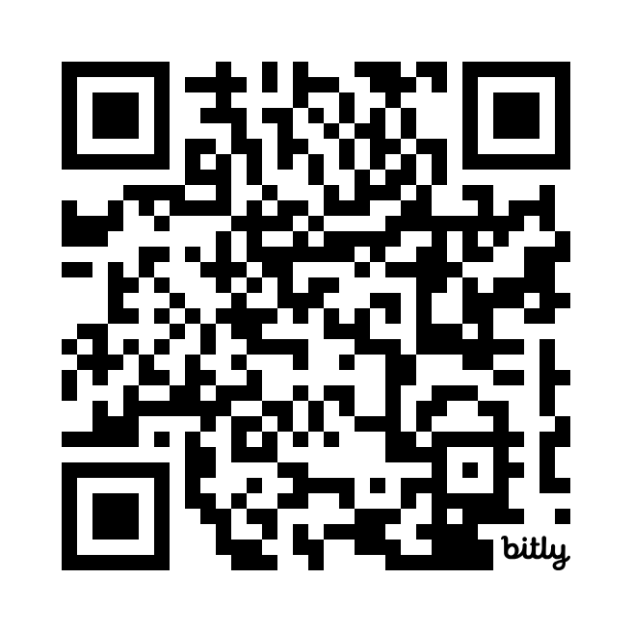
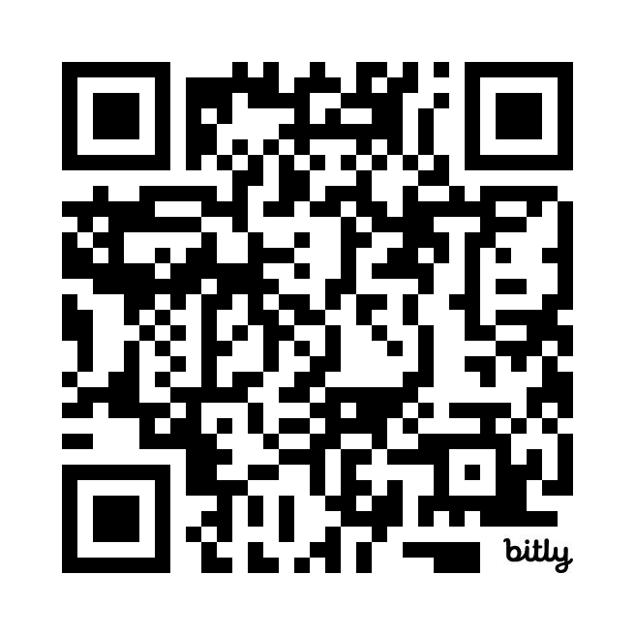
Join RSSE-Africa
LinkedIn Group
Member spotlights
Newsletter
Meetups
Slack channel
Share opportunities, resources, achievements, challenges, events, and much more.
Create awareness of the breadth of knowledge and experience on the continent.
Stay up to date with community news. Subscribe to our newsletter.
Join our monthly meetups. Showcase your work. Learn about resources and opportunities.
We host a channel on the international RSE Slack workspace.
bit.ly/3rWezvz
bit.ly/RSSEA-spotlights
bit.ly/rsse-newsletter
rsse.africa/events
bit.ly/45z8eWm
https://talarify.co.za
https://rsse.africa/
https://researchsoft.org/

Slide 17
2
https://talarify.co.za
https://rsse.africa/
https://researchsoft.org/

Slide 18


Share this info
Please tell your students, colleagues, employers, and funders about resources and opportunities shared in this presentation.
https://talarify.co.za
https://rsse.africa/
https://researchsoft.org/

Slide 19
3
https://talarify.co.za
https://rsse.africa/
https://researchsoft.org/

Slide 20

Make your voice heard
Help shape policy, funding, and research by sharing information
about your research software work through a variety of surveys,
working groups, meetups and more!
https://talarify.co.za
https://rsse.africa/
https://researchsoft.org/
Notes:
What to fund: A group of funding agencies from various countries around the world (https://www.researchsoft.org/funders-forum) is discussing the possibility of issuing a joint multilateral call to fund projects related to Research Software. The goal is to strengthen the software infrastructure aimed specifically at supporting research.
Usability & Design: Fill in Superbloom’s survey to contribute to research on how scientific open source software teams understand, consider, and undertake usability and design initiatives. An optional $15 USD Tremendous gift card is offered for your time.

Slide 21
Acknowledgements
We’d like to thank the following people for their support, contributions and collaboration
Peter van Heusden (SANBI, South Africa)
Kim Martin (RSE @ SUN founder and RSE advocate)
Mireille Grobbelaar & Richard Dushime (Independent consultants contributing to RSSE Africa)
ReSA (Director: Michelle Barker & Community managers: Saranjeet, Jyoti, Kim)
Members of the UK RSE community who joined our community meetups, share advice, support
Member of RSSE-Africa for being part of the community
The global community for being open and collaborative!
https://talarify.co.za
https://rsse.africa/
https://researchsoft.org/

Slide 22
Thank you for your time!
We look forward to seeing you in the community!!
Questions?
https://talarify.co.za
https://rsse.africa/
https://researchsoft.org/

Slide 23
A selection of fantastic resources and events
Annual RSECon - https://rsecon23.society-rse.org/
Research Software Funders Forum - https://www.researchsoft.org/funders-forum/
Collaborations Workshop - https://www.software.ac.uk/programmes-and-events/collaborations-workshops
RSE Fellows - https://society-rse.org/community/rse-fellows/
SSI Fellows - https://software.ac.uk/programmes-and-events/fellowship-programme
Mentorship - https://openlifesci.org/
Research software community forum - https://www.researchsoft.org/events/2022-06/
Did you know that there’s an International RSE Day (10 OCT 2024)?
Research software directory - https://research-software.dev/
Practical guide to software management plans - https://doi.org/10.5281/zenodo.7038280
Job descriptions: https://www.software.ac.uk/blog/2022-08-12-how-do-we-assess-candidates-rse-jobs
Loads of other resources: https://www.software.ac.uk/resources/guides
Research software studies in Zenodo: https://zenodo.org/communities/researchsoftwarestudies/
Links to work done by Dr Kim Martin around RSE@SUN through collaboration with SSI: https://www.software.ac.uk/blog/2023-04-27-presenting-rsecon22-and-starting-rse-group-south-africa
https://talarify.co.za
https://rsse.africa/
https://researchsoft.org/

Slide 24
This presentation is available under
the CC-BY 4.0 international license.
Please cite it as follows:
Anelda van der Walt. (2024). The Research Software & Systems Community in Africa. RSE-AfOx Workshop - June 2024.
https://talarify.co.za
https://rsse.africa/
https://researchsoft.org/

