Slide 1

Intuitive ELN
designed for life sciences labs
that supports your workflows
Digital notebooks:
Productivity Tools for Researchers
TU Delft 15 March 2018
Richard Adams richard@researchspace.com

Slide 2

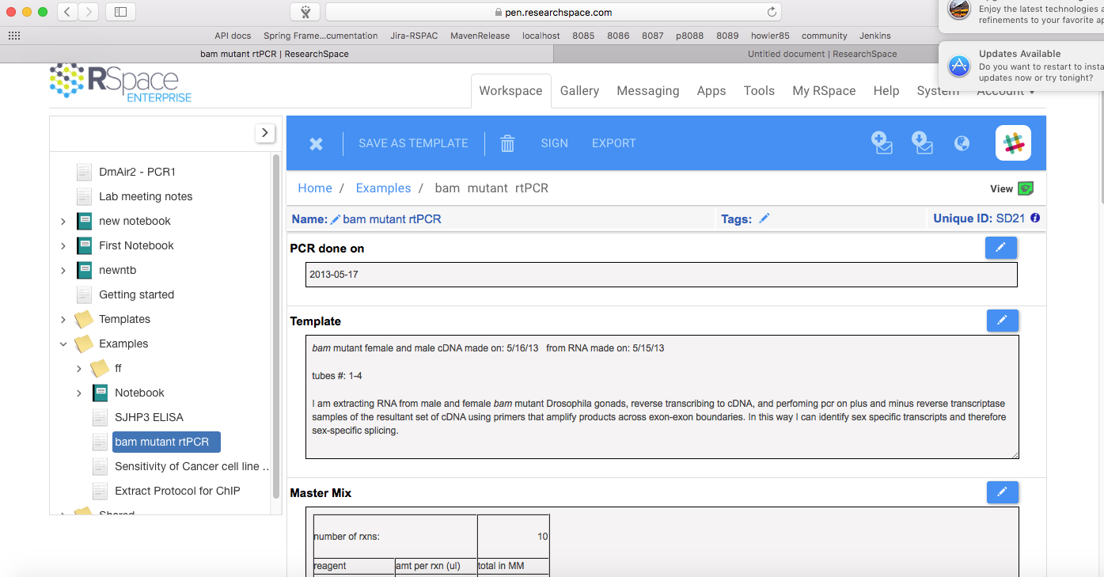
Interface design
Notes:
You can easily locate and link to other documents when editing a Notebook entry.
Get started quickly by importing protocols other docs in Word format and have them automatically transformed into RSpace docs, MAINTAINING THE FORMATTING.

Slide 3
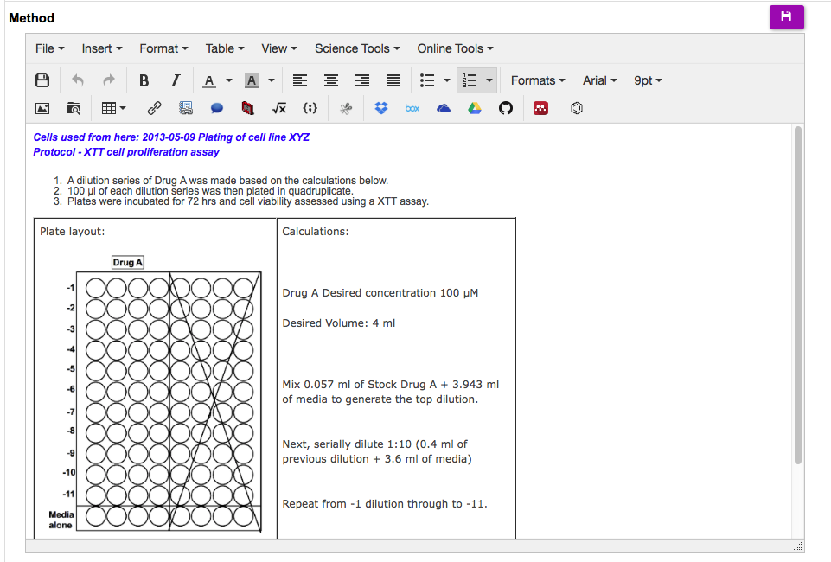
Editing
Interface design
Notes:
here is a view of our editing tool – familiar editing features plus easy ways to link to other content. RSpace supports annotations (click) math equations (click –click) and chemistry structure editing. Also use Science Tools to easily access basic calculations without breaking your editing flow.
Any content can be added to your notebook entry by Drag and Drop.

Slide 4
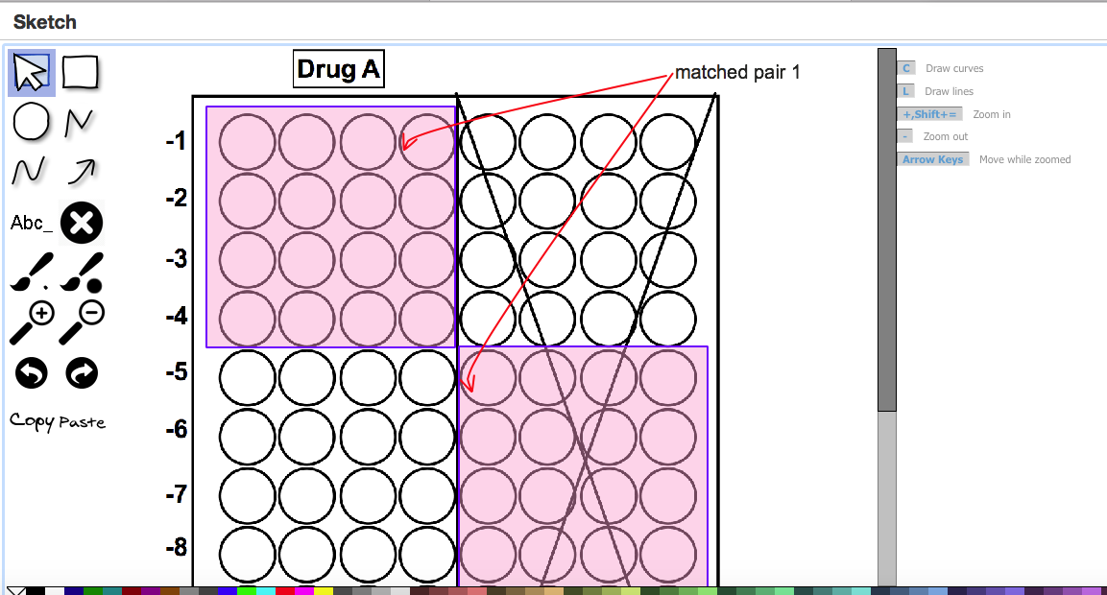
Editing
Interface design
Notes:
here is a view of our editing tool – familiar editing features plus easy ways to link to other content. RSpace supports annotations (click) math equations (click –click) and chemistry structure editing. Also use Science Tools to easily access basic calculations without breaking your editing flow.
Any content can be added to your notebook entry by Drag and Drop.

Slide 5
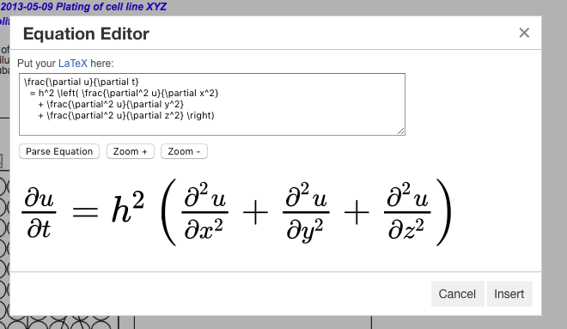
Editing
Interface design
Notes:
here is a view of our editing tool – familiar editing features plus easy ways to link to other content. RSpace supports annotations (click) math equations (click –click) and chemistry structure editing. Also use Science Tools to easily access basic calculations without breaking your editing flow.
Any content can be added to your notebook entry by Drag and Drop.

Slide 6
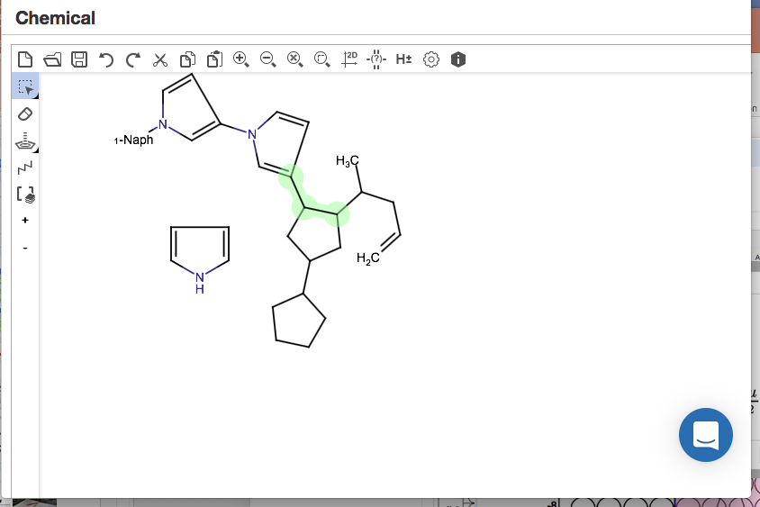
Editing
Interface design
Notes:
here is a view of our editing tool – familiar editing features plus easy ways to link to other content. RSpace supports annotations (click) math equations (click –click) and chemistry structure editing. Also use Science Tools to easily access basic calculations without breaking your editing flow.
Any content can be added to your notebook entry by Drag and Drop.

Slide 7
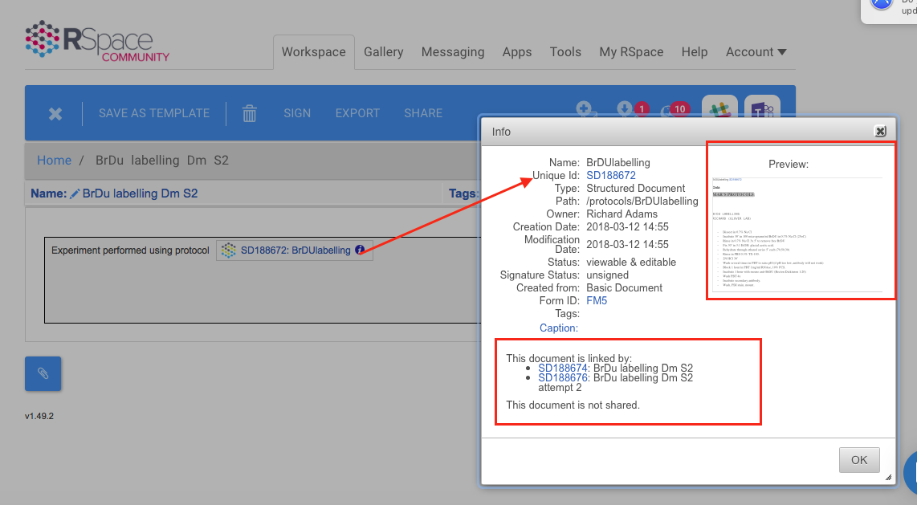
Linking your work together
Notes:
With Rspace you can keep track of how your experiments and data relate to one another. Find all the experiments you did using a particular protocol. When preparing a publication, all your data is at your fingertips.

Slide 8
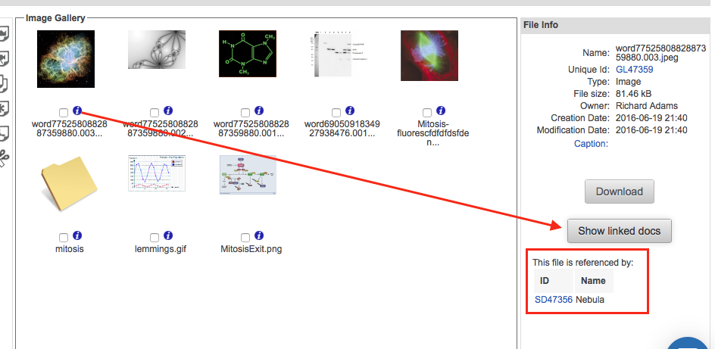
Linking your work together
Notes:
Or Browse your images and find the experiments that generated them. When preparing a publication, all your data is at your fingertips.

Slide 9
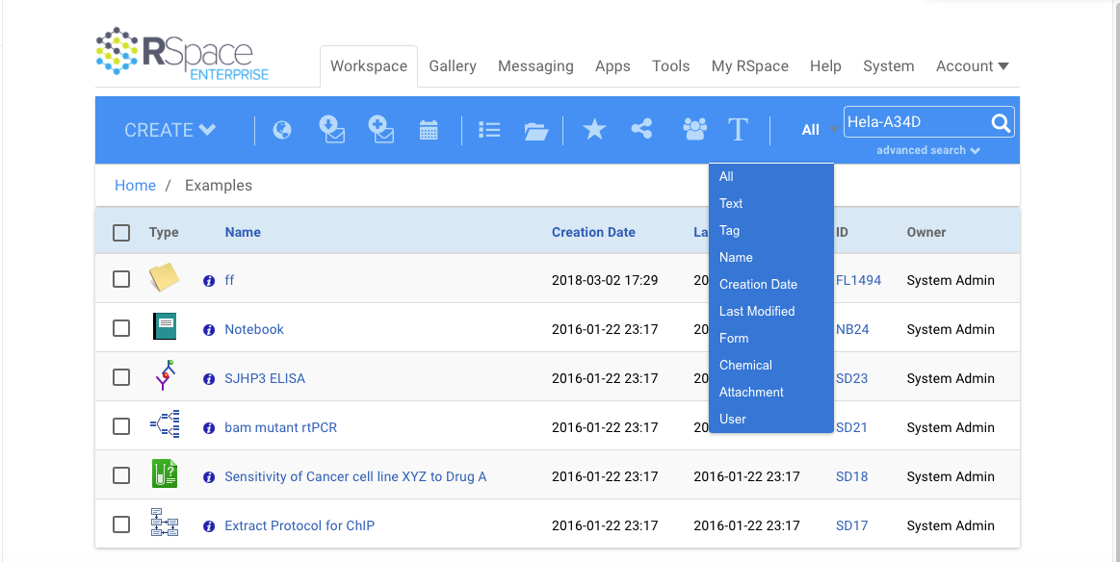
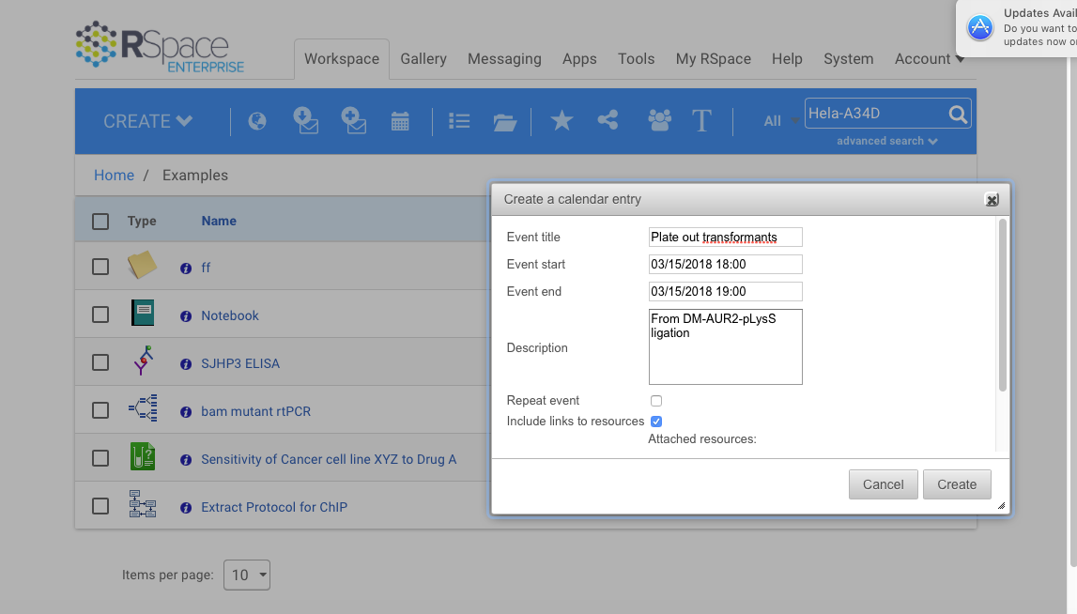
Navigation and workflow
Notes:
Rspace has a powerful search functionality, including full text search of imported PDFs and Word documents.
Also, add reminders and events straight to your calendar.

Slide 10
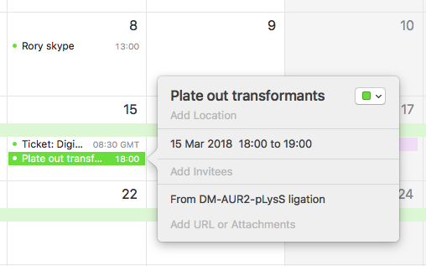
Navigation and workflow
Notes:
Rspace has a powerful search functionality, including full text search of imported PDFs and Word documents.
Also, add reminders and events straight to your calendar.

Slide 11
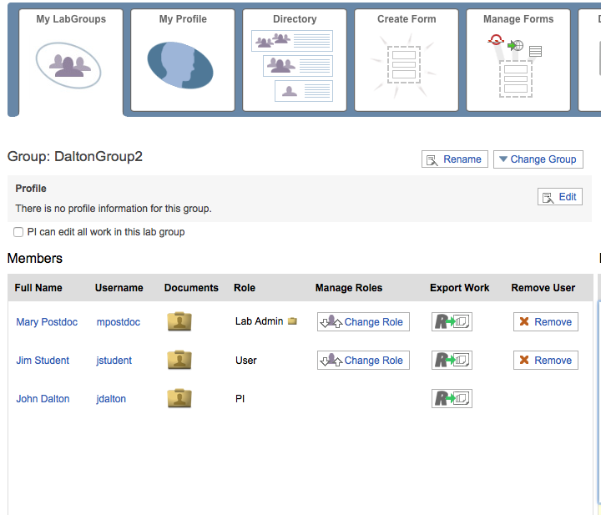

Designed for life sciences labs
Discipline
Life sciences
Plant /environmental science
Materials science
Chemistry/Biochemistry
Engineering /materials science
Notes:
Rory comment: move this to slide 4.
RSpace is specifically designed for academic labs in life sciences and related disciplines.
RSpace is very usable for individuals but shines when working in a group, with its easy and intuitive sharing mechanism with support for lab workflows with PI and lab admin roles.

Slide 12
Data Management and storage
Feature | Support
What is format and restriction on files? | Any format, 500Mb max per file
Can multiple files be uploaded/downloaded simultaneously?
Can the data be linked from a different storage location?
What’s the maximum storage per user? | Unlimited !
Where is the data stored and is it backed up? | Amazon Web Services (AWS) hosted in EU(Ireland). Backed up to AWS S3 and Glacier.
Notes:
These answers are for our free community edition. If you have your own instance you can connect to your internal file stores or upload files of any size.

Slide 13
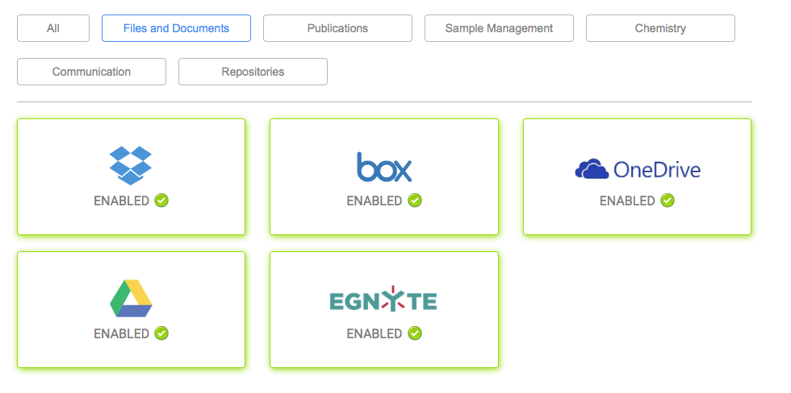
Integration with other software and/or cloud services
Notes:
Rspace apps provide rich integrations with file providers, repositories and publishers. We are also working with new work communication apps such as Slack, Microsoft Teams and Google Hangouts Chat so that you can link messaging and chat to your research record.

Slide 14
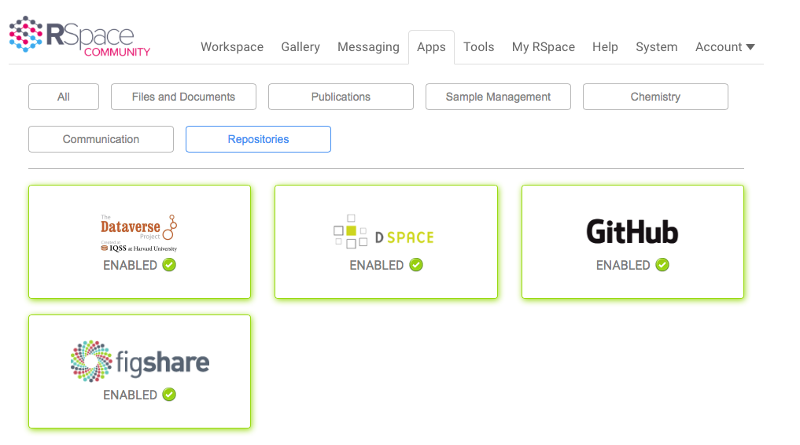
Integration with other software and/or cloud services
Notes:
Rspace apps provide rich integrations with file providers, repositories and publishers. We are also working with new work communication apps such as Slack, Microsoft Teams and Google Hangouts Chat so that you can link messaging and chat to your research record.

Slide 15
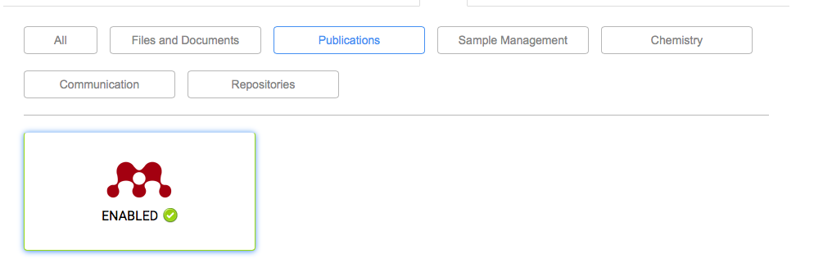
Integration with other software and/or cloud services
Notes:
Rspace apps provide rich integrations with file providers, repositories and publishers. We are also working with new work communication apps such as Slack, Microsoft Teams and Google Hangouts Chat so that you can link messaging and chat to your research record.

Slide 16
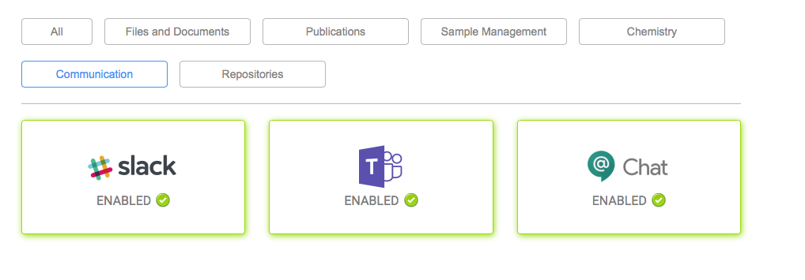
Integration with other software and/or cloud services
Notes:
Rspace apps provide rich integrations with file providers, repositories and publishers. We are also working with new work communication apps such as Slack, Microsoft Teams and Google Hangouts Chat so that you can link messaging and chat to your research record.

Slide 17






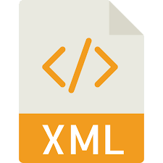
Export features: convenient and no lock in.
What to export?
Selection of content
All my work
All my group’s work
What format?
Where to export ?
Download
Store in RSpace
Notes:
How to get data out of an ELN is probably its most important feature! Storing data in an ELN isn’t the end goal – eventually you want to share, archive or publish your data. Whatever ELN you choose, you must be sure you can get your data out in a variety of formats, including machine-readable formats. Eventually, you will want to change ELN and migrate your data.
If your vendor doesn’t support machine readable formats such as JSON or XML you risk losing data in the future, or being locked in to one supplier!
At Rspace we want you to feel comfortable that you can get your data out at any time.

Slide 18
Why come to the demo?
RSpace is designed for use by academic labs.
An intuitive interface and supports your workflows.
RSpace’s linking and automatic metadata generation makes it simple to bring
together experimental writeups, statistical analyses, and raw data when you’re
ready to publish.
Rich API enables scripted import, search and retrieval of notebook data..
Try for free and it stays free! – free for individuals and groups AND free data storage
Easy and flexible data export means no vendor lock-in.
ResearchSpace is completely independent – we are not owned by another company
and your data belongs to you at all times.
https://community.researchspace.com
Notes:
You can easily share content in Rspace either with individuals or with our whole group. There are various roles in a group which I can explain at the

Slide 19
https://community.researchspace.com
Please sign up to try RSpace!

Slide 20

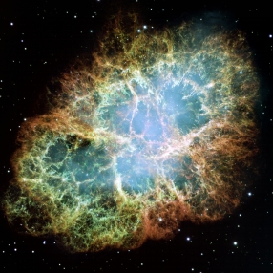





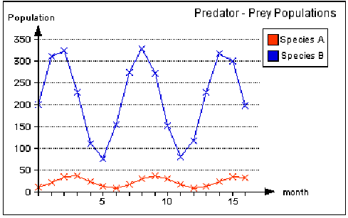
Linking your research together
Files on your servers
E1
E2
E3
E4
E5
Files on the cloud
Protocol1
Protocol2
Notes:
With Rspace you can keep track of how your experiments and data relate to one another. Browse your images and find the experiments that generated them. Or find all the experiments you did using a particular protocol. When preparing a publication, all your data is at your fingertips

