Slide 1

Alastair Downie
Gurdon Institute, University of Cambridge

Slide 2
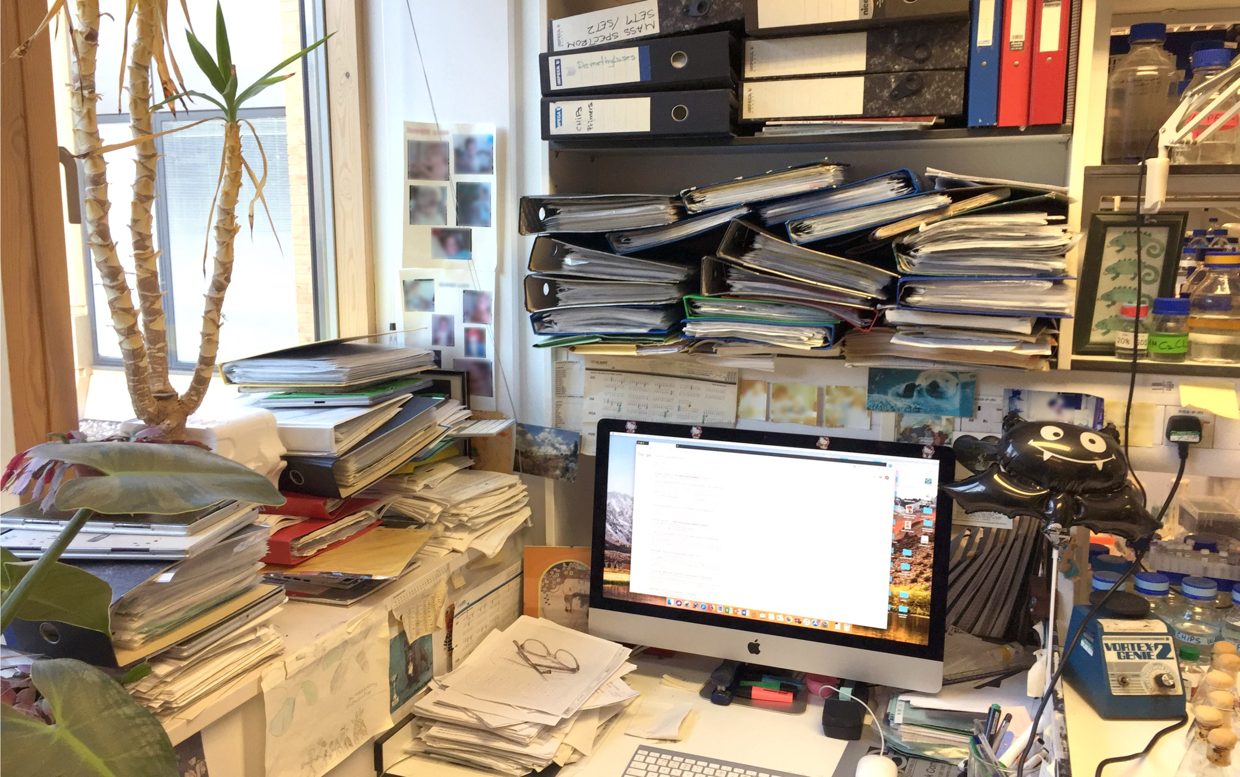

Slide 3
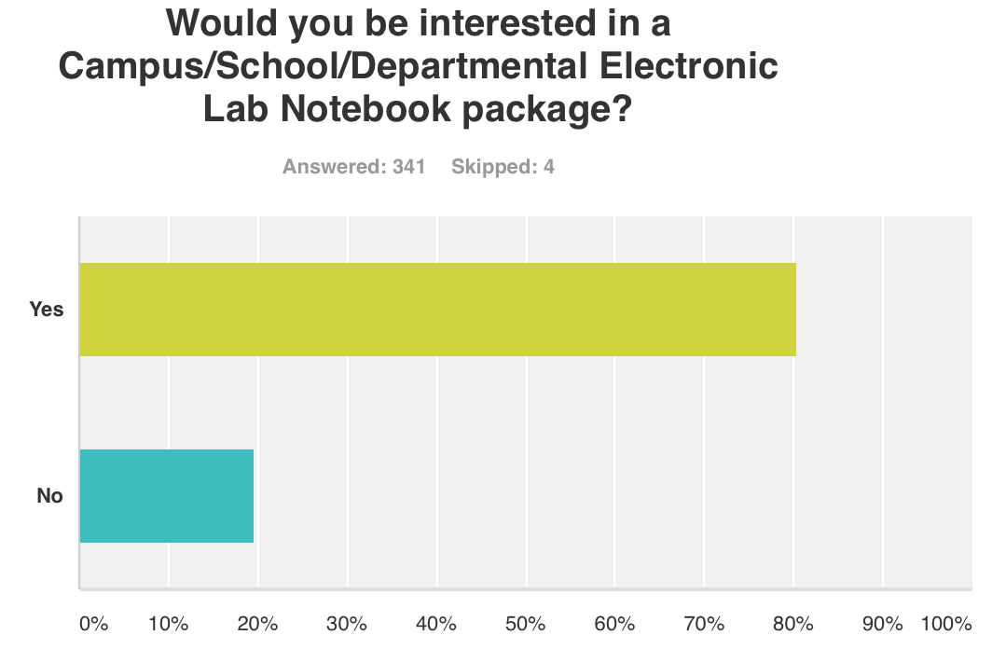
Would you be interested in a Campus/School/Departmental Electronic Lab Notebook package?
Yes
274
No
67
n=341
School of Biological Sciences,
University of Cambridge, Dec 2016

Slide 4
1st ELN in 1997 - Industry was quick to adopt
• Scale of operations
• Requirement for absolutely consistent processes
• Protection of Intellectual Property
• Other commercial and corporate responsibilities

Slide 5
1st ELN in 1997 - Industry was quick to adopt
• Scale of operations
• Requirement for absolutely consistent processes
• Protection of Intellectual Property
• Other commercial and corporate responsibilities
• Boardroom

Slide 6
1st ELN in 1997 - Industry was quick to adopt
• Scale of operations
• Requirement for absolutely consistent processes
• Protection of Intellectual Property
• Other commercial and corporate responsibilities
• Boardroom...
• vs Academic freedom

Slide 7
What’s holding University researchers back?
Benchling, Biovia, Docollab, e-Notebook, e-Workbook, eLabFTW, eLABJournal, Findings, Hivebench, LabArchives, LabCloud, LabCollector, Labfolder, LabGuru, Labii, LabTrove, Mbook, Open Science Framework, OpenLab, Quiver, REDCap, RSpace, SciNote, Signals, SLIMS....

Slide 8
What’s holding University researchers back?
Benchling, Biovia, Docollab, e-Notebook, e-Workbook, eLabFTW, eLABJournal, Findings, Hivebench, LabArchives, LabCloud, LabCollector, Labfolder, LabGuru, Labii, LabTrove, Mbook, Open Science Framework, OpenLab, Quiver, REDCap, RSpace, SciNote, Signals, SLIMS....
Research work, grant applications, research strategy, competition, staff management, teaching, lab management, primary manuscripts, review manuscripts, peer review, recruitment, committees, budget management, license management....

Slide 9
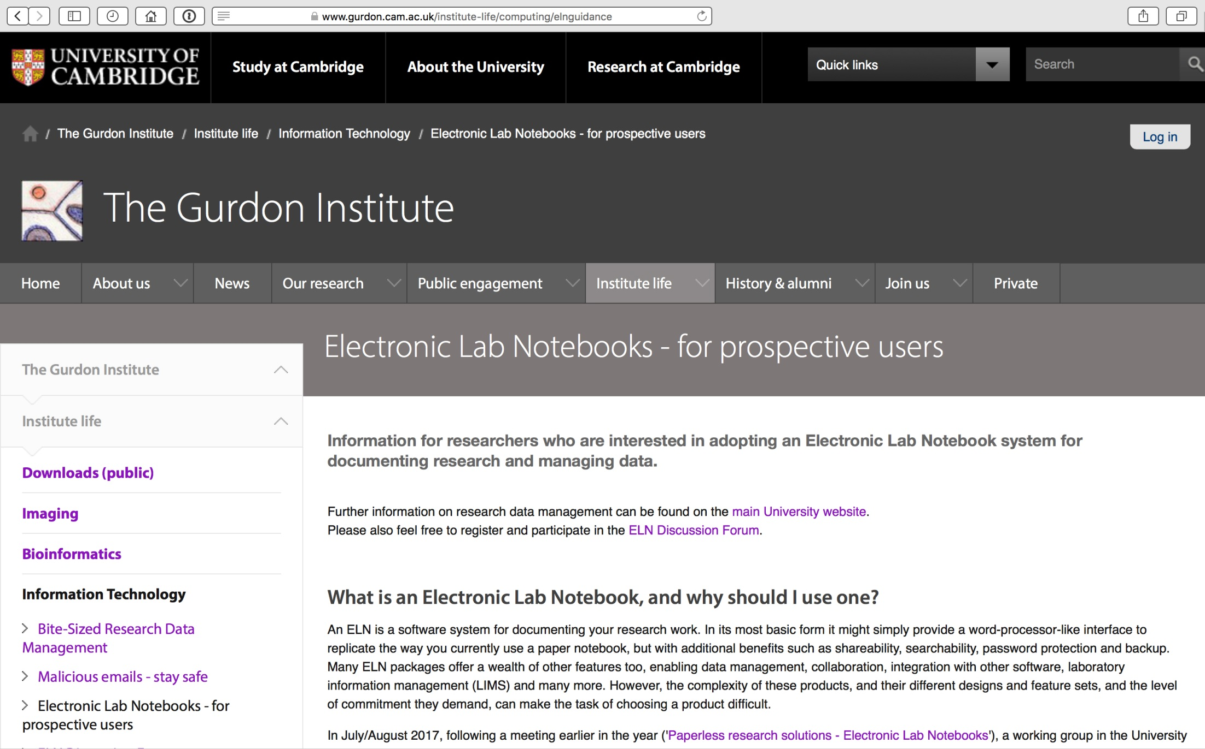

Slide 10
www.gurdon.cam.ac.uk/eln
• What is an electronic lab notebook and why should I use one?
• A note about DIY systems
• ELN vs LIMS
• Disengagement – what if I want to change systems?
• Narrowing the scope, creating a shortlist
• Evaluating ELN products
• Table of 25 current ELN products
• Discussion forum

Slide 11






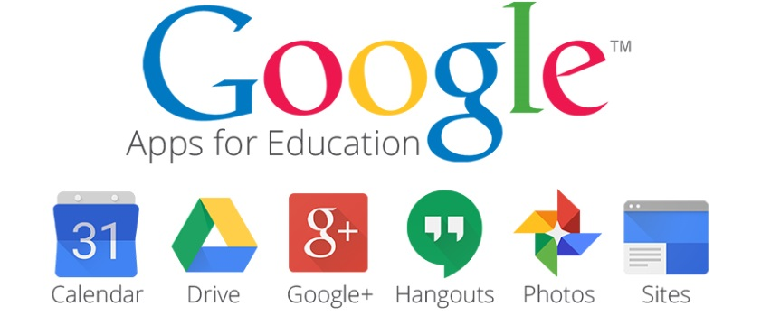


Alternative / DIY Electronic Lab Notebooks

Slide 12
LIMS
ELN
• Heavy duty database
• Sample management
• Freezer stocks
• Reagents
• Protocol management
• Data capture / automation
• Procurement / ordering
• + ELN
• Journal
• Collaboration
• Experiment design
• Data management
• Protocol management
• Scheduling
• Version control
• + LIMS

Slide 13
What if I make a mistake?

Slide 14

What if I make a mistake?

Slide 15
What if I make a mistake?
Search ✓
Share ✓
Secure ✓
Backup ✓
Print ✓

Slide 16
Creating a shortlist
• Do you have a budget?
• Will you use the software as an individual or a group?
• Do you need supervisor features?
• Departmental or Institutional deployment?
• Do you need multi-OS compatibility?
• What devices will be used to operate the software?
• Data security and compliance requirements?

Slide 17
Creating a shortlist
• Do you have a budget? Is it really free forever? How much is the right product worth?
• Will you use the software as an individual or a group?
• Do you need supervisor features?
• Departmental or Institutional deployment?
• Do you need multi-OS compatibility?
• What devices will be used to operate the software?
• Data security and compliance requirements?

Slide 18
Creating a shortlist
• Do you have a budget?
• Will you use the software as an individual or a group? Collaborative vs self-contained, comprehensive vs lightweight
• Do you need supervisor features?
• Departmental or Institutional deployment?
• Do you need multi-OS compatibility?
• What devices will be used to operate the software?
• Data security and compliance requirements?

Slide 19
Creating a shortlist
• Do you have a budget?
• Will you use the software as an individual or a group?
• Do you need supervisor features? Group activity dashboard, commenting & discussions
• Departmental or Institutional deployment?
• Do you need multi-OS compatibility?
• What devices will be used to operate the software?
• Data security and compliance requirements?

Slide 20
Creating a shortlist
• Do you have a budget?
• Will you use the software as an individual or a group?
• Do you need supervisor features?
• Departmental or Institutional deployment? Please everyone? Or focus on stability, accessibility and universal relevance?
• Do you need multi-OS compatibility?
• What devices will be used to operate the software?
• Data security and compliance requirements?

Slide 21
Creating a shortlist
• Do you have a budget?
• Will you use the software as an individual or a group?
• Do you need supervisor features?
• Departmental or Institutional deployment?
• Do you need multi-OS compatibility? Browser-based & OS agnostic, or application-based?
• What devices will be used to operate the software?
• Data security and compliance requirements?

Slide 22
Creating a shortlist
• Do you have a budget?
• Will you use the software as an individual or a group?
• Do you need supervisor features?
• Departmental or Institutional deployment?
• Do you need multi-OS compatibility?
• What devices will be used to operate the software? Tablets on bench? Voice recognition? Phones? Paper?
• Data security and compliance requirements?

Slide 23
Creating a shortlist
• Do you have a budget?
• Will you use the software as an individual or a group?
• Do you need supervisor features?
• Departmental or Institutional deployment?
• Do you need multi-OS compatibility?
• What devices will be used to operate the software?
• Data security and compliance requirements? GDPR vs location of storage? Use local storage? Or locally-managed ELN?

Slide 24
Evaluating your shortlisted products
• Interface design
• Workflow suitability
• Content creation tools
• Data management & storage features
• Integration with other software and/or cloud services
• Collaboration features
• PI/Supervisor features
• Export features

Slide 25
Evaluating your shortlisted products
• Interface design Look and feel? Intuitive? Efficient? Comfortable?
• Workflow suitability
• Content creation tools
• Data management & storage features
• Integration with other software and/or cloud services
• Collaboration features
• PI/Supervisor features
• Export features

Slide 26
Evaluating your shortlisted products
• Interface design
• Workflow suitability ELN workflow vs real workflow? Linear vs all-over-the-place?
• Content creation tools
• Data management & storage features
• Integration with other software and/or cloud services
• Collaboration features
• PI/Supervisor features
• Export features

Slide 27
Evaluating your shortlisted products
• Interface design
• Workflow suitability
• Content creation tools Writing, drawing, annotation, markup, equations, chemical structures...
• Data management & storage features
• Integration with other software and/or cloud services
• Collaboration features
• PI/Supervisor features
• Export features

Slide 28
Evaluating your shortlisted products
• Interface design
• Workflow suitability
• Content creation tools
• Data management & storage features Upload typical file types/sizes? Larger files? Display/operation? Backed-up?
• Integration with other software and/or cloud services
• Collaboration features
• PI/Supervisor features
• Export features

Slide 29
Evaluating your shortlisted products
• Interface design
• Workflow suitability
• Content creation tools
• Data management & storage features
• Integration with other software and/or cloud services Office apps, Statistics, Institutional storage, Community repositories…
• Collaboration features
• PI/Supervisor features
• Export features

Slide 30
Evaluating your shortlisted products
• Interface design
• Workflow suitability
• Content creation tools
• Data management & storage features
• Integration with other software and/or cloud services
• Collaboration features Share data and comments in group? Invite external collaboration?
• PI/Supervisor features
• Export features

Slide 31
Evaluating your shortlisted products
• Interface design
• Workflow suitability
• Content creation tools
• Data management & storage features
• Integration with other software and/or cloud services
• Collaboration features
• PI/Supervisor features Sufficient oversight and feedback tools? Team/account management?
• Export features

Slide 32
Evaluating your shortlisted products
• Interface design
• Workflow suitability
• Content creation tools
• Data management & storage features
• Integration with other software and/or cloud services
• Collaboration features
• PI/Supervisor features
• Export features Pages, Sections, Entire ELN? Data in original formats?

Slide 33
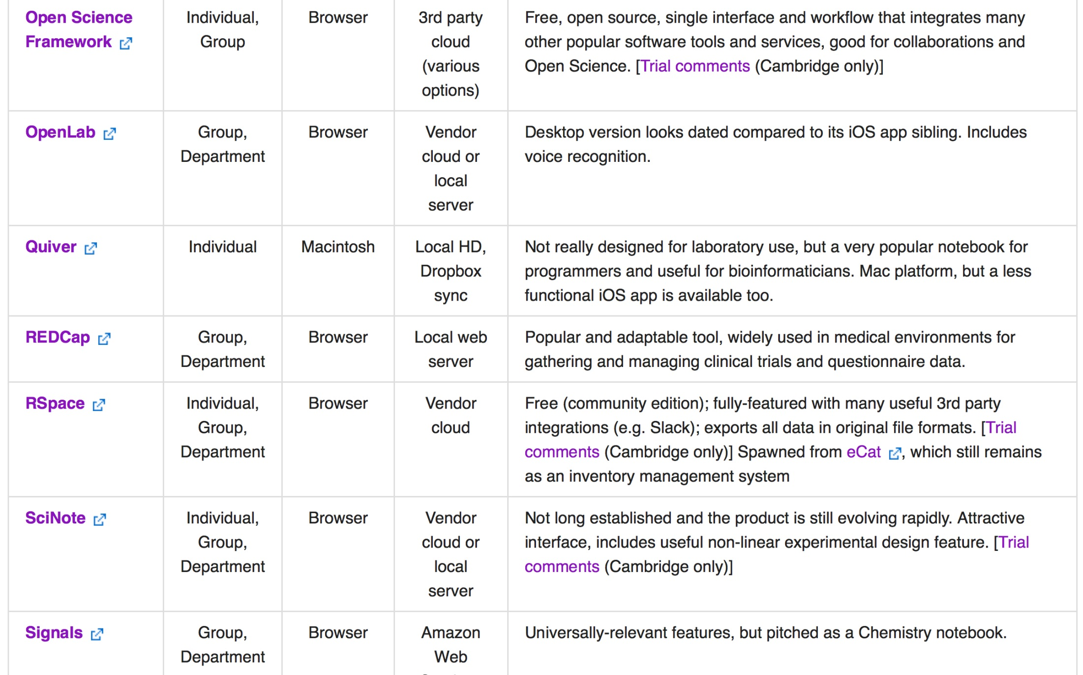

Slide 34
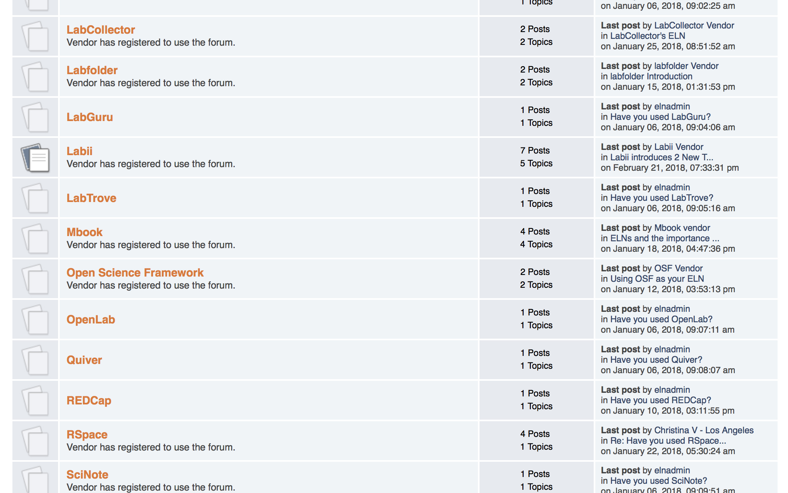

Slide 35

www.gurdon.cam.ac.uk/eln
Alastair Downie
a.downie@gurdon.cam.ac.uk
+44 1223 762556

