Slide 1
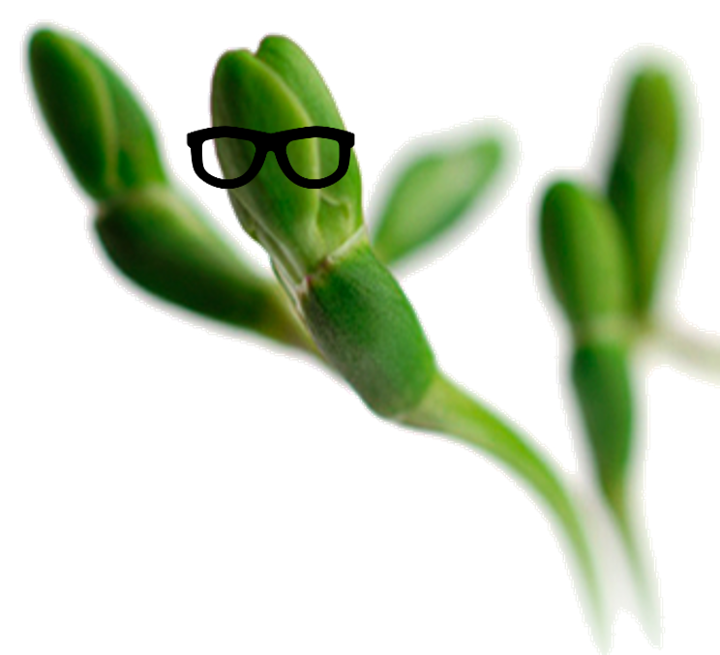



Katharina Hanika
From paper to screen
What users really think of electronic lab notebooks
TU Delft - 15 March 2018
@KatharinaHanika
katharina.hanika@wur.nl

Slide 2
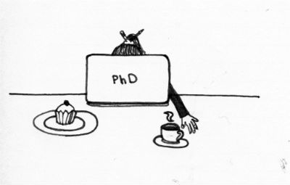
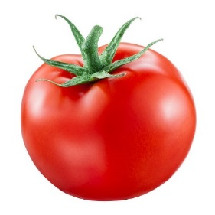
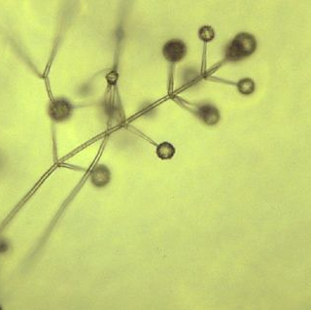
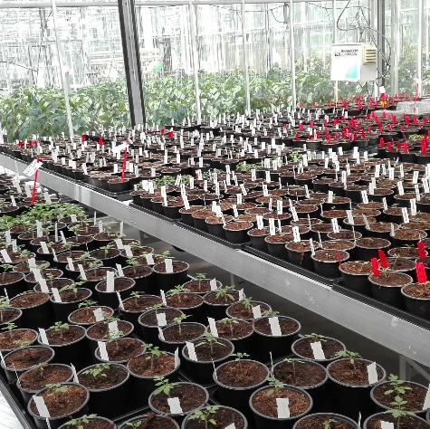
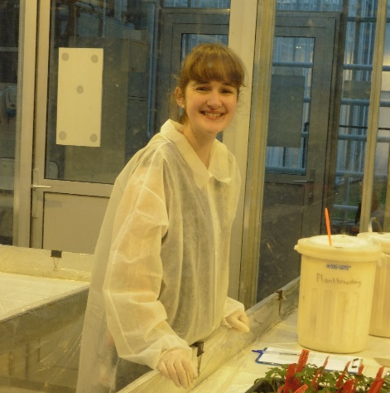
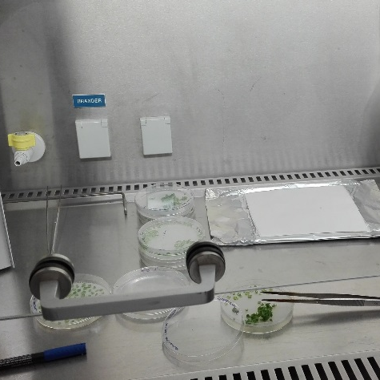
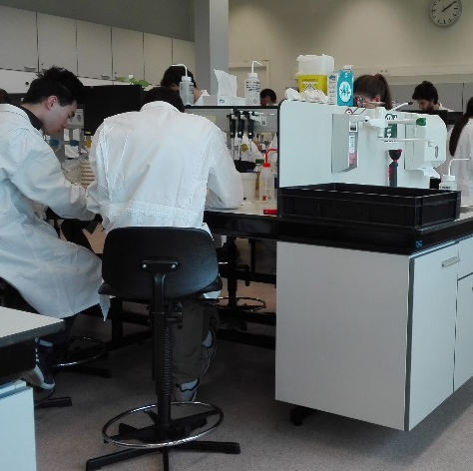
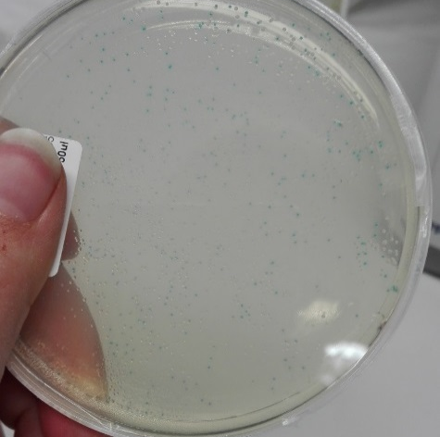
My background
September 2016
plant – pathogen interaction
greenhouse work → → → molecular work
Katharina Hanika

Slide 3

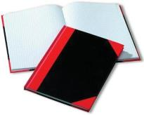
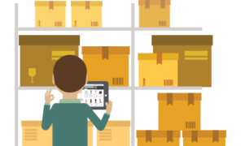
My experience with eLabjournal
September 2016
eLabjournal user
~ 2 years experience
eLabjournal
eLabinventory
Katharina Hanika

Slide 4




My insights into using electronic lab notebooks
Electronic lab notebooks
Points of view
user
team/supervisor
department
Katharina Hanika

Slide 5
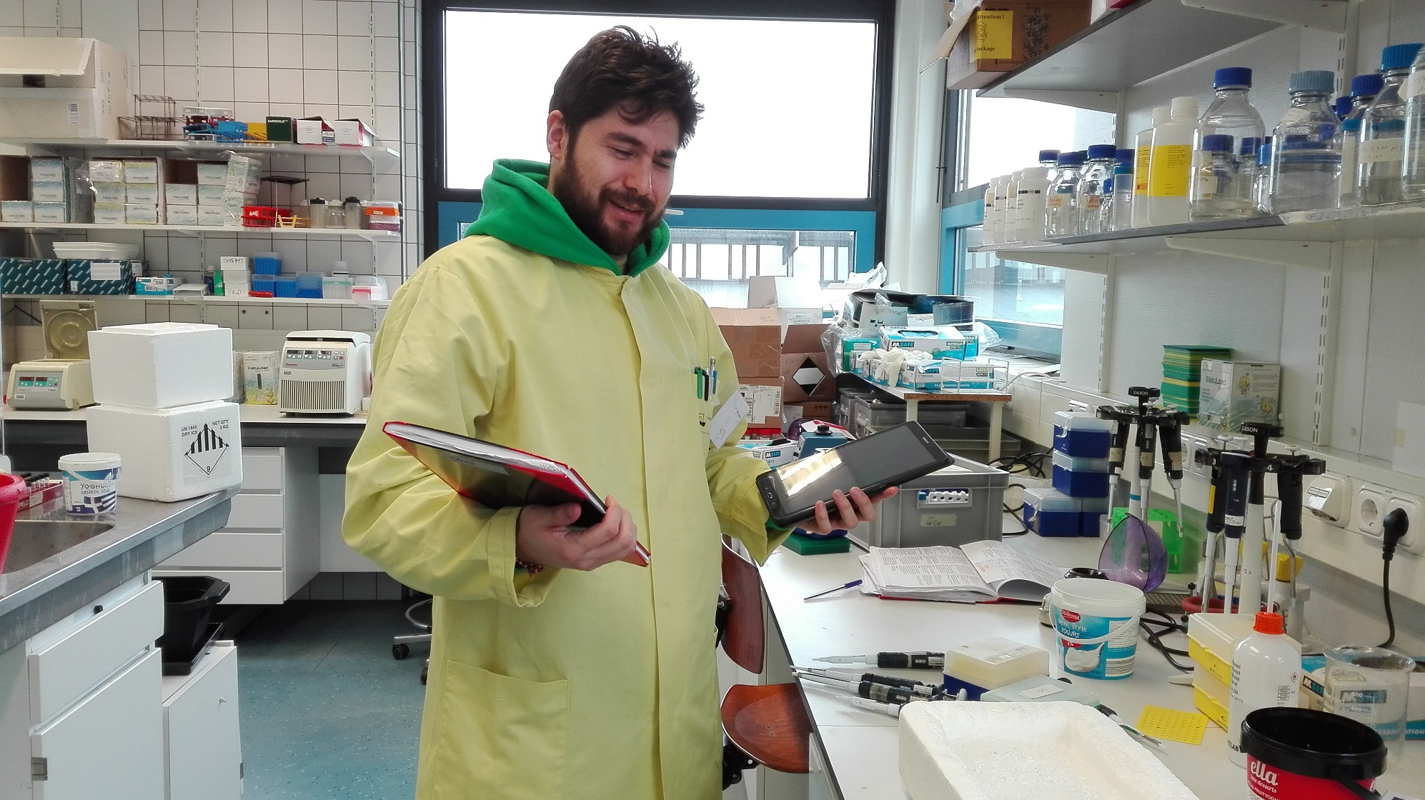

user
Why switch from paper to screen?
?
?
?
hard-copy vs. electronic
Katharina Hanika

Slide 6


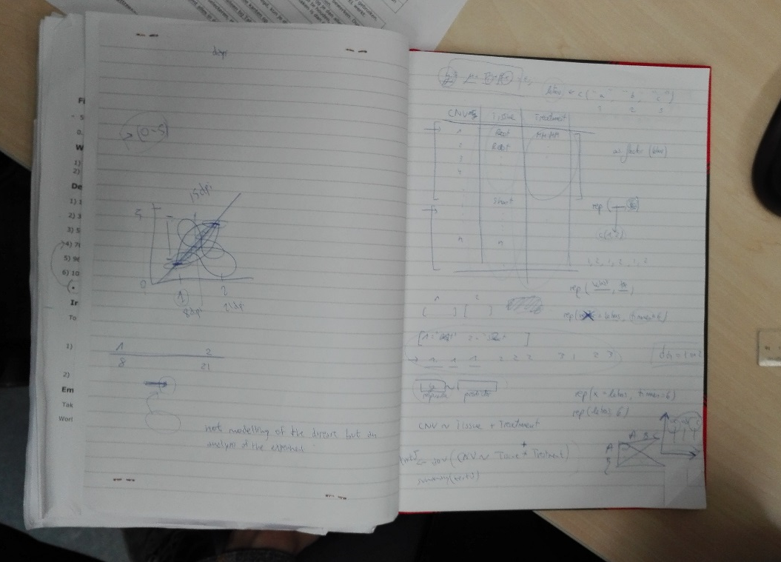
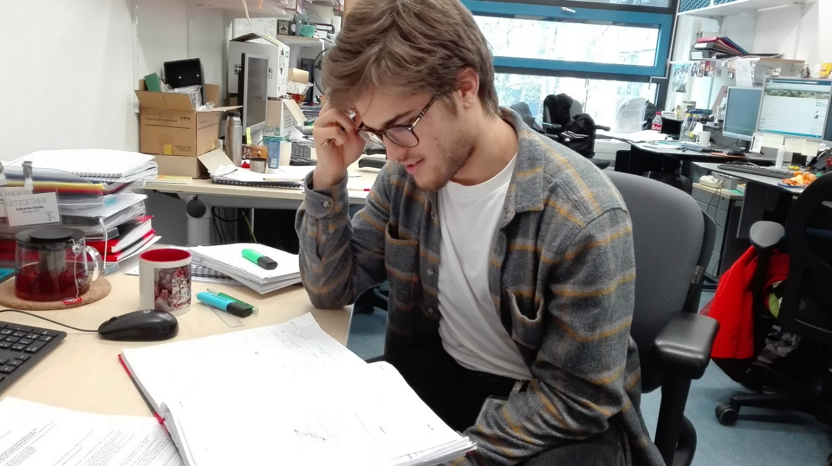
user
Why switch from paper to screen?
Pros
Cons
readable and structured information
digital storage of samples
easy collaboration with colleagues
time-intensive starting up
efficiency limited without Wifi/tablets
still under improvement
?
?
?
I don’t understand anymore ...
Katharina Hanika

Slide 7


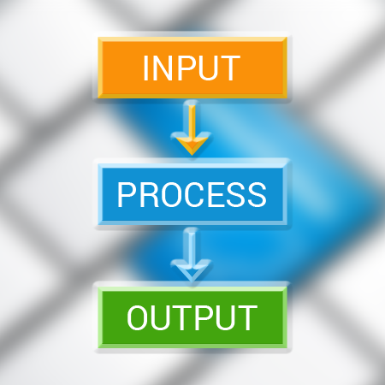

user
Why switch from paper to screen?
Pros
readable and structured information
experiment
sample
project
study
RNA
experiment
Katharina Hanika

Slide 8
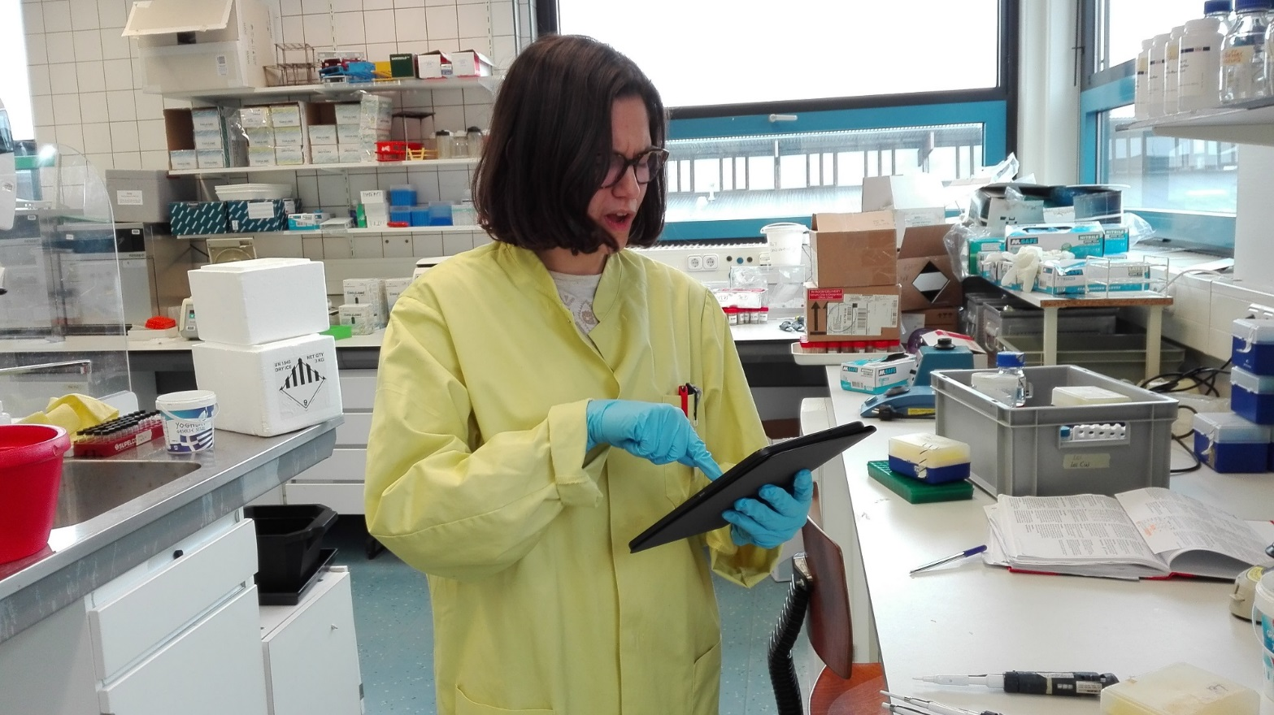
user
Why switch from paper to screen?
Pros
Cons
readable and structured information
digital storage of samples
easy collaboration with colleagues
time-intensive starting up
efficiency limited without Wifi/tablets
still under improvement
Where do I find what?
How can I set up my experiment?
Whom can I ask for help?
How does this work?
Katharina Hanika

Slide 9
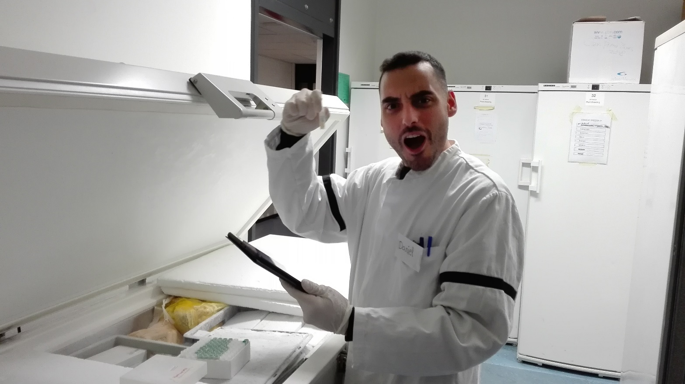
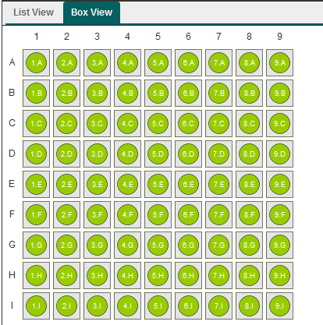
user
Why switch from paper to screen?
Pros
Cons
readable and structured information
digital storage of samples
easy collaboration with colleagues
time-intensive starting up
efficiency limited without Wifi/tablets
still under improvement
YEAH!
track & trace of samples
Found my sample!!!
Katharina Hanika

Slide 10
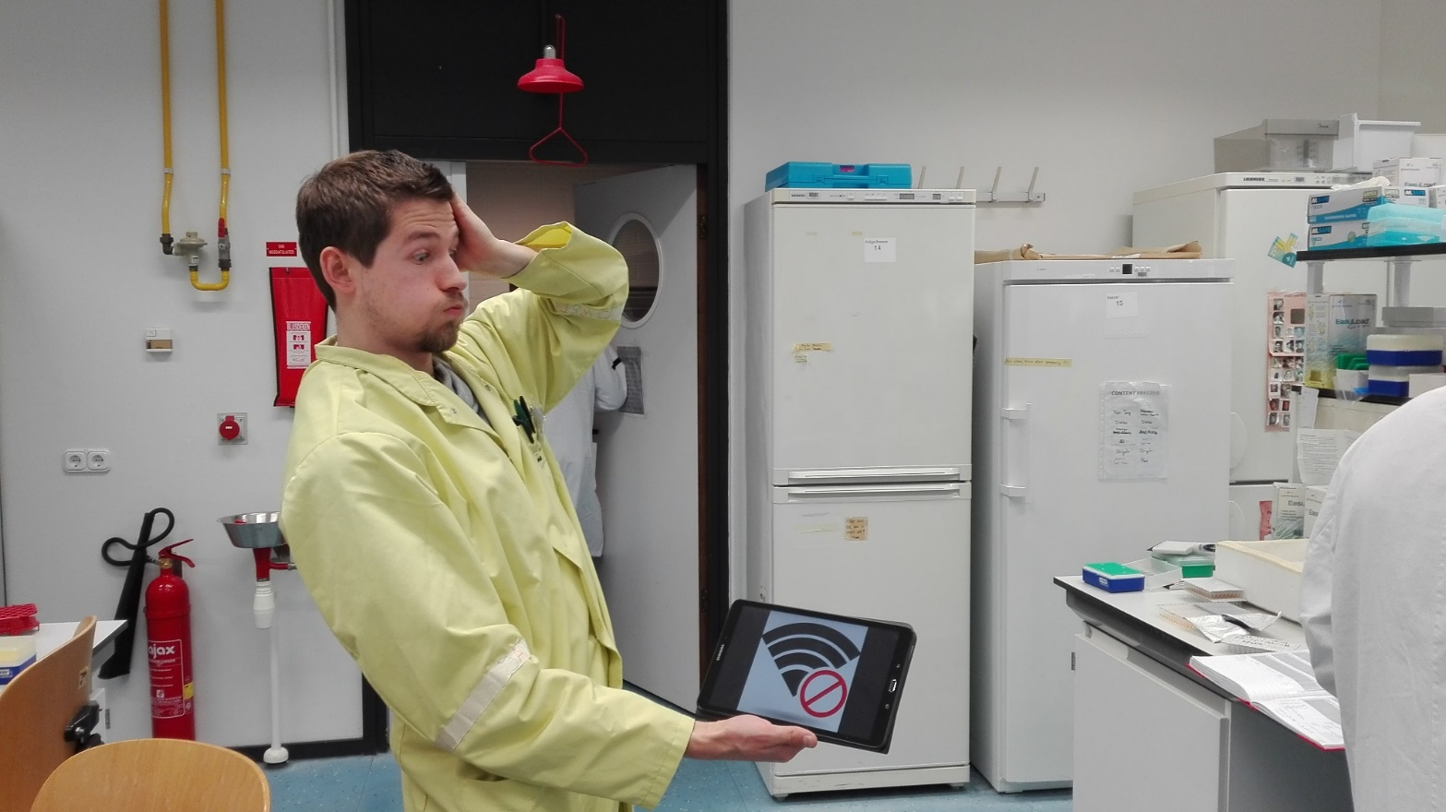
user
Why switch from paper to screen?
Pros
Cons
readable and structured information
digital storage of samples
easy collaboration with colleagues
time-intensive starting up
efficiency limited without Wifi/tablets
still under improvement
No Wifi?
Katharina Hanika

Slide 11
user
Why switch from paper to screen?
Pros
Cons
readable and structured information
digital storage of samples
easy collaboration with colleagues
time-intensive starting up
efficiency limited without Wifi/tablets
still under improvement
Katharina Hanika

Slide 12



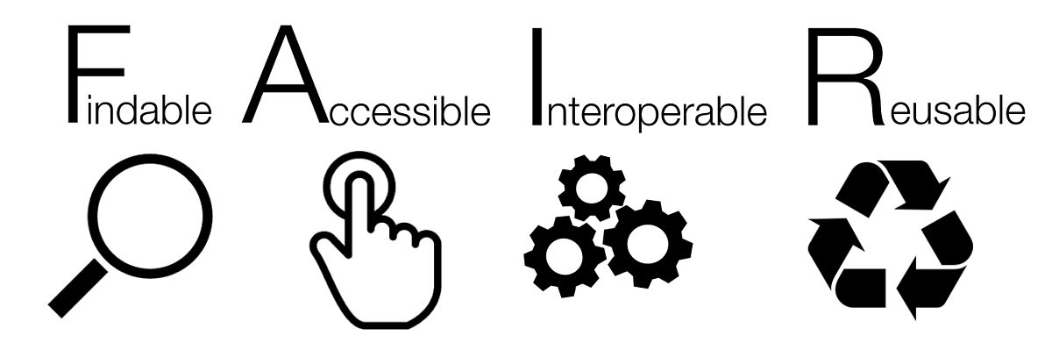




team
Collaboration
discussing
sharing
data/samples
protocols
supervising
students & co-workers
team
managing data
updating
FAIR data
data re-use
results
files
Katharina Hanika

Slide 13
department
Department-wide implementation
With whom to start?
How to start?
→ with volunteers
team
→ workshops & contact persons
challenging: “creatures of habit”
department
Katharina Hanika

Slide 14
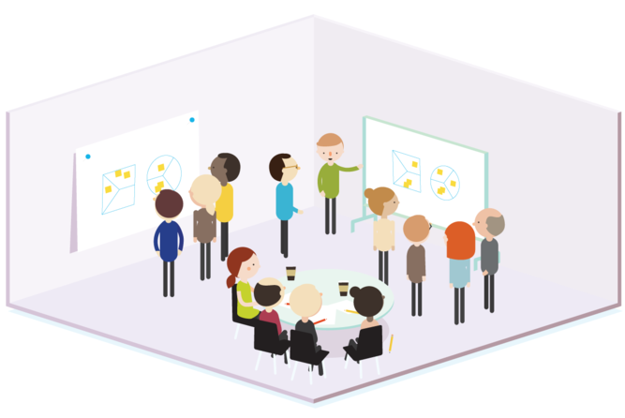

department
Workshops: How to get people started
How does this work?
Where do I find what?
→ online demonstration
How can I set up my experiment?
→ hands-on exercises
Whom can I ask for help?
→ intranet group & key users
Katharina Hanika

Slide 15



What users really think of electronic lab notebooks ...
Any (electronic) lab notebook is only as good as its user.
What it takes:
time
commitment
adaptability
Katharina Hanika

Slide 16
Thank you for your attention!
Katharina Hanika
From paper to screen
What users really think of electronic lab notebooks
Acknowledgments
Eliana Papoutsoglou
Patrick Hendrickx
René de Koster
Jacques Davies
... and all my lab mates on the pictures!
TU Delft - 15 March 2018
@KatharinaHanika
katharina.hanika@wur.nl

Slide 17
References
slide | retrieved | link
1 | 7/3/2018 | https://presentationpictures.wordpress.com/2010/07/15/kleine-wachsende-pflanze-auf-hand-junge-pflanzen-young-plants-growing-growth/green-plant-on-white-background/ (modified); https://twitter.com/wur
2 | 1/3/2018 | http://blogs.nature.com/naturejobs/2014/08/21/thesis-writing-tips-for-the-i-left-it-to-the-last-minute-phd-student/; https://www.istockphoto.com/nl/fotos/tomato?excludenudity=false&sort=mostpopular&mediatype=photography&phrase=tomato (modified)
3 | 6/3/2018 | https://www.toner-dumping.de/kladde/notizbuch-kladde-mit-festem-einband-din-a4-96-blatt-70g-karriert (modified); https://www.taringa.net/posts/links/19910504/Usas-Excel-Llevate-estas-plantillas-para-tu-negocio.html; https://www.elabjournal.com/press-kit/ (modified); https://www.apsnet.org/edcenter/intropp/lessons/fungi/ascomycetes/Pages/VerticilliumWilt.aspx (modified)
4 | 6/3/2018 | https://www.iconfinder.com (modified); https://thenounproject.com/term/supervisor/200065/ (modified); https://www.staphyt.com/about-us/ (modified)
5 | 6/3/2018 | https://splice-bio.com/electronic-lab-notebooks-survey/
8 | 7/3/2018 | https://twitter.com/bikoderdestek (modified)
12 | 7/3/2018 | https://nl.wikipedia.org/wiki/FAIR_principes (modified)
14 | 6/3/2018 | http://blog.strategyzer.com/posts/2014/12/02/how-to-design-great-workshops
Katharina Hanika

