Slide 1


Welcome to the Digital Lab Notebooks event of March 15th
ELN Event
Password:Tudelft2018
#ELNDelft

Slide 2

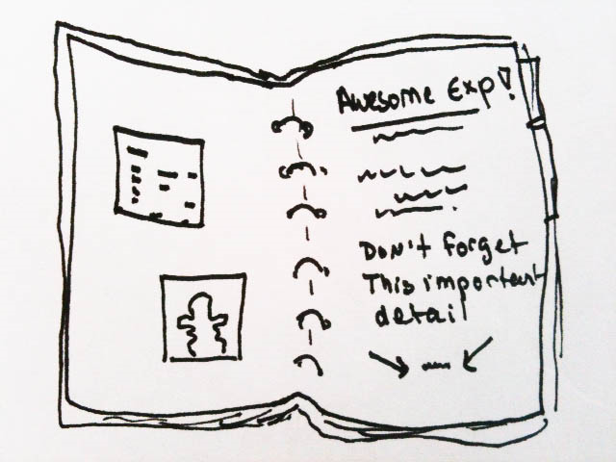



Slide 3




Why archive?

Slide 4



What’s in it for me?

Slide 5




Slide 6

Digital Notebooks - productivity tools for researchers
Alastair Dunning
Head, 4TU Centre for Research Data
& TU Delft Research Data Services
@alastairdunning, 15 March 2018
#ELNDelft

Slide 7
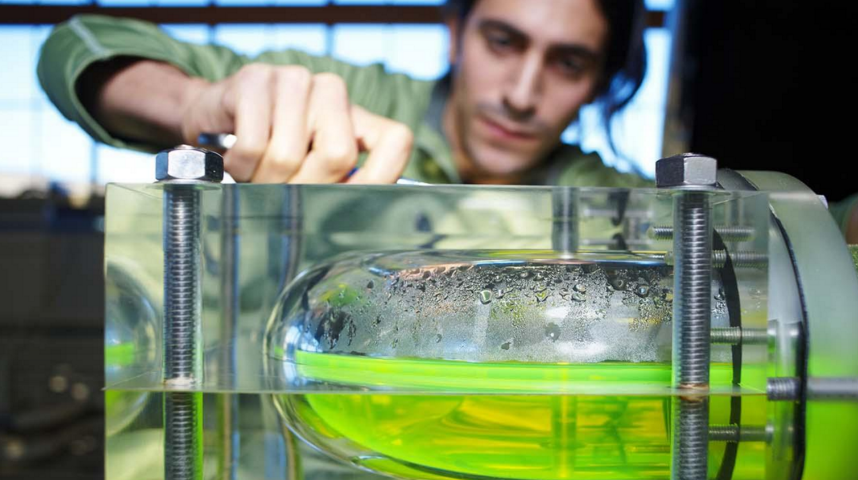
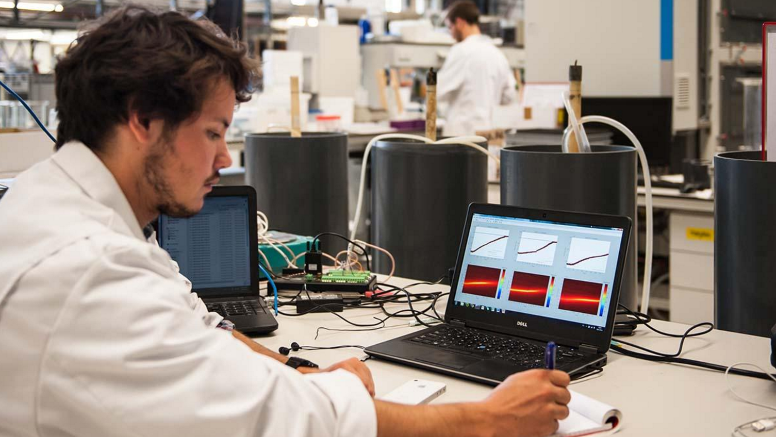
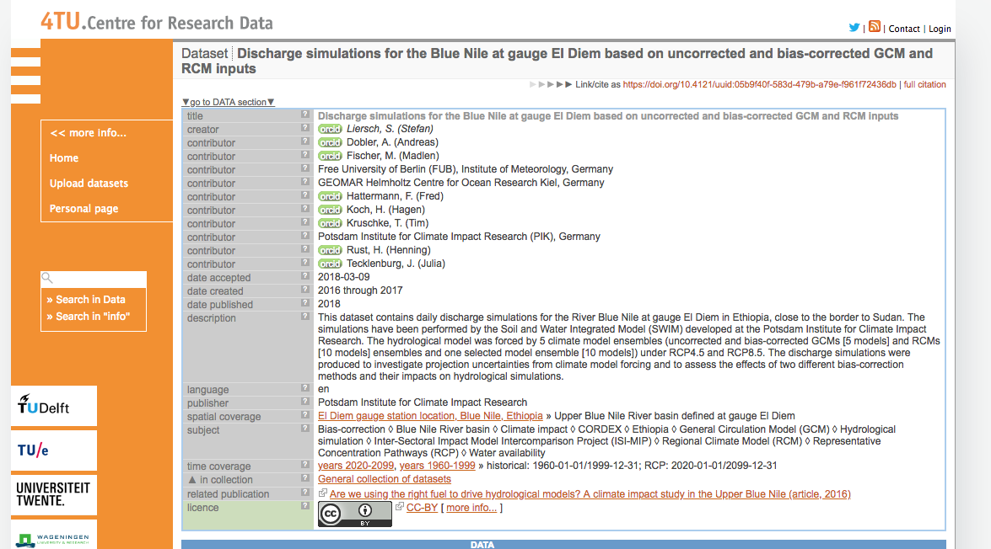
… how can we make this process smoother?
From experimenting, processing, indexing, analysing and publishing data is time consuming, involving many disjointed jumps ...

Slide 8
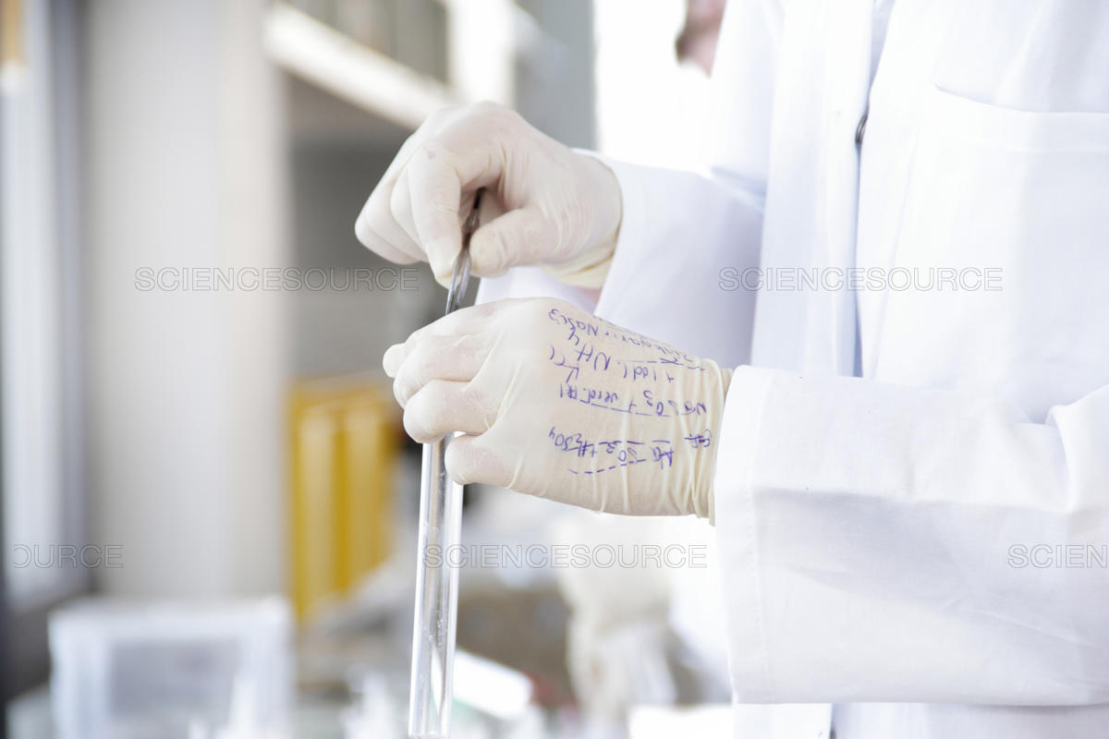
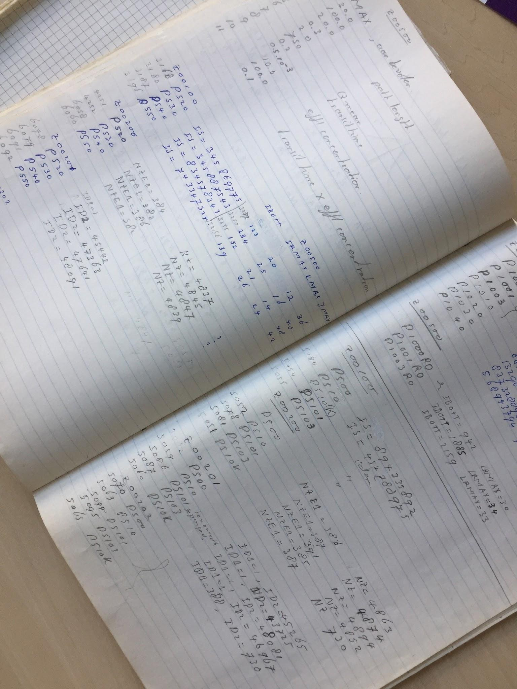
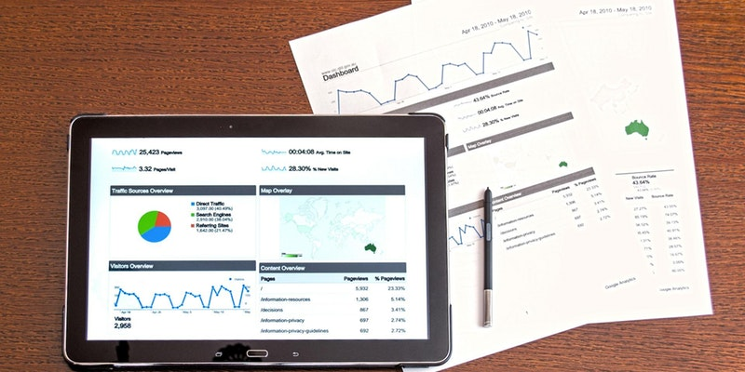
At the same time new solutions cannot have poorer usability than current ones

Slide 9
Goals and Agenda for Today
Discuss the pros and cons of Electronic Lab Notebooks
Learn what to look for when searching for the right tool
Get an opportunity to test out and start using Electronic Lab Notebooks
Morning Session - Three case studies exploring what has and hasn’t worked but some principles for choosing lab notebooks
Afternoon Session - Hands-on workshops and opportunity to test tools offered by various providers of electronic lab notebooks plus follow on discussion

