Slide 1
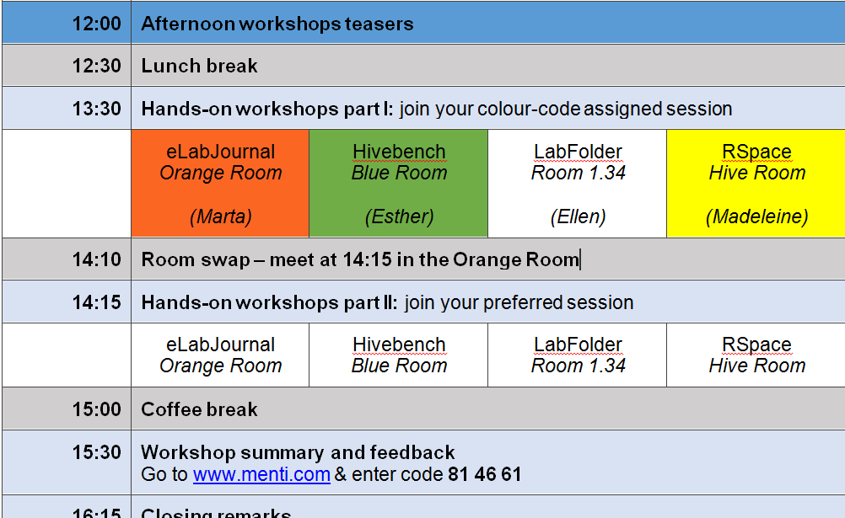

Slide 2
Create accounts before lunch:
Hivebench: https://www.hivebench.com/
LabFolder: https://www.labfolder.com/sign-up-free/
RSpace: https://community.researchspace.com/signup
eLabJournal: not required

