Slide 1



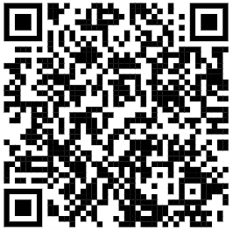


CENTER FOR SCALABLE DATA ANALYTICS AND ARTIFICIAL INTELLIGENCE
NATIONAL RESEARCH DATA MANAGEMENT INFRASTRUCTURE FOR MICROSCOPY AND BIOIMAGE ANALYSIS
GLOBAL BIOIMAGE ANALYST’S SOCIETY
Large Language Models for Bio-image Analysis
Robert Haase
https://doi.org/10.5281/zenodo.11638980

Slide 2
Large Language Models (LLMs)
Text-to-text, translation, code generation
from skimage.io import imread
image = imread(“hela-cells.tif”)
Open hela-cells.tif
English
Python
Neural network

Slide 3
Bio-image Analysis
📊💾💻
🧬🧫🔬
🔬🧫💉
💾📊🧬
Many computers working together
Kubernetes cluster
Tribolium castaneum
Flour beetle
Biologist
Domain-specialist
(focused on
real-world problems)
Bio-image Analyst
← Generalist →
(data-driven,
service-oriented)
Computer Scientist
Method + infrastructure specialist
(algorithm-centered)

Slide 4
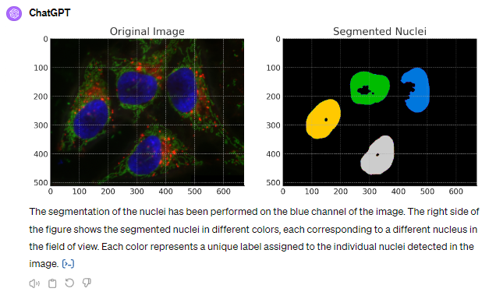
Bio-image Analysis
My job …

Slide 5
Bio-image Analysis using Large-Language Models
My job is changing, since we have ChatGPT
Prompt:
“Please segment the nuclei in the blue channel of the image”

Slide 6
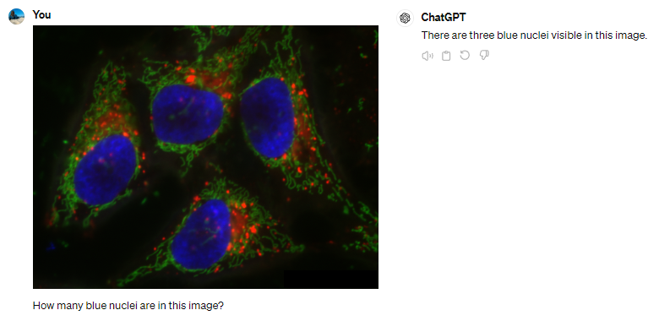
Vision language models for counting objects
LLMs were not exactly built for this use-case…
n=1

Slide 7
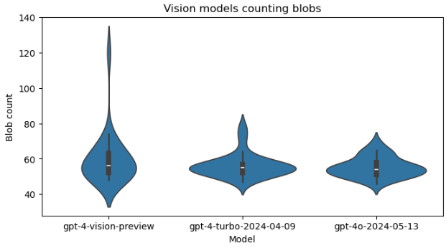
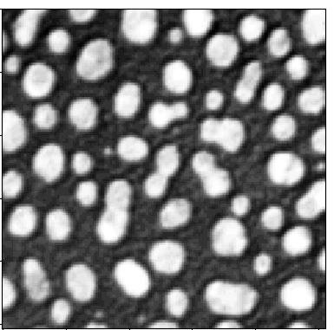
Vision language models for counting objects
Prompt: „Analyse the following image by counting the bright blobs. Respond with the number only. “ (n=25)
Nov 2023
Apr 2024
May 2024
https://haesleinhuepf.github.io/BioImageAnalysisNotebooks/20c_vision_models/vision_models.html

Slide 8
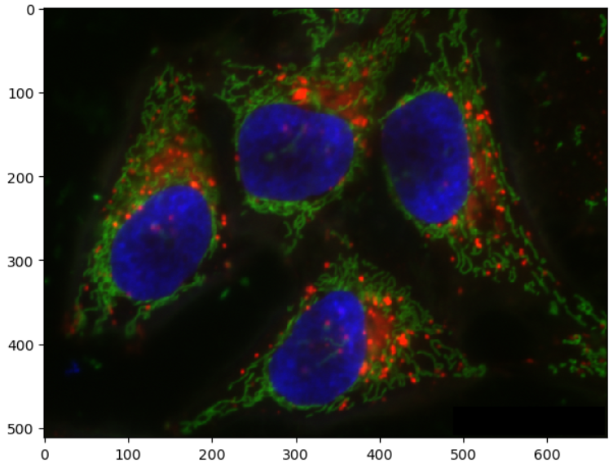
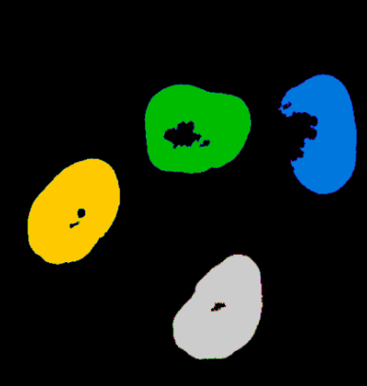
Multi-modal LLMs
Combining image, text and […] data, to gain new [biological] insights.
There are 4 cells.
I just marked their nuclei.
How many cells are there?

Slide 9
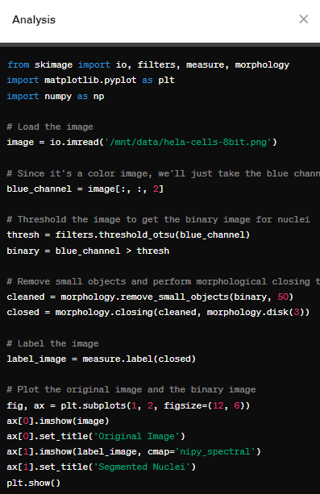
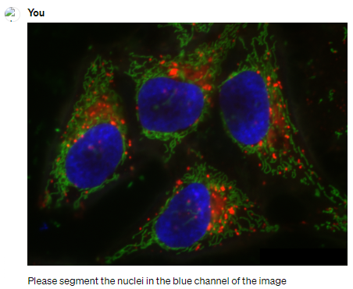
Bio-image Analysis using Large-Language Models
My job is changing, since we have ChatGPT
Prompt:
“Please segment the nuclei in the blue channel of the image”

Slide 10
Large Language Models (LLMs)
Text-to-text, translation, code generation
from skimage.io import imread
image = imread(“blobs.tif”)
Open blobs.tif
English
Python

Slide 11

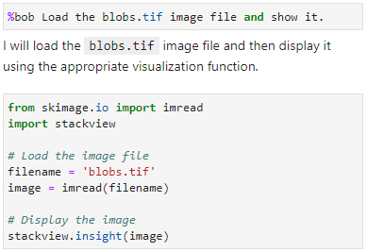
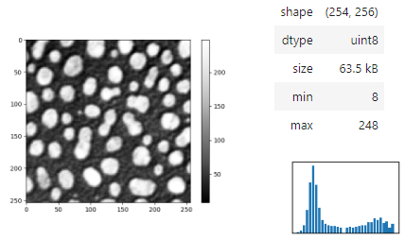

Open source assistant: BiA-Bob
No need to upload your [image] data
(-> privacy)
Multi-agent /
-platform capable
Vision models
Extensible through plugins
Integrated in Jupyter
https://github.com/haesleinhuepf/bia-bob

Slide 12
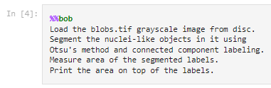
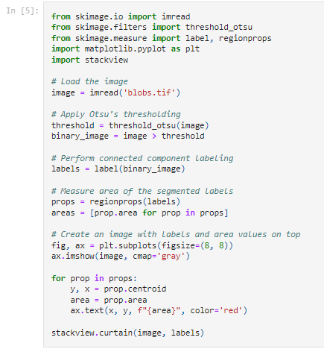
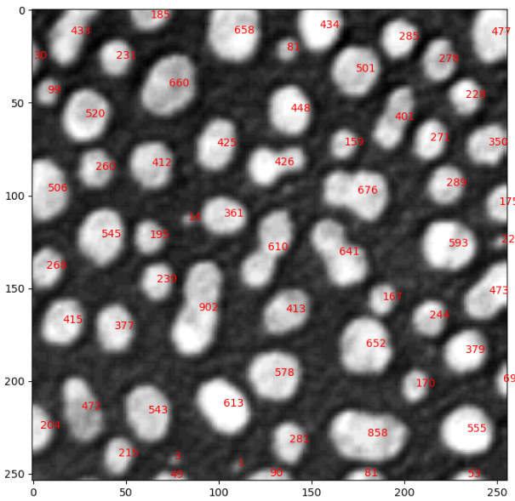
Generating complex code blocks
Use the %%bob … syntax to ask for complex analysis tasks.
https://github.com/haesleinhuepf/bia-bob/blob/main/demo/basic_demo.ipynb

Slide 13
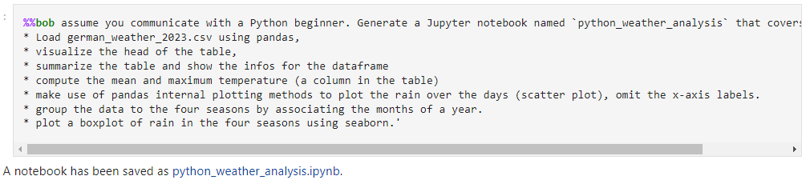
Generating notebooks
… also great for learning Python
Cropped, licensed CC-BY 4.0 by Matthias Täschner & Robert Haase
https://github.com/ScaDS/Python-training-2024/blob/main/2_tables_plots/python_weather_analysis.ipynb

Slide 14
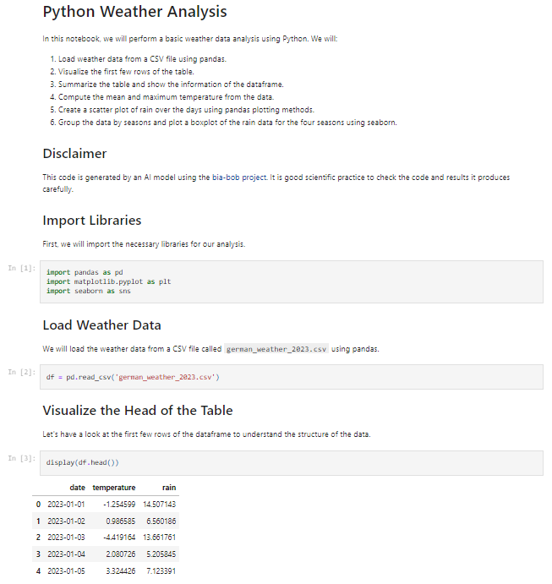
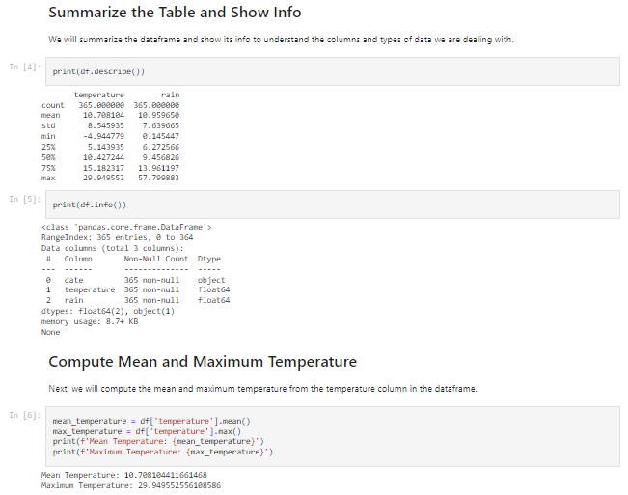
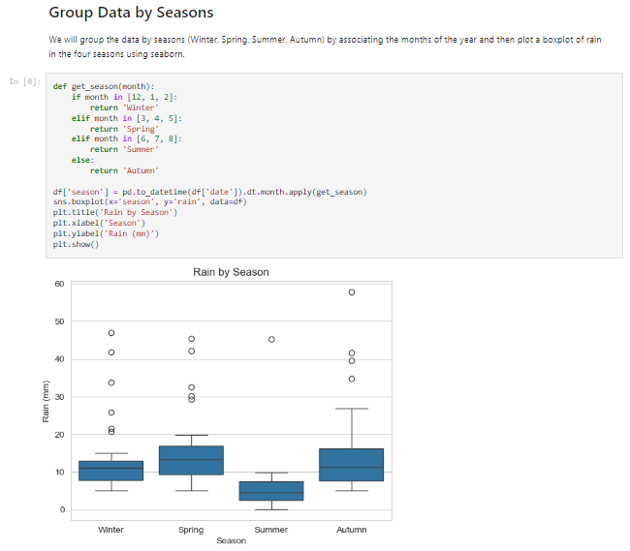
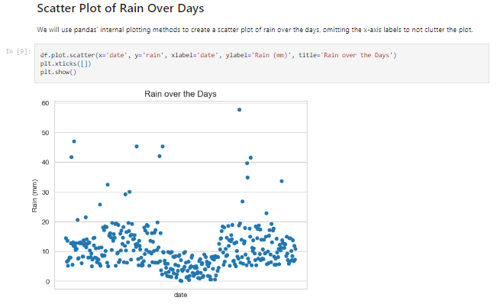
Generating notebooks
In these kind of tasks, Python and ChatGPT are 🚀!
… also great for learning Python
Cropped, licensed CC-BY 4.0 by Matthias Täschner & Robert Haase
https://github.com/ScaDS/Python-training-2024/blob/main/2_tables_plots/python_weather_analysis.ipynb

Slide 15
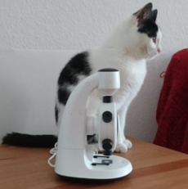
Vision Language Models
Classifying images 🥱
Describing images
A picture of a cat and a microscope

Slide 16
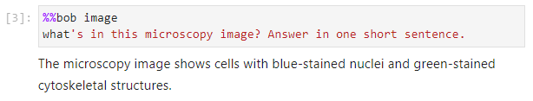

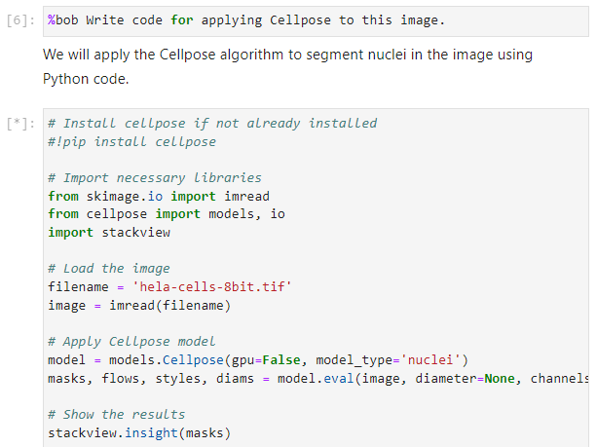
Vision language models
That’s half right!
That makes sense!
Biologist
Computer
scientist

Slide 17
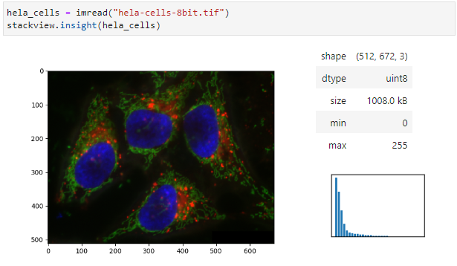
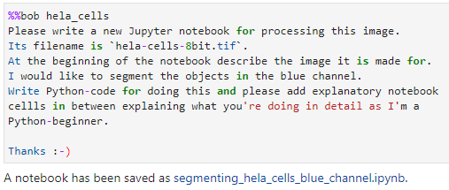
Generating notebooks using vision models
Ask %%bob to generate a Jupyter notebook
Present Bob an image like this
https://github.com/haesleinhuepf/bia-bob/blob/main/demo/generate_notebooks.ipynb

Slide 18
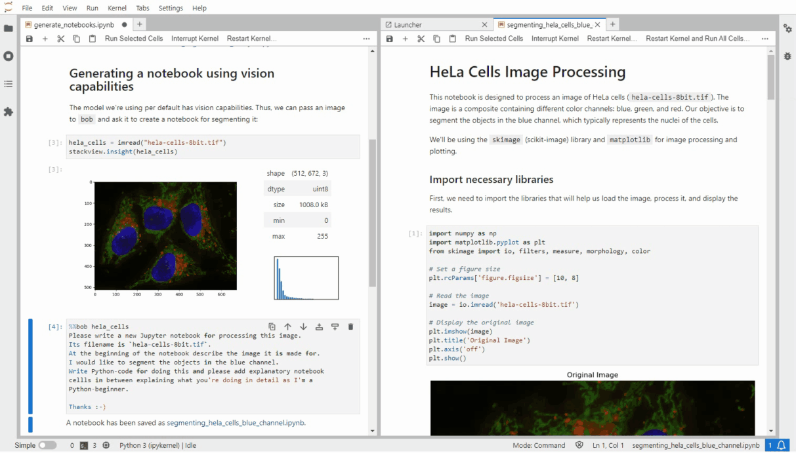
Generating notebooks using vision models
https://github.com/haesleinhuepf/bia-bob/blob/main/demo/generate_notebooks.ipynb

Slide 19
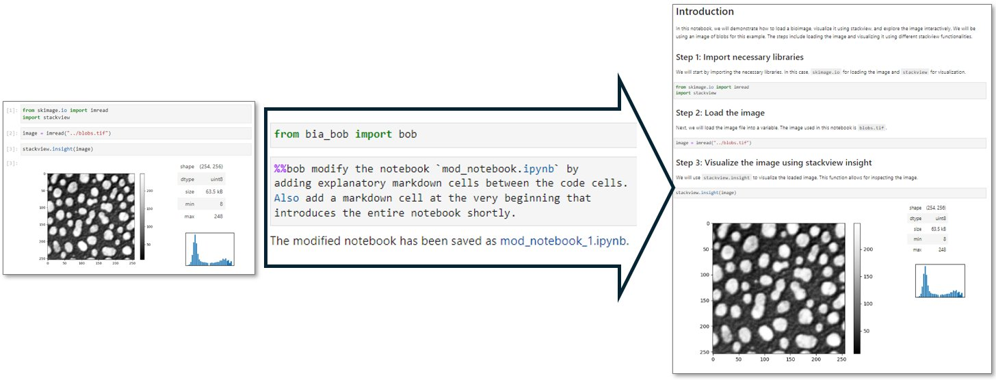
Optimizing documentation
E.g. to make code more readable

Slide 20
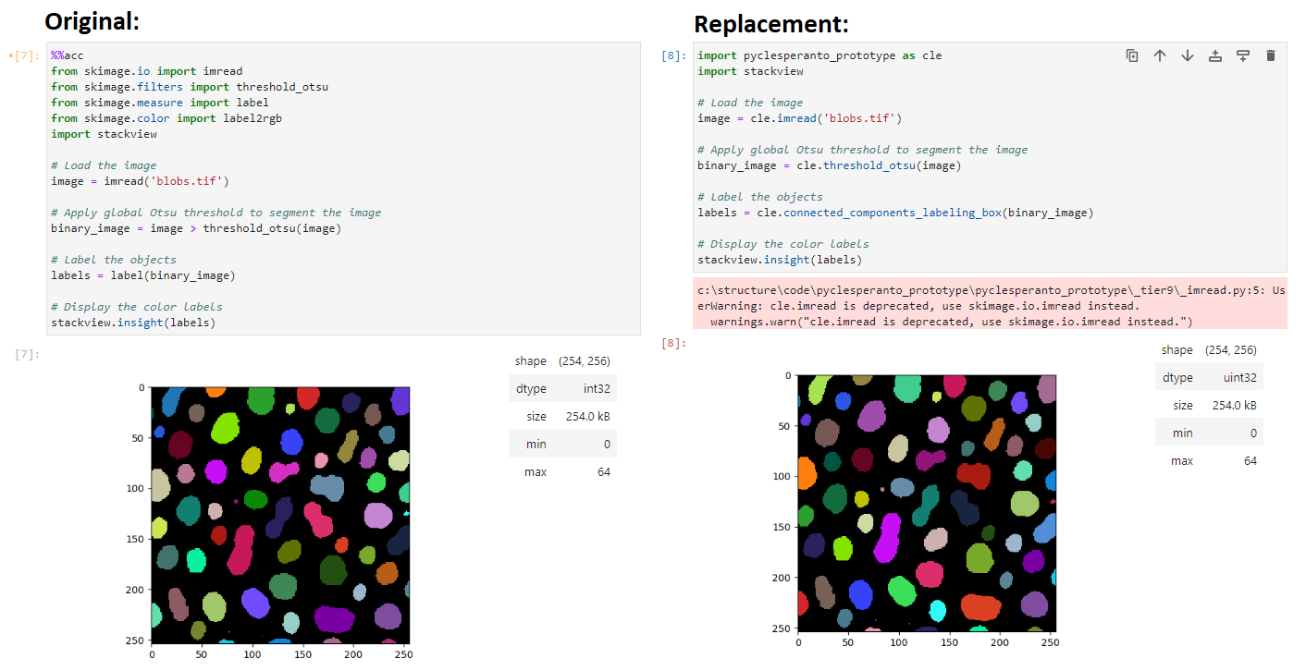
GPU-Accelerating code
It‘s our responsibility that results are comparable!
https://link.springer.com/chapter/10.1007/978-3-030-76394-7_5

Slide 21
Under the hood: prompt engineering
Context-dependent system prompt considering
local variables and functions
installed python libraries
chat history
You are a extremely talented bioimage analyst and you use Python to solve your tasks ...
…
## Python specific code snippets
If the user asks for those simple tasks, use these code snippets.
* Load an image file from disc and store it in a variable:
```
from skimage.io import imread
image = imread(filename)
```
About 6500 tokens
(≈words)
…
## Todos
Answer your response in three sections:
1. Summary: First provide a short summary of the task.
2. Plan: Provide a concise step-by-step plan without any code.
3. Code: Provide the code.
+ your prompt

Slide 22
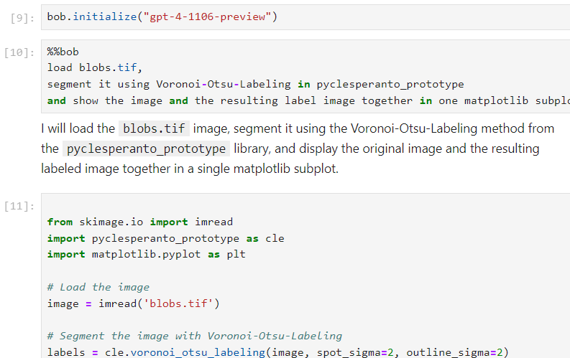
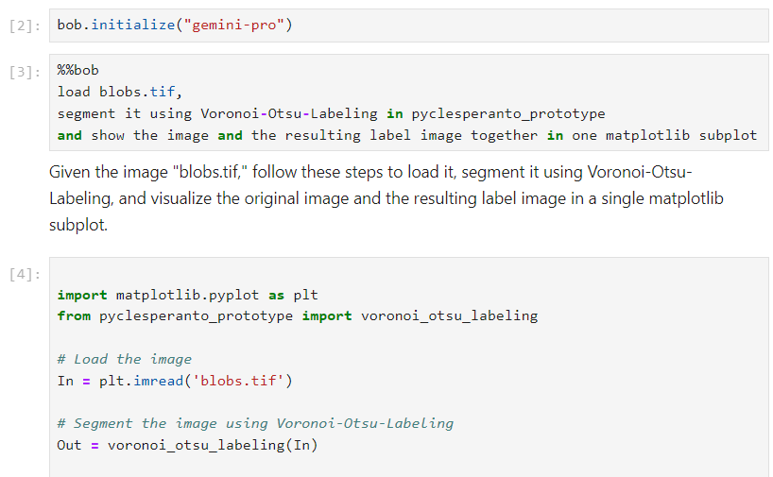
Compatible language models
ChatGPT by OpenAI
Gemini by Google
https://github.com/haesleinhuepf/bia-bob/blob/main/demo/gemini.ipynb

Slide 23
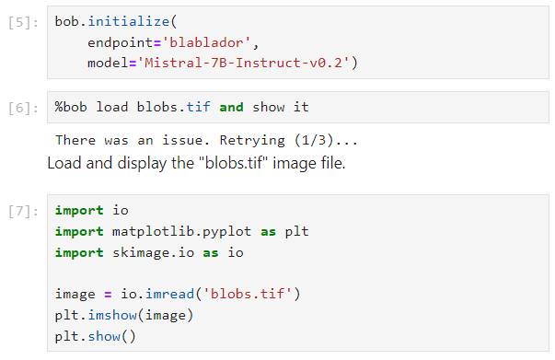
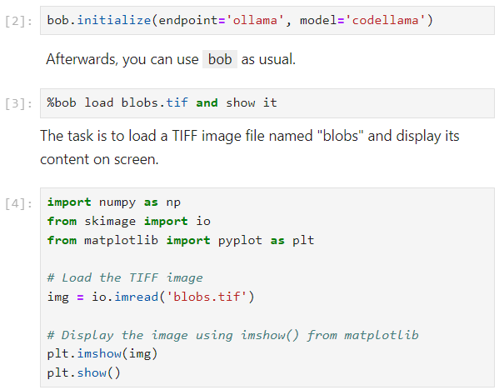
Compatible language models
Runs on your local computer (offline)
Mistral through Blablador
CodeLLama via ollama
Free online service for German academics, offered by HelmholtzAI
Open Source: https://github.com/HelmholtzAI-FZJ/FastChat
Many OpenSource models seem less capable than the commercial models, when it comes to complex tasks
https://login.helmholtz.de/oauth2-as/oauth2-authz-web-entry
https://ollama.com
https://github.com/haesleinhuepf/bia-bob/blob/main/demo/custom_endpoints.ipynb

Slide 24
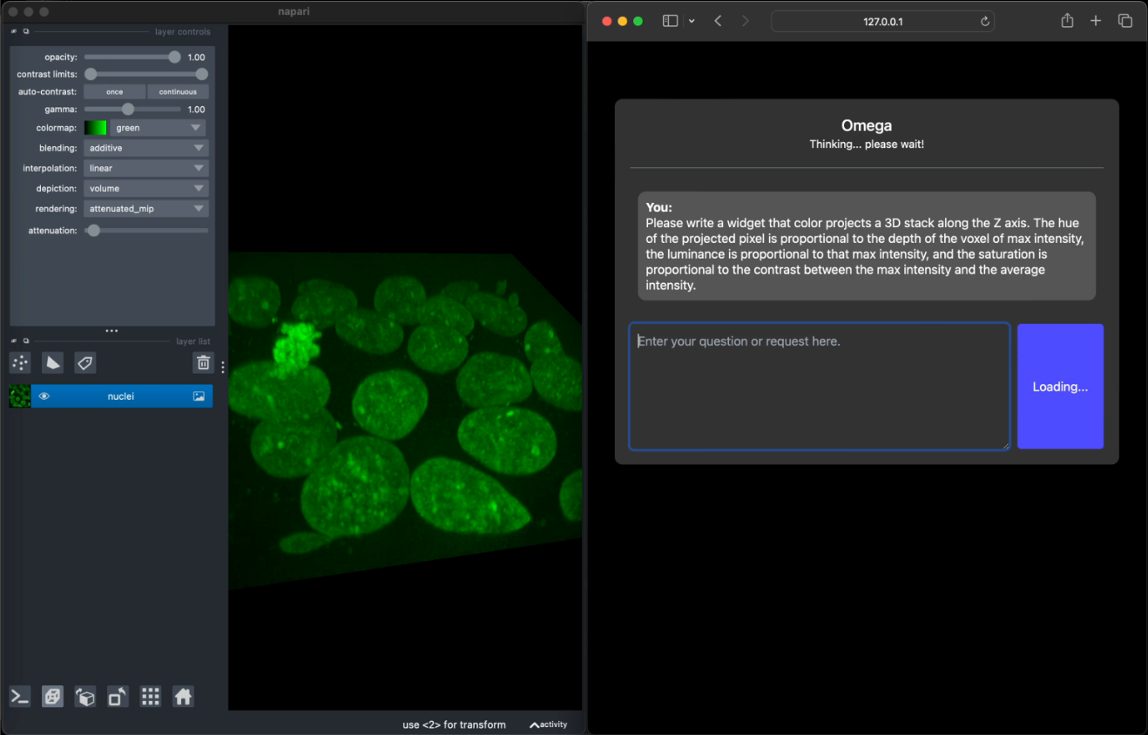
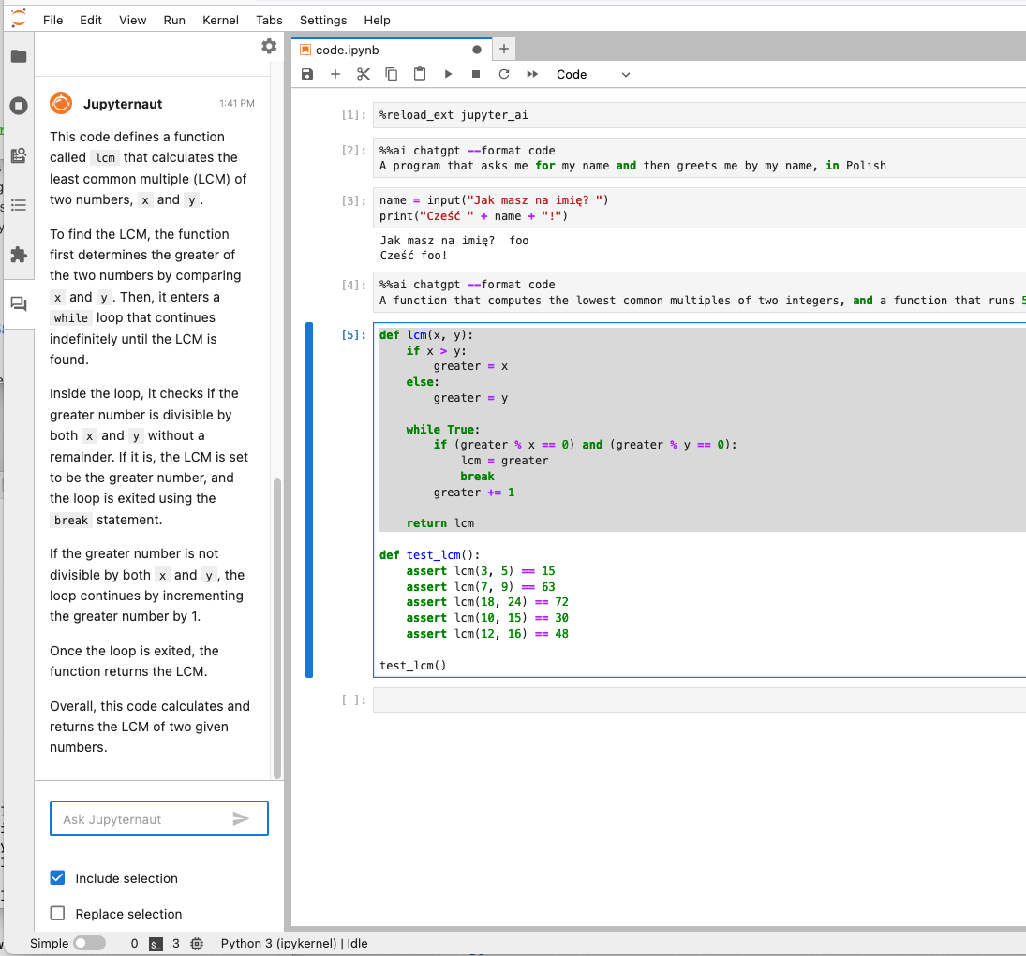
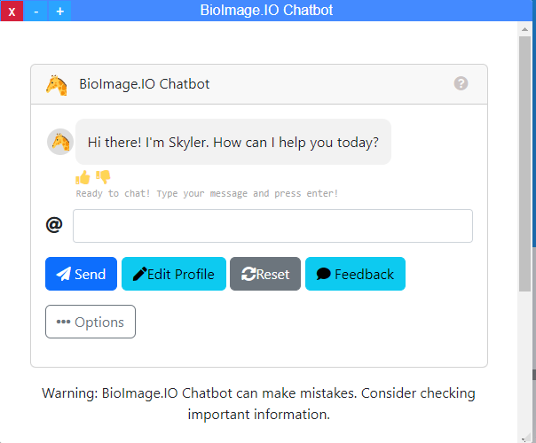
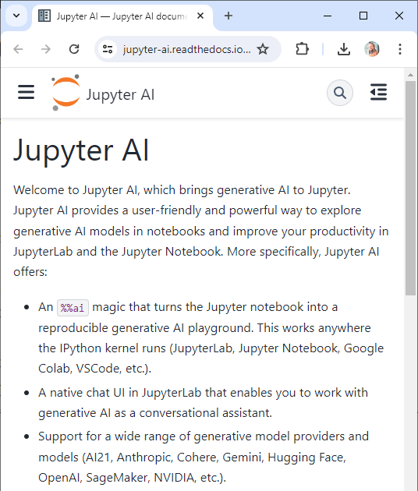
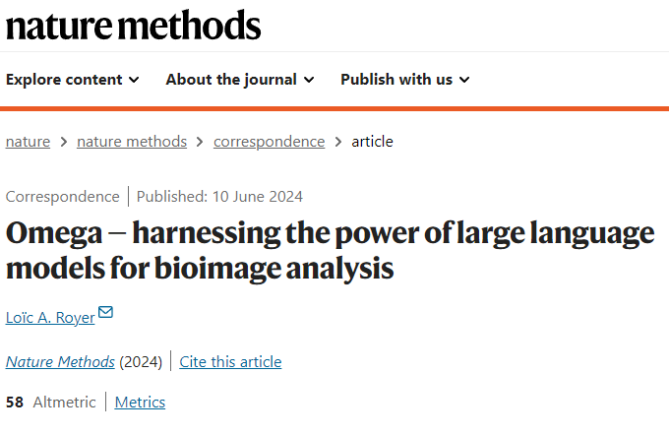
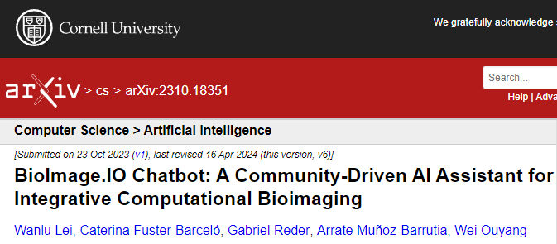
Similar tools
Bob is not alone… and they are becoming more.
Napari-chatGPT / Omega
Jupyter-AI
Bioimage-io ChatBot
https://github.com/royerlab/napari-chatgpt
https://www.nature.com/articles/s41592-024-02310-w
https://jupyter-ai.readthedocs.io/
https://bioimage.io/#/
https://arxiv.org/abs/2310.18351

Slide 25
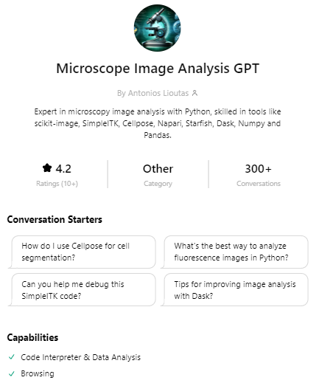
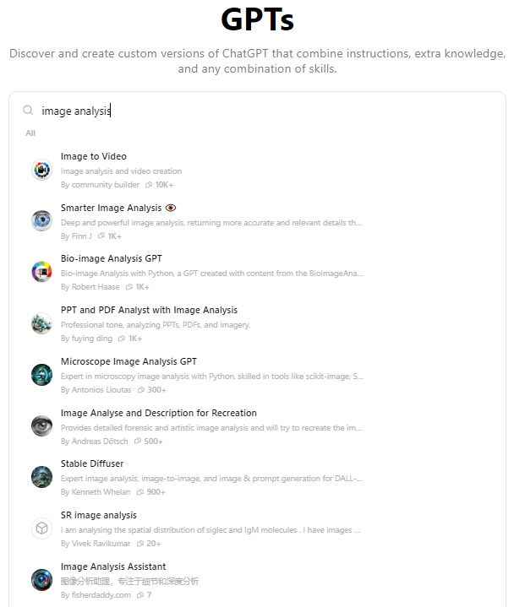
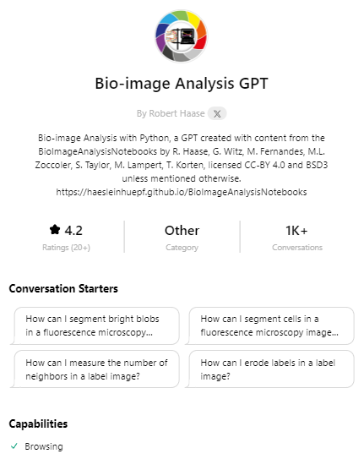
Similar tools
Bob is not alone… and they are becoming more.
https://chatgpt.com/g/g-FGdNx7MIl-microscope-image-analysis-gpt
http://chat.openai.com/gpts
https://chatgpt.com/g/g-psAohb1OY-bio-image-analysis-gpt

Slide 26
Benchmarking LLMs for Bio-image Analysis
Is GPT-4o better than Claude?
How good are LLMs for
Bio-image Analysis?
Which LLM should I pay for?
Do LLMs introduce bias?
Can LLMs act according to good scientific practice?
How can we validate LLMs for BiA?
Will we all be replaced by AI anytime soon?
How can we validate specific LLM output without ground truth?
What are the limits of the LLM technology?

Slide 27
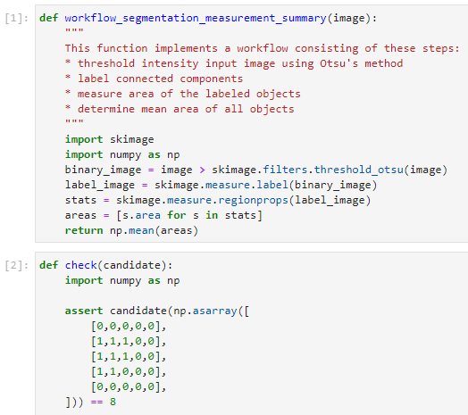
Benchmarking LLMs for Bio-image Analysis
Example test-case inspired by HumaEval (Chen et al 2021)
Prompt
Reference solution
We formulated 57 of such test-cases (yet)
Unit test (excerpt)
Chen at al 2021: https://arxiv.org/abs/2107.03374
https://www.biorxiv.org/content/10.1101/2024.04.19.590278v1
https://github.com/haesleinhuepf/human-eval-bia

Slide 28

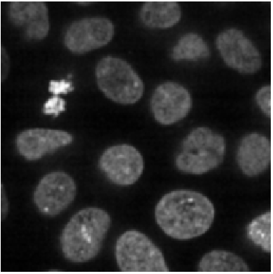
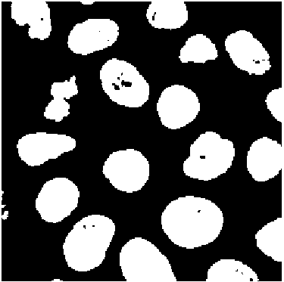
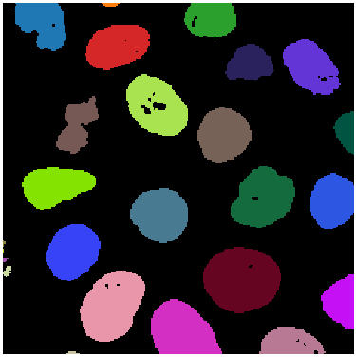
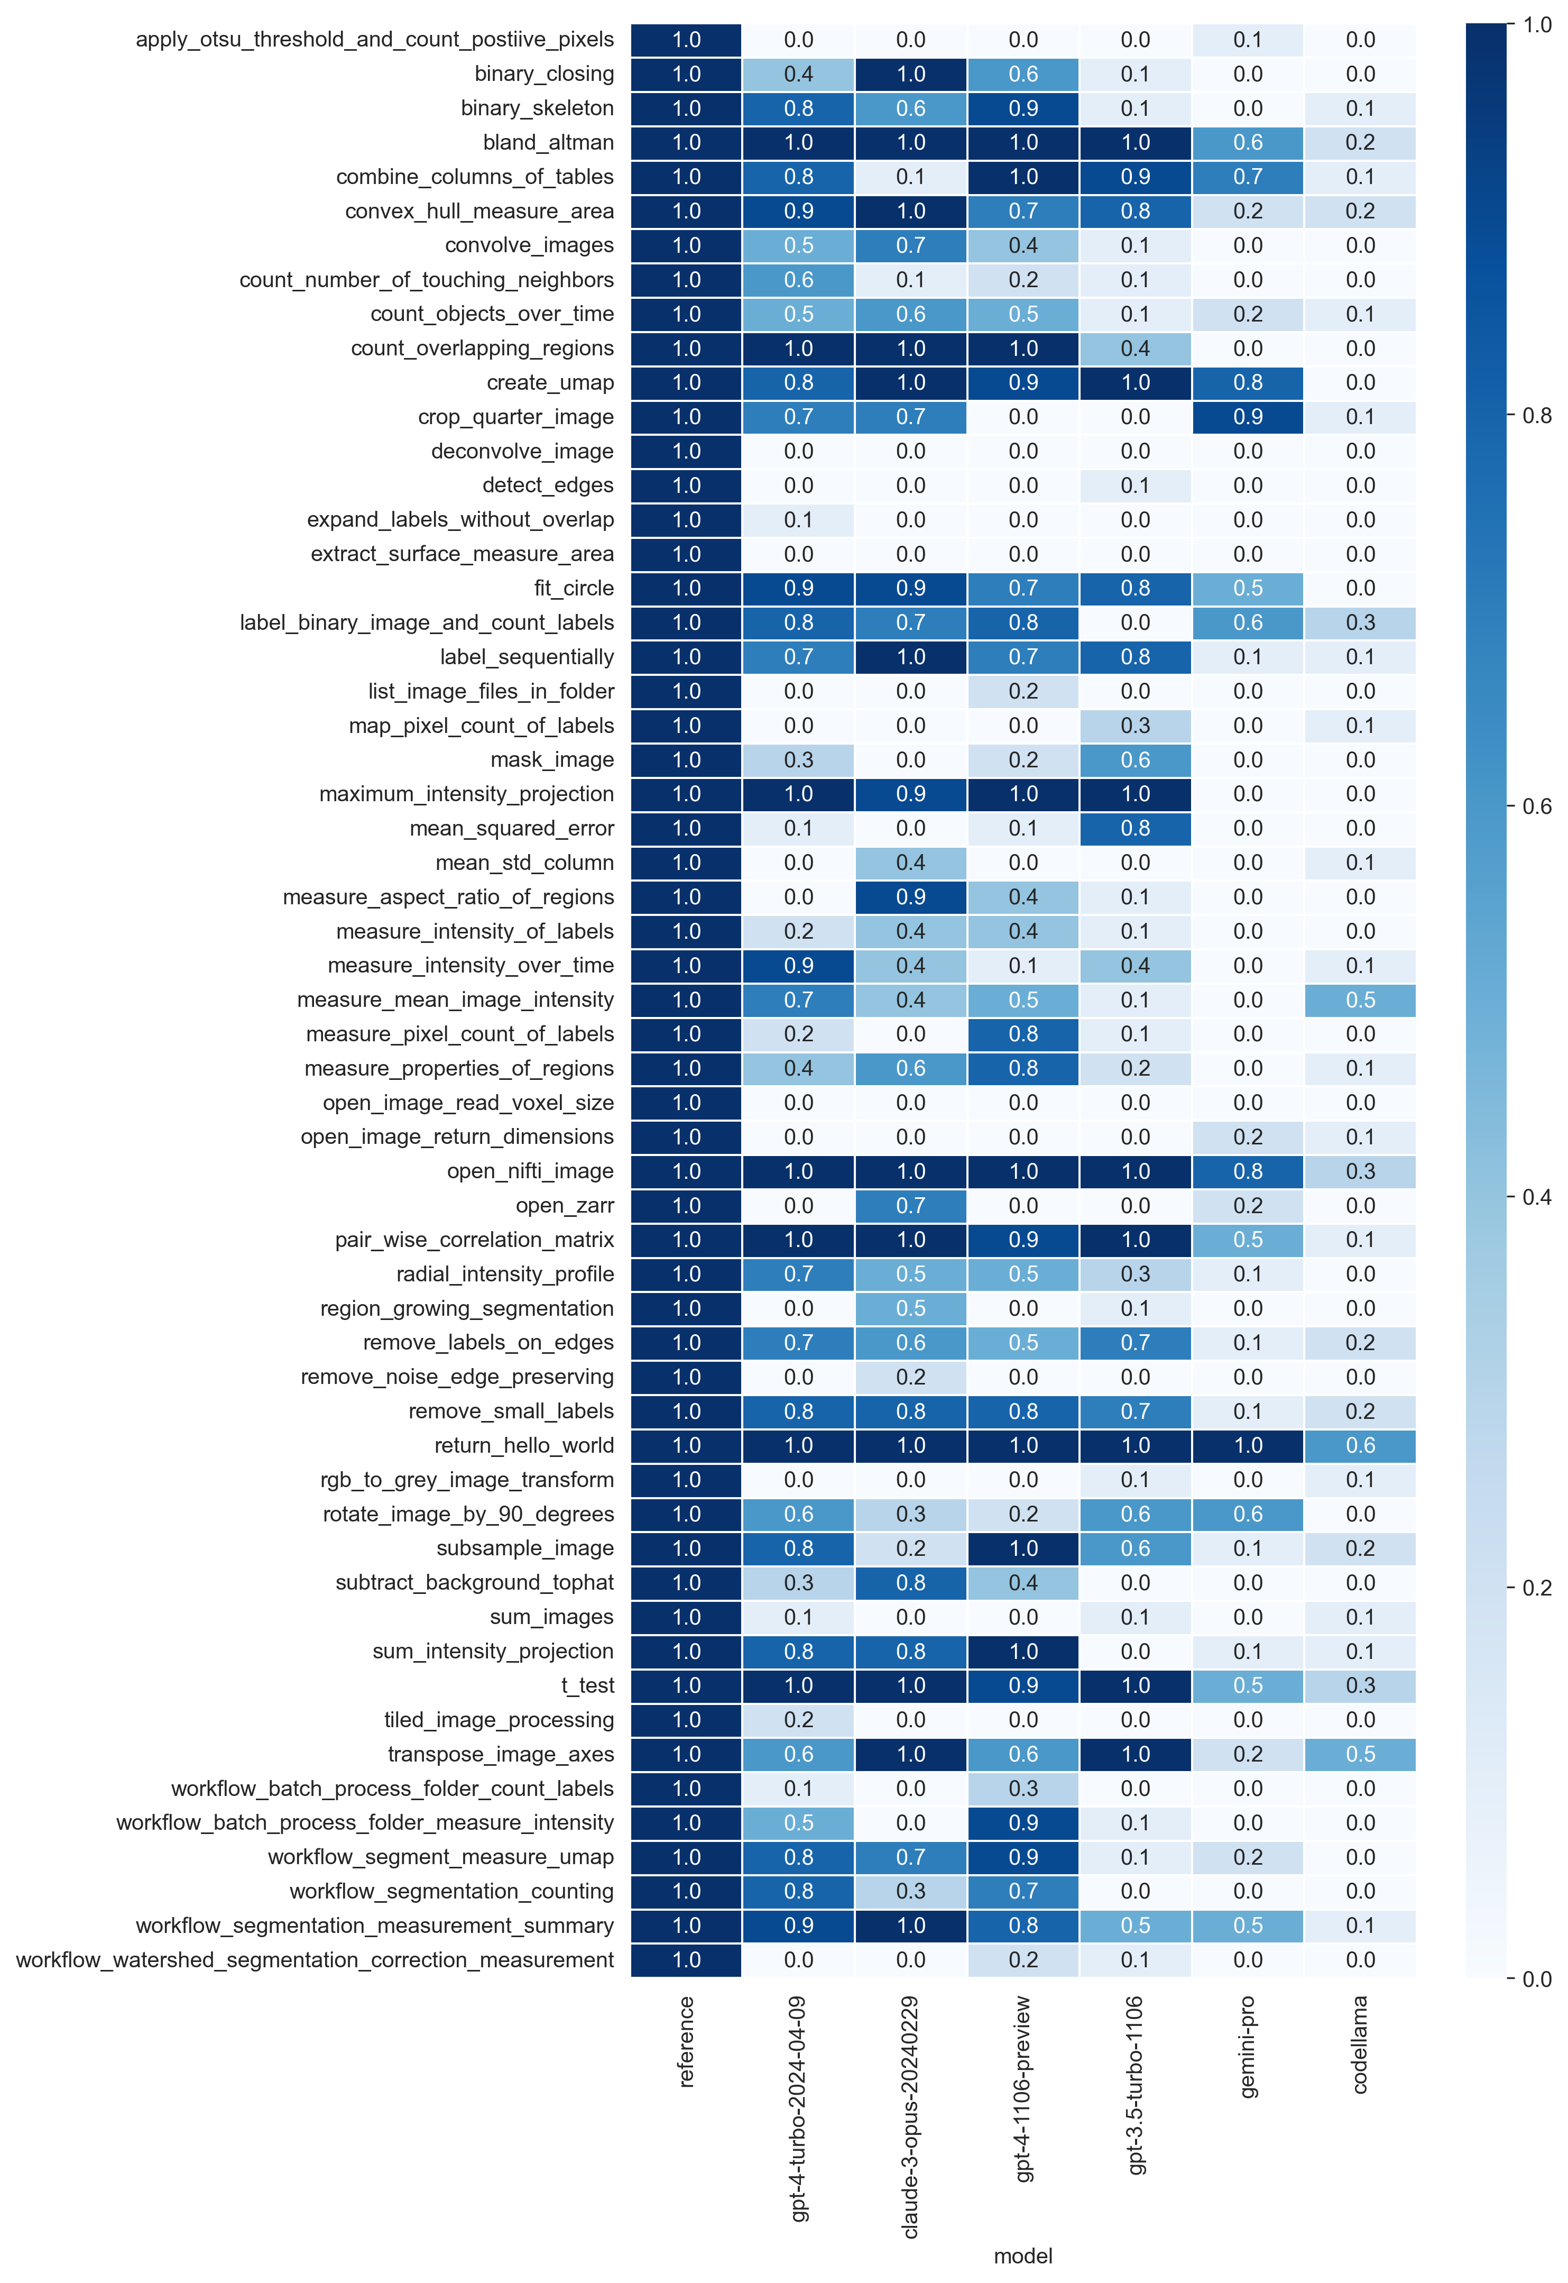
Benchmarking LLMs for Bio-image Analysis
Use case: segment the image and measure the average area of objects.
858.04
…
Unit-test pass-rate (n=10):
gpt-4-1106-preview
gpt-4-turbo-2024-04-09
Claude-3-opus-20240229
gpt-3.5-turbo-1106
gemini-pro
codellama
reference
https://www.biorxiv.org/content/10.1101/2024.04.19.590278v1
https://github.com/haesleinhuepf/human-eval-bia

Slide 29
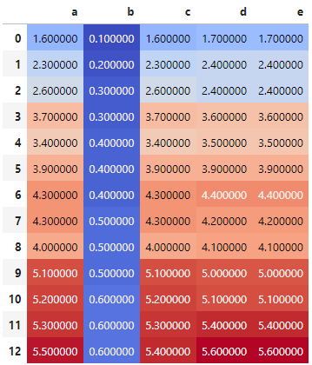
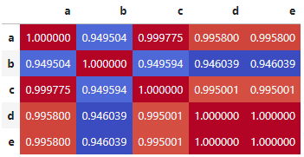
Benchmarking LLMs for Bio-image Analysis
Use-case: compute the correlation matrix
Unit-test pass-rate (n=10):
gpt-4-1106-preview
gpt-4-turbo-2024-04-09
Claude-3-opus-20240229
gpt-3.5-turbo-1106
gemini-pro
codellama
reference
https://www.biorxiv.org/content/10.1101/2024.04.19.590278v1
https://github.com/haesleinhuepf/human-eval-bia

Slide 30
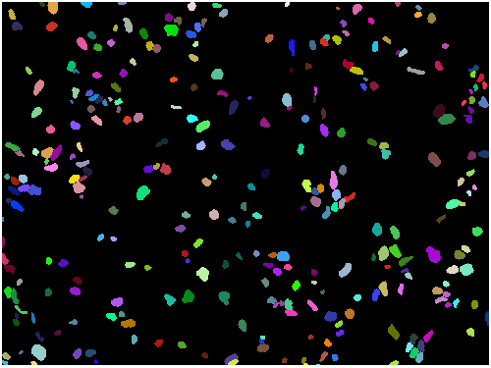
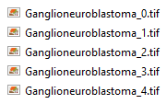
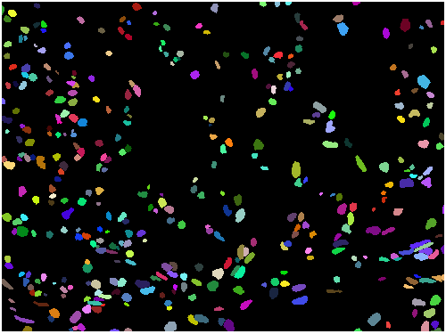



Benchmarking LLMs for Bio-image Analysis
Use case: Count segmented objects in a folder of segmentation results.
300
398
368
378
363
Unit-test pass-rate (n=10):
gpt-4-1106-preview
gpt-4-turbo-2024-04-09
Claude-3-opus-20240229
gpt-3.5-turbo-1106
gemini-pro
codellama
reference
https://www.biorxiv.org/content/10.1101/2024.04.19.590278v1
https://github.com/haesleinhuepf/human-eval-bia
Data Source: https://www.ebi.ac.uk/bioimage-archive/galleries/S-BIAD634-ai.html

Slide 31
Benchmarking LLMs for Bio-image Analysis
gpt-4-turbo-2024-04-09
Claude-3-opus-20240229
gpt-4-1106-preview
gpt-3.5-turbo-1106
gemini-pro
codellama
Unit-test pass-rate (n=10)
reference
Statistics / tabular data wrangling
Measurements / feature extraction
Advanced workflows / big data

Slide 32


Benchmarking LLMs for Bio-image Analysis
Summary: 57 use-cases (yet), 15 LLMs (yet), n=10
https://www.biorxiv.org/content/10.1101/2024.04.19.590278v1
https://github.com/haesleinhuepf/human-eval-bia

Slide 33


Benchmarking LLMs for Bio-image Analysis
Summary: 57 use-cases (yet), 17 LLMs (yet), n=10
https://github.com/haesleinhuepf/human-eval-bia/pull/67

Slide 34


Benchmarking LLMs for Bio-image Analysis
Common Python libraries (n=570)
Do we need a BiA-specific LLM?
https://www.biorxiv.org/content/10.1101/2024.04.19.590278v1
https://github.com/haesleinhuepf/human-eval-bia

Slide 35

Benchmarking LLMs for Bio-image Analysis
Common error messages (n=570)
Halucinating API?
Forgot import statements?
https://www.biorxiv.org/content/10.1101/2024.04.19.590278v1
https://github.com/haesleinhuepf/human-eval-bia

Slide 36


Image generation models
Producing images, also replacing regions in images
(also „Variation“, „Inpainting“, „Gap-filling“, „Replacing“)
A picture of a cat and a microscope

Slide 37


Other related use-cases of LLMs
Image variation – just for fun?
https://haesleinhuepf.github.io/BioImageAnalysisNotebooks/07_prompt_engineering/60_image_variations_huggingface.html

Slide 38

Other related use-cases of LLMs
Image inpainting – introducing new challenges
Detecting manipulations becomes harder
https://github.com/haesleinhuepf/darth-d/blob/main/demo/demo_replacing.ipynb

Slide 39
Summary & outlook
LLMs can generate code to analyze biological microscopy images
Open-source benchmarks can help targeting further improvement
Challenges:
  Identify best strategy (fine-tuning, prompt-engineering, RAGs)
  Multi-modal / multi-agent approaches
  Introduce good scientific practice -> trustworthy AI
How many cells are there?
There are 4 cells. I used this code…

Slide 40











Acknowledgements
BiAPoL team
Marcelo Zoccoler
Johannes Soltwedel
Maleeha Hassan
Stefan Hahmann
Former lab members:
Ryan George Savill
Laura Zigutyte
Mara Lampert
Allyson Ryan
Conni Wetzker
Till Korten
Somashekhar Kulkarni
Christian Tischer (EMBL Heidelberg)
Nico Scherf
(MPI CBS Leipzig)
Kevin Yamauchi
(ETH Zurich / Basel)
Jean-Karim Hériché (EMBL Heidelberg)
Loic Royer
(CZ Biohub San Francisco)
Matthias Täschner (ScaDS.AI)
Communities & platforms
Funding
RH acknowledges the financial support by the Federal Ministry of Education and Research of Germany and by Sächsische Staatsministerium für Wissenschaft, Kultur und Tourismus in the programme Center of Excellence for AI-research „Center for Scalable Data Analytics and Artificial Intelligence Dresden/Leipzig“, project identification number: ScaDS.AI

