Slide 1

QoS-Aware Orchestration in the SWITCH environment
Sandi Gec, Jernej Trnkoczy, Uroš Paščinski, Matej Cigale, Vlado Stankovski

Slide 2
Outline
Problem statement
Videoconferencing approaches
Technological requirements
Proposed solution:
  Architecture & Workflow of Decision Making process
  Decision making
Experimental evaluation
  CPU usage
  Frame delay
  VC network metrics

Slide 3
Problem statement
Based on the studies of videoconferencing application
Problem 1: How to achieve scaling of computing and networking resources that is:
  efficient and
  cost-effective?
Problem 2: How to achieve high QoE?
Problem 3: For the proposed solution, how to conduct measurements to obtain QoE model?

Slide 4
Videoconferencing approaches
Videoconferencing: P2P vs centralized network topology:
  WebRTC VC applications most often use full mesh network topology
  Cloud-based realizations of WebRTC most often use centralized approach (a star topology)
Centralized VC service applications are implemented in one of the following ways:
  Multipoint Control Unit (MCU)
  Selective Forwarding Unit (SFU)
Other approaches: multi-tenant, multi-instance, event-driven,...
Notes:
Multi-tenant vs multi-instance vs event-driven:
Traditionally, a multi-tenant approach is used for VC in Clouds
Multi-instance approach
Event-driven approach

Slide 5
Technological requirements
Service instance creation time should be low → use container technologies.
Leasing the infrastructure on-demand → use DRIP or Kubernetes' capability.
Guaranteed and fine-grained compute resource reservation → e.g. Joyent container Cloud.
Possibility to run services globally → multi-cloud environment.
Highly-automated and efficient services orchestration → use Kubernetes.

Slide 6
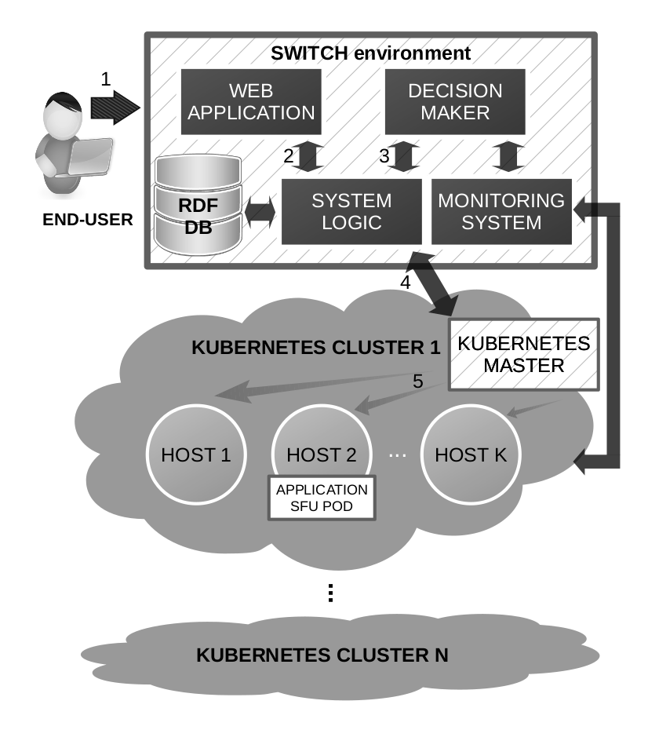
Architecture & Workflow of Decision Making process
A conference organizer creates a new VC session request and provides a context by visiting a Web application.
The context is extracted from the Web application.
Depending on the context, the QoS/QoE model and monitoring results the Decision Maker selects the best host machine.
The System Logic component invokes Kubernetes API for deployment of new VC application.
During the creation of pod the user is notified upon the status. Finally, the URL to the deployed service is provided.

Slide 7
Decision making
Input 1: table of measurements M with all (non-QoS) metrics performed just before the deployment decision is about to be made. One row represents averaged performance of a single machine.
Input 2: QoS model q.
For every pair (i, j) of two measurements on different machines:
  Compute differences: d(i) = M(i, :) - M(j, :)
  Keep only values of signum function: s(i) = sign (d(i))
  Increase count if i is better than j for each individual metric: c(i) +=s(i) * sign (q) > 0
For machine i:
  Normalize counts c to [0, 1] into c_{n}.
  Compute correlation (i.e. scalar product) between normalized counts and the QoS model q: score(i) = c_{n}(i)^{T}* q
Output: score

Slide 8
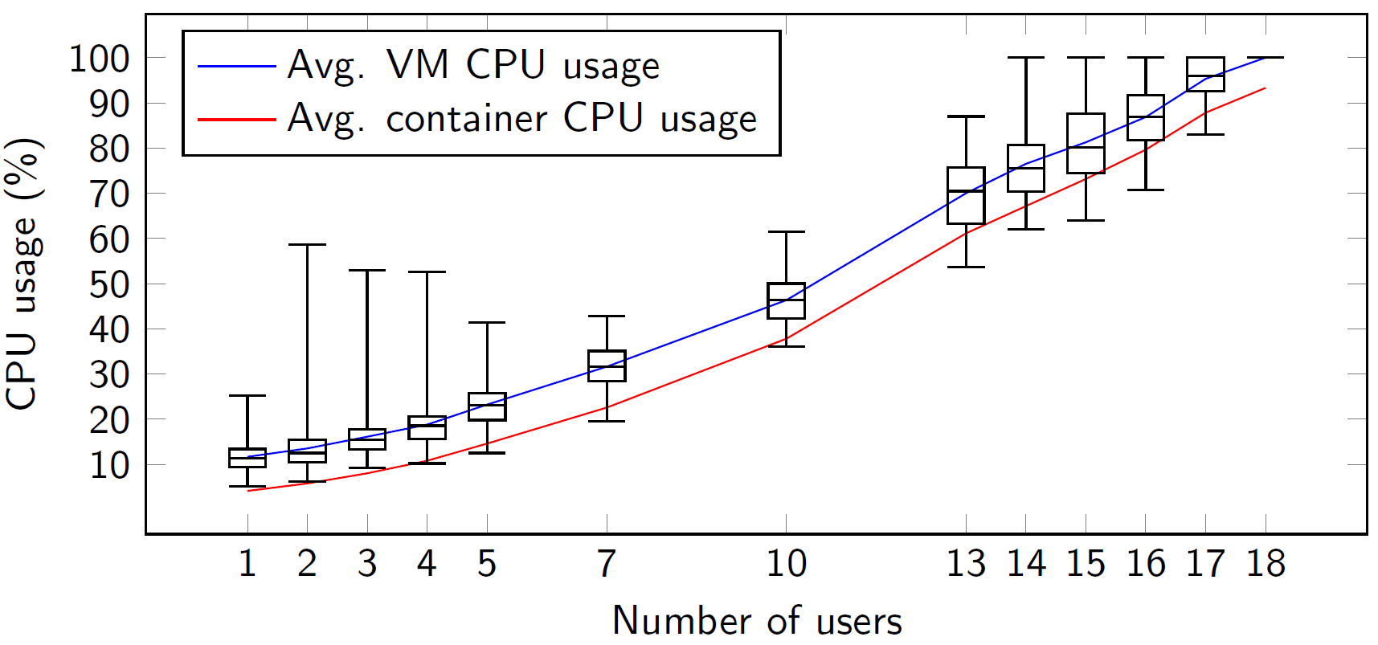
Results: CPU usage
Experiment: Deploy Jitsi Meet services as a Kubernetes pod at a fixed location and utilize Jitsi Hammer stress test to simulate end users.
Average CPU usage of VM (blue) and its container (red) during Jits Meet running in Kubernetes cluster deployed in GCP US West region over 120 runs.

Slide 9
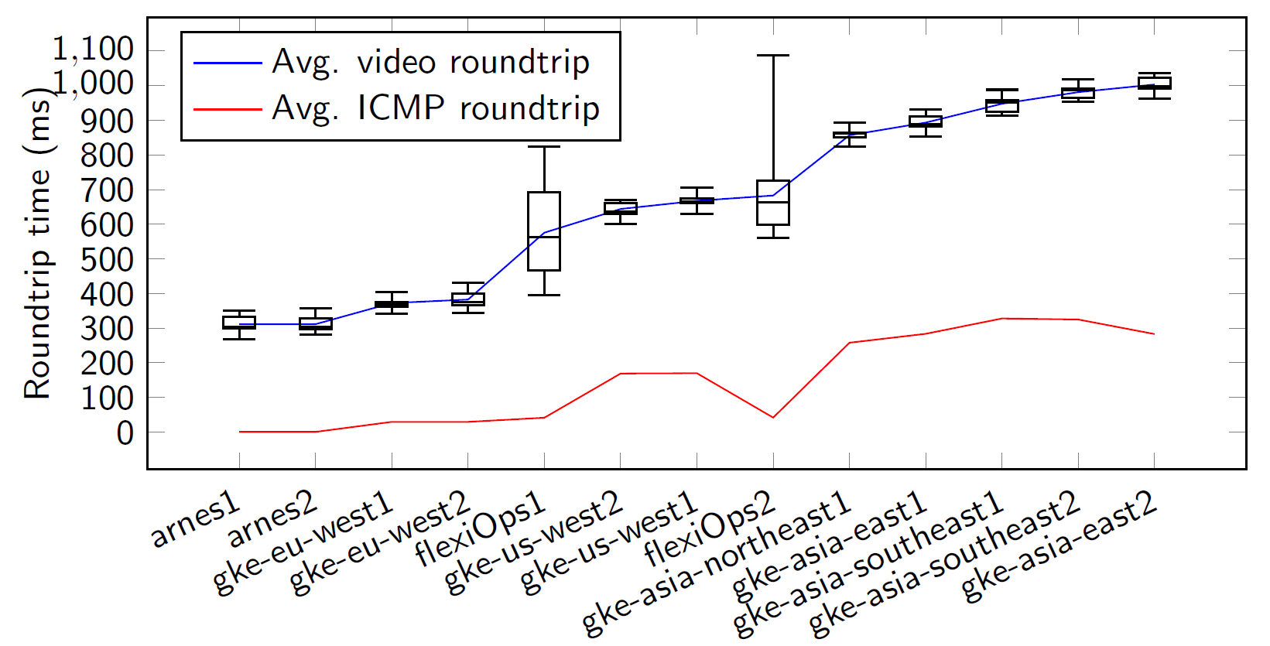
Results: Frame delay
Experiment: Deploy Jitsi Meet services as a Kubernetes pod and repeat experiment at various server locations by engaging 2 clients.
Video and ICMP echo roundtrip time measurements for Jitsi Meet server deployed in various locations.

Slide 10
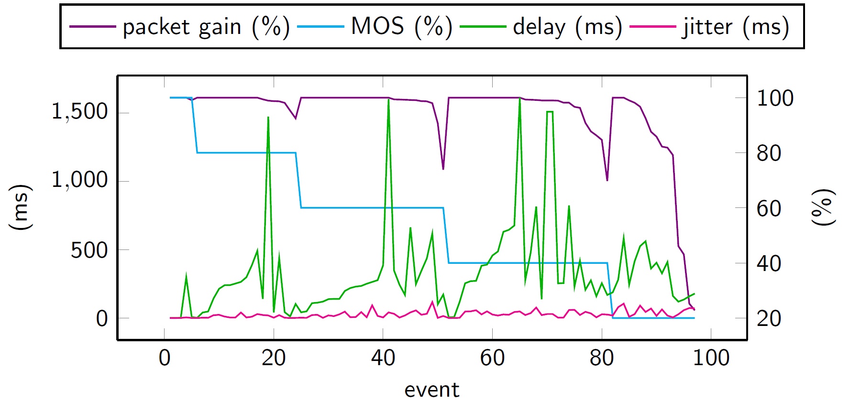
Results: VC network metrics
Experiment: Setup a VC server, connect two clients to the server and perform network simulations of packet delay, jitter and packet loss by using Linux tc netem tool.
The results of the quality assessment for the VC application sorted by the mean opinion score and then by the packet loss, descending.
Notes:
MOS = mean opinion score aka star rating

Slide 11
Thank you
Questions?

