Slide 1



AI-assisted pre-screening
of biomedical
research proposals.
Ethical considerations
and the pilot case of
”la Caixa” Foundation
DATA FOR POLICY 2024 – DECODING THE FUTURE: TRUSTWORTHY GOVERNANCE WITH AI?
Carla Carbonell¹, César Parra² , Albert Pérez³ et al.
¹ “la Caixa” Foundation, ²SIRIS Academic, ³Ithink UPC
9-11 JULY 2024 I LONDON, UK

Slide 2






Outline
1
2
3
4
5
6
CaixaResearch Health Call
Context and motivation
Using AI to improve matching b/w reviewers and projects
AI-assisted eligibility process
Main takeaways & conditions for success
Ongoing & future work – open questions

Slide 3
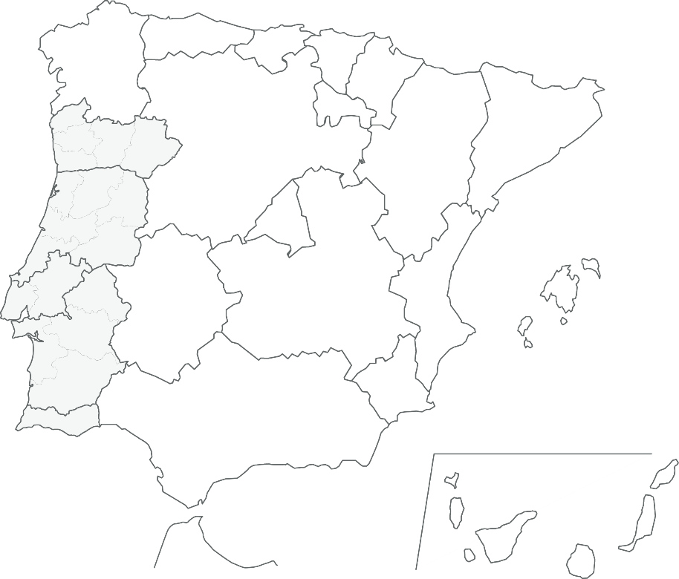







1
CaixaResearch
Health Call
Proposals
based on:
Thematic areas:
HR18-HR23:
2 / PAÍS VASCO
3 / galicia
Basic, clinical and translational research.
Scientific excellence.
High impact.
4 / navarrA
Neuroscience
Oncology
Cardiovascular and associated metabolic disease
Infectious diseases
Enabling technologies (focused on the four previous thematic areas)
17 / nortE
2 / castilla
Y leon
60 / catalUÑA
5 / CENTRO
34 / comunidad de madrid
2 types of
proposals:
31 / lisboa
1 / castilla
la-mancha
6 / COMUNIDAD VALENCIANA
1. INDIVIDUAL:
Up to 500.000€
2. CONSORTIUM:
(2 to 5 Research organizations)
Up to 1.000.000€
1 / murcia
4 / andaluCÍa
1/ ALGARVE
3,705
171
€120M
Both types can include
Civil Society
Organizations
Submitted proposals
Proposals selected
Budget

Slide 4

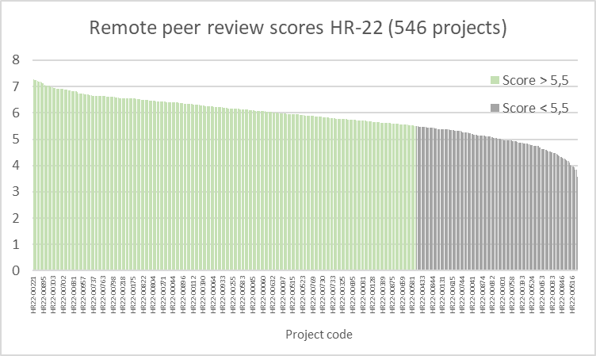
2
Context and motivation
Evaluation phases
Project 1
Project 2
Elegible proposals (2024: 535)
challenge:
solution:
challenge:
solution:
A /
Preselection
Remote evaluation
How to match reviewers with proposals considering the huge dimensionality problem (hundred thousands of MeSH terms)
AI algorithm for the Matching process
Can the initial screening be improved so that the workload of the evaluators is alleviated?
AI pre-screening to assist detecting proposals with low chances to be funded
3 peers / Proposal
(+1 peer in case of discrepancy)
90 PROPOSALS / 18 FOR THEMATIC AREA
B/
SELECTION COMMITTEES (INTERVIEWS)
FACE TO FACE EVALUATION
1 Committee (8-12 experts)
/ Thematic Area
384
projects
(70%)
162
projects
(30%)
SELECTED PROPOSALS (2024: 33-35)

Slide 5



Process Remote Evaluation
3
Projects characterization /
Self selection
Reviewers characterization / Scrapping
Matching process /
AI algorithm
Basic, clinical and translational research.
1 to 3 Main keywords from NIH MeSh Tree.
3 to 5 other important keywords from NIH MeSh Tree.
Basic, clinical and translational Research (self Selection).
MeSH terms obtained from all the scientific articles from the last 10 years (1st or last author). Yearly updated.
>10 years of postdoctoral experience.
>5 publications on the last 10 years as 1st or last author
Not based in Spain or Portugal.
Different weights for the variables:
  main keywords -sec keywords - B/C/T.
  Weight group of 3 or 1
  MeSH frequency
  Evaluation tag (reviewers excellence)
  Between 5-15 proposals per reviewer.
  > 40 % women.
Better reviewer characterization
Better matching
201
1.635
Finally evaluated
Reviewers on the pool
1.560
>10 years of post-doctoral experience, NOT Spain or Portugal
1.085
719
publications requirements (15.042 scientific articles
and 63.056 MeSH terms)
available

Slide 6

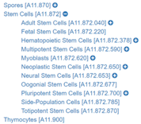



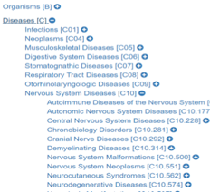
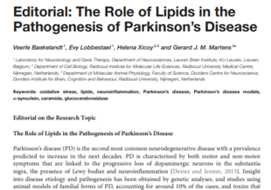

Matching: a HUGE lineal optimization problem
3
Proposals
characterization
Around
4,000
MeSH terms
Reviewers
characterization
15,900
Scientific
articles
247,992
MeSH terms
Matching
+ 1,600
remote evaluations
(535 in 2024):
(719 reviewers in 2024):
Medical Subject Headings (MeSH)
Veerle Baekelandt,
Professor at KU Leuven, Belgium.
Expert in neurobiology and genetic therapy.
Neurodegenerative Diseases score 1
Neural Pathways score 1
Neural Stem Cells score 1
Other important Keywords
Proposal: In vivo reprogramming
to rescue alterations in Huntington’s disease – Dr. Canals (UB)
Main Keywords:
A11.872.653 Neural Stem Cells
A08.612 Neural Pathways
C10.574 Neurodegenerative Diseases
Other important Keywords:
Human Development
Neurodevelopmental Disorders
Genes
Developmental
Fetal Development
Steve Dunnett, Emeritus Professor,
Cardiff University, United Kingdom.
Expert in neurodegenerative diseases as
Parkinson and Huntington.
Neurodegenerative Diseases score 1
Neural Pathways score 0.44
Neural Stem Cells score 1
Other important Keywords
Notes:
Para encontrar el mejor grupo de 3 evaluadores diferentes para cada proyecto utilizamos un software de inteligencia artificial creado por una spinoff de la UPC.
El software compara y puntua las palabras clave que definen cada proyecto teniendo en cuenta principales (1-3) y secundarias (3-5), con las que definen la experiencia de cada evaluador.
También se tiene en cuenta la clasificación entre B/C/T.
Se fuerza para que haya una participación mínima del 40% de mujeres.
Se asignan entre 5 y 15 proyectos por evaluador.
Se definen pesos distintos entre las diferentes variables que intervienen en el matching:
0.6 main keywords, 0.25 sec keywords, 0.15 B/C/T
matching global (3 peers) o par 1 a 1: 40-60
Teniendo en cuenta todo esto se obtiene una clasificación de los mejores evaluadores para cada proyecto.

Slide 7



AI-assisted eligibility process:
Prior Ethical considerations
Human agency
and oversight
4
Accountability
Technical
robustness
and safety
What makes
the application...
To be continuously
evaluated and
addressed throughout
the AI system’s
life cycle
Socially
acceptable?
Fair?
Reliable?
Societal and
environmental
wellbeing
Privacy and data governance
Diversity
non-discrimination
and fairness
Transparency
EC High-Level Expert Group on AI.
"Ethics guidelines for trustworthy AI" (2019)

Slide 8

4
Prior Ethical considerations
Social acceptability
Fairness
Reliability
Depends on the attitude of researchers and general public towards the use of AI-assisted technologies
Requires managing the expectations of the applicants with respect to the selection criteria of the programme
Transparency in the presentation of the rules and assurance of ethical practices are essential
Compliance with the law
Sources of biases should be identified and constantly monitored
Final decisions should be made by a human being
Redress mechanisms should be put in place
The outputs of the algorithm should be explainable in a manner that allows feedback to be given to the applicants
The model should be resilient and its predictions accurate and replicable

Slide 9
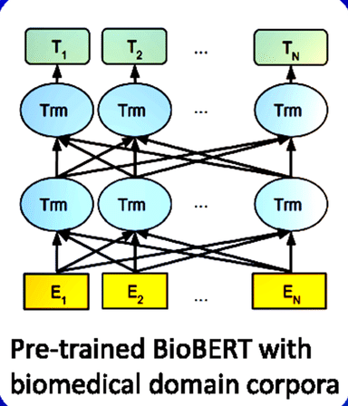



AI to assess elegibility: LCF journey
4
2020-2021
2022
2023
Proof of concept
Pilot
Application
Several AI models based on natural language processing were tested
Data for training
and validation:
3.212 proposals (HR18-HR22)
Promising results
546 proposals (HR22)
Pre-rejected proposals by AI are evaluated
by 2 experts:
  Proposals are rejected if both experts confirm it
  Proposals are saved if at least 1 expert has doubts
In HR22 86 proposals would have been rejected (AI + experts). Only 1 arrived to selection comittees and was funded (from reservation panel).
493 proposals presented:
430 elegible and
63 non elegible
(AI + experts).
Results HR23

Slide 10
Proof of concept
4
BioBERT Pre-training
This new tool combines three AI biomedical research models based on natural language processing:
BioBERT,
BioELECTRA
BioBERT with Adapter blocks.
Analysis:
1
Analysis concluded the data did not contain any obvious bias that needed to be addressed before developing the models.
2
Analysis of the homogeneity and quality of the data to assess the suitability of the application and
of the models pretrained on biomedical text. The same type of analysis was carried out for the innovation programme and it was deemed unsuitable.
3
The data used corresponds only to the proposal texts, and not personal data.
Training:
So that the model can learn how to predict the goodness of each project, we split the proposals in 3 partitions:
1
2
3
Training:
Validation:
Test:
Model learns patterns from both inputs (text) and labels (evaluation results).
70% of proposals from
HR18, HR19, HR20 and HR21.
Model only sees the inputs (text) and it doesn’t learn from the evaluation results.
30% of proposals
from HR18, HR19, HR20 and HR21.
This data is used
for the final validation of the model.
HR22
Notes:
10

Slide 11


Pilot: 3 rejection scenarios and expert confirmation
4
Rejection Scenarios
Expert Confirmation
Unanimity:
Majority:
“At least one”:
Experts had participated in CaixaResearch Selection Committees in previous editions (8 men, 6 women)
Each expert evaluate 20-25 proposals (2 of them are positive controls, not rejected by AI).
Experts were informed of the pilot study.
216 proposals were evaluated; 50% of them had multiple evaluation.
Evaluation: rejection confirmed or reasonable doubt/ weaknesses of the proposal.
Evaluation timing:
March to April.
Pre-rejection of those projects where all 3 AI models agree on rejection.
(HR22: 116/546)
Pre-rejection of those projects where at least 2 AI models agree on rejection.
(HR22: 160/546)
Pre-rejection of those projects where at least one AI model agrees on rejection.
(HR22: 216/546)

Slide 12




Pilot 3: results
4
Only 1 proposal of the
86 pre-rejected (AI and Experts)
has reached the Selection Committees and has finally been awarded (reserve)
Call HR22
Current Selection Model:
Ai assisted model:
546
546
86
eligibles
eligibles
116
experts
rejected
Pre-rejected
30
460
430
Rescued*
Eligibles +
Eligibles +
Remote
Evaluation
ai
Remote
Evaluation
Selection
commitees
…
466
rejected
80
47
33
Pre-selected
Not-awarded
awarded
(*) A project is rescued if there’s at least
a reviewer who doesn’t confirm AI pre-rejection.

Slide 13
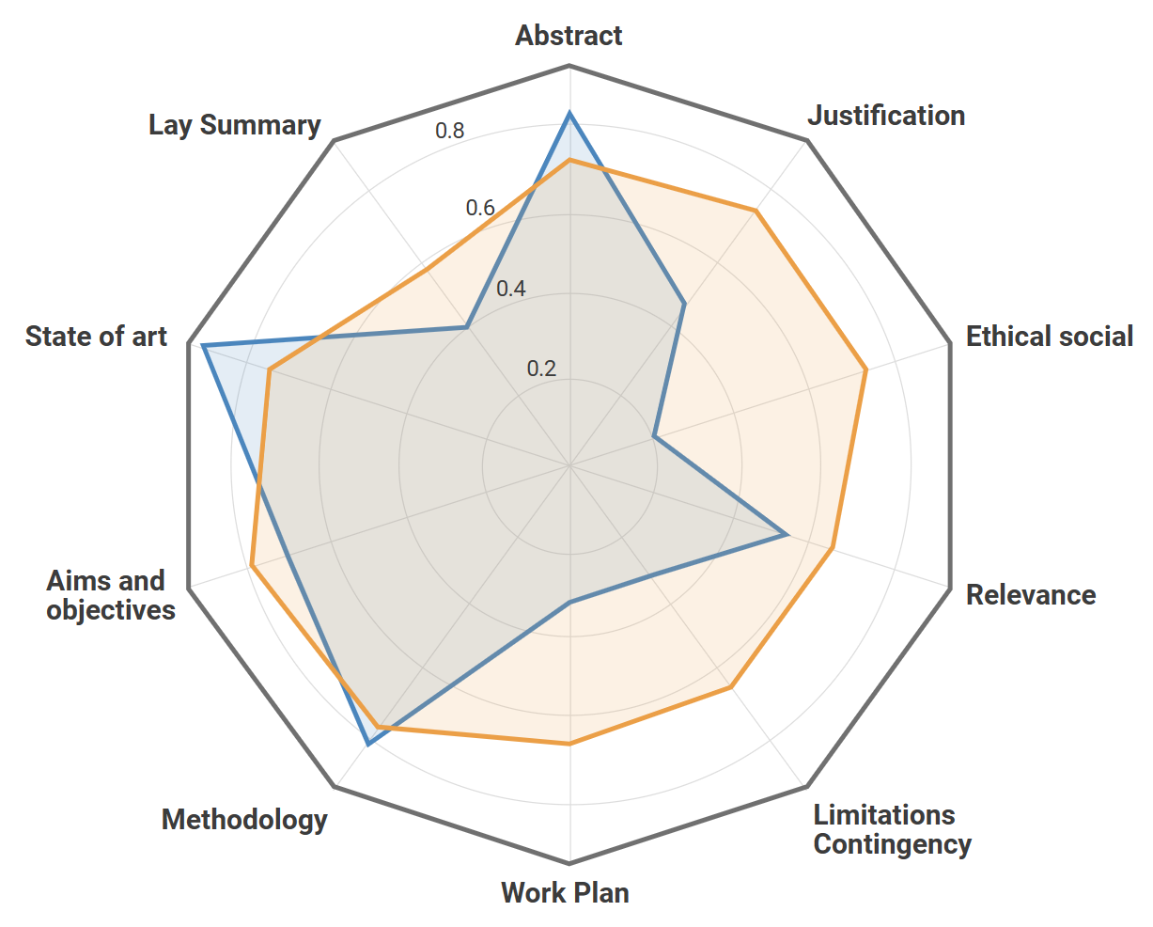
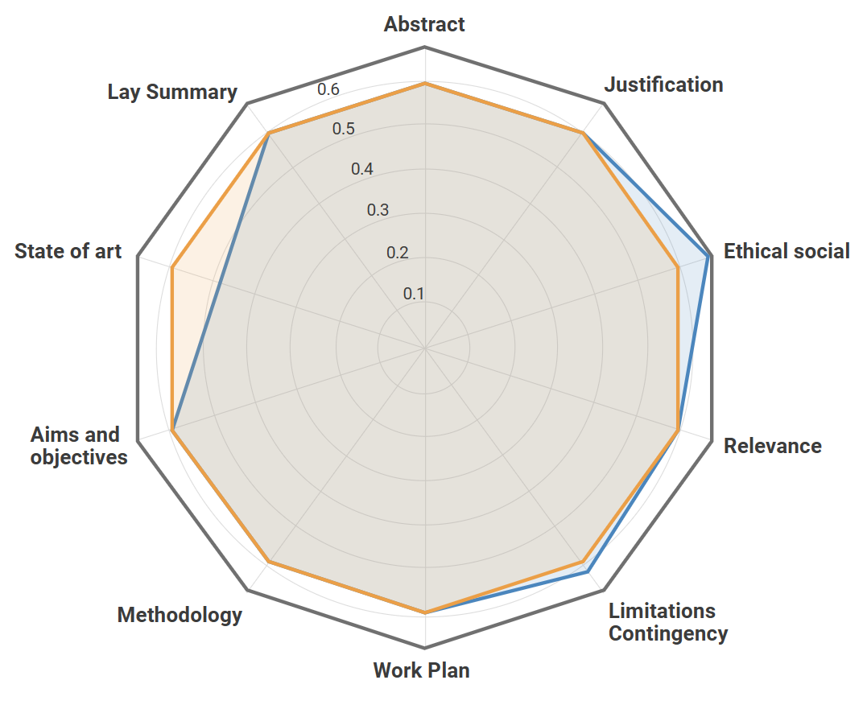
POC: initial version of explainability
4
Multiple predictions translated into a “quality score” → inverse probability of belonging to the bottom class
  Global prediction: the actual prediction using the full text of the proposal.
  Local prediction by section: predictions generated for each single section of the proposal (e.g., abstract, methodology).
  Local predictions excluding sections: predictions generated using the full text excluding specific sections
The local predictions for each section of a proposal (blue) are compared to the average of each section across the entire call (orange). This particular proposal’s strengths with respect to the other proposals lie in its state of the art, abstract, and methodology, while its weak sections correspond to work plan, ethical & social, and limitations & contingency
The local predictions excluding each one of the sections of a proposal (blue) are compared to the score obtained using the proposal’s full text (orange). In this case, the section contributing most positively to the proposal’s score is the state of the art; conversely, the ethical & social section has a negative impact (the score increases when this section is omitted)
Notes:
13

Slide 14


Pilot: workshop with experts
4
Socio-technical system:
Discussion highlights:
Essential to understand how the users of the tool interact with it and involve them throughout its development in order to improve the methodology and provide thorough guidelines for its use
Concerns about:
  Classification criteria
  of the model
    no explicit criteria, statistical similarity to poor-performance proposals from previous years
    emphasis on the fact that proposals that have a language that is too “different” or “innovative” may be flagged for removal -> role of evaluators is fundamental and must be highlighted in the guidelines
  Bias amplification
    emphasis on the study prior to the implementation of the solution
    commitment to continuous monitoring
  Accuracy of the model and incentive to accept the model’s outputs
    guidelines must highlight the higher impact of ratifying the rejection of a wrongly flagged proposal
    experts must be encouraged to be conservative in their decisions
  Cost effectiveness
  of the solution
    the goal is reducing the workload of the peer reviewers, and the number of immature proposals reaching the remote evaluation phase and requiring reviewer matching, however small in scale

Slide 15
Application 2023: Results
4
None AI labelled proposal (not even any labelled
by only 1 algorithm) has been finally selected.
493
63
63
PROPOSALS
98
experts
REJECTED
NON ELEGIBLE
LABELLED
35
430
345
53
RESCUED
395
Elegible
DON’T REACH PANELS
NO seleccionados
ELEGIBLE
AI
REMOTE EVALUATION
INTERVIEWS
85
32
Pre
selecTED
27+4+1
selecTED
ELEGIBILITY
(December)
REMOTE EVALUATION
(January - April)
PANELS
(May 30-31)

Slide 16




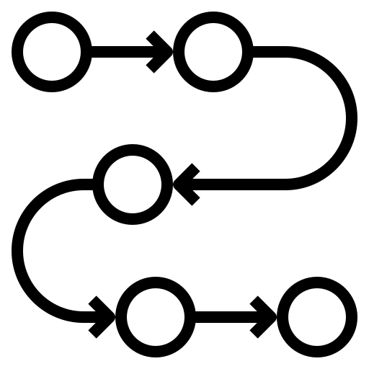


Main takeaways & conditions for success
5
Initial assessment
and data selection
  data quality, homogeneity and quantity
  historical biases
  avoid the use of personally identifiable information
Implementation
  model selection
  and evaluation
  pilot phase
  thorough documentation
  of the process
Ensure human agency
  model explainability to provide feedback to evaluators and applicants
  involve evaluators in the development of the solution — give them full discretion over the outputs
  implement redress mechanisms for the applicants
Transparent communication
  publish details of the implementation with the rules of the call
  make explicit which stages of the process are automated, emphasise human judgement
  provide guidelines
  for redress
Step by step
to ensure acceptance. Solid results. Transparency.
(NOTE: Status Quo is NOT perfect)

Slide 17

Ongoing & future work – Open Questions
6
Start a specific project to study different options for the improvement of the explainability of the content eligibility process.
Evaluating:
  The most appropriate approach to sharing reviewers’ feedback with the applicants.
  Creating a tool so the applicants could check the probability of being selected before applying (based on the previous year information).
Any final decision is under human validation. With solid results, can we lower the human intervention?
Can we consider the scenario of majority as opposed to the conservative approach of unanimity?
These algorithms have been trained to detect low probability of being selected, but what conditions would need to be met for the solution to be applied to identify the “best” proposals instead?
Notes:
here defend the idea of no redress, because it’s not trivial
in principle we believe redress and/or the possibility of resubmission, is needed, because the decision is semi-automated, the evaluators carry out a superficial assessment and they have an incentive to accept the algorithm’s outputs
however at this stage we believe that this is not entirely necessary because we encourage evaluators to be super conservative and require that all their decisions are justified, submitting feedback regarding why they have ratified a given rejection
furthermore, we are exploring the best way to share this feedback with the rejected applicants, along with improved explainability measures
Also, while we do not allow resubmission, we are exploring the idea of making the prefilter, based on the trained models from the previous year, openly available to applicants
what does the audience think?

Slide 18



Thank you for your attention

