Slide 1


VISUALIZING COLONIAL BIAS
IN NATURAL HISTORY COLLECTIONS
SAKURA MORALES FURUTA*
ANA REVIEJO SALAMANCA*
MICHAELA TODD*
LISE STORK
ANDREAS WEBER
* Sakura Morales Furuta, Ana Reviejo Salamanca and Michaela Todd share the first authorship of this presentation and paper.

Slide 2
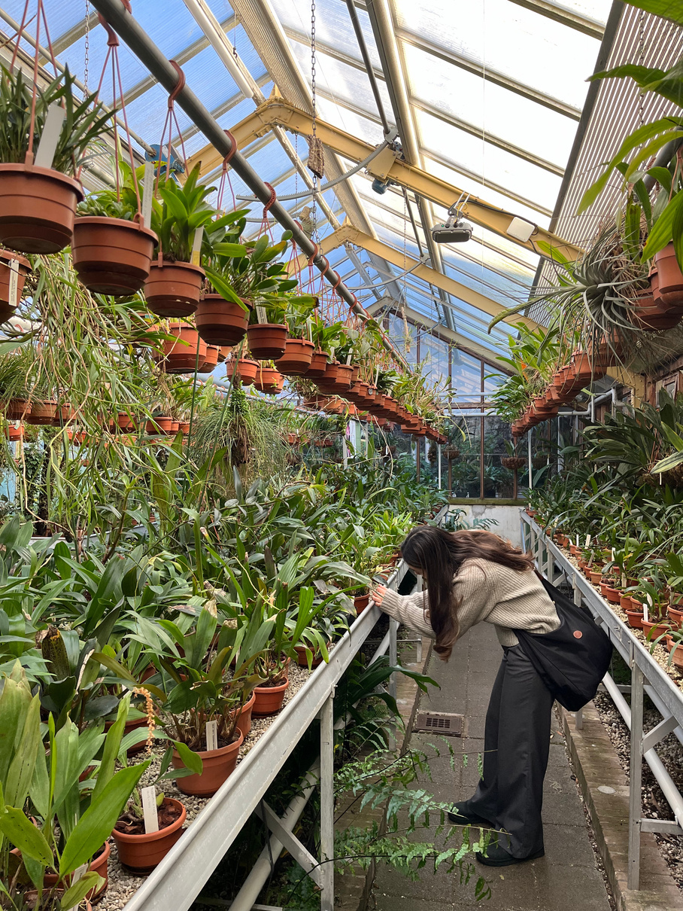
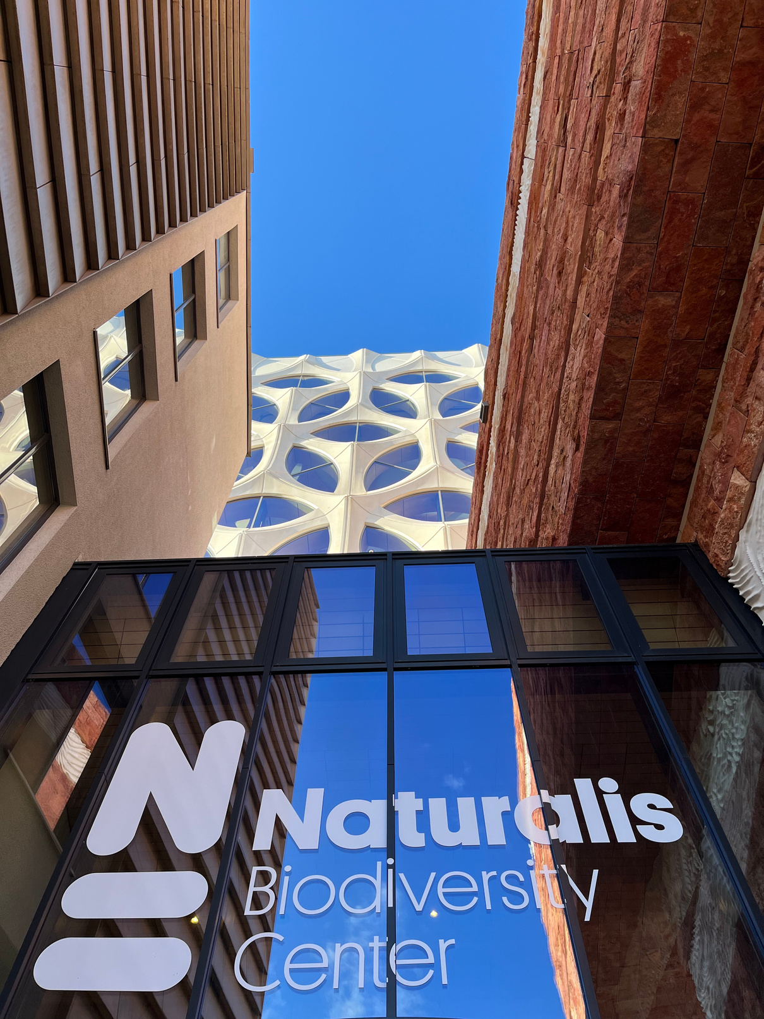

DH BENELUX - LEUVEN 2024
Our Project
  First things first: Who are we?
  Task: visualise colonial bias of natural history collections... in 4 weeks!
  Rich world of (natural history) data BUT limited accessibility
  Goals:
    Address a gap in historical research and computer science research
    Highlight importance of accurate and accessible visual representations of biodiversity collection histories

Slide 3
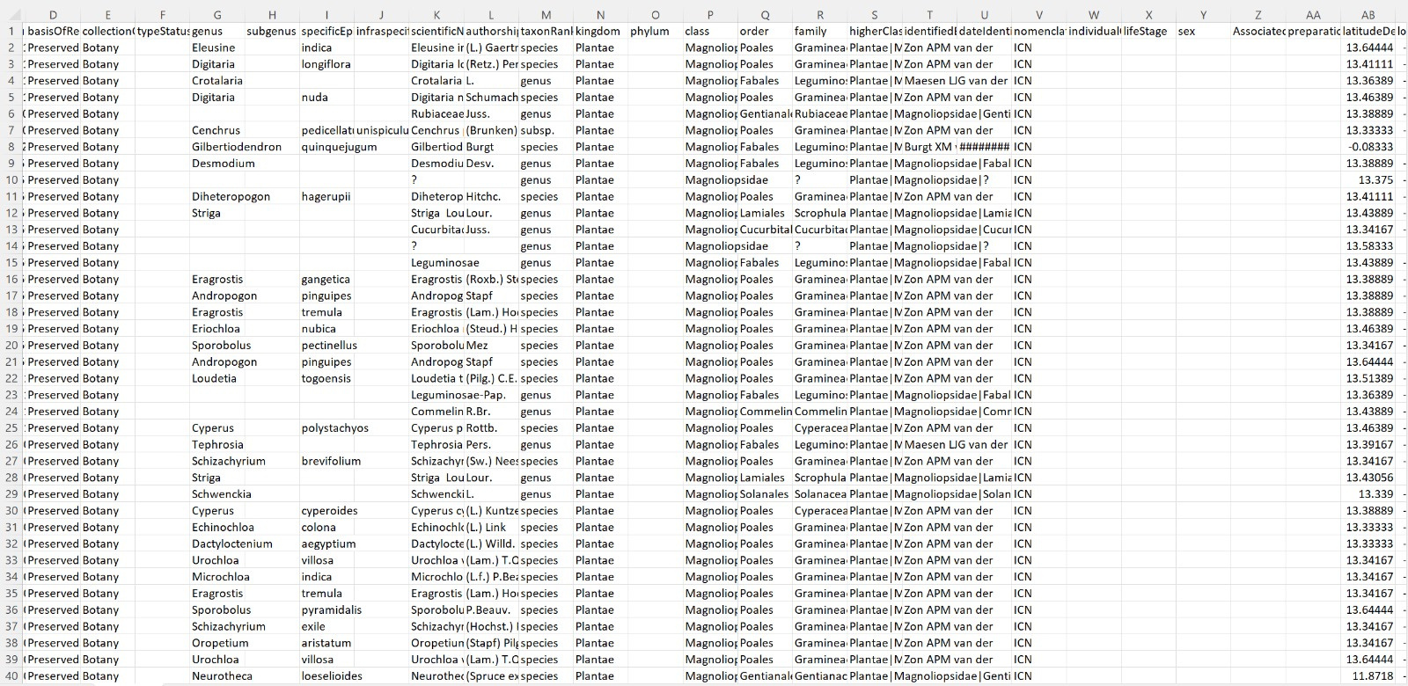
DH BENELUX - LEUVEN 2024
Dataset
Naturalis Biodiversity Center (NL) - Botany
  Created by Amsterdam University, Leiden University, Wageningen University and Research Centre (National Herbarium Nederland) and the Dutch National Natural History Museum Naturalis in Leiden
  5 million entries
  From 1550 - 2023

Slide 4

DH BENELUX - LEUVEN 2024
Visualizing Data in Microsoft Power BI
01/01/2001-31/01/2001
01.
02.
Splitting the eventDate row (date of registration of the specimen) into two to create a timeline
Loading dataset into Power BI as an Excel sheet
01/01/2001 | 31/01/2001
03.
04.
Choosing appropiate filters for our data:
Recorded by, Family, Continent and Type of Status
Choosing appropiate visualisations for our data:
World map, pie chart and timeline

Slide 5
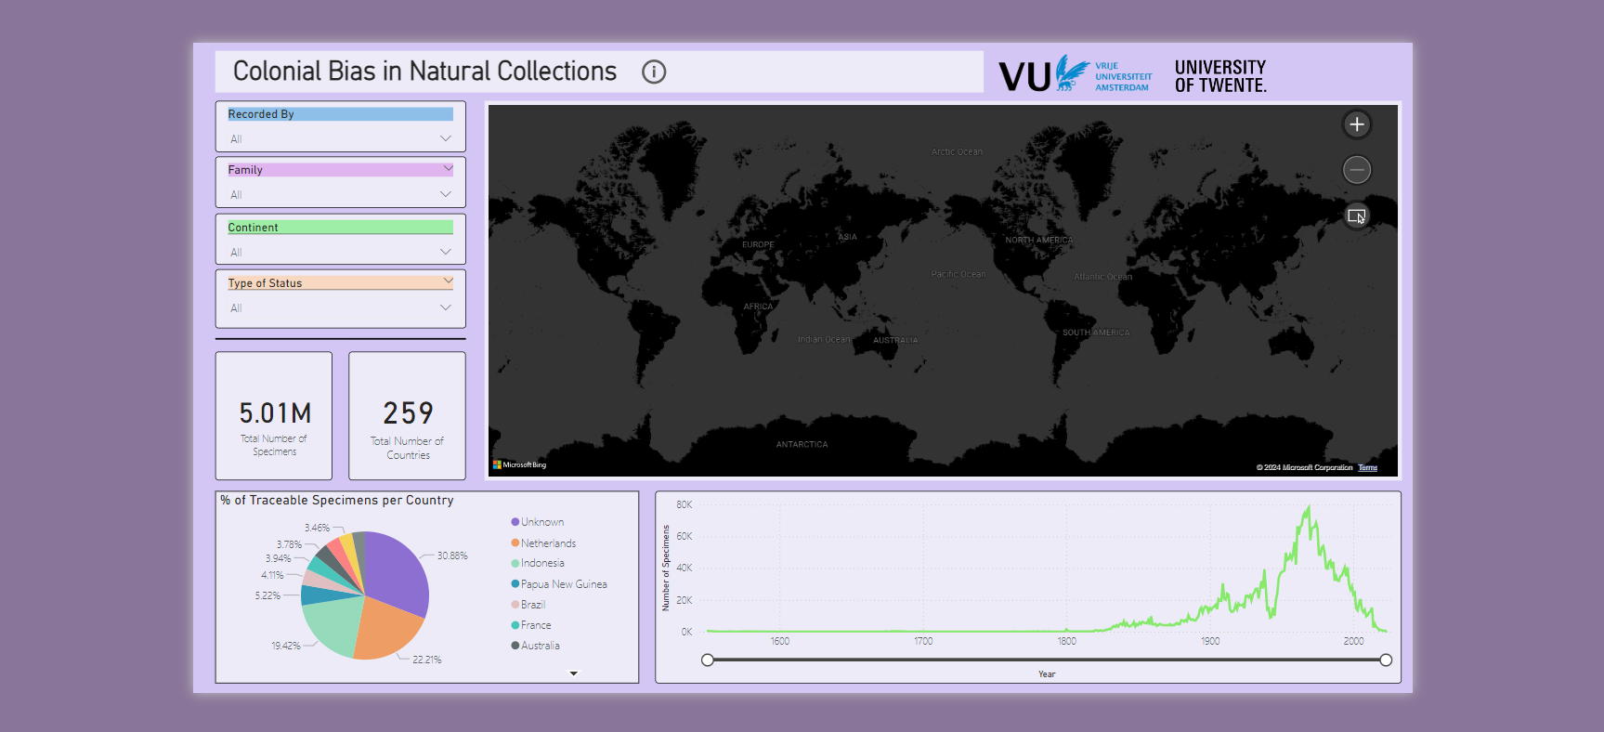
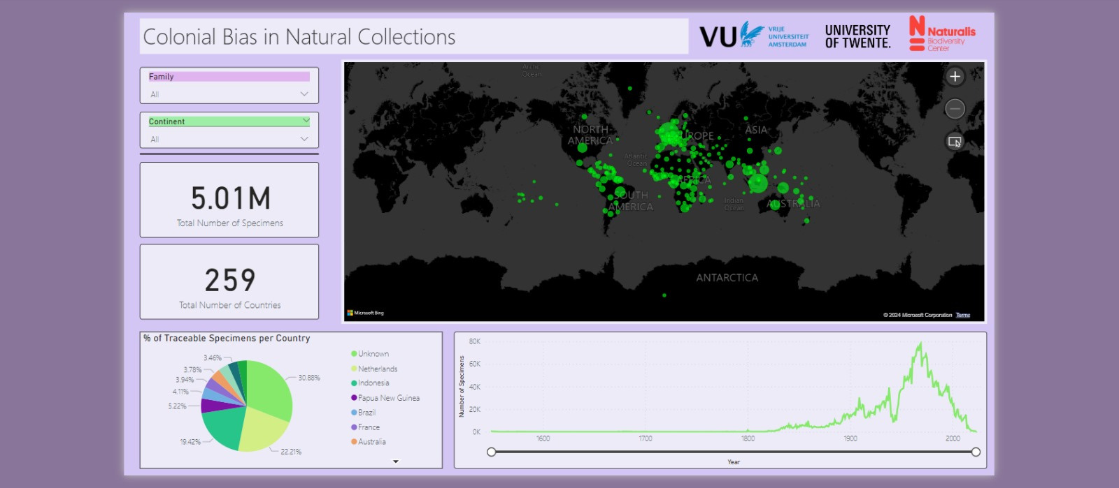

Slide 6
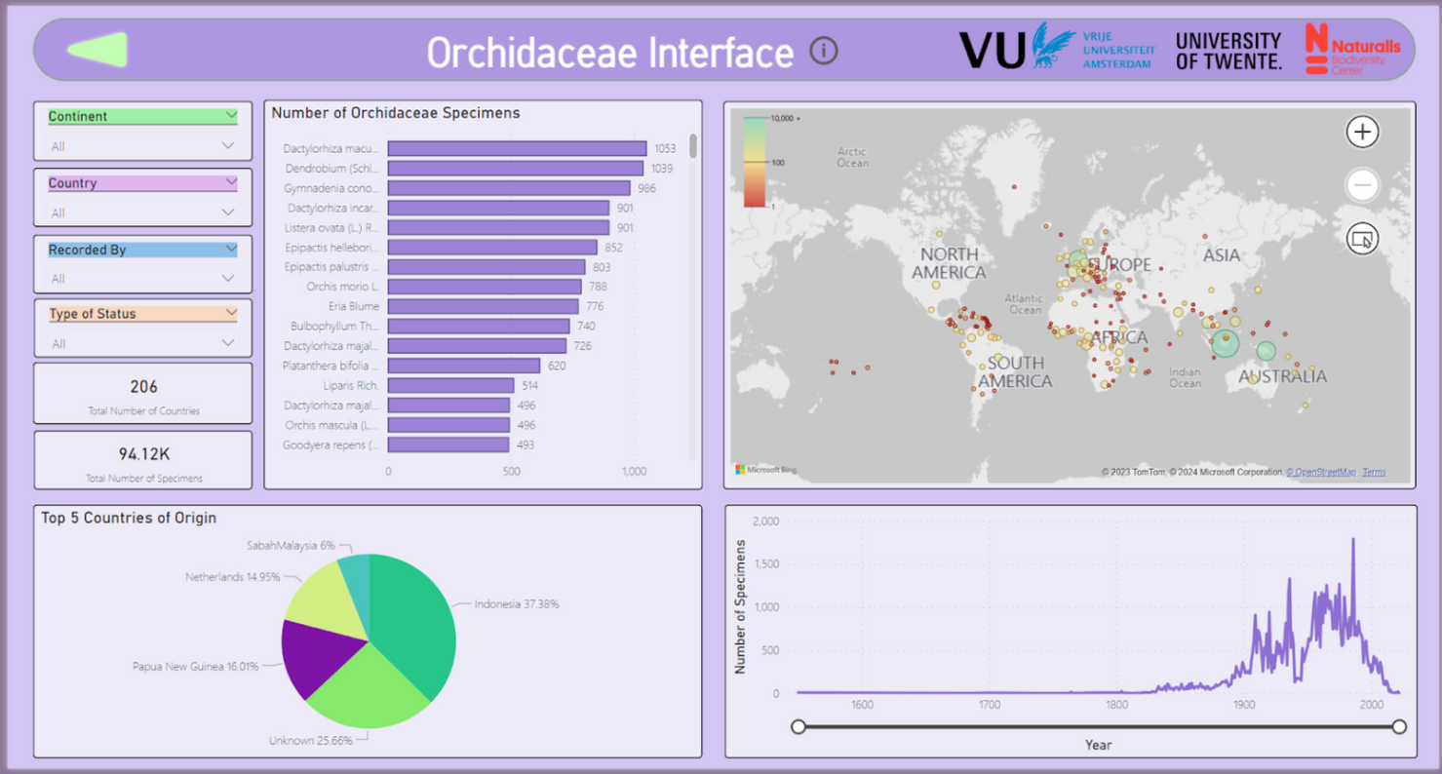
DH BENELUX - LEUVEN 2024
Results
Interactivity, accessibility, potential
  Unknown cases: starting point
  Interactivity: makes data accessible
    Reveals cultural histories and socio-political contexts
  User-friendly tool

Slide 7
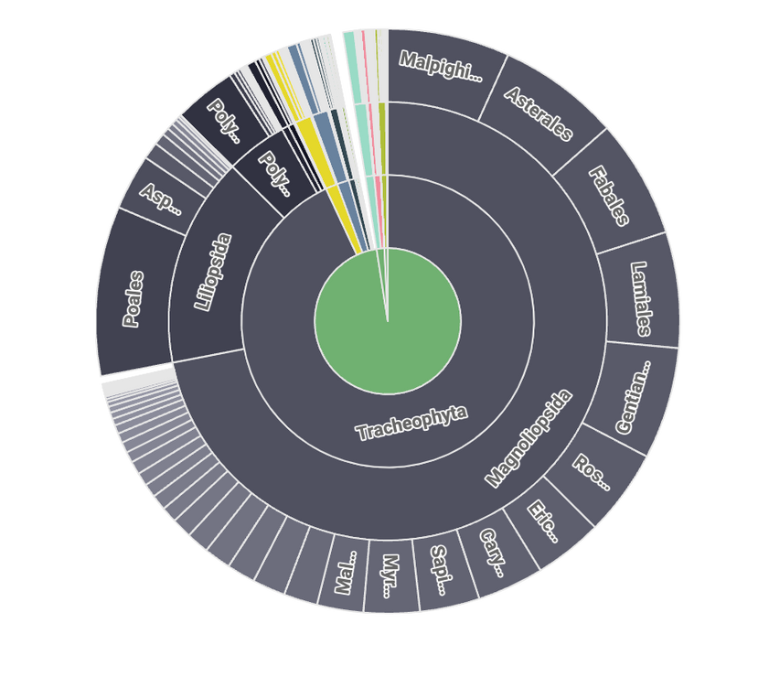

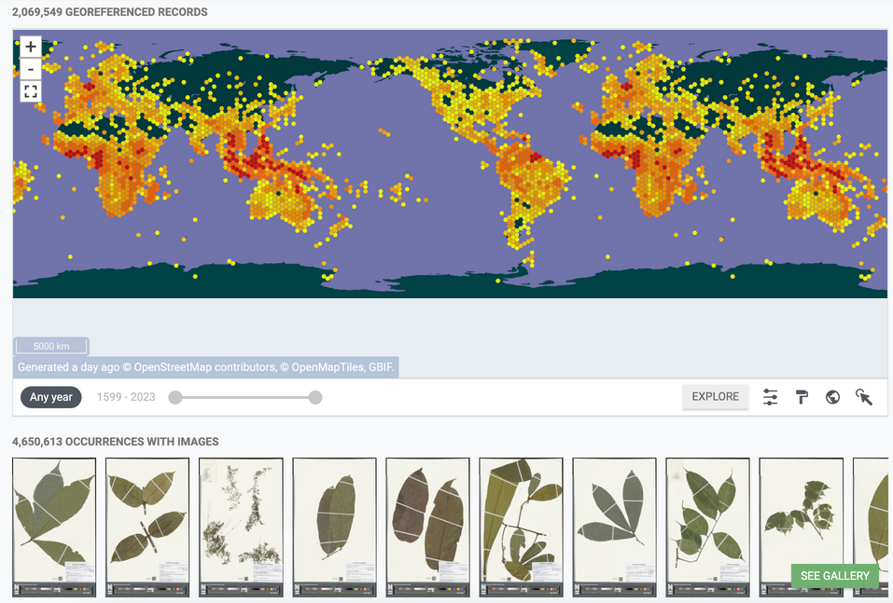
DH BENELUX - LEUVEN 2024
Taxonomic Distribution of Occurrences from the Naturalis Dataset
Applicability & Scope
  Provides a starting point for tracing the histories of any museum collection
  Scope can be extended to address other contemporary relevant questions
Future Work
  Broader range of specimens not limited to herbaria
  Data pre-processing for PowerBi may limit accessibility
  Other types of visualizations with other programs
*access to video

Slide 8


