Slide 1
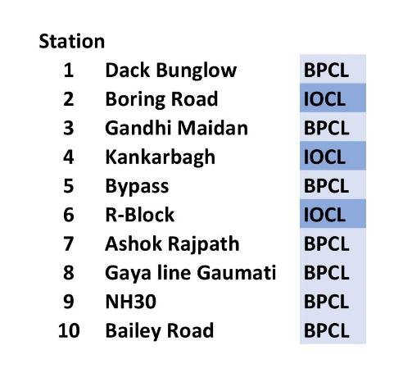
FUEL STATIONS
# stations
10
IOCL = Indian Oil
BPCL = Bharat Petroleum

Slide 2
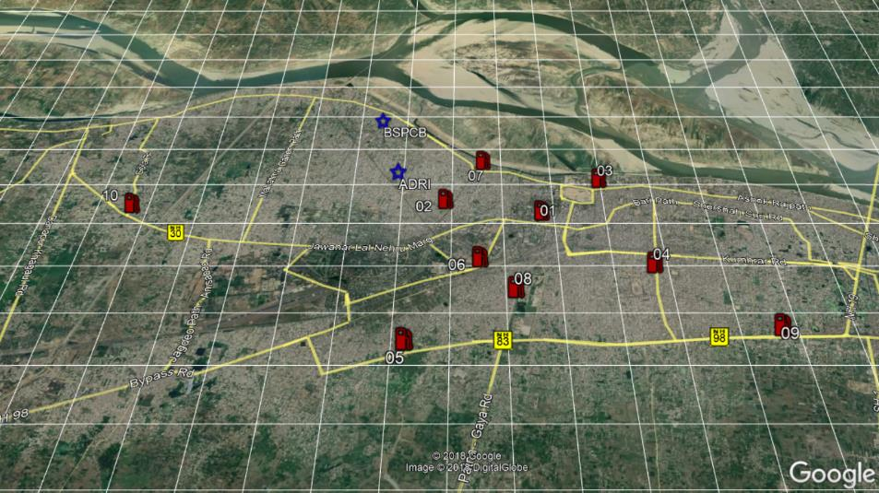
FUEL STATIONS

Slide 3
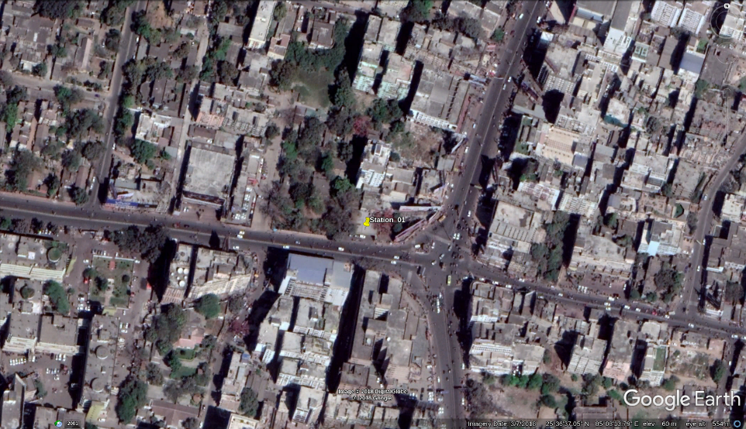
Station 01: Dack Bunglow - BPCL

Slide 4
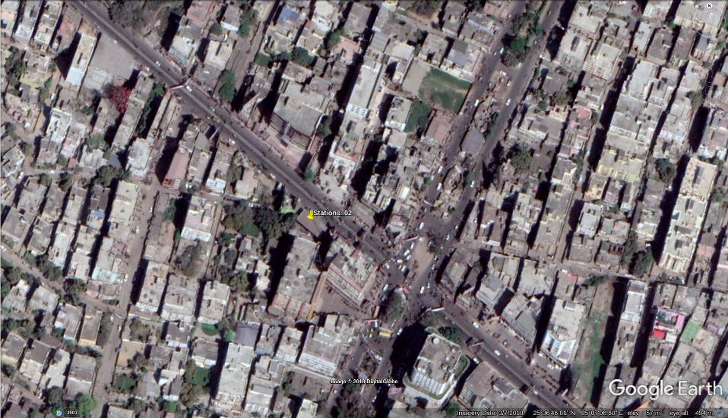
Station 02: Boring Road - IOCL

Slide 5
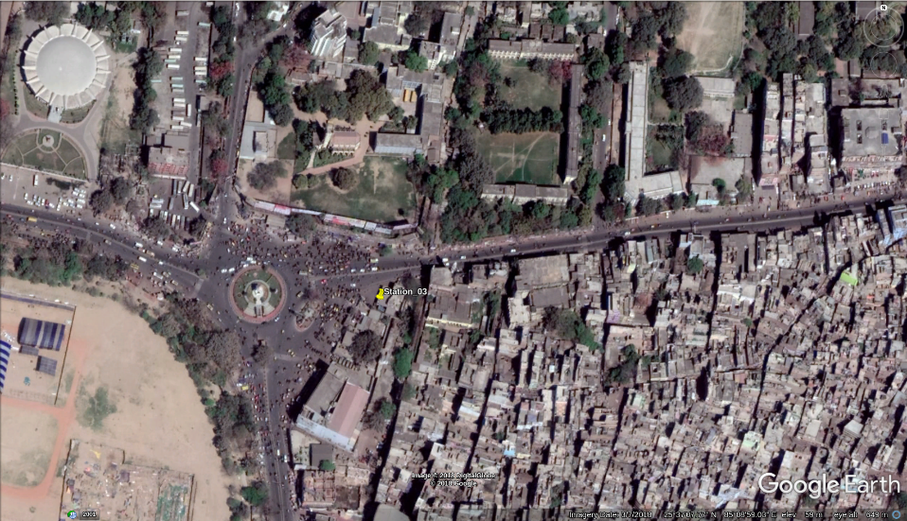
Station 03: Gandhi Maidan - BPCL

Slide 6
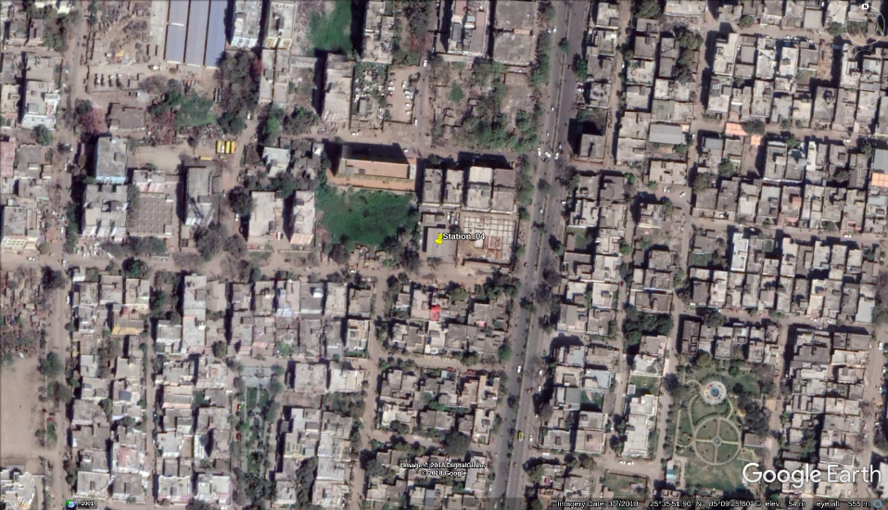
Station 04: Kankarbagh - IOCL

Slide 7
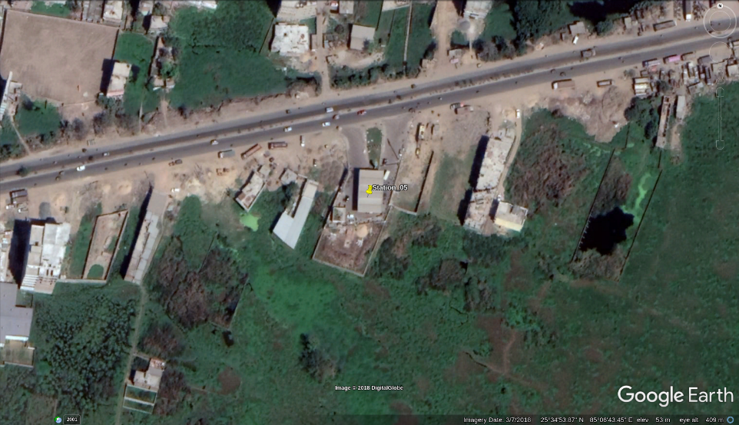
Station 05: Bypass - BPCL

Slide 8
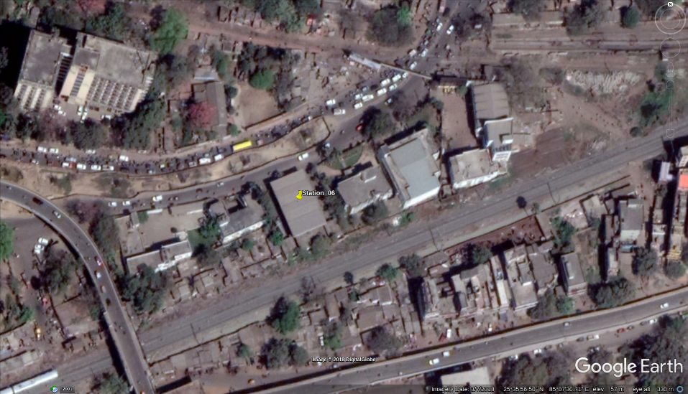
Station 06: R-Block - IOCL

Slide 9
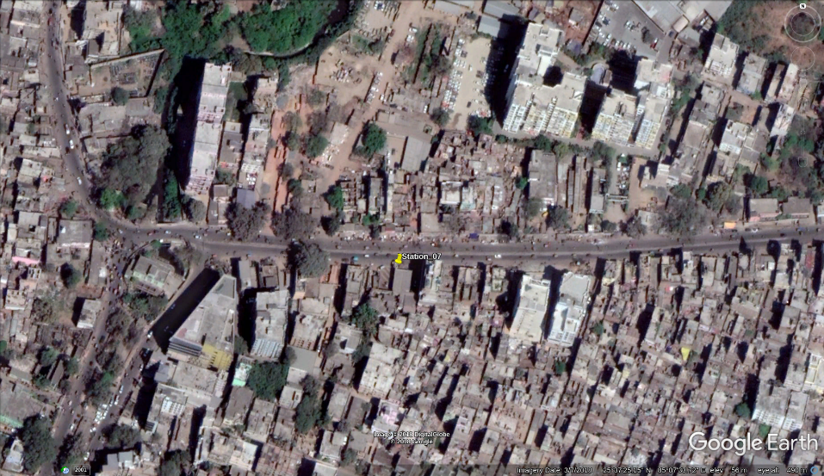
Station 07: Ashok Rajpath - BPCL

Slide 10
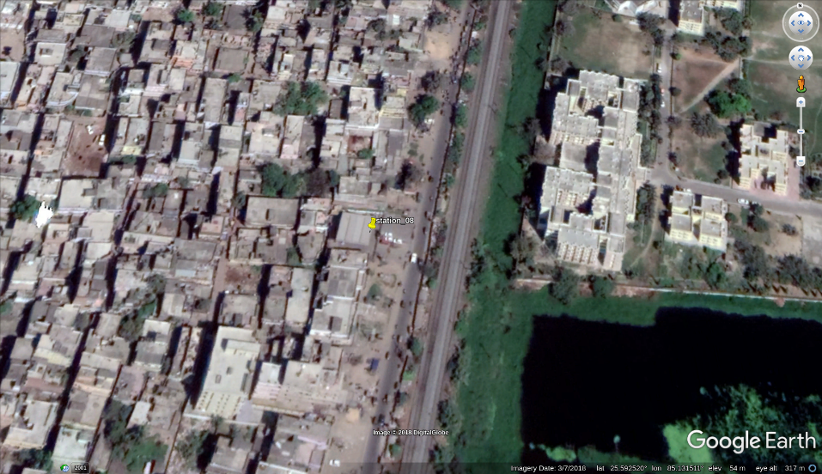
Station 08: GayaRd Gaumati - BPCL

Slide 11
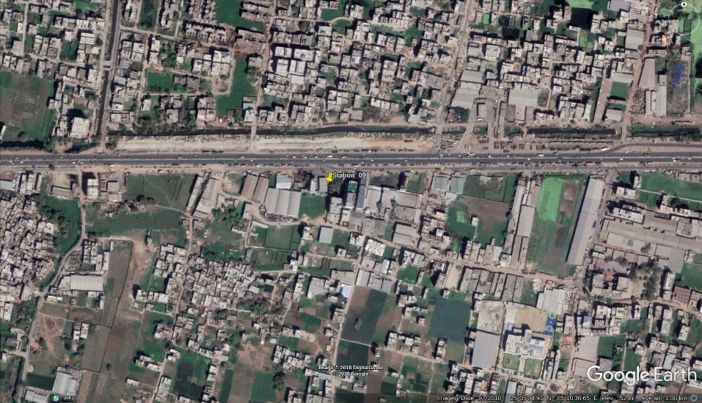
Station 09: NH30 - BPCL

Slide 12
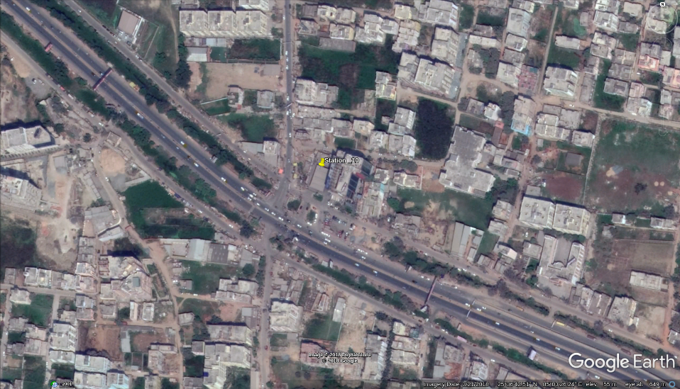
Station 10: Bailey Road - BPCL

