Slide 1
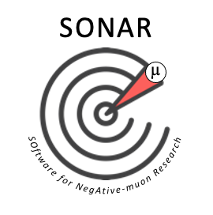
SONAR 1: First Workshop on SOftware for NegAtive-muon Research
Monday 15 Apr 2024, 10:00 - 16:00 Europe/London
Virtual Workshop
Adrian Hillier (Muon Group, ISIS, STFC, UKRI, UK), Ben Ohayon (Faculty of Physics, Technion IIT, Israel), Leandro Liborio (Scientific Computing Department, STFC, UKRI, UK)
Please register at https://indico.stfc.ac.uk/e/SONAR1

Slide 2






MuDirac and Its Software Philosophy
Leandro Liborio¹
¹Theoretical and Computational Physics Group, SCD, STFC
SONAR 1: First Workshop on SOftware for NegAtive-muon Research, April 15th 2024, Virtual Edition

Slide 3
Summary
Why MuDirac?: Muonic X-ray Codes and Databases for Non-destructive Elemental Analysis
Stages of a Muonic X-ray (µXES) Experiment
Muonic Cascade: Adapting Dirac’s Equation
Muonic Cascade: Modelling of X-Ray Energies
MuDirac: Its Software Philosophy
MuDirac in Galaxy
Example: Muonic Atom Lines
Example: Muonic Spectra
MuDirac 2.0
Conclusions

Slide 4
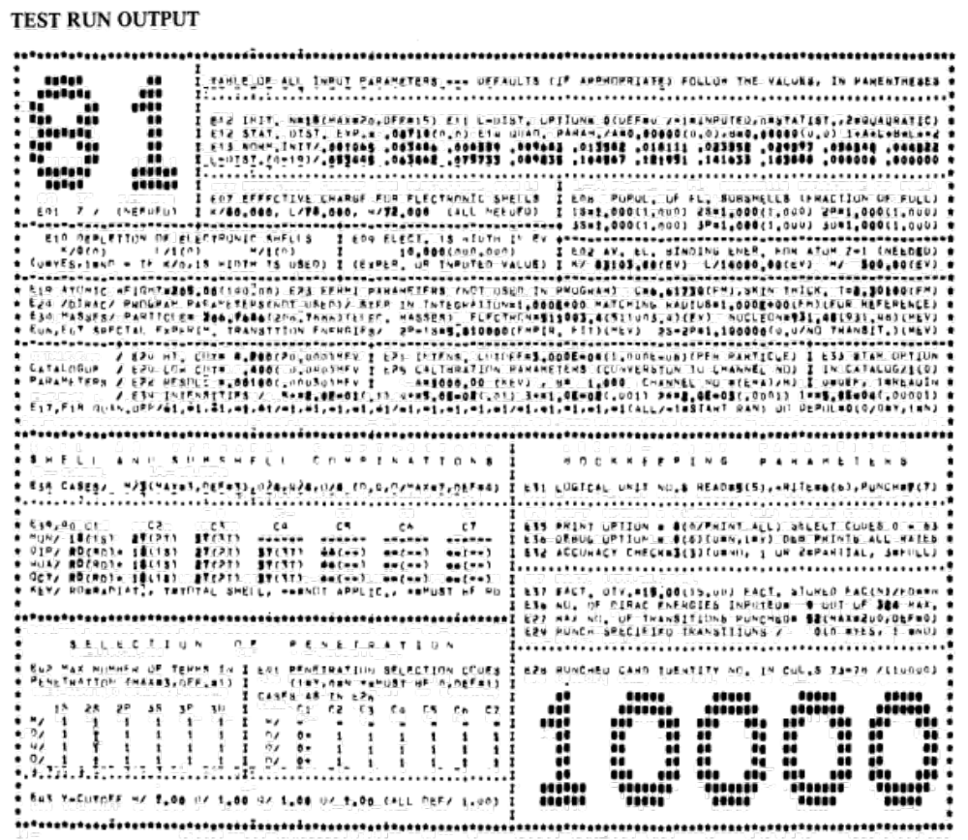
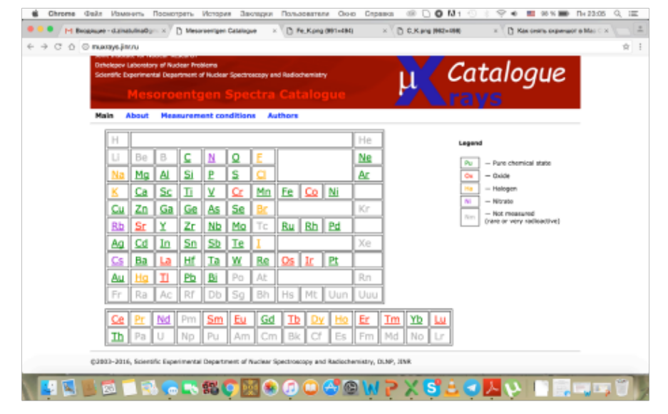
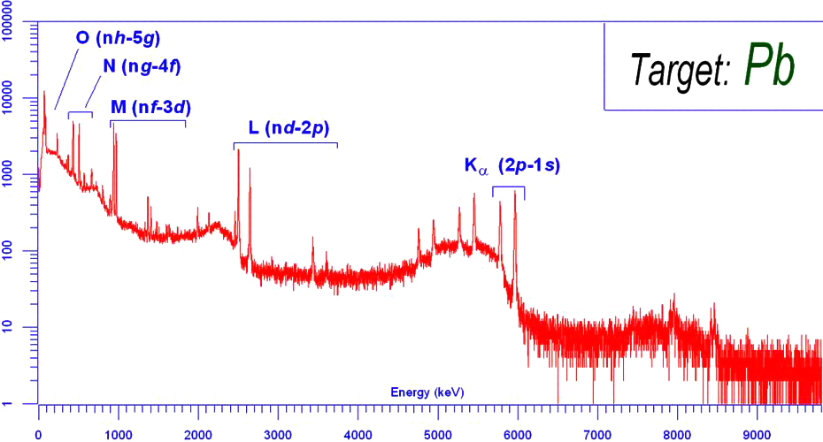
Why MuDirac?: Muonic X-ray Codes and Databases for Non-destructive Elemental Analysis
Muonic Atom Cascade (70’s code)
Mu X-Ray Catalogue (Russia-PSI-MUSIC)
Focused on reliable identification of background lines and correct choice of targets and construction materials
The muonic x-ray lines of elements contained in things such as: target chemical compound, target package material, equipment materials and air (nitrogen, oxygen, carbon).
Not FAIR (Findable, Accessible, Interoperable and Reusable)

Slide 5
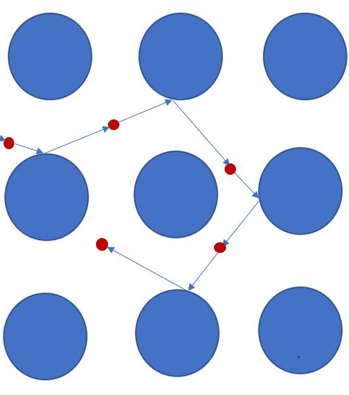
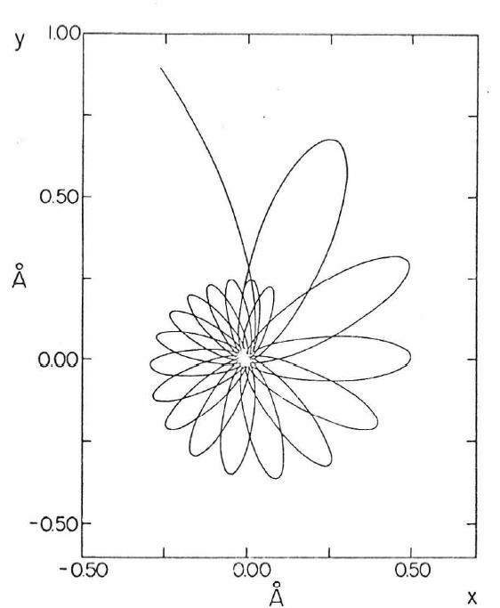
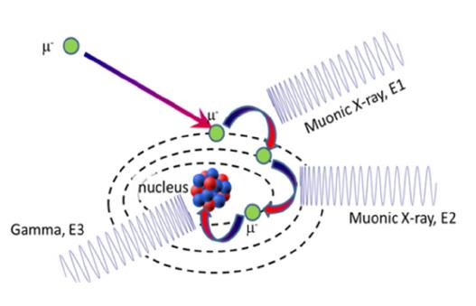
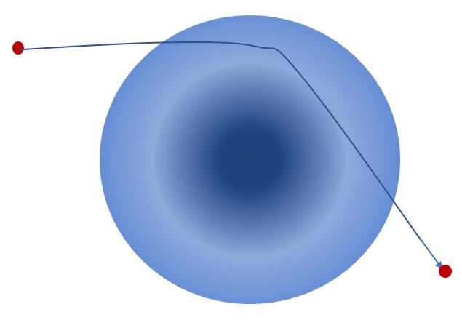
Stages of a µXES Experiment
High Energy
Slow Down
Low Energy
Slow Down
Atomic
Capture
Muonic
Cascade
Nuclear
Capture
E(µ-)~E(e)
E(µ-)~ 2keV
Frictional electronic force on µ-
Elastic Collisions
Penetration depth defined
Muon capture rate prop. Z
Initial muon population on initial energy level: l-distribution
Intensities depend on l-distribution
MuDirac 2.0 will address this
Transition between muonic states
Emission of muonic x-rays
THIS IS WHAT WE MODEL NOW
Nuclei absorbs µ-
Nuclei may transmute into different element
Nuclei emits gamma rays

Slide 6
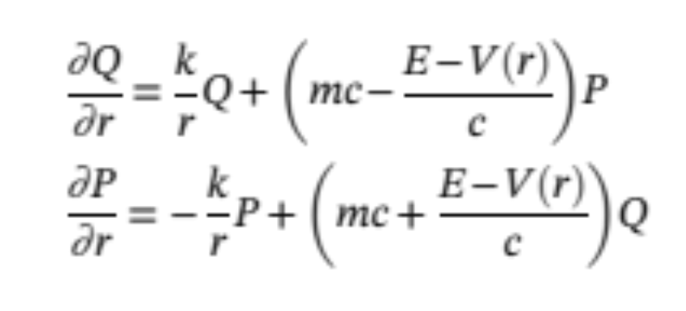
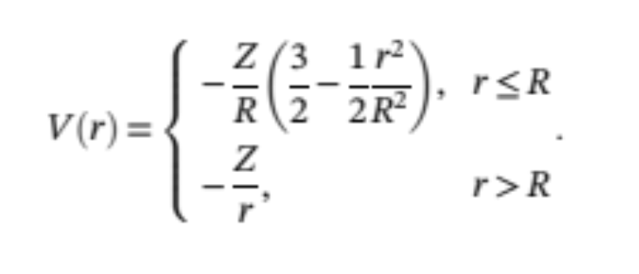
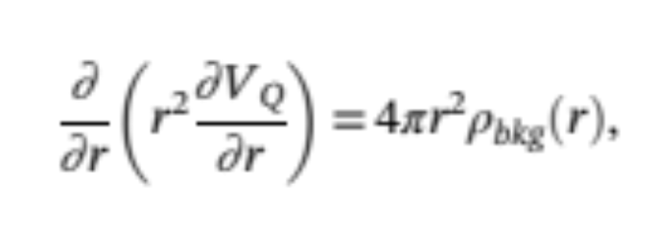
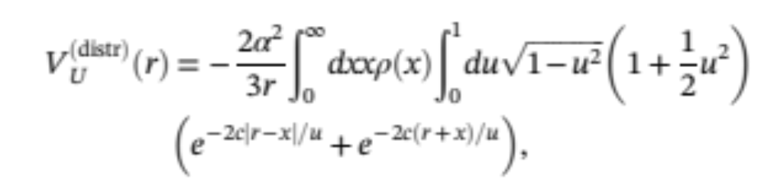
Muonic Cascade: Adapting Dirac’s Equation
Dirac Eq. for Radial V(r)
Uniformly Charged Sphere radius R
Smooth cutoff: Fermi Distribution
R_{F}
R
𝛿_{F}
NOT Potential of a Point Charge
Correct Potential for Vacuum Polarizability
Electronic Background Correction
Overlap high E muonic orbital and low E electronic orbitals
Tauscher method
Uehling Potential

Slide 7
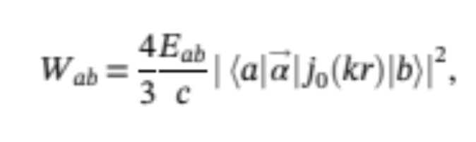
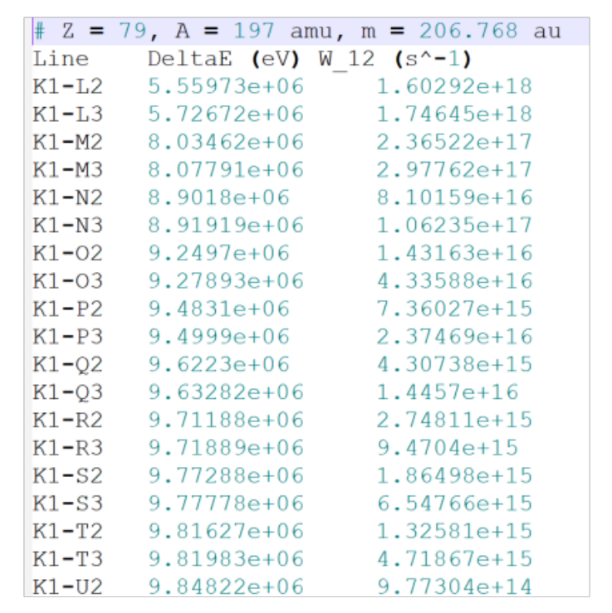
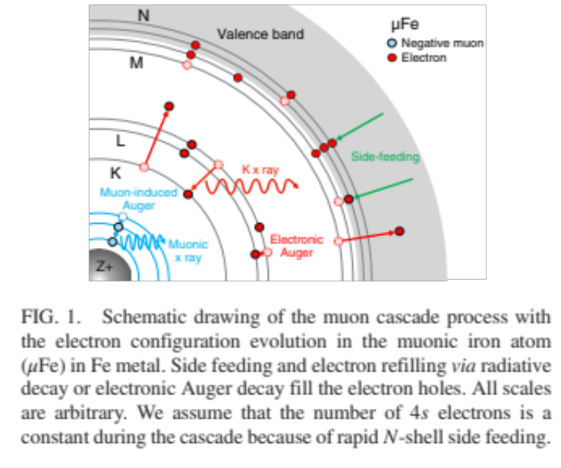
Muonic Cascade: Modelling of X-Ray Energies
Dirac Eq. for Radial V(r)
X-ray Energies and
Transition Probabilities between states a and b
Radial Dirac Equation
Solve Coulomb Potential
Correct Coulomb Potential
Correct for Electronic Background
NOT Potential of a Point Charge
PRL, 127, 053001 (2021)
Muonic Gold Isotope

Slide 8



MuDirac: Its Software Philosophy
MuDirac is part of the Muon Spectroscopy Computational Project (MSCP). MuDirac is maintained as part of the MSCP. https://muon-spectroscopy-computational-project.github.io/software.html
MuDirac is open-source software and has been released publicly under the MIT License.
MuDirac has been written to comply with the C++ 11 ISO standard.
GitHub repository: https://github.com/muon-spectroscopy-computational-project/mudirac
Online reference manual with description of keywords and instructions for developers: https://muon-spectroscopy-computational-project.github.io/mudirac/index.html
Command line running of MuDirac: mudirac input.in
Working on including MuDirac into the Materials Galaxy online platform:
    https://materialsgalaxy.stfc.ac.uk/
LIBORIO
AUSTIN
DEVADASAN

Slide 9
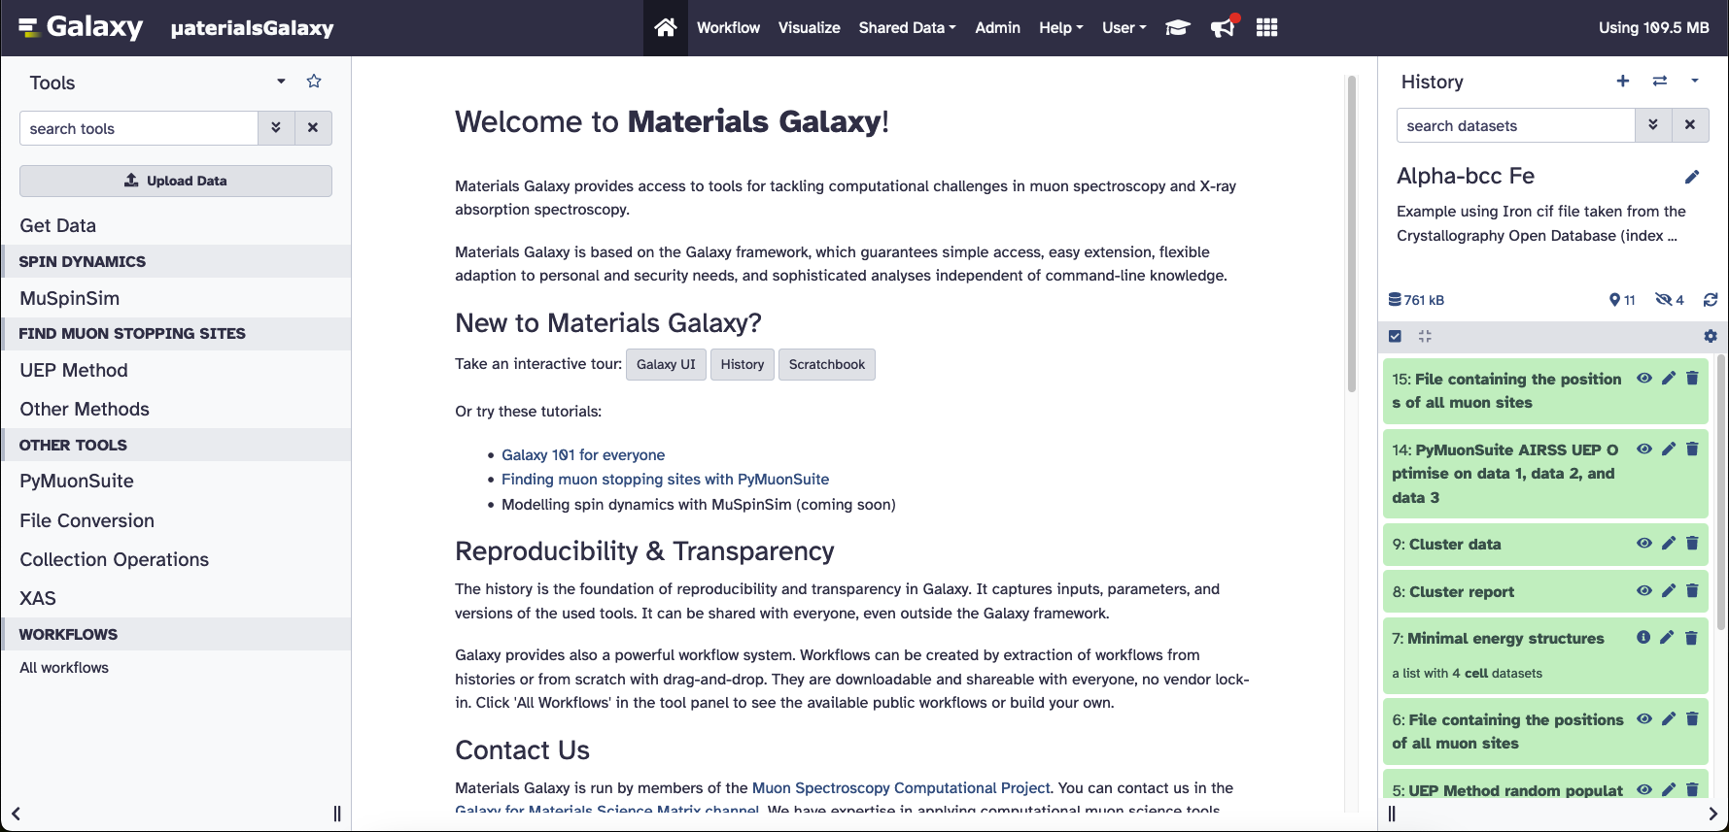
MuDirac in the:
https://materialsgalaxy.stfc.ac.uk/

Slide 10
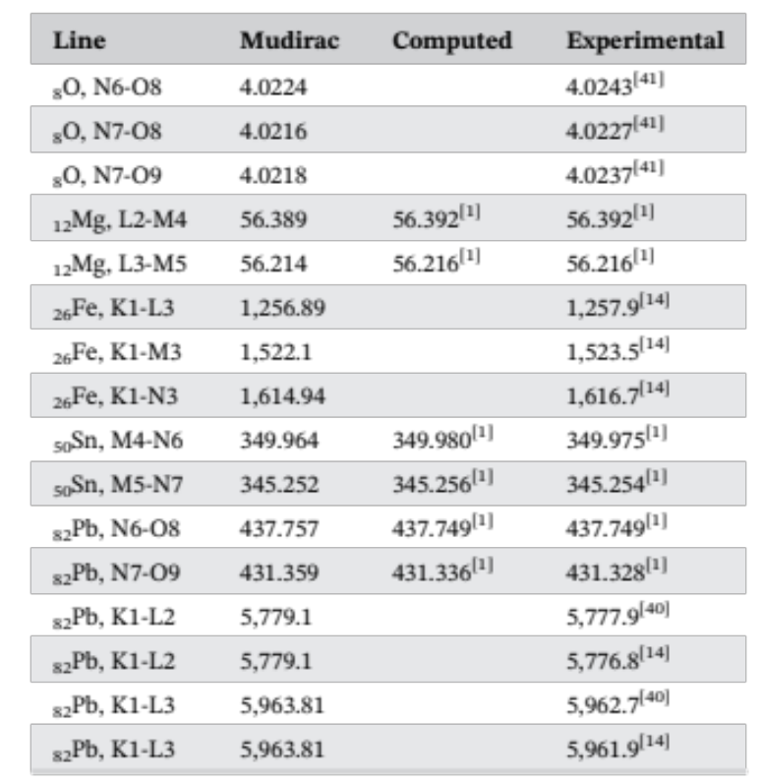
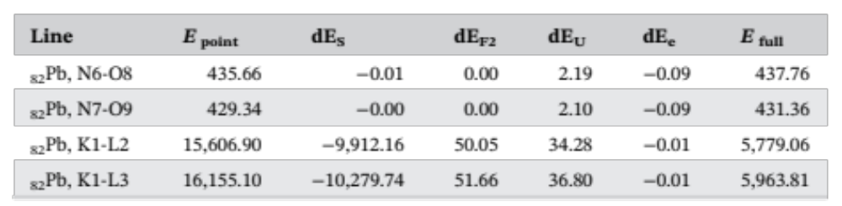
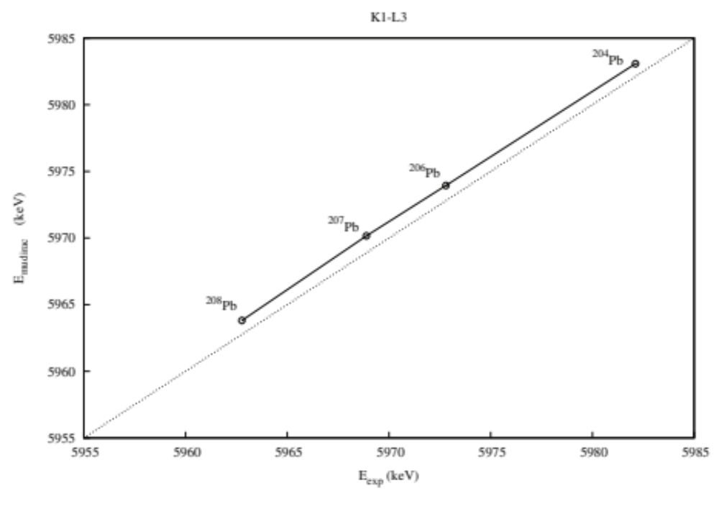
Example: Muonic Atom Lines
Ideal point-like Coulomb potential energy (Epoint); contribution from uniform charged sphere nucleus (dE_{S}), Fermi 2-term charge distribution correction (dE_{F2}), the Uehling correction (dE_{U}) electronic screening correction (dE_{e}). Final energy, E_{full}.
Experimental versus computed energies for the K1-L2 transition in various isotopes of lead
MuDirac calculations use smooth cutoff Fermi correction for the nucleus, plus an Uehling correction to the potential and an electronic background correction.
S. Sturniolo, A. Hillier, X-Ray Spectrom. 2021;50:180–196.

Slide 11
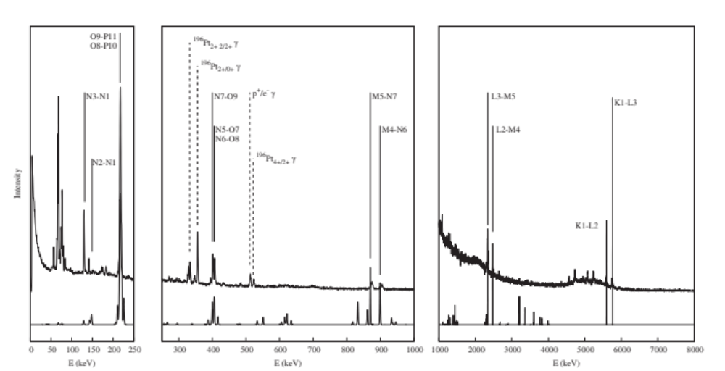
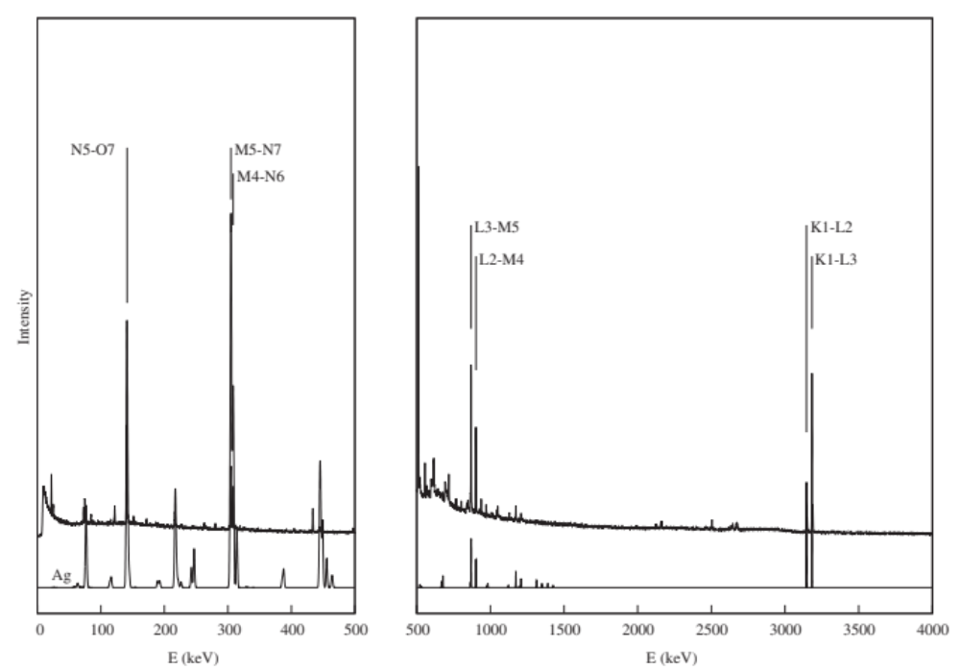
Example: Muonic Spectra
Experimental (top) and computed (bottom) X-ray spectrum for muonic gold
Experimental (top) and computed (bottom)
X-ray spectrum for muonic silver
S. Sturniolo, A. Hillier, X-Ray Spectrom. 2021;50:180–196.

Slide 12
Example: Muonic Spectra
Experimental (top) and computed (bottom) X-ray spectrum for muonic gold
Experimental (top) and computed (bottom)
X-ray spectrum for muonic silver
S. Sturniolo, A. Hillier, X-Ray Spectrom. 2021;50:180–196.

Slide 13
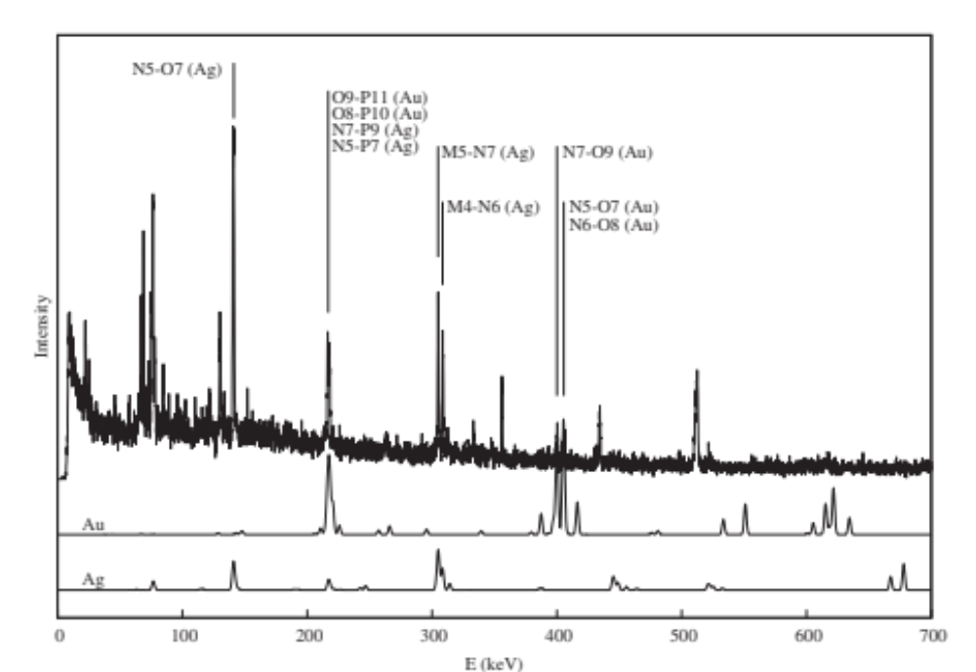
Example: Muonic Spectra
Experimental (top) and computed
(bottom) X-ray spectrum for
muonic gold
Experimental (top) and computed
(bottom) X-ray spectrum for
muonic silver
Experimental (top) X-ray spectrum for muons in a 30–70 Au–Ag alloy. Below are the computed spectra for muonic gold (middle) and silver (bottom)
S. Sturniolo, A. Hillier, X-Ray Spectrom. 2021;50:180–196.

Slide 14
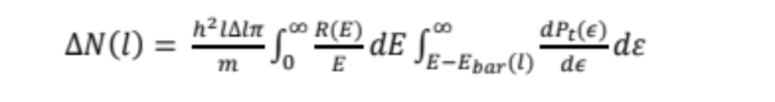





MuDirac 2.0
Intensities are important for elemental analysis
Intensities depend on muon population of initial level: l-distribution
Try some functional forms of l-distribution (∆N(l))
Need to study Integro-differential systems of equations to find (∆N(l))
PhD project started to develop MuDirac 2.0
Potential applications of MuDirac in new scientific areas?
Atomic
Capture
Muon capture rate prop. Z
Initial muon population on initial energy level: l-distribution
Intensities depend on l-distribution
MuDirac 2.0 will address this
Muon Group – ISIS - STFC
University of Warwick
Scientific Computing Department - STFC
HILLIER
JONES
BARTOK-PARTAY
HINE
LIBORIO
PLUMMER

Slide 15
Conclusions and Future Work
  MuDirac is a sustainable, open-source code that solves the radial Dirac equation for muonic atoms
  MuDirac can compute energies and transition rates for all the main X-ray spectral lines for muonic atoms across the periodic table, accounting for effects such as the finite size of the atomic nuclei and the Uehling correction
  The sustainable design of MuDirac can easily accommodate the addition of new corrections and extensions to improve its accuracy
  MuDirac is useful for the interpretation of muonic X-Ray experiments for elemental analysis
  MuDirac can account for isotopic effects to the muonic X-Rays
  Working on MuDirac 2.0, which will focus on an accurate estimation of the X-Rays intensities
  Working on adding MuDirac to Materials Galaxy

