Slide 1

Open Science + Accessibility = A Winning Formula
Kim Ferguson
Research Data Management Specialist @ DANS-KNAW
SURF Research Day 2024 – May 30th, 2024 - Amersfoort
10.5281/zenodo.11392951

Slide 2
Some questions to consider for today…
Accessibility – what is it (and in what context)?
What legal frameworks exist?
Why make things more accessible?
How to make things more accessible?
Where do we go from here?
https://doi.org/10.5281/zenodo.11392951

Slide 3

Accessibility & FAIR
Here, Accessible essentially means that: (1) (meta)data is retrievable through a standardized protocol, and (2) metadata is always available to be retrieved
FAIR image: Sangya Pundir, CC by 4.0

Slide 4

Accessibility & Open Science
From Open Access NL,
“A publication is defined 'open access' when there are no financial, legal or technical barriers to accessing it - that is to say when anyone can read, download, copy, distribute, print, search for and search within the information, or use it in education or in any other way within the legal agreements.”

Slide 5

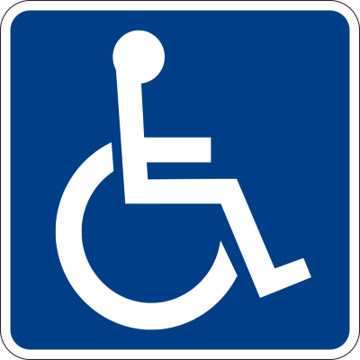
Accessibility & disability
Toegankelijkheid in Dutch
From Accessibility.nl,
“Accessibility is about ensuring that everyone, with or without disabilities, has the opportunity to use all forms of facilities, information and services.
Everyone should be able to participate fully in society.”

Slide 6

Web/digital accessibility
Web accessibility refers to how websites, tools, applications, and technologies are designed and improved so that people with disabilities can use them (W3C)
Web Content Accessibility Guidelines (WCAG) standards
Interventions can range from adding additional metadata or coding to rebuilding entire user-facing interfaces
Devices to support web accessibility can include: screenreaders, magnifiers, screen capture, screen filters, eye tracking software, bluetooth or wired interfaces for external hardware, etc.

Slide 7
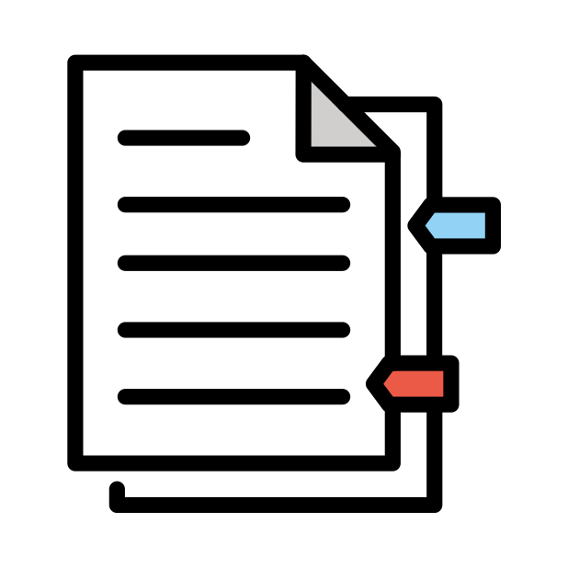
Legal frameworks for accessibility
Worldwide:
Europe/Netherlands
UN Convention for the Rights of Persons with Disability includes accessibility, including:
“Recognizing the importance of accessibility to the physical, social, economic and cultural environment, to health and education and to information and communication, in enabling persons with disabilities to fully enjoy all human rights and fundamental freedoms”
The Netherlands ratified the UN CRPD in 2016
EU:
  Web Accessibility Directive (2016)
  European Accessibility Act (2019)
Netherlands: Aligns with EU legislation, along with legislation on disability

Slide 8
European Accessibility Act
Started its life in 2019 as the ”Directive (EU) 2019/882 on the accessibility requirements for products and services”
→ computers, ATMs, television, smartphones, ticket services, e-commerce, etc.
→ Some particular exceptions for web content generated before the deadline to apply measures
Main aim is to harmonize regulations across the EU in the private sector
→ From June 2022, all EU member states needed to harmonize their legislation (and have)
→ From June 2025, all EU member states must apply measures (exceptions possible)

Slide 9
European Web Accessibility Directive (WAD)
Started its life as “Directive (EU) 2016/2102 on the accessibility of the websites and mobile applications of public sector bodies”
Explicitly aimed at public sector bodies (governments) for websites and applications
Harmonisation deadline was 2020
There is an entire FAQ page dedicated to it for more details: https://web-directive.eu/

Slide 10
What about Dutch (public) websites?
There’s a dashboard for that! https://dashboard.digitoegankelijk.nl/
First, there are five levels:
  A: Completely compliant
  B: Partially compliant
  C: First measures taken
  D: Not sufficient
  E: No explanation
The Dutch government is responsible for 8945 websites.
Question: How do you think are many are level A compliant?

Slide 11
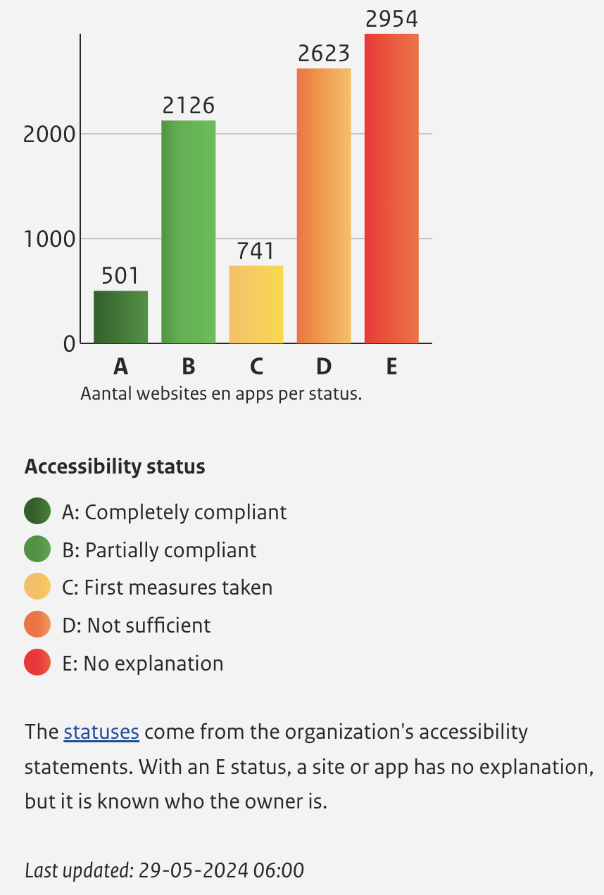
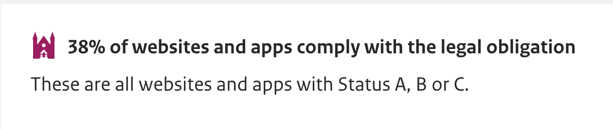
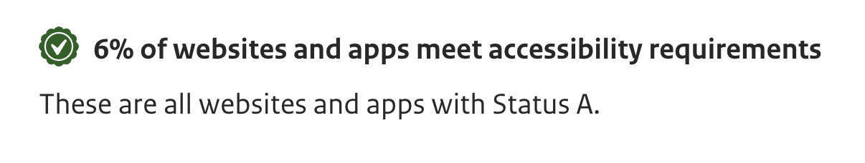
Dutch public websites
Certainly, that’s room for improvement – but you can’t improve what you don’t measure, so this is a good first step!
Source: https://dashboard.digitoegankelijk.nl/

Slide 12
So, why should Open Science be accessible?

Slide 13

If you need reasons:
Legal (already covered)
  Especially web-based platforms or initiatives
Ethical
  Science is for the benefit of all of society
  Funding comes from the taxpayers
  Education and the so-called “leaky pipeline” is unjust
Moral
  Now you know that there’s an issue – do you ignore it?
  Establishing workflows and adhering to standards could benefit you one day
Practical/”business case”
  More diverse perspectives improve scientific output (so researchers and citizens alike)
  Accessibility features help beyond those with disabilities

Slide 14
Okay, but how can Open Science be more accessible?

Slide 15
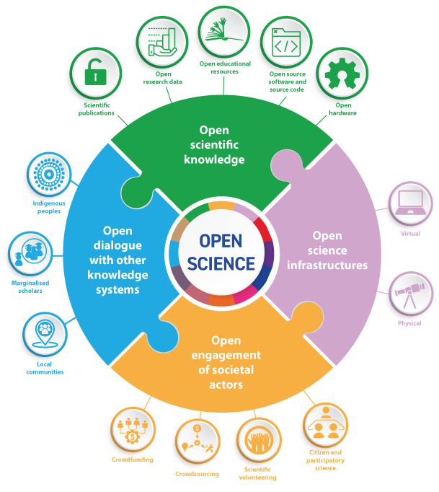
UNESCO Open Science Pillars
Accessibility can be assessed in each of these elements – some more explicit than others
UNESCO

Slide 16
The Research Data Life Cycle
PLAN FOR DATA
COLLECT DATA
ANALYSE & PROCESS DATA
PUBLISH & SHARE DATA
PRESERVE DATA
RE-USE DATA
UK Data Service

Slide 17

Plan for Data: Citizen Science & Co-Creation
Question: Who is involved in a citizen science or co-creation initiative?
Is accessibility mentioned in the project planning for the entire process?
    Example: MuseIT
    Music co-creation
    Haptic feedback
    Experiencing CH in VR

Slide 18
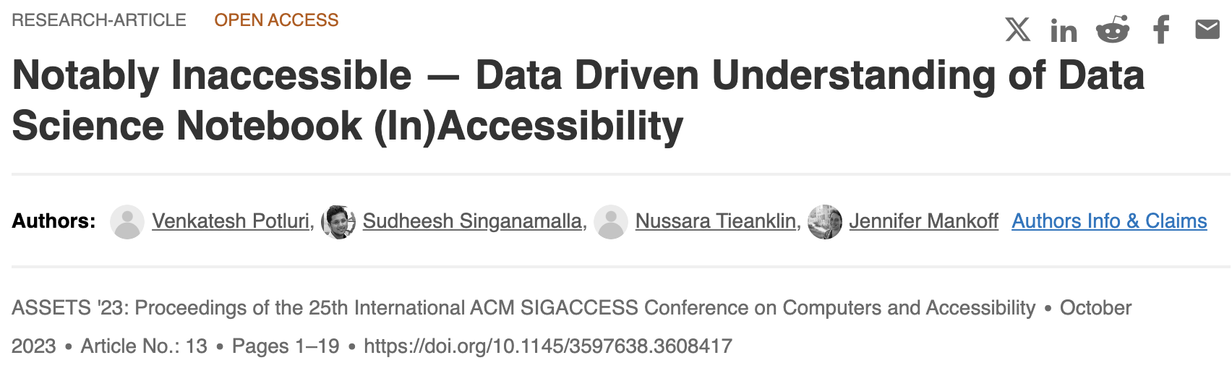
Analysing & Processing Data: eNotebooks
Question: In your work, do you use Jupyter notebooks?
Potential partial solution: matplotalt, a small python package

Slide 19
Publish & Share Data: Accessible Articles
Question: Are your journal articles accessible once they go to the publisher? Even your Open Access ones, are they truly accessible?
Example: Accessibility Commitment from Taylor & Francis
How to find out about other publishers?
Look for Accessibility Statement on publisher website
Email the author contact about how they will be meeting accessibility requirements

Slide 20


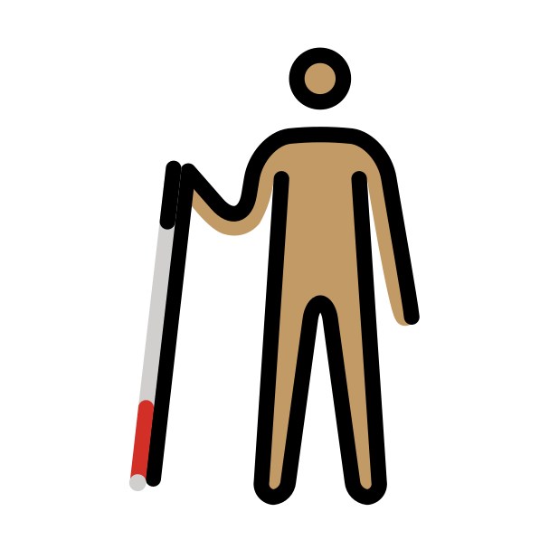

Other aspects to consider:
Creation of dissemination, communication, promotional, or educational content
  Accessible PDFs, Powerpoint slide decks, captions on videos, colour palette, image descriptions, transcripts, etc.
Networking and community events
  Accessible venues, options for access, communication of expectations
Hiring and mentoring practices
  Ensuring a safe, secure, and accessible work environment
Funders → requirements & guidance from the proposal stage
Recognising and compensating the experience of disabled scholars and citizens

Slide 21
Where do we go from here?

Slide 22





Things to consider…
Open Science
Accessibility
Group & Individual Effort
Funding
Awareness
Time
https://doi.org/10.5281/zenodo.11392951

Slide 23
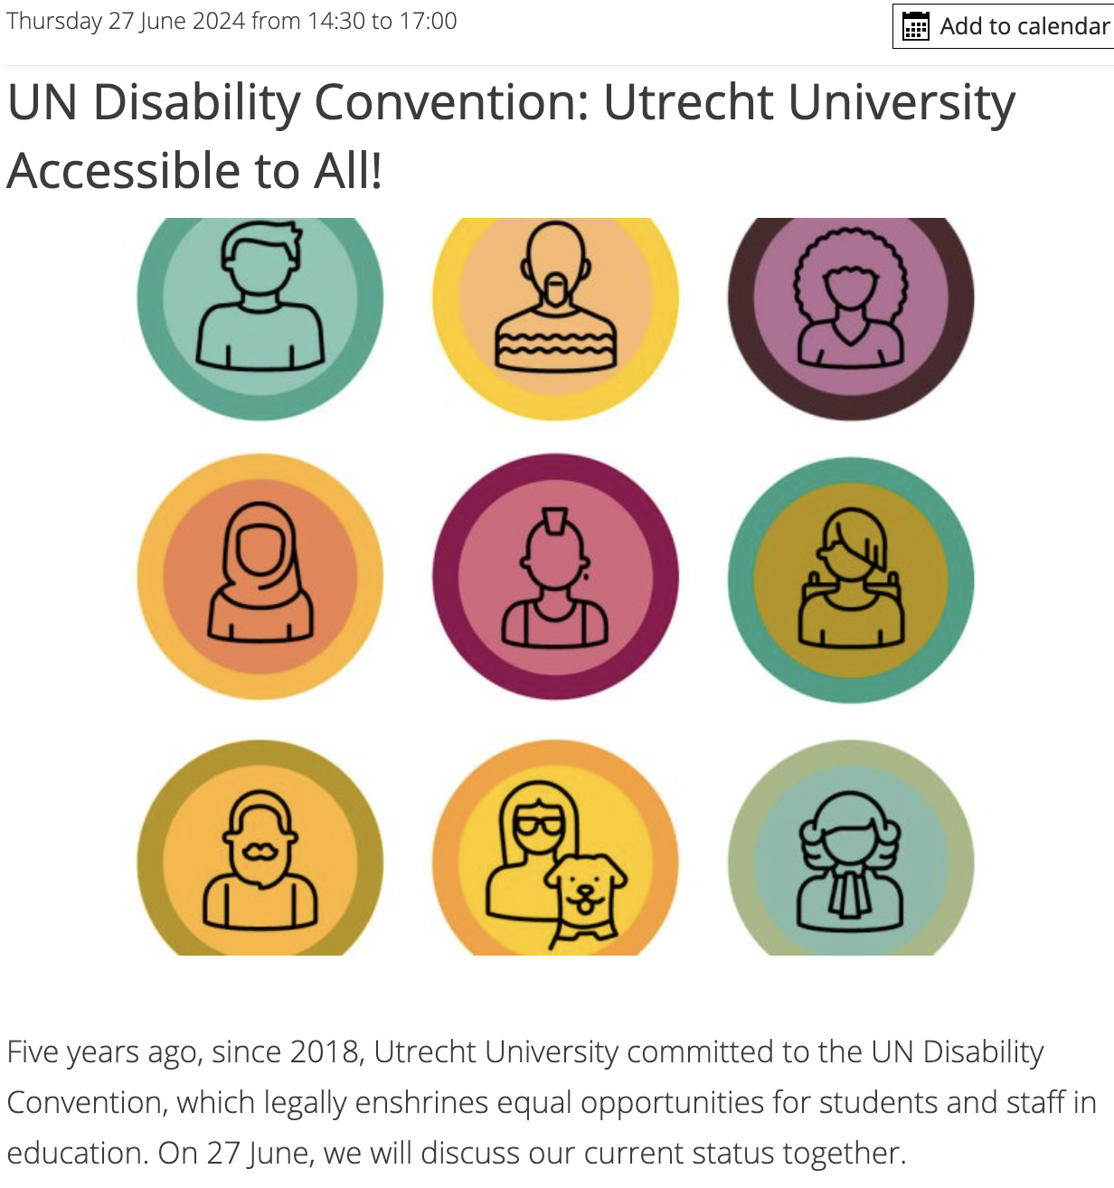

Final notes
https://doi.org/10.5281/zenodo.11392951

Slide 24
Resources & References

Slide 25
Diving into accessibility: starting resources
European Council (2024) Disability in the EU: facts and figures, Consilium EU. Available at: https://www.consilium.europa.eu/en/infographics/disability-eu-facts-figures/ (Accessed: 25 May 2024).
  Facts and figures on disability within the EU
Ferguson, K.B. (2022) ‘Using an accessibility checker to increase the accessibility of your work’, 28 March. Available at: https://doi.org/10.5281/zenodo.6391146.
  Presentation on the use of Microsoft’s Accessibility Checker found in the MS Office Suite
Göransson, D. (2017) Alt-texts: The Ultimate Guide, Axess Lab. Available at: https://axesslab.com/alt-texts/ (Accessed: 25 May 2024).
  Walkthrough guide on drafting alt-text from someone who relies on them
EU’s Web Accessibility Directive: FAQ’s https://web-directive.eu/ (Accessed: 25 May 2024).
  A readable FAQ on the WAD including references to additional resources (very important for those in EU projects!)
WAVE® Web Accessibility tools: https://wave.webaim.org/ (Accessed: 25 May 2024).
  Recommend installing the browser extension, otherwise can use the web version to investigate web sites and generate reports (the tools also explain why these elements are important to consider)
Collection of potential useful tools/articles (curated by me, not the be-all end-all of lists but a place to start!): https://www.are.na/kim-ferguson/accessibility-101-tackling-ableism

Slide 26
Resources for web designers/software engineers
W3C Web Accessibility Initiative, Courses on Accessibility: https://www.w3.org/WAI/courses/foundations-course/
  Free course with option of certificate, as well as list of other courses
EMBL-EBI (2023) Improving the accessibility of the EMBL-EBI website: background, process, and lessons. Available at: https://www.ebi.ac.uk/training/events/web-accessibility (Accessed: 21 June 2023).
  A good primer for those who are able to improve website for organisations or databases, including using the WAVE Web Accessibility assessment tool.
WAVE® Web Accessibility tools: https://wave.webaim.org/
  Recommend installing the browser extension, otherwise can use the web version to investigate web sites and generate reports (the tools also explain why these elements are important to consider)
Kristen Shinohara, Nayeri Jacobo, Wanda Pratt, and Jacob O. Wobbrock. 2019. Design for Social Accessibility Method Cards: Engaging Users and Reflecting on Social Scenarios for Accessible Design. ACM Trans. Access. Comput. 12, 4, Article 17 (December 2019), 33 pages. https://doi.org/10.1145/3369903
  Also contains examples of working with users with lived experience

Slide 27
Resources for trainers/librarians/educators and event organisers
Ferguson, K. et al. (2023) Incorporating accessibility into training on EOSC, OpenPlato. Available at: https://openplato.eu/blocks/catalog/detail.php?id=55 (Accessed: 25 May 2024).
  While from a course for the EOSC Portal, the takeaways are applicable beyond the EOSC, as well as a wider consideration of accessibility (includes language and internet access)
Make Your Event More Accessible for Everyone (book), by Marianne Dijkhoorn (https://geenbeperkingmeer.nl/book/)
  An English translation of Dijkhoorn’s original book (“Maak je event toegankelijk voor iedereen”) so check out the Dutch version if you prefer Dutch
  This book is applicable to the Dutch perspective of organising events; for event planning in The Netherlands, potentially more useful than other English-language resources

Slide 28
Projects/Groups of interest
MuseIT: https://www.muse-it.eu/
  EU-funded project (2023-2025) that aims to develop technologies that facilitate and widen access to cultural heritage
WAI-CooP (Web Accessibility Initiative – Communities of Practice): https://www.w3.org/WAI/about/projects/wai-coop/
  Project under EU (2021-2024), whose results include lists of available standards and courses
SUITCEYES: https://suitceyes.eu/
  Project to develop haptic communication technologies for people with deafblindness (2018-2021)
Research Center for Inclusive Digital Design & Engineering (HAN University of Applied Sciences): https://www.hanuniversity.com/en/research/research-center/inclusive-digital-design-engineering/
  Several interesting projects including EU-funded projects and tools for web accessibility
Stichting Accessibility, part of Stichting Bartiméus: https://www.accessibility.nl/en/english
  Provide trainings; work on projects related to improving accessibility in education and design
Ieder(in): https://iederin.nl/onze-doelen/toegankelijkheid/
  Dutch advocacy organisation
Accessible Academia: https://www.accessible-academia.nl/en/
  Collective of disabled & chronically ill academics, mainly based in The Netherlands – peer support & advocacy

Slide 29
References
Open Access NL, What is Open Access https://www.openaccess.nl/en/what-is-open-access
Accessibility.nl, Toegankelijkheid - Wat is het?, https://www.accessibility.nl/over-toegankelijkheid/wat-is-toegankelijkheid
UN Convention for the Rights of People with Disabilities, https://social.desa.un.org/issues/disability/crpd/convention-on-the-rights-of-persons-with-disabilities-crpd#Fulltext
UK Data Service, Research Data Management https://ukdataservice.ac.uk/learning-hub/research-data-management/
Business case for accessibility, W3C: https://www.w3.org/WAI/business-case/
Potluri, V. et al. (2023) ‘Notably Inaccessible — Data Driven Understanding of Data Science Notebook (In)Accessibility’, in The 25th International ACM SIGACCESS Conference on Computers and Accessibility. ASSETS ’23: The 25th International ACM SIGACCESS Conference on Computers and Accessibility, New York NY USA: ACM, pp. 1–19. Available at: https://doi.org/10.1145/3597638.3608417.
Matplotalt: https://courses.cs.washington.edu/courses/cse493e/23au/projects/matplotalt.html
Emojis are open source from OpenMoji, with a CC BY-SA 4.0 license

Slide 30



More information
Visit our website www.dans.knaw.nl
And follow us online
Mastodon @DANS_knaw_nwo
LinkedIn @DANS
X @DANS_knaw_nwo
10.5281/zenodo.11392951

