Slide 1


Documenting Reproducibility:
The Integral Role of Documentation in Transparent Qualitative Research
Maureen Haaker
Copyright © 2024 University of Essex. Created by University of Essex, UK Data Service.

Slide 2
G19: [W]e wis brought up on ‘fit, soup, tatties... butter, eggs.. fit else? Veggies. A real... a substantial meal. I mean, we niver got steak an' things like that.. I mean there wis meatless days, some days you couldnae get meat. I believe we wis healthier than what my kids were. They got a’ this... a’ the goodness has gone oot o’ the grub, I think.
LP: Uh-huh... you think that food's got quite a lot to do with it?
G19: Well, my bringin’ up made us healthier than the brinin’ up I've gien them... comin’... wi' the things we ate. Wi' the things that we was forced to eat or do withoot. But nowadays... baked rice... now, you got baked rice. It wis made wi' eggs an’ there wis currants in it, an’ this wis a luxury, mind?
H: Nowadays, they'd sooner buy a tin.
G19: Nowadays they get a tin an’ there's nae eggs in it an' the goodness is oot o’ it. Like... have you ever had frozen stuff an’ you've cooked it an' you feel as though it didnae taste right... Isabel wis that fat, but she wis goin’ to be a ballet dancer an’ she wis gaun aboot like an elephant! Ken. We all laugh aboot this nowadays. They were happy, days. Kids are nae happy nowadays. They're gettin’ too much. They're never deprived of onythin’, they get it eventually. Even wi' the school... they're nae feart at their teachers the wey we were. The wey they were, we used to come hame... "I got the strap" an' then get a punch up for gettin' the strap. Karen comes hame an' says to me "I got the strap today". I says "Oh well, ging back an’ get anither een"... she thinks I should ging up an' say to the teacher "Dinna strap my daughter". Ken fit I mean? It's a difference... they're defiant wi' the strap they were feart at the strap...
Notes:
Before we start – I just wanted to a very quick, individual exercise. I have up here a very small snippet of data. I want you to guess the age and nationality of this participant and year this interview was taken based on the information. What I will say – and what you would gather if you had more than just snippet – is that Isabel and Karen are this person’s children, and G19 stands for Grandmother19, H for Husband, and LP is the interviewer. Just going to give you a minute to read it.
This is a young grandmother, at the age of 43, who was interviewed for a collection by Mildred Blaxter titled “Mothers and Daughters”, which was conducted in 1978 and which explored how concepts of health can be socially reproduced through the generations. What this exercise is meant to show is how documentation can change the data. For example, I see the word Grandmother, and my mind immediately goes to image of my grandparents, aged 70+. But of course, that is image very specific to my social location, so the documentation helps me see the data reflexively.
This, I think is the wonderful power of documentation to reveal something about the data and its collection. Today, in this talk, I’m going to cover 2 key areas: one is to talk through the movement on reproducibility in research, which has been on-going for a few years now – but specifically where qualitative research sits within this discussion. I’m going to make the argument that qualitative researchers, in particular, should be capitalizing on the opportunities in documentation as a way of demonstrating reproducibility, positionality, and good data management, and two: I’m going to give some exemplary cases of documentation that are held at the UK Data Service, to give an idea of the breadth and richness that can be released through documentation. I’ll also highlight where technology can be utilized to make documentation.

Slide 3
Reproducibility in Research
Conflation with replication?
  Janz (2015, p. 3) explains replication “is the process by which a published article’s hypotheses and findings are re-analyzed to confirm or challenge the results”.
Lincoln and Guba (1985): “Trustworthiness”
Cresswell (1998): “Verification”
Moravscik (2014): “Transparency”
Policies: “Openness”
Notes:
So to start off with: Reproducibility, I think, is a term that can sometimes make some qualitative researchers squirm a bit. So first, and foremost, I want to define reproducibility. Some of this discomfort derives, I think because of how reproducibility is sometimes used interchangeably – or perhaps just often concurrently – with replication. But there is an important distinction between these terms: reproducibility does not mean replication. Janz (2015, p. 3) explains, replication “is the process by which a published article’s hypotheses and findings are re-analyzed to confirm or challenge the results”. Within the quantitative tradition, this is routinely done and often used to teach quantitative methods. Reproducibility, conversely, is the process of providing context and background to better understand and evaluate how research was done.
Reproducibility in research became a catch phrase at some point around 2010 to address the growing awareness of perceived issues of research quality. The general discussion of “how to assess research rigour”, however, goes back further. Lincoln and Guba (1985), for example, wrote about how trustworthiness was a good concept to use when talking about qualitative work. Creswell (1998) built upon this idea, but believed verification was at the root of qualitative research quality, and they identified eight procedures for verifying research findings. There are many other suggested models for this, but all aim to address how in-depth, immersive research requires a more nuanced conversation, and one which considers the greater the use of interpretative frames.
It is important to note that conversations at policy level of improving research quality and integrity to prevent these sorts of mishaps have largely ignored the language used by qualitative researchers. This language of “trustworthiness”, “verification”, and even “transparency” are left to the wayside, and instead calls for openness in research, bringing with it a whole other crisis. This kind of language has (rightfully so) alarmed qualitative researchers, whose in-depth, highly localised data leaves room for disclosure of participant identities, and perhaps some concern over how processes of interpretation are understood to those who have not spent the time and energy needed to fully understand the context of the research and data collection. Reproducibility, on the other hand, is term that I think qualitative researchers could embrace, and we can use DART’s model of transparency to help us think through how we contextualise research.

Slide 4
DA-RT Guidelines for Transparency
Data Transparency
Providing full or partial access to data
Analytic Transparency
Comprehensively documenting processes for data analysis
Process Transparency
Comprehensively documenting processes for data collection
Notes:
Most recently, we have what Moravscik (2014) calls “the revolution in qualitative research”: transparency. Transparency, and how this is evaluated within research, was the focus of Data Access and Research Transparency (DA-RT), a subcommittee of the American Political Science Association. In 2012, DA-RT proposed changes in their ethics guidelines which advanced this discussion around how qualitative researchers demonstrate the evidence behind the conclusions. These changes outline transparency on multiple levels: data, methods, and analysis.

Slide 5
Openness in Research
Funders, professional societies, and journals driving open research mandates
  COPE guidelines
  Universities UK Concordat to Support Research Integrity
  RCUK Common Principles on Data Policy
  UK House of Commons Science, Innovation and Technology Committee’s (2023) report on reproducibility calls to “open research…to the broader research community and beyond in perpetuity.”
Notes:
It is important to note that conversations at policy level of improving research quality and integrity to prevent these sorts of mishaps have largely ignored the language used by qualitative researchers. This language of “trustworthiness”, “verification”, and even “transparency” are left to the wayside, and instead calls for openness in research, bringing with it a whole other crisis. This kind of language has (rightfully so) alarmed qualitative researchers, whose in-depth, highly localised data leaves room for disclosure of participant identities, and perhaps some concern over how processes of interpretation are understood byto those who do not fully understand the context of the research and data collection.

Slide 6
Providing context through documentation
Research Data Policy in place in UK since 1995
People share what they feel they ‘can’ share
Evidence base: 1200 qualitative data collections shared
Practical guidance and protocols on sharing datasets and methods
Notes:
But we can respond to these calls using what quali research is known for best: context. I want to now talk about today is the methods and analysis levels of transparency, and give exemplary cases of this kind of documentation we hold with our data collections at the UK Data Service. In 2018, we decided to make a bit of an inventory of all our qualitative collections, noting what kind of research was done, what kind of documentation was available, and how much data was available. We sifted through over 1200 collections – and here, I’ll show you some of my favourite examples. As I talk through these examples, I’ll make just a couple observations – what we see a lot of or not at all or how re-users have used it.

Slide 7
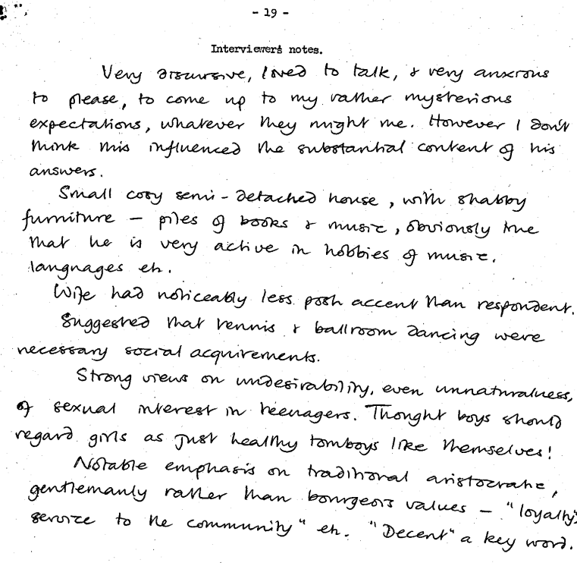
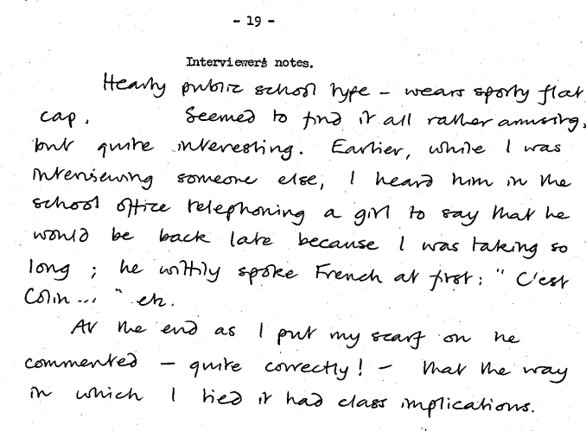
Affluent Worker: Interviewer comments
https://discover.ukdataservice.ac.uk/catalogue/?sn=6512&type=Data%20catalogue
Notes:
The goal of our inventory was to actually find examples of collections with field notes. Out of 1200 collections, only half a dozen actually had this. A couple had this through observations written by researchers in the moment of data gathering. Some types of methods dictate taking time for self-reflection as part of the method, and this may even be used as data. Others recommend this as a good practice. These are comments are just a few sentences, written after every interview, by the interviewers of the Affluent Worker, seminal research conducted in the 1970s which was used to create our ONS categories of class. They help to contextualise the relationships between researcher and participant. Seeing this in the archived collection was unusual – I’m not sure if methods don’t often dictate this kind of quick reflection or if it’s just something that is not often shared, but it really helps to rebuild the power dynamics of the interview. We’ve also had researchers who do research on these reflections alone – we currently have an interdisciplinary team from University of Durham looking to continue analysing some of these comments to better understand issues of race, sex and class and how it affected understandings of class.

Slide 8
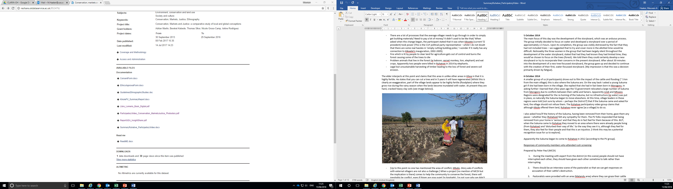
Field notes
https://discover.ukdataservice.ac.uk/catalogue/?sn=852476&type=Data%20catalogue
Notes:
Field notes are another example of very detailed documentation. Field notes are a bit different in that they occupy this grey space of being both data and documentation at different times. It’s worth pointing out documentation is something that is normally openly available, so field notes and other reflections – depending on the level of detail – may need to be put under similar access restrictions as data. Of the collections that had either reflections or field notes, almost all of them, like this collection, were ethnographic.

Slide 9
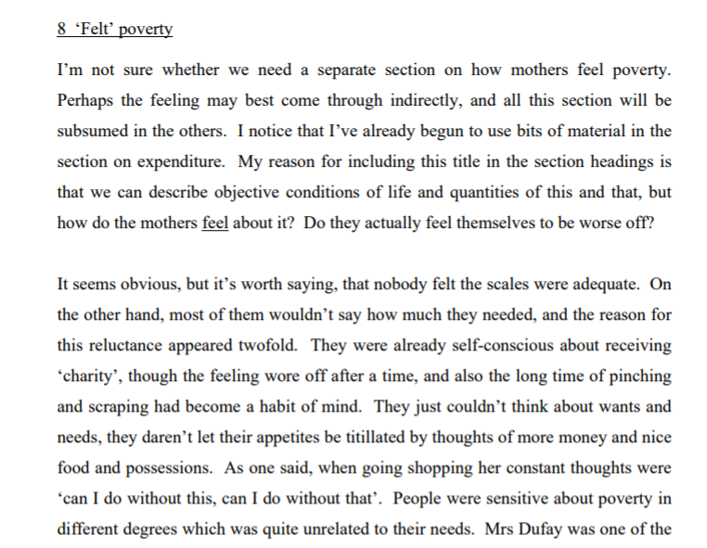
Marsden’s reflection on “felt poverty”
https://discover.ukdataservice.ac.uk/catalogue/?sn=5072&type=Data%20catalogue
Notes:
Field notes are great for documenting the research process, but you can also document the analysis process. Dennis Marsden’s Mothers Alone collection had an example of this in its documentation. His piece on “felt poverty”, as written, never made it to publication, but it included in the documentation for the collection. This is an interesting collection – led by white, educated men, interviewing single mothers living on welfare – but this piece really provides the context to show the sympathy the research team felt toward their participants. If field notes were rare, this kind of analysis documentation is even rarer. This is, I think one of three collections we found with analytic notes which documented the development of ideas across analysis.

Slide 10
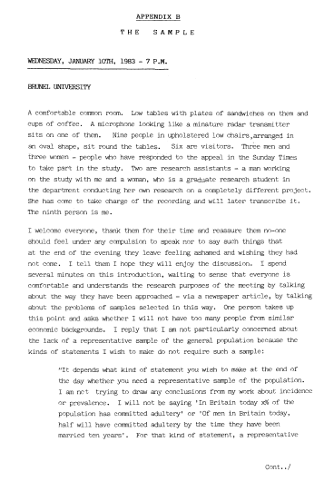
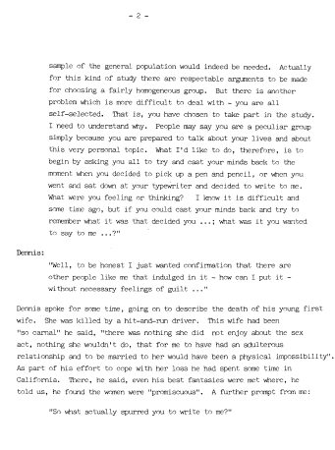
Sampling
https://discover.ukdataservice.ac.uk/catalogue/?sn=4858&type=Data%20catalogue
Notes:
More prevalent, but also of varying standards, were unpublished pieces expanding on the methods. Often in publication you get this sanitised paragraph about how it all went, but we know research is never that neat. Annette Lawson’s study, Adultery: An Analysis of Love and Betrayal, was a project conducted in the 1980s, aiming to explore an extremely taboo topic (at the time anyway). As such, it was really hard to recruit participants. Lawson chose to put out a call for participants in a newspaper, but it created an arguably biased sample – mostly white, middle class women responded to her call for participants. As such, Lawson was preoccupied with the sample, and wrote a 54-page defense of her sample. She started here, with a discussion on ethical conundrums that arose from the sampling strategy, including jealous partners sending in information of their married partners to participate, or another man who called from a psychiatric ward.

Slide 11
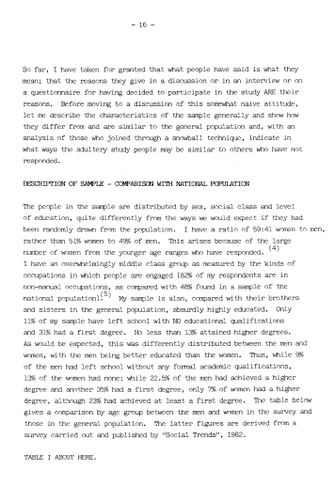
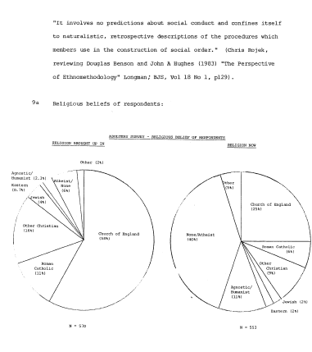
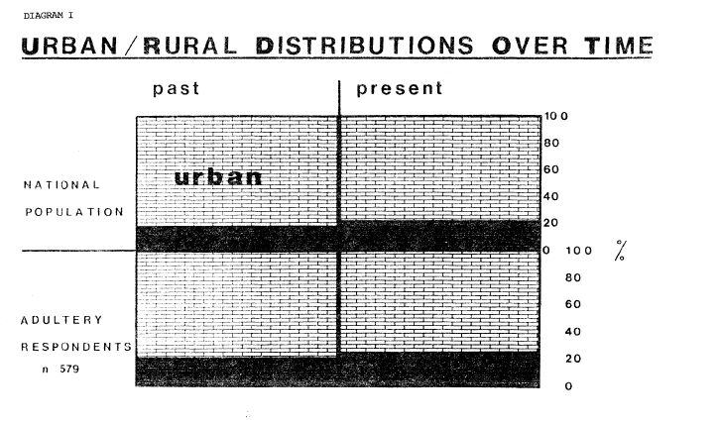
More on sampling…
https://discover.ukdataservice.ac.uk/catalogue/?sn=4858&type=Data%20catalogue
Notes:
She also had extensive comparison between her sample an the national population, exploring what was a significant difference from the national population and whether this would affect her data…

Slide 12
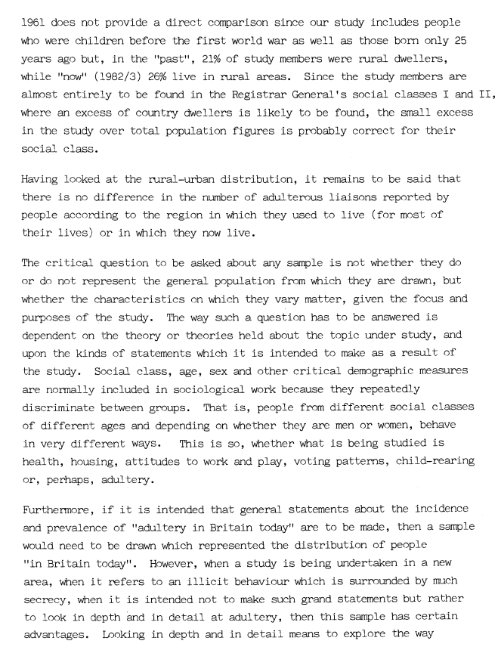
…and even more on sampling
The critical question to be asked about any sample is not whether they do or do not represent the general population from which they are drawn, but whether the characteristics on which they vary matter, given the focus and purposes of the study…
Furthermore, if it is intended that general statements about the incidence and prevalence of “adultery in Britain today” are to be made, then a sample would need to be drawn which represented the distribution of people “in Britain today”. However, when a study is being undertaken in a new area, when it refers to an illicit behaviour which is surrounded by much secrecy, when it is intended not to make such grad statements but rather to look in depth and in detail at adultery, then this sample has certain advantages…
https://discover.ukdataservice.ac.uk/catalogue/?sn=4858&type=Data%20catalogue
Notes:
Until finally, she comes to some very interesting conclusions about sampling strategies more broadly, including the point the sampling needs to match the context of the study, and that exploratory studies are benefitted from a greater focus on the ability to talk about the topic in detail, rather than a focus on the participants.

Slide 13
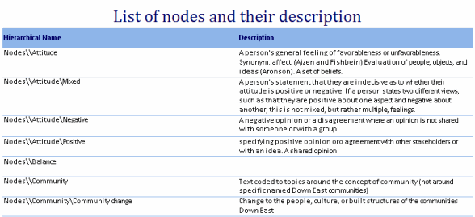
New possibilities with changing technology
Notes:
There are new possibilities with changing technology. NVivo and other computer-assissted qualitative analysis software allow you to download your codebooks, memos, and mind maps. Here you can see a list of nodes and their descriptions – all very easily downloadable. When we received the Edwardians collections, which contained 453 80+ page interviews with British residents born during the Edwardian period, it was accompanied with this work done by hand. 16 shelves were dedicated to holding the coding of these transcripts into key themes. Now, this can all be downloaded in a single file, at any point during or after coding.

Slide 14
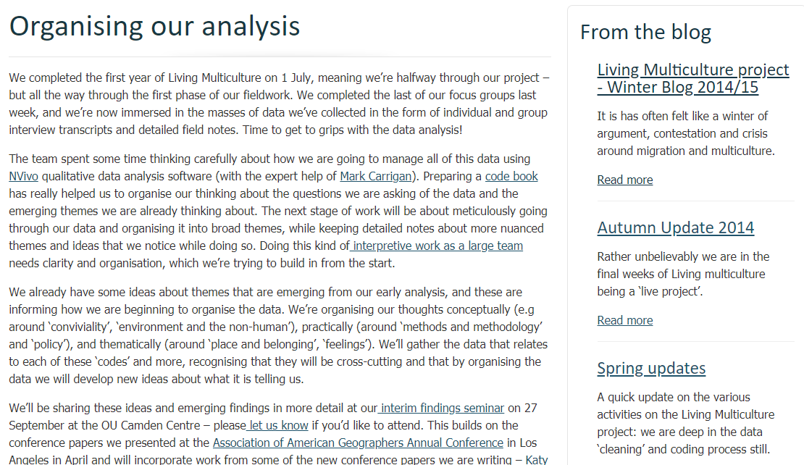
Living Multicultural: blog
https://discover.ukdataservice.ac.uk/catalogue/?sn=851852&type=Data%20catalogue
Notes:
Research teams can also use blogs and websites to keep in touch with participants, keep a research blog which updates others on the progress, posts information for participants or even send out calls for participants. Once the project is done, that site can then site alongside the project as a related resource, providing that additional documentation.

Slide 15
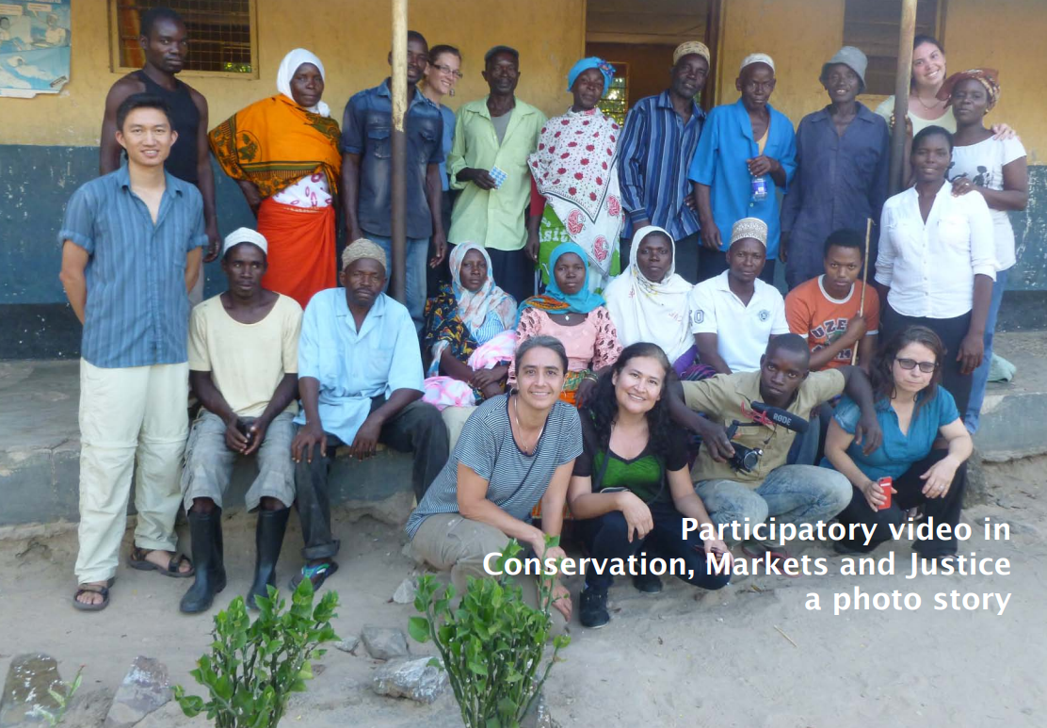
Creative documentation
https://discover.ukdataservice.ac.uk/catalogue/?sn=852476&type=Data%20catalogue
Notes:
We also see more creative documentation too, such as this photo story. Again, this sort of thing can be classed as either documentation or potentially data, but there is scope to use video and audio files to accompany the data.

Slide 16
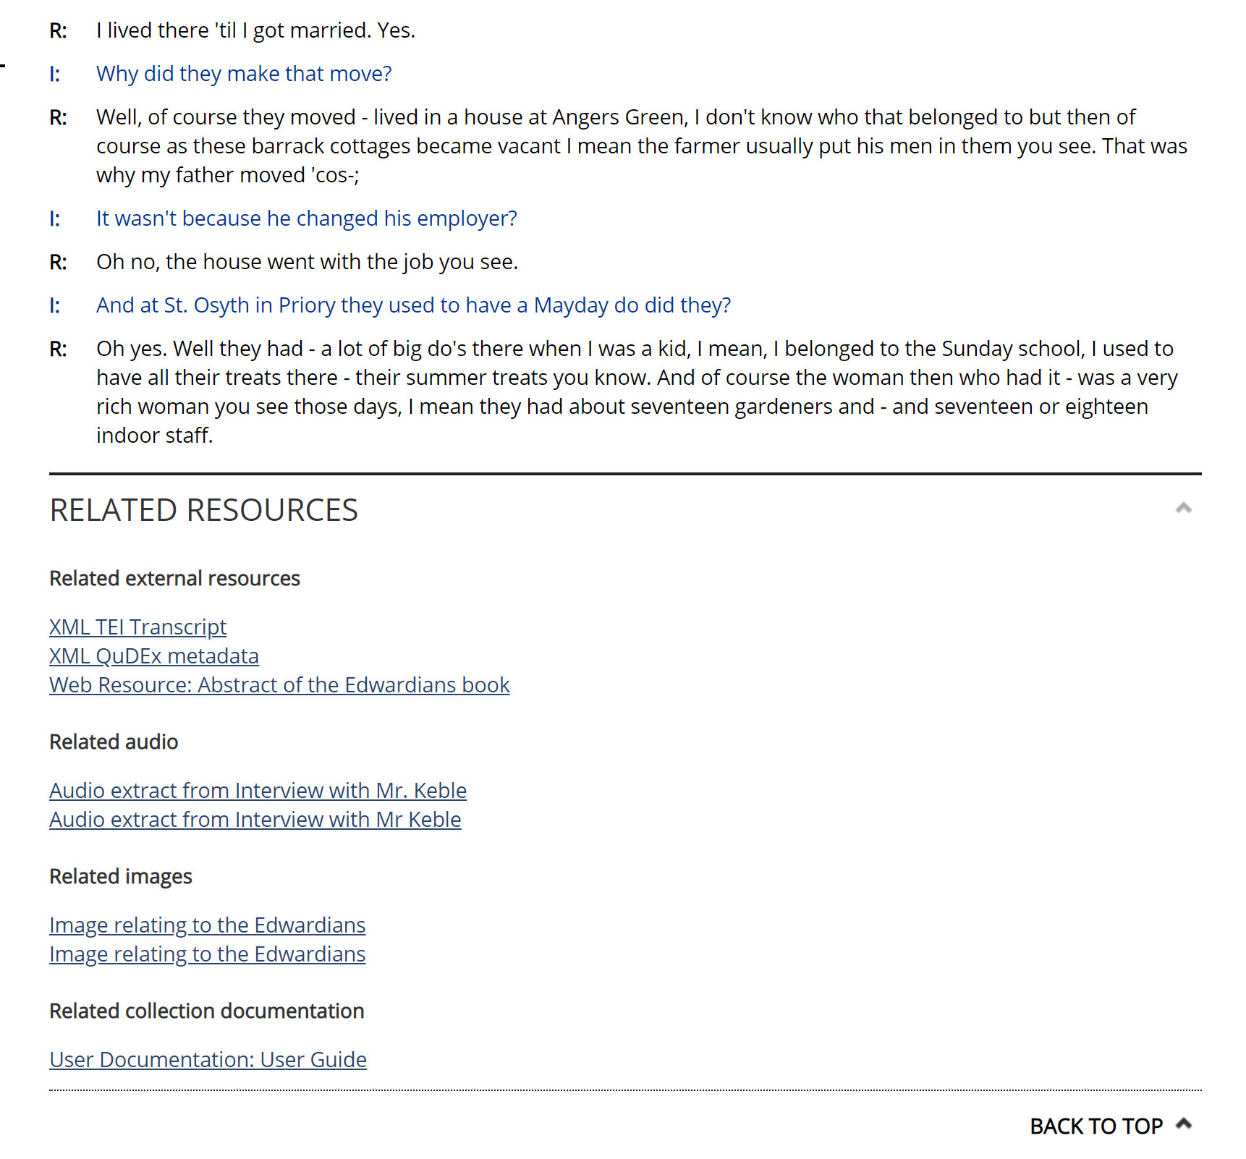
Linking specific documentation to specific data
Notes:
Finally, changing technology is not just for how research is done, but also how we archive. The UK Data Service has create Qualibank, an online tool for searching, browsing and citing qualitative data. As part of this tool, you can search and view qualitative data online, and also view linked documentation. This documentation can relate to specific data or the collection as whole – but it allows for the distinction between project level and data level documentation.

Slide 17
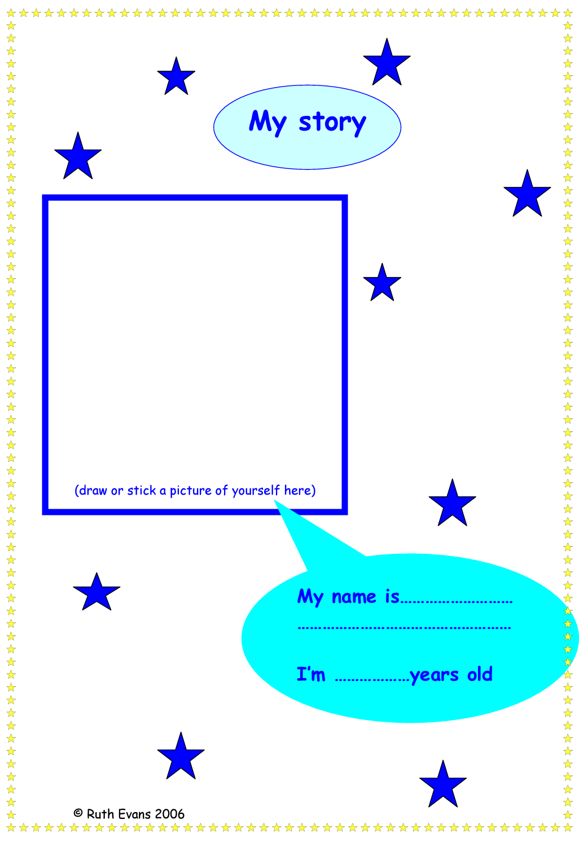
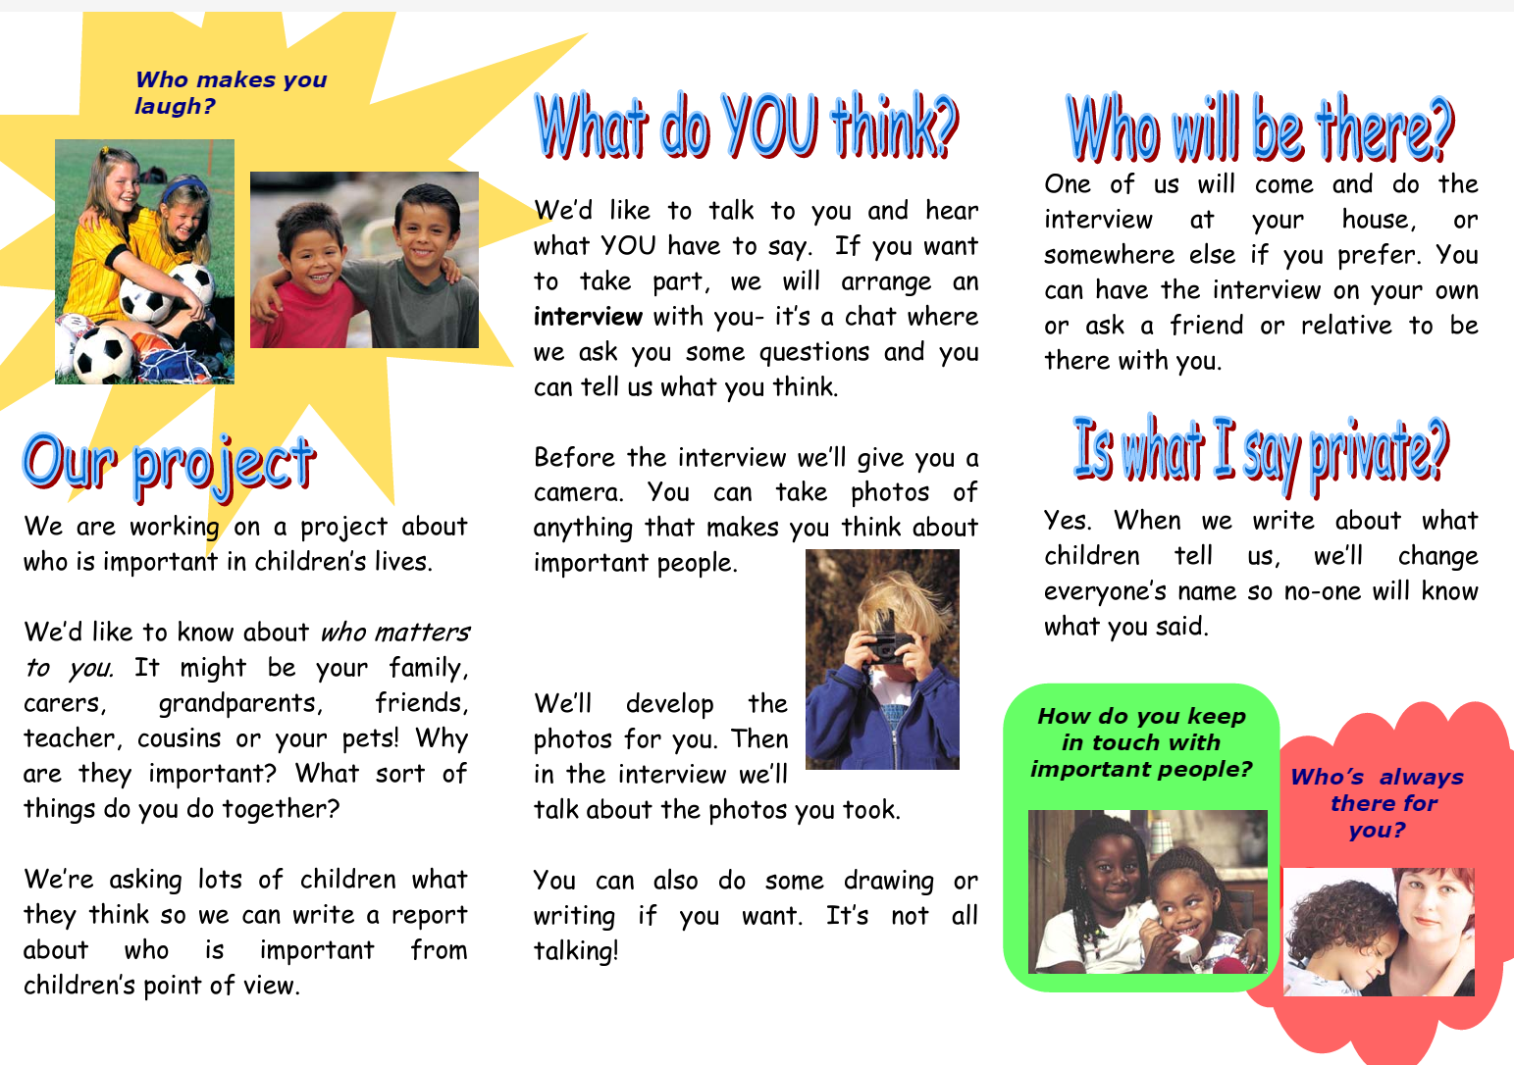
Researching with children and vulnerable groups
Notes:
Finally, I want to make three summary points about the value documentation.
Often we think about the re-use value of data specifically, but less about how documentation has its own value. Documentation can serve as a inspiration for good practices – so adapting consent forms and information sheets, rather than writing from scratch. We have 100s of consent forms documented within our collections, including snippets of ones you see here, explaining what data sharing means. You can also examine how to do research with children and vulnerable groups. Writing up information letters and consent forms for children in especially difficult, but we have a few collections which provide good examples of how this was produced in the past. So we can learn from documentation about good practices in research.

Slide 18
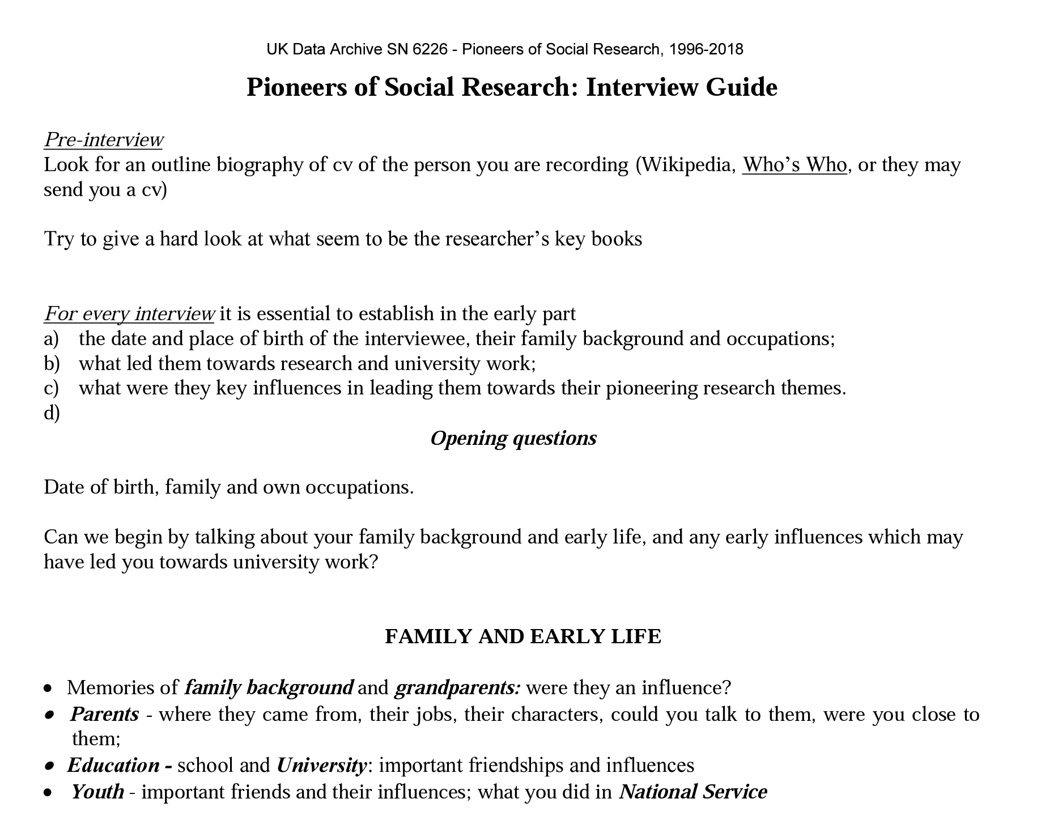
Developing an interview guide
Notes:
2. Documentation itself can be re-used. One collection, the Foot and Mouth Disease in North Cumbria deposited their interview guides, which we were reused by med students to better understand doctor-patient dynamics. I also refer dissertation students to find a similar interview guide before settling on making one themselves to help them see what’s important to ask and what’s not. Documentation, then becomes an impactful output for researchers, which when deposited with their collection can receive a DOI and usage can be tracked.

Slide 19
In summary
Documentation teaches good research practices.
Documentation is reusable and impactful.
Documentation helps to build (historical) provenance.
As qualitative researchers, how do we respond to calls for reproducibility within research? By creating and sharing comprehensive documentation for our research projects.
Notes:
Finally, documentation helps to build provenance. Many of our qualitative re-users who re-use data for research are historians, who rely upon documentation to not only make the data more discoverable, as we often think of the purpose of documentation, but also to help build up the starting point for historical narratives. We can learn a lot from how historians do their work, but it’s really important that they do have this background context: it helps them situate the researcher and themselves in relation to the people who took part in the research.
In conclusion, in all the discussions about open science and open data, I think this conversation has been largely dominated by research traditions which find it easy to document and share data. We also need to be mindful of terminology we use, and actively encourage archiving standards as not only good practice, but impactful and innovative sources for future research. The blueprints of FAIR are still relevant to qualitative research, and I think it’s important to highlight that qualitative researcher can respond to these calls in a unique and robust way. Part of what makes qualitative research unique is its context, so we need to make sure this is recognised within the calls for FAIR data.

Slide 20
Thank you.
Maureen Haaker
mahaak@essex.ac.uk

