Slide 1


Segment Anything for Microscopy
Interactive & Automatic Microscopy Segmentation
Constantin Pape
Institut für Informatik, Georg August Universität Göttingen
ccpape
https://user.informatik.uni-goettingen.de/~pape41/

Slide 2
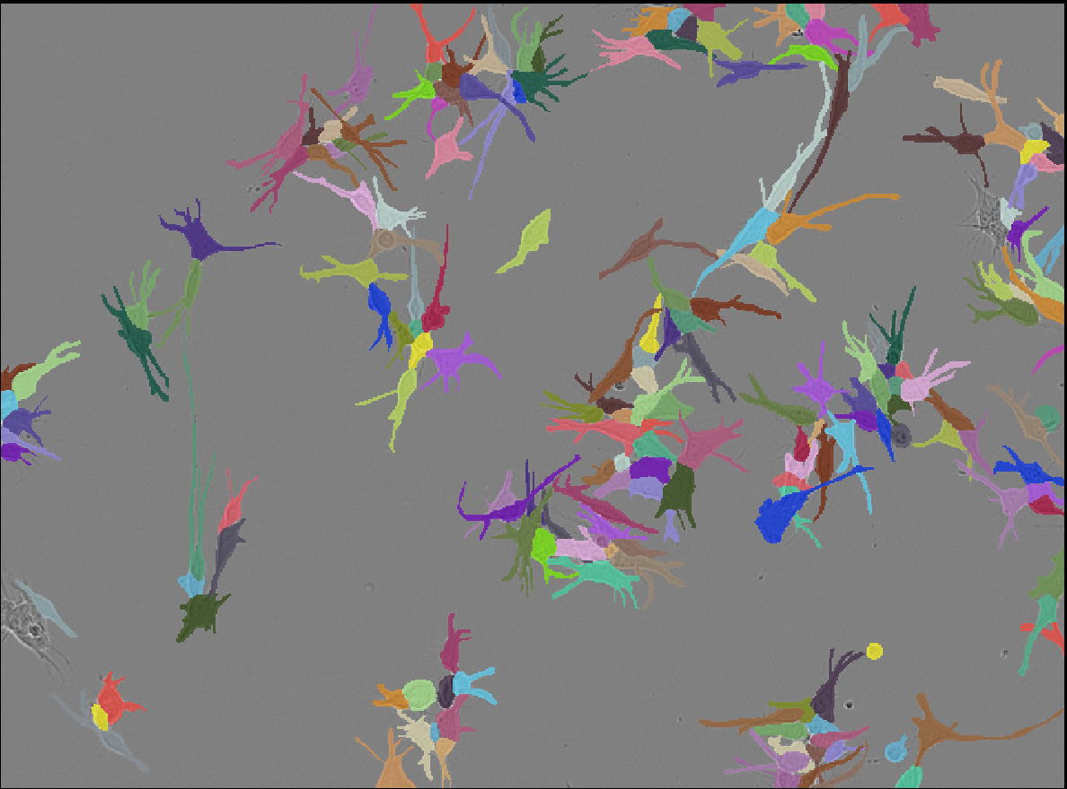
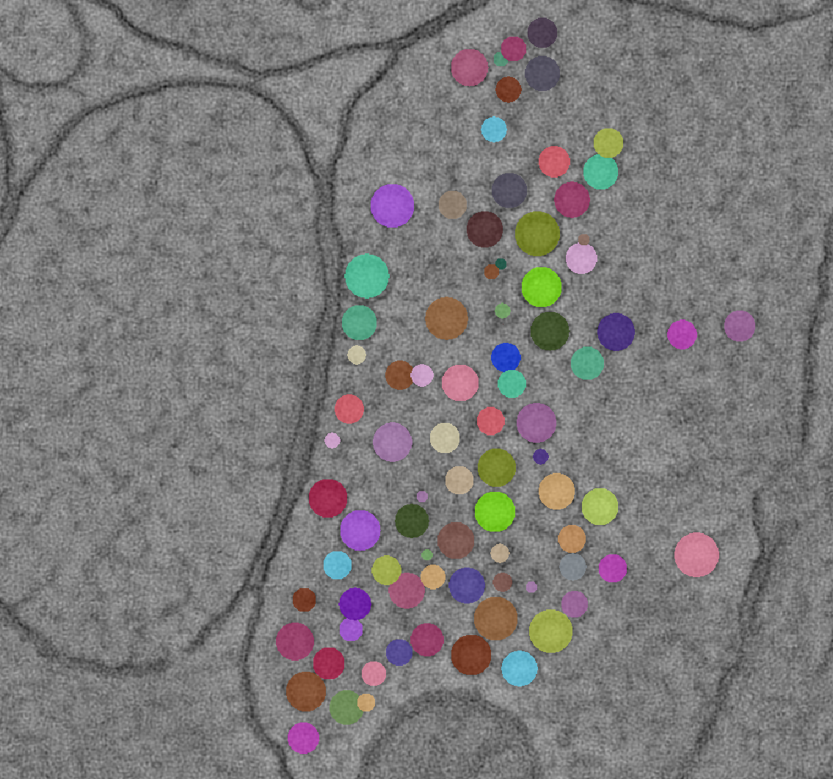
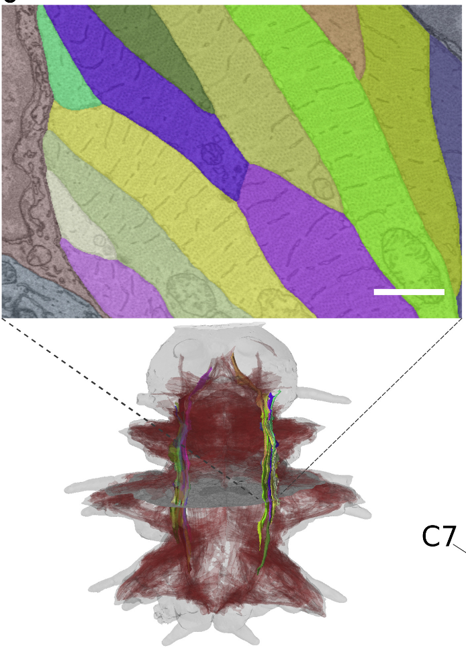
Things the group does…
Method development for microscopy image analysis:
Vision: from images to insight and clinical relevance in collaboration with life scientists
Segmentation and tracking tasks
High content microscopy for clinical decision making
EM tomography for synaptic biology
Volume EM for tissue and whole organism analysis
Representation learning for microscopy and multi-modal data
Protein structure analysis in cryo ET and optical microscopy

Slide 3
Segment Anything

Slide 4
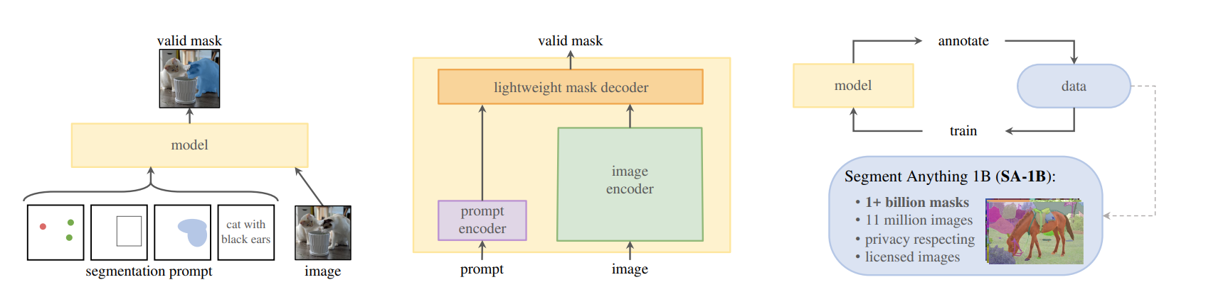
Segment Anything
https://arxiv.org/abs/2304.02643
Pretrained model for interactive segmentation from Meta.AI
SAM: Interactive segmentation
Notes:
Transformer based model for interactive segmentation
Based on user input “prompts”: points, boxes or rough masks outlining object
(Text)
Model: image encoder: transformer predicts image representation
prompt encoder: small transformer that processes prompts
mask decoder: predict current object based on image encoder and prompt
Trained on a very large dataset
Dataset is build iteratively through annotation by annotating with the model (which is retraiend)

Slide 5
Segment Anything
https://arxiv.org/abs/2304.02643
* MobileSAM: https://arxiv.org/abs/2306.14289
Pretrained model for interactive segmentation from Meta.AI
SAM: Interactive segmentation
4 different sizes:
VIT-B (Base)
VIT-L (Large)
VIT-H (Huge)
VIT-T (Tiny)*
Notes:
Transformer based model for interactive segmentation
Based on user input “prompts”: points, boxes or rough masks outlining object
(Text)
Model: image encoder: transformer predicts image representation
prompt encoder: small transformer that processes prompts
mask decoder: predict current object based on image encoder and prompt
Trained on a very large dataset
Dataset is build iteratively through annotation by annotating with the model (which is retraiend)

Slide 6
Segment Anything: What’s special?
Interactive segmentation: segment arbitrary objects from annotations
  “prompts”: points and/or box and/or mask
  more prompts improve the predictions
Versatile: can be integrated within pipelines that provide prompts
  From user inputs, object detectors, nucleus seeds, …
  Model is fully open-source!
Notes:
Why the hype?
Interactive segmentation works well for different kinds of models and modalities; improve segmenations through more prompts
Versatility
Achieves through the large training dataset AND iterative training loop

Slide 7
Segment Anything: What’s special?
Interactive segmentation: segment arbitrary objects from annotations
  “prompts”: points and/or box and/or mask
  more prompts improve the predictions
Versatile: can be integrated within pipelines that provide prompts
  From user inputs, object detectors, nucleus seeds, …
  Model is fully open-source!
How?
  Large dataset with diverse images and objects
  Iterative training loop
Notes:
Why the hype?
Interactive segmentation works well for different kinds of models and modalities; improve segmenations through more prompts
Versatility
Achieves through the large training dataset AND iterative training loop

Slide 8
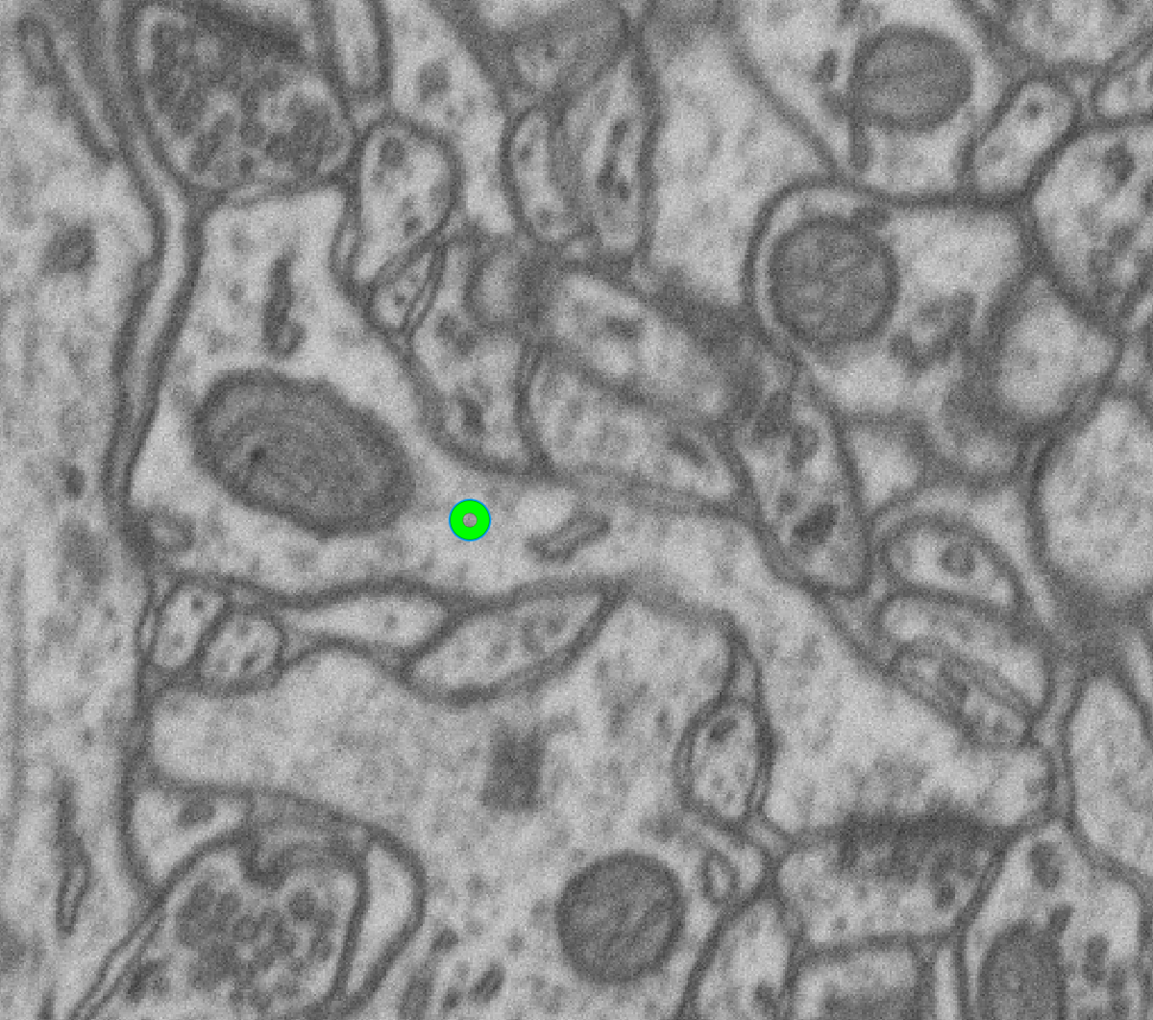
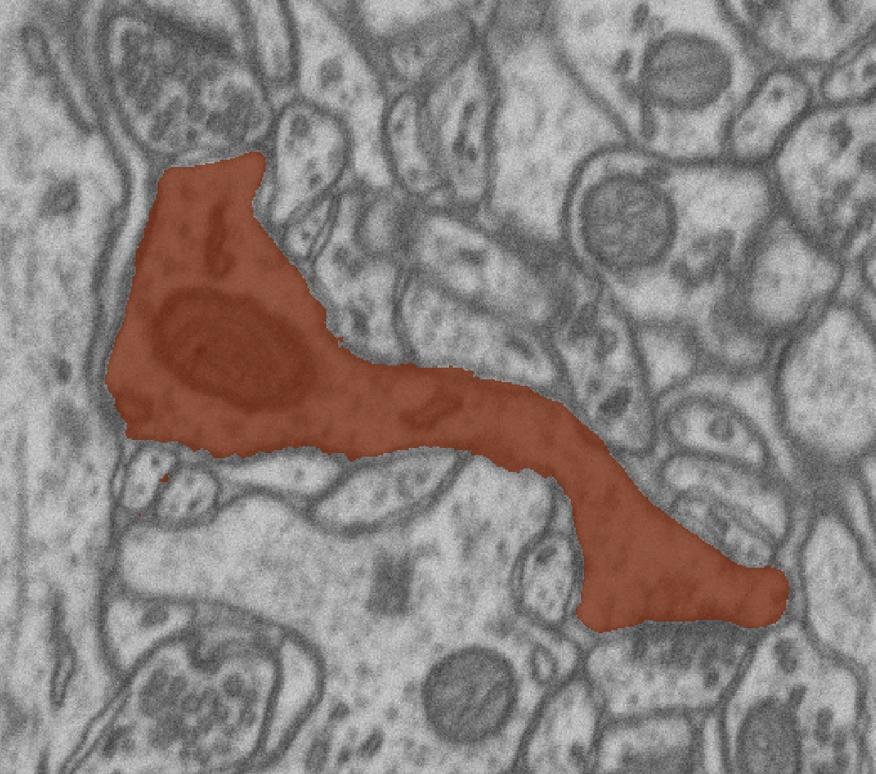
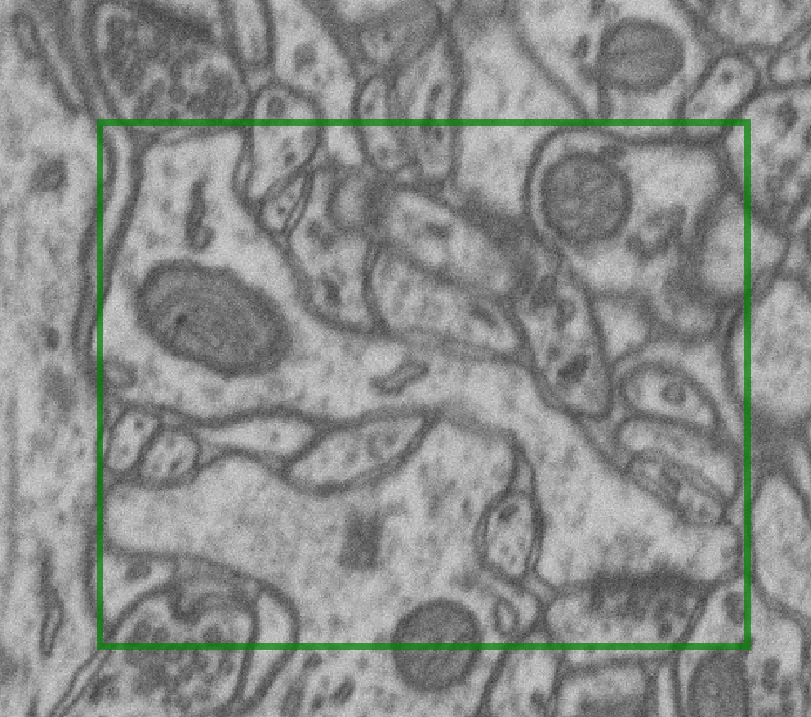
Segment Anything: Training iteration
Given image and ground-truth mask
Compute image embeddings,
sample positive point or box
random point
bounding box
Notes:
The training loop

Slide 9
Segment Anything: Training iteration
Given image and ground-truth mask
Compute image embeddings, sample positive point or box
Notes:
From lecture 1, TODO copy image credits

Slide 10
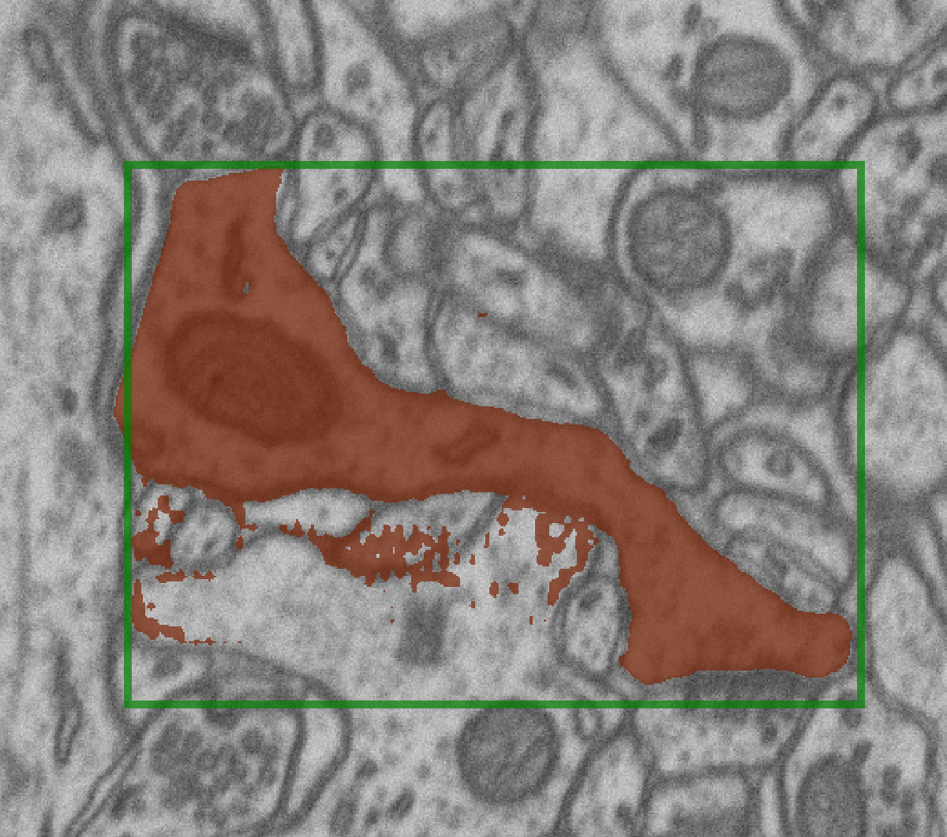
Segment Anything: Training iteration
Given image and ground-truth mask
Compute image embeddings, sample positive point or box
Run prediction, compute loss for object and IOU estimate
Mask Loss
Notes:
From lecture 1, TODO copy image credits

Slide 11
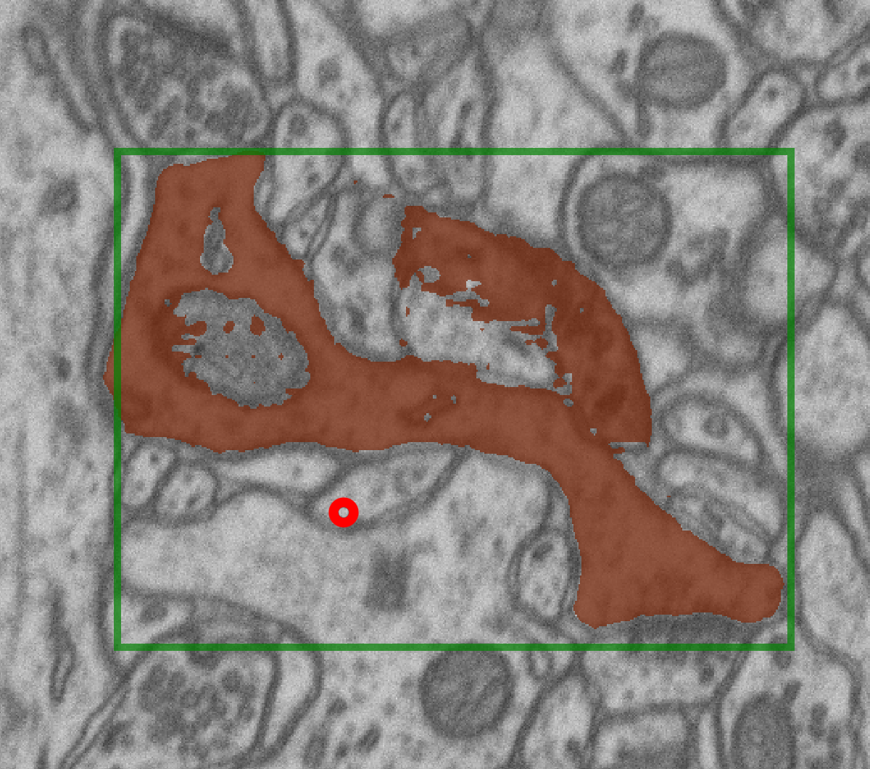
Segment Anything: Training iteration
Given image and ground-truth mask
Compute image embeddings, sample positive point or box
Run prediction, compute loss for object and IOU estimate
Sample point prompts where prediction is wrong, rerun prediction with all prompts + mask
Mask
Loss
…
Notes:
From lecture 1, TODO copy image credits

Slide 12
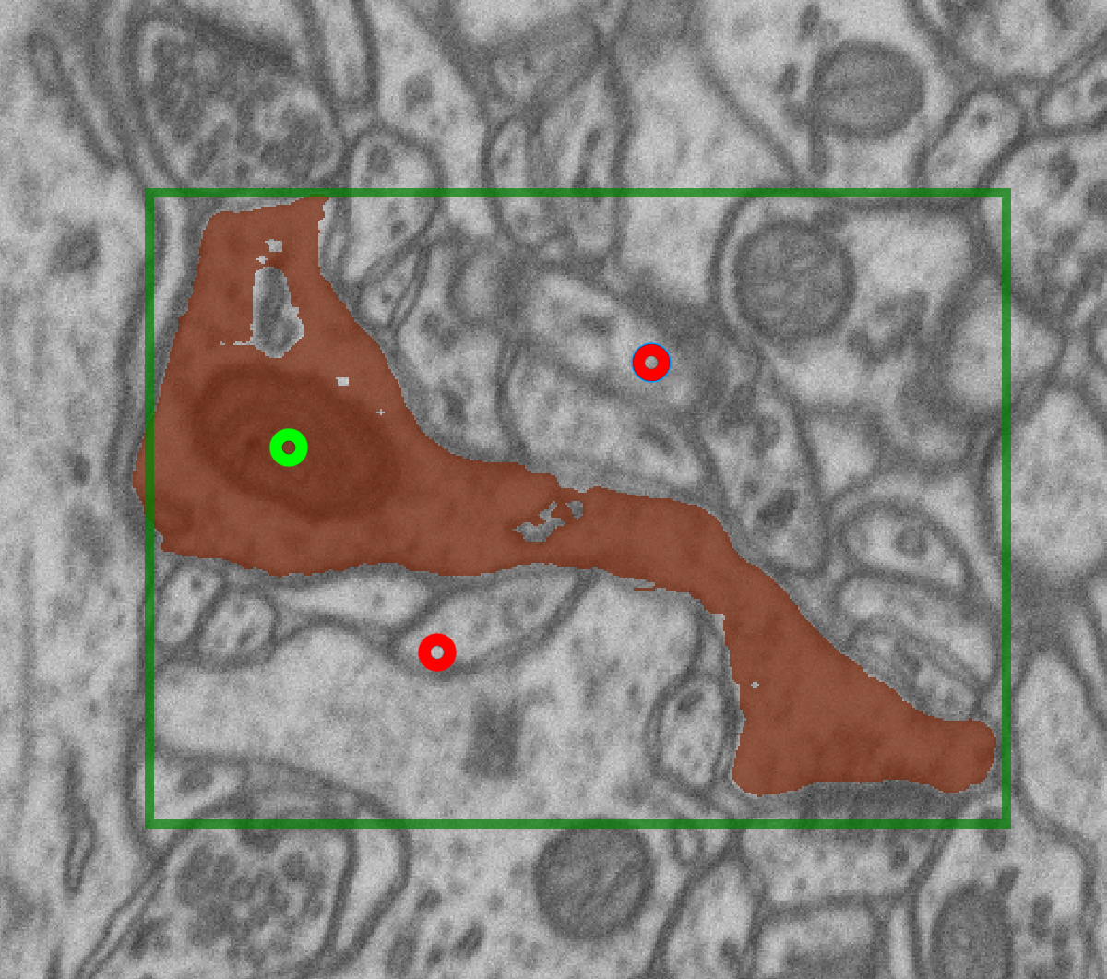
Segment Anything: Training iteration
Given image and ground-truth mask
Compute image embeddings, sample positive point or box
Run prediction, compute loss for object and IOU estimate
Sample point prompts where prediction is wrong, rerun prediction with all prompts + mask
Repeat
Mask Loss
…
Notes:
From lecture 1, TODO copy image credits

Slide 13

Segment Anything: Training iteration
Given image and ground-truth mask
Compute image embeddings, sample positive point or box
Run prediction, compute loss for object and IOU estimate
Sample point prompts where prediction is wrong, rerun prediction with all prompts + mask
Repeat
Mask Loss
…
Notes:
From lecture 1, TODO copy image credits

Slide 14
Segment Anything: Training iteration
Given image and ground-truth mask
Compute image embeddings, sample positive point or box
Run prediction, compute loss for object and IOU estimate
Sample point prompts where prediction is wrong, rerun prediction with all prompts + mask
Repeat
Average losses, update weights
…
Notes:
From lecture 1, TODO copy image credits

Slide 15
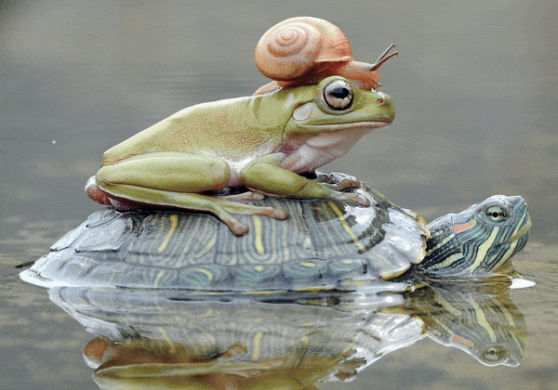
Segment Anything: Capabilities
https://segment-anything.com/
Segmentation from user inputs (prompts)
Notes:
After this: Interactive segmentation

Slide 16
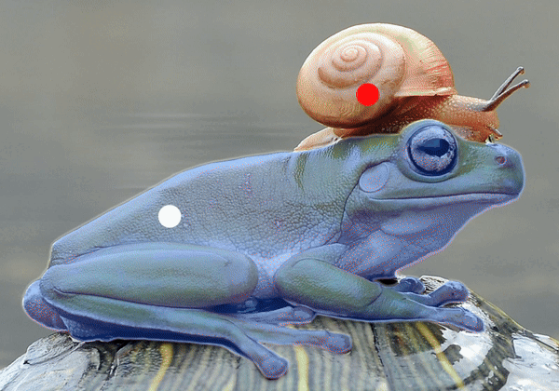

Segment Anything: Capabilities
https://segment-anything.com/
Segmentation from user inputs (prompts)
Automatic Mask Generation (AMG)
Notes:
Automatic mask generation by covering the image with grid of points, predicting masks for all points and filter out unlikely masks

Slide 17
Segment Anything for Microscopy

Slide 18

Our aims & contributions
Anwai
Archit
Archit, …, Pape, bioRxiv (2023)
https://doi.org/10.1101/2023.08.21.554208
How well does SAM work for microscopy data? Which model size is best?
Can we improve it (by finetuning) on microscopy data?
Build a napari-based tool for interactive and automatic segmentation and tracking.
Collaboration between my group and DFKI; + several open source contributions.
Notes:
We got interested, and:
- Want to evaluate how well it works for microscopy.
- Can we improve it for microscopy? -> Finetuning
- Build a tool in napari for interactive + automatic segmentation and tracking.
- Acknowledgments

Slide 19
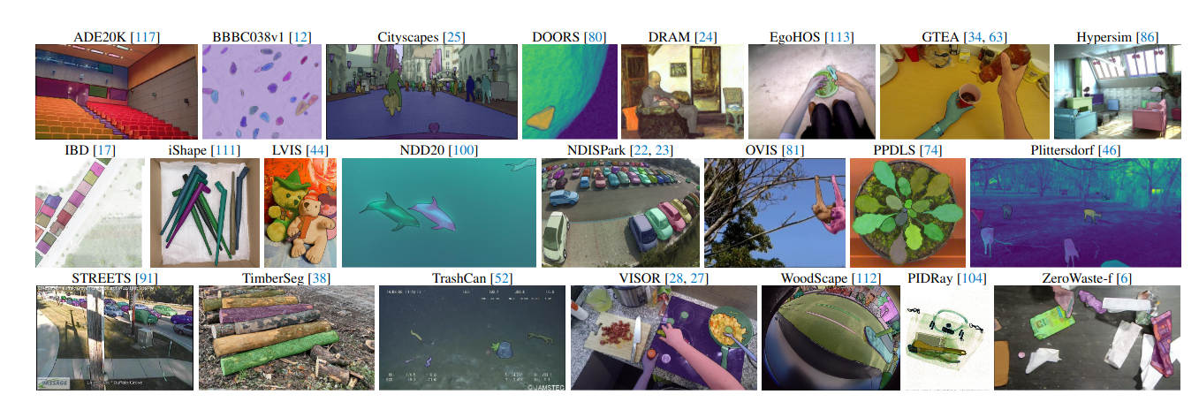
Our aims & contributions
Anwai
Archit
Archit, …, Pape, bioRxiv (2023)
https://doi.org/10.1101/2023.08.21.554208
How well does SAM work for microscopy data? Which model size is best?
Can we improve it (by finetuning) on microscopy data?
Build a napari-based tool for interactive and automatic segmentation and tracking.
Collaboration between my group and DFKI; + several open source contributions.
SAM authors test the model on nucleus segmentation and find good performance.
Model was predominantly trained on natural images!
Notes:
We got interested, and:
- Want to evaluate how well it works for microscopy.
- Can we improve it for microscopy? -> Finetuning
- Build a tool in napari for interactive + automatic segmentation and tracking.
- Acknowledgments

Slide 20
Our aims & contributions
Anwai
Archit
Archit, …, Pape, bioRxiv (2023)
https://doi.org/10.1101/2023.08.21.554208
How well does SAM work for microscopy data? Which model size is best?
Can we improve it by finetuning on microscopy data?
Build a napari-based tool for interactive and automatic segmentation and tracking.
Collaboration between my group and DFKI; + several open source contributions.
We are in revision; will submit revised version this week!
Results are from revision experiments and not in preprint yet.
Notes:
PRELIMINARY

Slide 21
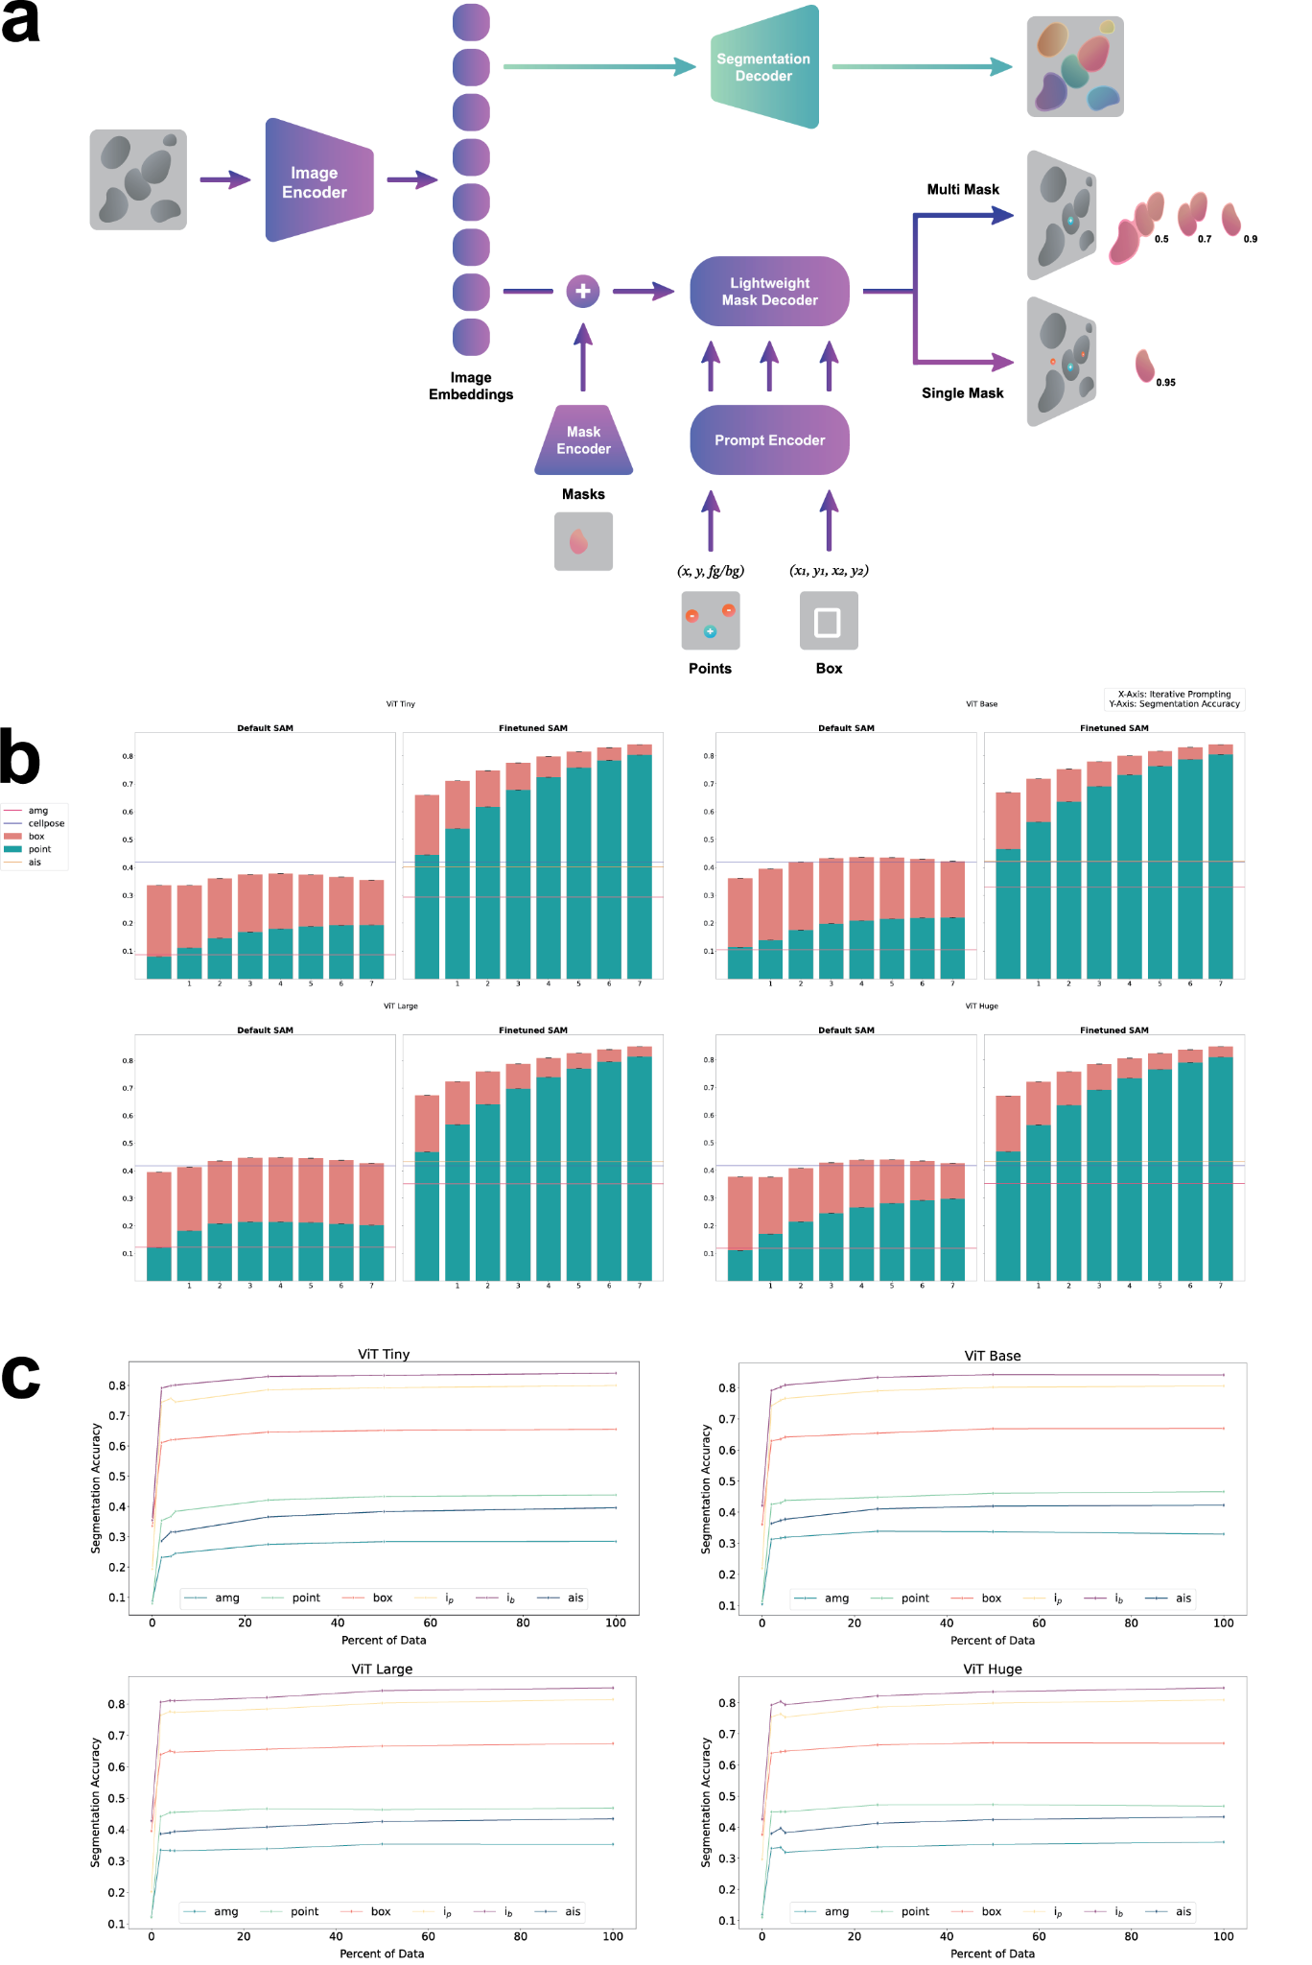
Finetuning SAM
Our contributions:
Re-implement iterative training
  Original code not published
  Complex procedure
  Use to finetune SAM components

Slide 22
Finetuning SAM + improve instance seg
Our contributions:
Re-implement iterative training
  Original code not published
  Complex procedure
  Use to finetune SAM components
Add decoder for instance segmentation (AIS)
  Predicts foreground
  Regresses distances to boundary + centroid
  Input for watershed

Slide 23
Finetuning for light microscopy
Training data: cell and nucleus segmentation (published datasets)
  Cells in Phase-contrast (LiveCELL)
  Cells in Tissue (TissueNet)
  Cells and Nuclei in Fluorescence (Neurips Cell Seg, DSB)
  Cells in LightSheet (PlantSeg-Roots)
  Bacteria in labelfree imaging (DeepBacs)
Evaluate on test-split of training datasets (“in domain”)
and unseen datasets (“out of domain”):
  Nuclei and cells in confocal, cells in immunofluorescence, nuclei in histopathology, …
Compare interactive and automatic instance segmentation
  Compare to CellPose baseline for automatic segmentation

Slide 24
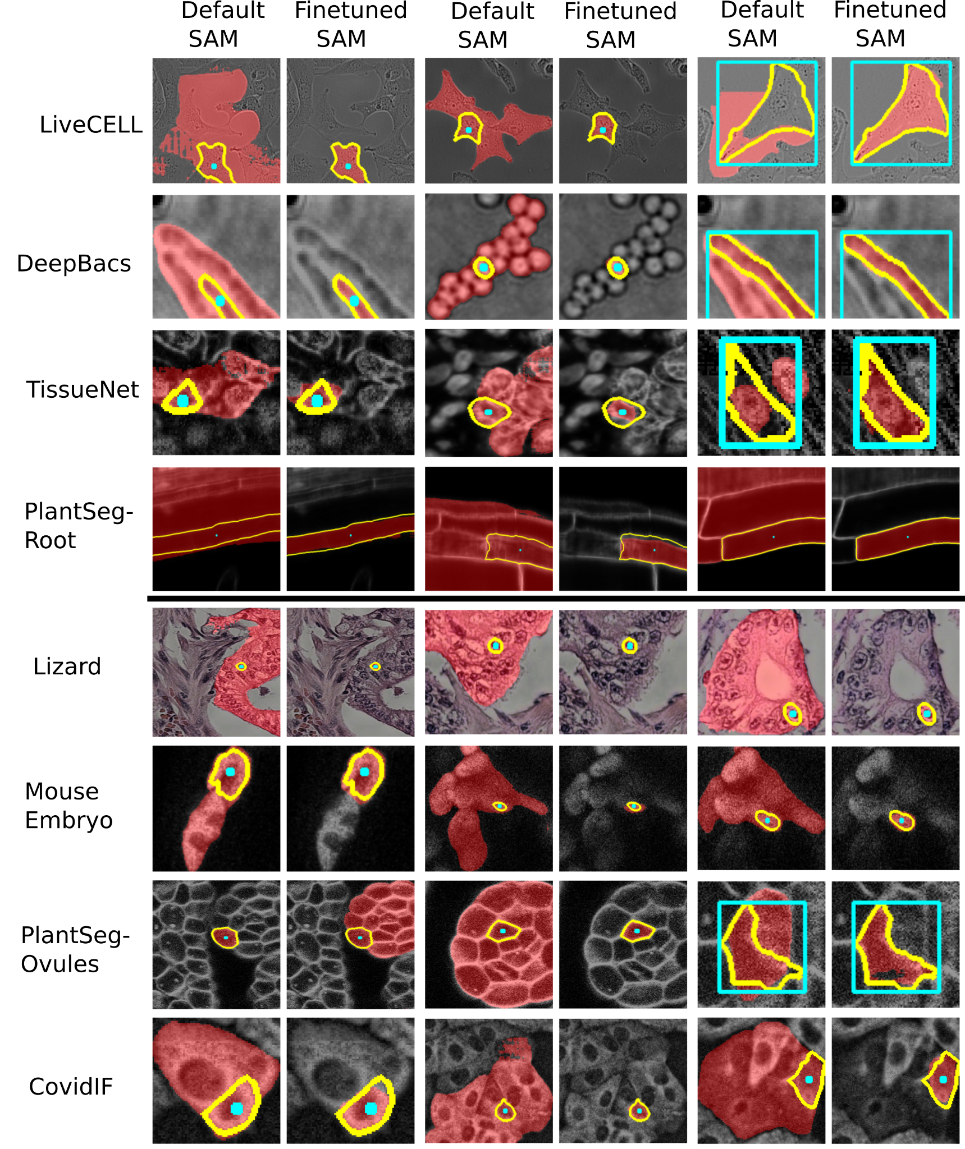
Interactive Segmentation:
In domain & Out-of-domain

Slide 25
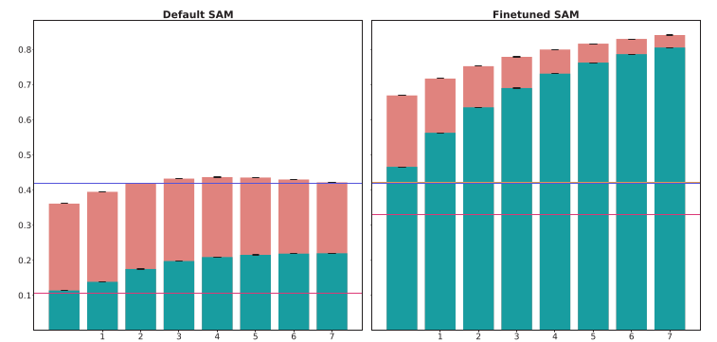
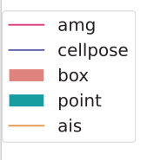
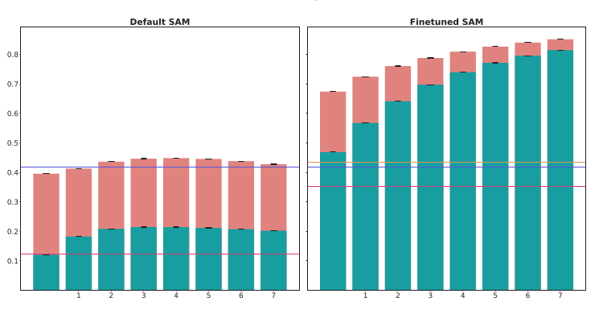
Results: In Domain
ViT Base
Results for LIVECell Dataset
(In Domain; Test Split)
Evaluation:
Interactive Segmentation:
  Derive prompts from ground-truth, improve iteratively
Instance segmentation:
  Compare with CellPose
Both: compute segmentation accuracy (compared to ground-truth)
ViT Large

Slide 26
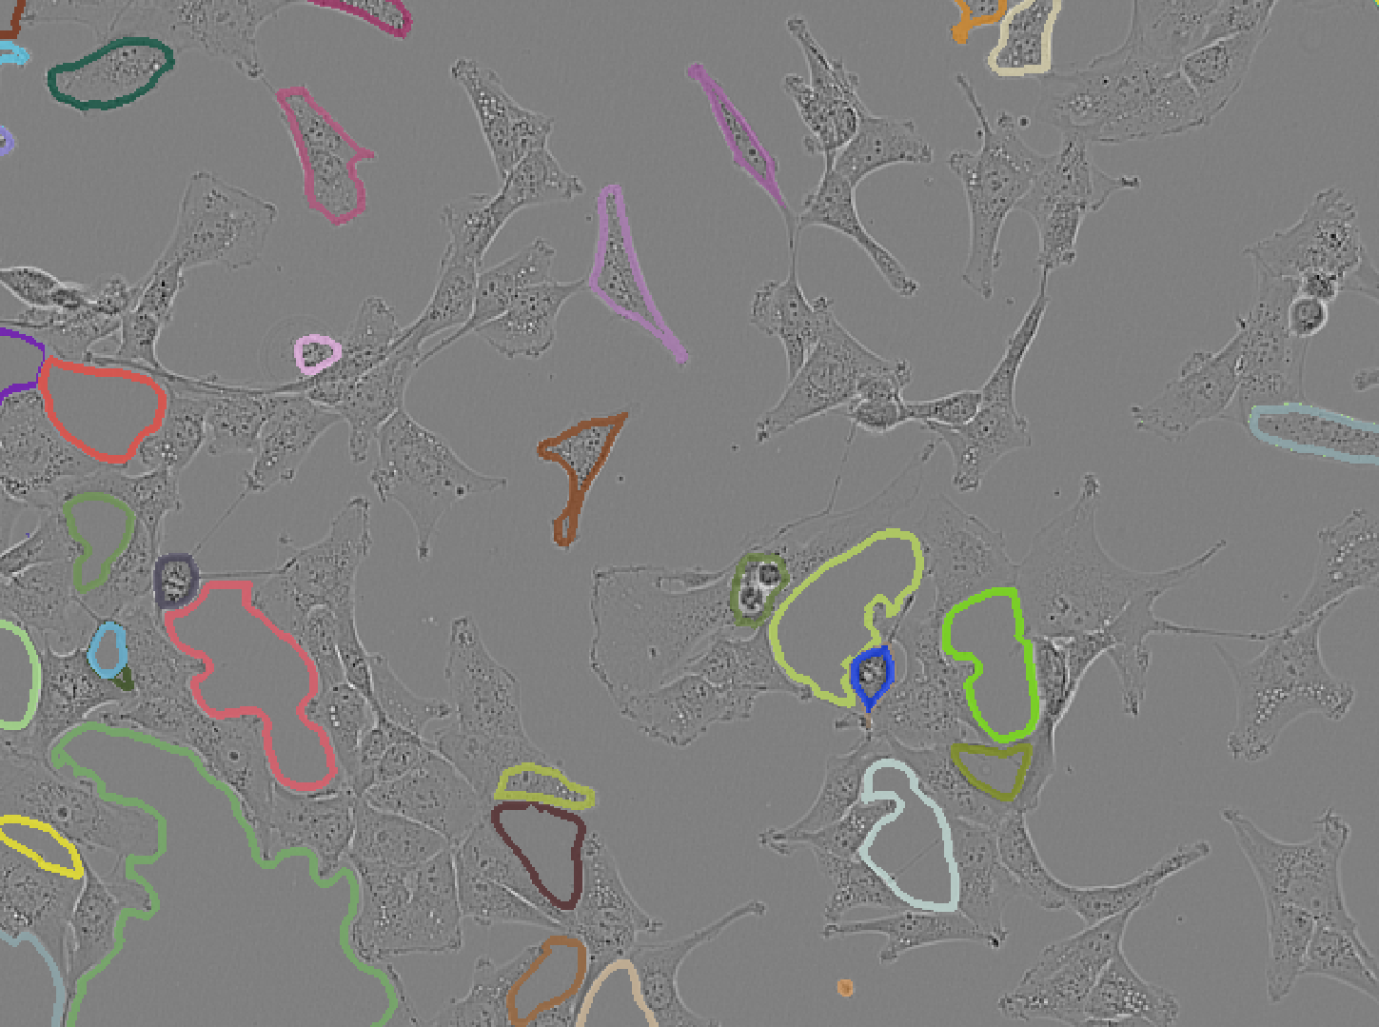
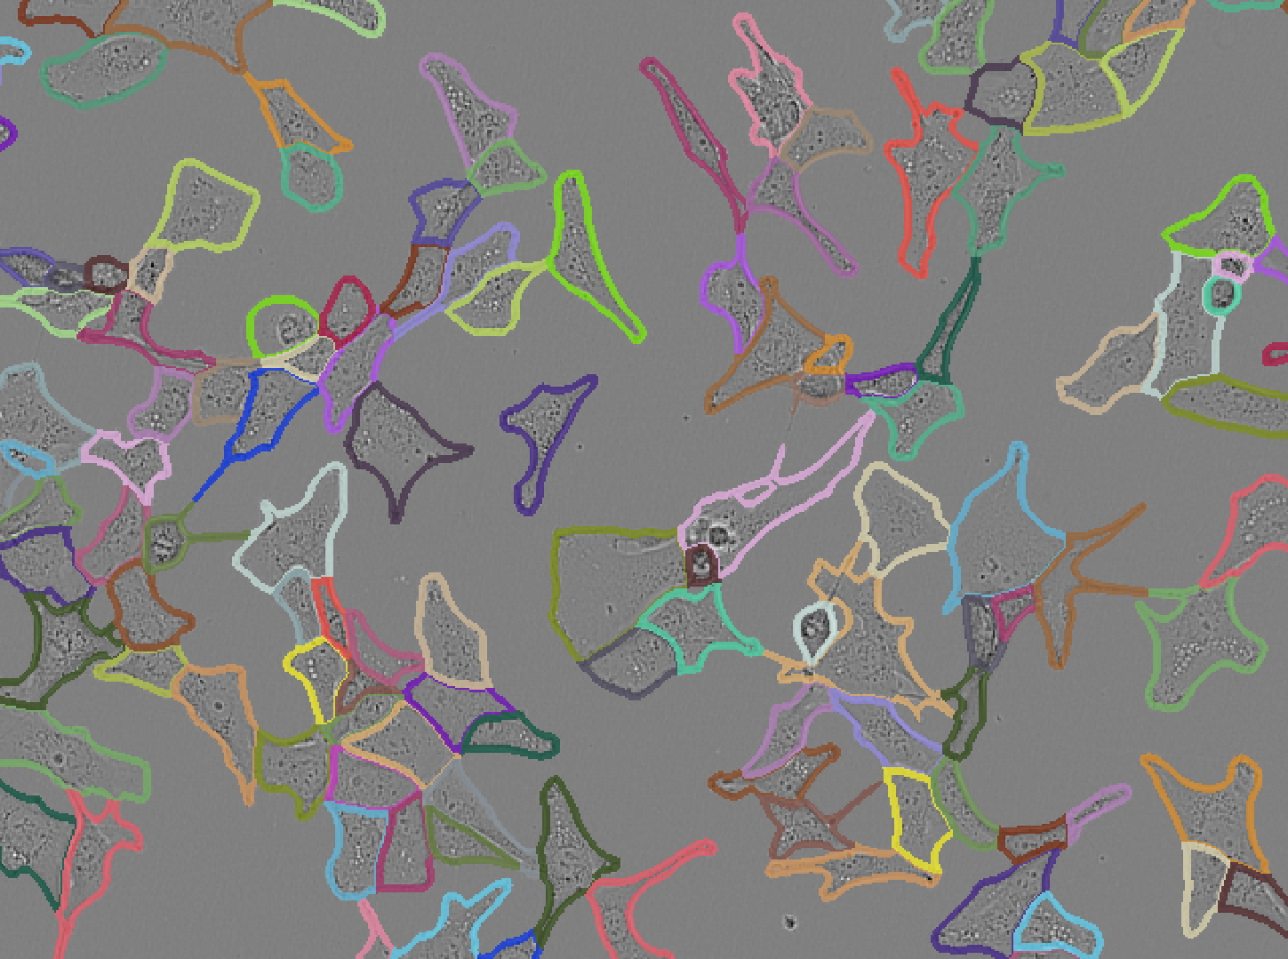
Automatic Segmentation
Instance segmentation on LIVECell Dataset
Runtimes on laptop (CPU);
including embedding computation (dominates for AIS)
VIT-B-LM
AIS: 9 sec
VIT-B
AMG: 75 sec

Slide 27
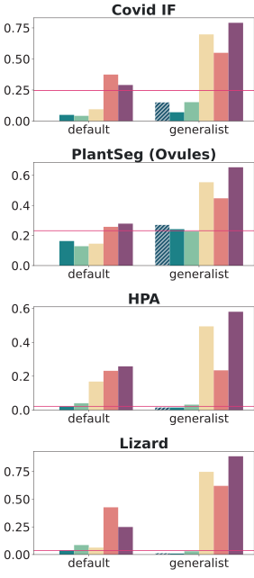
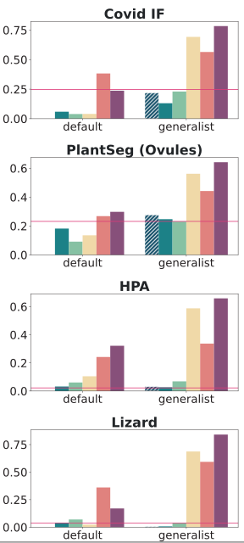
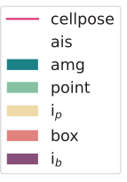
Results: Out of domain
ViT Base
ViT Large
Results for out of-domain datasets.
Same evaluation procedure as before.

Slide 28
Results: Out of domain
ViT Base
ViT Large
Results for out of-domain datasets.
Same evaluation procedure as before.
Conclusions:
Finetuning improves models!
Best model: vit_l
  If runtime matters: vit_b / vit_t
Comparison to CellPose (automatic seg.):
  Similar performance on most out of domain datasets (cyto2 model)

Slide 29
Finetuning for electron microscopy
Training data: Mitochondria and nucleus segmentation in electron microscopy
  Most training data from MitoNet (https://doi.org/10.1016/j.cels.2022.12.006).
Compare default and finetuned model.
  Compare automated segmentation with MitoNet.
Evaluate on test-split of training datasets (“in domain”)
and unseen datasets (“out of domain”)
  Application to EM mitochondria from non-training data.

Slide 30
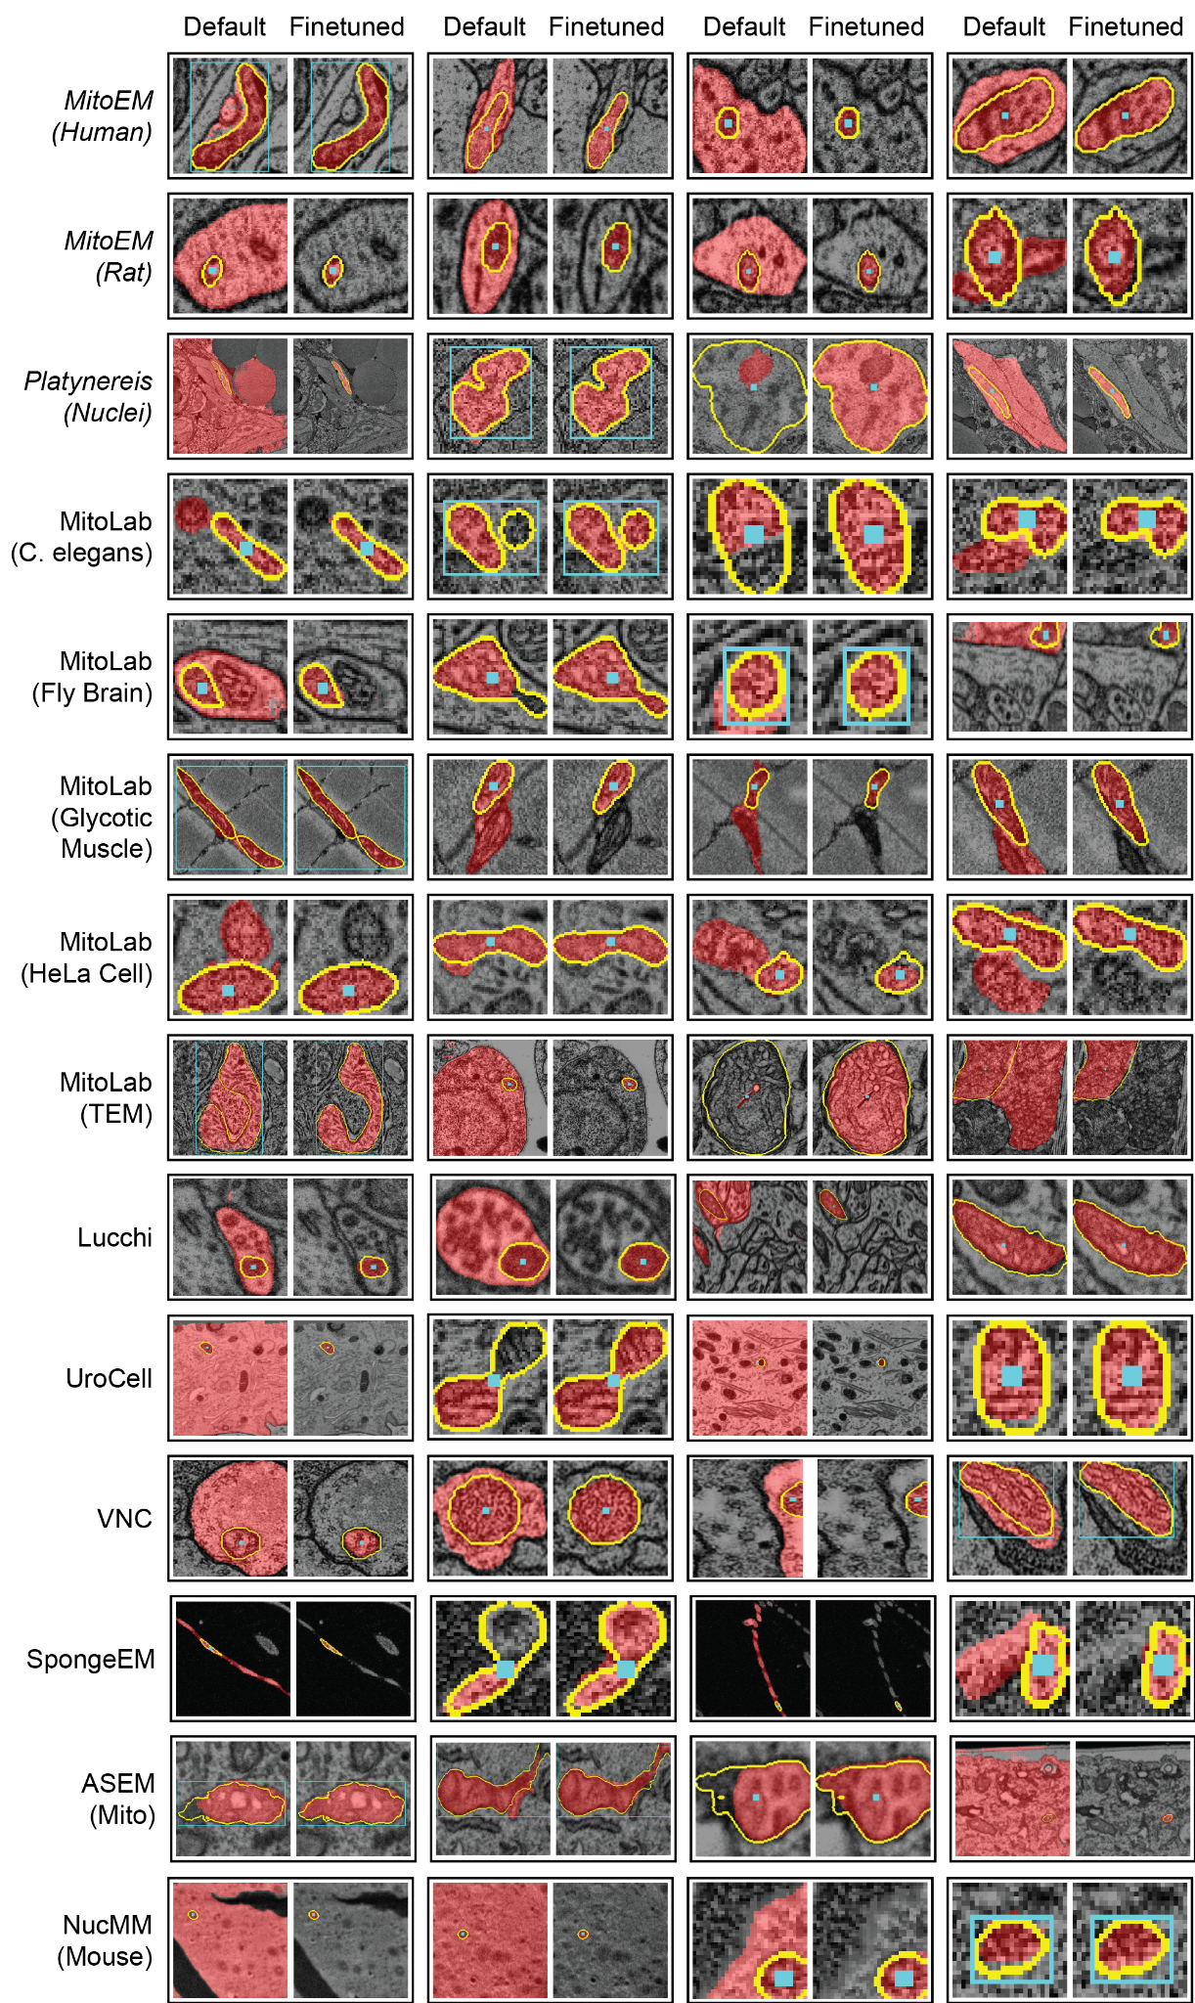
Interactive Segmentation:
In domain & Out-of-domain

Slide 31
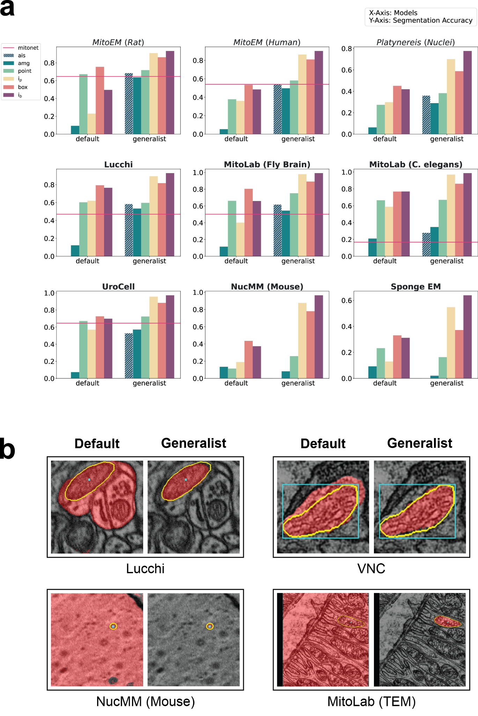
Results: In & out-of domain
ViT Large
Evaluation: Same approach as for LM
In domain (top row)
Out of domain (rest)

Slide 32
Results: In & out-of domain
ViT Large
Evaluation: Same approach as for LM
In domain (top row)
Out of domain (rest)
Conclusions:
Finetuning improves, best model is vit_l
Similar performance to MitoNet on most datasets (AIS)
Improves segmentation for some other organelles (cilia, microvilli), but worsens it for cellular compartments
  Bigger diversity in EM!

Slide 33
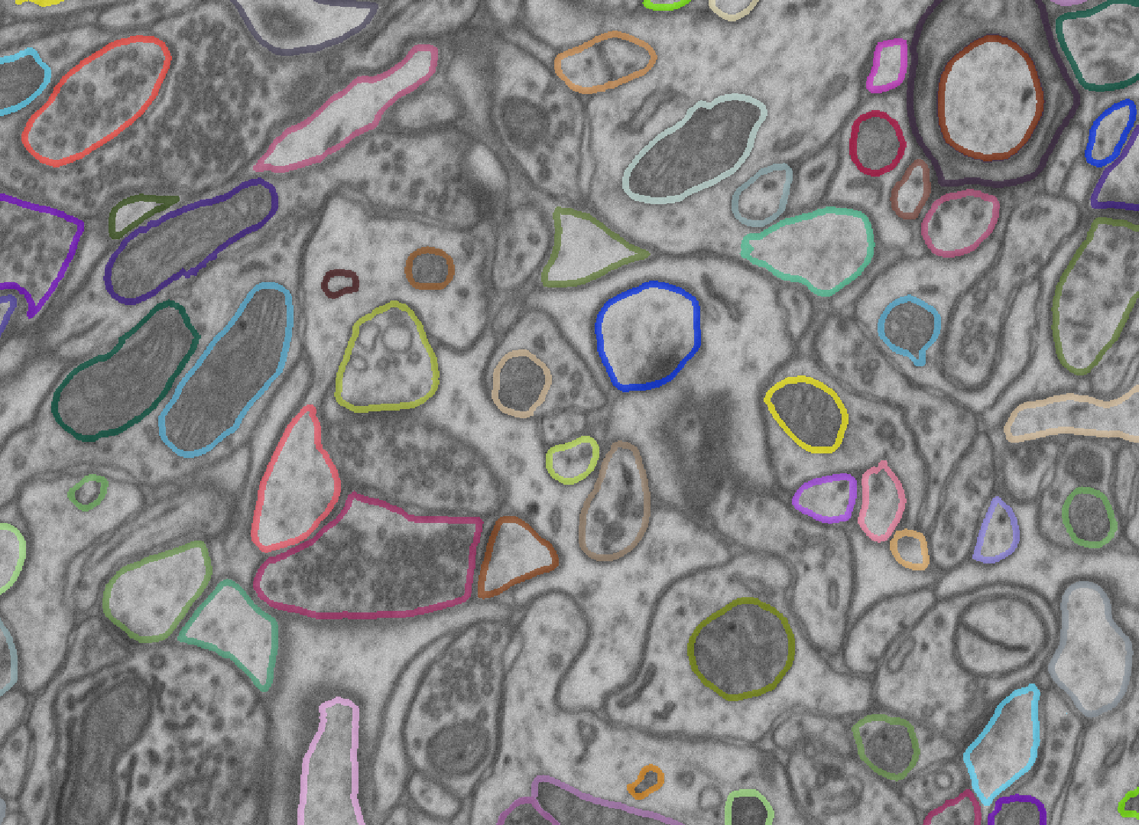
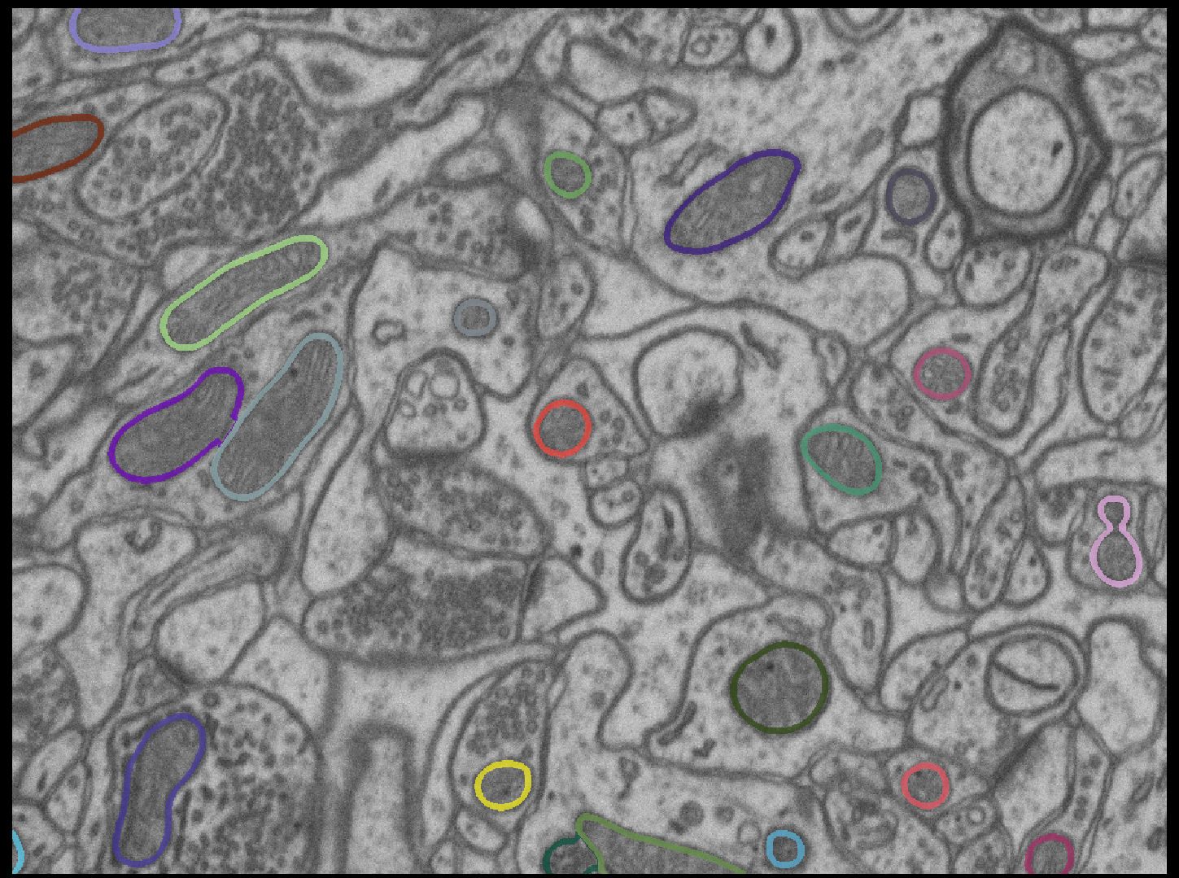
Mitochondria
Instance segmentation on Lucchi Dataset
Runtimes on laptop (CPU);
including embedding computation (dominates for AIS)
VIT-B-EM
AIS: 10 sec
VIT-B
AMG: 80 sec

Slide 34
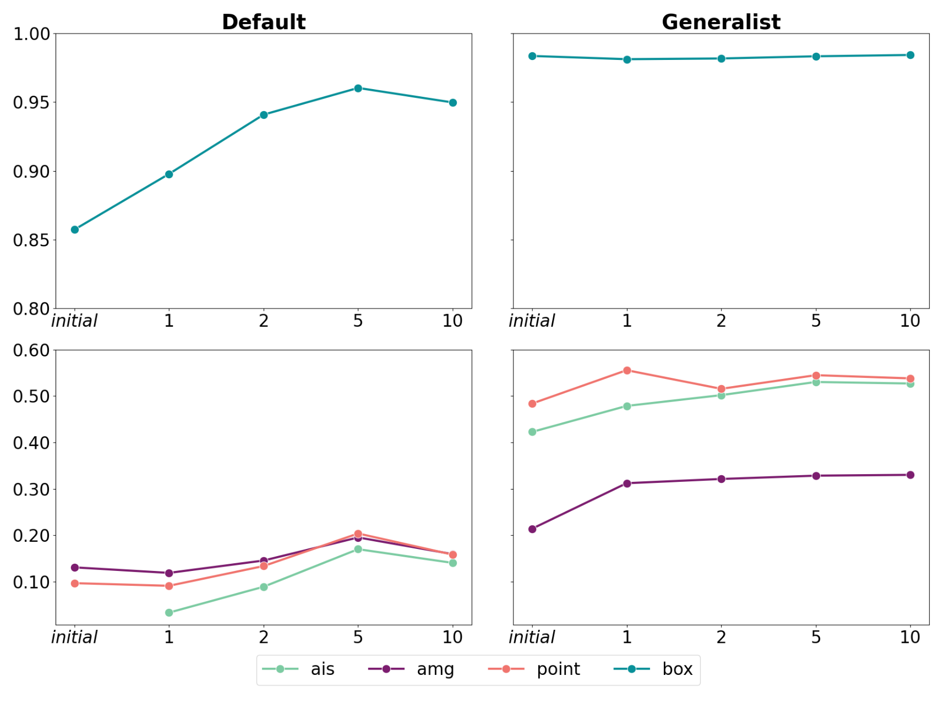
Finetuning as a user
Improve models further for your data?
How much data is needed?
Which computational resources are required?

Slide 35
Finetuning as a user
Improve models further for your data?
How much data is needed?
Which computational resources are required?
Few images with annotations are sufficient!
Finetuning is possible on CPU (but takes quite long); reasonable time on a GPU.

Slide 36
Application in practice
SAM (pretrained
for modality)
New microscopy data
Automatic Segmentation

Slide 37
Application in practice
SAM (pretrained
for modality)
New microscopy data
Automatic Segmentation
Result not
good enough?
Interactive correction

Slide 38
Application in practice
SAM (pretrained
for modality)
New microscopy data
Automatic Segmentation
Result not
good enough?
Interactive correction
Small dataset?
Done!

Slide 39
Application in practice
“Personalized” SAM
Retrain!
Large dataset?
New microscopy data
Automatic Segmentation
Result not
good enough?
Interactive correction
Small dataset?
Done!

Slide 40
Application in practice
“Personalized” SAM
Retrain!
Large dataset?
New microscopy data
Automatic Segmentation
Result not
good enough?
Interactive correction
Small dataset?
Compared to CellPose “Human-in-the loop”
Support for more modalities (EM!)
Interactive correction speeds up annotation significantly!
BUT: Training model takes longer (esp. on CPU)
Done!

Slide 41
microSAM:
Napari Integration

Slide 42
microSAM: SAM for napari
napari plugins that enable interactive and automatic:
  2D Segmentation
  3D Segmentation
  Tracking (2D + time)
  Finetuning on own data
Core functionality:
  Default + finetuned models
  Multidimensional segmentation / tracking
  (interactive and automatic)
  Tiled prediction for large images

Slide 43

microSAM: SAM for napari
napari plugins that enable interactive and automatic:
  2D Segmentation
  3D Segmentation
  Tracking (2D + time)
  Finetuning on own data
Core functionality:
  Default + finetuned models
  Multidimensional segmentation / tracking
  (interactive and automatic)
  Tiled prediction for large images
Code and documentation available at:
https://github.com/computational-cell-analytics/micro-sam
New release (v0.5):
Latest microscopy models,
compatible with BioImage.IO modelzoo.
Updated and extended UI,
napari plugin integration.
Will be announced later this or early next week
(it’s done, but we need to test it and
update documentation).

Slide 44
Plan Live Demos
Starting the tool, explain components
2D Segmentation on LiveCELL
  Compare default and finetuned model (vit_b, show auto segmentation for vit_b)
2D Segmentation with tiling (with vit_t)
3D Segmentation on Lucchi
  Use precomputed embeds and amg
Finetuning (on the Lucchi data we have annotated)

Slide 45
Next Steps & Outlook

Slide 46
Next steps
Feedback and contributions on the tool are very welcome!
Create v1.0 release: same as v0.5 with additional:
  Full BioImage.IO integration to enable cross-compatibility.
    Microscopy Image Browser, QuPath, BioEngine, …
Integration of efficient training procedures for finetuning (LoRA)
  To enable better training on CPU and small GPUs
Provide better and more models:
  EM Organelle Generalist Model
    Training on OpenOrganelle and other organelle segmentation datasets.
  Histopathology Model
Check out our repository for all the details:
https://github.com/computational-cell-analytics/micro-sam

Slide 47
Outlook:
Universal microscopy segmentation and tracking
Incorporate 3D (2D + time) segmentation in SAM-like model
  Advantage Transformer: same model for 2d and 3d is possible!
Vision Mamba: Investigate newer (more efficient) architectures
  Our recent (preliminary!) work: https://arxiv.org/abs/2404.07705
Semantic awareness (e.g. differentiate organelles in EM, one model for microscopy)
Zero-shot adaptation (improve segmentation from examples)

Slide 48
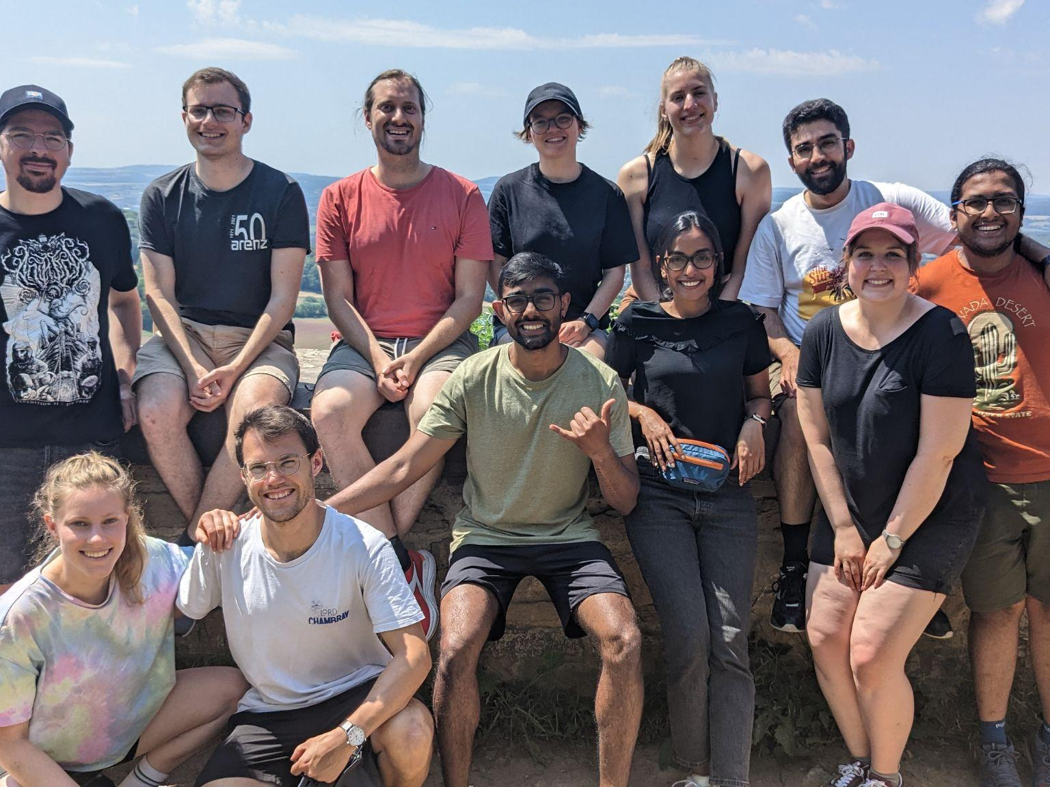


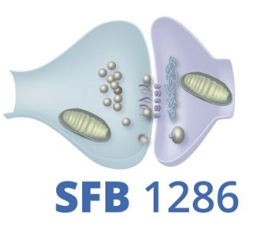



Acknowledgments
EMBL Heidelberg
Anna Kreshuk & her group
et al.
Uni Göttingen & Campus
Alexander Ecker
Tobias Moser
Silvio Rizzoli
et al.
My group
Anwai Archit
Luca Freckmann
Sushmita Nair
Marei Freitag
Sagnik Gupta
et al.

