Slide 1


Vision Transformers & Vision Foundation Models
Segment Anything & Applications in Microscopy
Constantin Pape
Institut für Informatik, Georg August Universität Göttingen
ccpape
https://user.informatik.uni-goettingen.de/~pape41/

Slide 2
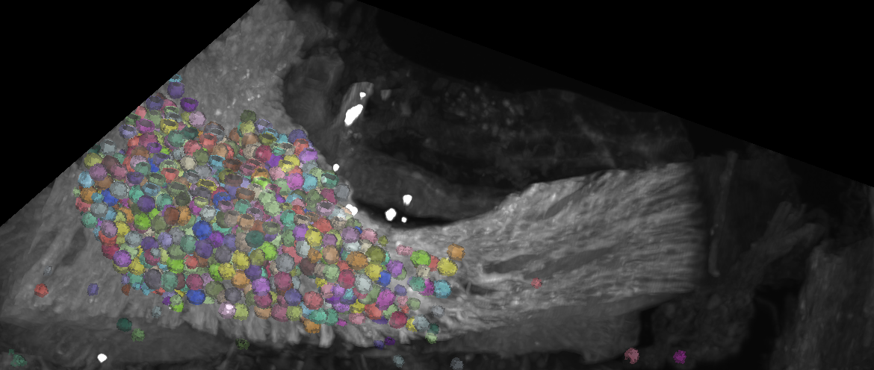
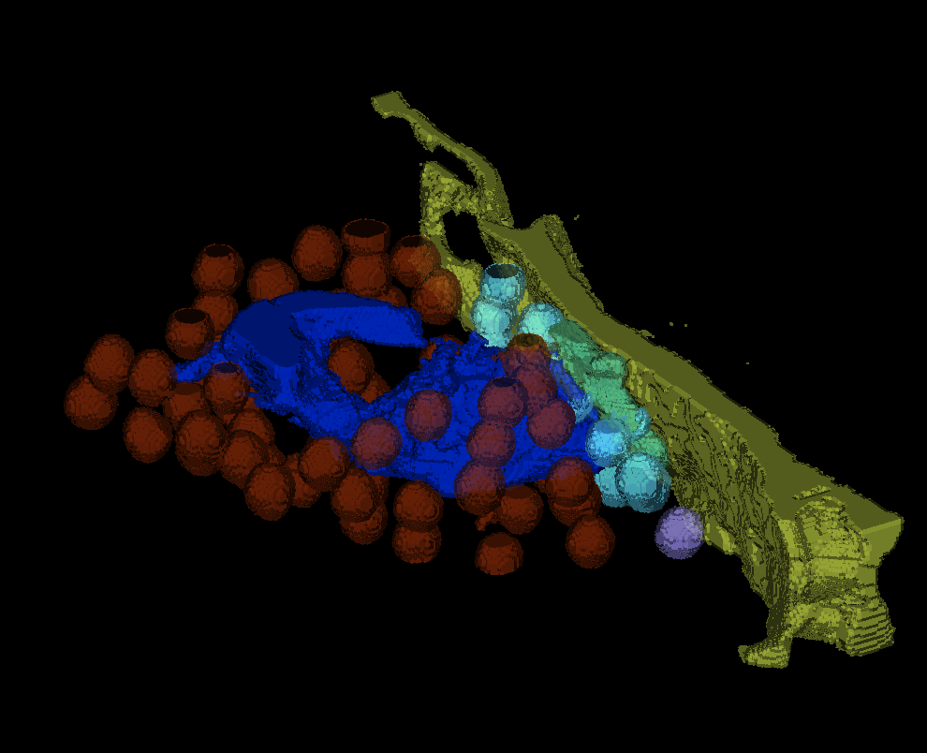
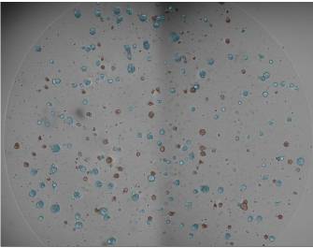
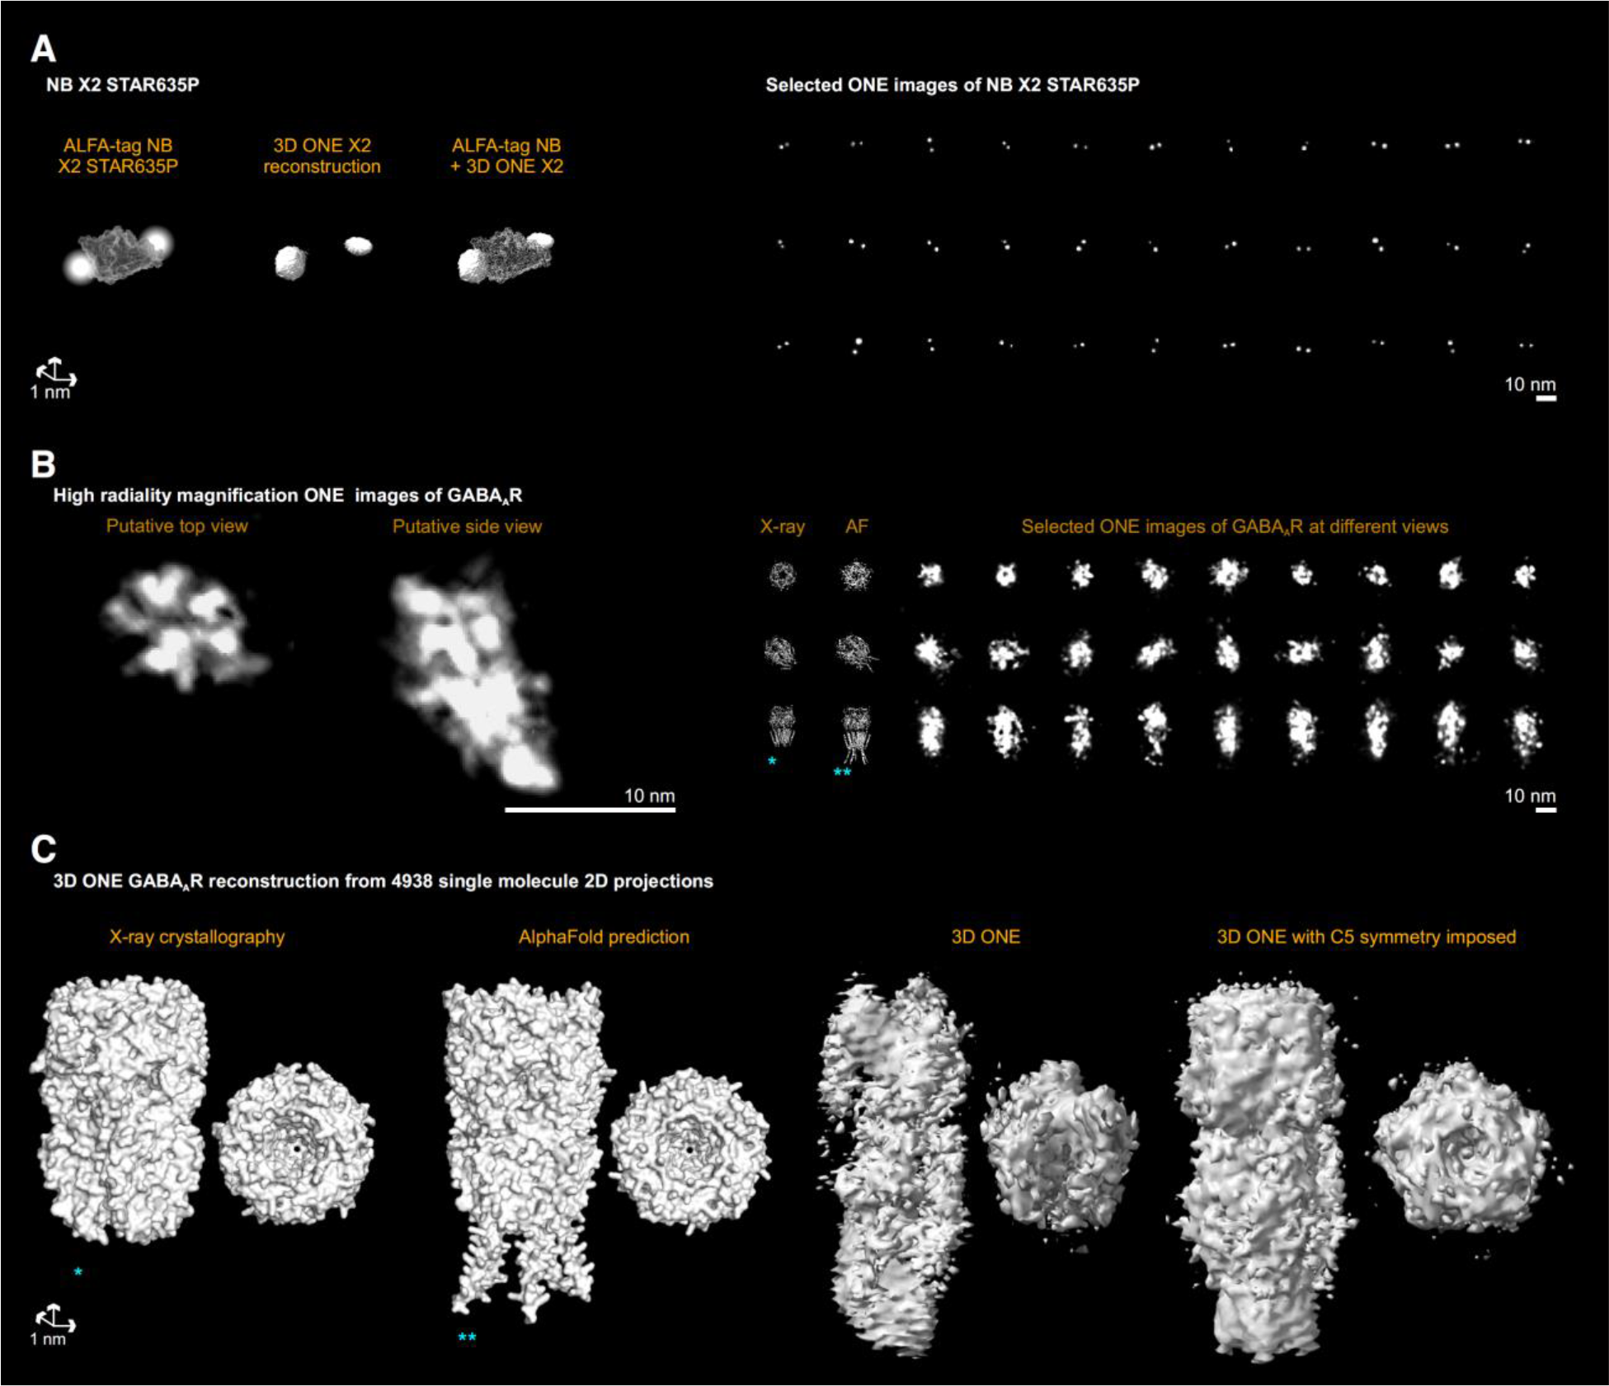
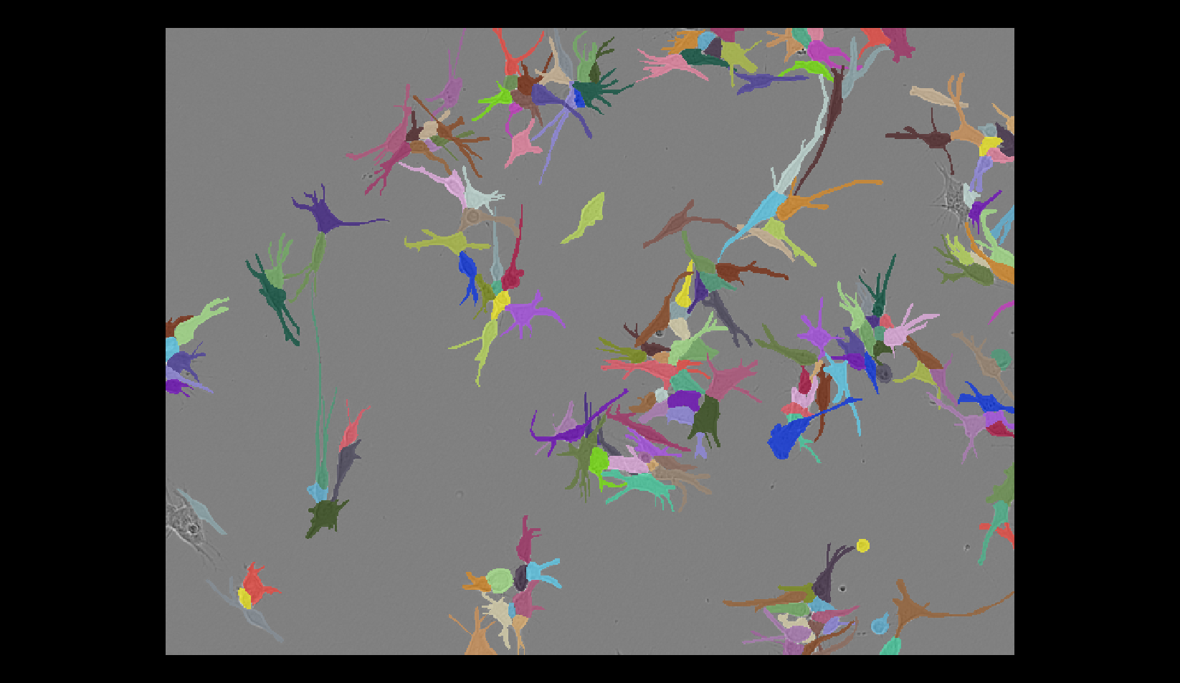
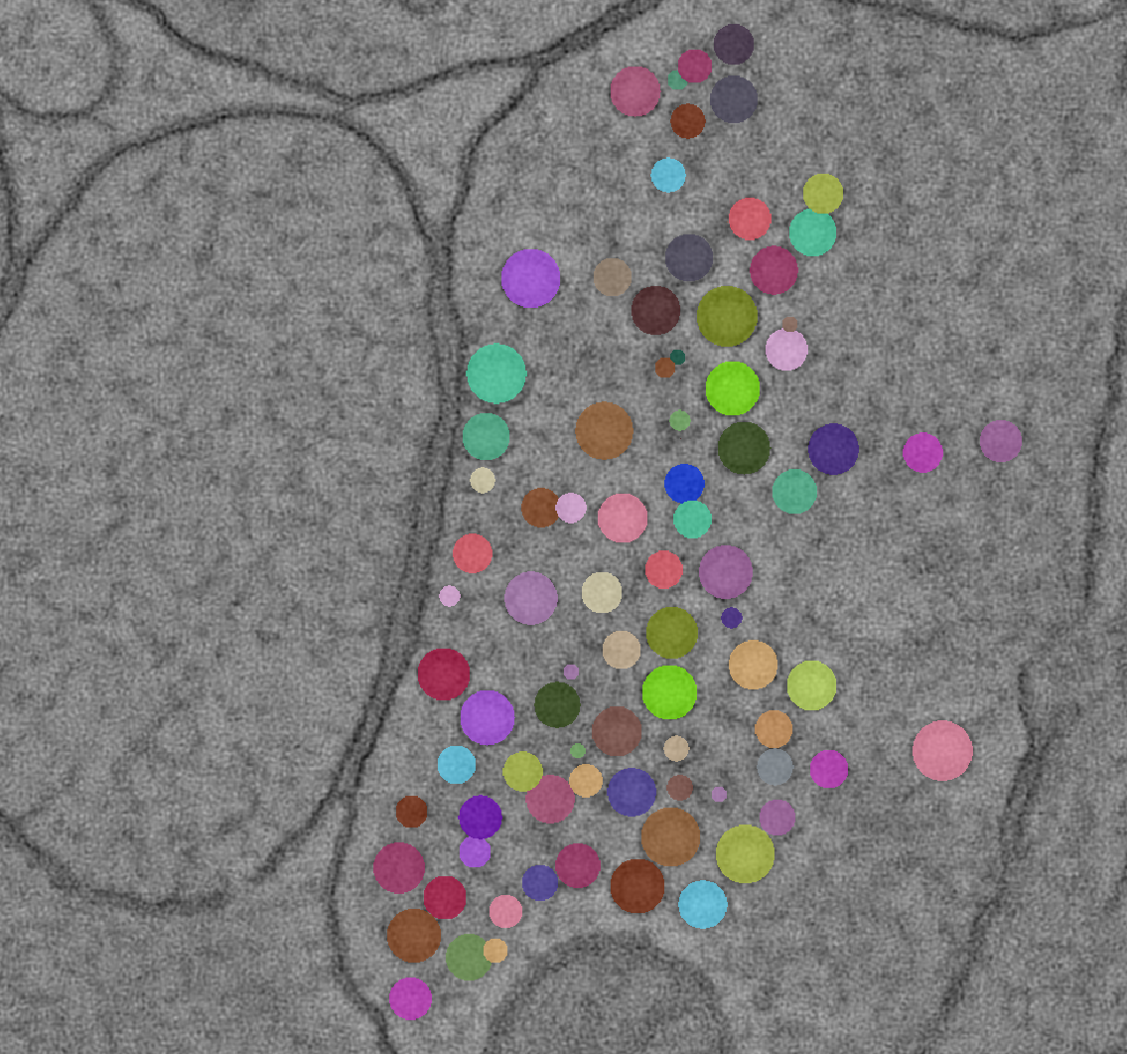
Group vision: from images to insight and clinical relevance in collaboration with life scientists
What we do …
Representation learning for microscopy and multi-modal data
Segmentation and tracking lots of stuff in microscopy
Protein structure analysis in cryo ET and optical microscopy

Slide 3
Group vision: from images to insight and clinical relevance in collaboration with life scientists
Segmentation and tracking lots of stuff in microscopy
Feasible with established DL methods (U-Net -> CellPose / StarDist, …)
IF sufficient annotations / ground-truth!
Data annotation is a big bottleneck!
“Zero-shot” generalization is limited
-> need retraining unless their training data is quite similar

Slide 4
Vision Transformers
& Vision Foundation Models

Slide 5


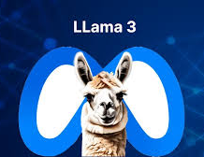
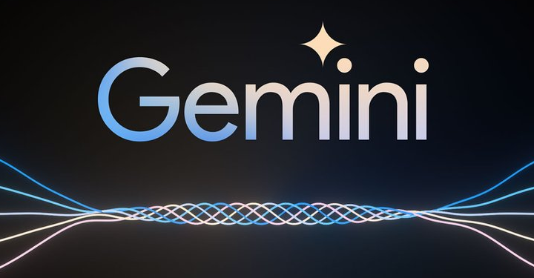
Large language models
Notes:
From lecture 1, TODO copy image credits

Slide 6
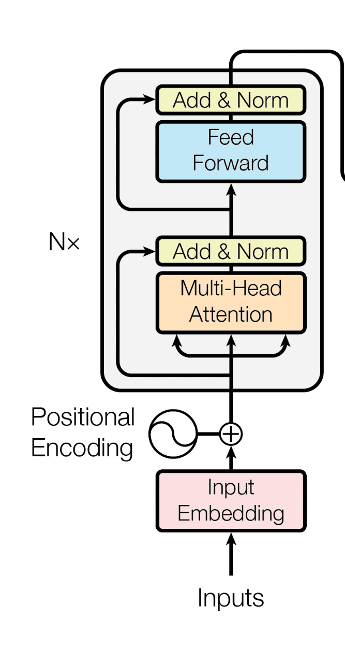





Large language models
Massive Dataset
Transformer
Downstream Tasks
Chatbot
Translation
Text Analysis
& Summary
Coding assistant
Notes:
From lecture 1, TODO copy image credits

Slide 7
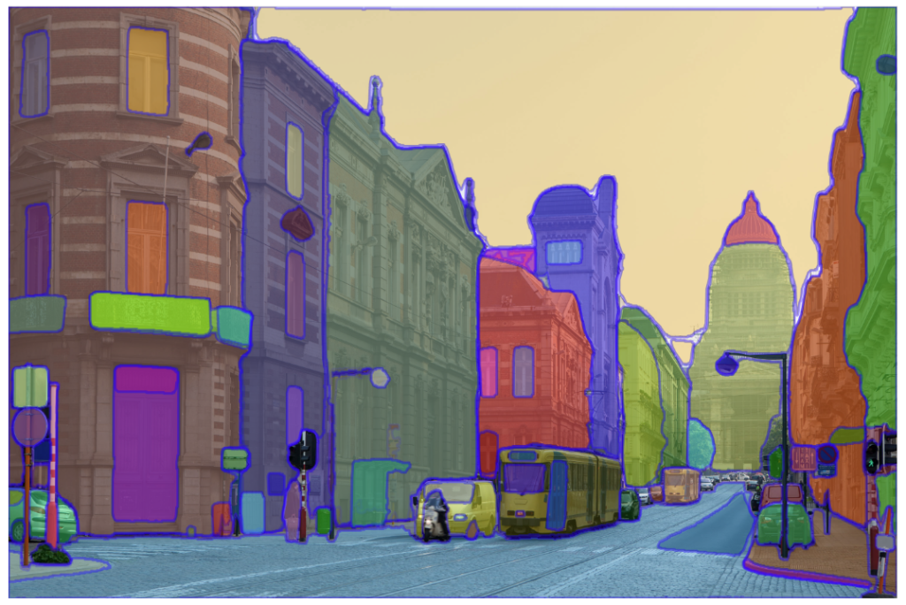
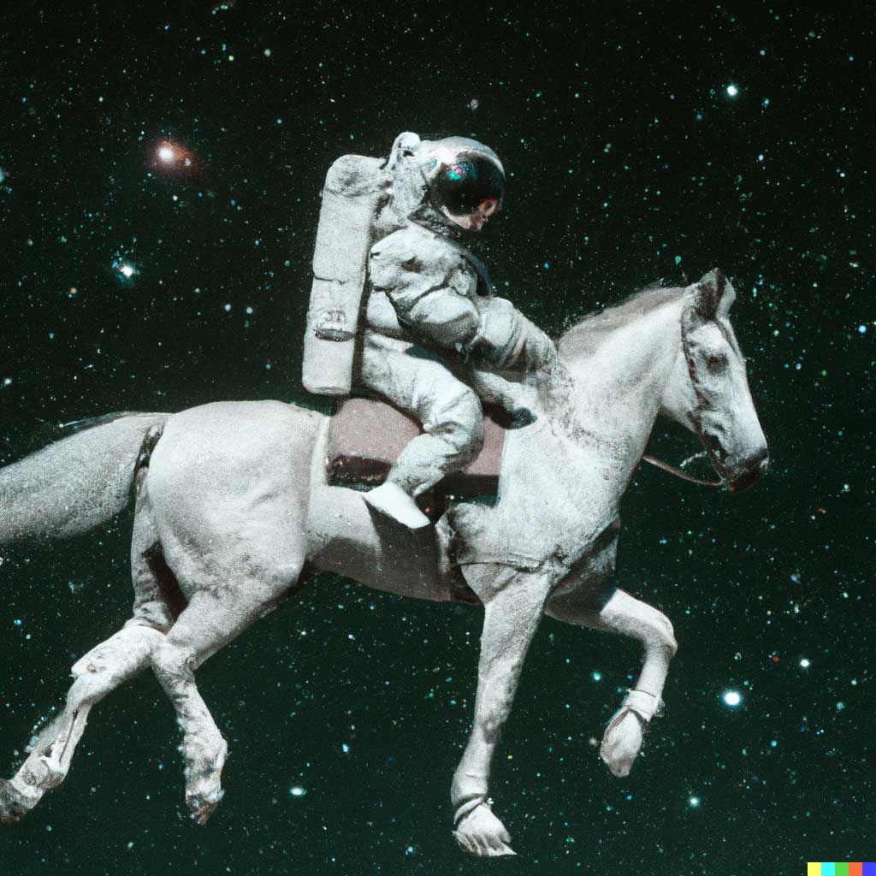
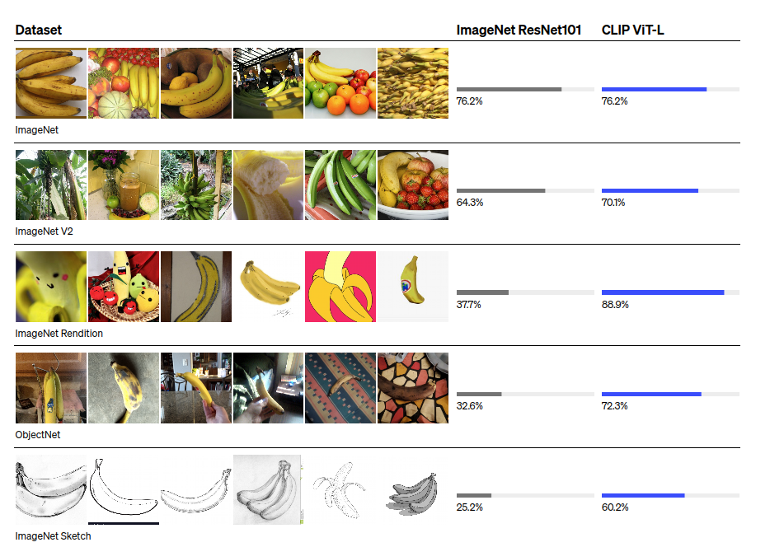
Can we do the same for vision?
Vision foundation models
CLIP: Connecting
text and images
An astronaut riding
a horse in photorealistic
style.
Segment Anything

Slide 8
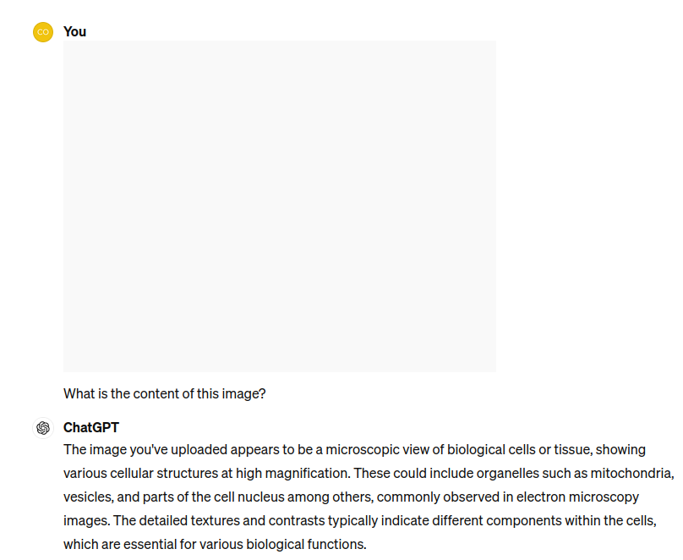
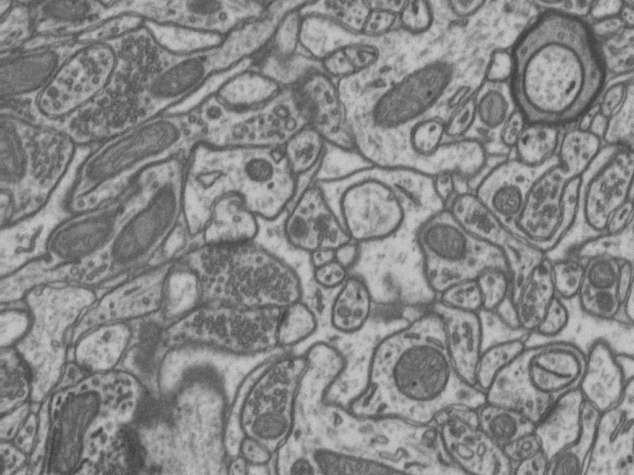
Can we do the same for vision?
Vision foundation models
GPT4 Vision
CLIP: Connecting
text and images
An astronaut riding
a horse in photorealistic
style.
Segment Anything

Slide 9
What is a transformer?

Slide 10
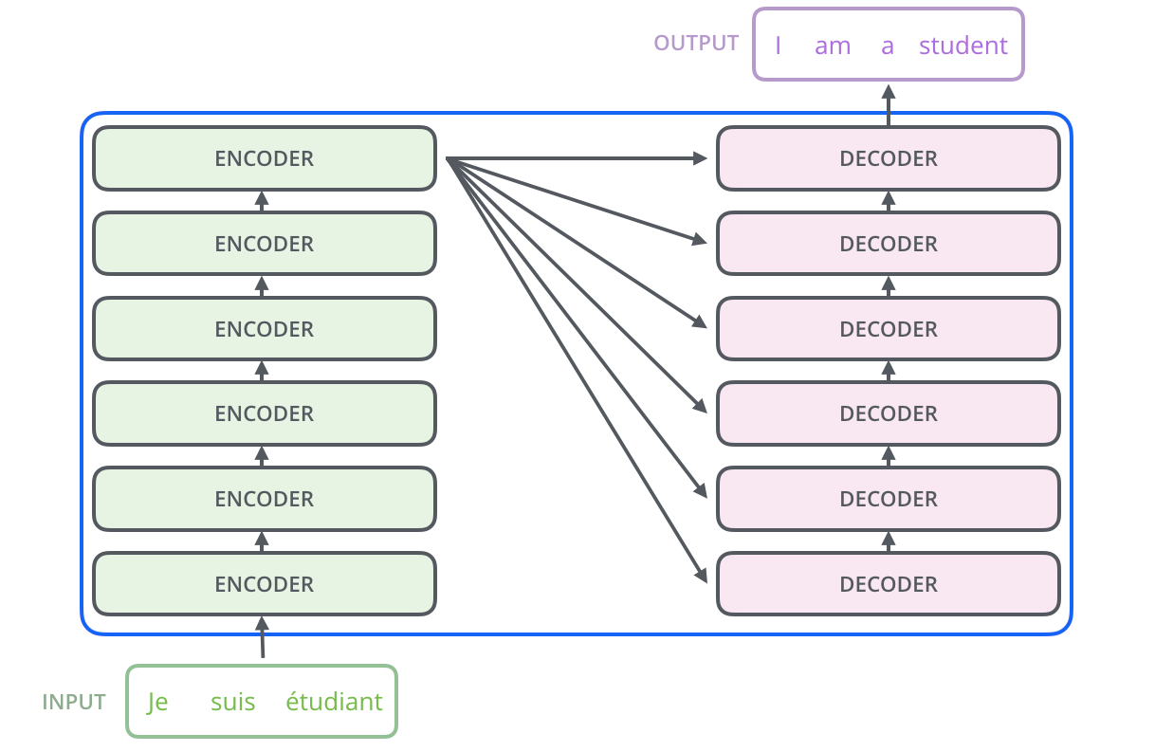
Transformer
Sequence to sequence models
Translation
Text generation
…

Slide 11
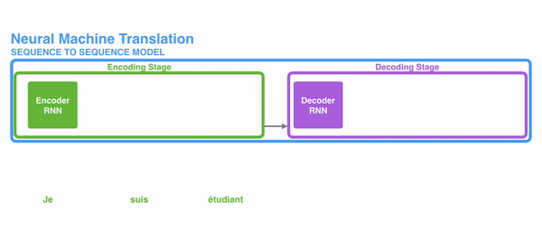
Why transformers?
Previously: Recurrent Neural Networks (RNNs) like LSTM
Problem: information decays over steps / “not enough memory”

Slide 12
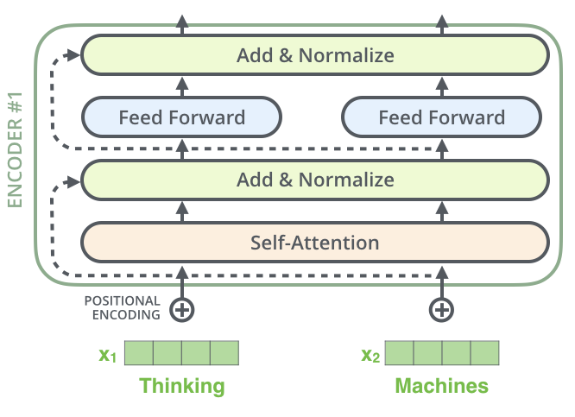
Transformer Block
https://jalammar.github.io/illustrated-transformer/
https://arxiv.org/abs/1706.03762

Slide 13
Transformer Block
https://jalammar.github.io/illustrated-transformer/
https://arxiv.org/abs/1706.03762
The input: “tokenize” elements of your input
sequence: compute a vector for each
element
Problem dependent!

Slide 14
Transformer Block
https://jalammar.github.io/illustrated-transformer/
https://arxiv.org/abs/1706.03762
Self-attention: propagate information between
tokens, all-to-all connectivity
Attention: learns “affinities” between
pairs of elements

Slide 15
Transformer Block
https://jalammar.github.io/illustrated-transformer/
https://arxiv.org/abs/1706.03762
Add & Normalize: propagate information from before the layer, like ResNet
Learn residual transformations,
helps gradient flow

Slide 16
Transformer Block
https://jalammar.github.io/illustrated-transformer/
https://arxiv.org/abs/1706.03762
Feed forward: process the individual tokens
= individual elements

Slide 17
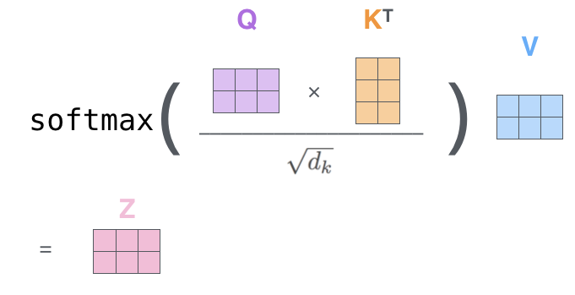
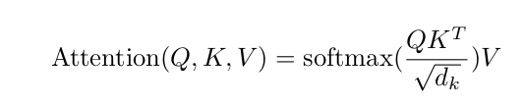
Self-Attention
https://jalammar.github.io/illustrated-transformer/
https://arxiv.org/abs/1706.03762

Slide 18
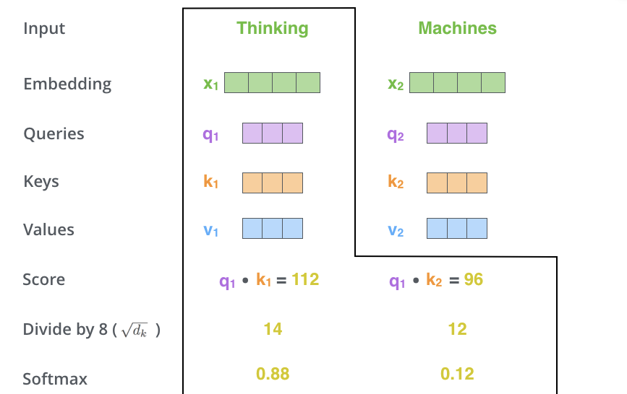
Self-Attention
https://jalammar.github.io/illustrated-transformer/
https://arxiv.org/abs/1706.03762

Slide 19
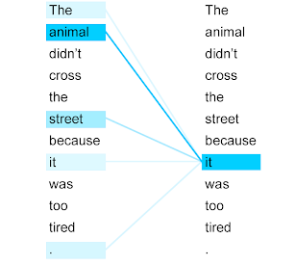
Self-Attention
https://jalammar.github.io/illustrated-transformer/
https://arxiv.org/abs/1706.03762

Slide 20
Where is the learning happening???
https://jalammar.github.io/illustrated-transformer/
https://arxiv.org/abs/1706.03762

Slide 21
Where is the learning happening???
https://jalammar.github.io/illustrated-transformer/
https://arxiv.org/abs/1706.03762
How do we obtain Q, K, V?

Slide 22
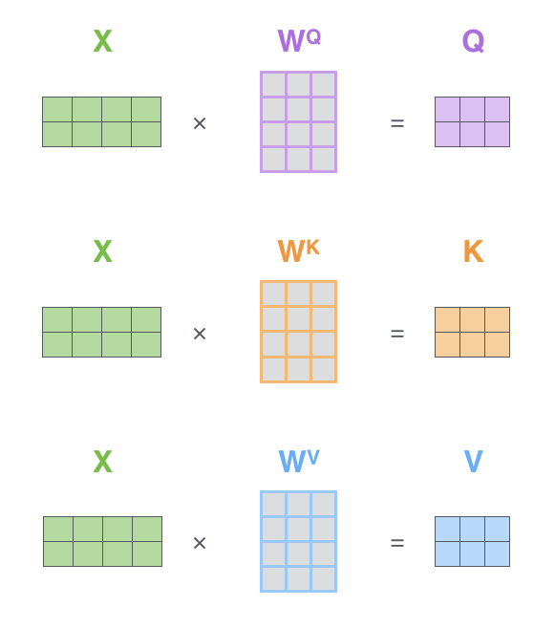
Where is the learning happening???
https://jalammar.github.io/illustrated-transformer/
https://arxiv.org/abs/1706.03762
How do we obtain Q, K, V?
Computed from X (input tokens) with learned weights.
A fully connected layer.

Slide 23




Self-Attention vs. Feed-Forward
Self-Attention:
Fully connected layer:

Slide 24
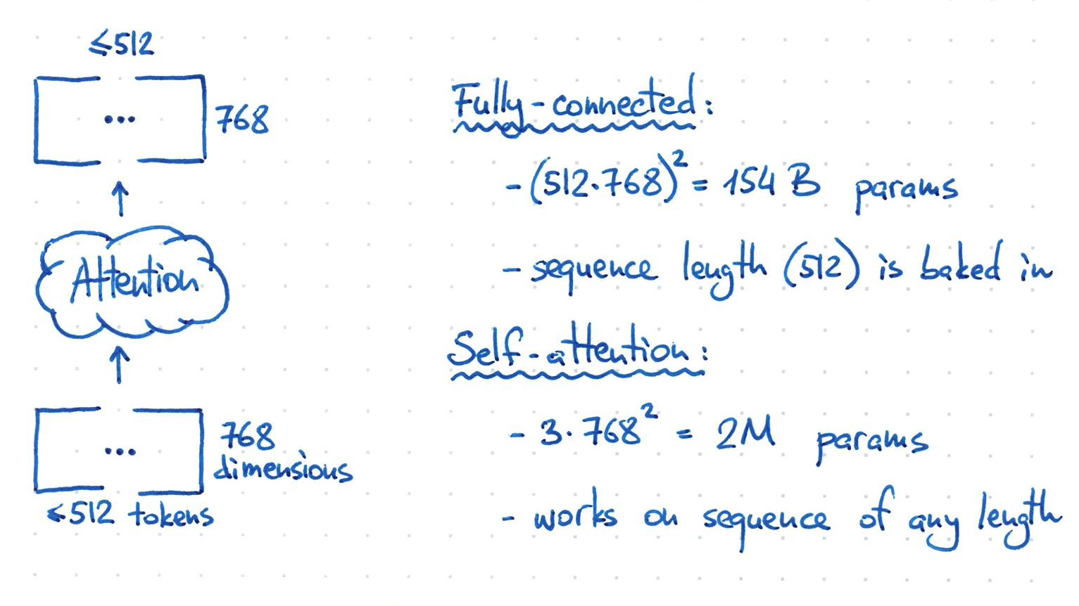
Self-Attention vs. Feed-Forward
https://twitter.com/hippopedoid/status/1641432291149848576

Slide 25
Self-Attention vs. Feed-Forward
https://twitter.com/hippopedoid/status/1641432291149848576
Learnable parameters
Learnable parameters

Slide 26
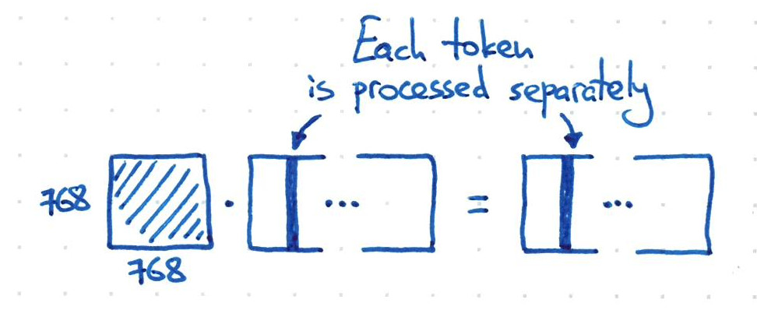
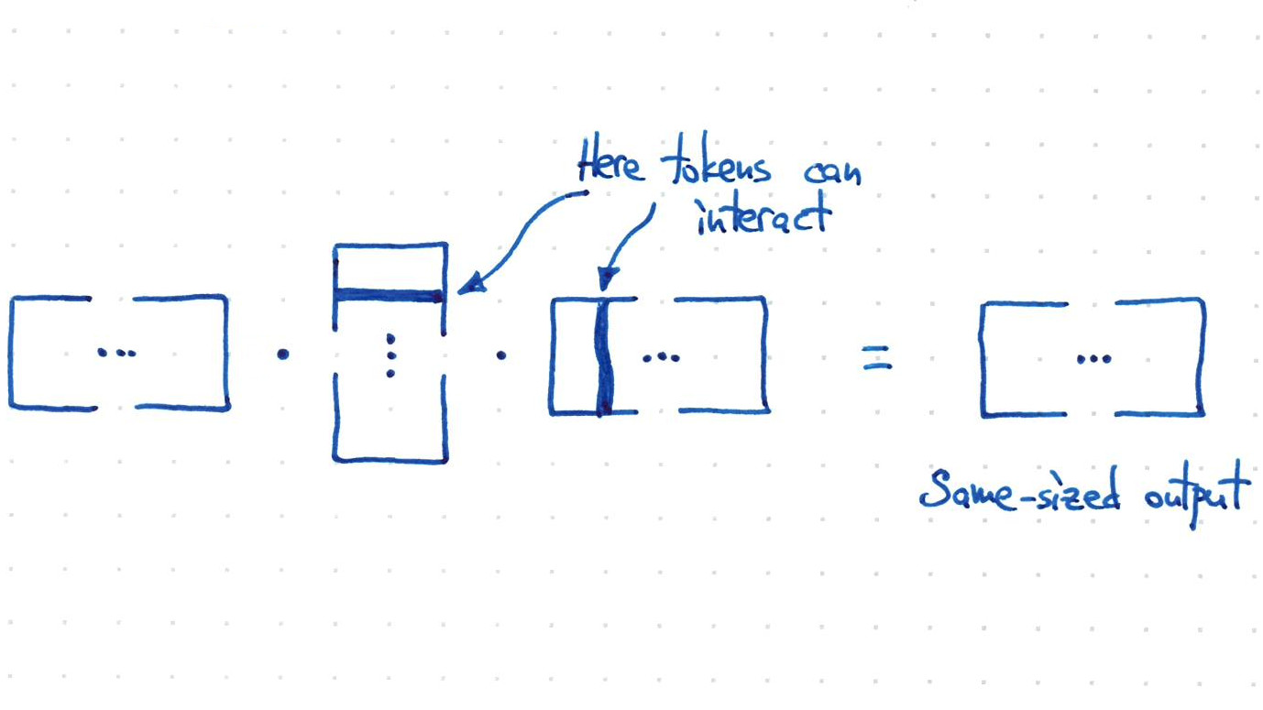
Self-Attention in a nutshell
https://twitter.com/hippopedoid/status/1641432291149848576
The weights:
Self-attention:
arbitrary sequence length
fixed number of learnable parameters
encodes pairwise affinity between sequence elements
softmax( )

Slide 27
Self-Attention in a nutshell
https://twitter.com/hippopedoid/status/1641432291149848576
The weights:
Arbitrary sequence length, fixed number of parameters!
Did we get a free lunch???
Self-attention:
arbitrary sequence length
fixed number of learnable parameters
encodes pairwise affinity between sequence elements
softmax( )

Slide 28
Self-Attention in a nutshell
https://twitter.com/hippopedoid/status/1641432291149848576
The weights:
Arbitrary sequence length, fixed number of parameters!
Did we get a free lunch???
Quadratic complexity in sequence length (at runtime):
Self-attention matrix is of size: n_{elements} x n_{elements}
Self-attention:
arbitrary sequence length
fixed number of learnable parameters
encodes pairwise affinity between sequence elements
softmax( )

Slide 29
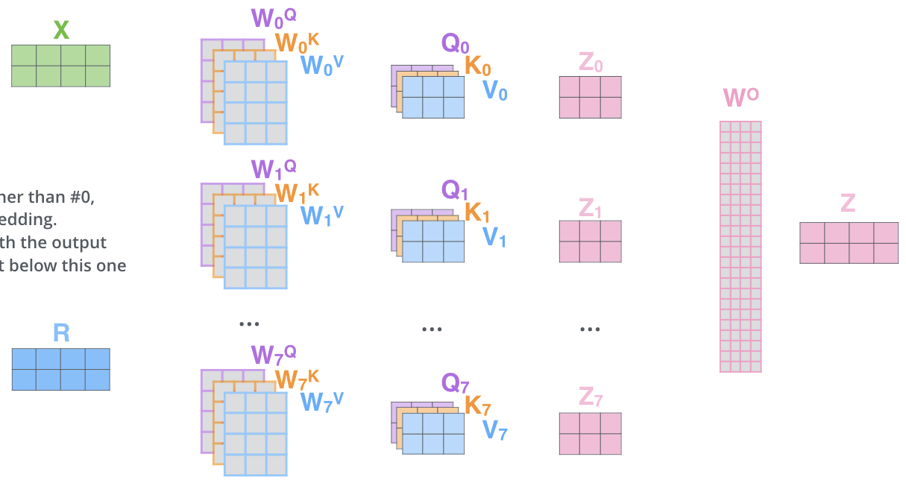
Multi-head self-attention
https://jalammar.github.io/illustrated-transformer/
https://arxiv.org/abs/1706.03762
One attention head is limited in learning interactions.
Combine multiple attention heads!

Slide 30
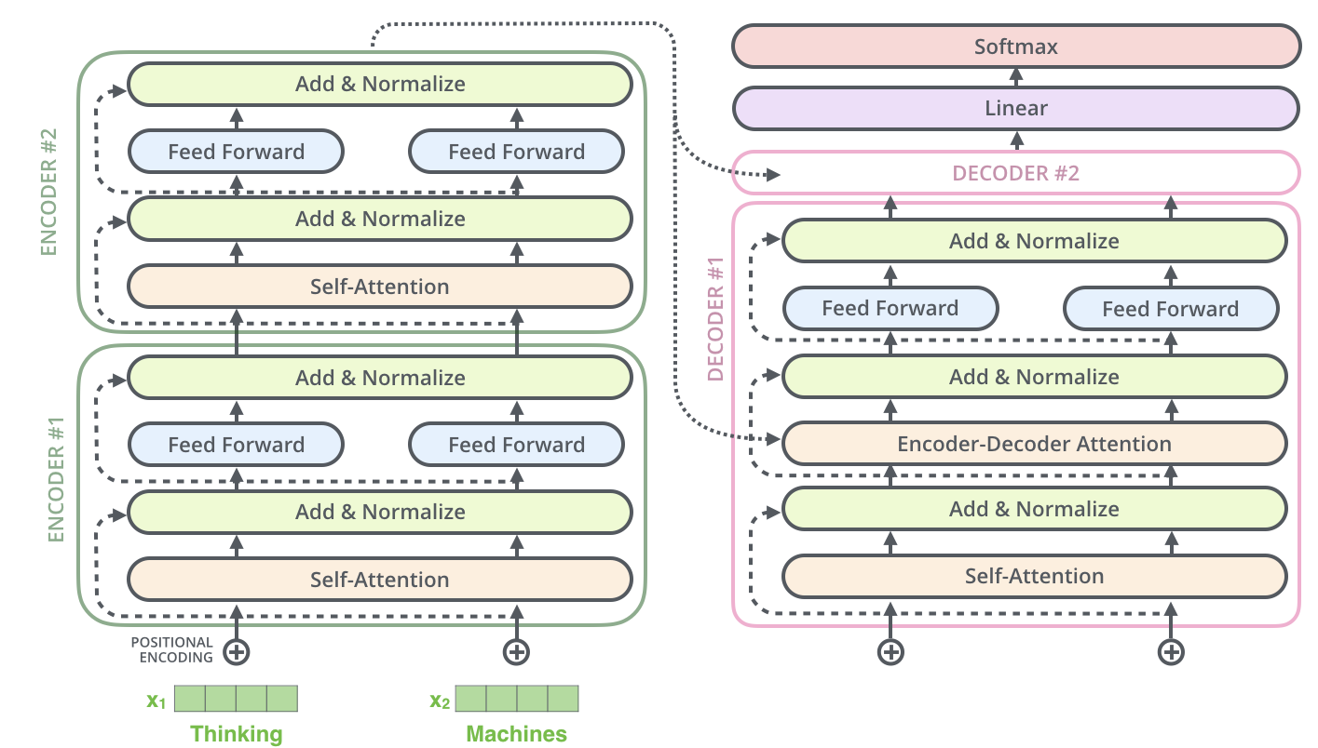
The transformer architecture
https://jalammar.github.io/illustrated-transformer/
https://arxiv.org/abs/1706.03762
Encoder:
stack transformer blocks.
Maps to internal sequence representation
Decoder:
Encoder-Decoder Attention
uses outputs from last
layer as keys

Slide 31
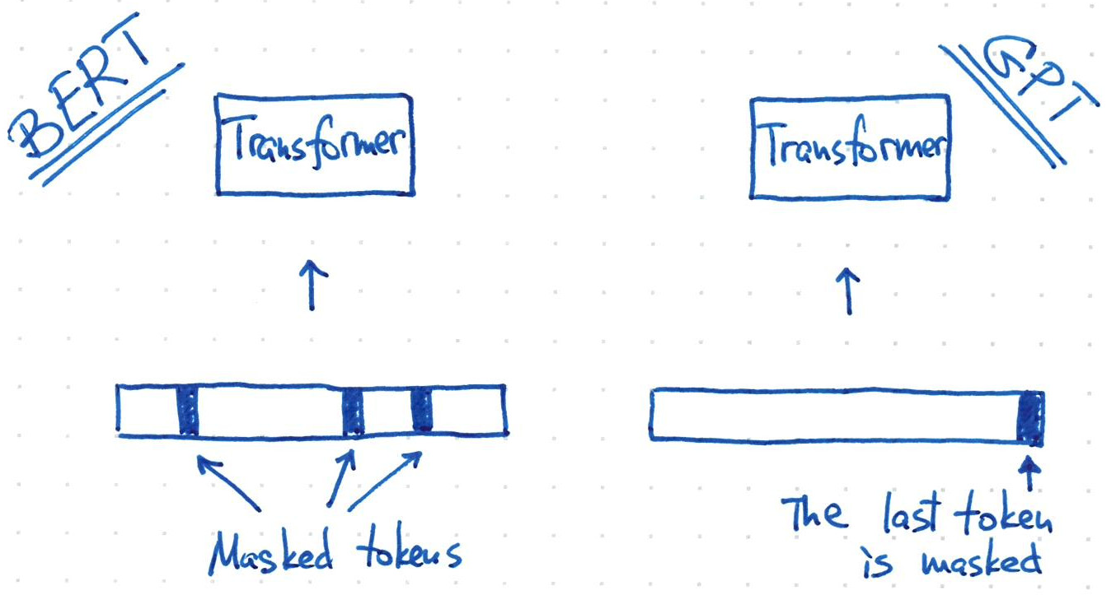
Transformers in NLP: Large Language Models
BERT: https://arxiv.org/abs/1810.04805
GPT3: https://arxiv.org/abs/2005.14165
Instruction Finetuning: https://arxiv.org/abs/2203.02155
RLHF: https://arxiv.org/abs/1909.08593
Autoregressive pretraining: predict part of sequence from the rest, trained on large corpus
  BERT: Mask random tokens
  GPT: Mask last token
  ChatGPT, GPT4, LLAMA, …
Application to downstream tasks (Translation, Chatbot, …)
  Instruction fine-tuning (training on supervised samples)
  Reinforcement learning from human feedback (RLHF) (rating of reponses)

Slide 32
Vision transformers

Slide 33
Why and how?
Motivations:
Success in NLP
“Scaling laws”: transformer performance scales with dataset size
Sequence representation is universal -> combine vision, text etc.
Remove inductive biases?

Slide 34
Why and how?
Motivations:
Success in NLP
“Scaling laws”: transformer performance scales with dataset size
Sequence representation is universal -> combine vision, text etc.
Remove inductive biases?
How can we represent an image as a sequence?

Slide 35
Why and how?
Motivations:
Success in NLP
“Scaling laws”: transformer performance scales with dataset size
Sequence representation is universal -> combine vision, text etc.
Remove inductive biases?
How can we represent an image as a sequence?
Tokenize every pixel: too many elements! (Remember quadratic complexity)
Tokenize small patches!

Slide 36
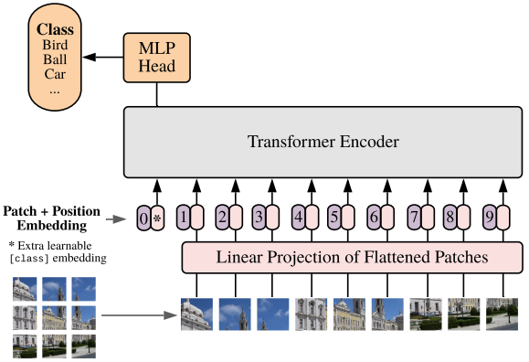
The Vision Transformer (ViT)
https://arxiv.org/abs/2010.11929
Tokenize patches + position embedding
(encode position of patch in the image)
Encoder: same as in NLP
Classification based head on top of
transformer output.

Slide 37
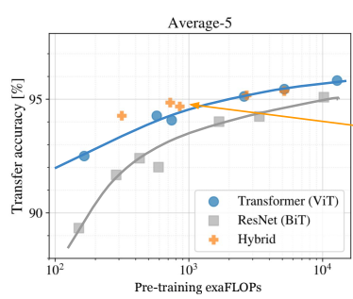
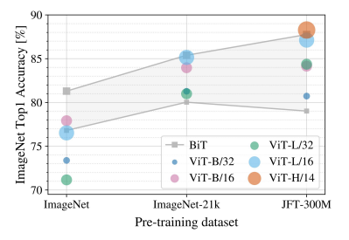
The Vision Transformer (ViT)
https://arxiv.org/abs/2010.11929

Slide 38
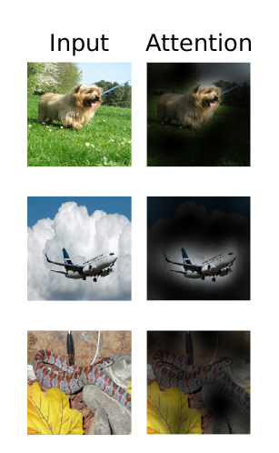
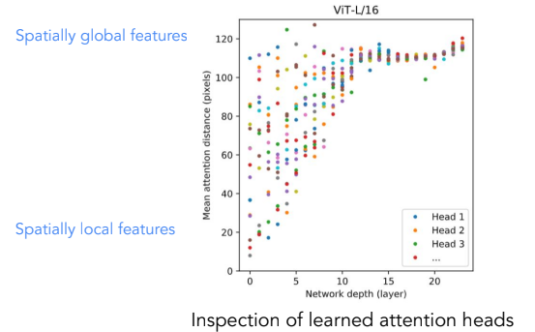
What does attention learn?
https://sites.google.com/view/cvpr-2022-beyond-cnn
https://arxiv.org/abs/2010.11929

Slide 39
Autoregressive training with ViT?

Slide 40
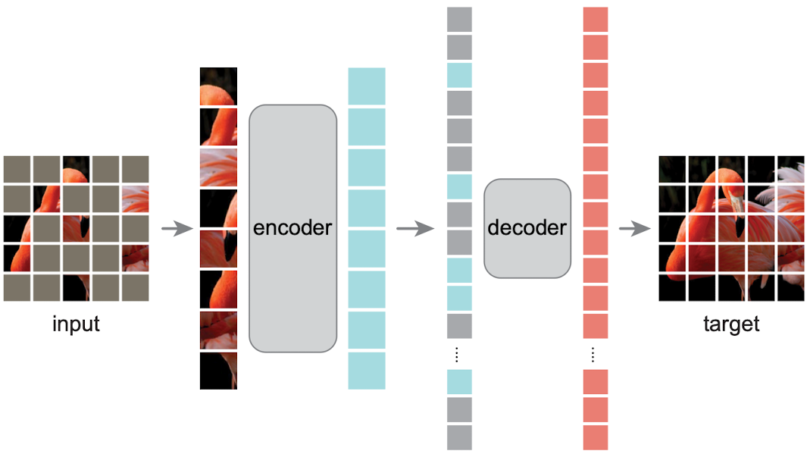
Autoregressive training with ViT!
https://arxiv.org/abs/2111.06377
Masked Auto Encoders

Slide 41
Vision Foundation Models
CLIP: Transformers that encode text and image to shared representation
  Main ingredient of generative image methods: DALL-E, Stable Diffusion, …
DINO v2: Large vision transformer trained with different self-supervised losses
  Powerful image features that enable many downstream tasks
GPT4 Vision / Gemini Vision / …
  Presumably similar architecture to CLIP (no publication!)
Segment Anything Model
  Towards universal and promptable segmentation

Slide 42
Segment Anything
Vision foundation model for segmentation

Slide 43
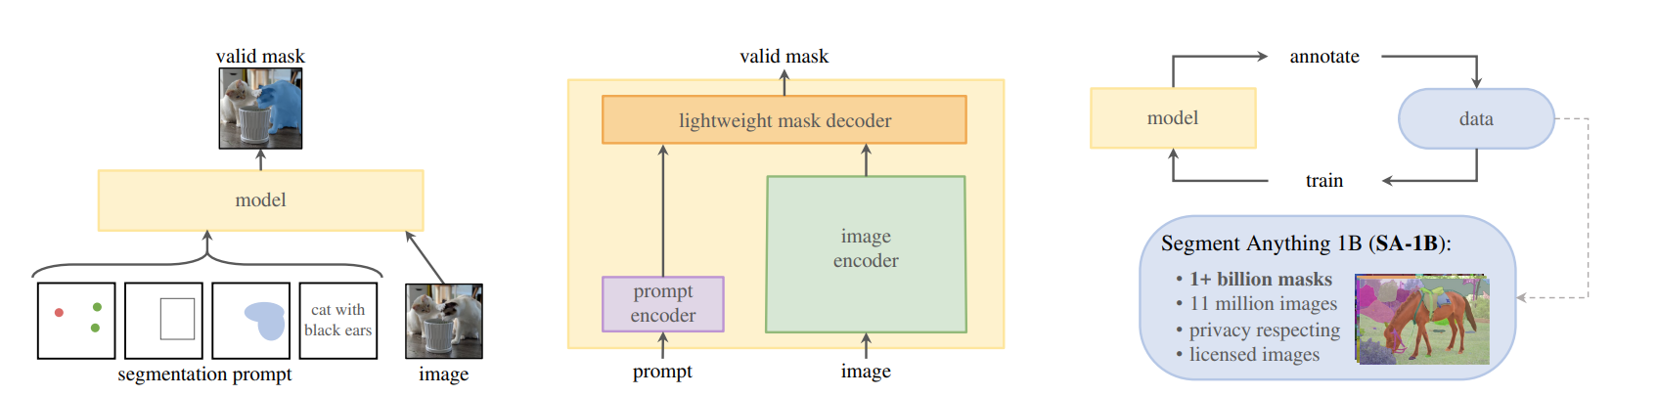
Segment Anything
https://arxiv.org/abs/2304.02643
Pretrained model for interactive segmentation from Meta.AI
SAM: Interactive segmentation
Notes:
Transformer based model for interactive segmentation
Based on user input “prompts”: points, boxes or rough masks outlining object
(Text)
Model: image encoder: transformer predicts image representation
prompt encoder: small transformer that processes prompts
mask decoder: predict current object based on image encoder and prompt
Trained on a very large dataset
Dataset is build iteratively through annotation by annotating with the model (which is retraiend)

Slide 44
Segment Anything
https://arxiv.org/abs/2304.02643
* MobileSAM: https://arxiv.org/abs/2306.14289
Pretrained model for interactive segmentation from Meta.AI
SAM: Interactive segmentation
4 different sizes:
VIT-B (Base)
VIT-L (Large)
VIT-H (Huge)
VIT-T (Tiny)*
Notes:
Transformer based model for interactive segmentation
Based on user input “prompts”: points, boxes or rough masks outlining object
(Text)
Model: image encoder: transformer predicts image representation
prompt encoder: small transformer that processes prompts
mask decoder: predict current object based on image encoder and prompt
Trained on a very large dataset
Dataset is build iteratively through annotation by annotating with the model (which is retraiend)

Slide 45
Segment Anything: What’s special?
Interactive segmentation: segment (almost) arbitrary objects from annotations
  “prompts”: points and/or box and/or mask
  more prompts improve the predictions
Versatile: can be integrated within pipelines that provide prompts
  From user inputs, object detectors, nucleus seeds, …
  Model is fully open-source!
Notes:
Why the hype?
Interactive segmentation works well for different kinds of models and modalities; improve segmenations through more prompts
Versatility
Achieves through the large training dataset AND iterative training loop

Slide 46
Segment Anything: What’s special?
Interactive segmentation: segment (almost) arbitrary objects from annotations
  “prompts”: points and/or box and/or mask
  more prompts improve the predictions
Versatile: can be integrated within pipelines that provide prompts
  From user inputs, object detectors, nucleus seeds, …
  Model is fully open-source!
How?
  Large dataset with diverse images and objects
  Iterative training loop
Notes:
Why the hype?
Interactive segmentation works well for different kinds of models and modalities; improve segmenations through more prompts
Versatility
Achieves through the large training dataset AND iterative training loop

Slide 47
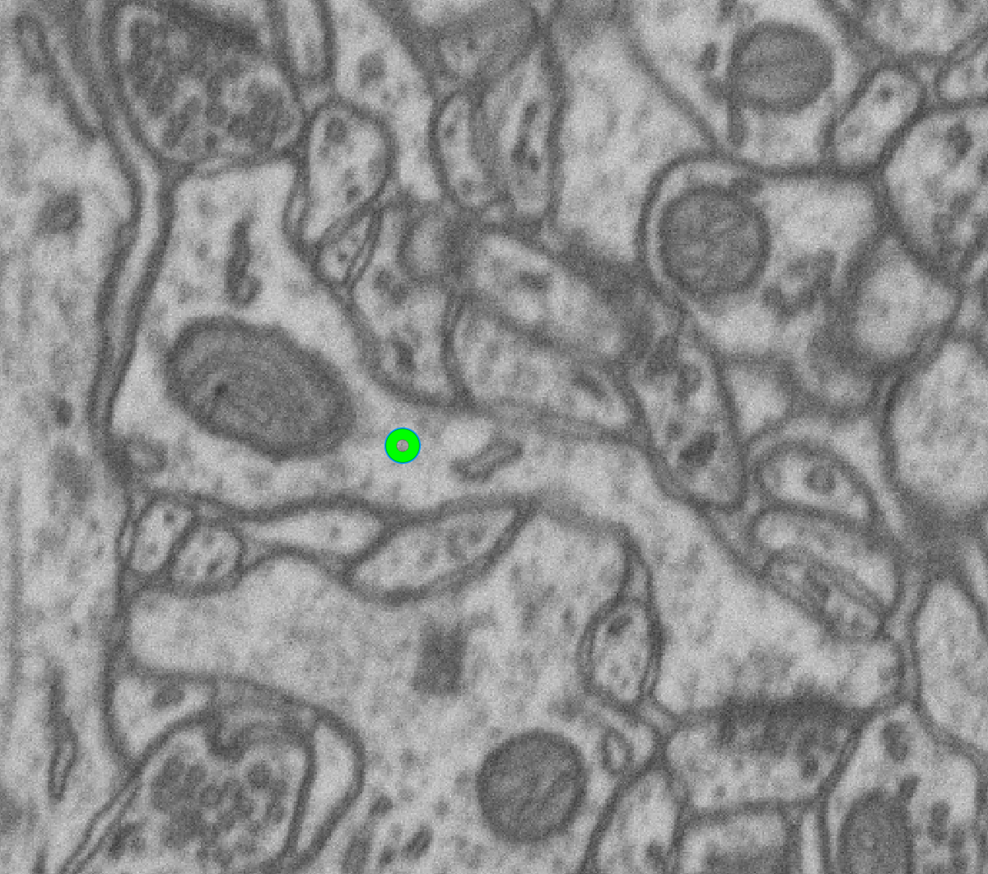
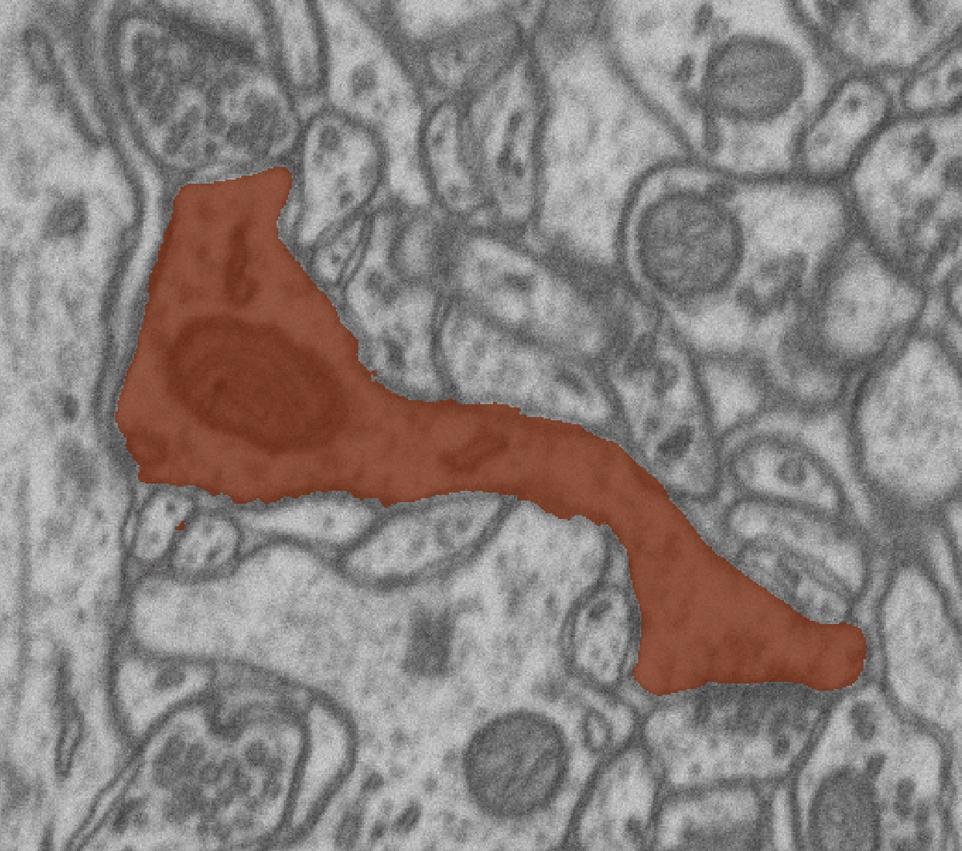
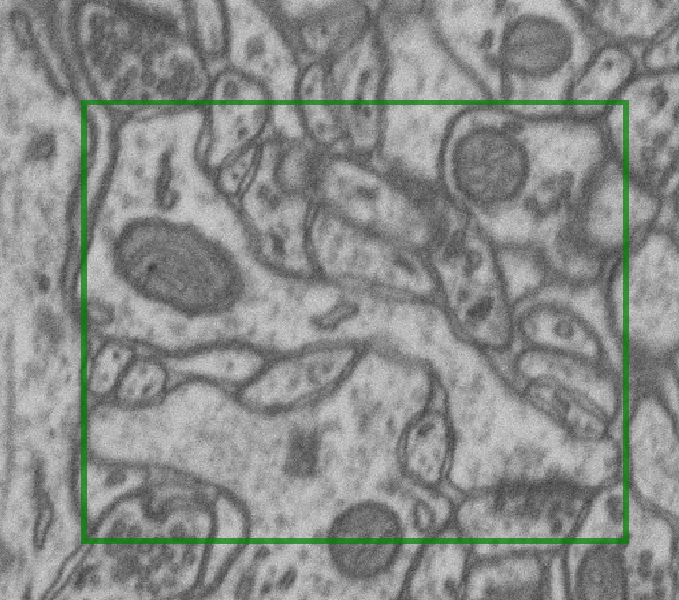
Segment Anything: Training iteration
Given image and ground-truth mask
Compute image embeddings,
sample positive point or box
random point
bounding box
Notes:
The training loop

Slide 48
Segment Anything: Training iteration
Given image and ground-truth mask
Compute image embeddings, sample positive point or box
Notes:
From lecture 1, TODO copy image credits

Slide 49
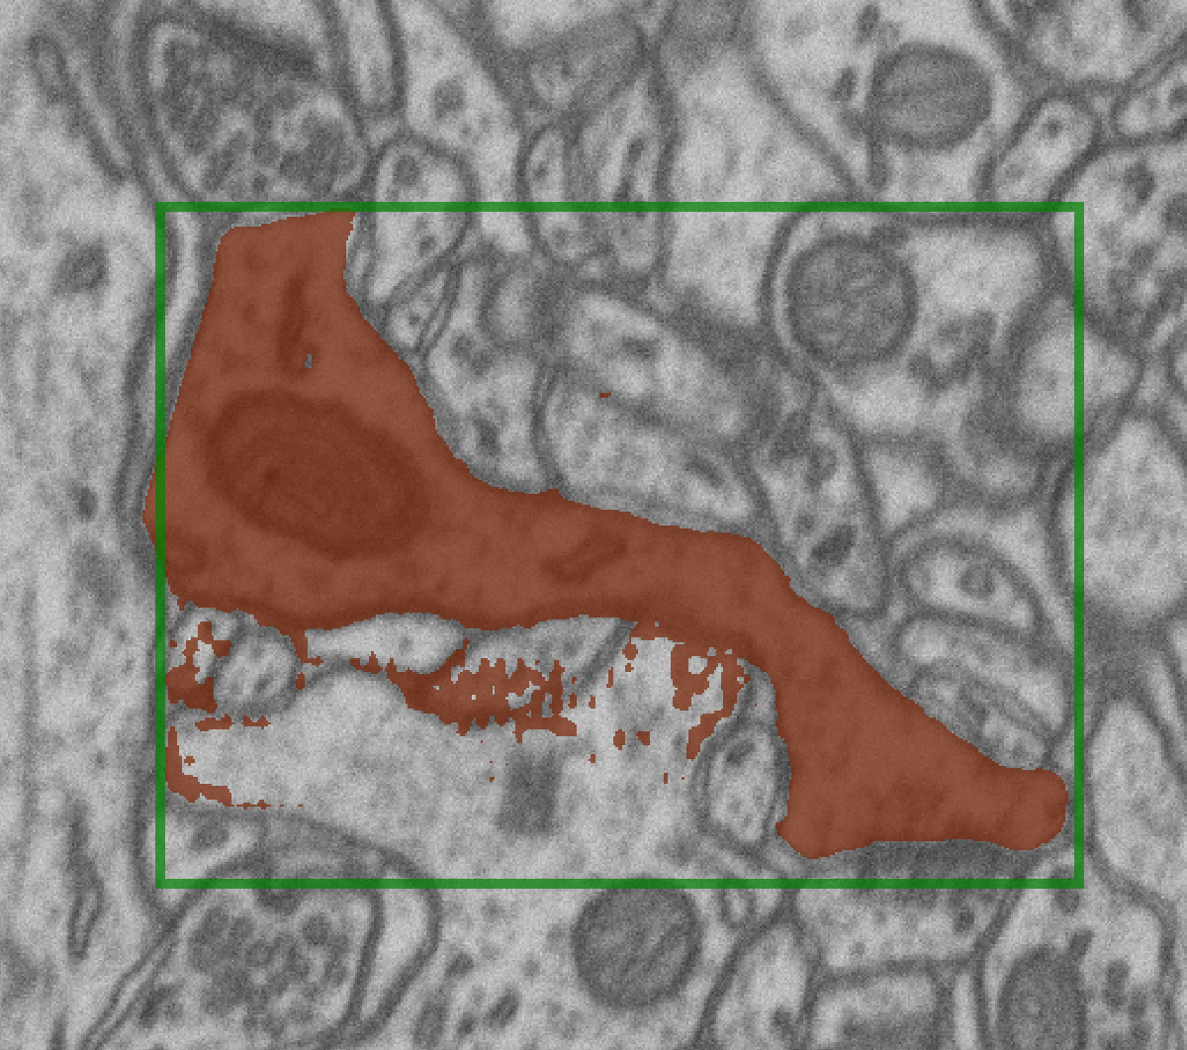
Segment Anything: Training iteration
Given image and ground-truth mask
Compute image embeddings, sample positive point or box
Run prediction, compute loss for object and IOU estimate
Mask Loss
Notes:
From lecture 1, TODO copy image credits

Slide 50
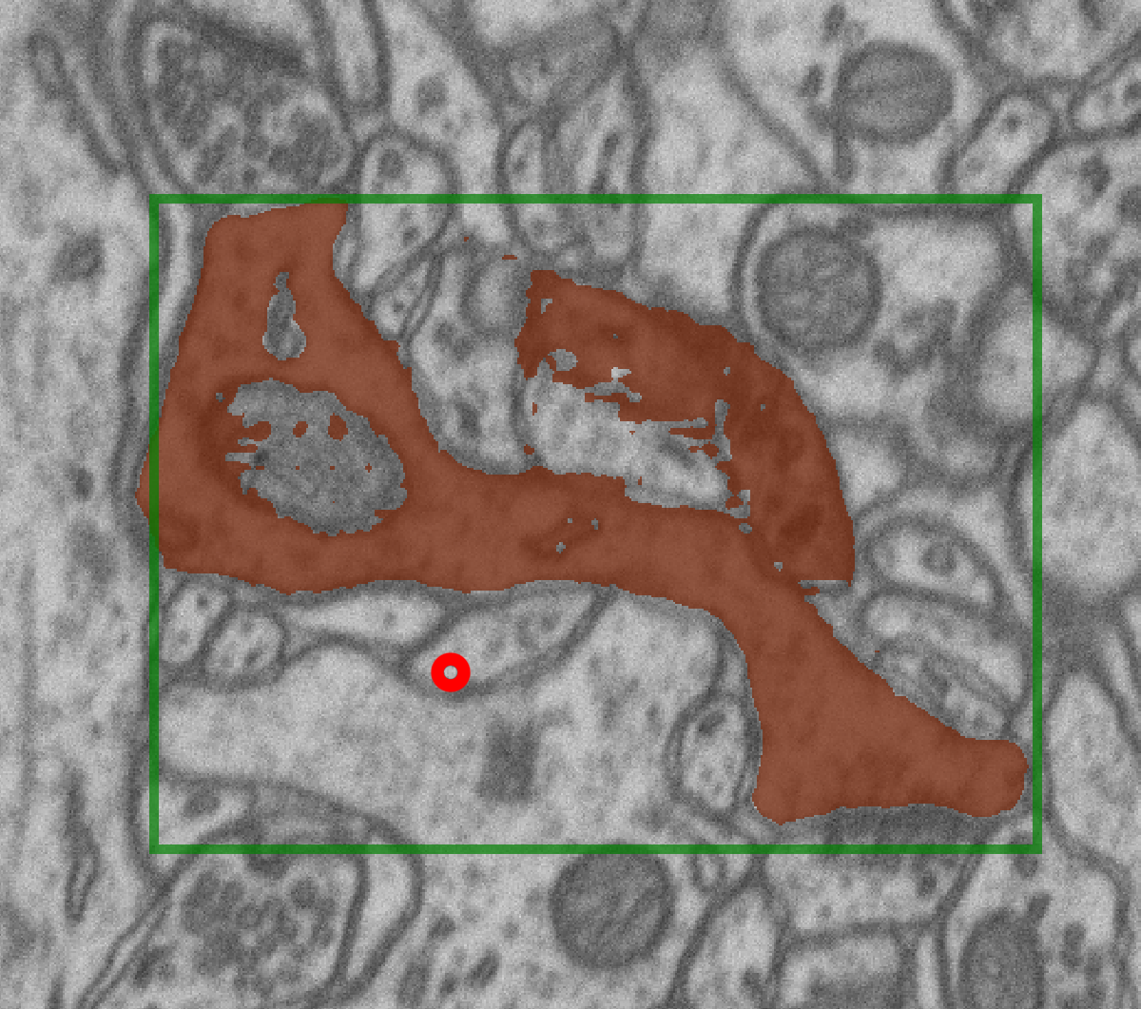
Segment Anything: Training iteration
Given image and ground-truth mask
Compute image embeddings, sample positive point or box
Run prediction, compute loss for object and IOU estimate
Sample point prompts where prediction is wrong, rerun prediction with all prompts + mask
Mask
Loss
…
Notes:
From lecture 1, TODO copy image credits

Slide 51
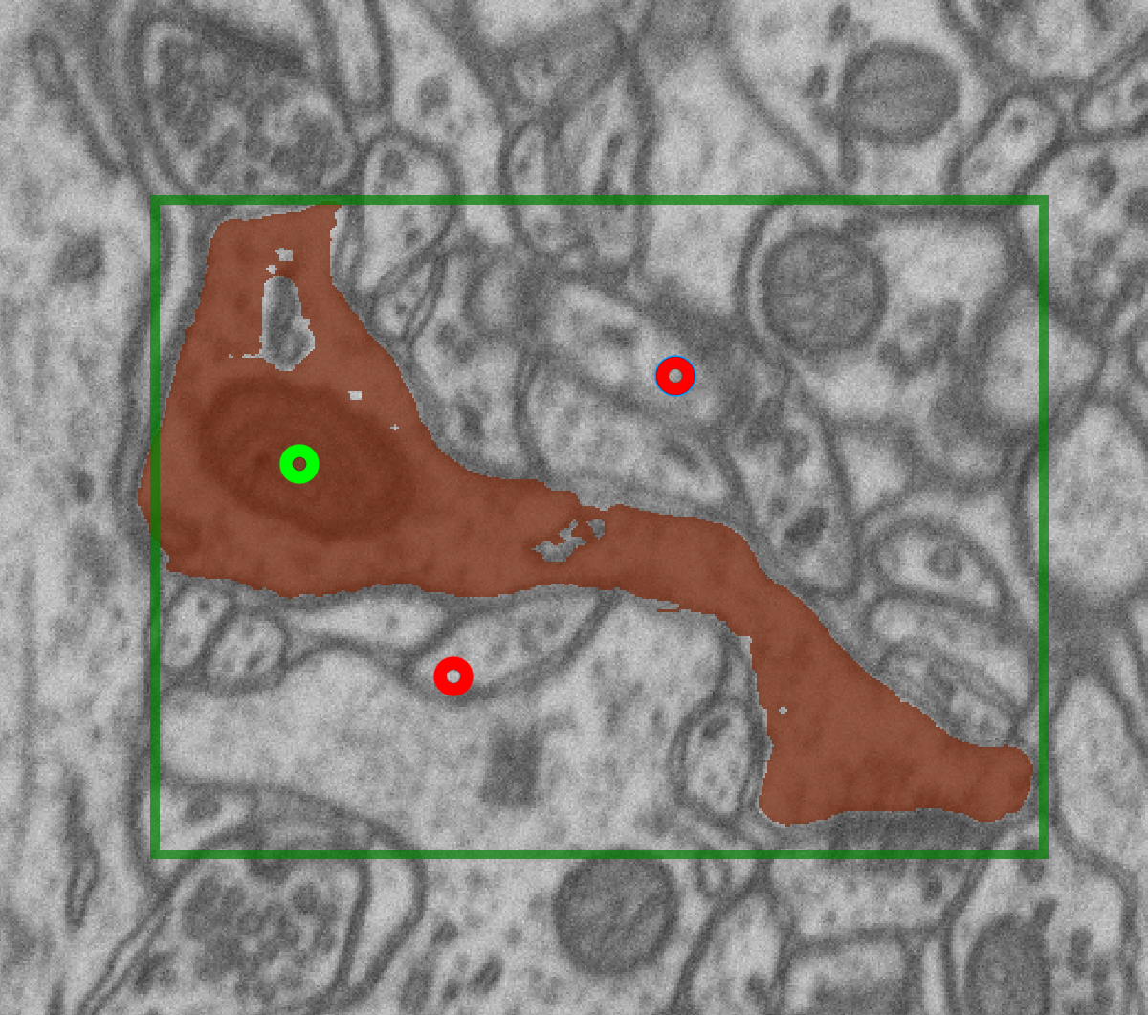
Segment Anything: Training iteration
Given image and ground-truth mask
Compute image embeddings, sample positive point or box
Run prediction, compute loss for object and IOU estimate
Sample point prompts where prediction is wrong, rerun prediction with all prompts + mask
Repeat
Mask Loss
…
Notes:
From lecture 1, TODO copy image credits

Slide 52

Segment Anything: Training iteration
Given image and ground-truth mask
Compute image embeddings, sample positive point or box
Run prediction, compute loss for object and IOU estimate
Sample point prompts where prediction is wrong, rerun prediction with all prompts + mask
Repeat
Mask Loss
…
Notes:
From lecture 1, TODO copy image credits

Slide 53
Segment Anything: Training iteration
Given image and ground-truth mask
Compute image embeddings, sample positive point or box
Run prediction, compute loss for object and IOU estimate
Sample point prompts where prediction is wrong, rerun prediction with all prompts + mask
Repeat
Average losses, update weights
…
Notes:
From lecture 1, TODO copy image credits

Slide 54
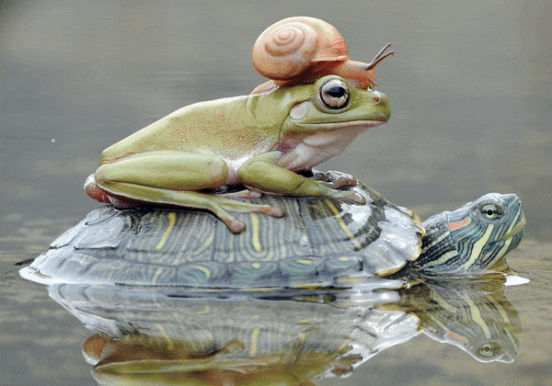
Segment Anything: Capabilities
https://segment-anything.com/
Segmentation from user inputs (prompts)
Notes:
After this: Interactive segmentation

Slide 55
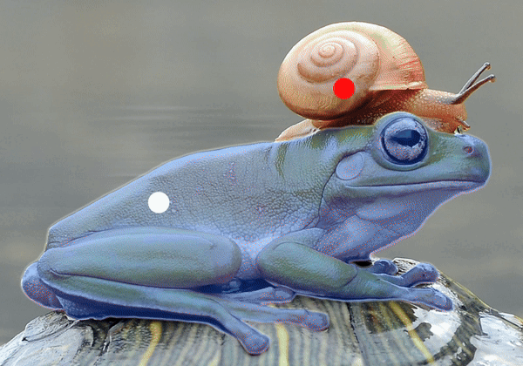
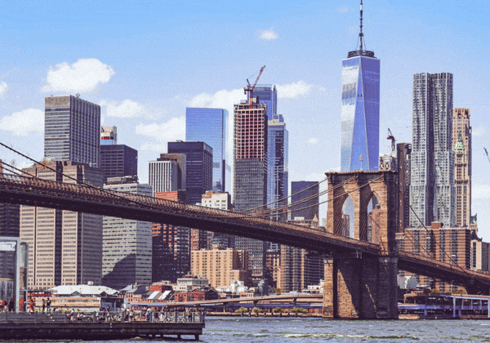
Segment Anything: Capabilities
https://segment-anything.com/
Segmentation from user inputs (prompts)
Automatic Mask Generation (AMG)
Notes:
Automatic mask generation by covering the image with grid of points, predicting masks for all points and filter out unlikely masks

Slide 56
Segment Anything for Microscopy

Slide 57
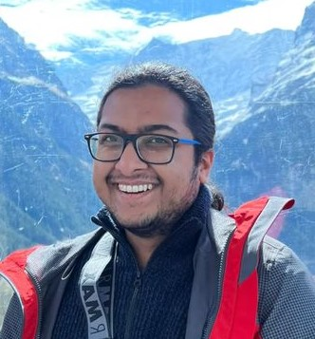
Our aims & contributions
Anwai
Archit
Archit, …, Pape, bioRxiv (2023)
https://doi.org/10.1101/2023.08.21.554208
How well does SAM work for microscopy data? Which model size is best?
Can we improve it (by finetuning) on microscopy data?
Build a napari-based tool for interactive and automatic segmentation and tracking.
Collaboration between my group and DFKI; + several open source contributions.
Notes:
We got interested, and:
- Want to evaluate how well it works for microscopy.
- Can we improve it for microscopy? -> Finetuning
- Build a tool in napari for interactive + automatic segmentation and tracking.
- Acknowledgments

Slide 58
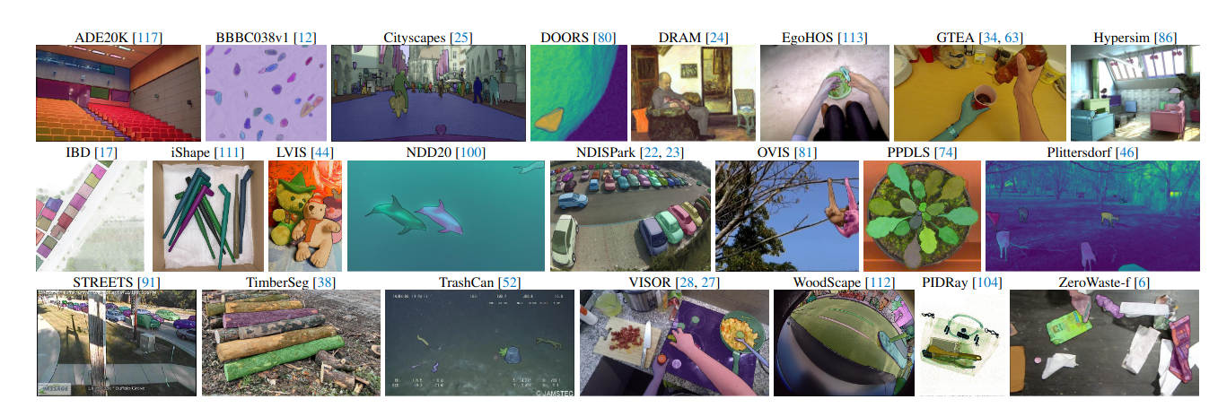
Our aims & contributions
Anwai
Archit
Archit, …, Pape, bioRxiv (2023)
https://doi.org/10.1101/2023.08.21.554208
How well does SAM work for microscopy data? Which model size is best?
Can we improve it (by finetuning) on microscopy data?
Build a napari-based tool for interactive and automatic segmentation and tracking.
Collaboration between my group and DFKI; + several open source contributions.
SAM authors test the model on nucleus segmentation and find good performance.
Model was predominantly trained on natural images!
Notes:
We got interested, and:
- Want to evaluate how well it works for microscopy.
- Can we improve it for microscopy? -> Finetuning
- Build a tool in napari for interactive + automatic segmentation and tracking.
- Acknowledgments

Slide 59
Our aims & contributions
Anwai
Archit
Archit, …, Pape, bioRxiv (2023)
https://doi.org/10.1101/2023.08.21.554208
How well does SAM work for microscopy data? Which model size is best?
Can we improve it by finetuning on microscopy data?
Build a napari-based tool for interactive and automatic segmentation and tracking.
Collaboration between my group and DFKI; + several open source contributions.
We just released our stable v1.0 version!
And submitted revision -> experiments are not in our preprint yet.
Notes:
PRELIMINARY

Slide 60
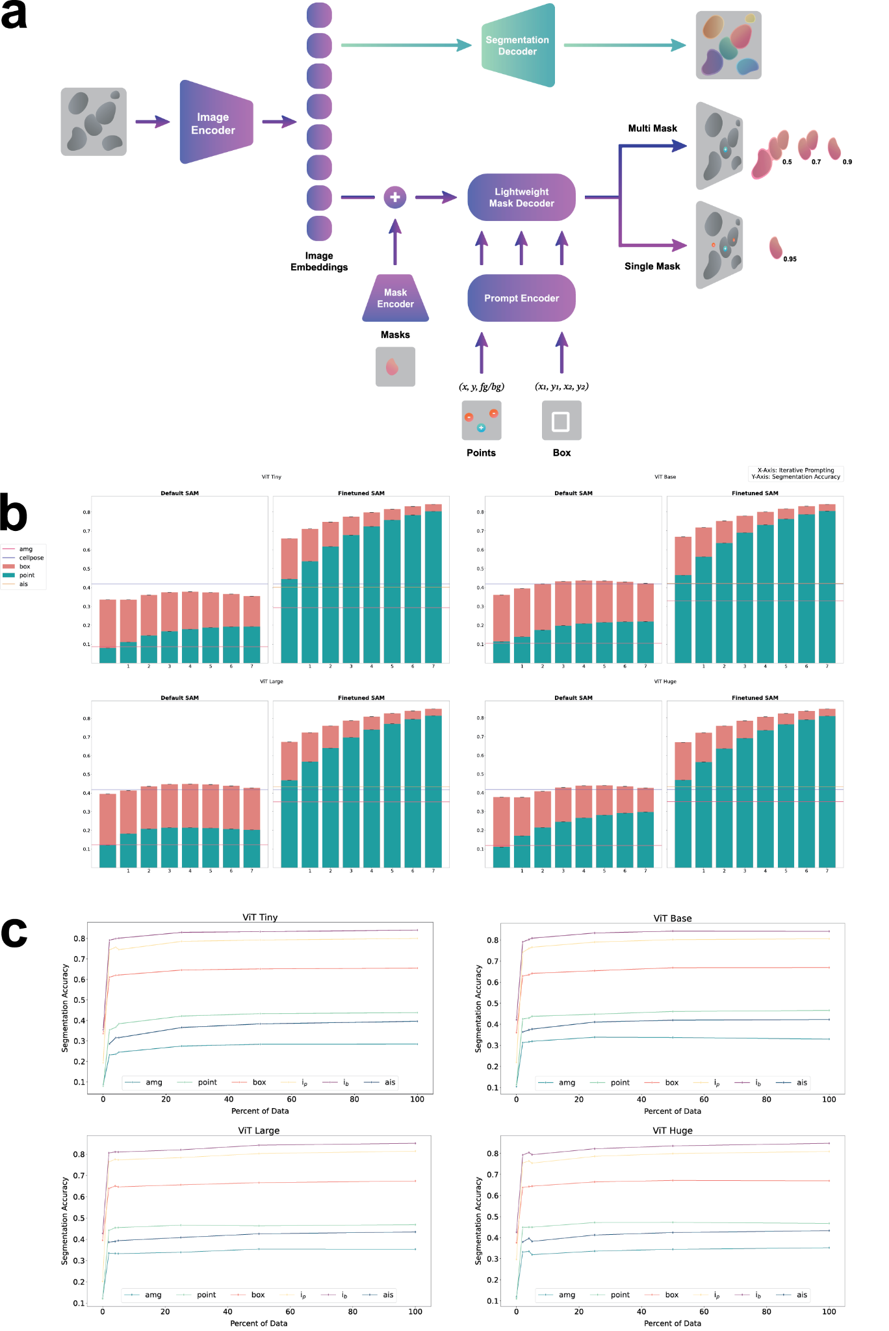
Finetuning SAM
Our contributions:
Re-implement iterative training
  Original code not published
  Complex procedure
  Use to finetune SAM components

Slide 61
Finetuning SAM + improve instance seg
Our contributions:
Re-implement iterative training
  Original code not published
  Complex procedure
  Use to finetune SAM components
Add decoder for instance segmentation (AIS)
  Predicts foreground
  Regresses distances to boundary + centroid
  Input for watershed

Slide 62
Finetuning for light microscopy
Training data: cell and nucleus segmentation (published datasets)
  Cells in Phase-contrast (LiveCELL)
  Cells in Tissue (TissueNet)
  Cells and Nuclei in Fluorescence (Neurips Cell Seg, DSB)
  Cells in LightSheet (PlantSeg-Roots)
  Bacteria in labelfree imaging (DeepBacs)
Evaluate on test-split of training datasets (“in domain”)
and unseen datasets (“out of domain”):
  Nuclei and cells in confocal, cells in immunofluorescence, nuclei in histopathology, …
Compare interactive and automatic instance segmentation
  Compare to CellPose baseline for automatic segmentation

Slide 63
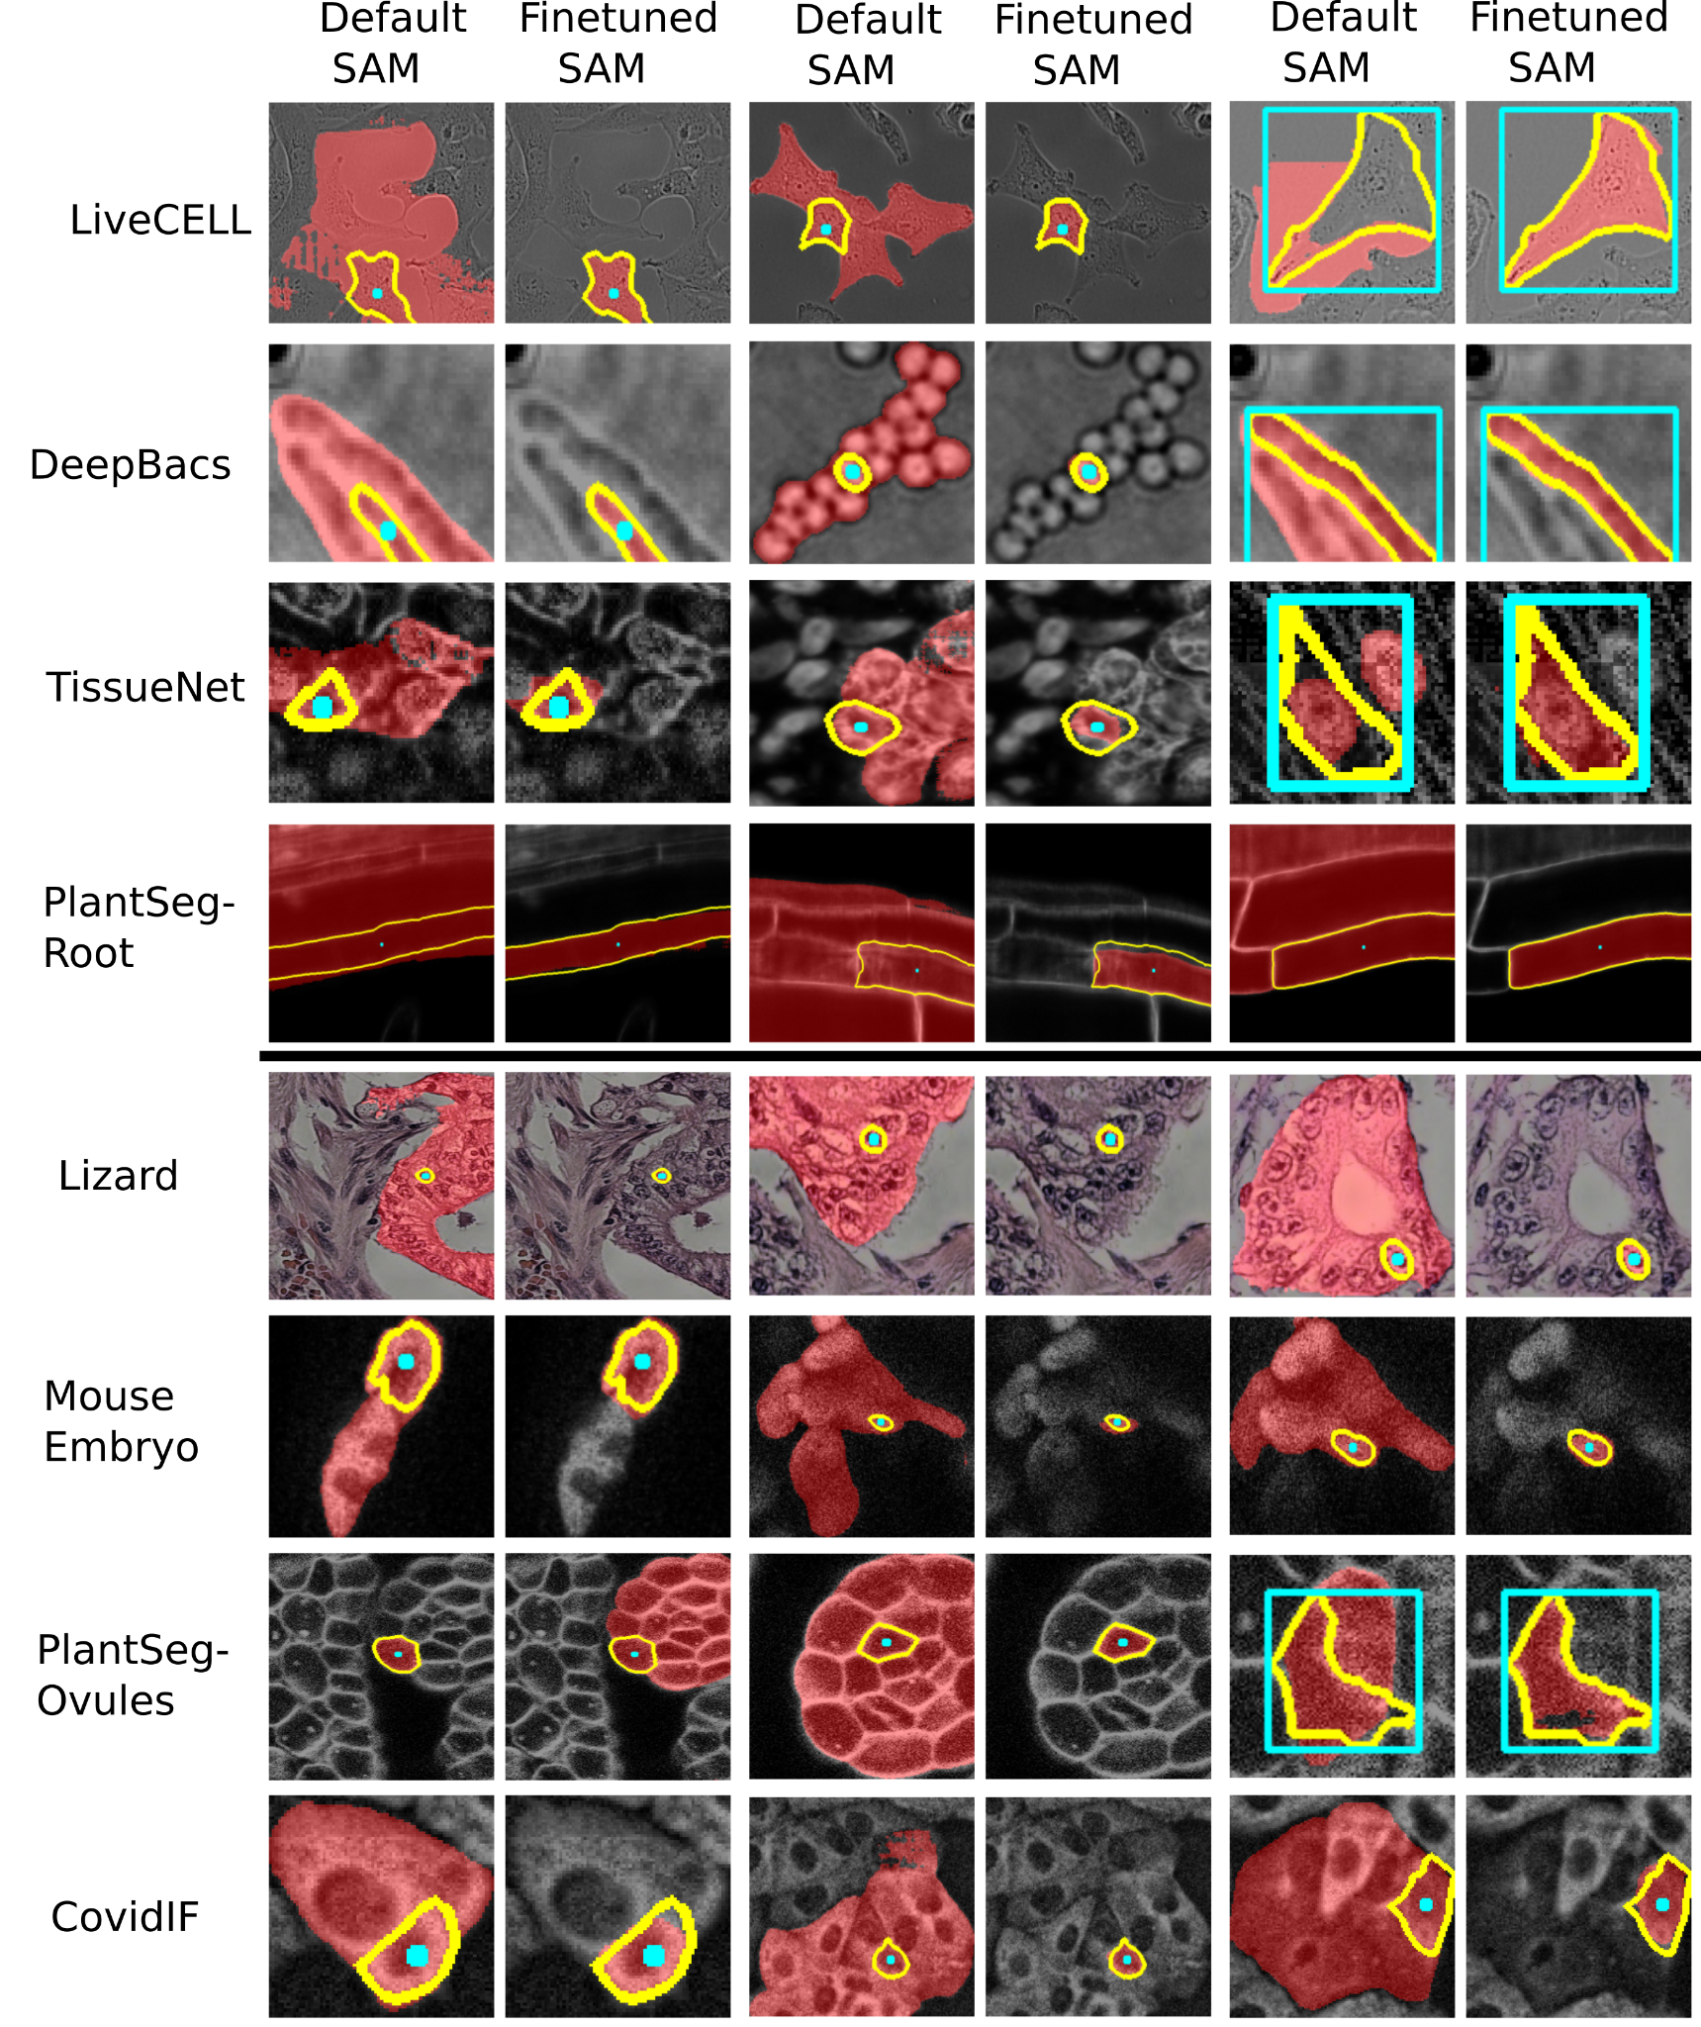
Interactive Segmentation:
In domain & Out-of-domain

Slide 64
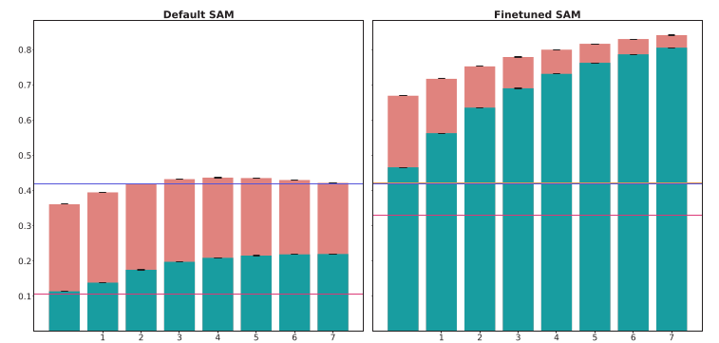
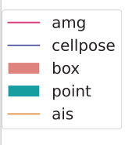

Results: In Domain
ViT Base
Results for LIVECell Dataset
(In Domain; Test Split)
Evaluation:
Interactive Segmentation:
  Derive prompts from ground-truth, improve iteratively
Instance segmentation:
  Compare with CellPose
Both: compute segmentation accuracy (compared to ground-truth)
ViT Large

Slide 65


Automatic Segmentation
Instance segmentation on LIVECell Dataset
Runtimes on laptop (CPU);
including embedding computation (dominates for AIS)
VIT-B-LM
AIS: 9 sec
VIT-B
AMG: 75 sec

Slide 66



Results: Out of domain
ViT Base
ViT Large
Results for out of-domain datasets.
Same evaluation procedure as before.

Slide 67
Results: Out of domain
ViT Base
ViT Large
Results for out of-domain datasets.
Same evaluation procedure as before.
Conclusions:
Finetuning improves models!
Best model: vit_l
  If runtime matters: vit_b / vit_t
Comparison to CellPose (automatic seg.):
  Similar performance on most out of domain datasets (cyto2 model)

Slide 68
Finetuning for electron microscopy
Training data: Mitochondria and nucleus segmentation in electron microscopy
  Most training data from MitoNet (https://doi.org/10.1016/j.cels.2022.12.006).
Compare default and finetuned model.
  Compare automated segmentation with MitoNet.
Evaluate on test-split of training datasets (“in domain”)
and unseen datasets (“out of domain”)
  Application to EM mitochondria from non-training data.

Slide 69

Interactive Segmentation:
In domain & Out-of-domain

Slide 70

Results: In & out-of domain
ViT Large
Evaluation: Same approach as for LM
In domain (top row)
Out of domain (rest)

Slide 71
Results: In & out-of domain
ViT Large
Evaluation: Same approach as for LM
In domain (top row)
Out of domain (rest)
Conclusions:
Finetuning improves, best model is vit_l
Similar performance to MitoNet on most datasets (AIS/AMG)
Improves segmentation for some other organelles (cilia, microvilli), but worsens it for cellular compartments
  Bigger diversity in EM!

Slide 72


Mitochondria
Instance segmentation on Lucchi Dataset
Runtimes on laptop (CPU);
including embedding computation (dominates for AIS)
VIT-B-EM
AIS: 10 sec
VIT-B
AMG: 80 sec

Slide 73

3D Segmentation with AIS
Segment objects slice by slice and merge across 3D

Slide 74

Finetuning as a user
Improve models further for your data?
How much data is needed?
Which computational resources are required?

Slide 75

Finetuning as a user
Improve models further for your data?
How much data is needed?
Which computational resources are required?

Slide 76
Finetuning as a user
Improve models further for your data?
How much data is needed?
Which computational resources are required?
Few images with annotations are sufficient!
Possible on CPU
  here: ca. 6 hours
Faster on GPU
  here: ca. 30 minutes

Slide 77
Application in practice
SAM (pretrained
for modality)
New microscopy data
Automatic Segmentation

Slide 78
Application in practice
SAM (pretrained
for modality)
New microscopy data
Automatic Segmentation
Result not
good enough?
Interactive correction

Slide 79
Application in practice
SAM (pretrained
for modality)
New microscopy data
Automatic Segmentation
Result not
good enough?
Interactive correction
Small dataset?
Done!

Slide 80
Application in practice
“Personalized” SAM
Retrain!
Large dataset?
New microscopy data
Automatic Segmentation
Result not
good enough?
Interactive correction
Small dataset?
Done!

Slide 81
Application in practice
“Personalized” SAM
Retrain!
Large dataset?
New microscopy data
Automatic Segmentation
Result not
good enough?
Interactive correction
Small dataset?
Compared to CellPose “Human-in-the loop”
Support for more modalities
Interactive correction speeds up annotation significantly!
BUT: Training model takes longer (esp. on CPU)
Done!

Slide 82


Application in practice
Segmenting mitochondria in electron
tomography with Wiebke Möbius
and Leonie Schadt (MPI Göttingen)
Segmenting organelles in phytoplankton
with Karel Mocaer (EMBL Heidelberg)

Slide 83
microSAM:
Napari Integration

Slide 84
microSAM: SAM for napari
napari plugins that enable interactive and automatic:
  2D Segmentation
  3D Segmentation
  Tracking (2D + time)
  Finetuning on own data
Core functionality:
  Default + generalist models
  Multidimensional segmentation / tracking
  (interactive and automatic)
  Tiled prediction for large images

Slide 85

microSAM: SAM for napari
napari plugins that enable interactive and automatic:
  2D Segmentation
  3D Segmentation
  Tracking (2D + time)
  Finetuning on own data
Core functionality:
  Default + generalist models
  Multidimensional segmentation / tracking
  (interactive and automatic)
  Tiled prediction for large images
Code and documentation available at:
https://github.com/computational-cell-analytics/micro-sam
New release (v1.0):
Latest microscopy models,
compatible with BioImage.IO modelzoo.
Updated and extended UI,
napari plugin integration.

Slide 86
Parallel Developments &
Next Steps &
Outlook

Slide 87



Are vision transformers better than CNNs?
https://arxiv.org/abs/2404.09556
https://www.biorxiv.org/content/10.1101/2024.04.06.587952v1

Slide 88
Are vision transformers better than CNNs?
https://arxiv.org/abs/2404.09556
https://www.biorxiv.org/content/10.1101/2024.04.06.587952v1
Transformers are not inherently better than CNNs!
Disadvantages for small data and runtimes
Possible advantage for large data
Advantage of same architecture as NLP
  Can profit from improvements and easier to build multi-modal models.

Slide 89
Next steps
Feedback and contributions on the tool are very welcome!
Integration of efficient training procedures for finetuning (LoRA, QLoRA)
  To enable better training on CPU and small GPUs
Provide better and more models:
  EM Organelle Generalist Model
    Training on OpenOrganelle and other organelle segmentation datasets.
  Histopathology Model
Check out our repository for all the details:
https://github.com/computational-cell-analytics/micro-sam

Slide 90
Outlook:
Universal microscopy segmentation and tracking
Incorporate 3D (2D + time) segmentation in SAM-like model
  Advantage ransformer: same model for 2d and 3d
Vision Mamba: Investigate newer (more efficient) architectures
  Our recent (preliminary!) work shows promise: https://arxiv.org/abs/2404.07705
Semantic awareness (e.g. differentiate organelles in EM, one model for microscopy)
Zero-shot adaptation (improve segmentation from examples)

Slide 91








Acknowledgments
EMBL Heidelberg
Anna Kreshuk & her group
et al.
Uni Göttingen & Campus
Alexander Ecker
Tobias Moser
Silvio Rizzoli
et al.
My group
Anwai Archit
Luca Freckmann
Sushmita Nair
Marei Freitag
Sagnik Gupta
et al.

Slide 92
Hands-on Session

Slide 93
Before the break: Access VM, Install micro-sam
Access your VM and run:
$ mamba create -c pytorch -c nvidia -c conda-forge -n micro-sam pytorch micro_sam pytorch-cuda=11.6 -y

Slide 94
Plan Hands-On-Session
Starting the tool, explain plugins
  See https://youtu.be/gcv0fa84mCc for a rough idea
2D Segmentation on LiveCELL
  Compare default and finetuned model (vit_b, show auto segmentation for vit_b_lm)
  See https://youtu.be/9xjJBg_Bfuc for a rough idea
3D Segmentation on Lucchi
  Segment mitos in 3d with the em model
  See https://youtu.be/nqpyNQSyu74 for a rough idea
If there is still time students can choose to:
  Try annotation on their own data
  Start finetuning a model, either on their own data or on our sample data. Using
  https://github.com/computational-cell-analytics/micro-sam/blob/master/notebooks/sam_finetuning.ipynb

Slide 95

Application on your data
2D segmentation -> “Annotator 2d” or “Image Series Annotator”
3D segmentation -> “Annotator 3d”
Tracking -> “Annotator Tracking”
Which model should I use?
LM -> vit_X_lm
EM (potato-shaped structures)
-> vit_X_em_organelles
Other -> vit_X

Slide 96

Finetuning Notebook
https://github.com/dl4mia/03_learned_representations/blob/main/sam_finetuning_HT.ipynb
To get it on your VM:
$ git pull origin main

