Slide 1
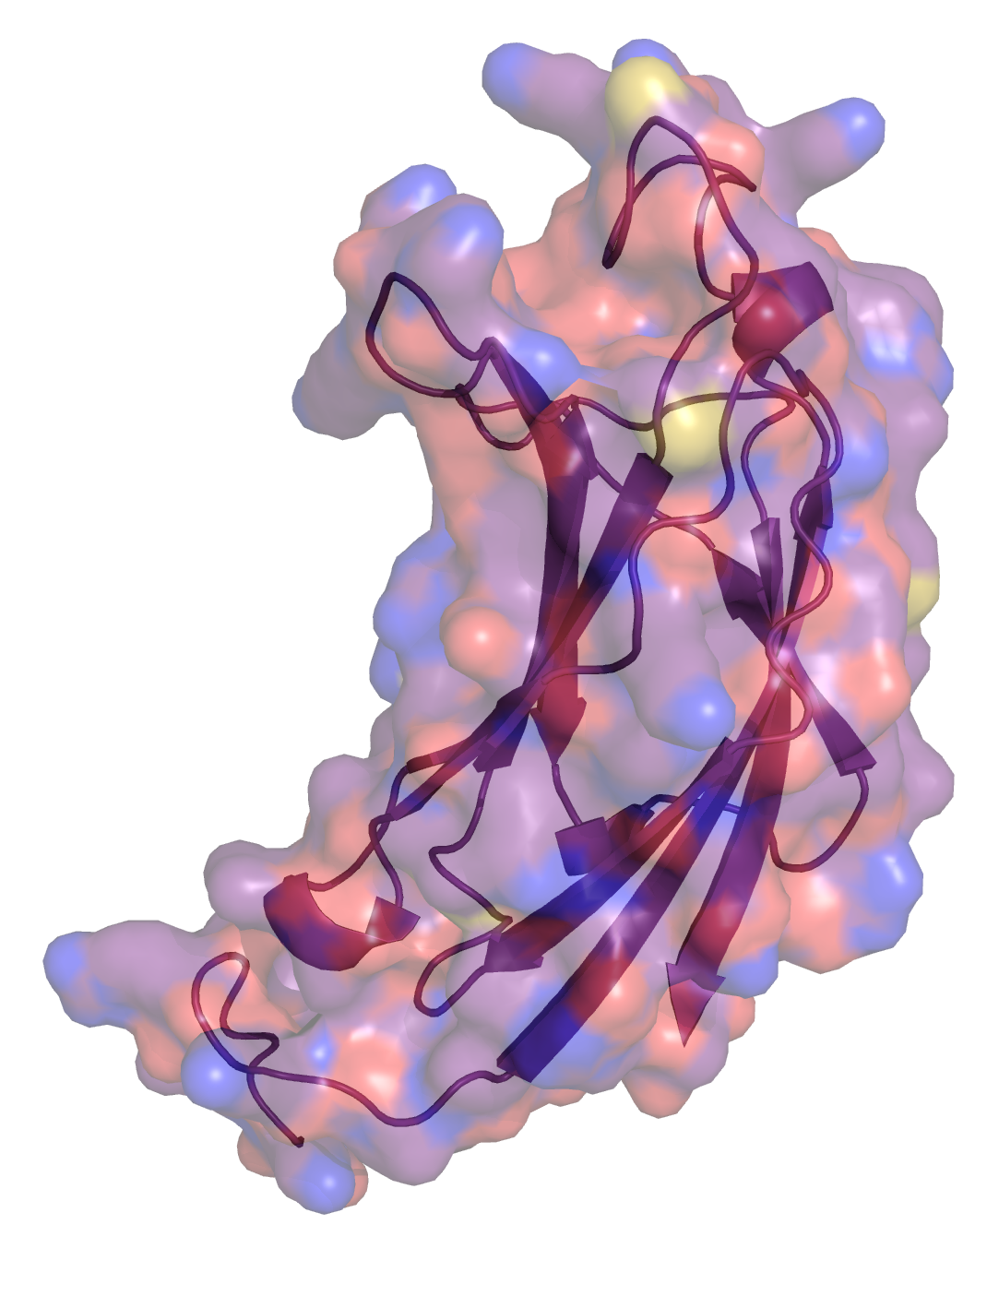
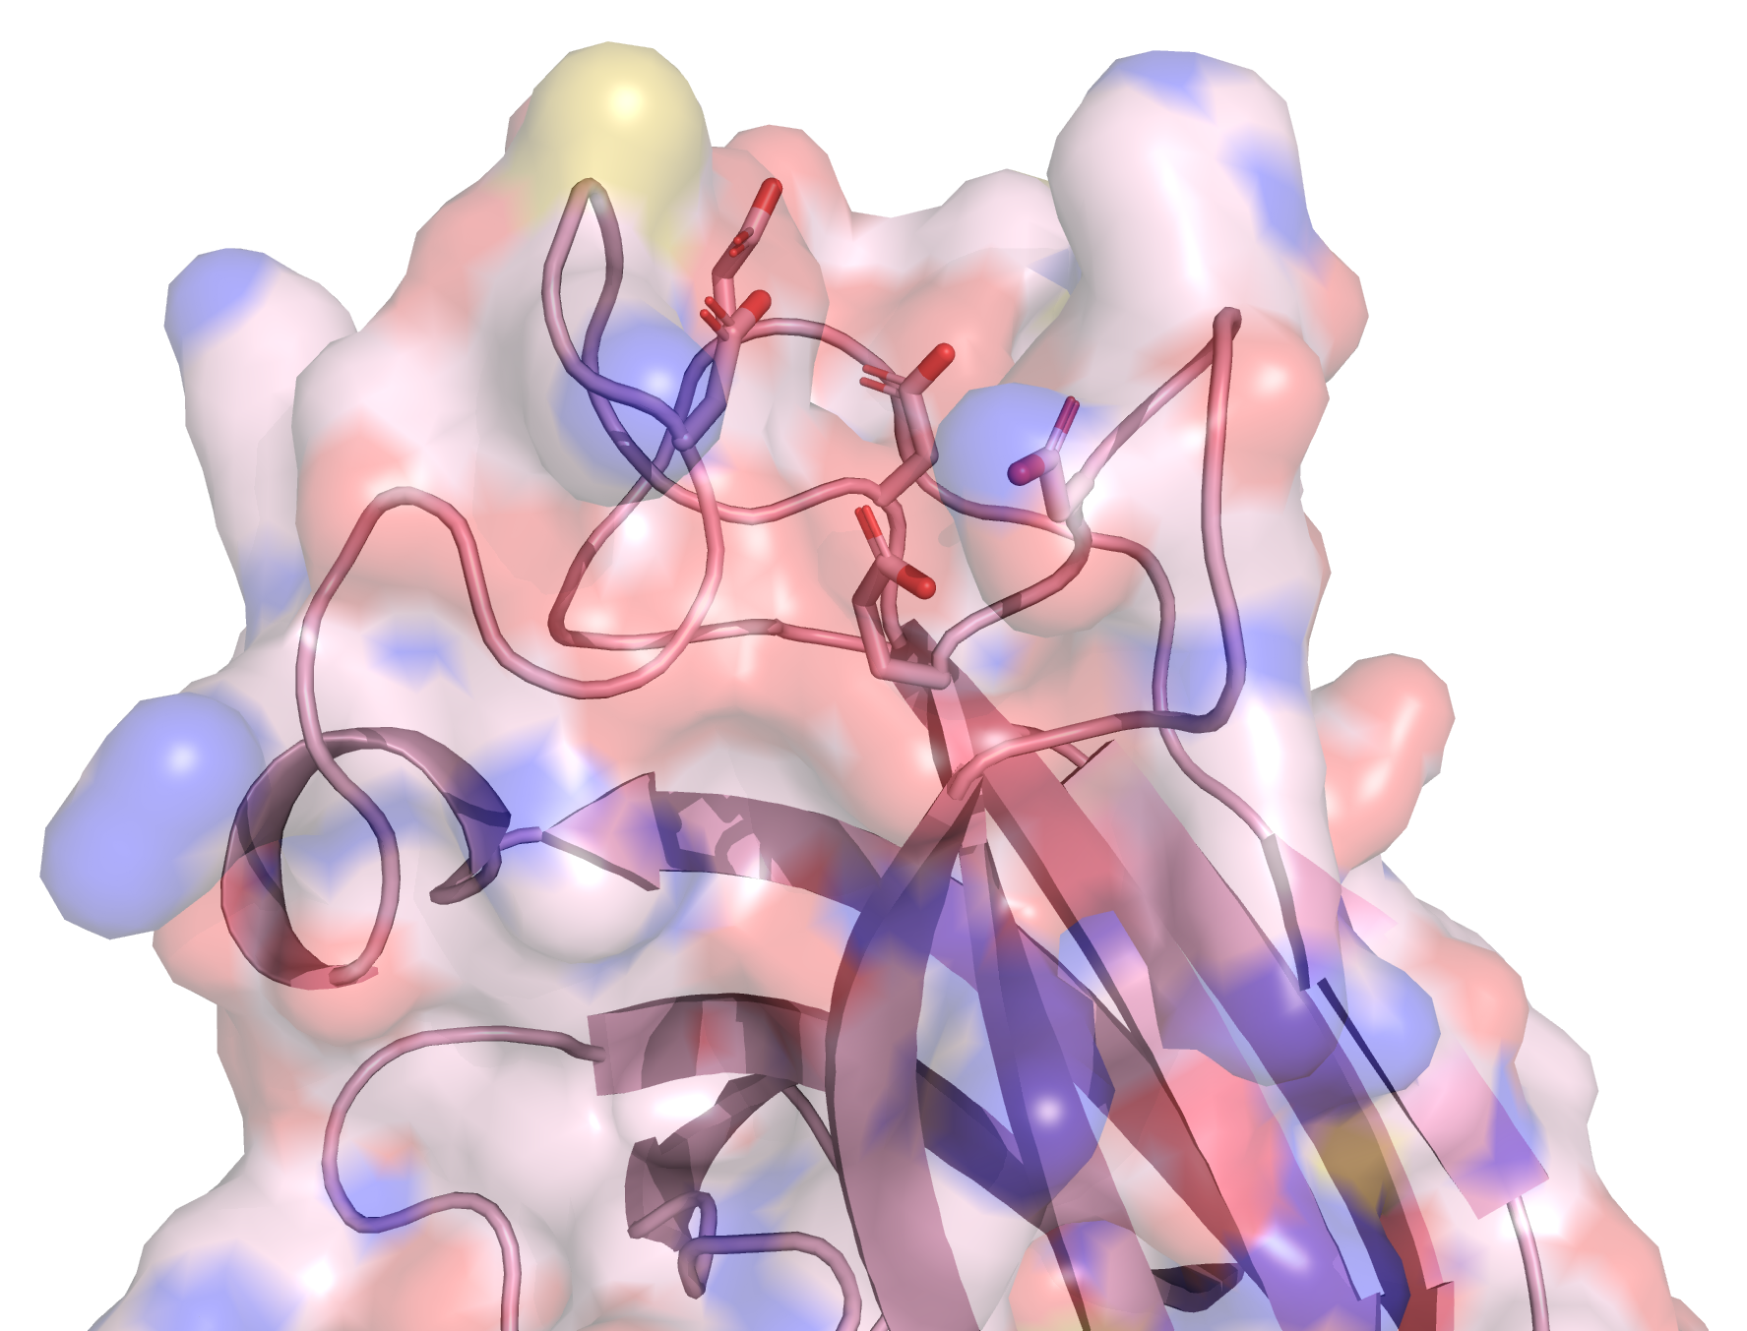
A.
*
*
*
*
*
B.
C.
Asp515
Asp491
Asp485
Asp545
Glu543
Figure S4. Structural features of the C2 domain of crop PI-PLCs. (A) Motif conservation of the catalytic residues. PI-PLC sequences of table S3 were aligned using the Clustal Omega webserver [45]. The consensus logo motif of the C2 domain was drawn by WebLogo [53] with the Clustal Omega Colorcode for the residues. The * indicate the residues displayed in B. (B) Structure of the C2 domain of TaPI-PLC2_1A. C. Close-up of the loop coordinating calcium. The structures were predicted by Alphafold [36] and represented by the PyMOL Molecular Graphics System, Version 2.0 Schrödinger, LLC.

