Slide 1
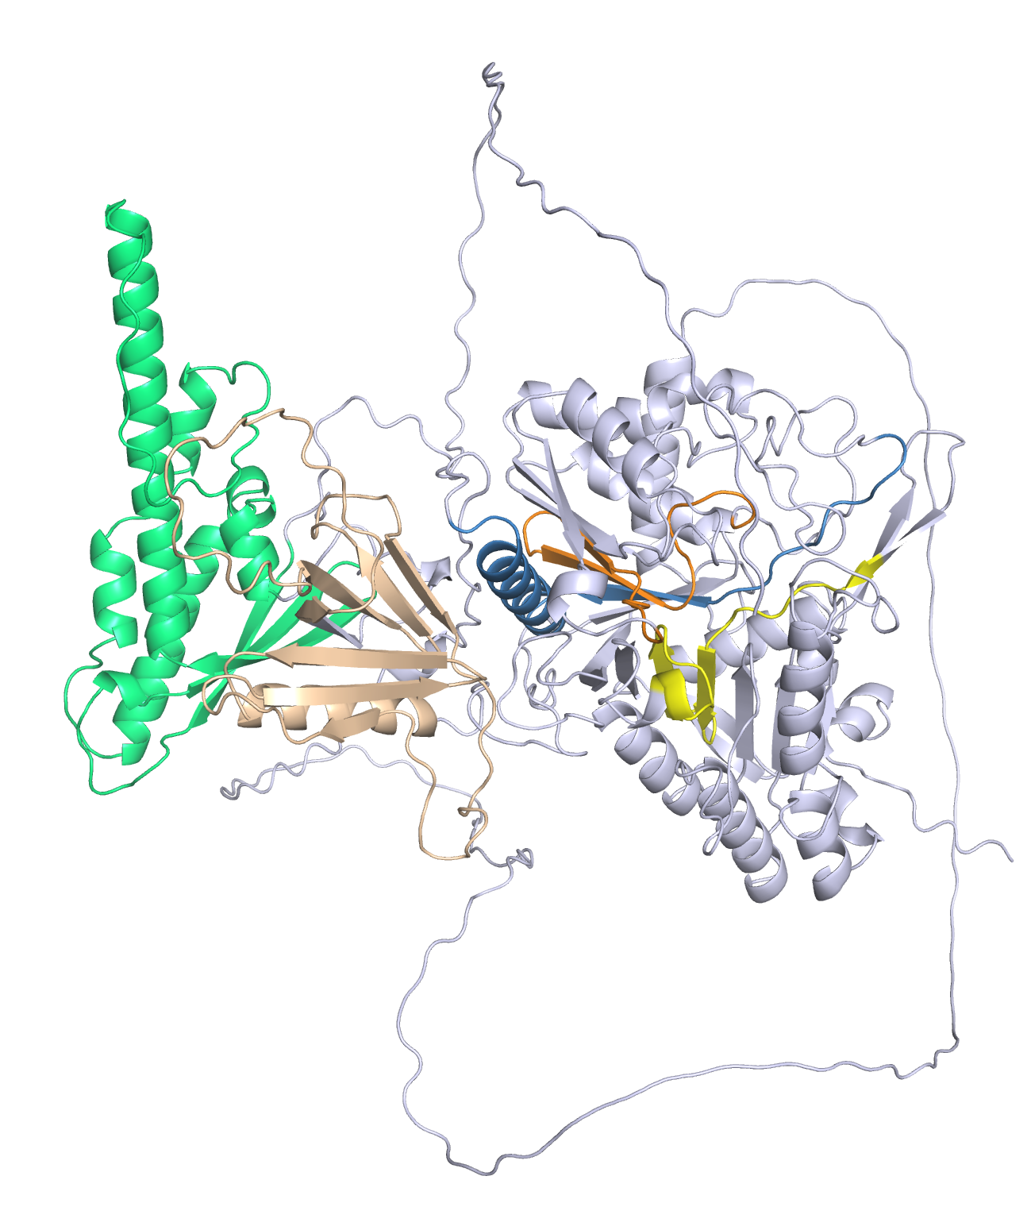
Figure S1. Predicted structure of TaPLD9. The structure was predicted by Alphafold [36] and represented by the PyMOL Molecular Graphics System, Version 2.0 Schrödinger, LLC. Green, PX domain; brown, PH domain; orange, first HKD domain; yellow, second HKD domain; red, PIP2 binding region 1 (PBR1, [47]) domain.

