Slide 1
Research Assessment in the
Research Data Alliance
Françoise Genova, on behalf of the RDA Evaluation of Research Interest Group
Hilary Hanahoe, Secretary General of the RDA
La Referencia – LIBER
13 May 2024

Slide 2

THE RESEARCH DATA ALLIANCE
www.rd-alliance.org
building the social and technical bridges that enable open sharing and re-use of data
Vision
Researchers and innovators openly share and re-use data across technologies, disciplines, and countries to address the grand challenges of society.
Mission
RDA builds the social and technical bridges that enable open sharing and re-use of data.
72 FLAGSHIP OUTPUTS
including 8 ICT Technical Specifications
200+ ADOPTION CASES
across multiple disciplines, organisations & countries
89 GROUPS WORKING ON GLOBAL DATA INTEROPERABILITY CHALLENGES
35 Working Groups
53 Interest Groups
1 Community of Practice
14,251 INDIVIDUAL MEMBERS FROM 152 COUNTRIES
70% Academia & Research
14% Public Administration
13% Enterprise & Industry
67 ORGANISATIONAL MEMBERS
13 AFFILIATE MEMBERS
February 2024

Slide 3
The Reseach Data Alliance
A unique international Forum to discuss all the aspects of research data sharing – technical AND sociological
Diversity of
  Subjects tackled by the Interest and Working Groups and the Community of Practice
  Participants’ profiles and locations
Two Plenary Meetings/year
  P23 12-14 Nov. 2024 in San José, Costa Rica (also P16, Nov. 2020)

Slide 4
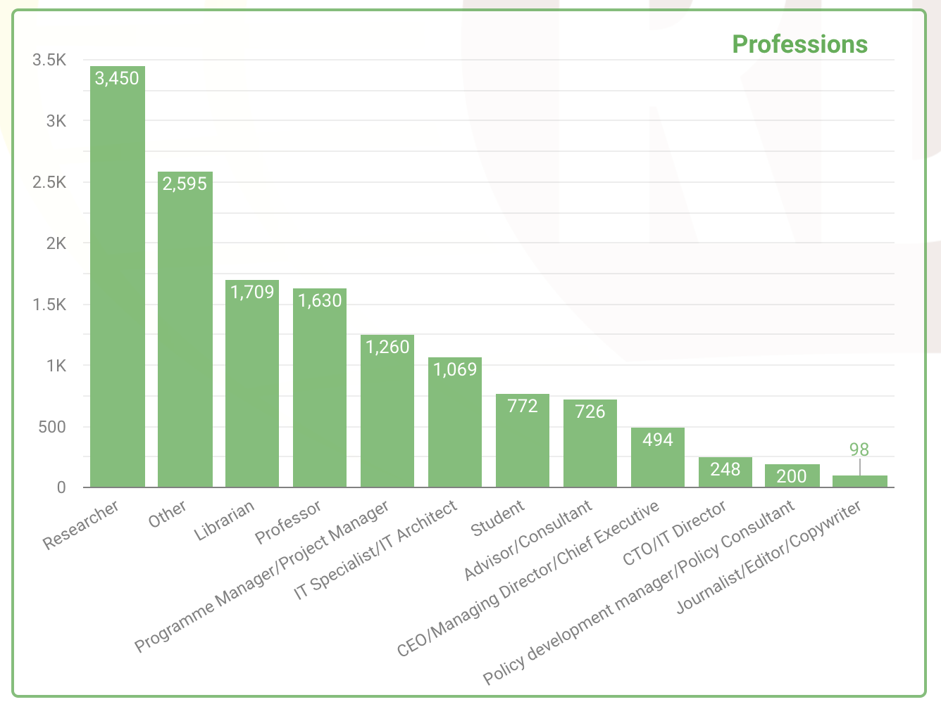
Who is RDA – Professional Title
February 2024

Slide 5
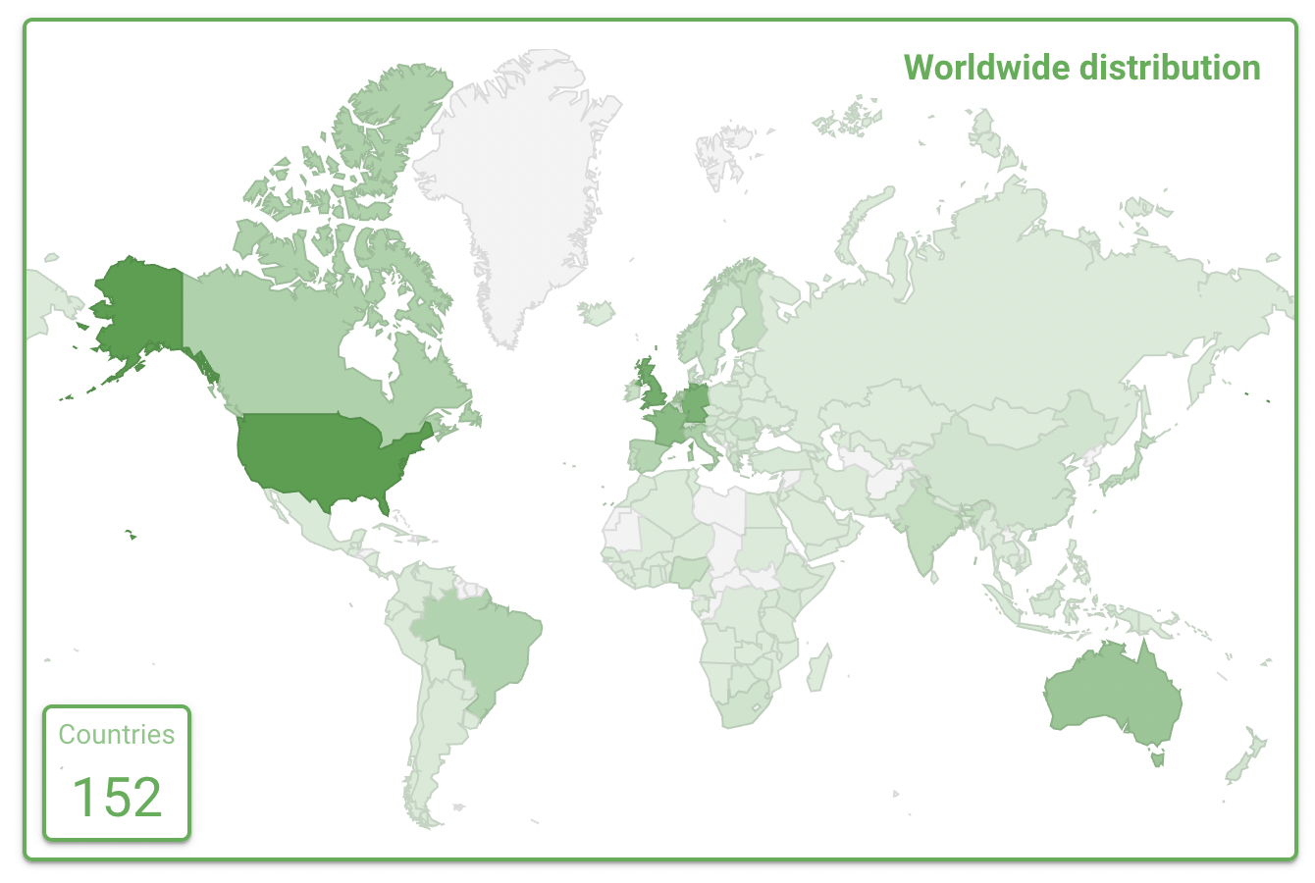
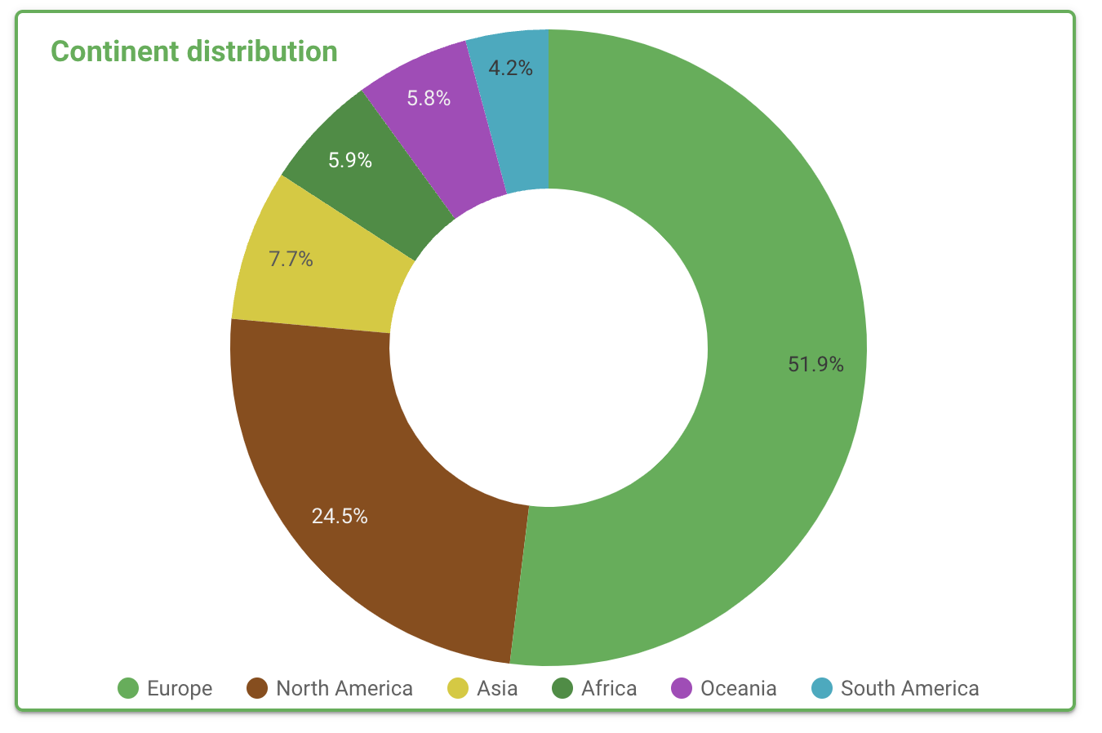
Who is RDA – Geographical Distribution
14,251 RDA members from 152 different countries
February 2024

Slide 6


RDA Secretary General visit to Latin America and the Carribean
Hilary Hanahoe’s tour is facilitated and organised by La Referencia
April 2024
  Peru: April 15 and 16
  Columbia: April 18 and 19
  Panama: April 22 and 23
  Costa Rica: April 25, 26 and 27
May 2024
  Ecuador: May 8, 9 and 10
  Brazil: May 13 and 14
  Argentina: May 16 and 17
  Uruguay: May 20 and 21
  Chile: May 23 and 24

Slide 7
Evaluation of Research in the RDA
The RDA is an appropriate forum to discuss the evolution of evaluation of research as they relate to Open Science practices
  Global reach
  Diversity of community profiles
  Funders’ Forum and Organisational Members
Interest Group (IG) created in June 2023 to organise the discussion on the subject, in particular as it relates to data, and also in relation to RDA activities on research software

Slide 8
RDA Role in the Evaluation of Research Landscape
First IG output
  Draft will be discussed during the RDA P22 IG sessions (14-23 May 2024)
Diversity of RDA topics => Diversity of possible contributions
Five categories
  Possible metrics and criteria
  Stakeholder representation
  Research outputs and their relevant properties
  Disciplinary aspects
  Support activities contributing to the ecosystem progression

Slide 9
A few examples of relevant RDA Groups (1)
Possible metrics and criteria
  Data Usage Metrics WG
  Sharing Rewards and Credit (SHARC) IG
  Possible new IG Understanding and Capturing the Usage of Digital Research Infrastructure
Stakeholder representation
  Funders Forum and Interest Group
  Organisational Assembly and Regional Assembly
  Early Career and Engagement IG
  Data Policy Standardisation and Implementation IG (publishers and other stakeholders involved in the subject)

Slide 10
A few examples of relevant RDA Groups (2)
Research outputs and their relevant properties
  FAIR for different kinds of research outputs, incl.
    FAIR Data Maturity Model WG
    FAIR for Research Software WG
  Physical Samples and Collections in the Research Data Ecosystem IG
Disciplinary aspects
  Many disciplinary Interest and Working Groups
  Agriculture Data and the proposed Earth and Environmental Science Data Communities of Practices
  Domain Ambassador IG being discussed

Slide 11
Two examples of relevant RDA Outputs
RDA Data Usage Metrics WG Recommendations
  The document outlines next steps and recommendations for widespread adoption of normalized data usage practices, as well as hurdles and limitations to be prioritized going forward. Repositories that utilize these recommendations will help drive a better understanding of data usage and contribute towards the development of research data assessment metrics.
  DOI: 10.15497/RDA00062
Sharing Rewards and Credits (SHARC) IG
  Finalises an output on guidance on open science rewrads and incentives aimed at different stakeholders: research performing institutions, funders, publishers, policy makers, researchers

Slide 12


Liaison with CoARA
A key IG objective is to bring the voice of RDA community of experts to the world-wide discussion of evaluation of research
Liaison is established with CoARA
Initial task: mapping RDA activities and outputs with CoARA WGs

Slide 13

Thanks for your attention!
You are welcome to join the RDA and the IG if you are interested to participate
Join the RDA

Slide 14
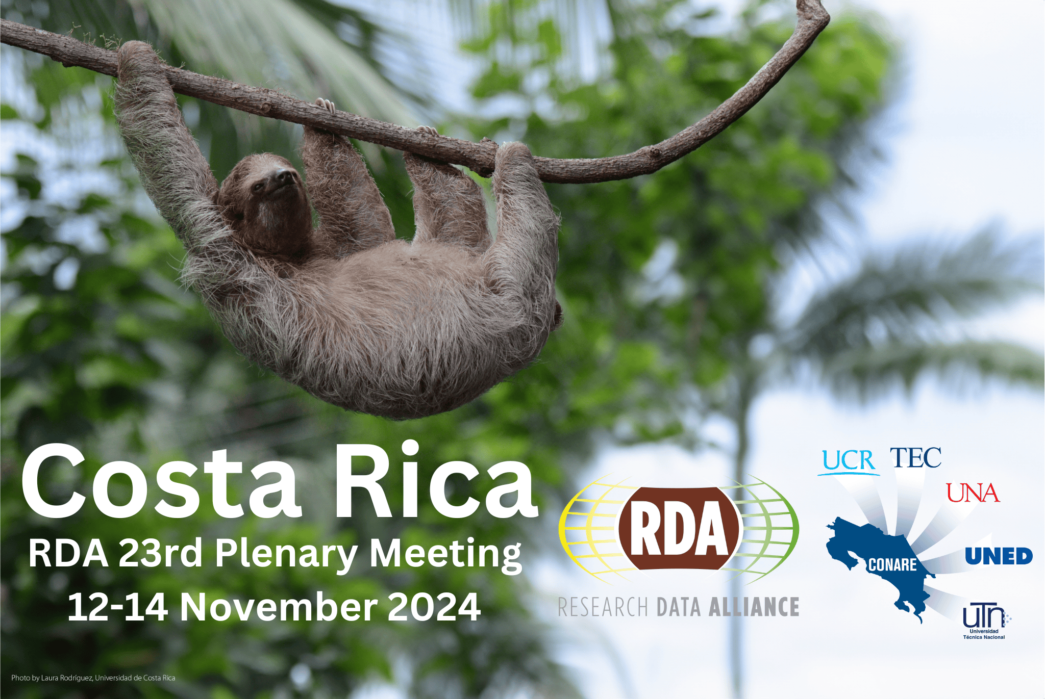
https://www.rd-alliance.org/event/rda-23rd-plenary-meeting-san-jose-costa-rica/

Slide 15

Including
Research Data Alliance 25th Plenary Meeting
https://www.rd-alliance.org/plenaries/international-data-week-2025-brisbane-australia

Slide 16

The Research Data Alliance: How to get involved AS AN INDIVIDUAL

Slide 17


WHY Join RDA as an Individual Member?
Contribute to debates, Recommendations and Outputs
Become part of the community
Gain experience and professional development
Free and open to ALL
Full details at https://www.rd-alliance.org/individual-membership/
Notes:
Contribute to debates, Recommendations and Outputs
Participate in global discussions on Open Science, research data management, the FAIR Guiding Principles, and more.
Engage with RDA community groups (Working Groups, Interest Groups, and Communities of Practice).
Propose new topics for discussion and contribute to the practical development of concrete solutions.
Receive regular updates on the work and activities of the RDA community.
Create, access, and adopt the RDA’s recommendations and outputs.
Become part of the community
Access an extraordinary network of data experts with a broad set of experiences, perspectives, practices, and intellectual frameworks relevant to data-driven innovation.
Become a voice to advocate for the RDA and data interoperability in your organisations, sectors, markets, and regions.
Have a voice in the RDA, providing advice and counsel on the needs of your organisations, sectors, markets, and regions, and the problems faced in data exchange.
Participate in RDA voting processes to drive change within the organisation.
Participate in RDA events, including webinars, workshops, and our bi-annual Plenary meetings.
Gain experience and professional development
Gain expertise in data-related topics across all stages of the research data lifecycle, regardless of career stage. Students, early and senior professionals are all welcome.
Learn from lessons learned by others and implement their good practices to enhance the quality and effectiveness of your own research data-related activities.
Improve your competitive advantage in a professional setting, and position yourself for leadership within the broader research community.

Slide 18
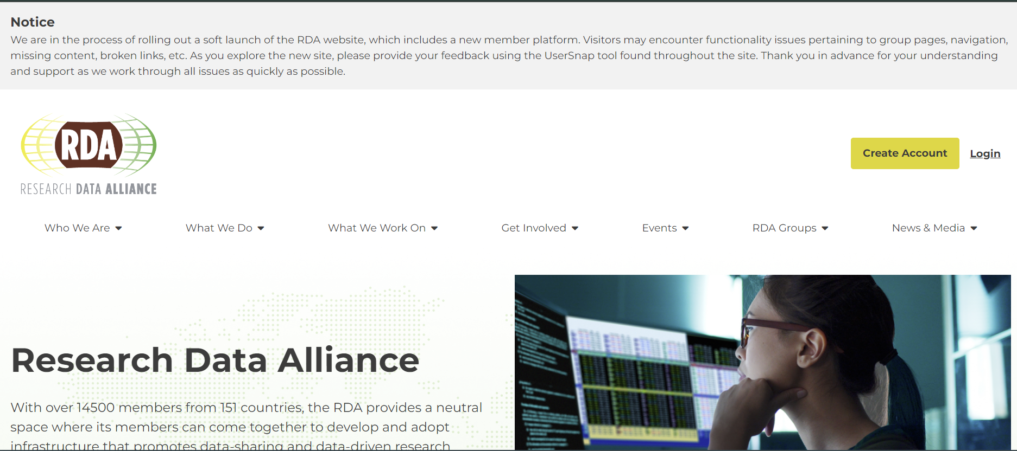
Join RDA as an Individual Member
https://www.rd-alliance.org
Disclaimer: New web platform from April 2024. Some delays, but please JOIN

Slide 19
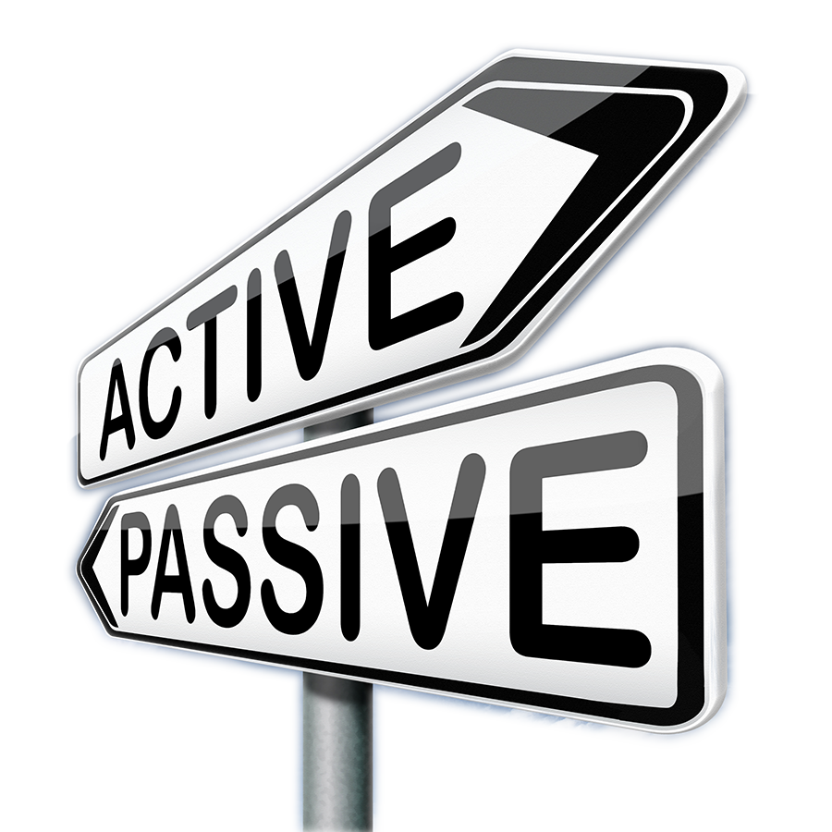
Join RDA as an Individual Member
Feel free to engage at the level of your choice:
Driver
Contributer
Observer
ALL ARE WELCOME

