Slide 1
System for detection of Threat Agents in Maritime Border Environment
Tudor Radulescu – UTI Grup, Romania
Wim Haelewyn – Police West Coast, Belgium
Workshop on border security related EU funded projects
Warsaw, Poland, 15-16 June 2016

Slide 2
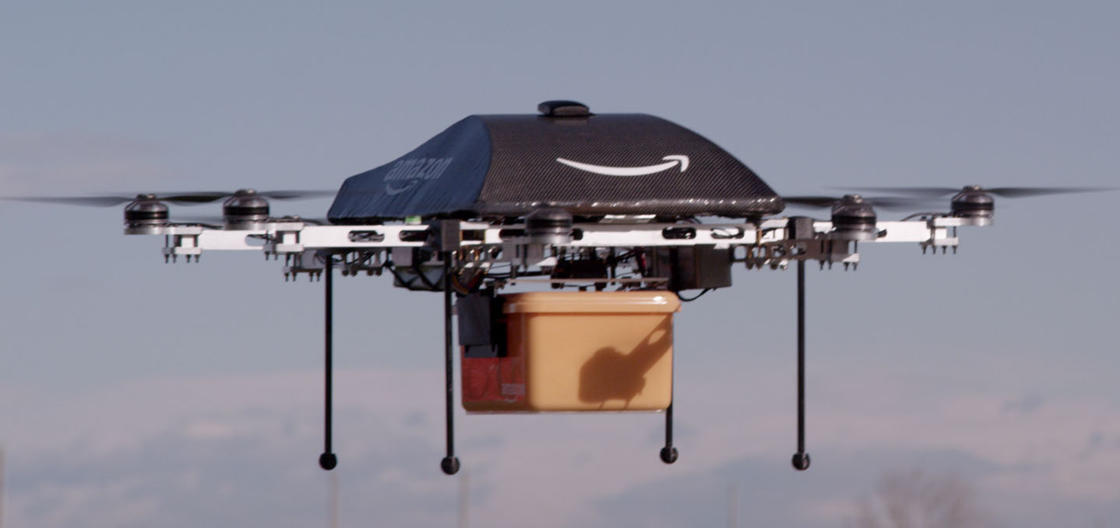
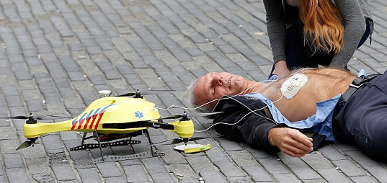
Legitimate use of UAVs for deliveries
  Commercial drones and UAVs are an affordable technology that started to be used in pilot projects for delivery of goods.
  Such a pilot project has been run by Amazon for parcel deliveries since 2014, under the name “Amazon Prime Air”.
  UAVs have been used in proof-of-concept projects to deliver first-aid equipment in case of emergencies (run by TU Delft University in Netherlands).
Confidential

Slide 3
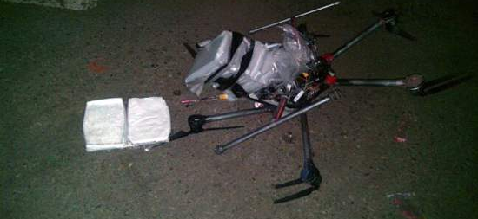
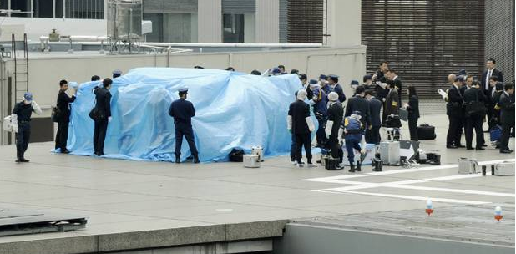
The Problem – Illegal use of UAVs
  UAVs can be used for smuggling items over borders or in restricted areas, in order to avoid detection of illegal items or to avoid taxing.
  Such a UAV has been found crashed in Tijuana while carrying high risk drugs (Mexico, 20 January 2015).
  In another incident, a drone was used to deliver a container with radioactive material on the roof of the Japan’s Prime Minster’s residence (9 April 2015).
Confidential

Slide 4
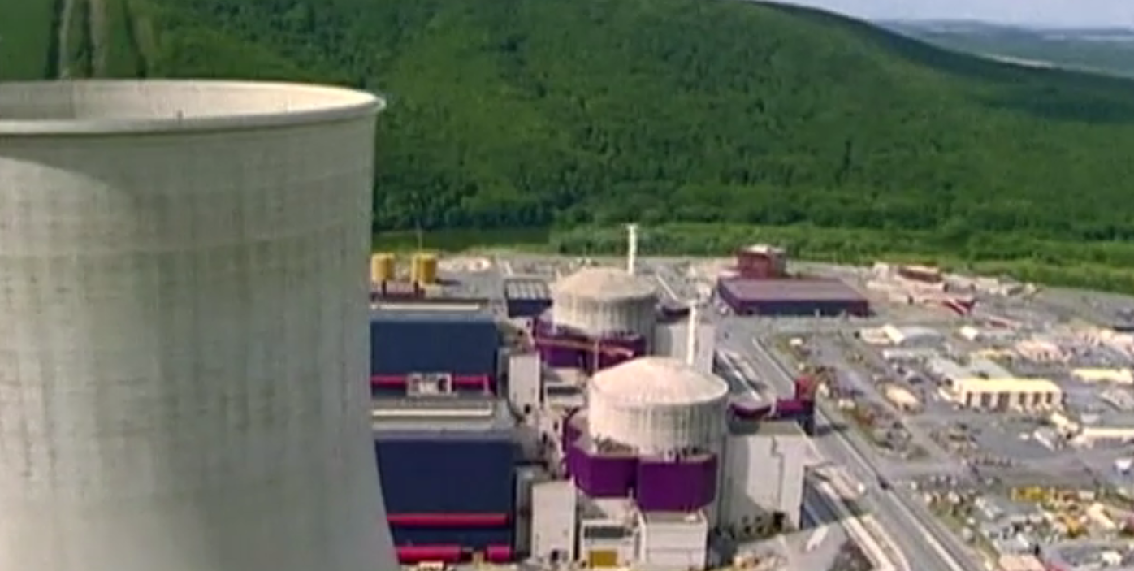
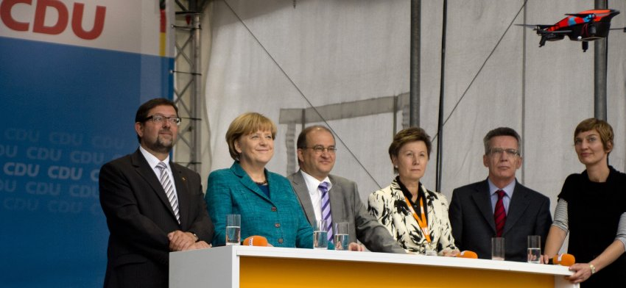
The Problem – Illegal use of UAVs
  Despite drones being banned in France, 56 cases of drones illegal surveillance of nuclear power plants since October 2014
  France has started a 1 million EUR program to develop drone detection solutions.
  Drones were used in a public event during the Angela Merkel election campaign in 2013.
Confidential

Slide 5
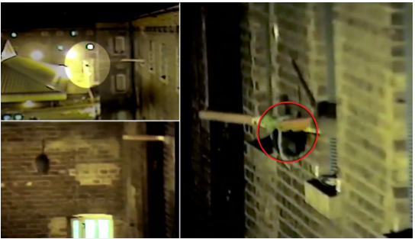
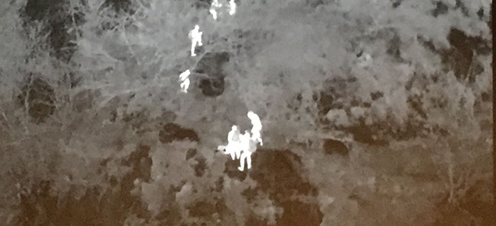
The Problem – Illegal use of UAVs
  Criminals use drone to deliver drugs straight to prisoner’s cell window in unique smuggling bid (Manchester 22 April 2016)
  The same event has been caught on CCTV in Wandsworth Prison, London
  Drones are being used as tactical intelligence gathering platform by organized crime, in order to plan and coordinate border traffic
Confidential

Slide 6
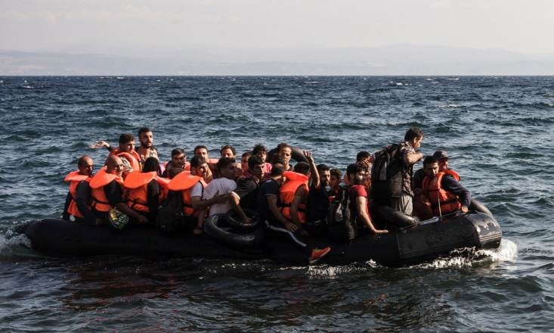
The Problem – Migrants in rubber dinghies
  With the crisis in the Middle East and Africa, 1000s of migrants arrived on the European shores in rubber dinghies which are not detected by conventional radar systems.
  Refugees rescued trying to get to UK in inflatable dinghy (Dunkirk 1 April 2016)
Confidential

Slide 7
H2020 Call BES-02-2015 Maritime Border Security
Topic 2: Affordable and easily deployable technologies for EU coastal border surveillance with reduced impact on the environment
Specific challenge
  The use of low cost and “green” technologies is expected to become mandatory for future border control systems in environmentally sensitive areas. Passive systems fit this application, due to electromagnetic invisibility, lower detectability and cost and the possibility of use practically anywhere.
Scope
  further development of devices and sensors for maritime targets and environment (e.g. fit for mobile platforms) easily deployable on field and with limited impact on spectrum environment.
  development of specific, early identification, tracking and fusion algorithms
  operation in network configurations together with other systems for improved performances
Proposal submitted on 27 August 2015
Project started on 01 May 2016
Confidential

Slide 8
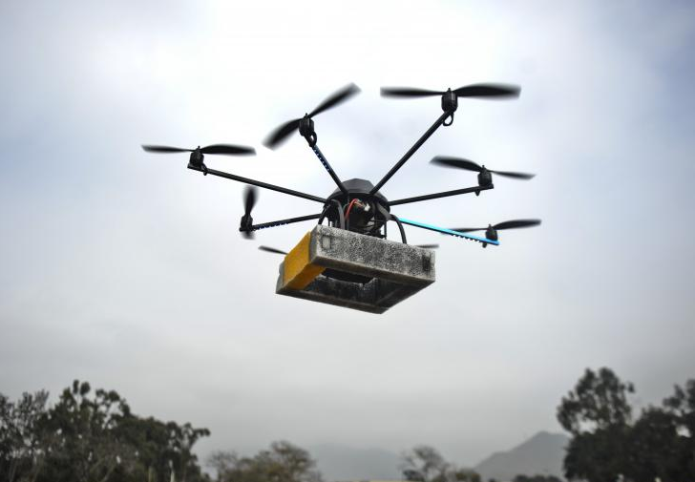
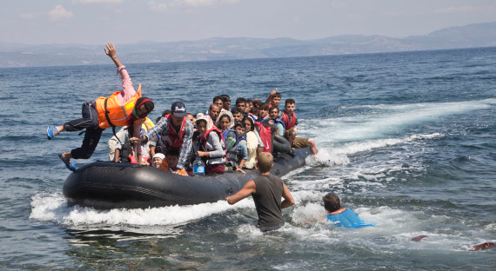
SafeShore proposed solution
Mission
  Detection of low altitude drones and their remote control equipment involved in unauthorized surveillance and offensive actions (delivery of explosive charges or small projectile attacks), launched from boats, ships or land, in border area harbours, in coast radar locations, at river border crossings and on-board oil platforms and large ships.
  Detection of small vessels coming to shore
Confidential

Slide 9
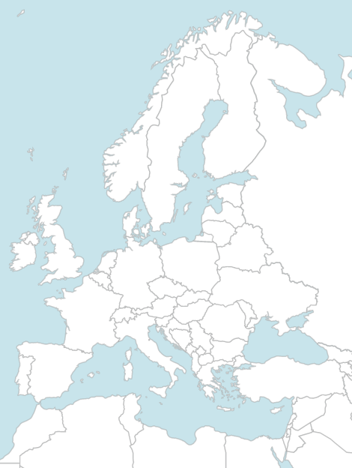
Project Consortium
Academia Partners | Country | Scope
Royal Military Academy of Belgium | Belgium | Consortium coordinator, passive radio detection
Queen Mary University | UK | Algorithms development
University of Salento | Italy | Requirements analysis
Industry Partners | Country | Scope
Dr. Frucht Systems Ltd. | Israel | Laser detection systems and algorithms
UTI Grup | Romania | Video analytics, data fusion, GIS & C2
TG Drives | Czech Republic | Laser detection systems platform
Optix | Bulgaria | Visible & thermal camera systems
Research Partners | Country | Scope
Institute of Optoelectronics | Romania | Visible & thermal camera systems
End User Partners | Country | Scope
The Protection and Guard Service | Romania | Field trial of the system (Black Sea)
Ministry of Public Security | Israel | Field trial of the system (Mediteranean Sea)
Police Region West Coast | Belgium | Field trial of the system (North Sea)
Confidential

Slide 10
Technology
SafeShore will develop a system integrating multiple commercially available detection technologies to ensure detection of low-altitude flying drones and small boats
  Laser ranging (LIDAR) detection of small drones at low altitude, where radars cannot ensure detection due to altitude radar limitation and small radar cross section of the target
  Passive acoustic detection, to offer a complementary detection technology that is not affected by the same adverse effects as the laser scanner, and to provide means for acoustic target classification
  Visible and thermal CCTV target classification, to provide means of verifying the detection and classifying the target based on its aspect; classification result will be combined with the acoustic target classification result
  Passive radio communication detection and localization of remote control stations on sea or land, by passive spectrum monitoring and triangulation
Confidential

Slide 11
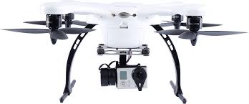
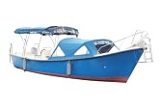

System Diagram
CCTV
Operator interface
CCTV
Maps & GIS engine
Command & Control server
Acoustic Sensors
Acoustic Sensors
Acoustic Sensors
Acoustic Sensors
Radio Monitoring
Scenarios & decision support
LIDAR
LIDAR
Interface to intelligence feed
Acoustic Sensors
Radio Monitoring
Acoustic Sensors
Fixed System
Deployable System
Data acquisition
Data acquisition
Data fusion
Local processing engine
Data fusion
Local processing engine
Video analytics engine
Video analytics engine
Target signature DB
Target signature DB
Confidential

Slide 12
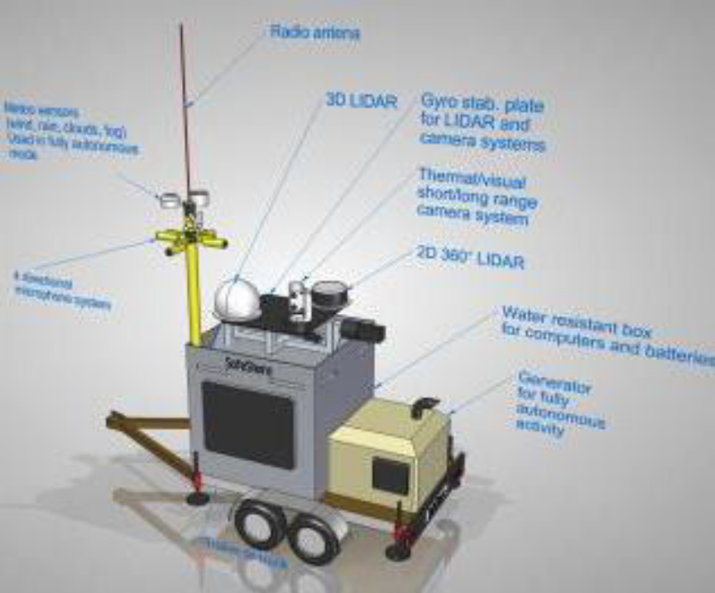
SafeShore Configurations
The SafeShore system can be used as:
  stationary detection point
    in harbour areas, at river border crossing, to detect remote delivery of explosives or chemical weapons, and border trafficking of drugs
    for coast radars, to detect remote delivery of explosive charges
  stationary chain-of-detectors along high-risk border areas, to provide long term protection in areas with persistent problems
  mobile deployable system in areas where intelligence predicts higher volume of illegal or threatening activities.
Confidential

Slide 13


Sample Deployment of Detection Systems
Protection of
oil platform
Continuous protection of border area
Protection of port or Coast radar installation
Protection of critical infrastructure element
Confidential

Slide 14
Operation
Border Protection Plan
Deployment of fixed detection systems
Operation of command & control centre
Detection of illicit traffic
Deployment of border police forces
Intelligence
Deployment of mobile detection systems
Confidential

Slide 15
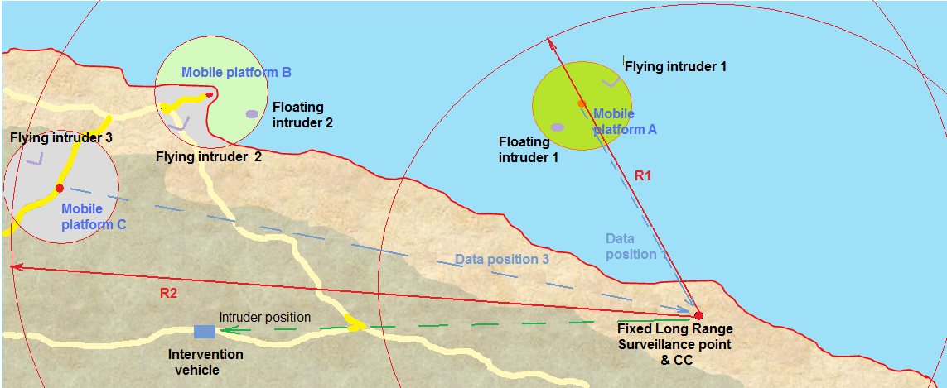
Detection, Assessment, Tracking & Response
Confidential

Slide 16
Adaptability to Other Uses
Protection of Critical Infrastructure
  Rogue drones can be used to deliver explosive charges or CBRN agents as part of a terrorist attack against Critical Infrastructure sites
  Early detection of such drones can be used in combination with various counter-drone measures (entanglement nets, ballistic)
Protection of government officials
  Drones are a risk factor in case of public events where government officials or other VIPs can be the target of attacks using drones as means of delivery
  Early detection of such drones can be used in combination with various counter- drone measures (entanglement nets, ballistic) or evacuation measures
Confidential

Slide 17
Project scope and organisation
WP1 – Ethics Requirements
Setting of the ethics requirements
WP2 - Regulations & Methodologies
Standardisation, certification and conformity assessment
Safety & Security regulations
Maritime borders security regulations
Privacy and ethical issues
Integration in the EUROSUR and the CISE frameworks
Mobile platform solutions (mechanical, energy and communication)
WP3 - Mission Requirements Definition in Maritime environment
Survey and characterization of target performance levels
User requirements collection and analysis
Environmental conditions and expected hazards
System architecture and specifications
WP4 - Hardware & Sensors Development
LIDAR platform development
Visible and thermal CCTV platform development
Acoustic sensing platform development
Radio passive monitoring system development
Mobile platform development
Confidential

Slide 18
Project scope and organisation
WP5 - Algorithms & Software Development
Video analytics engine adaptation
Data fusion engine development
GIS platform development
Scenarios and decision support module development
C2 server, interfaces and GUI development
WP6 - Prototype Development
Overall system prototype design
Integration of systems for standing configuration
Integration of systems on deployable platform
Integration of mixed platforms as one panoramic system
Prototype testing
Operational regulations and standards compliance
WP7 - Testing & Demonstration
Development of operational test scenarios
Users involvement and training and sites preparation
Field Trial 1: North Sea Scenario & Demonstrations
Field Trial 2: Mediterranean Scenario & Demonstrations
Field Trial 3: Black Sea Scenario & Demonstrations
Analysis and evaluation of test results
WP8 - Exploitation & Dissemination
Characterization of the system and final specification
Dissemination of results
Strategy for exploitation of results
Confidential

Slide 19
Thank you!

