Slide 1











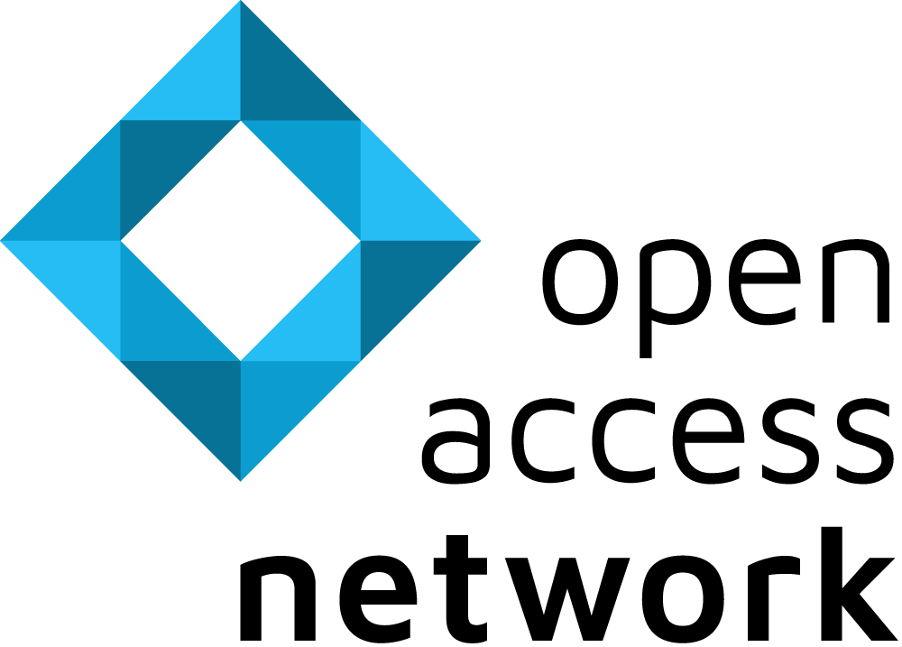

Finding Open Access Literature
Search engines, tools and resources for finding open access publications and providing worldwide, free access to full texts:
BASE
Dissemin
OpenAlex
The Bielefeld Academic Search Engine is one of the world's largest academic search engines. It indexes a vast number of documents from over 11,000 data providers and continuously expands. The majority of the academic content included is open access.
Dissemin supports authors to make a paywalled version of their paper freely available to the public. By analyzing the publication, Dissemin evaluates whether publications are openly accessible and invites authors to upload them to a repository.
OpenAlex is a comprehensive catalog of the global research system, including scholarly publications, authors, institutions, and more. They index over 250M documents, with extra focus on languages other than English, and on works from the Global South.
CORE
Europe PMC
OpenAIRE
CORE is dedicated to aggregating all open access research worldwide. It is the world's largest collection of freely available full texts and improves the findability and discoverability of open access content provided by repositories and journals.
Europe PMC provides access to a worldwide collection of life science publications and preprints, containing millions of full texts from trusted sources. Furthermore, it connects research articles to related resources, thus promoting reproducibility.
The OpenAIRE Research Graph brings together and interlinks hundreds of millions of metadata records from over 70k data sources trusted by researchers. The project has become the authoritative source for the European Open Science Cloud (EOSC).
OAIster
OSF
SHARE
OAIster is a union catalogue containing more than 50 million open access records. These are searchable via WorldCat and aggregated from over 2,000 data providers.
Open Science Framework is a cross-disciplinary platform for searching articles, data and materials, as well as for managing your own research and collaborations.
SHARE's open tools and services help bring together scholarly work distributed across different research ecosystems to make it more discoverable.
For more information visit open-access.network.
CREATED BY
AS PART OF
FUNDED BY
This work is available under a Creative Commons Attribution 4.0 International License. Logos used are excluded from this license.

Slide 2

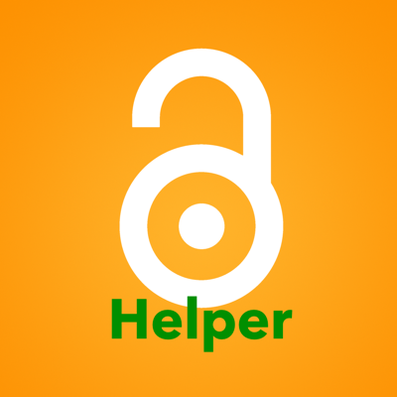



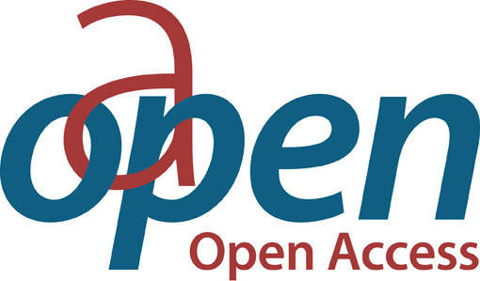


Finding Open Access Literature
Browser plug-ins or extensions for open access versions of scholarly articles:
Open Access Button
Open Access Helper
unpaywall
Among other tools OA.Works also offers the browser extension Open Access Button, which provides free and legal access to specialized publications or automatically requests them from authors.
The Open Access Helper supports searches for open access versions of articles. It is available as an app for iOS or as a browser extension for MacOS, Edge, Safari, Chrome or Firefox.
Unpaywall offers a browser extension for Chrome and Firefox. It automatically searches for open access versions of scholarly publications originally published behind a paywall.
Services for finding suitable open access books and open access journals:
B!SON
oa.finder
Journal Checker Tool
B!SON recommends Open Access journals based on user input (title, abstract, references). The tool is machine-learning based, open source and only uses open data sources (DOAJ, OpenCitations, Journal Checker Tool).
oa.finder is a research tool for scholarly publishing outlets that helps authors find Open Access options for their manuscripts in journals or books based on the publication type, role of submitter and organization.
The Journal Checker Tool by cOAlition S helps authors find Plan S compliant publishing routes. The tool checks if a combination of funder, institution, and journal is compliant with the funder’s open access policy.
OAPEN
DOAB
DOAJ
The library platform OAPEN makes open access e-books available as full texts. These are mainly from the fields of humanities and social sciences. Additionally, it provides the Open Access Book Toolkit with practical tips for publishing OA books.
The Directory of Open Access Books is a community-driven discovery service that indexes and provides access to scholarly, peer-reviewed open access books and helps users find trusted open access book publishers.
The Directory of Open Access Journals indexes high-quality, open access, and peer-reviewed journals from around the world. The community-driven platform offers a vast collection of quality open access journals for users.
For more information visit open-access.network.
CREATED BY
AS PART OF
FUNDED BY
This work is available under a Creative Commons Attribution 4.0 International License. Logos used are excluded from this license.

