Slide 1


OMERO & Fiji
Information Infrastructure
for BioImage Data
Workshop: FAIR data handling for microscopy: Structured metadata annotation in OMERO
April 29th & 30th, 2024
Day 2 Session 8
Trainer: Vanessa Fuchs, Tom Boissonnet, Christian Schmidt
30-04-2024
With the exception of the layout, logos, and unless cited third-party content, the content of these slides is shared under the terms of the Creative Commons Attribution License (CC-BY 4.0) unless the content is marked otherwise.

Slide 2


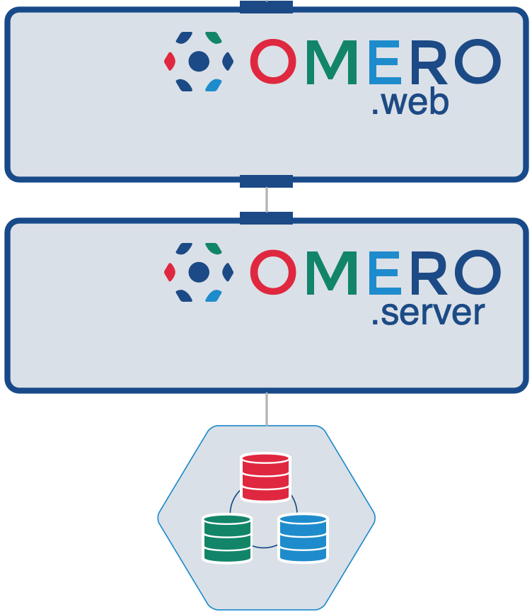

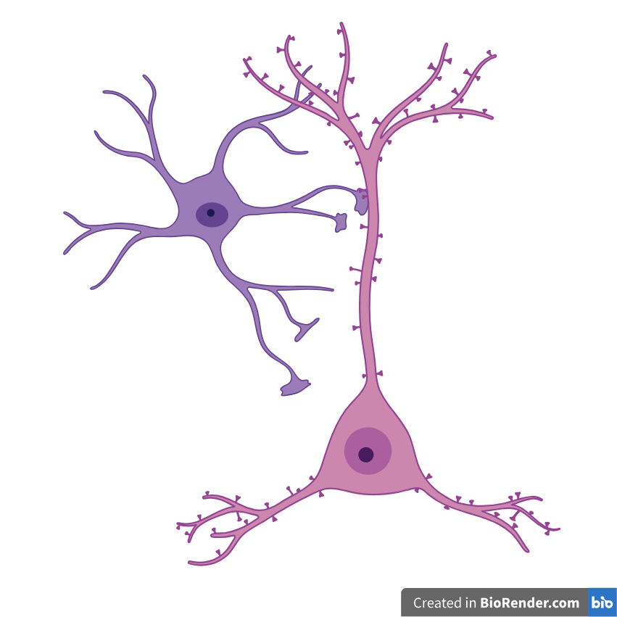
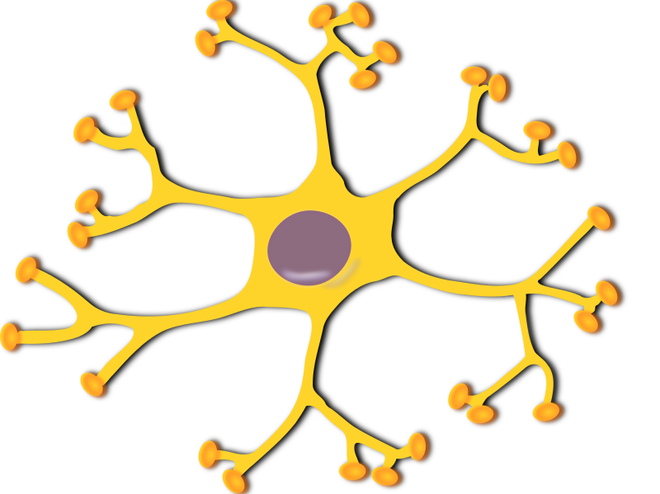
OMERO Virtual Machine
Workstation
OMERO
VM Filesystem
Fiji
napari
read plane
internal path
/OMERO/ManagedRepository/
Access image through OMERO.server
OME.TIFF (5D)
2
3
1
OMERO plugins
send plane
request plane
...
network
database
Fileserver
OMERO
VM Filesystem
import path
Fiji
napari
/Project_A/Experiment_1/
read import path (FS)
internal path
OME.TIFF (5D)
/OMERO/ManagedRepository/
Shortcut access for in-place imported images
OME.TIFF (5D)
...
2
SYMBOLIC LINK (in-place import)
4
access stack
database
request import path
3
send import path
1

Slide 3
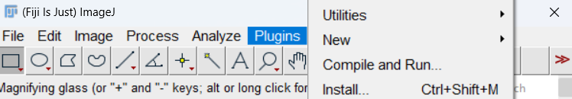
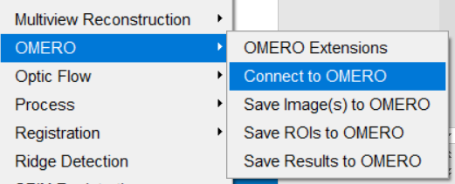
OMERO-Fiji plugin

Slide 4
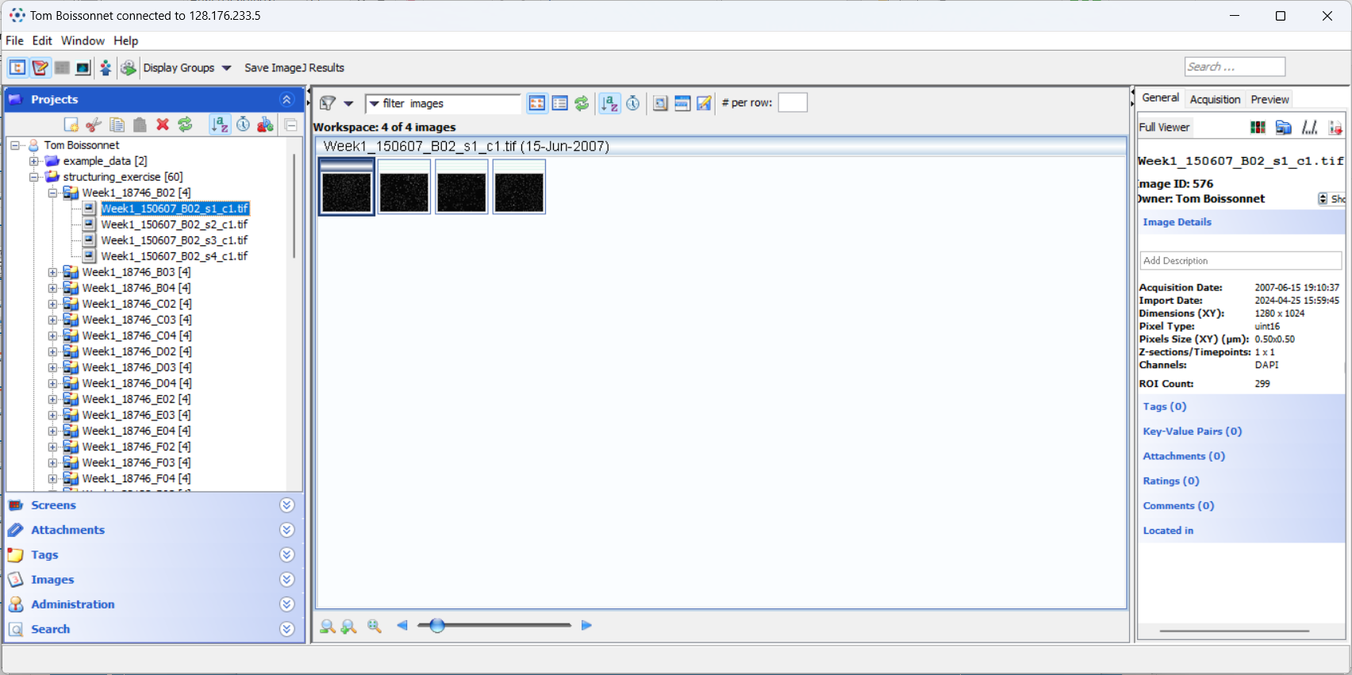
Fiji - OMERO.insight

Slide 5
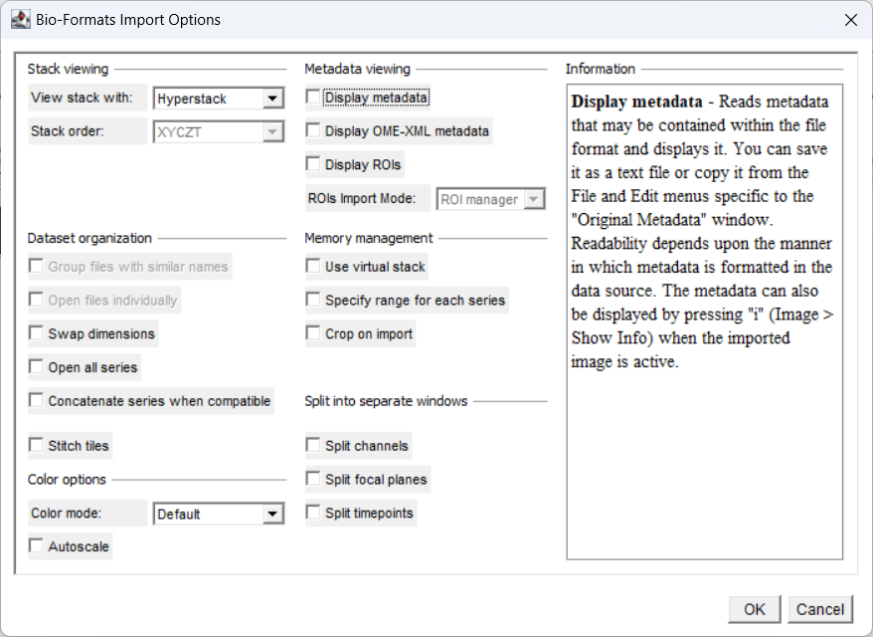
Bio-Formats importer

Slide 6

Activity 1
Goal is to familiarize with the connection to fiji
  Open images (plate from yesterday) from the Fiji-OMERO.insight client
  Segment nuclei (manually or with your imageJ skills)
  Measure the segmented nuclei and upload the results back to OMERO (ROIs and result table)
Optional: you can use the macro attached to this project to segment your images:
  With the search bar in Fiji, look at the different function used in the macro
- Do not use batch mode
- Careful with big images

Slide 7
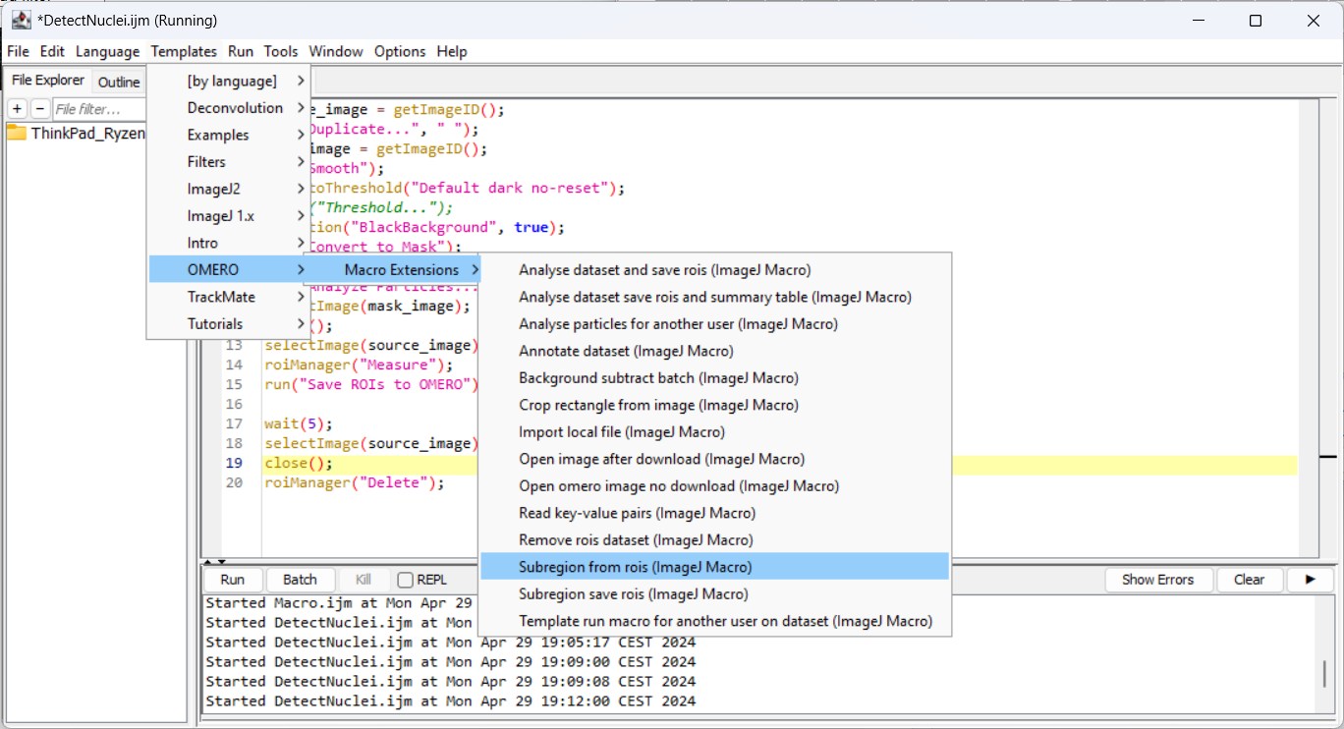
Automatizing - omero_macro_extension

Slide 8
Activity 2
Goal is to understand how image analysis can scale up
  Download the macro attached to the project
  This macro applies the nuclei detection to all images in a dataset
  What is the result output?
Look at the table attached to the dataset you processed
Optional: have a look at the predefined examples
  Load a subregion from ROI: try it with a reasonably small ROI on a histology image
  Print a key-value pair from the macro: this could be used in the logic of your script when you need to pair images or get important parameters.
- Do not use batch mode
- Careful with big images

