Slide 1

Recommended Metadata for Biological Images
Key-value pair annotation in OMERO
Workshop: FAIR data handling for microscopy: Structured metadata annotation in OMERO
April 29th & 30th, 2024
Day 1 Session 4
Trainer: Vanessa Fuchs, Tom Boissonnet, Christian Schmidt
With the exception of the layout, logos, and unless cited third-party content, the content of these slides is shared under the terms of the Creative Commons Attribution License (CC-BY 4.0) unless the content is marked otherwise.

Slide 2
REMBI provides guidelines for metadata for biological images
Metadata collected in 8 modules
See Sarkans et al., 2021, https://doi.org/10.1038/s41592-021-01166-8
“Fig. 2: Different categories of metadata that are covered by REMBI.”
Original publication: https://doi.org/10.1038/s41592-021-01166-8
https://www.ebi.ac.uk/bioimage-archive/rembi-help-overview/
(Copyright © 2021, Springer Nature America, Inc.)

Slide 3
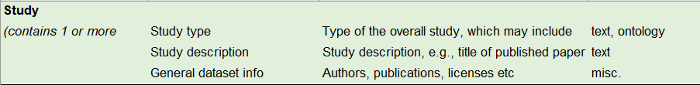
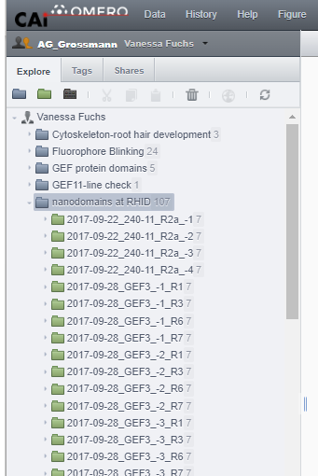
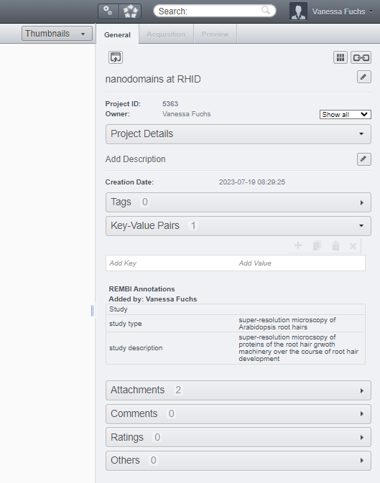
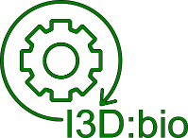
REMBI module 1: Study
“Study is the highest level metadata, describing your project, including funding and publications.”
Recommendation by I3D:bio:
Key-Value pairs in OMERO at the “Project”-level:
Data acquired in the lab of Prof. Grossmann
https://www.icib.hhu.de/
I3D:bio project: https://www.i3dbio.de/
Original publication: https://doi.org/10.1038/s41592-021-01166-8
https://www.ebi.ac.uk/bioimage-archive/rembi-help-overview/

Slide 4
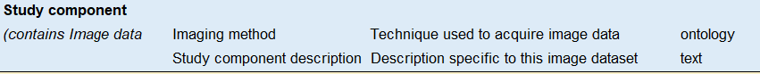
REMBI module 2: Study component
Study Component acts as a container that helps you organise your data, based on experiment types or samples etc. A Study Component contains one or more of the following components: biosample, specimen, image acquisition, image correlation, image analysis (latter two are only required if relevant).
Recommendation by I3D:bio:
One per Dataset (Key-Value Pairs in OMERO at the Dataset-level)
I3D:bio project: https://www.i3dbio.de/
Original publication: https://doi.org/10.1038/s41592-021-01166-8
https://www.ebi.ac.uk/bioimage-archive/rembi-help-overview/

Slide 5
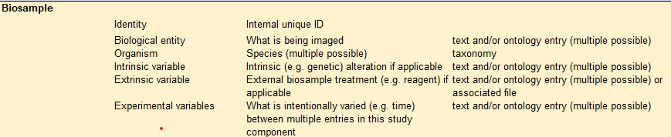
REMBI module 3: Biosample
Biosample describes what you have imaged, for example: the species, the organism, a particular cell line, genetic background etc.
Recommendation by I3D:bio:
One per Dataset (Key-Value Pairs in OMERO at the Dataset-level)
I3D:bio project: https://www.i3dbio.de/
Original publication: https://doi.org/10.1038/s41592-021-01166-8
https://www.ebi.ac.uk/bioimage-archive/rembi-help-overview/

Slide 6
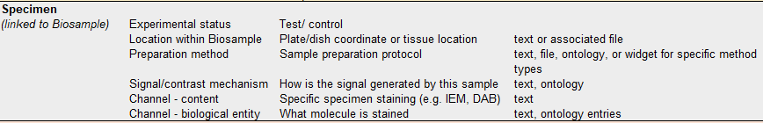
REMBI module 4: Specimen
Specimen metadata describes how your sample was prepared for imaging.
Recommendation by I3D:bio:
One per Dataset (Key-Value Pairs in OMERO at the Dataset-level)
I3D:bio project: https://www.i3dbio.de/
Original publication: https://doi.org/10.1038/s41592-021-01166-8
https://www.ebi.ac.uk/bioimage-archive/rembi-help-overview/

Slide 7
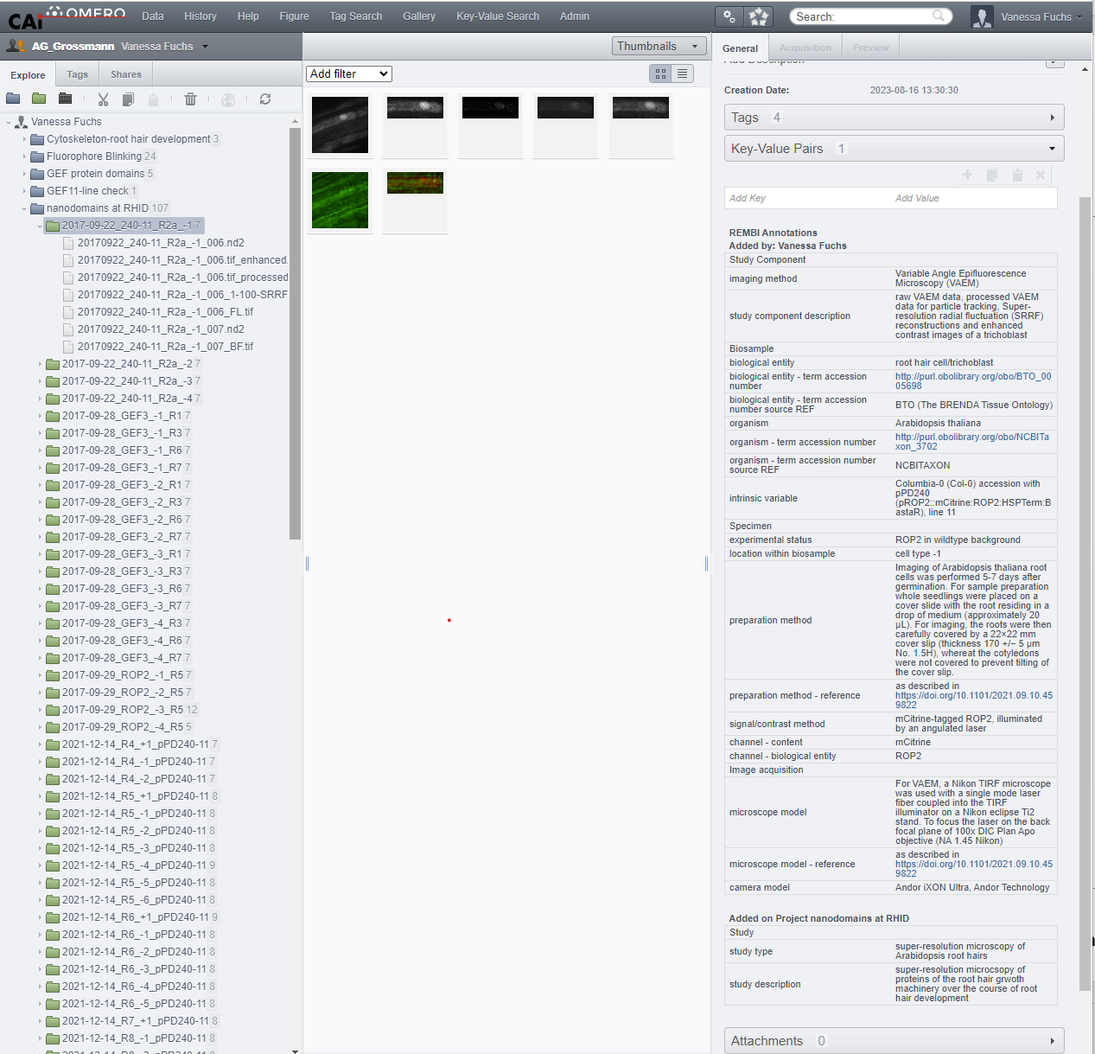
REMBI at CAi
Data acquired in the lab of Guido Grossmann
https://www.icib.hhu.de/

Slide 8
REMBI at CAi
Module1: Study – project level
Data acquired in the lab of Guido Grossmann
https://www.icib.hhu.de/

Slide 9
REMBI at CAi
Module2: Study component – dataset level
Data acquired in the lab of Guido Grossmann
https://www.icib.hhu.de/

Slide 10
REMBI at CAi
Module 3: Biosample – dataset level
Data acquired in the lab of Guido Grossmann
https://www.icib.hhu.de/

Slide 11
REMBI at CAi
Module 4: Specimen – dataset level
Data acquired in the lab of Guido Grossmann
https://www.icib.hhu.de/

Slide 12
REMBI at CAi
Module 5: Image acquisition – dataset level
Data acquired in the lab of Guido Grossmann
https://www.icib.hhu.de/

Slide 13


Acknowledgments
In cooperation with
Information Infrastructure for BioImage Data (I3D:bio)
https://www.i3dbio.de/
Center for Advanced imaging (CAi) at Heinrich-Heine University Düsseldorf
https://www.cai.hhu.de/
Funded by the Deutsche Forschungsgemeinschaft (DFG, German Research Foundation) under the National Research Data Infrasstructure – NFDI 46/1 – 501864659
The NFDI4BIOIMAGE consortium comprises legally independent partners and does not act autonomously towards third parties. The authors represent the contributions from their respective affiliated institutions and work together for the project.

