Slide 1

Introduction to Ontologies and a suggestions on how to use in OMERO
Workshop: FAIR data handling for microscopy: Structured metadata annotation in OMERO
April 29th & 30th, 2024, Day 1 – Session 5
Trainers: Tom Boissonnet, Vanessa Fuchs, Christian Schmidt
With the exception of logos and cited third-party content, the content of these slides is shared under the terms of the Creative Commons Attribution License (CC-BY 4.0) unless the content is marked otherwise.

Slide 2
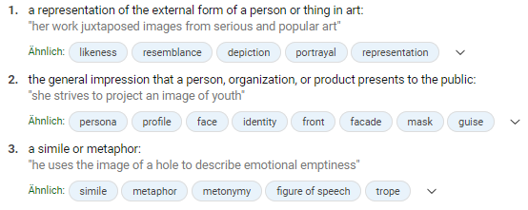

What is an image?
Microsoft Bing search for „image definition“
Asking a microscopist
https://en.wikipedia.org/wiki/Virtual_image
Asking a research software engineer…
https://docs.docker.com/guides/docker-concepts/the-basics/what-is-an-image/

Slide 3
Technical terms in science
Key: „cell type“ Value: „CD4+ T cell“
Key: „disease model“ Value: „Experimental Autoimmune Encephalomyelitis“
„cell type“ „type of cell“ „cell-type“ „cellular entity“ „cellular identity“
„CD4+ T cell“ „CD4-positive T-lymphocyte“ „naive, CD4-positive T cell“
„CD4-positive, alpha-beta T cell“ „Th0 cell“ „CD4+ T helper cell“
? ? ?
„Experimental Autoimmune Encephalomyelitis“ „EAE“ „Allergic Encephalomyelits“
How to avoid ambiguity?
How to describe the data objectively?
How to make the metadata machine-interpretable?
Adapted from: Schmidt C., Bortolomeazzi M., Boissonnet T., Fortmann-Grote C. et al. (2023). I3D:bio‘s OMERO training material: Re-usable, adjustable, multi-purpose slides for local user training. Zenodo. DOI: 10.5281/zenodo.8323588. If not stated otherwise, the content of this material (except for logos and the slide design) is published under Creative Commons Attribution 4.0 license.

Slide 4
Controlled vocabularies
A controlled vocabulary provides a list of terms.
a definition of each term
a unique identifier of each term
different types exist, e.g.,
  Alphabetical list
  Thesaurus (a collection of synonyms)
  Taxonomy (hierarchical or network-like list of terms)
  (ontology)
→ Allows standardized usage of terms
Adapted from: Schmidt C., Bortolomeazzi M., Boissonnet T., Fortmann-Grote C. et al. (2023). I3D:bio‘s OMERO training material: Re-usable, adjustable, multi-purpose slides for local user training. Zenodo. DOI: 10.5281/zenodo.8323588. If not stated otherwise, the content of this material (except for logos and the slide design) is published under Creative Commons Attribution 4.0 license.

Slide 5
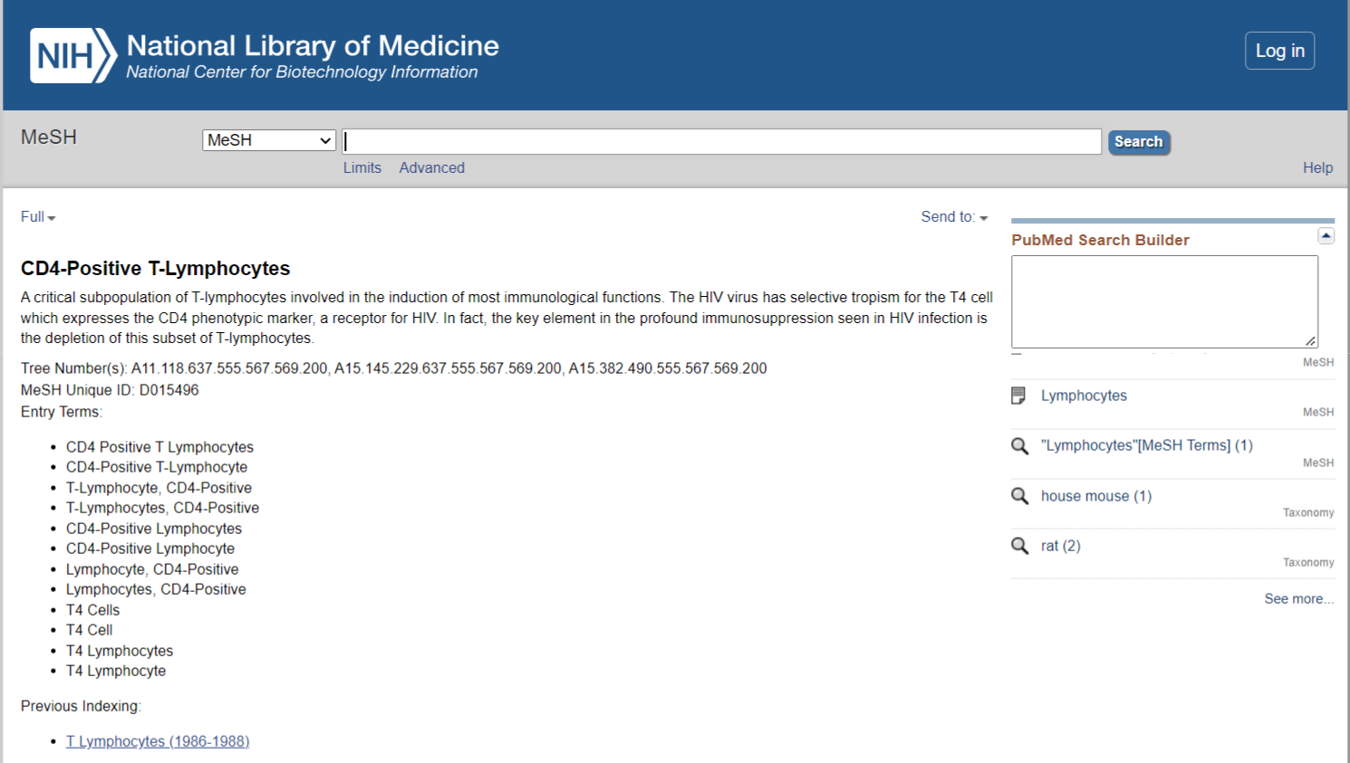
Controlled vocabularies examples
Medical Subject Headings (MeSH)
Controlled vocabulary in the form of a thesaurus
curated by the National Library of Medicine (US)
https://www.ncbi.nlm.nih.gov/mesh/ (last access: 2023-08-17)

Slide 6

Controlled vocabularies examples
Systematized Nomenclature for Medicine – Clinical Terms
Curated by SNOMED International, non-profit, membership fees, Germany is a member
https://www.bfarm.de/EN/Code-systems/Terminologies/_node.html
International Classification of Diseases (ICD), currently version 11
https://en.wikipedia.org/wiki/ICD-11

Slide 7
Ontologies
An ontology is a conceptual framework of how specific terms are used to represent domain knowledge in a (research) domain.
Defines term attributes/properties, and relationships between the terms
Terms with shared attributes are grouped into classes
Terms in different ontologies are mapped to each other or adopted
Can be extended over time with the evolving domain knowledge (i.e., an ontology is versioned)
Formalized, i.e., ontologies can be expressed in ontology formats (machine-interpretable), e.g., OWL, SKOS, OBO
Examples of Ontologies:
Experimental Factor Ontology (EFO) – curated by the EMBL EBI
Biological Imaging Methods Ontology (FBbi) – curated by the Cell Image Library
Cell Line Ontology (CLO) – community-based, curated at the University of Michigan
Adapted from: Schmidt C., Bortolomeazzi M., Boissonnet T., Fortmann-Grote C. et al. (2023). I3D:bio‘s OMERO training material: Re-usable, adjustable, multi-purpose slides for local user training. Zenodo. DOI: 10.5281/zenodo.8323588. If not stated otherwise, the content of this material (except for logos and the slide design) is published under Creative Commons Attribution 4.0 license.

Slide 8
Examples of potentially useful ontologies
Different ontologies are designed to optimally represent their respective domain knowledge (for example, the relationship between terms)
This knowledge can be represented as a tree structure or „knowledge graph“. Example:
leukocyte
(a class, SubClassOf „…“)
is a
(a class, SubClassOf of „leukocyte“)
lymphocyte
is a
(a class, SubClassOf of „lymphocyte“)
T cell
Property that defines the relationship
Here:
A T cell Is a lymphocyte
is a
B cell
(a class, SubClassOf of „lymphocyte“)
Adapted from: Schmidt C., Bortolomeazzi M., Boissonnet T., Fortmann-Grote C. et al. (2023). I3D:bio‘s OMERO training material: Re-usable, adjustable, multi-purpose slides for local user training. Zenodo. DOI: 10.5281/zenodo.8323588. If not stated otherwise, the content of this material (except for logos and the slide design) is published under Creative Commons Attribution 4.0 license.

Slide 9
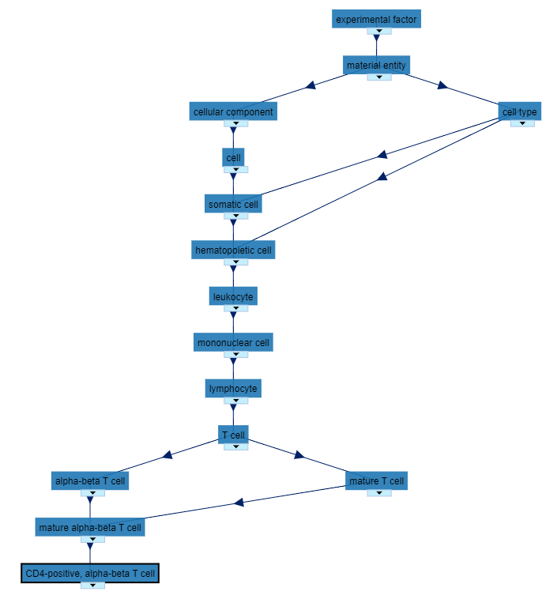
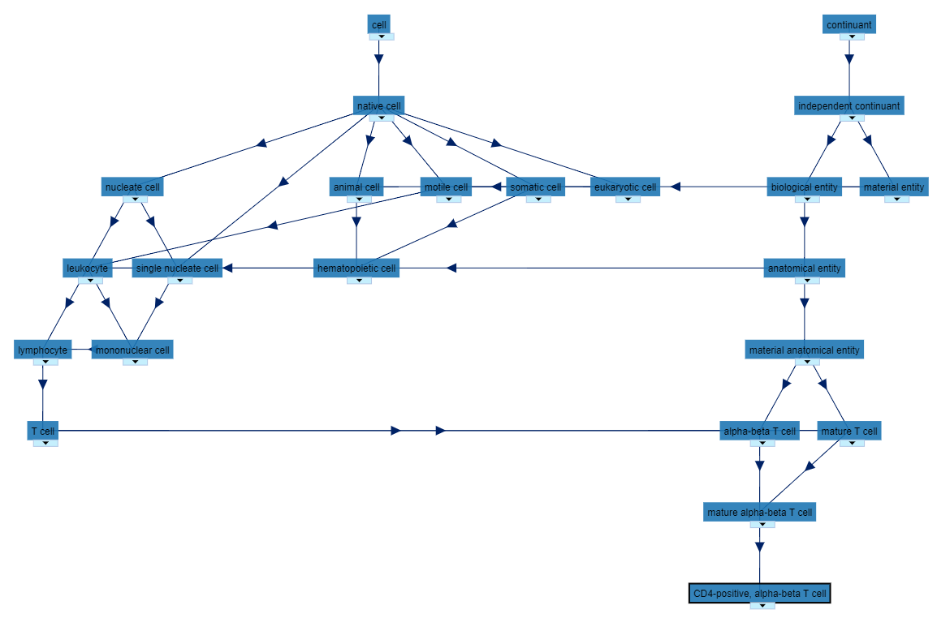
Examples of potentially useful ontologies
Term: CD4-positive, alpha-beta T cell; http://purl.obolibrary.org/obo/CL_0000624
EFO
CL
The term is part of both ontologies. It originates from the CL ontology and is adopted into the EFO ontology
Both visualizations taken from: https://bioportal.bioontology.org/
Adapted from: Schmidt C., Bortolomeazzi M., Boissonnet T., Fortmann-Grote C. et al. (2023). I3D:bio‘s OMERO training material: Re-usable, adjustable, multi-purpose slides for local user training. Zenodo. DOI: 10.5281/zenodo.8323588. If not stated otherwise, the content of this material (except for logos and the slide design) is published under Creative Commons Attribution 4.0 license.

Slide 10
Mapping across ontologies
EFO
CL
etc.
Both visualizations taken from: https://bioportal.bioontology.org/

Slide 11
Advantage of using ontologies
EFO
A single Key-Value Pair can carry extended domain knowledge!
„CD4-positive, alpha-beta T cell“ following an ontology (here: EFO) includes more information from the domain knowledge formalized in the ontology (and cross-domain knowledge formalized by mapping):
Is carrying a T cell receptor with αβ-chains
Has completed thymic selection (i.e., is mature)
Is a cell of the hematopoietic system
etc…
Due to the ontology format, a computer can read the knowledge!
Adapted from: Schmidt C., Bortolomeazzi M., Boissonnet T., Fortmann-Grote C. et al. (2023). I3D:bio‘s OMERO training material: Re-usable, adjustable, multi-purpose slides for local user training. Zenodo. DOI: 10.5281/zenodo.8323588. If not stated otherwise, the content of this material (except for logos and the slide design) is published under Creative Commons Attribution 4.0 license.

Slide 12
Examples of potentially useful ontologies
BAO BioAssays Ontology
EDAM Ontology of bioscientific data analysis and data management
(EDAM BioImaging)
EFO Experimental Factor Ontology
CLO Cell Line Ontology
CL Cell Ontology
GO Gene Ontology
UBERON Uber Anatomy Ontology
FBbi Biological Imaging Methods Ontology
ChEBI Chemical Entities of Biological Interest
Links resolve to https://www.go-fair.org/fair-principles/

Slide 13
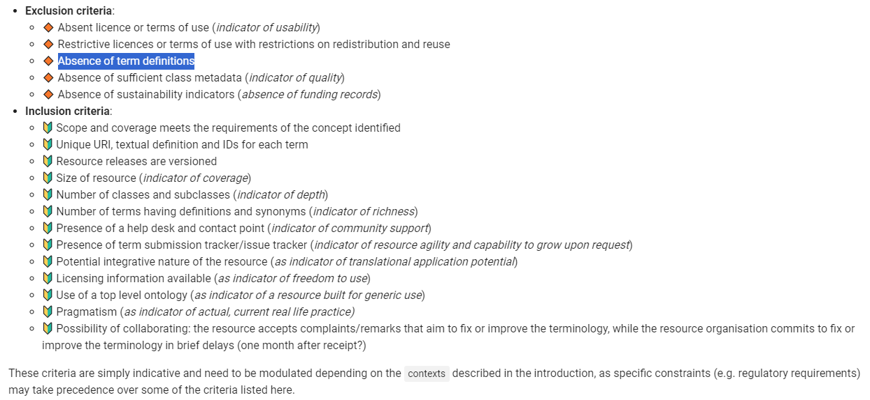
Inclusion and exclusion criteria for ontologies
Taken from: https://faircookbook.elixir-europe.org/content/recipes/interoperability/introduction-terminologies-ontologies.html

Slide 14
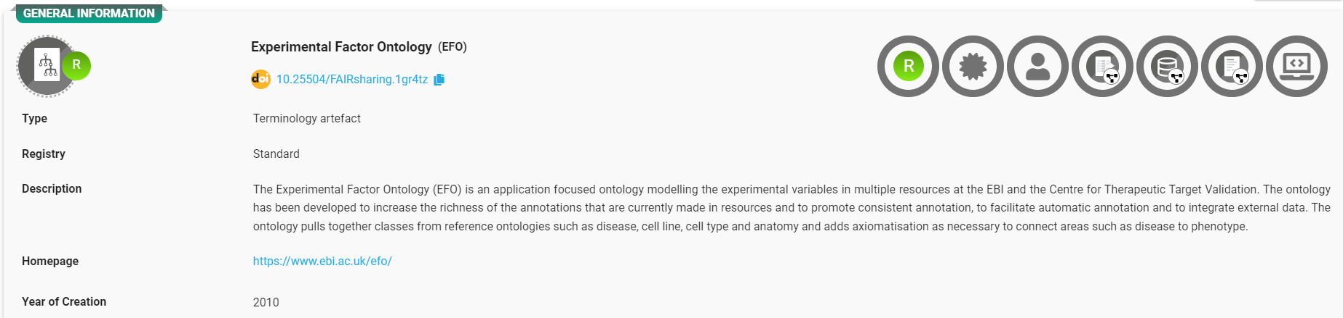
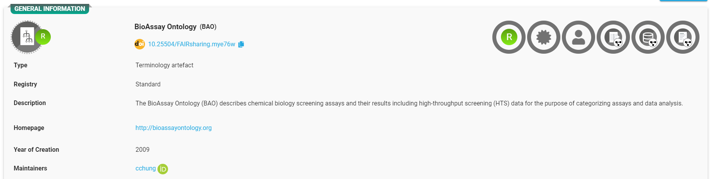
Ontologies (examples)
Taken from FAIRsharing.org

Slide 15
Demonstration and Group Task
Try out different ontology lookup services:
Ontology Lookup Service https://www.ebi.ac.uk/ols4/index
Semantic Lookup Service https://semanticlookup.zbmed.de/ols/index
BioPortal Bioontology https://bioportal.bioontology.org/
Ontobee https://ontobee.org/

Slide 16
Recommendation for Ontologies in OMERO
Where possible, use terms that are derived from a useful ontology
How to indicate the Ontology-compliant term choice:
Key: Biological entity Value: CD4-positive, alpha-beta T cell
Key: Biological entity Term Accession Number Value: http://purl.obolibrary.org/obo/CL_0000624
Key: Biological entity Term Source REF Value: http://www.ebi.ac.uk/efo/efo.owl or EFO
Why this style? Because it is already used by the ISA framework, hence, close to an annotation standard
Ontology compliance for all terms???
  Choose the essential keywords that represent your research
  Identify a few ontologies that you can use sustainably
Adapted from: Schmidt C., Bortolomeazzi M., Boissonnet T., Fortmann-Grote C. et al. (2023). I3D:bio‘s OMERO training material: Re-usable, adjustable, multi-purpose slides for local user training. Zenodo. DOI: 10.5281/zenodo.8323588. If not stated otherwise, the content of this material (except for logos and the slide design) is published under Creative Commons Attribution 4.0 license.

Slide 17
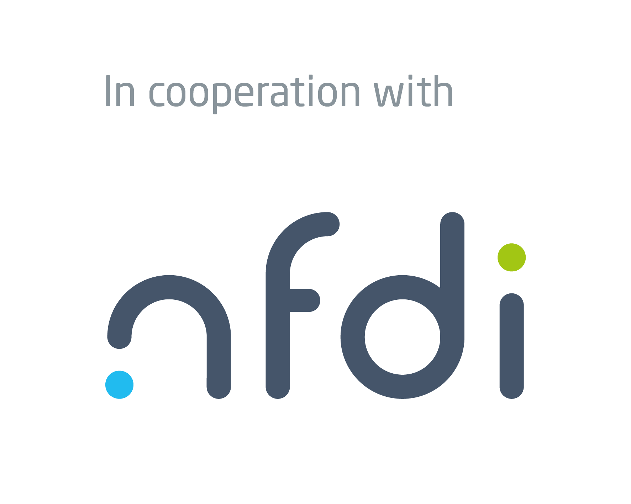

Acknowledgments
In cooperation with
Information Infrastructure for BioImage Data (I3D:bio)
https://www.i3dbio.de/
German Cancer Research Center (DKFZ), Heidelberg
Department Enabling Technology
Dr. Christian Schmidt, Project Coordinator
office@nfdi4bioimage.de
Funded by the Deutsche Forschungsgemeinschaft (DFG, German Research Foundation) under the National Research Data Infrasstructure – NFDI 46/1 – 501864659
The NFDI4BIOIMAGE consortium comprises legally independent partners and does not act autonomously towards third parties. The authors represent the contributions from their respective affiliated institutions and work together for the project.

