Slide 1

Introduction to the FAIR principles and the bioimage data type
Workshop: FAIR data handling for microscopy: Structured metadata annotation in OMERO
April 29th & 30th, 2024, Day 1 – Session 2
Trainers: Tom Boissonnet, Vanessa Fuchs, Christian Schmidt
With the exception of logos and cited third-party content, the content of these slides is shared under the terms of the Creative Commons Attribution License (CC-BY 4.0) unless the content is marked otherwise.

Slide 2
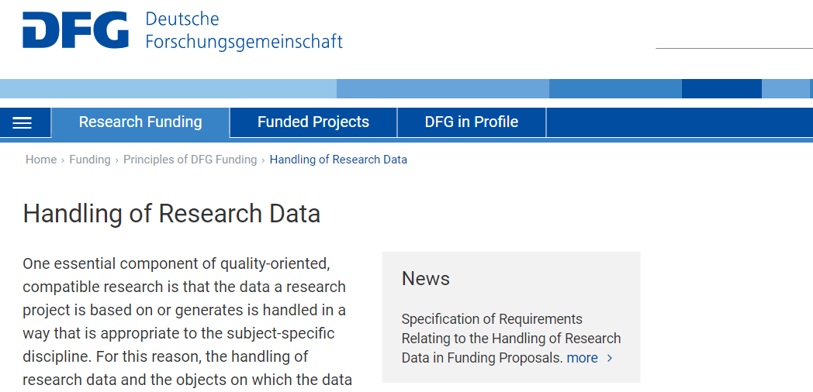
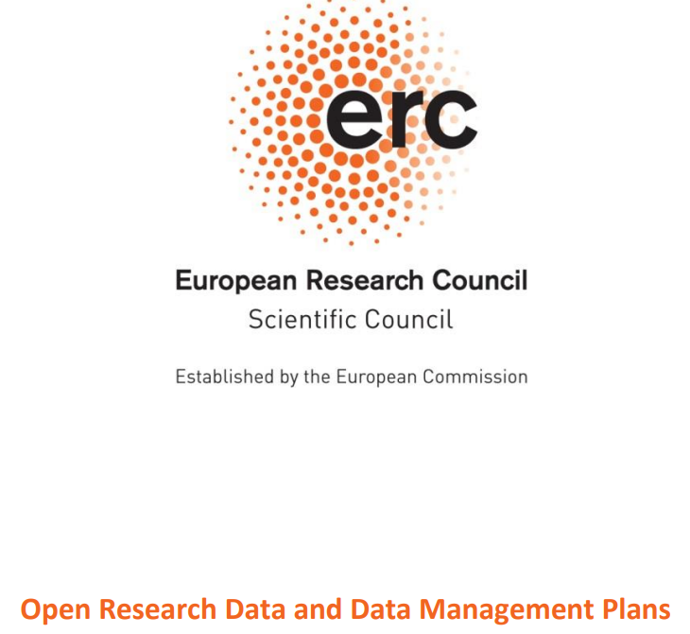
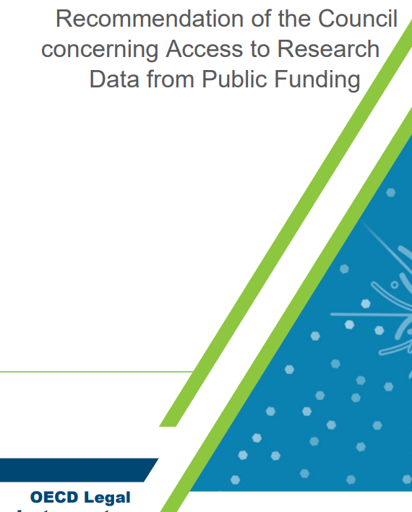
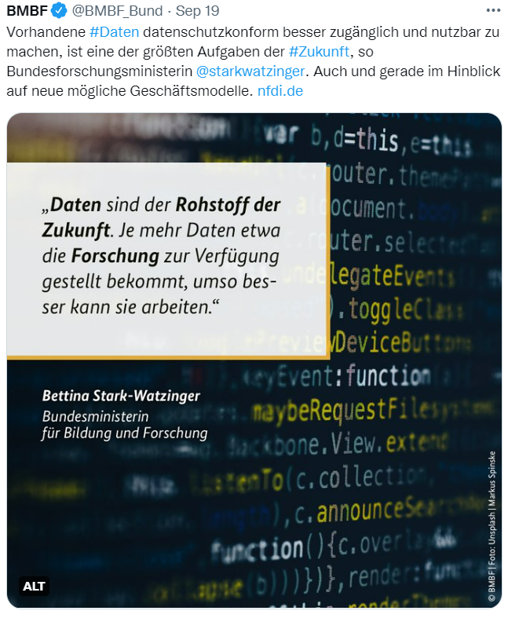
Significance of research data management
Intrinsic motivation
Impact and efficiency of my research
Extrinsic factors
Funding agency demands
Good Scientific Practice
Ethical aspect
Make science more sustainable
Promote Open Science and data sharing
https://www.dfg.de/en/research_funding/principles_dfg_funding/research_data/index.html
https://erc.europa.eu/sites/default/files/document/file/ERC_info_document-Open_Research_Data_and_Data_Management_Plans.pdf
https://twitter.com/BMBF_Bund/status/1571801906074337280?s=20&t=krDcwOPMuPwjs-VisYBgVg
https://legalinstruments.oecd.org/en/instruments/OECD-LEGAL-0347

Slide 3
Research Data Ecosystems Emerging in Europe
How to promote sharing and reuse?
      Guiding principles for data (FAIR)
Sharing and reproducibility
https://www.youtube.com/watch?v=j-6N3bLgYyQ&t=10s
Germany
2002
2006
2008
2012
2016
2018
2020
2022
„FAIR“
OECD:
Open Access
Europe (& beyond)

Slide 4
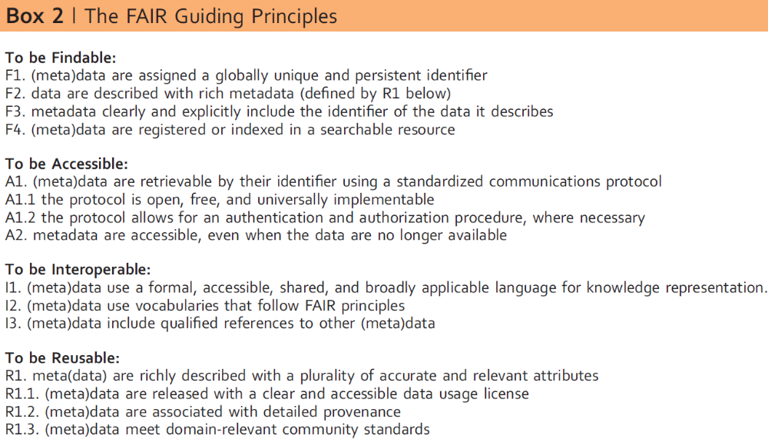
The FAIR principles for data and data stewardship
Findable Accessible Interoperable Reusable
Guiding principles
(not a dictation of technical solutions)
Goal is machine-readability
(not only human ability to reuse)
Guidelines for data producers
and publishers
Applies to data and their provenance
FAIR is not
the same as „open“
a standard
Wilkinson et al., 2016, Scientific Data, DOI: 10.1038/sdata.2016.18, CC-BY 4.0 (http://creativecommons.org/licenses/by/4.0)
Jacobsen et al., 2020, FAIR Principles: Interpretations and Implementation Considerations. Data Intelligence, DOI: 10.1162/dint_r_00024

Slide 5
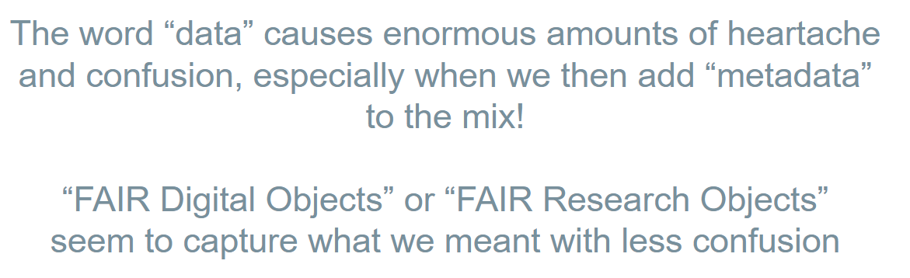
The FAIR principles for data and data stewardship
Findable Accessible Interoperable Reusable
Mark D. Wilkinson, Talk: FAIR in a Series of Vignettes, CoRDI 2023, Karlsruhe, https://tinyurl.com/FAIR-CoRDI23, CC-BY:
Guiding principles
(not a dictation of technical solutions)
Goal is machine-readability
(not only human ability to reuse)
Guidelines for data producers
and publishers
Applies to data and their provenance
FAIR is not
the same as „open“
a standard
Wilkinson et al., 2016, Scientific Data, DOI: 10.1038/sdata.2016.18, CC-BY 4.0 (http://creativecommons.org/licenses/by/4.0)
Jacobsen et al., 2020, FAIR Principles: Interpretations and Implementation Considerations. Data Intelligence, DOI: 10.1162/dint_r_00024

Slide 6
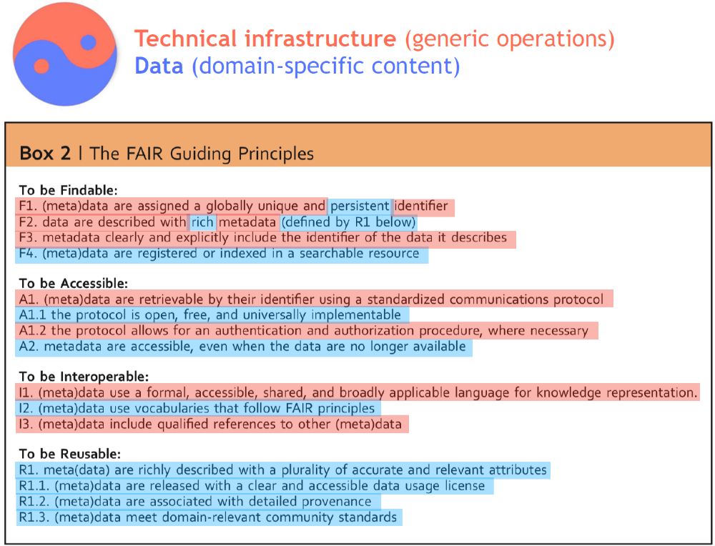
The FAIR principles for data and data stewardship
FAIR requires collaboration:
infrastructure providers
(IT, libraries, publishers, etc.)
stakeholder community members
(researchers, core facility specialists, research support staff)
Schultes E, 2020, GO FAIR conversion matrix – slides, https://osf.io/ceyvj/, (CC-BY 4.0: http://creativecommons.org/licenses/by/4.0)

Slide 7
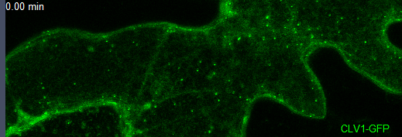
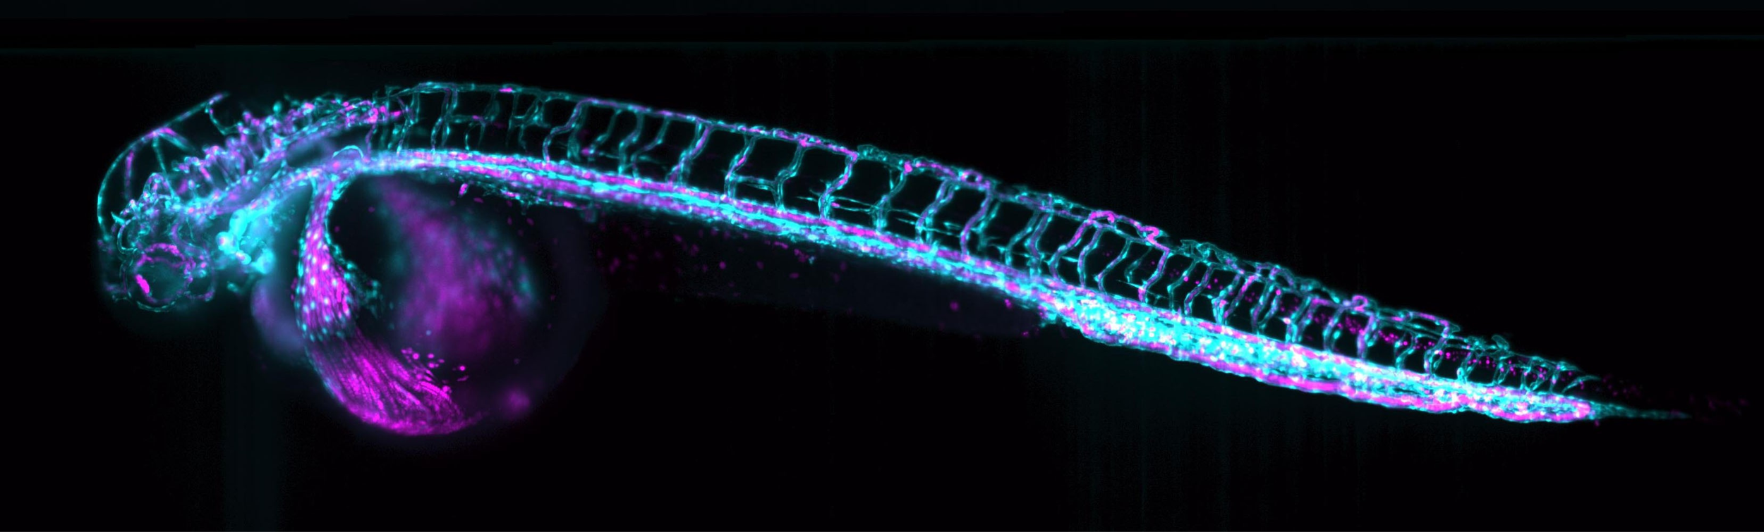
The bioimage data type
Microscopy data is (often):
high-dimensional (X, Y, Z, Channel, Time, …)
saved in proprietary file formats
of large file size
(often in GB-, sometimes in TB-range)
produced with complex experimental setups
used for quantitative analysis → derived data
… i.e. cumbersome to handle, store, and share?
Courtesy of: Y. Stahl, S. Weidtkamp-Peters, HHU Düsseldorf
Courtesy of: Jan Huisken, University of Göttingen

Slide 8
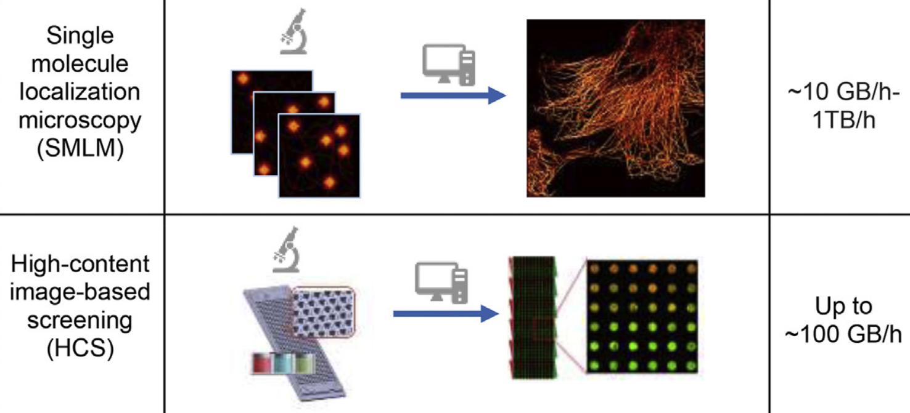
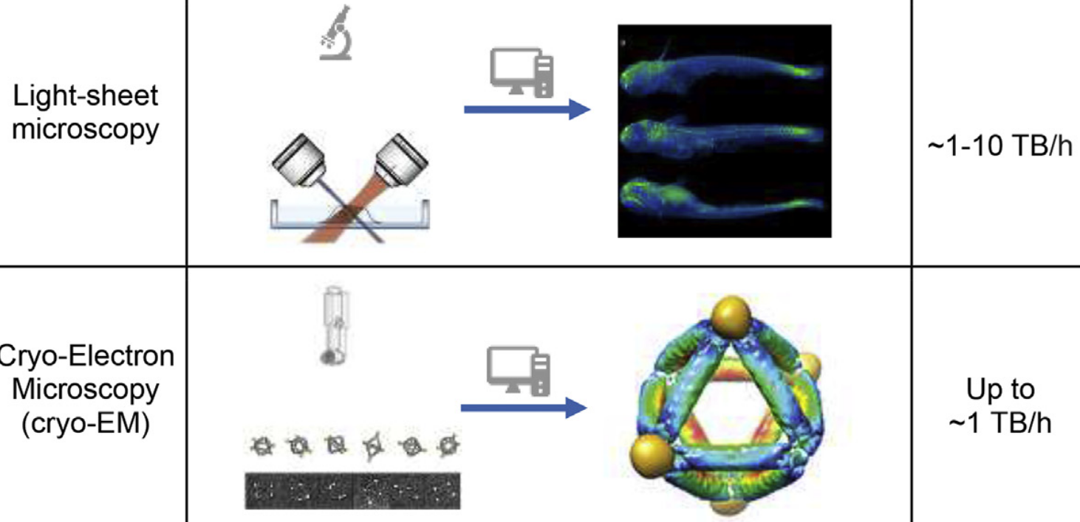
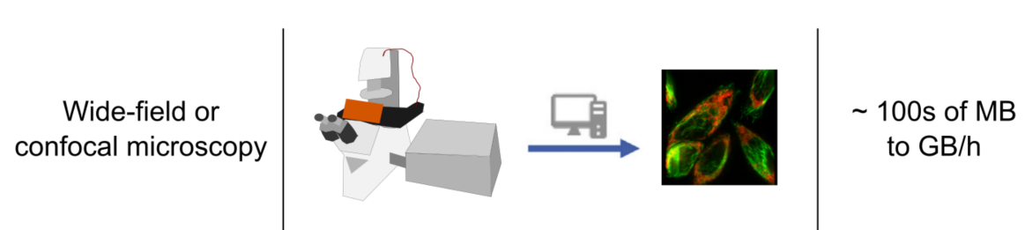
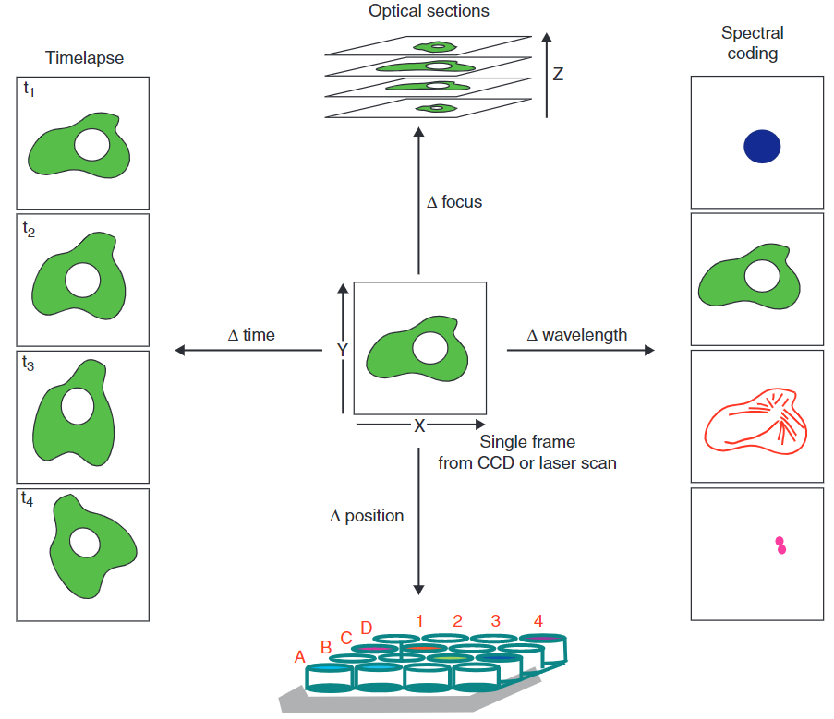
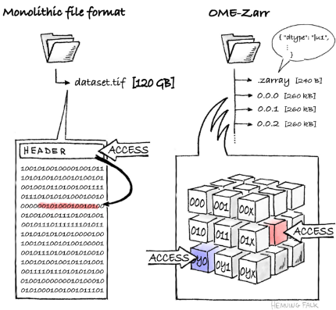
The bioimaging data challenge
Increase in data(set) size per experiment
Modified after: Ouyang a& Zimmer, 2017, Curr Op Sys Biol, doi: 10.1016/j.coisb.2017.07.011
Increase in complexity of data structures
5D image stacks
n-dimensional image
2D image planes
Falk, H. zarr-developers/zarr-illustrations-falk-2022 doi: 10.5281/zenodo.7037367
Copyright: see original publications
Goldberg et al., 2005, Genome Biol, doi: 10.1186/gb-2005-6-5-r47

Slide 9
Research Data Ecosystems Emerging in Europe
How to promote sharing and reuse?
      Guiding principles for data (FAIR)
In practice?
Data ecosystem at the European level (→ EOSC)
Data ecosystem at the German level (→ NFDI)
Germany
Nationale Forschungsdateninfrastruktur (NFDI)
2002
2006
2008
2012
2016
2018
2020
2022
„FAIR“
OECD:
Open Access
European Council:
European Open Science Cloud (EOSC)
Europe (& beyond)

Slide 10

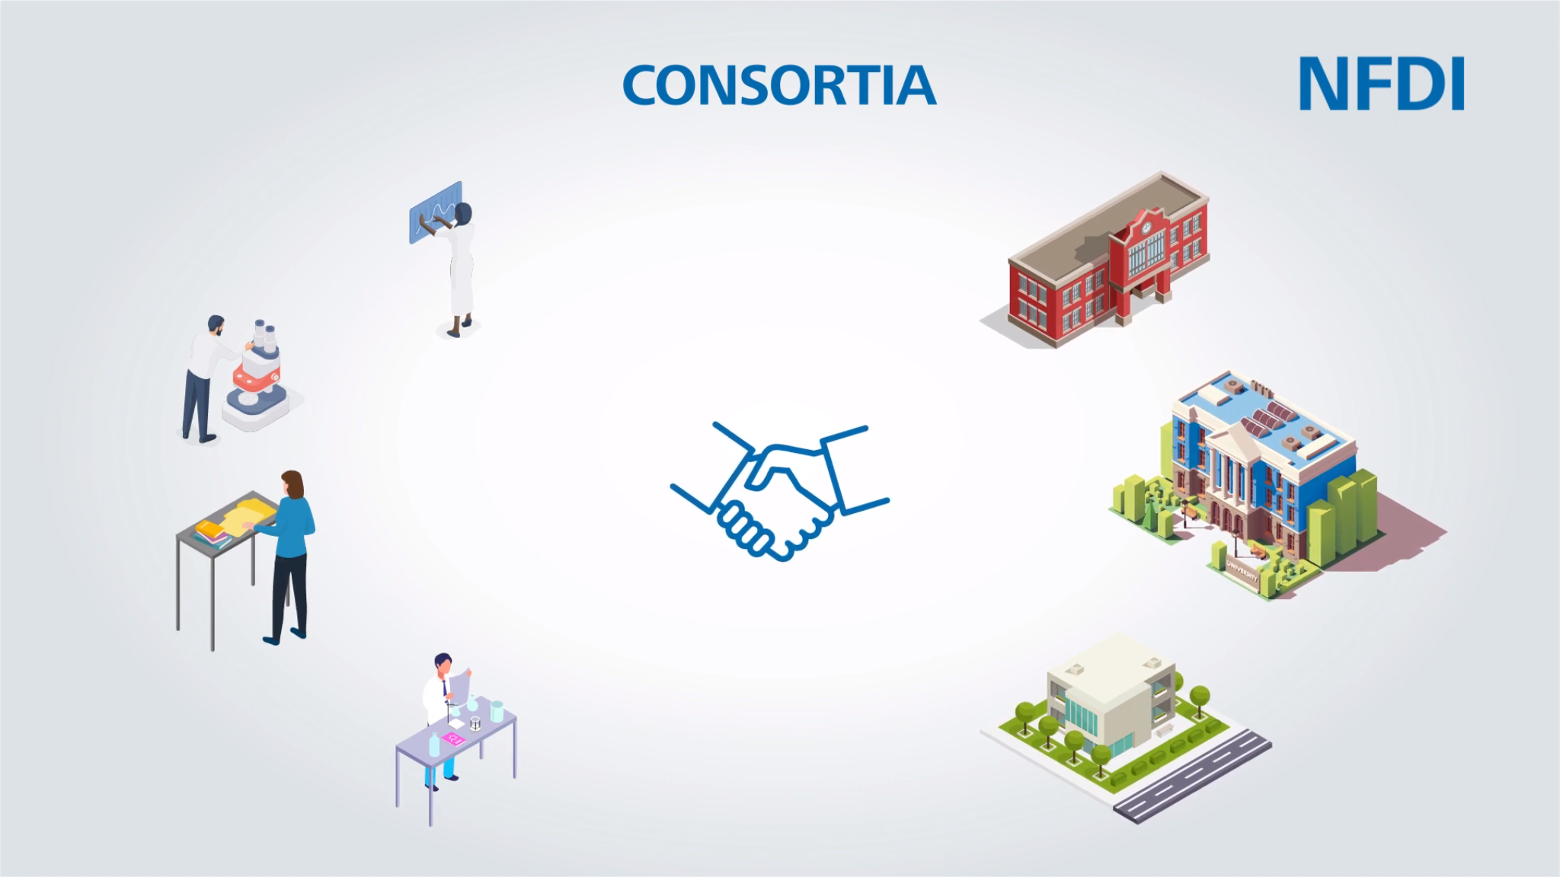
NFDI Nationale Forschungsdateninfrastruktur
“The aim (…) is to systematically manage scientific and research data, provide long-term data storage, backup and accessibility, and network the data both nationally and internationally.”
Science-driven (bottom-up)
“Invest into people, not into metal”
3 calls for application (2019 – 2021)
→ 26 consortia + 1 cross-consortia project
Network of
collaborating
CONSORTIA
(scientific discipline or method)
+ Consortia Assembly
+ NFDI Directorate
+ Scientific Senate
NFDI4BIOIMAGE started in 03/2023
Adapted from: https://www.dfg.de/foerderung/programme/nfdi/informationsmaterialien/index.html, copyright: Deutsche Forschungsgemeinschaft

Slide 11

The consortium NFDI4BIOIMAGE
11 co-applicant institutions (6 Task Areas)
Lead institution: Heinrich Heine University Düsseldorf
Speaker: Prof. Dr. Stefanie Weidtkamp-Peters
IT
IT infrastructure (storage & playground: @Uni Münster & @Uni Freiburg)
But not: a central data archive for all bioimaging data
IT
12 participating institutions
data stewards (DaSts) & research software engineers
2
2
community use cases
Community-oriented services (implemented or planned)
Help Desk for use community support
Training portfolio
Bioimage RDM playground infrastructure
Supporting reproducible image analysis
2
IT
Modified after: Stefanie Weidtkamp-Peters. (2023, Juni 22). NFDI4BIOIMAGE - National Research Data Infrastructure for Microscopy and BioImage Analysis - Online Kick-Off 2023. Zenodo. https://doi.org/10.5281/zenodo.8070038

Slide 12
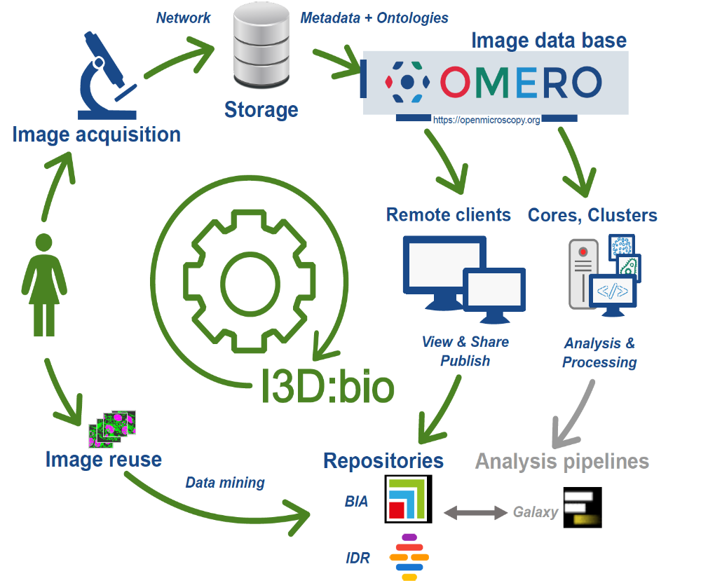
I3D:bio – OMERO-centered RDM project
Information Infrastructure
for BioImage Data (I3D:bio)
OMERO for bioimaging RDM
DFG-funded: 1st phase: 2022-2024
Partners: HHU Düsseldorf, Uni Osnabrück, Uni Freiburg, DKFZ Heidelberg
Goal: Implement new OMERO instances at universities and research institutions in Germany, and provide training for OMERO users
Taken from the I3D:bio grant proposal and published in: Stefanie Weidtkamp-Peters, Janina Hanne, & Christian Schmidt. (2023, Mai 3). A journey to FAIR microscopy data. Zenodo. https://doi.org/10.5281/zenodo.7890311

Slide 13
Findability
F1: (Meta) data are assigned globally unique and persistent identifiers
Mark D. Wilkinson, Talk: FAIR in a Series of Vignettes, CoRDI 2023, Karlsruhe, https://tinyurl.com/FAIR-CoRDI23, CC-BY:
Metadata for the purpose of discovery…
in the ‘F’ section of FAIR!
It should not be defining itself w.r.t. metadata for the purpose of reuse, which is the ‘R’ in FAIR…
F2: Data are described with rich metadata
(described by R1 below)
F3: Metadata clearly and explicitly include the identifier of the data they describe
F4: (Meta)data are registered or indexed in a searchable resource
Links resolve to https://www.go-fair.org/fair-principles/

Slide 14
Accessibility
A1: (Meta)data are retrievable by their identifier using a standardised communication protocol
A1.1: The protocol is open, free and universally implementable
A1.2: The protocol allows for an authentication and authorisation procedure where necessary
A2: Metadata should be accessible even when the data is no longer available
Links resolve to https://www.go-fair.org/fair-principles/

Slide 15
Interoperability
I1: (Meta)data use a formal, accessible, shared, and broadly applicable language for knowledge representation
I2: (Meta)data use vocabularies that follow the FAIR principles
I3: (Meta)data include qualified references to other (meta)data
Links resolve to https://www.go-fair.org/fair-principles/

Slide 16
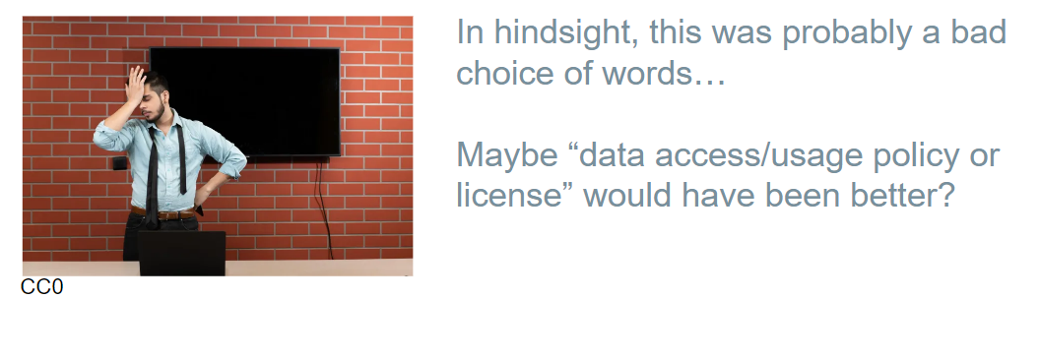
Reusability
R1: (Meta)data are richly described with a plurality of accurate and relevant attributes
Mark D. Wilkinson, Talk: FAIR in a Series of Vignettes, CoRDI 2023, Karlsruhe, https://tinyurl.com/FAIR-CoRDI23, CC-BY:
R1.1: (Meta)data are released with
a clear and accessible data usage license
R1.2: (Meta)data are associated with detailed provenance
R1.3: (Meta)data meet domain-relevant community standards
Links resolve to https://www.go-fair.org/fair-principles/

Slide 17
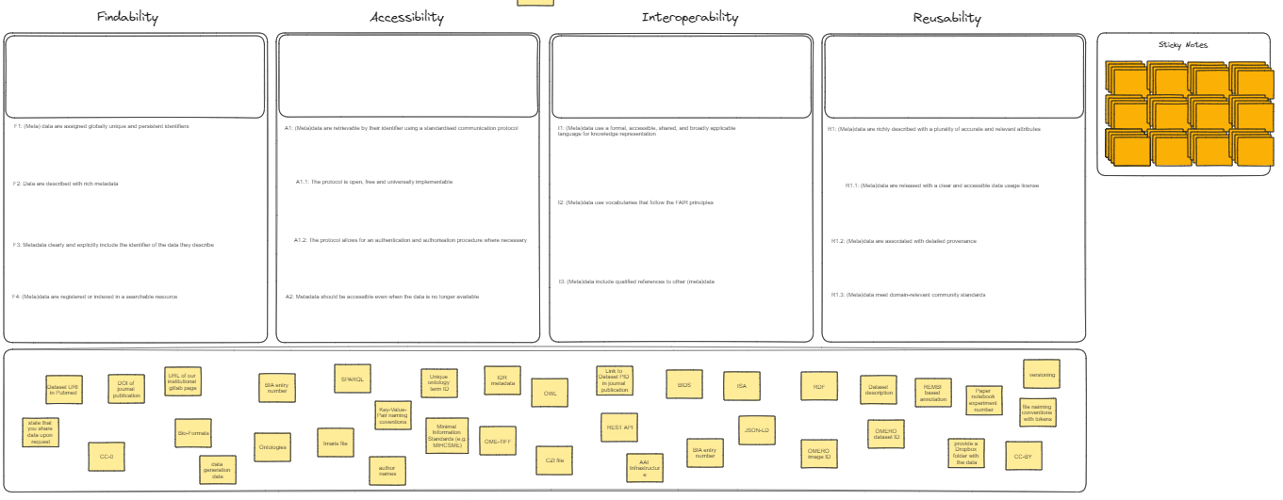
Group exercise:
What does FAIR mean for bioimaging?
→ Excalidraw
Use the sticky notes to assign concepts, tools, practices, or resources to the FAIR principles
Place sticky notes here:
Or here if you think they are specific for certain sub-category of FAIR
Optional:
You can use these prepared notes if you know the terms and if find them to apply

Slide 18
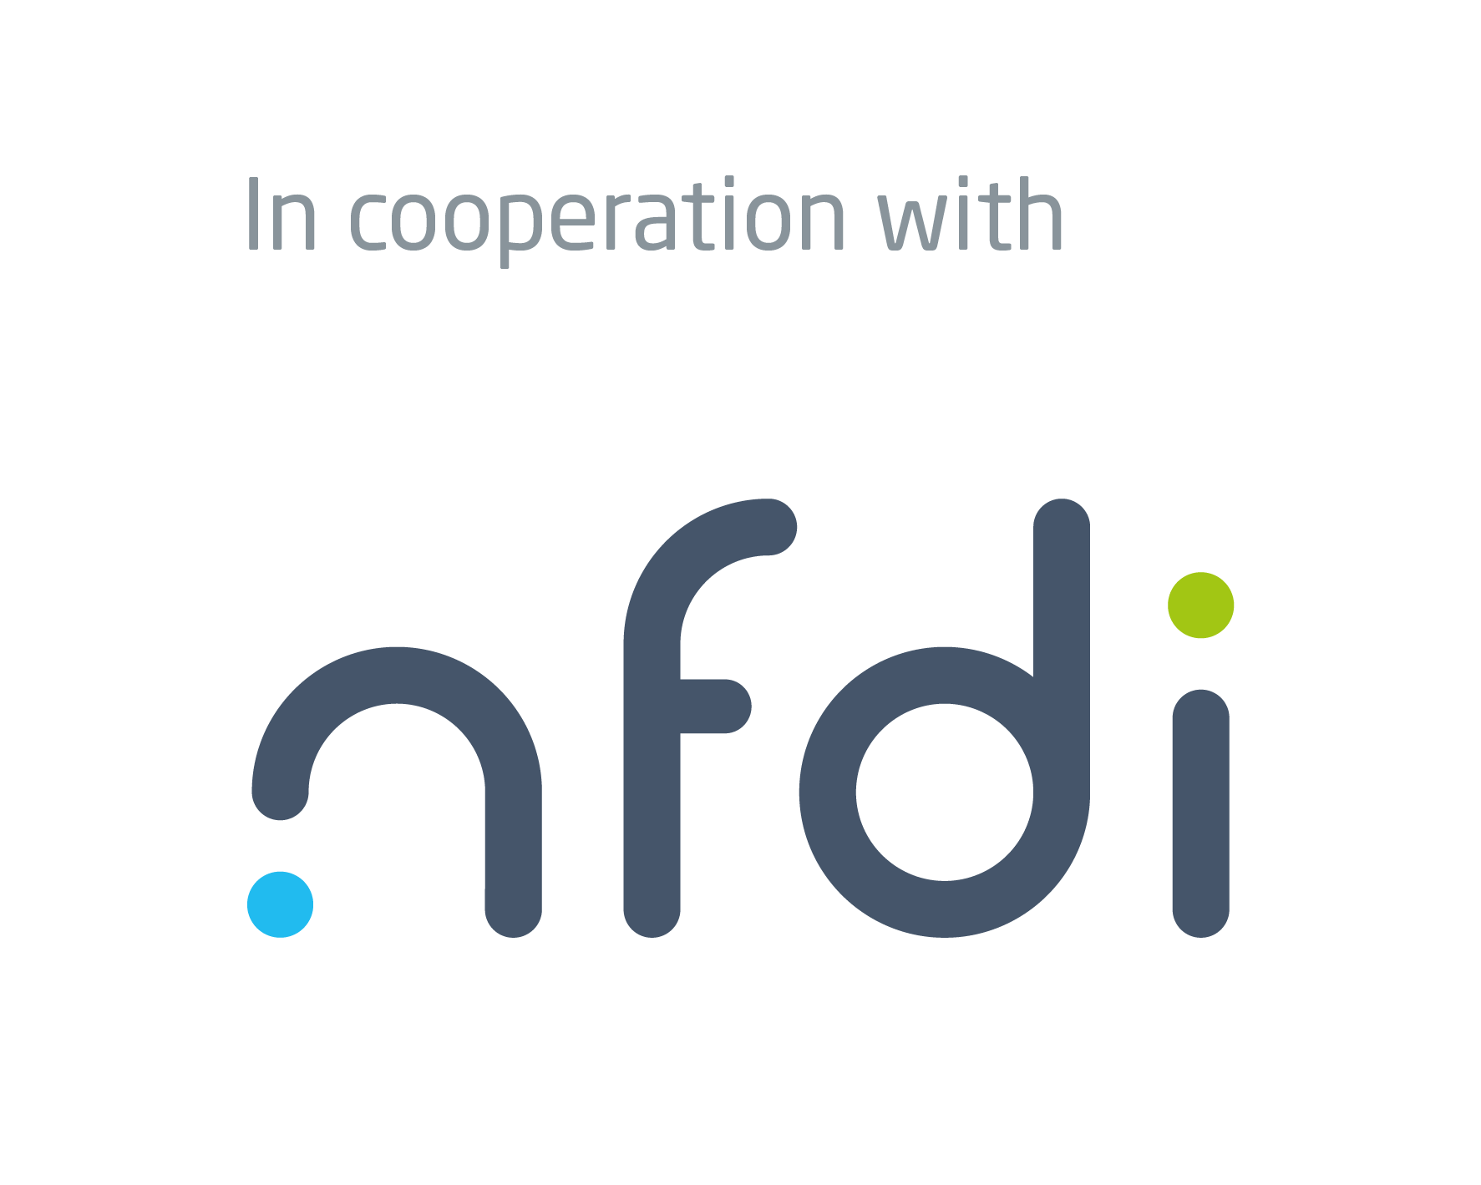

Acknowledgments
In cooperation with
Information Infrastructure for BioImage Data (I3D:bio)
https://www.i3dbio.de/
German Cancer Research Center (DKFZ), Heidelberg
Department Enabling Technology
Dr. Christian Schmidt, Project Coordinator
office@nfdi4bioimage.de
Funded by the Deutsche Forschungsgemeinschaft (DFG, German Research Foundation) under the National Research Data Infrasstructure – NFDI 46/1 – 501864659
The NFDI4BIOIMAGE consortium comprises legally independent partners and does not act autonomously towards third parties. The authors represent the contributions from their respective affiliated institutions and work together for the project.

