Slide 1


Data structure in OMERO and organization with tags
Information Infrastructure
for BioImage Data
Workshop: FAIR data handling for microscopy: Structured metadata annotation in OMERO
April 29th & 30th, 2024
Day 1 Session 3
Trainer: Vanessa Fuchs, Tom Boissonnet, Christian Schmidt
29-04-2024
With the exception of the layout, logos, and unless cited third-party content, the content of these slides is shared under the terms of the Creative Commons Attribution License (CC-BY 4.0) unless the content is marked otherwise.

Slide 2
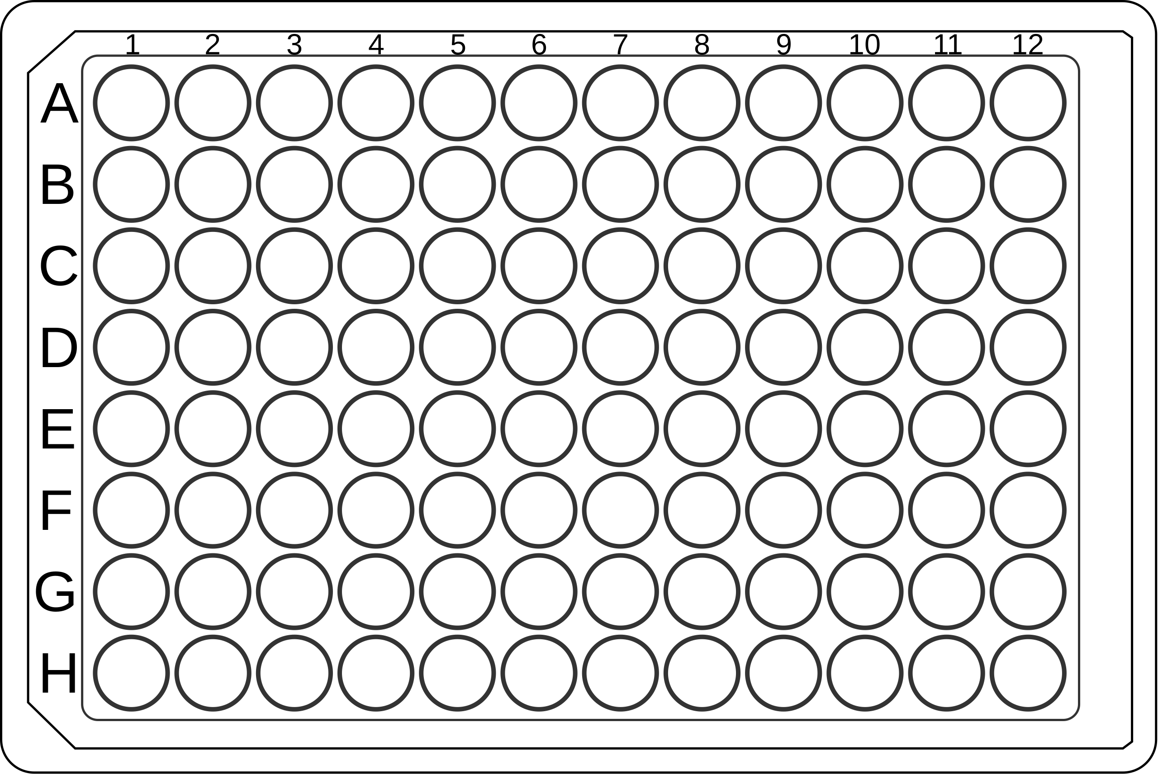
Example data for this session
2
5
10
A plate acquired at week intervals
One compound per row
  Compound B, Compound C, …
Tested at different concentration (columns):
  2 µM, 5 µM, 10 µM
Multiple images are taken from each well for an accurate sampling.

Slide 3
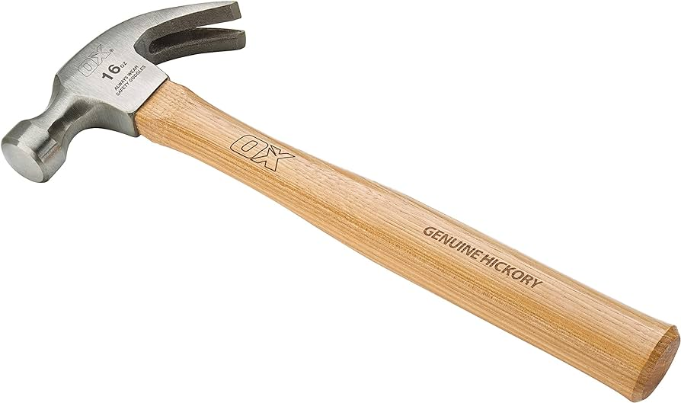
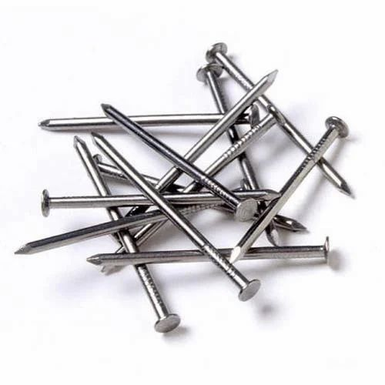
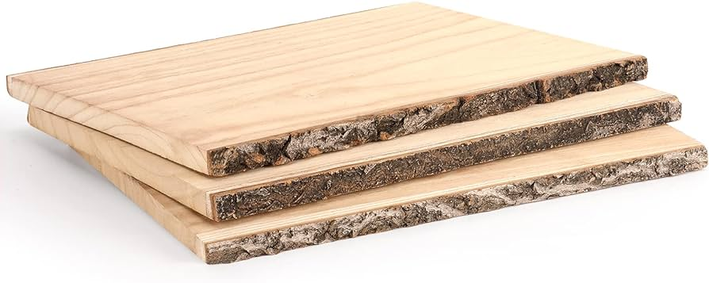
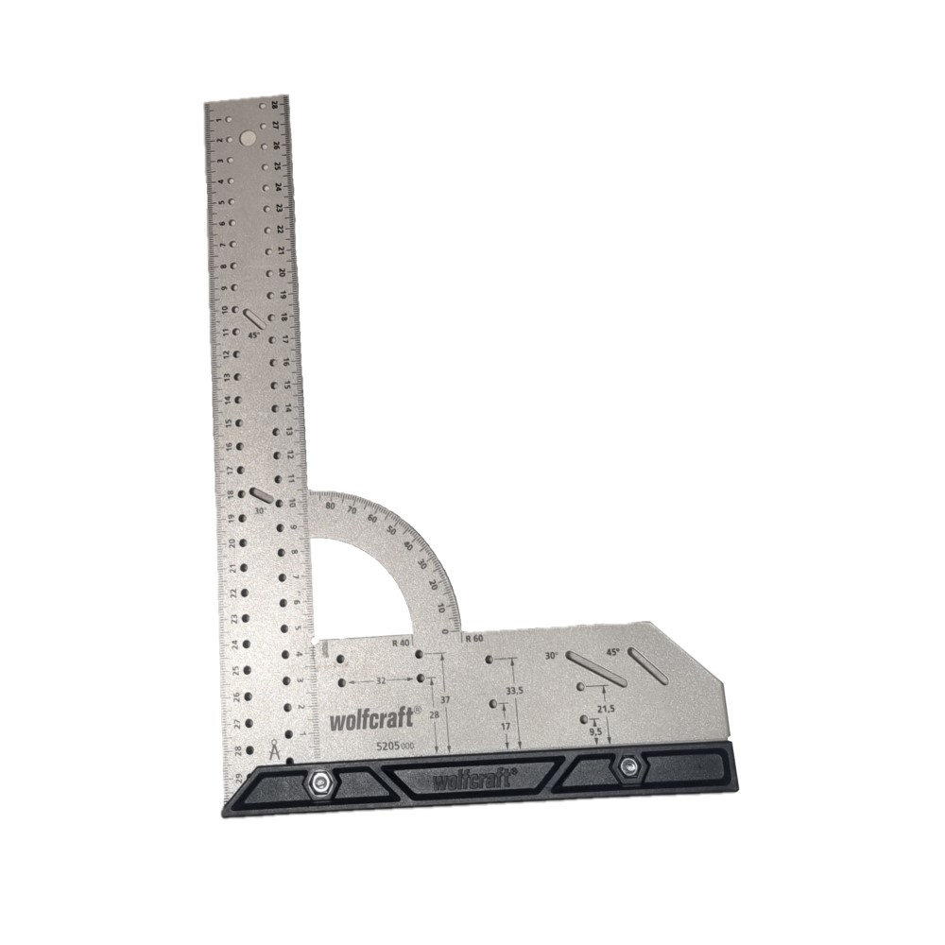
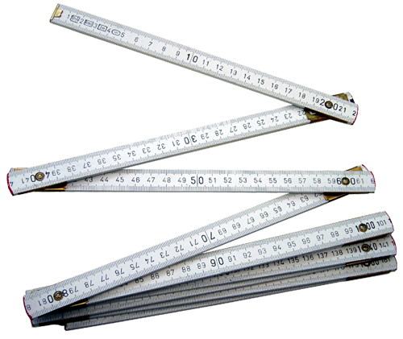
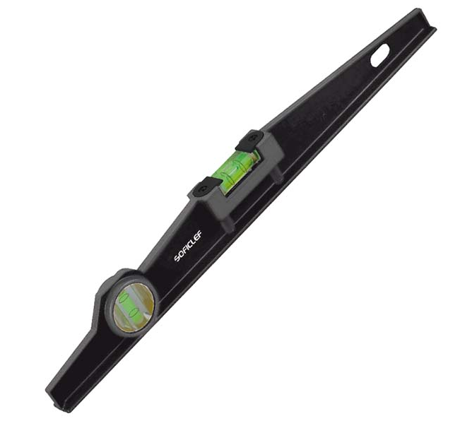
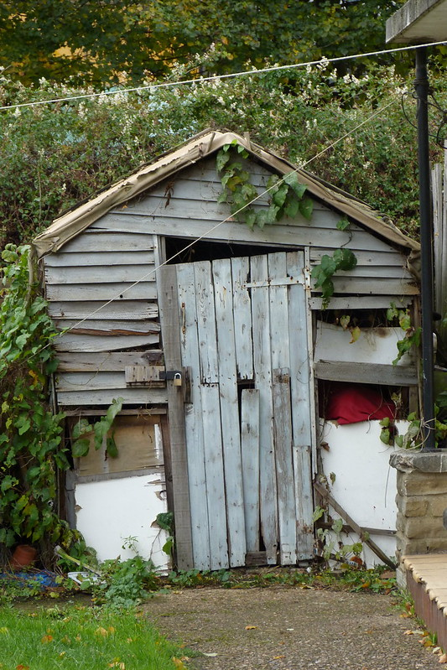
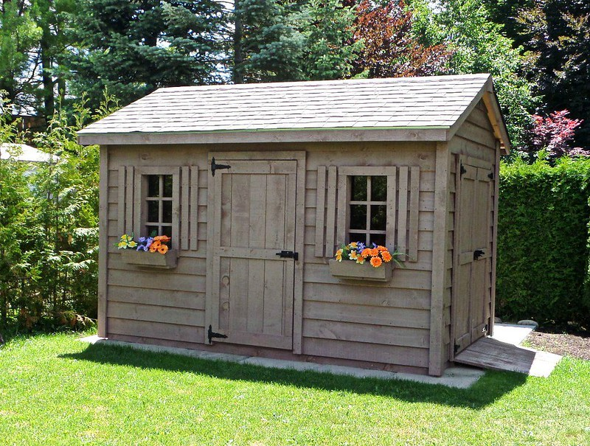

Not so serious analogy
datasets
images
annotations
By Gordon Jolly, https://flickr.com/photos/loopzilla/8132242517/, CC-BY-SA, https://creativecommons.org/licenses/by-sa/2.0/
By Tom Rossini, CC-BY

Slide 4

Not so serious analogy
datasets
images
Tags
Key-value pairs
By Gordon Jolly, https://flickr.com/photos/loopzilla/8132242517/, CC-BY-SA, https://creativecommons.org/licenses/by-sa/2.0/
By Tom Rossini, CC-BY

Slide 5
Searching the optimal organization
What should our "dataset unit" be ?
  the whole plate, of every week ?
  the whole plate, one dataset per week ?
  the compound of every week ?
  the compound of a single week ?
  …
What's a convenient way to describe the data content ?

Slide 6



Introducing OMERO at HHU
OMERO has only a two level hierarchy. But you can use tags
Tags: just like hashtags in Twitter or Instagram
I'll think about how to organize my data later
metadata?
You can use annotations
to add metadata

Slide 7
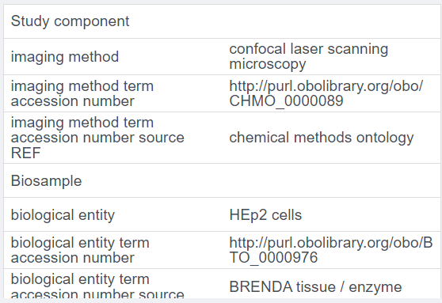
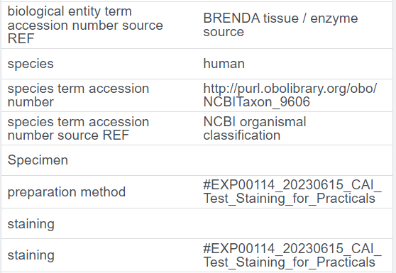
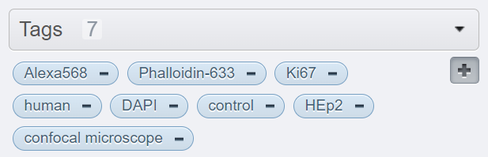
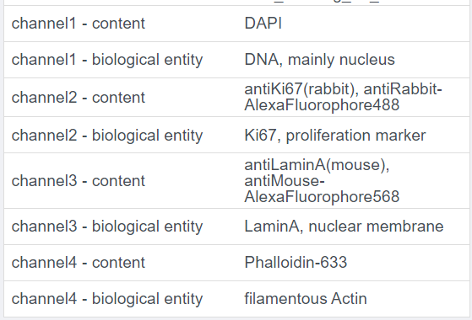
Overlapping concepts
Tags
Key-value pairs

Slide 8
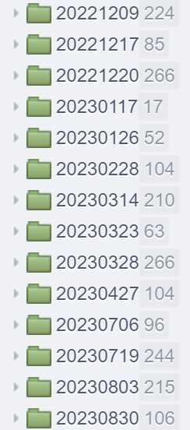
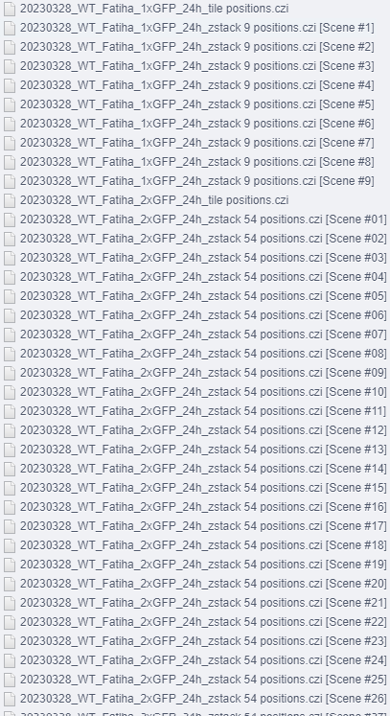
Using project & dataset as folders
Folder habits are intuitively matched to projects and datasets
Thinking dataset as folders leads to a confusing structure in OMERO:
How should I annotate this?
  Annotate dataset: unclear to know which images it applies to
  Annotate first image of every set: other images need reference to the annotated image
  Annotate every image: tedious and annotation duplication
What if someone wants to look at the data differently?

Slide 9
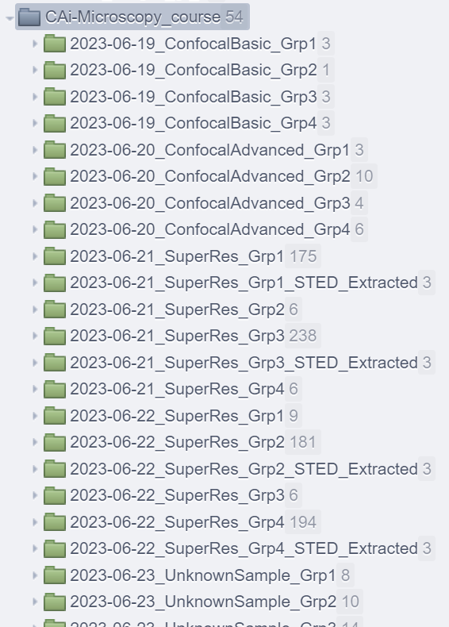
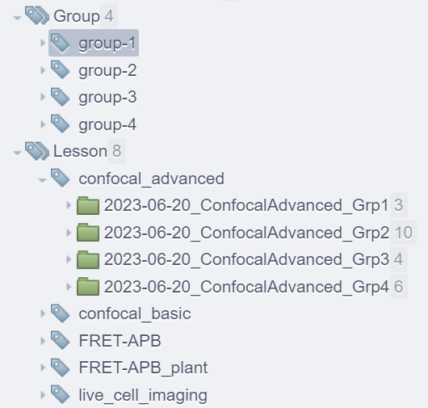
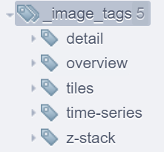
Need some organization for data?
We can use tags like folders (not possible with datasets)
Don't overdo it: less tag categories -> less work
(and less oversight)
Tags are flexible and should be used for individual preferences
Need to group images across datasets?
Tags can do that

Slide 10
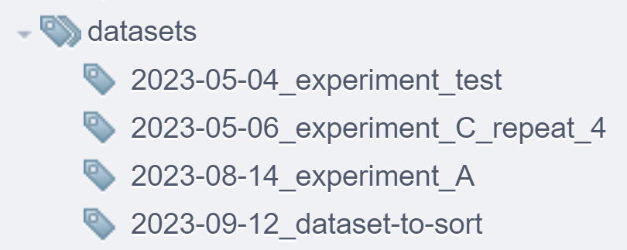
The scope of tags
KV-pairs takes care of describing the data, so no need to redo it with tags
Tags are like folders, but better (multiple tags per object, descriptions)
Tags can be categorized with Tagsets
-> Good for organizing and filtering
Tags could emulate my datasets (don't try)
So why should we even bother with datasets ?

Slide 11
The scope of datasets
Datasets can be annotated !
  tags
  key-value pairs
  attachements
  ratings
  comments
By annotating a dataset, I can implicitely annotate the images it contains
  group images of a same experiment in dataset
  -> less dupliction of annotations
  images can be annotated to give more details

Slide 12
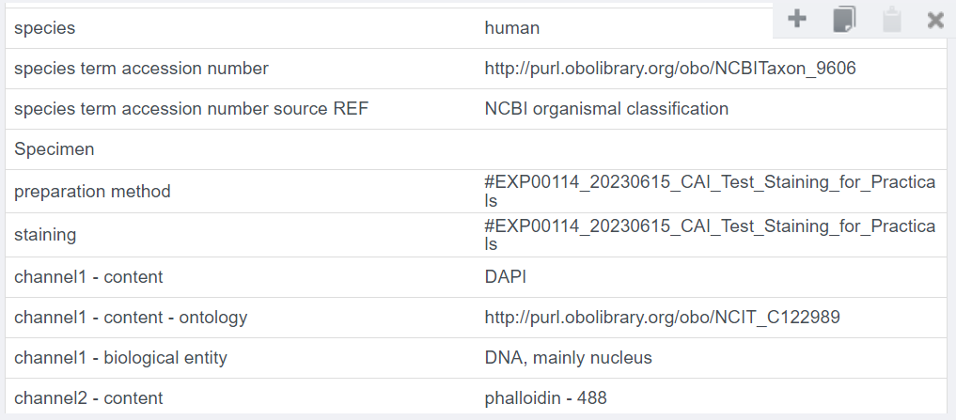
The scope of Key-value pairs
The annotation that describes the data in details:
Precise terms description with ontologies
(next session)
link to protocol

Slide 13
Back to the plate data
How do I describe the data content, with the lesser effort?
What is the "dataset unit"?
Practice time:
Split down the data so that a dataset contain only images of the exact same condition:
  Per well (one compound, one concentration)
  Per plate (one repetition of the experiment)
  Per week (one sampling)
Annotate condition with key value pairs on the dataset
Tag the datasets with what you estimate is necessary

Slide 14
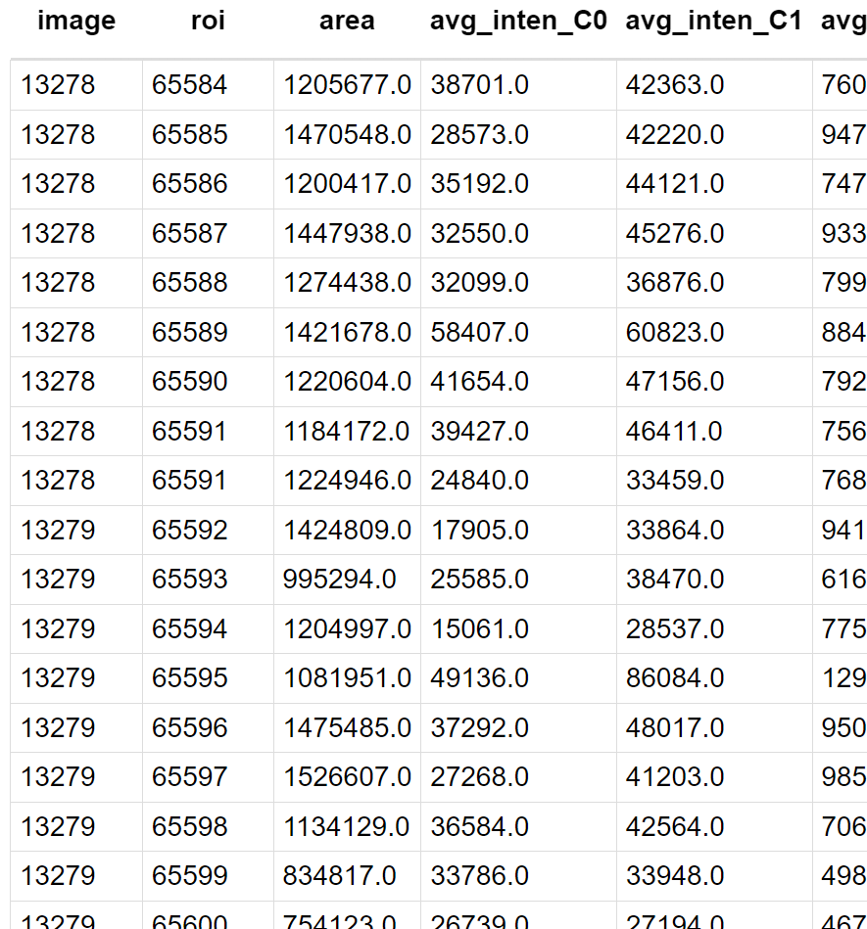





Annotations
Projects, Datasets and Images can be annotated
Table
Tags
Comments
Ratings
Key-value pairs
Attachments

Slide 15

Treasure hunt
Follow the clues left on OMERO to find a hidden reward.
Your search starts in the tags

