Slide 1
Making qualitative data reusable
Ricarda Braukmann - Data Station Manager Social Sciences
Interactive Workshop UHasselt
30 April 2024

Slide 2


DANS
Dutch national centre of expertise & repository for research data
Offers data publishing and archiving services for individual researchers and institutes
Offers advice and training on Research Data Management (RDM), FAIR data and Open Science

Slide 3
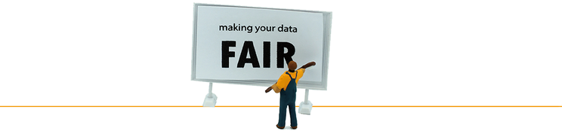
DANS
Dutch national centre of expertise & repository for research data
Offers data publishing and archiving services for individual researchers and institutes
Offers advice and training on Research Data Management (RDM), FAIR data and Open Science
Image CC-BY-SA https://dmeg.cessda.eu/

Slide 4

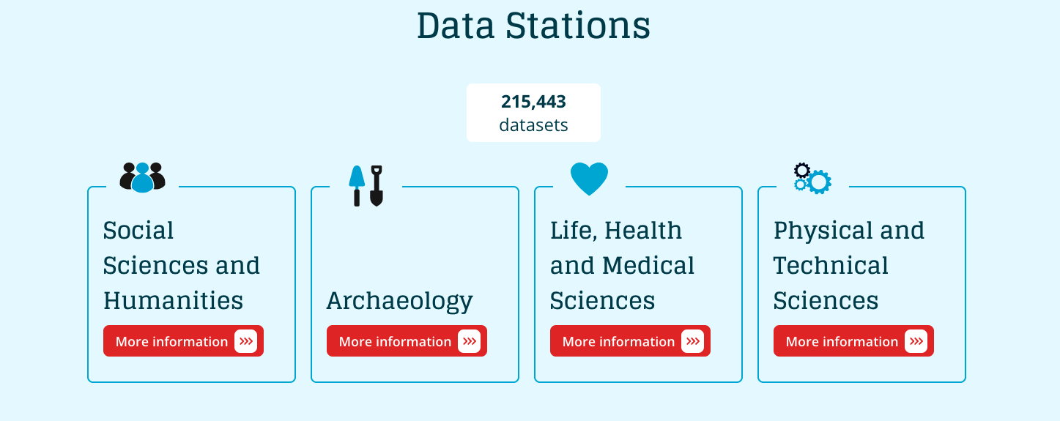
DANS Data Station
Domain-specific data publishing and archiving service for researchers
Making use of Dataverse technology
DANS manages the technical infrastructure
DANS manages the curation of the data
Long term storage in our Vault
CoreTrustSeal certified

Slide 5

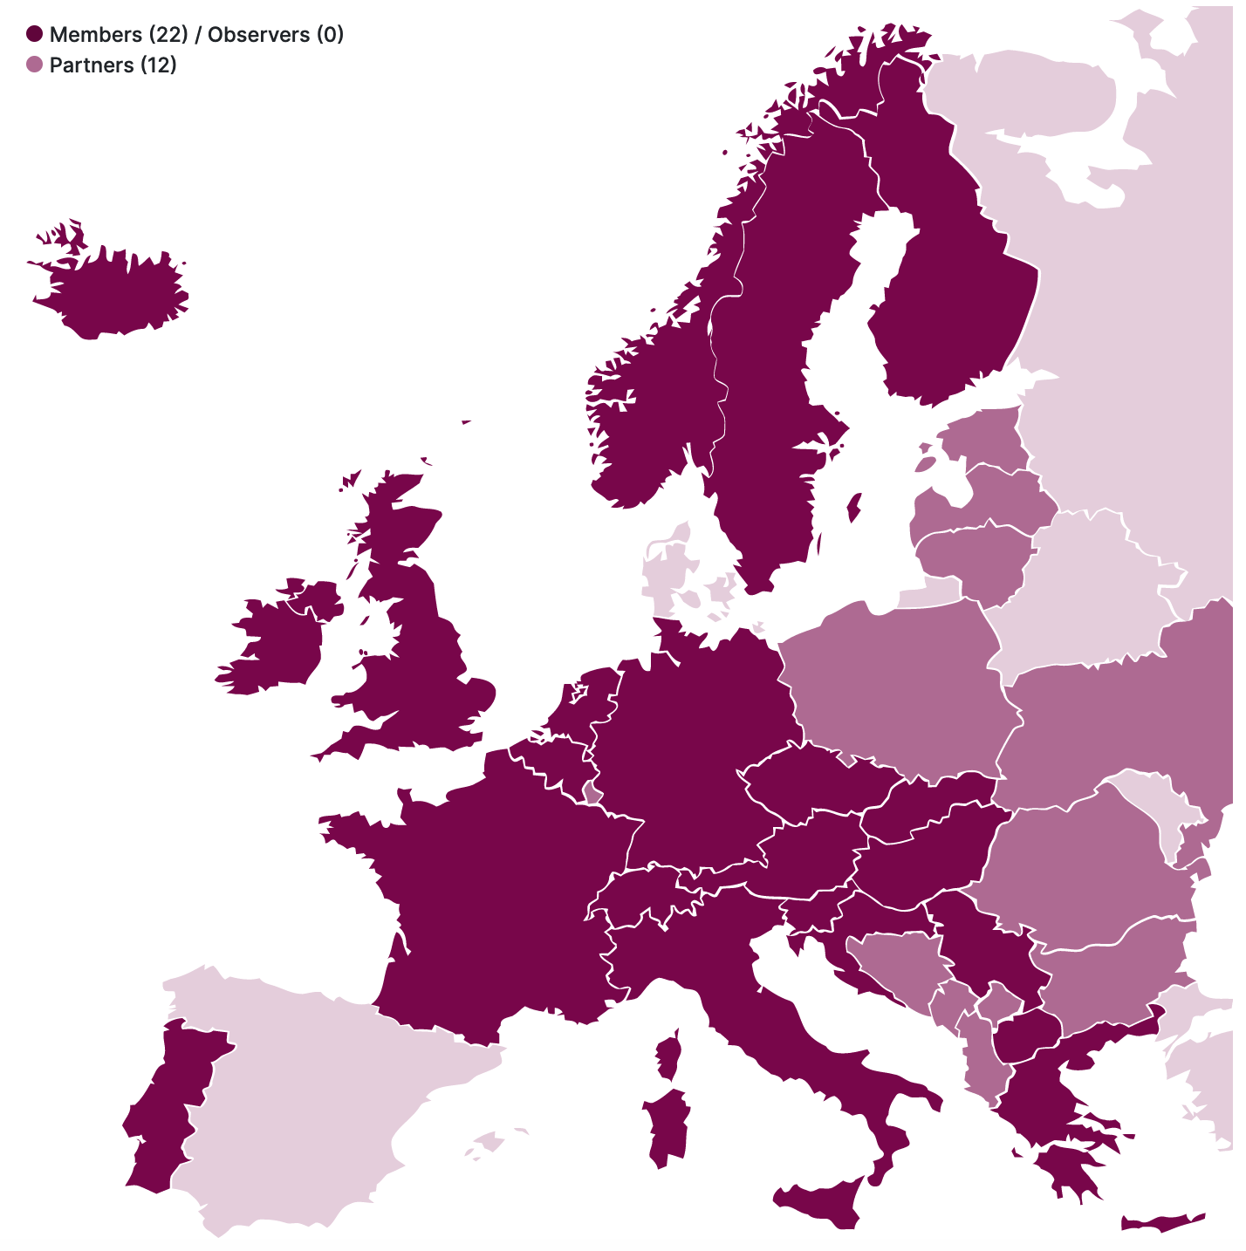



Consortium of European Social Science Data Archives
CESSDA provides large-scale, integrated and sustainable data services to the social sciences community, including
A Data Discovery Portal
Data Management Training
Controlled Vocabulary Services
DANS is the Service Provider for the Netherlands
The Belgium Service Provider is
https://www.cessda.eu/

Slide 6

As open as possible as closed as necessary
Following the Open Science principles you want to publish Open Access where possible

Slide 7

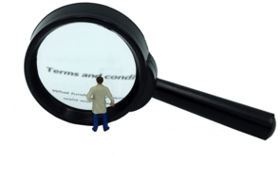
As open as possible as closed as necessary
Following the Open Science principles you want to publish Open Access where possible
Why would that not be possible?
  Personal data
  Sensitive information
Images CC-BY-SA https://dmeg.cessda.eu/

Slide 8

When working with personal data
Common recommendations
→ Gather informed consent (to share data) beforehand
→ Minimize the amount of personal data you collect
→ De-identify your data
  Remove personal information
  Anonymize or pseudonymise data

Slide 9

The challenges of qualitative data
Qualitative data refers to information that is not gathered in numerical form, but rather
describes qualities or characteristics.
Image CC-BY-SA https://dmeg.cessda.eu/

Slide 10
The challenges of qualitative data
Data which is hard to anonymise or pseudonymise!
You lose contextual information
Qualitative aspects are what you want to study
Qualitative data refers to information that is not gathered in numerical form, but rather
describes qualities or characteristics.
Image CC-BY-SA https://dmeg.cessda.eu/

Slide 11
The challenges of qualitative data
Data which is hard to anonymise or pseudonymise!
You lose contextual information
Qualitative aspects are what you want to study
A lot of existing guidance applies to quantitative data
→ More guidance needed!
Qualitative data refers to information that is not gathered in numerical form, but rather
describes qualities or characteristics.
Image CC-BY-SA https://dmeg.cessda.eu/

Slide 12
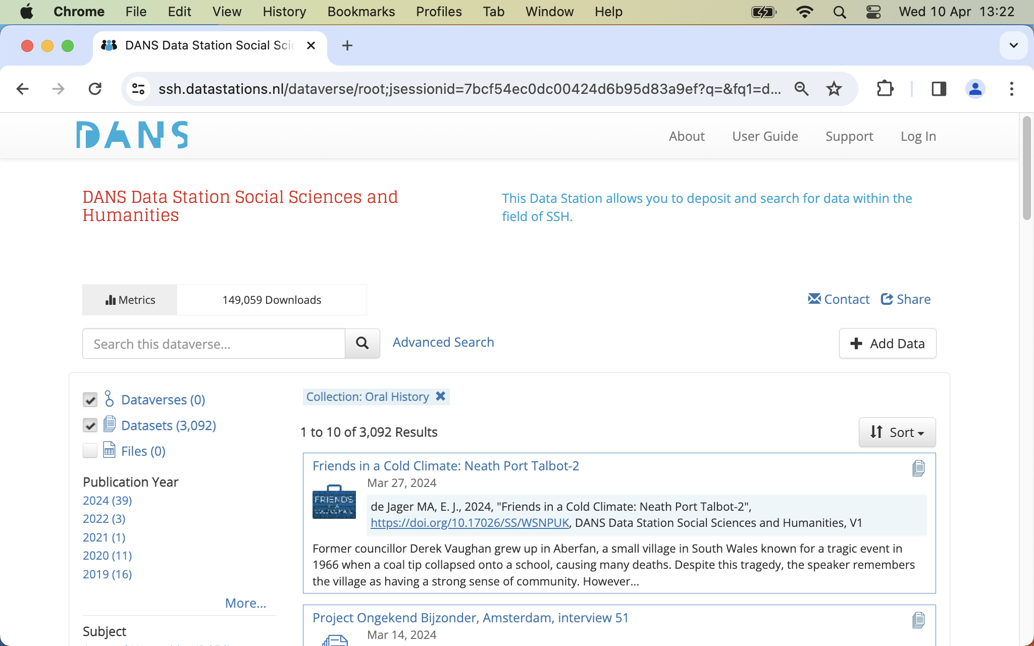
Archiving and publishing of qualitative data

Slide 13

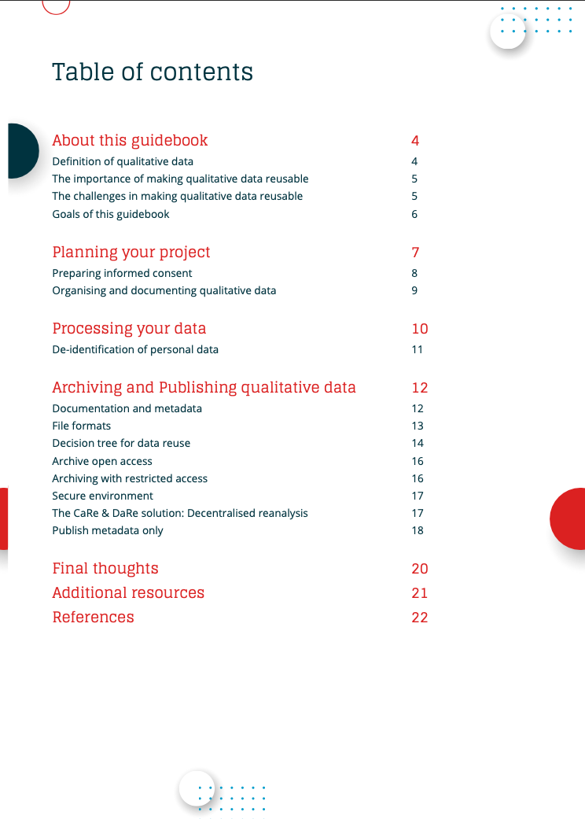
Making qualitative data reusable - Guide
https://doi.org/10.5281/zenodo.8160880

Slide 14
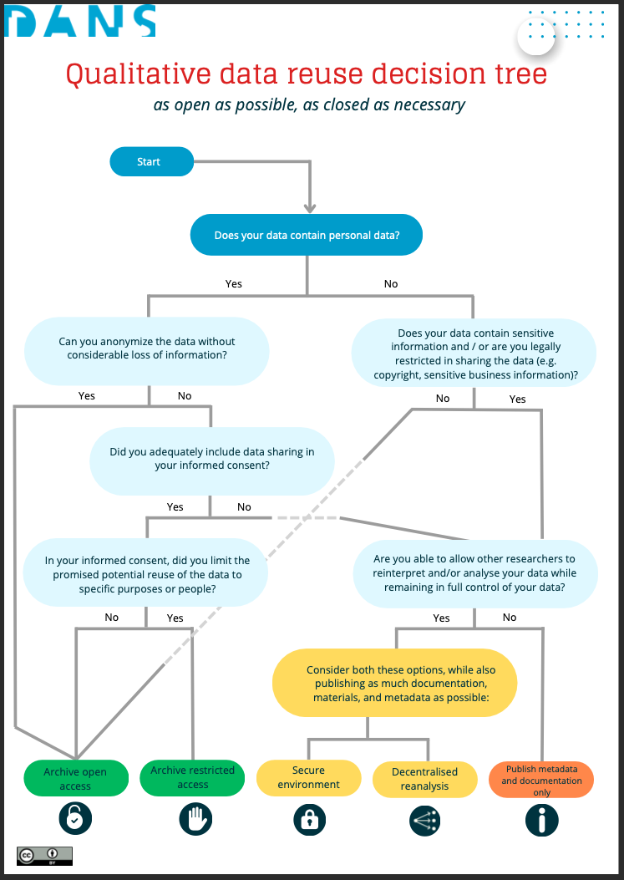
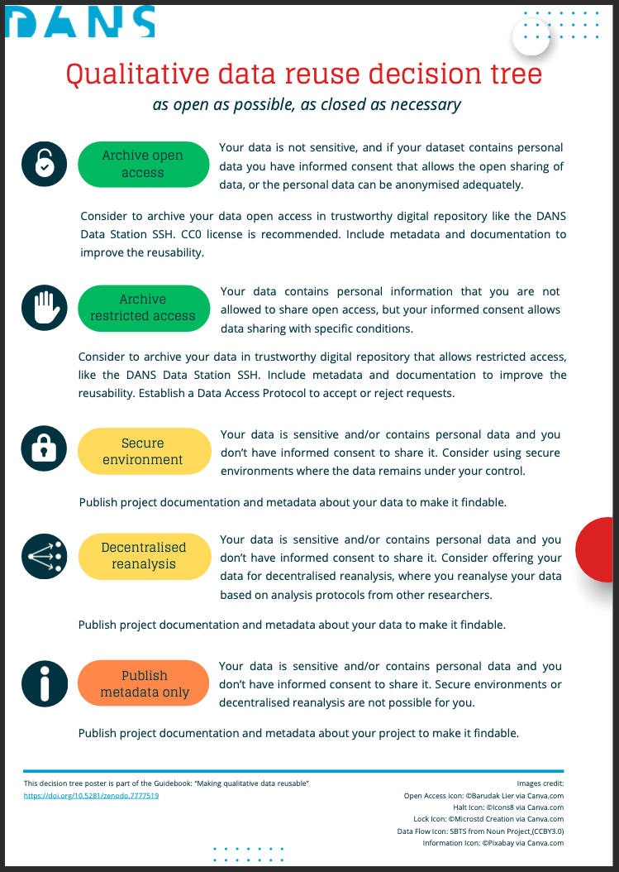
Making qualitative data reusable - Decision Tree
https://doi.org/10.5281/zenodo.8160890

Slide 15
Planning Your Project
Create a Data Management Plan (DMP) with reusability in mind
  Check the data sharing views of your collaborators
  Considerations around personal data
  Considerations around sensitive data
  Using open formats and tools
Prepare your Informed Consents form well to include data sharing
Consider best practices on file and folder naming to manage your data
https://doi.org/10.5281/zenodo.8160880

Slide 16
Processing Your Data
Consider if you can use open source software to process your data
Work with open file formats wherever possible
Consider the best techniques to de-identify your dataset
https://doi.org/10.5281/zenodo.8160880

Slide 17
Archiving and Publishing Your Data
Select a Trustworthy Digital Repository (TDR, e.g. CESSDA Service Providers)
Follow the TDR’s advice on data documentation and metadata
  This will be much easier if you collected all information in your DMP ;)
Use open file formats wherever possible
→ Decide whether your data can be published open or under restricted access
https://doi.org/10.5281/zenodo.8160880

Slide 18
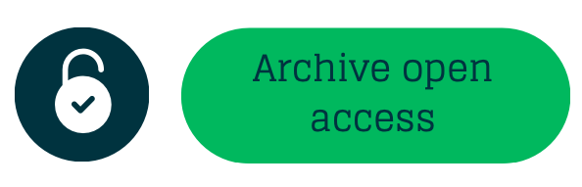


Decision tree [1]
Personal data
Anonymisation
Consent
Sensitive data (non-personal data)
Personal data
Anonymisation
Consent
Sensitive data (non-personal data)
Personal data
Anonymisation
Consent
Sensitive data (non-personal data)
https://doi.org/10.5281/zenodo.8160890

Slide 19

Decision tree [restricted access] [open access] [2]
Personal data
Anonymisation
Consent
Sensitive data (non-personal data)
https://doi.org/10.5281/zenodo.8160890

Slide 20
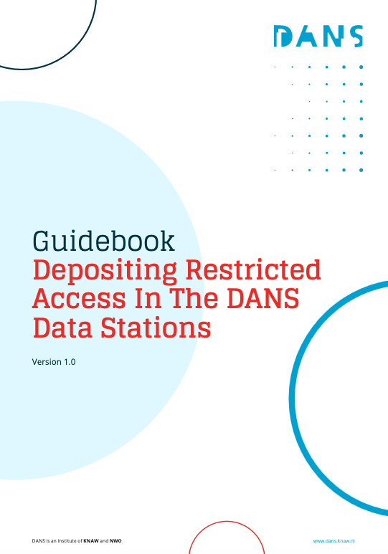
Decision tree [restricted access] [open access] [2]
New guidebook
Braukmann, R., Verburg, M., & Mahabier, W. (2024). Guidebook - Depositing Restricted Access In The DANS Data Stations (1.0). Zenodo. https://doi.org/10.5281/zenodo.10887484
https://doi.org/10.5281/zenodo.8160890

Slide 21

Decision tree [secure environment] [3]
Personal data
Anonymisation
Consent
Sensitive data (non-personal data)
Personal data
Anonymisation
Consent
Sensitive data (non-personal data)
If you are able to allow other researchers to reinterpret and/or analyse your data while remaining in full control of your data
https://doi.org/10.5281/zenodo.8160890

Slide 22
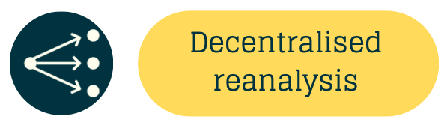

Decision tree [secure environment] [3]
Personal data
Anonymisation
Consent
Sensitive data (non-personal data)
Personal data
Anonymisation
Consent
Sensitive data (non-personal data)
If you are able to allow other researchers to reinterpret and/or analyse your data while remaining in full control of your data
https://www.nwo.nl/en/projects/40621eb014
https://doi.org/10.5281/zenodo.8160890

Slide 23

Decision tree [metadata only][5]
Personal data
Anonymisation
Consent
Sensitive data (non-personal data)
Personal data
Anonymisation
Consent
Sensitive data (non-personal data)
If you are NOT able to allow other researchers to reinterpret and/or analyse your data while remaining in full control of your data
https://doi.org/10.5281/zenodo.8160890

Slide 24

Any questions?

Slide 25

Contributors
Questions?
Creation of the guide
Maaike Verburg - DANS
Widia Mahabier - DANS
Jetze Touber – DANS
Samantha Willemsen – DANS
Hans Berends - VU
Eric Haynes – VU
Kacana Khadjavi Pour – VU
Fleur Deken - VU

Slide 26



More information
Visit our website www.dans.knaw.nl
And follow us online
Mastodon @DANS_knaw_nwo
LinkedIn @DANS
X @DANS_knaw_nwo

